Slide 1
Probability Review

Slide 2
Probability Review
Events and Event spaces
Random variables
Joint probability distributions
Marginalization, conditioning, chain rule, Bayes Rule, law of total probability, etc.
Structural properties
Independence, conditional independence
Mean and Variance
The big picture: probabilistic inference
Examples

Slide 3
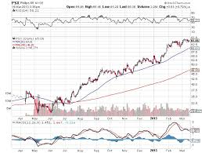

Why probability?
Probability is the proper mechanism for accounting for uncertainty
Measurement noise and incomplete knowledge
Is the image dark because the light level is low, or because the surface has low albedo? It is less common to see very dark surfaces under very bright lights than it is to see a range of albedoes under a reasonably bright light.
2D to 3D (shape from X)
Variations: scale, rotation, deformation, occlusion
Notes:
Fundamentals, technical strength, overall market trend, specific events affecting the market or a sector

Slide 4
Sample space and Events
Ω : Sample Space, result of an experiment
If you toss a coin twice Ω = {ΗΗ,ΗΤ,ΤΗ,ΤΤ}
Event: a subset of Ω
First toss is head = {HH,HT}
S: event space, a set of events:
Closed under finite union and complements
Entails other binary operation: union, diff, negation, intersection, etc.
Contains the empty event and Ω
Notes:
Show union, diff on the board

Slide 5
Probability Measure
Defined over (Ω,S) s.t.
P(α) >= 0 for all α in S
P(Ω) = 1
If α, β are disjoint, then
P(α U β) = p(α) + p(β)
We can deduce other axioms from the above ones
Ex: P(α U β) for non-disjoint event
P(α U β) = p(α) + p(β) – p(α ∩ β)
Notes:
Draw it on the board
S: event space
Omega: sample space

Slide 6
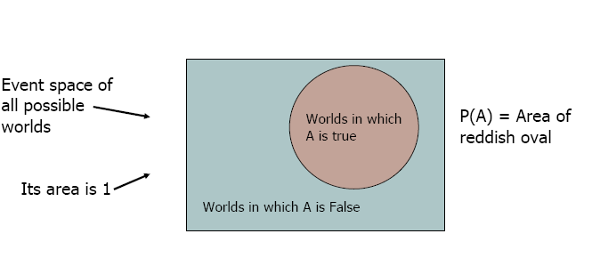
Visualization
We can go on and define conditional probability, using the above visualization
Notes:
In the case of conditional probability P(A|B), P(B) would be a smaller rectangle within the greenish rectangle

Slide 7
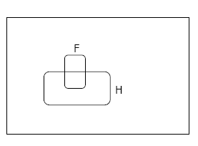
Conditional Probability
P(F|H) = Fraction of worlds in which H is true that also have F true

Slide 8
Rule of total probability
B₅
B₃
B₂
B₄
A
B₁
B₇
B₆
Notes:
Nice illustration! {Bi} is disjoint events

Slide 9
From Events to Random Variable
In many learning problems we will be dealing with RV
Concise way of specifying attributes of outcomes
Modeling students (Grade and Intelligence):
Ω = all possible students
What are events?
Grade_A = all students with grade A
Grade_B = all students with grade B
Intelligence_High = … with high intelligence
Very cumbersome
We need “functions” that maps from Ω to an attribute space.
P(G = A) = P({student ϵ Ω : G(student) = A})

Slide 10

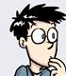
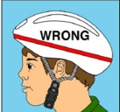

Random Variables
Ω
I:Intelligence
High
low
A
G:Grade
B
A+
P(I = high) = P( {all students whose intelligence is high})

Slide 11
Discrete Random Variables
Random variables (RVs) which may take on only a countable number of distinct values
E.g. the total number of tails X you get if you flip 100 coins
X is a RV with arity k if it can take on exactly one value out of {x₁, …, x_{k}}
E.g. the possible values that X can take on are 0, 1, 2, …, 100
Notes:
arity - the number of arguments that a function can take.

Slide 12
Probability of Discrete RV
Probability mass function (pmf): P(X = x_{i})
Easy facts about pmf
Σ_{i} P(X = x_{i}) = 1
P(X = x_{i}∩X = x_{j}) = 0 if i ≠ j
P(X = x_{i} U X = x_{j}) = P(X = x_{i}) + P(X = x_{j}) if i ≠ j
P(X = x₁ U X = x₂ U … U X = x_{k}) = 1

Slide 13
Common Distributions
Uniform X U[1, …, N]
X takes values 1, 2, … N
P(X = i) = 1/N
E.g. picking balls of different colors from a box
Binomial X Bin(n, p)
X takes values 0, 1, …, n
E.g. coin flips, P(k heads and n − k tails in n flips)

Slide 14
Continuous Random Variables
Probability density function (pdf) instead of probability mass function (pmf)
A pdf is any function f(x) that describes the probability density in terms of the input variable x.
Notes:
Portable Document Format

Slide 15
Probability of Continuous RV
Properties of pdf
Actual probability can be obtained by taking the integral of pdf
E.g. the probability of X being between 0 and 1 is

Slide 16
Cumulative Distribution Function
F_{X}(v) = P(X ≤ v)
Discrete RVs
F_{X}(v) = Σ_{vi} P(X = v_{i})
Continuous RVs

Slide 17
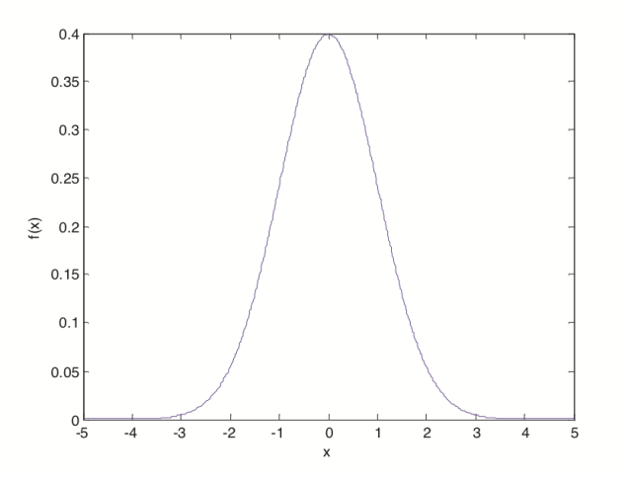
Common Distributions
Normal X N(μ, σ²)
E.g. the height of the entire population
Grades of the entire class?

Slide 18
Multivariate Normal
Generalization to higher dimensions of the one-dimensional normal
Covariance matrix
.
Mean (vector)

Slide 19
Probability Review
Events and Event spaces
Random variables
Joint probability distributions
Marginalization, conditioning, chain rule, Bayes Rule, law of total probability, etc.
Structural properties
Independence, conditional independence
Mean and Variance
The big picture: probabilistic inference
Examples

Slide 20
Joint Probability Distribution
Random variables encodes attributes
Not all possible combination of attributes are equally likely
Joint probability distributions quantify this
P( X= x, Y= y) = P(x, y)
Generalizes to N-RVs
Notes:
Continuous
Discerete

Slide 21
Chain Rule
Always true
P(x, y, z) = p(x) p(y|x) p(z|x, y)
= p(z) p(y|z) p(x|y, z)
=…

Slide 22
Conditional Probability
events
But we will always write it this way:

Slide 23
Marginalization
We know p(X, Y), what is P(X=x)?
We can use the law of total probability
B₅
B₃
B₂
B₄
A
B₁
B₇
B₆

Slide 24
Marginalization Cont.
Another example

Slide 25
Bayes Rule
We know that P(rain) = 0.5
If we also know that the grass is wet, then how this affects our belief about whether it rains or not?

Slide 26
Bayes Rule cont.
You can condition on more variables
Notes:
P(x|yz) = p(xyz)/P(yz) = [P(y|xz)P(y|z)P(z)] / [P(y|z)P(z)]

Slide 27
Probability Review
Events and Event spaces
Random variables
Joint probability distributions
Marginalization, conditioning, chain rule, Bayes Rule, law of total probability, etc.
Structural properties
Independence, conditional independence
Mean and Variance
The big picture: probabilistic inference
Examples

Slide 28
Independence
X is independent of Y means that knowing Y does not change our belief about X.
P(X|Y=y) = P(X)
P(X=x, Y=y) = P(X=x) P(Y=y)
The above should hold for all x, y
It is symmetric and written as X ⊥ Y

Slide 29
Independence
X₁, …, X_{n} are independent if and only if
If X₁, …, X_{n} are independent and identically distributed we say they are iid (or that they are a random sample) and we write
X₁, …, X_{n} ∼ P

Slide 30
CI: Conditional Independence
RV are rarely independent but we can still leverage local structural properties like Conditional Independence.
X ⊥ Y | Z if once Z is observed, knowing the value of Y does not change our belief about X
P(rain ⊥ sprinkler’s on | cloudy)
P(rain ⊥ sprinkler’s on | wet grass)
Notes:
The wet grass one is tricky – for conscious people they are (negatively) correlated

Slide 31
Conditional Independence
P(X=x | Z=z, Y=y) = P(X=x | Z=z)
P(Y=y | Z=z, X=x) = P(Y=y | Z=z)
P(X=x, Y=y | Z=z) = P(X=x| Z=z) P(Y=y| Z=z)
We call these factors : very useful concept !!
Notes:
All three forms? yes
The third one is fine, what about the first two? yes

Slide 32
Probability Review
Events and Event spaces
Random variables
Joint probability distributions
Marginalization, conditioning, chain rule, Bayes Rule, law of total probability, etc.
Structural properties
Independence, conditional independence
Mean and Variance
The big picture: probabilistic inference
Examples

Slide 33
Mean and Variance
Mean (Expectation):
Discrete RVs:
Continuous RVs:

Slide 34
Mean and Variance
Variance:
Discrete RVs:
Continuous RVs:
Covariance:
Covariance:
Notes:
proof

Slide 35
Mean and Variance
Correlation:
Notes:
Normalized, can be positive or negative

Slide 36
Properties
Mean
If X and Y are independent,
Variance
If X and Y are independent,

Slide 37
Some more properties
The conditional expectation of Y given X when the value of X = x is:
The Law of Total Expectation or Law of Iterated Expectation:

Slide 38
Some more properties
The law of Total Variance:

Slide 39
Probability Review
Events and Event spaces
Random variables
Joint probability distributions
Marginalization, conditioning, chain rule, Bayes Rule, law of total probability, etc.
Structural properties
Independence, conditional independence
Mean and Variance
The big picture: probabilistic inference
Examples

Slide 40
The Big Picture
Probability
Model
Data
Estimation/learning
Notes:
Computer vision / Data mining: models for objects, scenes, actions, relations, etc.

Slide 41
Statistical Inference
Given observations from a model
What (conditional) independence assumptions hold?
Structure learning
If you know the family of the model (ex, multinomial), what are the value of the parameters: MLE, MAP, Bayesian estimation.
Parameter learning
Knowing prior or not: MAP vs. MLE

Slide 42
Probability Review
Events and Event spaces
Random variables
Joint probability distributions
Marginalization, conditioning, chain rule, Bayes Rule, law of total probability, etc.
Structural properties
Independence, conditional independence
Mean and Variance
The big picture
Examples

Slide 43
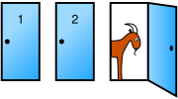
Monty Hall Problem
You're given the choice of three doors: Behind one door is a car; behind the others, goats.
You pick a door, say No. 1
The host, who knows what's behind the doors, opens another door, say No. 3, which has a goat.
Do you want to pick door No. 2 instead?

Slide 44

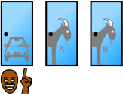


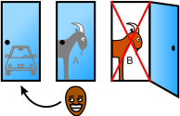
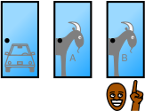
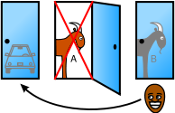
 |  | Host must reveal Goat B
 |  | Host must reveal Goat A
Host reveals Goat A or Host reveals Goat B

Slide 45
Monty Hall Problem: Bayes Rule
: the car is behind door i, i = 1, 2, 3
: the host opens door j after you pick door i
Notes:
What is k? k = 1, or 2 or 3 try enumerate all possibilities of Ck
The tricky one is P(H13|C2) = 1 (he has no choice but 3!!!) while P(H13|C1) = 1/2

Slide 46
Monty Hall Problem: Bayes Rule cont.
WLOG, i=1, j=3
Notes:
Without loss of generality
I is what you pick, j is what he chooses

Slide 47
Monty Hall Problem: Bayes Rule cont.
Notes:
No need to compute P(H13) actually, total probability

Slide 48
Monty Hall Problem: Bayes Rule cont.
You should switch!
Notes:
Vos Savant's response was that the contestant should switch to the other door. If the car is initially equally likely to be behind each door, a player who picks door 1 and does not switch has a 1 in 3 chance of winning the car (staying with the prior) while a player who picks door 1 and does switch has a 2 in 3 chance, because the host has removed an incorrect option from the unchosen doors, so contestants who switch double their chances of winning the car.
Many readers refused to believe that switching is beneficial. After the Monty Hall problem appeared in Parade, approximately 10,000 readers, including nearly 1,000 with PhDs, wrote to the magazine claiming that vos Savant was wrong (Tierney 1991). Even when given explanations, simulations, and formal mathematical proofs, many people still do not accept that switching is the best strategy (vos Savant 1991a). Decision scientist Andrew Vazsonyi described how Paul Erdős, one of the most prolific mathematicians in history, remained unconvinced until Vazsonyi showed him a computer simulation confirming the predicted result (Vazsonyi 1999).
Black Jack Table

Slide 49
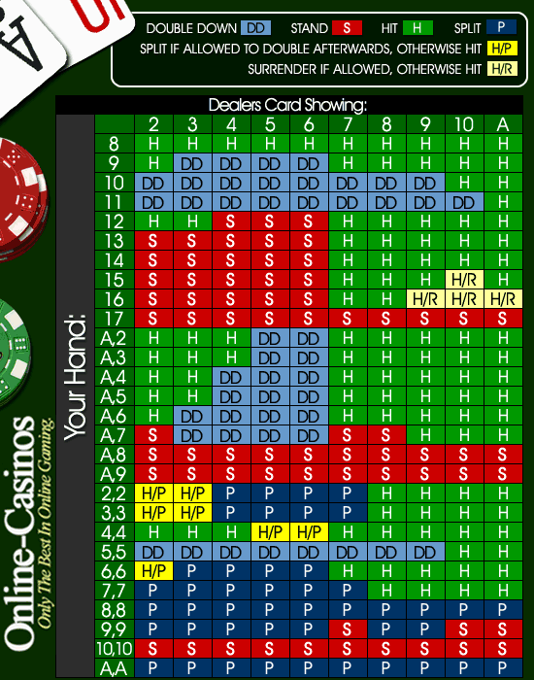
Black Jack Chart
Notes:
Vos Savant's response was that the contestant should switch to the other door. If the car is initially equally likely to be behind each door, a player who picks door 1 and does not switch has a 1 in 3 chance of winning the car (staying with the prior) while a player who picks door 1 and does switch has a 2 in 3 chance, because the host has removed an incorrect option from the unchosen doors, so contestants who switch double their chances of winning the car.
Many readers refused to believe that switching is beneficial. After the Monty Hall problem appeared in Parade, approximately 10,000 readers, including nearly 1,000 with PhDs, wrote to the magazine claiming that vos Savant was wrong (Tierney 1991). Even when given explanations, simulations, and formal mathematical proofs, many people still do not accept that switching is the best strategy (vos Savant 1991a). Decision scientist Andrew Vazsonyi described how Paul Erdős, one of the most prolific mathematicians in history, remained unconvinced until Vazsonyi showed him a computer simulation confirming the predicted result (Vazsonyi 1999).
Black Jack Table – gray zone when you have 13-17, because dealer has to hit below 17

Slide 50
Information Theory
P(X) encodes our uncertainty about X
Some variables are more uncertain that others (which?)
How can we quantify this intuition?
Entropy: average number of bits required to encode X
P(X)
P(Y)
X
Y
Notes:
Expectation of the inverse log lilkelihood

Slide 51
Information Theory cont.
Entropy: average number of bits required to encode X
We can define conditional entropy similarly
Interpretation: once Y is known, we only need H(X,Y) – H(Y) bits
We can also define chain rule for entropies (not surprising)
Notes:
Explain the chain rule very quick H (x,y,z) = H(z|x,y) + H (x,y)

Slide 52
Mutual Information: MI
Remember independence?
If X⊥Y then knowing Y won’t change our belief about X
Mutual information can help quantify this! (not the only way though)
MI:
“The amount of uncertainty in X which is removed by knowing Y” (or, the amount of information contained mutually)
Symmetric
I(X;Y) = 0 iff X and Y are independent!

Slide 53
Chi Square Test for Independence (Example)
 | Republican | Democrat | Independent | Total
Male | 200 | 150 | 50 | 400
Female | 250 | 300 | 50 | 600
Total | 450 | 450 | 100 | 1000
State the hypotheses
H₀: Gender and voting preferences are independent. H_{a}: Gender and voting preferences are not independent
Choose significance level
Say, 0.05

Slide 54
Chi Square Test for Independence
 | Republican | Democrat | Independent | Total
Male | 200 | 150 | 50 | 400
Female | 250 | 300 | 50 | 600
Total | 450 | 450 | 100 | 1000
Analyze sample data
Degrees of freedom =
(|g|-1) * (|v|-1) = (2-1) * (3-1) = 2
Expected frequency count =
E_{g,v} = (n_{g} * n_{v}) / n
E_{m,r} = (400 * 450) / 1000 = 180000/1000 = 180 E_{m,d}= (400 * 450) / 1000 = 180000/1000 = 180 E_{m,i} = (400 * 100) / 1000 = 40000/1000 = 40 E_{f,r} = (600 * 450) / 1000 = 270000/1000 = 270 E_{f,d} = (600 * 450) / 1000 = 270000/1000 = 270 E_{f,i} = (600 * 100) / 1000 = 60000/1000 = 60
Notes:
Why – 1?
What is E? Expected frequency count

Slide 55
Chi Square Test for Independence
 | Republican | Democrat | Independent | Total
Male | 200 | 150 | 50 | 400
Female | 250 | 300 | 50 | 600
Total | 450 | 450 | 100 | 1000
Chi-square test statistic
Χ² = (200 - 180)²/180 + (150 - 180)²/180 + (50 - 40)²/40 +
(250 - 270)²/270 + (300 - 270)²/270 + (50 - 60)²/40
Χ² = 400/180 + 900/180 + 100/40 + 400/270 + 900/270 +
100/60
Χ² = 2.22 + 5.00 + 2.50 + 1.48 + 3.33 + 1.67 = 16.2

Slide 56
Chi Square Test for Independence
P-value
Probability of observing a sample statistic as extreme as the test statistic
P(X² ≥ 16.2) = 0.0003
Since P-value (0.0003) is less than the significance level (0.05), we cannot accept the null hypothesis
There is a relationship between gender and voting preference

Slide 57
What you must know
See the last Table in the distributed material
Probability models
Random variables
Conditional probability
Probability density function
Marginalization
Expectation
Normal distribution
Probabilistic inference: MLE, MAP

Slide 58
What you MUST know
Probabilistic inference: MLE, MAP
MLE = arg max P (X|Y)
where X is the feature and Y is the class
P(X|Y) is the likelihood
MAP= arg max P (Y|X)
P(Y|X) is posterior (a posteriori)
where X is the feature and Y is the class

Slide 59
Acknowledgments
Carlos Guestrin recitation slides: http://www.cs.cmu.edu/~guestrin/Class/10708/recitations/r1/Probability_and_Statistics_Review.ppt
Andrew Moore Tutorial: http://www.autonlab.org/tutorials/prob.html
Monty hall problem: http://en.wikipedia.org/wiki/Monty_Hall_problem
http://www.cs.cmu.edu/~guestrin/Class/10701-F07/recitation_schedule.html
Chi-square test for independence
http://stattrek.com/chi-square-test/independence.aspx
David Forsyth, unpublished review chapter (available in blackboard)

Slide 60
Homework #2
Check Blackboard after class

Slide 61
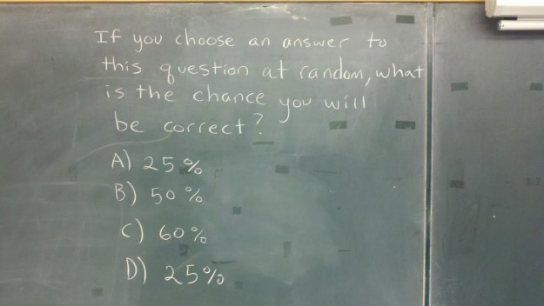
Had Enough?
Notes:
No answer in the choices.
Case 1: A is correct, then D is also correct. The probability will be 0.5. But the answers there are 0.25. So, not right. Case 2: B is correct. The prob. of choosing B will be 0.25. But, the answer there is 0.5. Case 3: C is correct. The prob. of choosing C will be 0.25. But, the answer there is 0.6. So, all of the choices are not correct.
Well presumably there is a correct answer, it’s either a) b) c) or d), and if the actual value is irrelevant since the correct answer is one of those letters (keys) rather than its value, then it’s 25%.
If the values matter, then the question is faulty and thus invalid.
That’s as far as I can go without chemical influence.
I don’t see that. ‘This question’ isn’t even a question so we must assume that it is referring to ANY multiple choice question. Therefore the answer is 25%. BUT that answer is there twice so its 50%. There is only one answer stating ’50%’ so that is the right answer. But it is still wrong. So what do we do? Common sense. There is a 25% chance you’ll get the answer right to a problem with four possible answers. If two of those answers are the exact same thing, then your professor is an asshole and you should answer E. none of the above: you are an asshole. Then you would be right.
Wow, I can’t believe I read the whole thing. If you’re reading this, you’re probably thinking the same thing. :)
Words first, then the math. The central issue here, as many have pointed out in different ways,”what is the question *actually* asking, as worded.” Because the question contains ambiguity, you have decide how you are reading the question and then answer accordingly.
I personally don’t read this as a multiple choice question, but rather an open-ended question that asks about a hypothetical answering of a multiple-choice question. I’m willing to assume the question is possible, that there is random distribution, and (key) I’m interpreting the meaning of “this” in the question in such a way that we are being asked “If you answered the question below, tell me the probability you would get it right.” (Nothing in the sentence says your *final* answer has to be one of the below. I read the sentence as saying that the multiple choice part is data needed to be able to come up with the correct answer. That just makes the most sense to me given the exact info we have.)
Many are instead interpreting “this” in such a way that the question becomes self-referential, IE trying to answer the question changes the answer etc. And there are other ways to read it and choose assumptions, such as “why are we assuming there is a correct answer listed?”
The language is imprecise (in particular what “this” exactly refers to in the question), and you have to make some choices about what assumptions you are willing to use. which is why so many knowledgeable people are coming up with different answers. There are different ways to read this, and each of those ways of reading it has a correct answer.
But I digress. For me personally, given exactly what we were given, I see this question as asking:
“A random number generator with equal distribution must randomly generate one of the following colors: A) Red B) Green C) Blue D) Red
- The correct choice for that question is either Red, Green, or Blue. - “A)”, “B)”, “C)”, and “D” are each equally likely. - For the scenario where “Red” is correct, either of answers “A)” and “D)” count as correct.
Given all that, calculate the probability that the random number generator will yield the correct answer.”
Note that the *actual question* is that last line. There’s nothing saying it’s multiple choice. The multiple choice was part of the information we base our calculation off of, not a set from which we must select our own answer.
In that scenario, which makes the most sense to me personally given the way the question is worded, the final answer is 37.5% because there are the following scenarios:
1) The correct answer is “Red.” [There is a 50% chance of the random number generator getting this scenario right, since A or D would count.] [Let's call this scenario "P1" when we get to the math.] 2) The correct answer is “Green.” [There is a 25% chance of the random number generator getting this scenario right, since only one of the four choices it chose from was correct.] [P2] 3) The correct answer is “Blue.” [There is a 25% chance of the random number generator getting this scenario right, since only one of the four choices it chose from was correct.] [P3]
Three scenarios, each equally likely to happen. Three possible answers, two of which happen 25% of the time and one of which happens 50% of the time.Thus we get the following calculations for how likely each scenario is to happen and how likely the random number generator is to get the correct answer in that scenario:
P= (chance of scenario happening) * (chance of random number generator choosing correct answer in that scenario)
Calculating for each scenario: P1= .25*.50=.0625 P2= .25*.25=.0625 P3= .25*.25=.125
Put that all together for your overall probability and you get .125+.0625+.0625+.125 = .375 (which is 37.5% when expressed as a percentage.)
Thus for the overall question, the computer will randomly generate the correct answer to the given hypothetical problem 37.5% of the time.
I like how Jay put this: “The trick is that the question isn’t really multiple choice – it’s short answer asking you to evaluate a multiple choice problem.”
If you read the ambiguous parts of the question otherwise, then there are correct and incorrect answers for your own version. Put another way, this is best evaluated as a two-part question:
1) “What do you think the question is actually asking?” [The language part of the question, particularly what does “this” in the sentence mean and what will your assumptions be?) 2) “Given your answer to 1), what is the correct calculation? (The actual number crunching.)
Thank you OP for causing me to lose an embarrassing amount of my morning. It was all worth it even if nobody at all reads this. :)
By way of Raymond Johnson, the best statistics multiple choice question ever written on a chalkboard. Try not to think too hard. [via]
No answer because it’s not a right question. If “random means random”, then 25%, A or D; if look at content shallowly, then 50%; if deep, no answer “none”

