Slide 1

Time Series Analysis and Forecasting Fall 2019

Slide 2
About the Instructors Ajay Anand
Currently the Deputy Director, Goergen Institute for Data Science, U of R (Office: Wegmans Bldg 1203)
12 years industry experience leading R&D projects in healthcare analytics (biomedical sensor analytics, time series analysis, image analytics)
Worked at multinational corporations: Philips Research (Greater NYC area) and Carestream (Rochester)
PhD in Electrical Engineering (specialization in biomedical signal/image analysis, medical/ultrasound imaging)

Slide 3
About the Instructors – Edgar A. Bernal
Currently Associate Director and Sr. Research Scientist, Rochester Data Science Consortium, U of R (Office: Sibley Building (downtown) 6108; Wegmans Building 1209)
12 years industry research experience on image processing, video analytics, computer vision and machine/deep learning (plus one year with RDSC)
Worked at multinational corporations: Xerox (Rochester) and United Technologies (Hartford, CT)
PhD in Electrical Engineering (focus on statistical signal/image processing)
RDSC is hiring! Email me your resume at Edgar.Bernal@Rochester.edu

Slide 4
Class enrollment
Currently, the class enrollment is full
There is an active waitlist with close to 10 students looking to enroll
Please add your name to the waitlist if not already
Email lisa.altman@Rochester.edu if you do not have the waitlist form link
We will process the waitlist over the next few days as we know the actual class enrollment

Slide 5
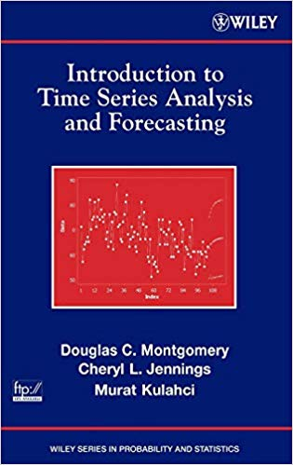
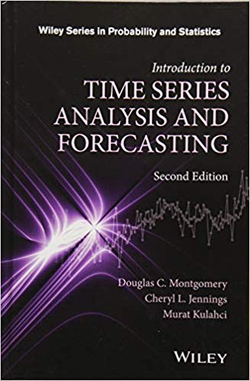
Textbook (1st half of course)

Slide 6

Introduction to Time Series Analysis and Forecasting
Chapter 1

Slide 7
Outline (Chapter 1)
What is a time-series ?
Time series applications
Terminology used with Time-series data and analysis
Forecasting Methodology

Slide 8
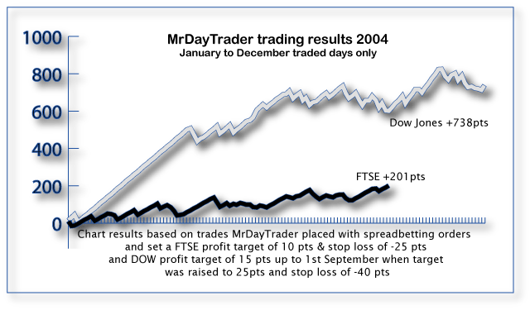
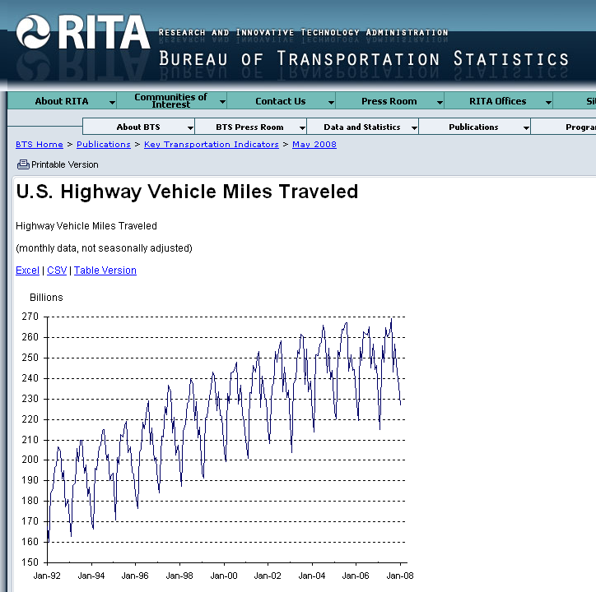
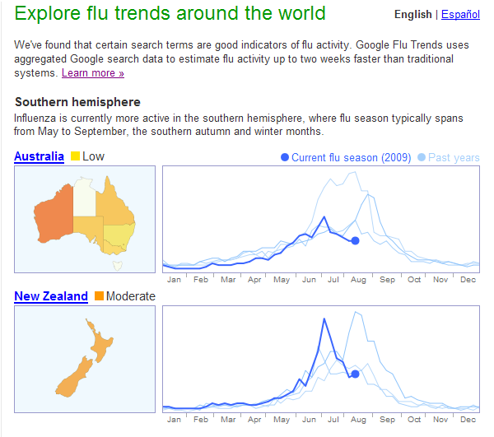
Time Series Everywhere
0

Slide 9
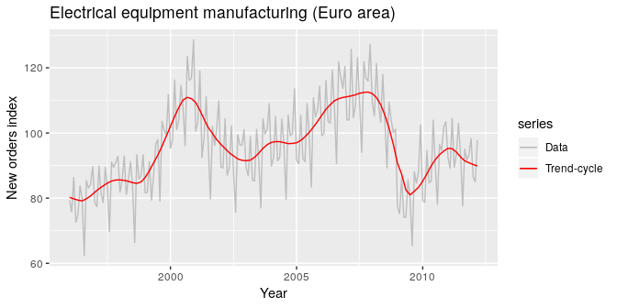
Time Series (Formal Definition) ….
A time series is a series of data points indexed in time order.
Most commonly, a time series is a sequence taken at successive equally spaced points in time.
Sequence of discrete-time data
Measured Quantity
Trend is superimposed on the original time series
Time

Slide 10
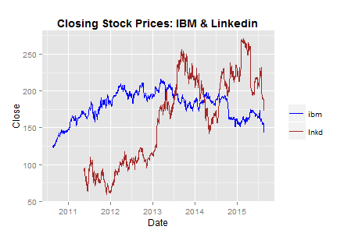
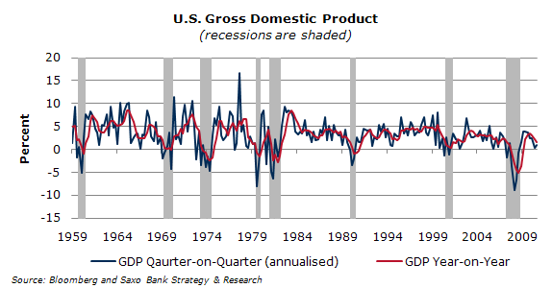
Financial/Economic time series
Interventions

Slide 11
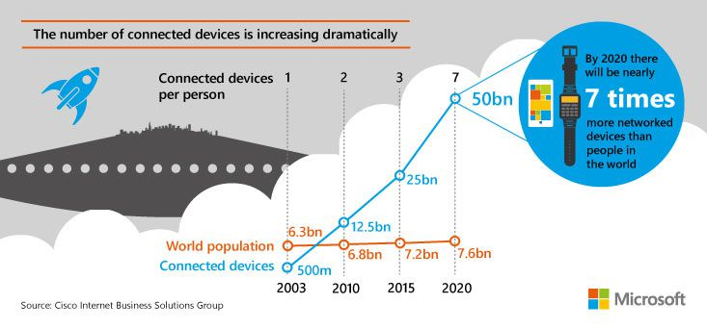
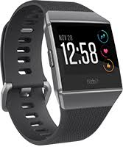
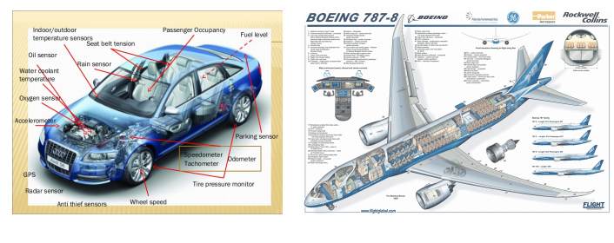
Another main source of time-series data: Sensor data and Internet of Things (IoT)
Jure Leskovec, Stanford

Slide 12
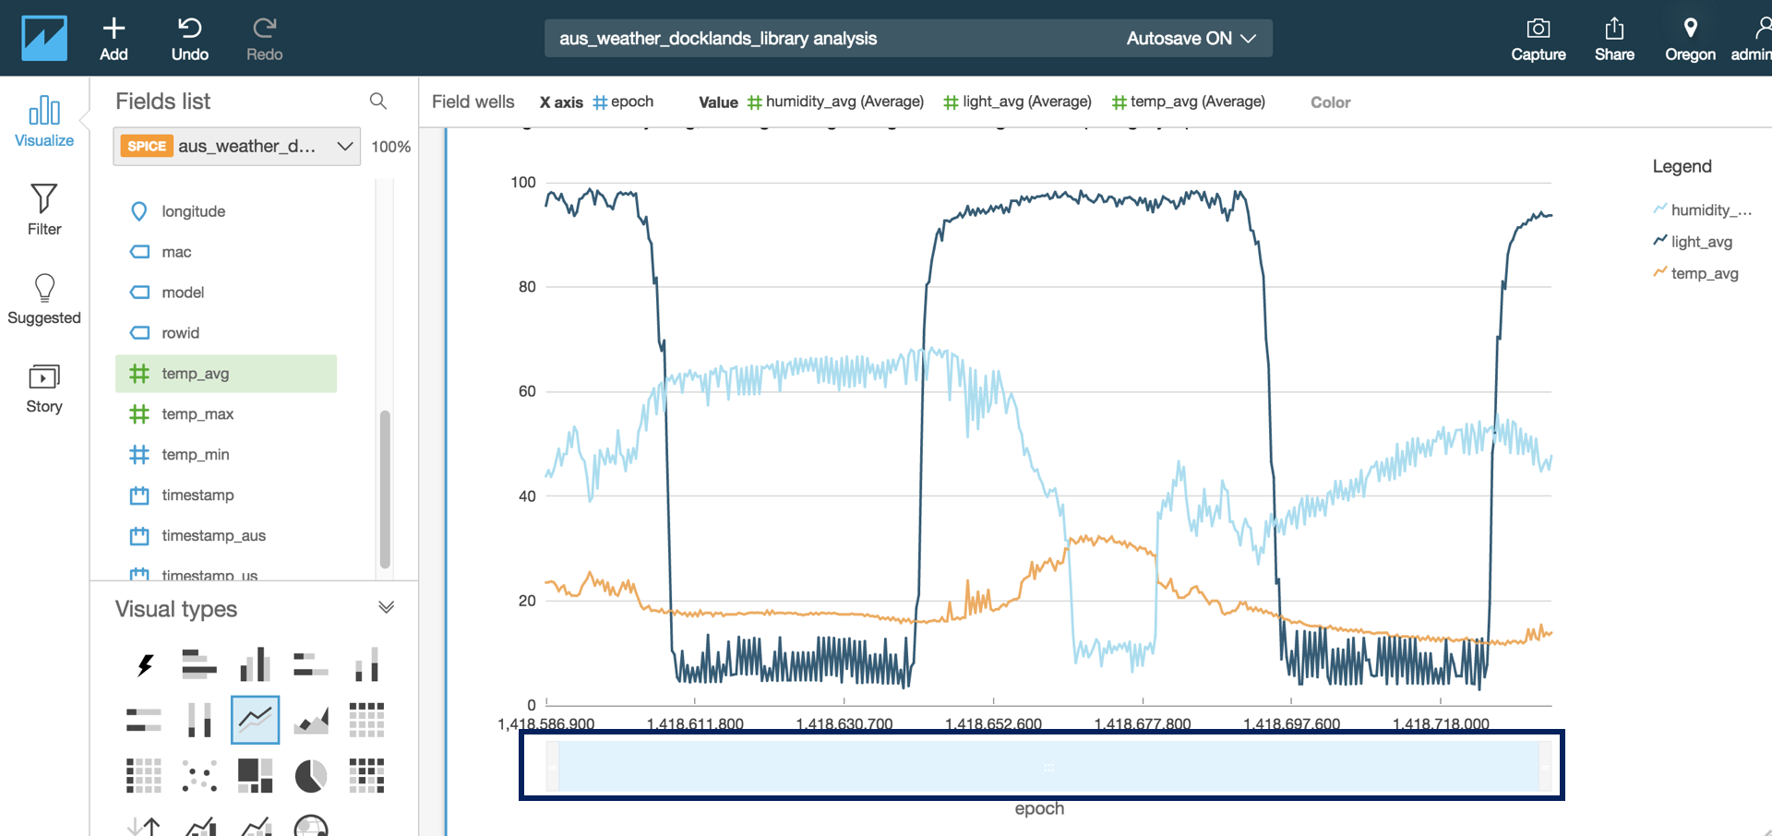
Another main source of time-series data: Sensor data and Internet of Things (IoT)
Amazon AWS IoT Analytics

Slide 13
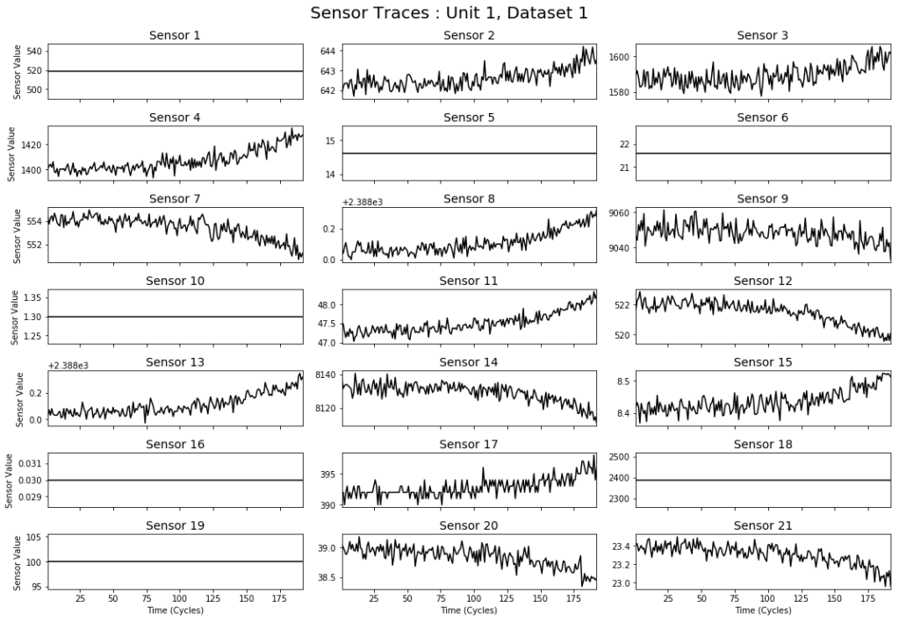
Multi-sensor data set
Noisy sensor channels
Potentially containing lots of missing or uninformative values
Notes:
Each of the sensors measures something about the physical state of the engine, like the temperature of a component or the speed of a fan. Notice that some sensor channels are quite noisy and appear to increase or decrease over time, while others don’t appear to change at all. This is exactly the kind of data you might expect an industrial IoT system to produce— multivariate series of sensor measurements each with its own amount of noise, and potentially containing lots of missing or uninformative values.

Slide 14
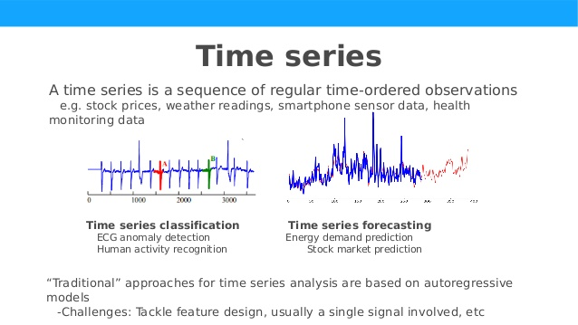
Time Series Analysis and Forecasting ….
Time series classification (Discrete):
Identify anomalous events
Time series Forecasting (Continuous):
Predict the actual values of the time series into the future
Measured Quantity
Time

Slide 15
What is a “forecast” ?
Forecast is a prediction of some future event or events.
Making good predictions is not always easy – Neil Bohr
Famously “bad” forecasts include the following from the book Bad Predictions:
•“The population is constant in size and will remain so right up to the end of mankind.” L'Encyclopedie, 1756.
•“1930 will be a splendid employment year.” U.S. Department of Labor, New Year's Forecast in 1929, just before the market crash on October 29.
•“Computers are multiplying at a rapid rate. By the turn of the century there will be 220,000 in the U.S.” Wall Street Journal, 1966.

Slide 16
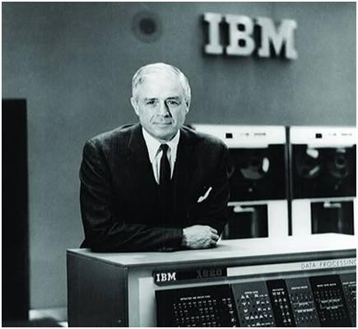
“I think there is a world market for maybe five computers.”
Thomas Watson, 1943

Slide 17
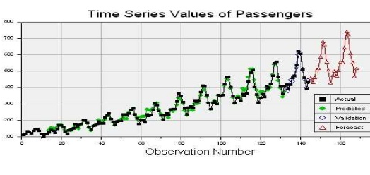
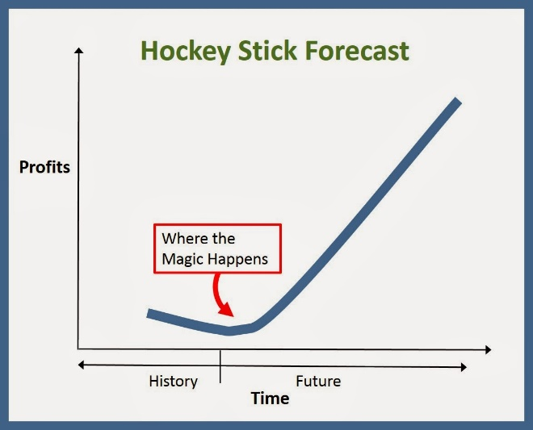
Forecasting problems occur in many fields …
Business and industry
Economics
Finance
Environmental sciences
Social sciences
Political sciences

Slide 18
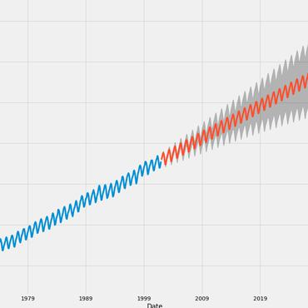
Forecasting Problems
Short-term
Predicting only a few periods ahead (hours, days, weeks)
Medium-term
One to two years into the future, typically
Long-term
Several years into the future
Typically based on modeling and extrapolating patterns in the data
Notes:
Forecasting problems are often classified as short-term, medium-term, and long-term.
Short-term forecasting problems involve predicting events only a few time periods (days, weeks, and months) into the future. Medium-term forecasts extend from 1 to 2 years into the future, and long-term forecasting problems can extend beyond that by many years.
Short- and medium-term forecasts are required for activities that range from operations management to budgeting and selecting new research and development projects. Long-term forecasts impact issues such as strategic planning.
Short- and medium-term forecasting is typically based on identifying, modeling, and extrapolating the patterns found in historical data. Because these historical data usually exhibit inertia and do not change dramatically very quickly, statistical methods are very useful for short- and medium-term forecasting. This book is about the use of these statistical methods.

Slide 19
Most forecasting problems involve a time series:

Slide 20
Forecasting time intervals
Daily, weekly, monthly, quarterly, or annual .. Any interval can be used
The data may be:
Instantaneous: e.g. Measurement at a single time point
Cumulative: Total sales of a product during the month
Derived statistic: That in some way reflects the activity of the variable during the time period, e.g. daily closing price of a specific stock on the New York Stock Exchange.

Slide 21
Two broad types of methods:
Quantitative forecasting methods
Makes formal use of historical data
A mathematical/statistical model
Past patterns are modeled and projected into the future
Qualitative forecasting methods
Subjective
Little available data (new product introduction)
Expert opinion often used (Intuition / “gut” feel)
This course!

Slide 22
Quantitative Forecasting Methods
Smoothing methods
Often justified empirically
Chapter 4
Formal time series analysis methods
Chapters 5 and 6
Some other related methods are discussed in Chapter 7

Slide 23
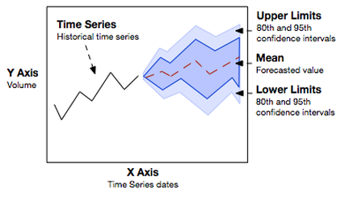
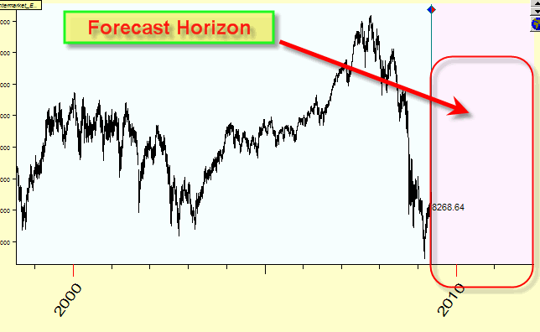
Some Terminology …
Point forecast or point estimate
Single number that represents our best estimate of the future value of the variable of interest
Prediction interval
Range of values of a future observation … far more useful than a single number
Forecast horizon or lead time
Number of future periods for which forecasts must be produced.
Often dictated by the nature of the problem
Almost always wrong !!
Prediction interval
Notes:
The form of the forecast can be important. We typically think of a forecast as a single number that represents our best estimate of the future value of the variable of interest. Statisticians would call this a point estimate or point forecast. Now these forecasts are almost always wrong; that is, we experience forecast error.
Consequently, it is usually a good practice to accompany a forecast with an estimate of how large a forecast error might be experienced. One way to do this is to provide a prediction interval (PI) to accompany the point forecast.
The PI is a range of values for the future observation, and it is likely to prove far more useful in decision-making than a single number. We will show how to obtain PIs for most of the forecasting methods discussed in the book.

Slide 24
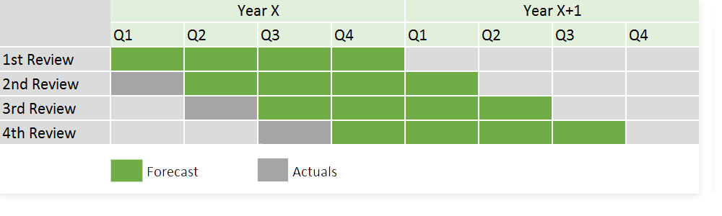
Some Terminology …
Forecasting interval
How often a new forecast is created ?
e.g. Forecast 3 months ahead, on a monthly forecasting interval
Moving horizon (Rolling) forecast
Forecast horizon
Notes:
The form of the forecast can be important. We typically think of a forecast as a single number that represents our best estimate of the future value of the variable of interest. Statisticians would call this a point estimate or point forecast. Now these forecasts are almost always wrong; that is, we experience forecast error.
Consequently, it is usually a good practice to accompany a forecast with an estimate of how large a forecast error might be experienced. One way to do this is to provide a prediction interval (PI) to accompany the point forecast.
The PI is a range of values for the future observation, and it is likely to prove far more useful in decision-making than a single number. We will show how to obtain PIs for most of the forecasting methods discussed in the book.

Slide 25
Examples of time series: Uncorrelated data, constant process model
Relatively flat
Tends to be constant over time

Slide 26
Autocorrelated data
Tending to average of about 85 cP
Has a structured, not completely random, appearance
More to come on Auto-correlations !
Time-series analysis involves looking at correlation between time points

Slide 27
Trend
Linear trend
Positive slope with random, year-to-year variation
More to come on (de)Trending !!

Slide 28
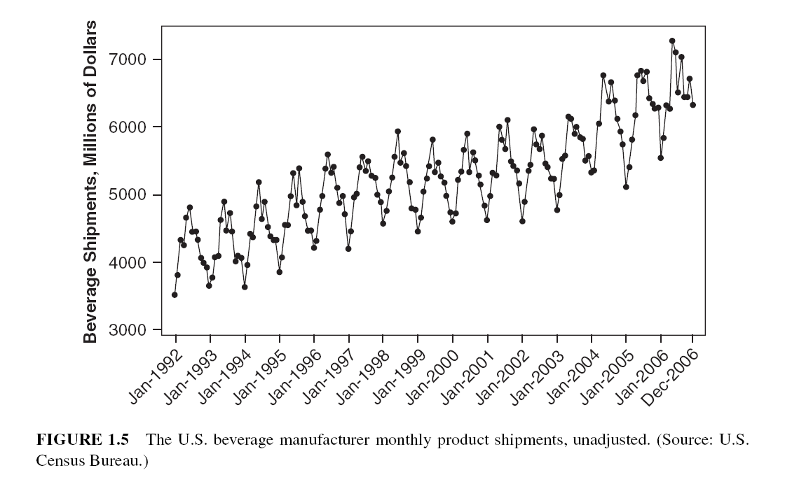
Cyclic or seasonal data
overall increasing trend
distinct cyclic pattern that is repeated within each year
How to account for seasonality?

Slide 29
Nonstationary data
Plot of the annual mean anomaly in global surface air temperature shows an increasing trend since 1880;
Slope, or rate of change, varies with time periods
Slope from about 1975 to the present appears much steeper than the rest of the plot.
An example of nonstationary behavior

Slide 30
Another example of non-stationary
Price constant in short time periods … No consistent mean level over time.

Slide 31
A mixture of patterns
Monthly unadjusted unemployment rates exhibits a mixture of patterns
Distinct cyclic pattern within a year: January, February, and March generally have the highest unemployment rates.
Overall level is also changing, from a gradual decrease, to a steep increase, followed by a gradual decrease.
Seasonal adjustments makes it easier to observe the nonseasonal movements in time series data.

Slide 32
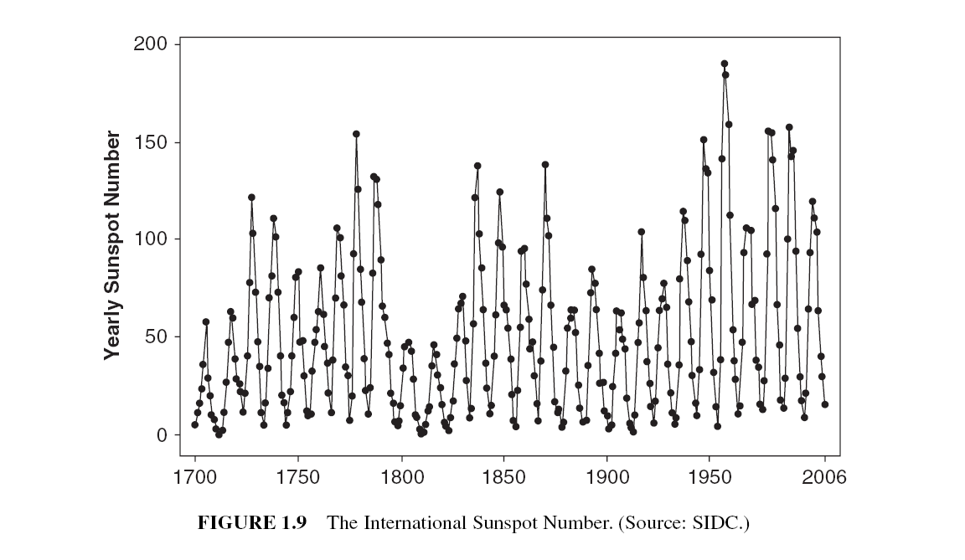
Cyclic patterns of different magnitudes

Slide 33
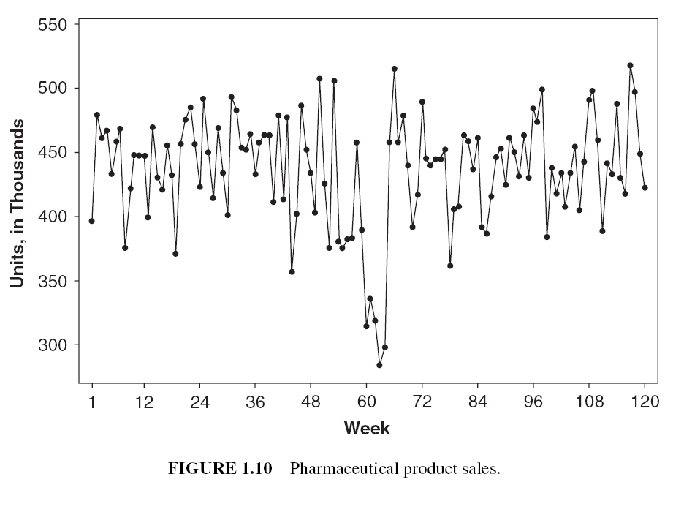
Identifying Atypical events from time-series plots
(Anomaly detection)

Slide 34
The Forecasting Process
Problem definition : Understand how the forecast will be used along with the expectations of the “customer”
Data collection : Obtain the relevant history for the variable(s) that are to be forecast, including historical information on potential predictor variables.
Data analysis: Important preliminary step .. Leads to selection of the forecasting model to be used. Obtain some “feel” for the data, and a sense of how strong the underlying patterns such as trend and seasonality are.

Slide 35
The Forecasting Process
Model selection and fitting: Choosing one or more forecasting models and fitting the model to the data. Estimate the unknown model parameters (e.g. using least squares estimation)
Model validation: Evaluate the forecasting model to determine how it is likely to perform in the intended application. Evaluate on historical (training) and “fresh” (test) data
Forecasting model deployment: Get the model and the resulting forecasts in use by the customer. Ensure that the customer understands how to use the model. Ensure that generating timely forecasts from the model becomes as routine as possible.

Slide 36
The Forecasting Process
Monitoring forecasting model performance: An ongoing activity after the model has been deployed to ensure that it is still performing satisfactorily.

Slide 37
Data Warehouse
(Raw) Data
[ From data warehouse]
Forecasting System
Information / Insight
Types of data: Sales, transactions, company financial and business performance, supplier performance, and customer activity.
Storage formats: Single data storage system vs Cloud data storage.
Organize → Manipulate → Integrate data from multiple sources

Slide 38
Required Functionality of Data Warehouse
ETL
Data Extraction
Data Transformation (Cleaning)
Duplication of records
Missing data
Other problems
Sometimes called data cleaning
Data Loading
“Most data scientists spend only 20 percent of their time on actual data analysis and 80 percent of their time finding, cleaning, and reorganizing huge amounts of data”

Slide 39
Data Quality
Accuracy
How close the data conforms to its “real” values
Timeliness
Data are as current as possible
Completeness
The data content is complete, with no missing data and no outliers
Representativeness
Is it truly the quantity of interest: e.g. using sales as measure of orders
Consistency
How do you define a time period ? Year → 52 weeks /13 months vs 12 months

Slide 40
Data Cleaning
Looking for and fixing potential errors, missing data, outliers, inconsistencies
Some common “automatic” checks include:
Is data missing?
Does the data fall within expected ranges? (Use domain knowledge & intuition…)
Are there outliers or unusual values?
Graphical as well as analytical methods can be useful

Slide 41
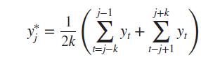
Data Imputation
Correcting missing values
Mean value imputation
Replacing a missing value with the sample average
Cannot account for seasonality well …
Stochastic mean value imputation
a random variable is added to the mean value to capture some of the noise or variability in the data
Mean value imputation using a subset of the data:
Better suited for seasonal / trend data
K=2 points on either side

Slide 42
Data Imputation
Regression imputation – the imputed value is computed from a model
Variation of mean value imputation where the imputed value is computed from a model used to predict the missing value.
The prediction model does not have to be a linear regression model.
Could be a time series model (using methods we learn later !)

Slide 43
Some useful resources:

