Slide 1

Chapter 2: Statistics Introduction to Forecasting (Part 2) Fall 2019

Slide 2
Announcements (09/10/19)
HW #1 has been posted on Blackboard
It is due on September 13 at 11:59 pm
Course / Lecture schedule has been posted online (See link on Blackboard)
HW #2 should be posted by Friday this week, and will be due on Tuesday (09/24)

Slide 3
Outline (for today’s lecture)
Terminology used in forecasting
Mathematical notation
Basic Smoothing filters
Linear filters
Median filters
Formal definition of Stationarity
Autocovariance and Autocorrelation
(Part 2)

Slide 4
Autocovariance and Autocorrelation
Covariance between y_{t} and y_{t+k} is called auto-covariance at lag k, defined by :
For k=0, above equation is variance,
Auto-correlation coefficient at lag k is:
$$Remember, Cov(X1,X2)=E[(X_{1}−μ_{1})(X_{2}−μ_{2})]$$

Slide 5
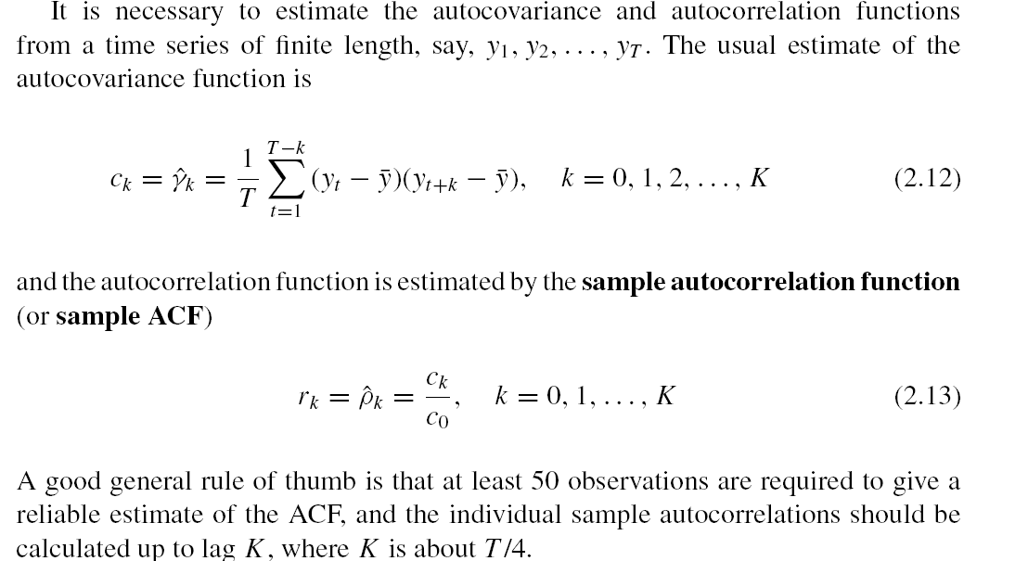
Sample Autocovariance and Autocorrelation Function (ACF)
How to compute the autocovariance?
How to compute autocorrelation function ?
Rule of thumb:
-- Use T=~50 observations to compute ACF
-- Sample autocorrelations computed until lag K=T/4

Slide 6
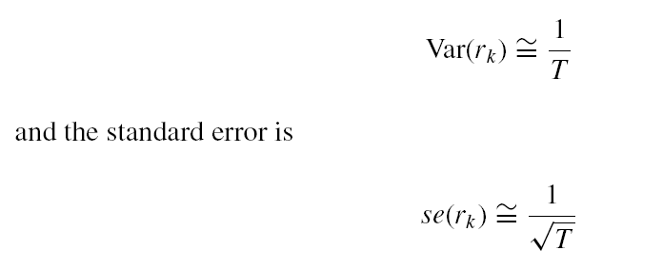
Autocorrelation coefficient
Many times, will need to determine if coefficient at particular lag is zero
To determine if autocorrelation coefficient is zero, compare with the standard error
T = number of values in the time series

Slide 7
Some of the chemical process viscosity data
.... Total of 100 time points given

Slide 8
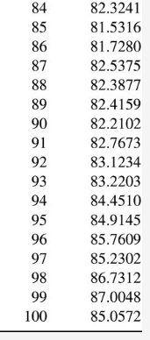
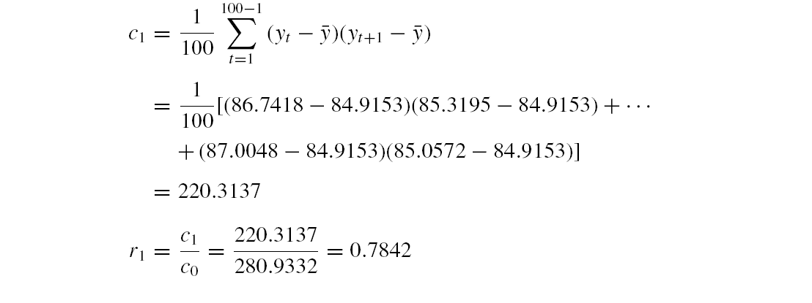
Let’s calculate the Sample Auto-correlation
Mean
y₁
y₁ and y₂

Slide 9
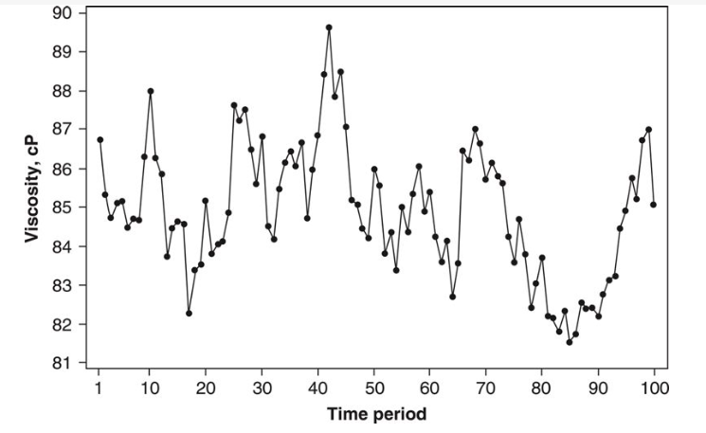

Autocorrelation plots with confidence intervals
Confidence interval
ACF
Time series
Note the rate of decrease or decay in ACF values from 0.78 to 0, followed by a sinusoidal pattern about 0. This ACF pattern is typical of stationary time series
Confidence interval:
(detailed in Chap 5)
(Confidence interval is calculated as a constant in some programming packages)

Slide 10
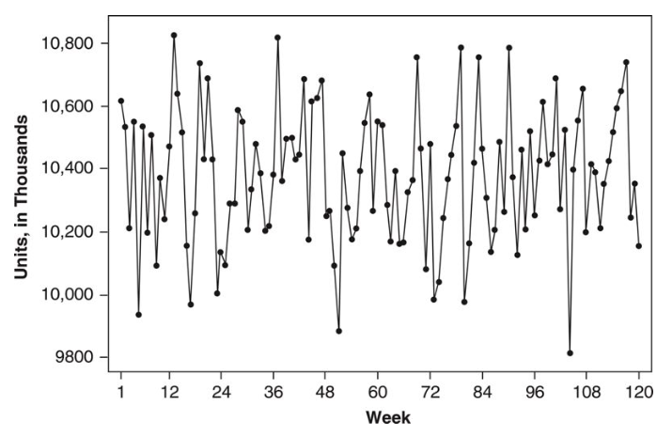
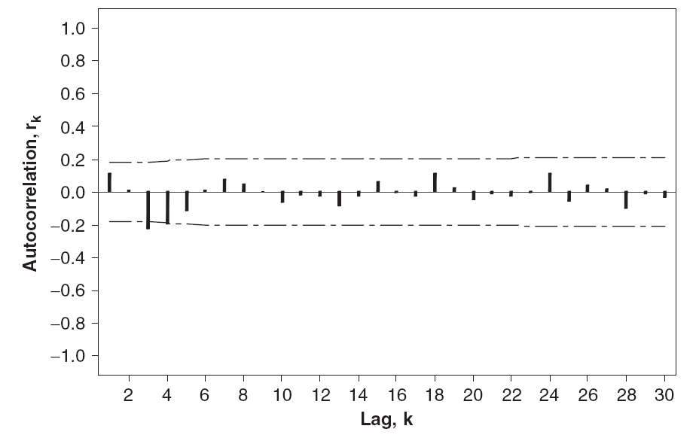
Autocorrelation (ACF) plots
ACFs for a time series of random values with constant mean
The sample ACFs appear randomly positive or negative, with values near zero
ACF
Time series
Plot starts at Lag 1; Lag 0 not shown

Slide 11
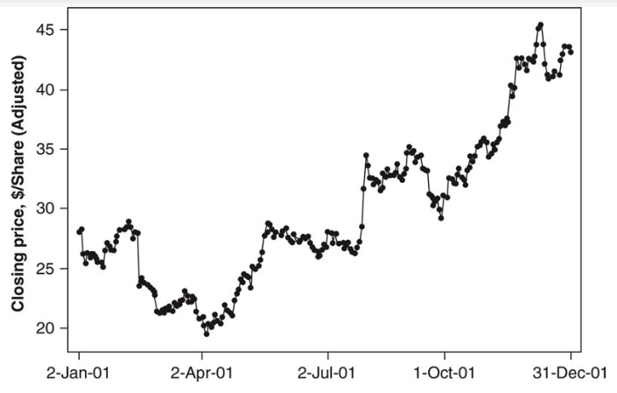
What does the sample ACF of a nonstationary time series look like?
sample ACF is very persistent;
Decays very slowly
large values even at long lags
All are characteristic of a nonstationary time series
Remember: If the sample ACF does not dampen out within about 15 to 20 lags, the time series is nonstationary

Slide 12
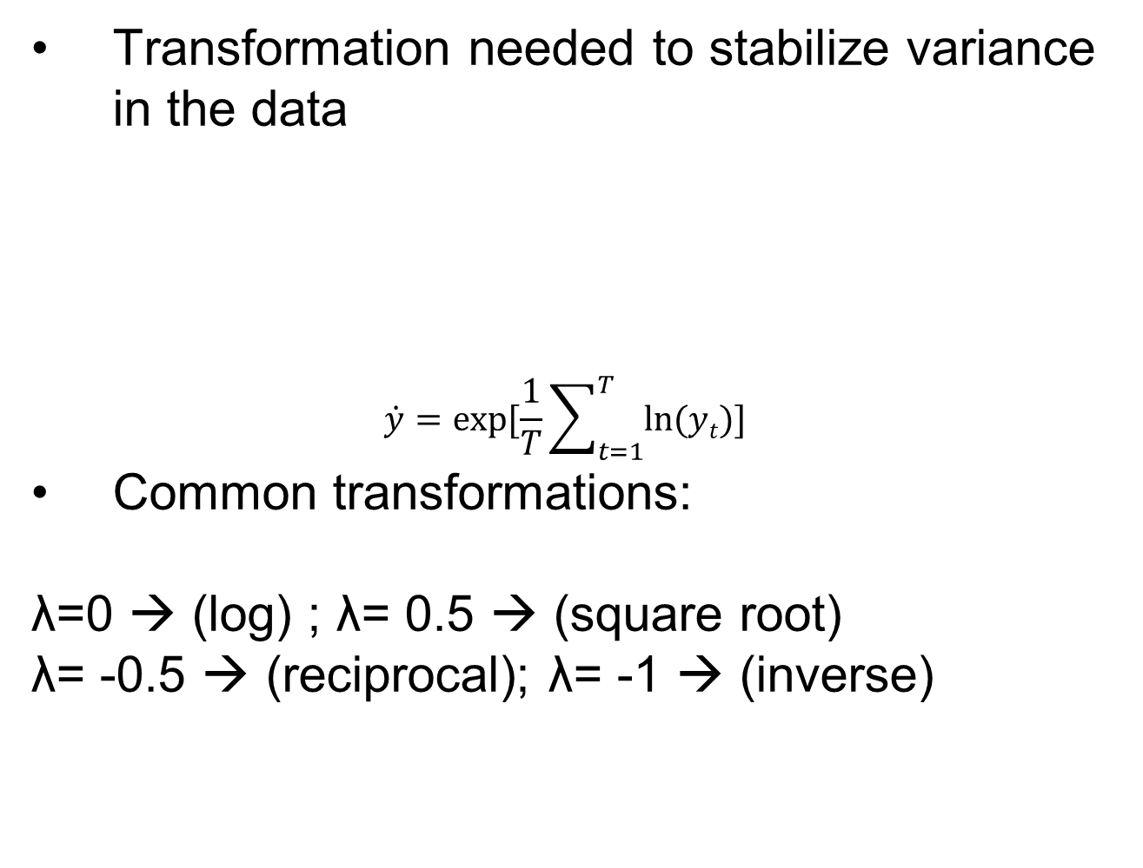
Data Transformation and Adjustments
Transformation needed to stabilize variance in the data
$$\dot{y}=exp⁡[\frac{1}{T}\sum_{t=1}^{T}{ln⁡(yt)]}$$
Common transformations:
λ=0 → (log) ; λ= 0.5 → (square root)
λ= -0.5 → (reciprocal); λ= -1 → (inverse)
(Geometric mean)

Slide 13
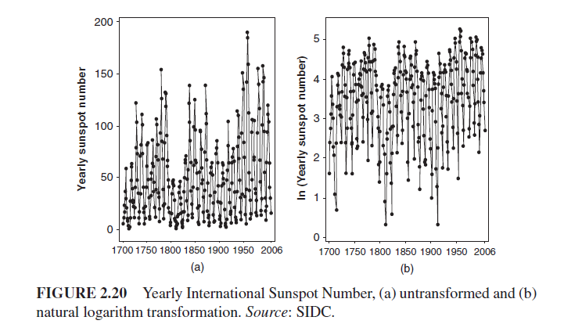
Transformed Data

Slide 14
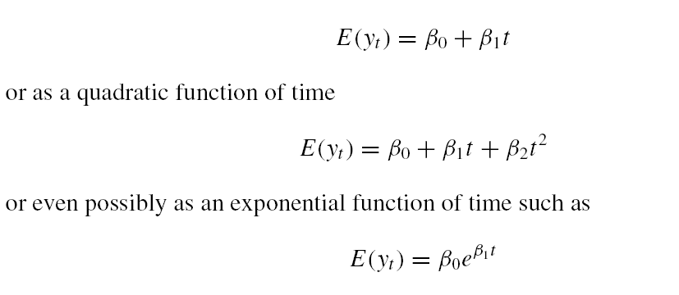
Trend and Seasonal Adjustments
Two widely used adjustments: Trend and Seasonal
Time series with trend is non-stationary
One way to remove trend is regression modeling
With a trend, mean of y_{t} changes linearly with time:

Slide 15
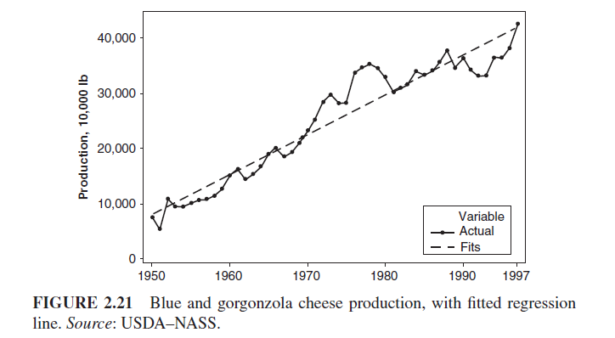

Slide 16
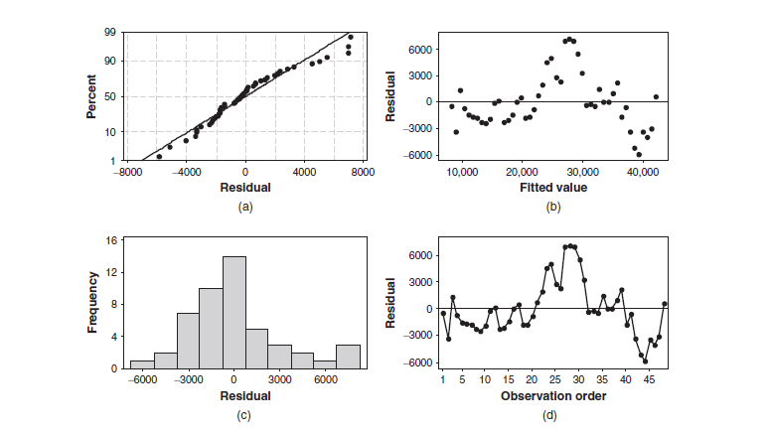
Fig. 2.22
Structure to the residuals
Structure to residuals indicate linear fit is not adequate … implies model error

Slide 17
Removing trend by differencing
Difference the data: apply difference operator
or, a backshift operator (B) , By_{t} = y_{t-1}
Second order difference can also be computed:
y_{t}
y_{t} - y_{t-1}

Slide 18
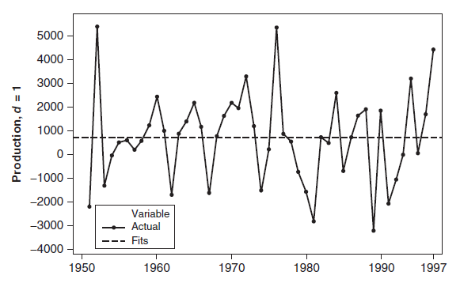
Removing trend by differencing

Slide 19
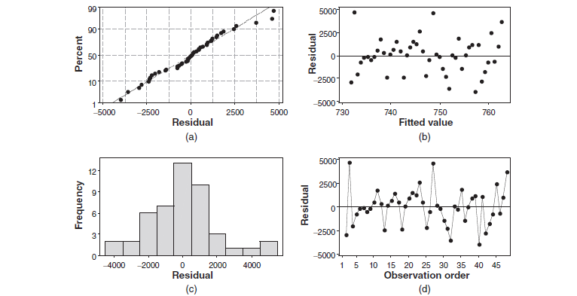
Residual plots after differencing

Slide 20
Removing seasonality and trend
Trend and seasonal are present in many time series
Differencing can be used to remove seasonality
Lag d difference defined as :
To remove annual seasonality (d=12):

Slide 21
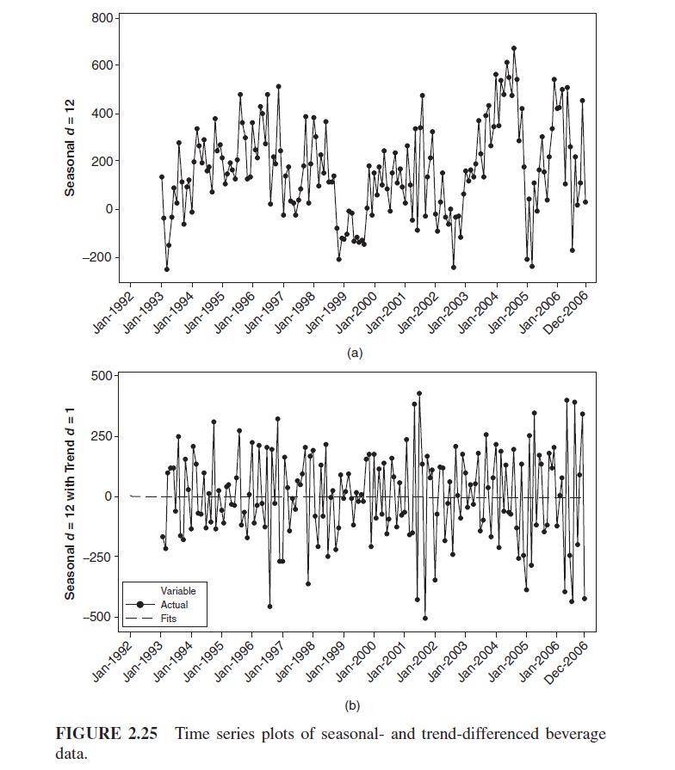
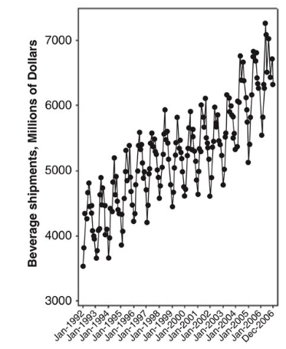
Seasonal-differenced
Seasonal and Trend
Time series
Trend-differenced
Slope = 0

Slide 22
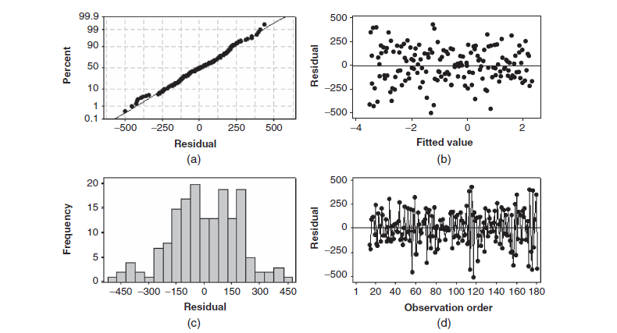
Examination of the residual plots does not reveal any problems with the linear trend model fit to the differenced data.

Slide 23
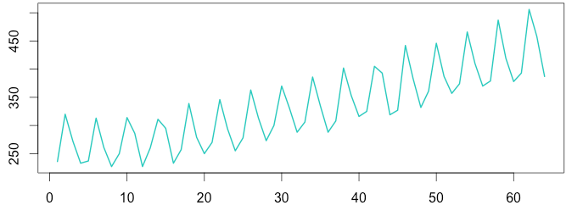
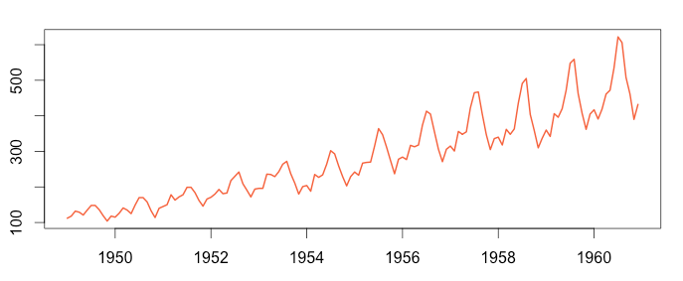
Classical Decomposition Approach
Decompose time series into seasonal, trend, and random error
S_{t} = seasonal component; T_{t} = trend; ε_{t} = error
(Additive model)
Seasonal variation is constant
(Multiplicative model)
Seasonal variation increases with time

Slide 24
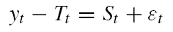
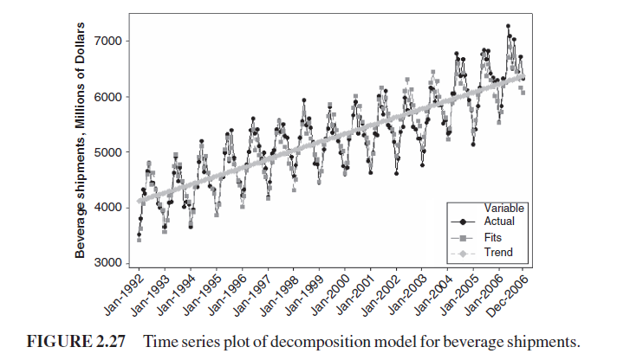
Classical Decomposition Approach
Estimate trend component, and remove it :
Now, can estimate the seasonal indices, i.e.
January seasonal factors are averaged to produce a January season index; all of the February seasonal factors are averaged to produce a February season index; and so on.
T_{t} =

Slide 25
Time Series Decomposition
What type (multiplicative or additive) is it ?

Slide 26
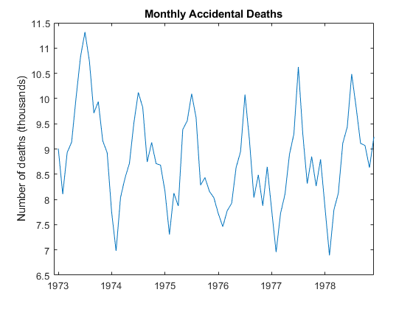
Example: Time Series Decomposition
The data exhibits a strong seasonal component with periodicity 12.

Slide 27
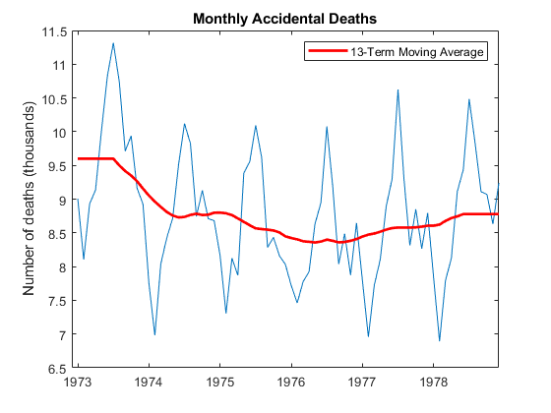
Example: Time Series Decomposition
Estimate the Trend: Apply a 13-term centered moving average (Why 13?)
Repeated values

Slide 28
Example: Time Series Decomposition
Remove the Trend ;

Slide 29
Example: Time Series Decomposition
Apply a seasonal filter – estimate the seasonal indices
Calculate Average for each month of the year (from 1973-1979)
Replicate 6 times
Replicate
1973
1974
Dec 1979
Jan 1973

Slide 30
Example: Time Series Decomposition
Compute the residuals
-
=
Residuals

Slide 31
Example: Time Series Decomposition
Alternatively, remove seasonal component from original to look at at residuals
-
=
Original
Seasonal index
A Quadratic trend is clearly visible after removing ONLY the seasonality

Slide 32
Compare Fitted value with Raw Data
Value
Time

Slide 33
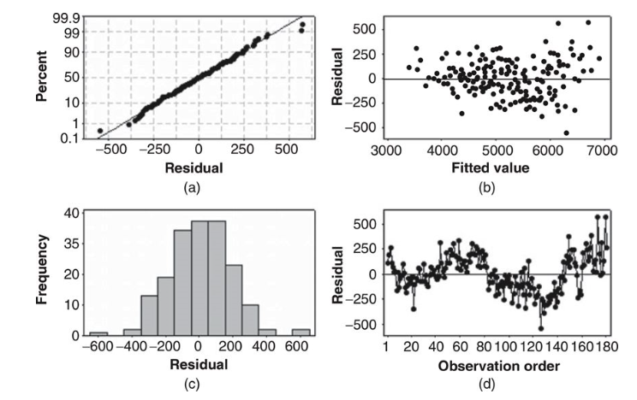
Review of Performance (Original Data)
Increased variance

Slide 34
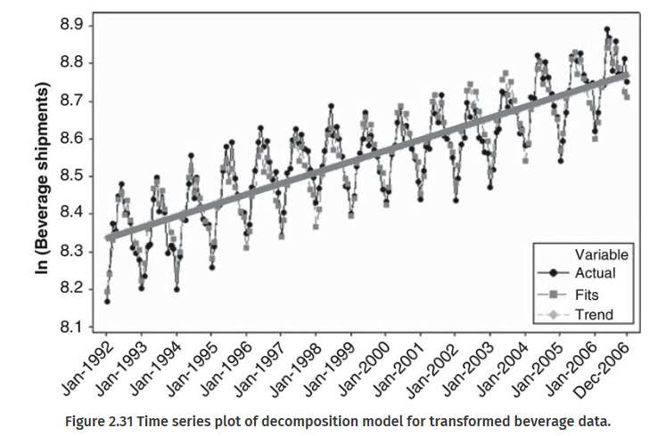
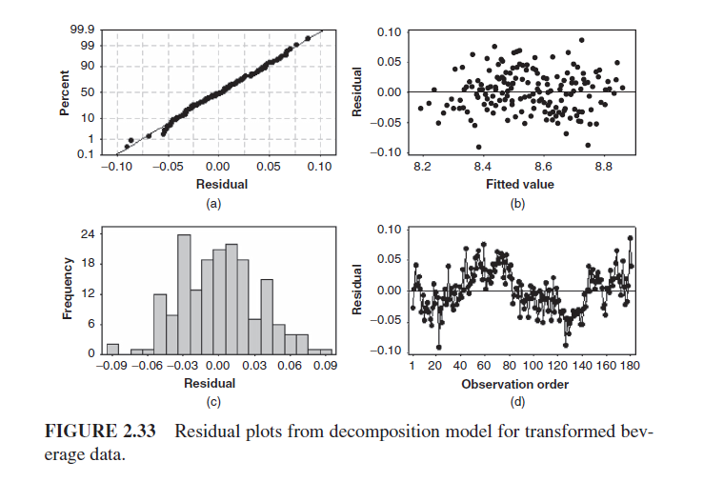
Review of Performance (Log Data)
Log transformed

Slide 35

General Approach to Time Series Modeling and Forecasting
Plot the time series → determine its basic features
Check if trend and seasonality is present?
Eliminate any trend or seasonal components
Use differencing or fit an appropriate model to the data
Develop a forecasting model for the residuals
Multiple models could be applied; might need to choose from multiple
Validate the performance of the model (or models) from the previous step
Apply split-sample or cross-validation procedure
Reverse any transformations applied, e.g. if , change to

Slide 36
General Approach to Time Series Modeling and Forecasting
If prediction intervals are desired for the forecast
Apply transformations and construct prediction intervals for the residuals
Then, reverse the transformations made to produce the residuals
Develop and implement a procedure for monitoring the forecast
Ensures that deterioration in performance will be detected reasonably quickly

Slide 37

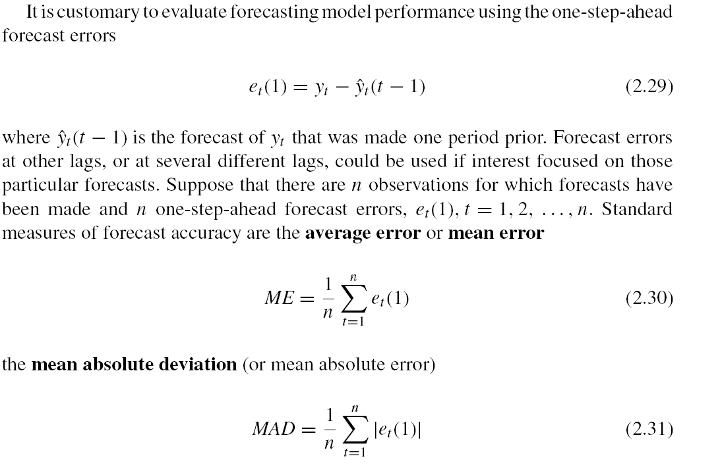
Evaluating and Monitoring Forecast Performance
Evaluate using one-step ahead forecast errors
Suppose we need to evaluate error at n different time points:
Measure of bias
Mean error

Slide 38
Evaluating and Monitoring Forecast Performance
Other ways to monitor forecast:
Measures of variability

Slide 39
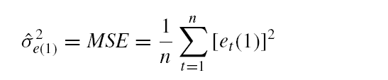
Measure of variability
MSE is measure of variability
If errors are normally distributed, standard deviation is related to MAD

Slide 40
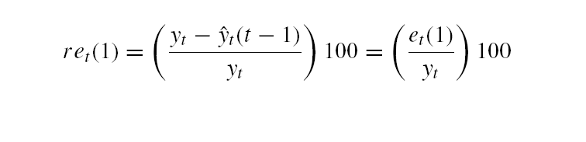
Relative Forecast Error
relative forecast error (in percent):
Mean percent errors …

Slide 41
Why do we need relative forecast errors ?
Absolute values are harder to compare
If we were forecasting demand for electricity in Phoenix during the summer, the units would be megawatts (MW)
If the MAD for the forecast error during summer months was 5 MW, we might not know whether this was a large forecast error or a relatively small one
However, knowing that the relative or percent forecast error or the MAPE is 3% (say) can be much more meaningful than knowing that the MAD is 5 MW.
Note that the relative or percent forecast error only makes sense if the time series y_{t} does not contain zero values.

Slide 42
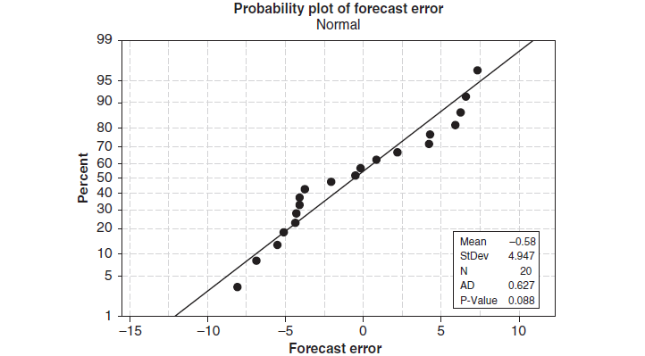
Normality of forecast errors
Forecast errors deviate somewhat from the straight line
→ Normal distribution is not a perfect model for the distribution of forecast errors

Slide 43
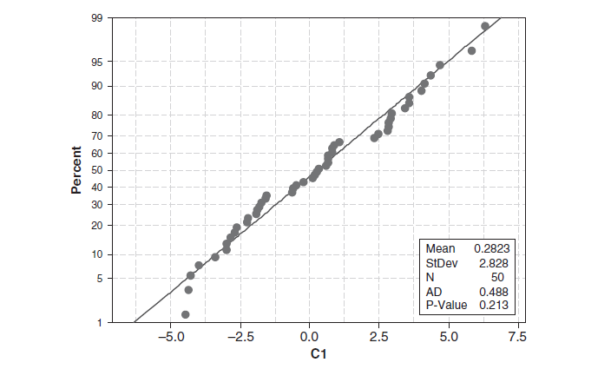
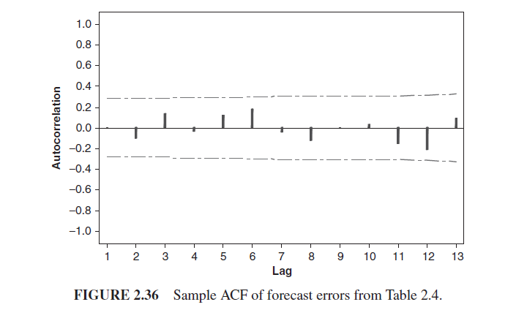
ACF of residuals
1.96/sqrt(T), where T= no of samples
sample ACF of the forecast error is like the ACF of random data;
No large “spikes” on the sample ACF at low lag

Slide 44
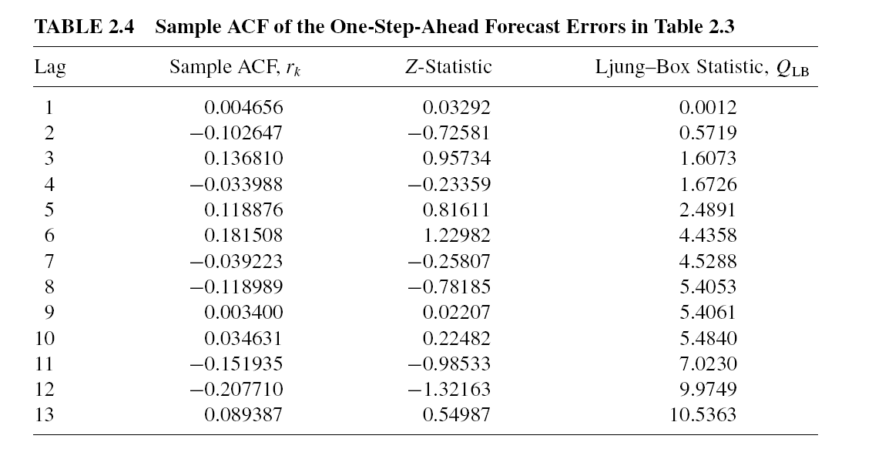
How to test if autocorrelation values are significant
Set a significance level, α= 0.05
Null hypothesis is autocorrelation values are zero
Compute the Z statistic at chosen α, Z_{α/2}= 1.96
If auto-correlation value r_{k *}sqrt(T) > Z_{α/2}, reject the null hypothesis → autocorrelation values are not zero

Slide 45
END CHAPTER 2

Slide 46
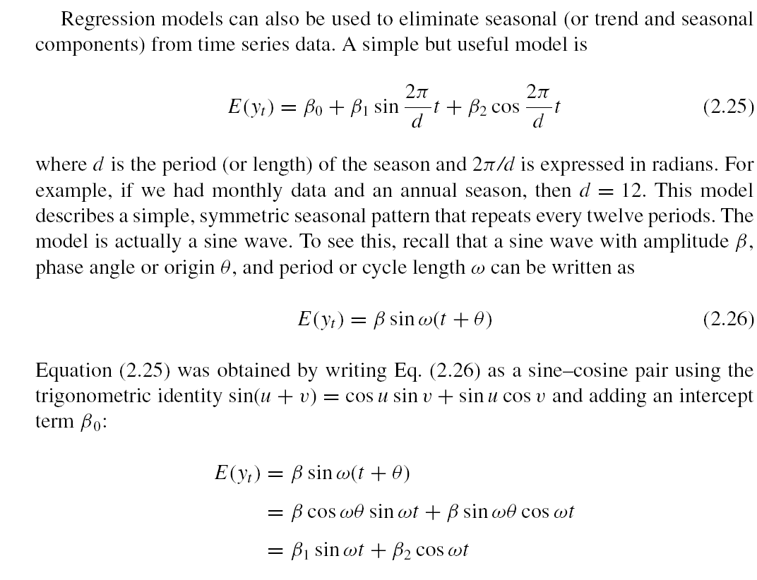

Slide 48
Variogram
Variogram measures differences between observations k lags apart
If the time series is stationary,
For a stationary series, ρ_{k} → 0 as k increases, G_{k} reaches 1/(1 – ρ₁)

Slide 49
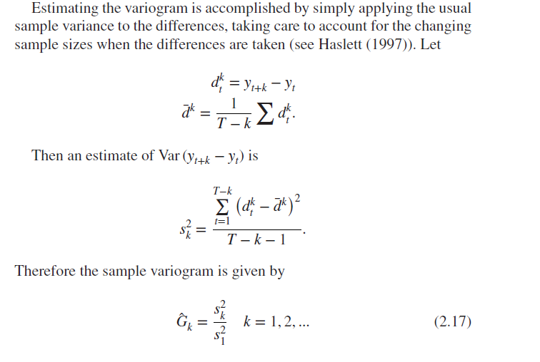
Sample Variogram
Estimating the variogram accomplished by simply applying the usual sample variance to the differences
Note the changing sample sizes when differences are taken

Slide 50
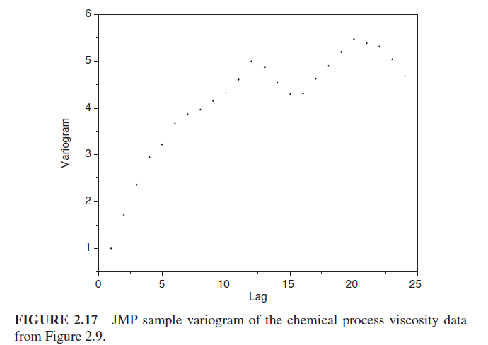
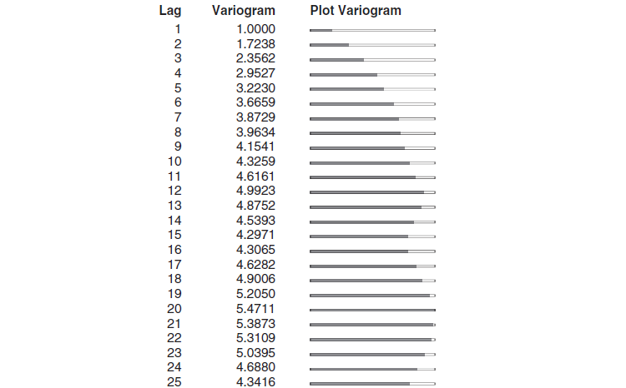
Sample Variogram – Stationary Time Series
Converging to stable
Sample variogram generally converges to a stable level and then fluctuates around it

Slide 51
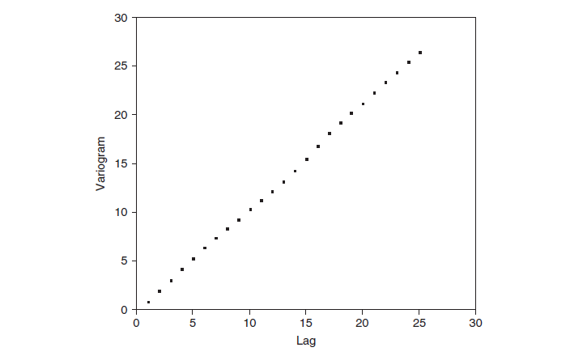
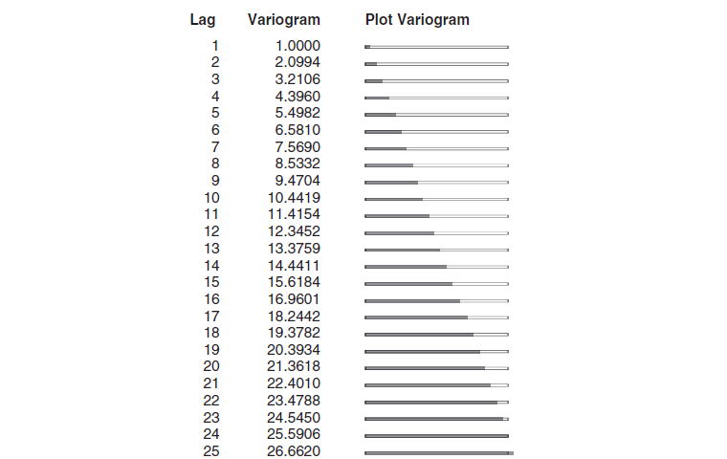
Sample Variogram – Non-Stationary Time Series
Sample variogram increases monotonically for all 25 lags → Strong indication that the time series is nonstationary

