Slide 1

Chapter 2: Statistics Introduction to Forecasting (Part 3) Fall 2019

Slide 2
Announcements (09/12/19)
HW #1 has been posted on Blackboard
Due on September 13 at 11:59 pm
You are welcome to use any programming tool (this is also an opportunity to build skills in Python/R)
HW #2 should be posted by Friday this week, and will be due on Tuesday (09/24)

Slide 3
Clarification on determining stationarity
Check if trend is present
Check if seasonality is present
If (a) and (b) are present, it will impact the ACF as follows:
If trend is present, the ACF will decay slowly
If seasonality is present, the ACF will have multiple peaks (distance between peaks is equal to the seasonal period)
For HW 1, you are asked to determine if stationarity is present or absent based on the appearance of the time series plot and the ACF

Slide 4
Outline (for today’s lecture)
Terminology used in forecasting
Mathematical notation
Basic Smoothing filters
Linear filters
Median filters
Formal definition of Stationarity
Autocovariance and Autocorrelation
Evaluating Forecast performance
Part 3

Slide 5
Why do we emphasize removing Seasonality ?
Seasonality does not add any new information
Many time-series are inherently seasonal, e.g. house prices are higher in summer; retail sales are high during holidays (Dec); temperatures are highest in summer.
E.g. When house price index suddenly goes down, it is not always because it signals something important in economy, but it could simply be the seasonal drop, which has no significant information. Hence, we want to deseasonalize the series to understand the broader insight
If you deal with multiple time-series, each of them can have its own seasonality. So, it's easier to de-seasonalize all series before analyzing them together
Alternative to removing is to incorporate seasonality explicitly in a model, e.g. Seasonal models (SARIMA etc)

Slide 6
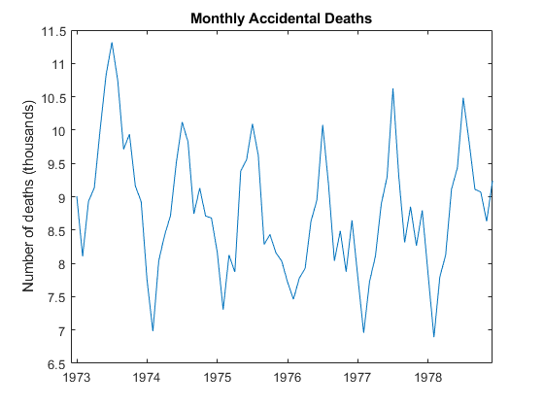
Example: Time Series Decomposition
This example demonstrates how seasonality removal helps with capturing the underlying pattern better
The data exhibits a strong seasonal component with periodicity 12.

Slide 7
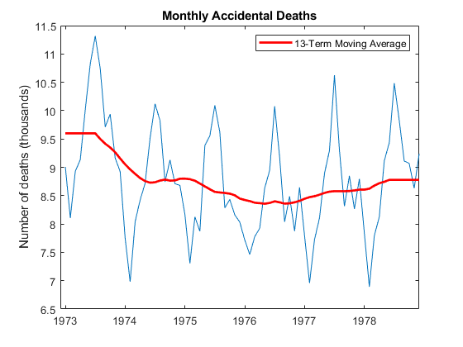
Example: Time Series Decomposition
Estimate the Trend: Apply a 13-term centered moving average (Why 13?)
Repeated values

Slide 8
Example: Time Series Decomposition
Remove the Trend ;

Slide 9
Example: Time Series Decomposition
Apply a seasonal filter – estimate the seasonal indices
Calculate Average for each month of the year (from 1973-1979)
Replicate 6 times
Replicate
1973
1974
Dec 1979
Jan 1973

Slide 10
Example: Time Series Decomposition
Compute the residuals
-
=
Residuals

Slide 11
Example: Time Series Decomposition
Alternatively, remove seasonal component from original to look at at residuals
-
=
Original
Seasonal index
A Quadratic trend is clearly visible after removing the seasonality

Slide 12
Compare Fitted value with Raw Data
Value
Time

Slide 13

General Approach to Time Series Modeling and Forecasting
Plot the time series → determine its basic features
Check if trend and seasonality is present?
Eliminate any trend or seasonal components
Use differencing or fit an appropriate model to the data
Develop a forecasting model for the residuals
Multiple models could be applied; might need to choose from multiple
Validate the performance of the model (or models) from the previous step
Apply split-sample or cross-validation procedure
Reverse any transformations applied, e.g. if , change to

Slide 14
General Approach to Time Series Modeling and Forecasting
If prediction intervals are desired for the forecast
Apply transformations and construct prediction intervals for the residuals
Then, reverse the transformations made to produce the residuals
Develop and implement a procedure for monitoring the forecast
Ensures that deterioration in performance will be detected reasonably quickly

Slide 15

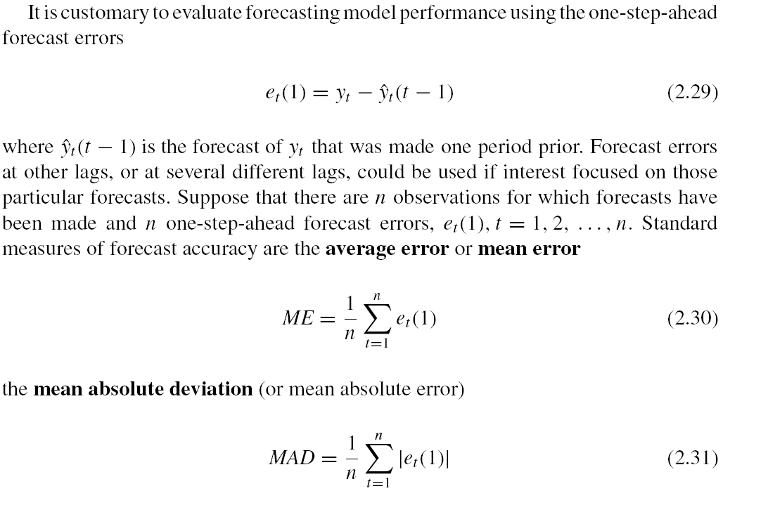
Evaluating and Monitoring Forecast Performance
Evaluate using one-step ahead forecast errors
Suppose we need to evaluate error at n different time points:
Measure of bias
Mean error

Slide 16
Evaluating and Monitoring Forecast Performance
Other ways to monitor forecast:
Measures of variability

Slide 17
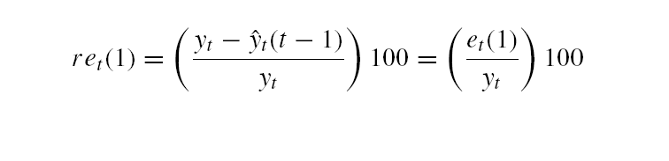
Relative Forecast Error
relative forecast error (in percent):
Mean percent errors …

Slide 18
Why do we need relative forecast errors ?
Absolute values are harder to compare
If we were forecasting demand for electricity in Phoenix during the summer, the units would be megawatts (MW)
If the MAD for the forecast error during summer months was 5 MW, we might not know whether this was a large forecast error or a relatively small one
However, knowing that the relative or percent forecast error or the MAPE is 3% (say) can be much more meaningful than knowing that the MAD is 5 MW.
Note that the relative or percent forecast error only makes sense if the time series y_{t} does not contain zero values.

Slide 19
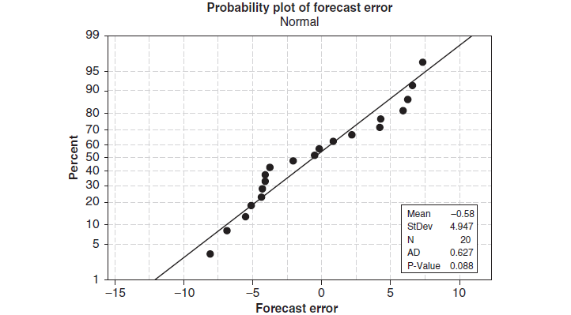
Normality of forecast errors
Forecast errors deviate somewhat from the straight line
→ Normal distribution is not a perfect model for the distribution of forecast errors

Slide 20
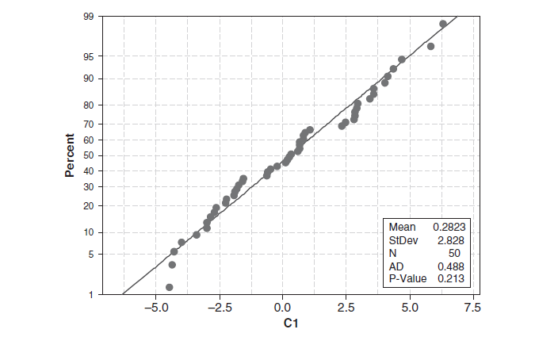
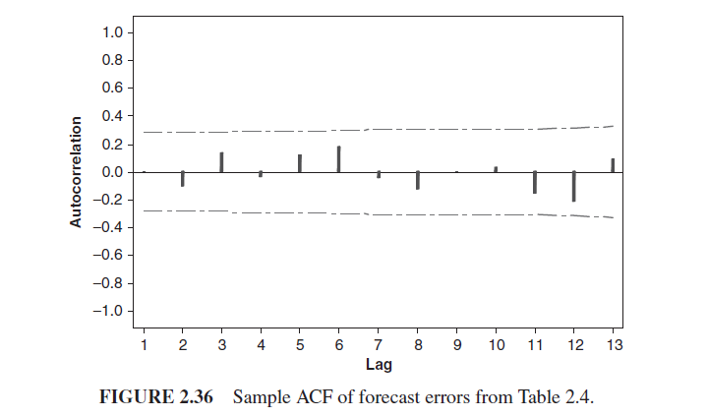
ACF of residuals
Confidence bounds= ±1.96/sqrt(T), where T= no of samples
sample ACF of the forecast error is like the ACF of random data;
No large “spikes” on the sample ACF at low lag

Slide 21
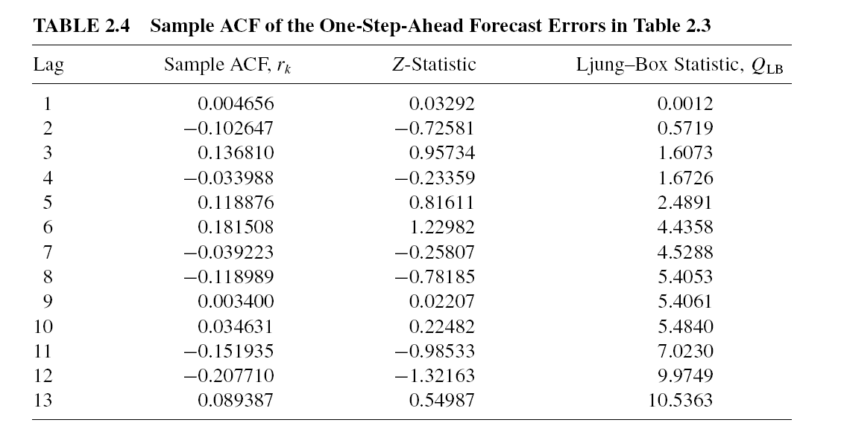
How to test if autocorrelation values are significant
Set a significance level, α= 0.05
Null hypothesis : autocorrelation values are zero
Compute the Z statistic r_{k} × sqrt(T)
Compare with threshold Z_{α/2} for chosen α, threshold is 1.96
If auto-correlation value r_{k} × sqrt(T) > 1.96, reject the null hypothesis → autocorrelation values are not zero
T is length of time-series

Slide 22
END CHAPTER 2

