Slide 1

Chapter 4: Smoothing Methods Fall 2019
Part 2

Slide 2
Announcements (09/17/19)
HW #2 has been posted on Blackboard
Due on September 24 at 11:59 pm
Correction to HW #2 (Problem 3): You can ignore the question “Comment on which smoothing constant was better suited for this time series”
This HW has an additional question (Problem 2) for graduate students ONLY
No extra credit is available for undergraduate students who solve Problem 2… there will other opportunities later !

Slide 3
Outline
Review: Smoothing using Moving Averages
Drawbacks of Moving Average approaches
Simple Exponential Smoothing
– No trend, no seasonal pattern
Second Order Exponential Smoothing
– Trend, no seasonal pattern
• Holt-Winters Methods
– Both trend and seasonal pattern
Multiplicative Holt-Winters method
Additive Holt-Winters Method

Slide 4
RECAP: Simple Moving Average – Parameter selection
Critical issue in simple moving averages is choice of span (N)
Smaller N → Simple Moving Average reacts faster
However, we know that variance reduces as N increases → tradeoffs !
See effect of N from 15 to 33
As N gets smaller, MA(N) reacts faster to the changes in the data!

Slide 5
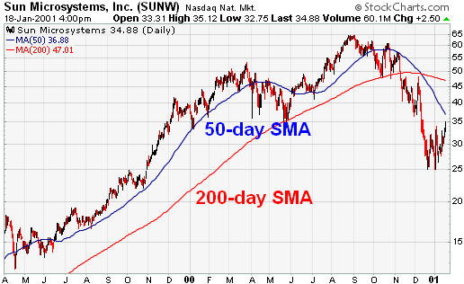
RECAP: Example
Simple moving average can lag the increasing and decreasing trend
SMA : Simple Moving Average

Slide 6
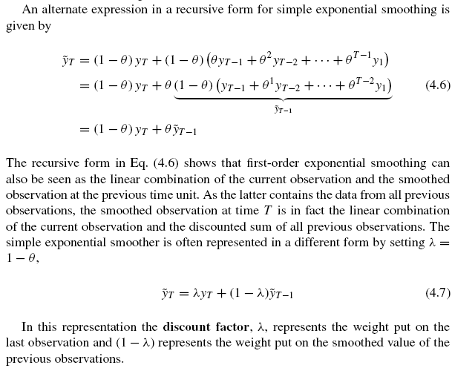
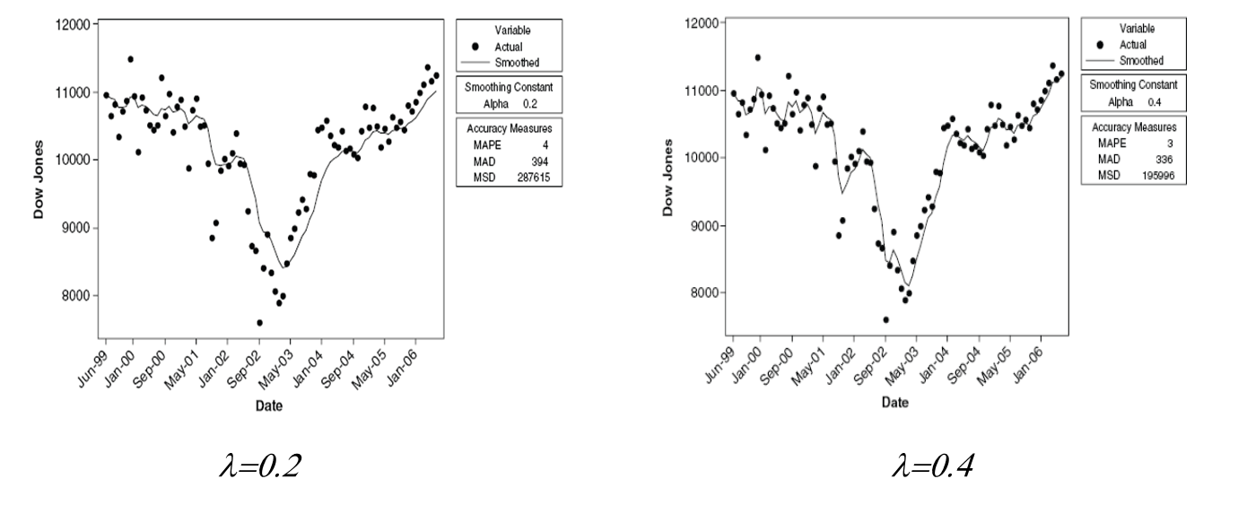
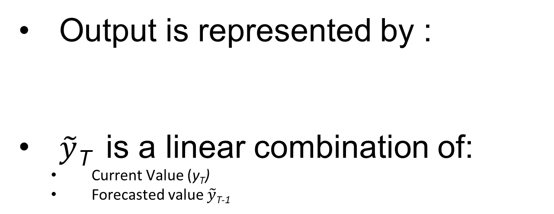
RECAP: First-Order (Simple / Single) Exponential Smoothing
Output is represented by :
$\tilde{y}$_{T} is a linear combination of:
Current Value (y_{T})
Forecasted value $\tilde{y}$_{T-1}

Slide 7
RECAP: Bias in First-Order (Simple) Exponential Smoothing
Linear trend
Simple Exponential
Bias in First-order exponential smoothing!

Slide 8


A more general model
For a more general model for y in time, we have
where β is the vector of unknown parameters and ε_{t} are the uncorrelated errors.
A time series with constant mean is a member of this general class of models:
Time (t)
(where $β0$ is the constant mean)

Slide 9
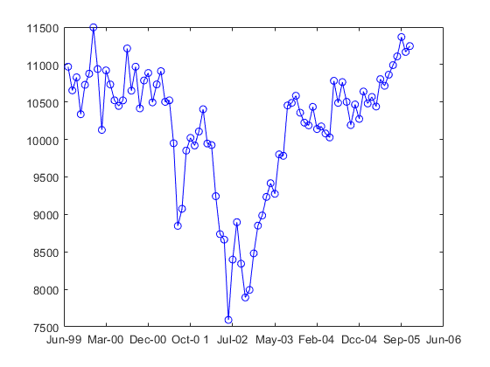
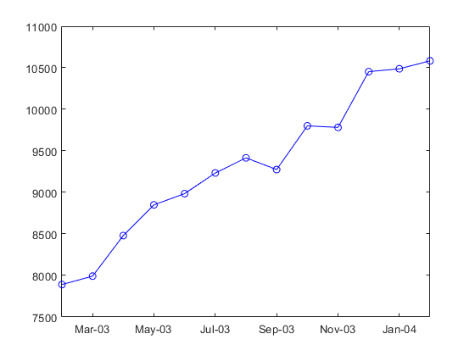
Second-Order Exponential Smoothing
If the data shows a linear trend, a more appropriate model will be:
where β₀ and β₁ are unknown parameters and ε_{t} are the uncorrelated errors.
Dow Jones Index
Dow Jones Index
Time (t)
Time (t)

Slide 10
Second-Order Exponential Smoothing
Apply first order smoothing again to the first-order exponential smoother
Remember, this is the first order smoother!
Apply first order smoothing to
Second-order smoothed value of previous time step
First order smoothed value

Slide 11

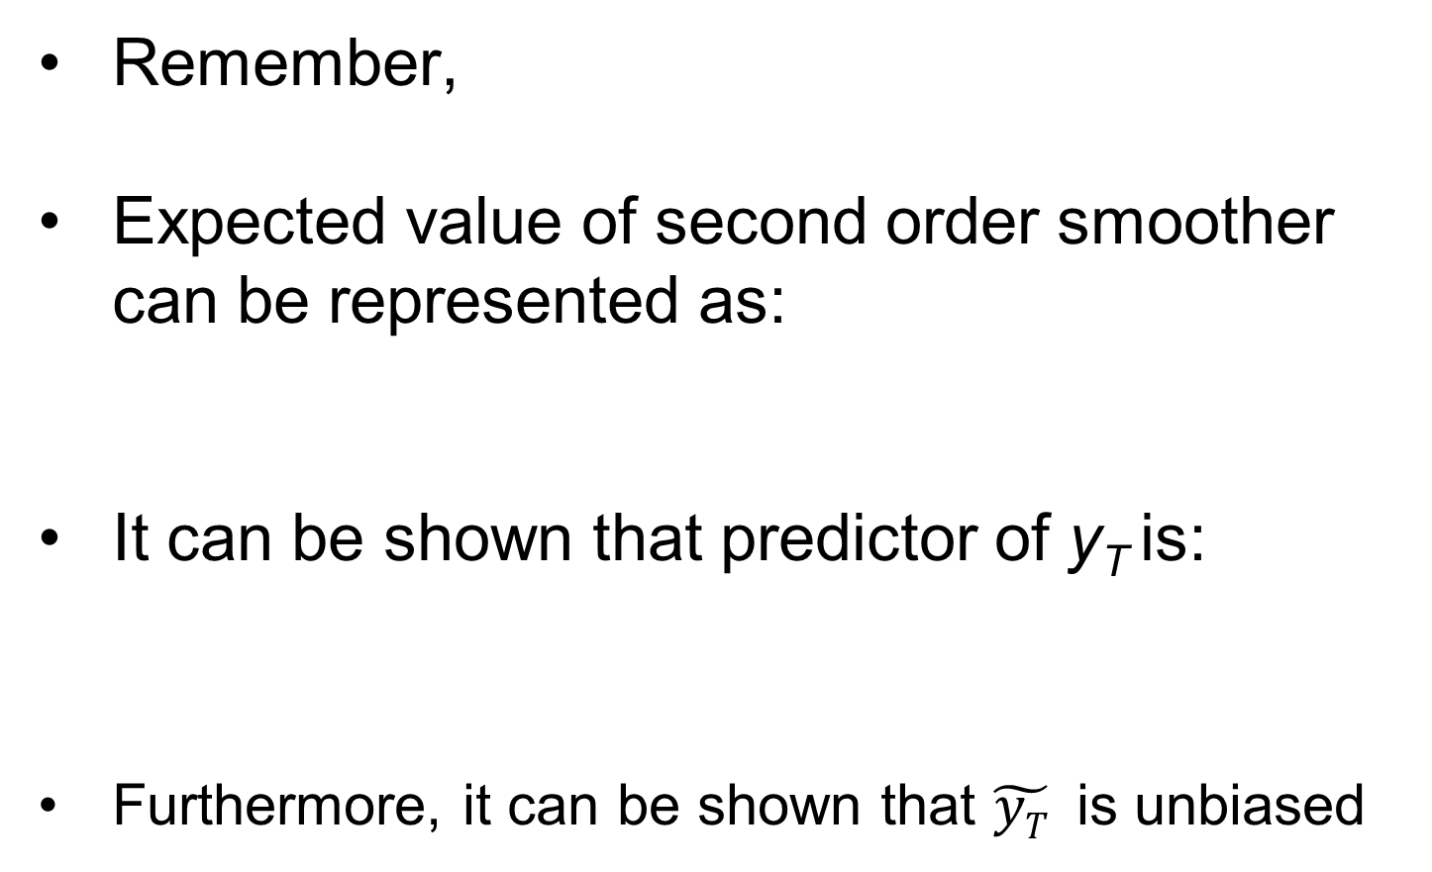
Bias in Second-Order Exponential Smoothing
Remember,
Expected value of second order smoother can be represented as:
It can be shown that predictor of y_{T} is:
Furthermore, it can be shown that $\tilde{yT}$ is unbiased
(From last class)

Slide 12
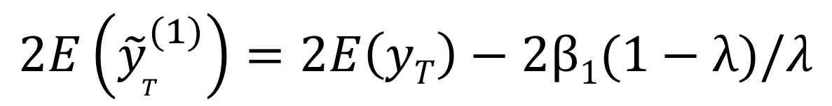
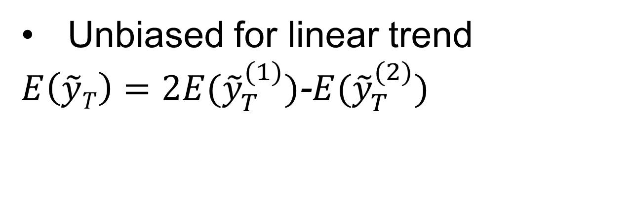

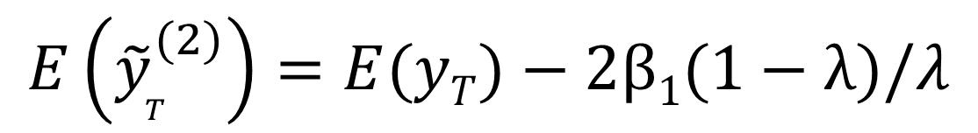
Second-order Exponential Smoothing
Unbiased for linear trend
$E\left(\tilde{y}T\right)=2E({\tilde{y}}_{T}^{(1)})$-$E({\tilde{y}}_{T}^{(2)})$
… (1)
$$2E\left({\tilde{y}}_{T}^{(1)}\right)=2E\left(yT\right)−2β1(1−λ)/λ$$
(a)
$$E\left({\tilde{y}}_{T}^{(2)}\right)=E(yT)−2β1(1−λ)/λ$$
(b)
Substituting (a) and (b) in (1),
$$E\left(\tilde{y}T\right)=E\left(yT\right)$$

Slide 13
Second-order Exponential Smoothing
Note lack of bias for the linear trend

Slide 14
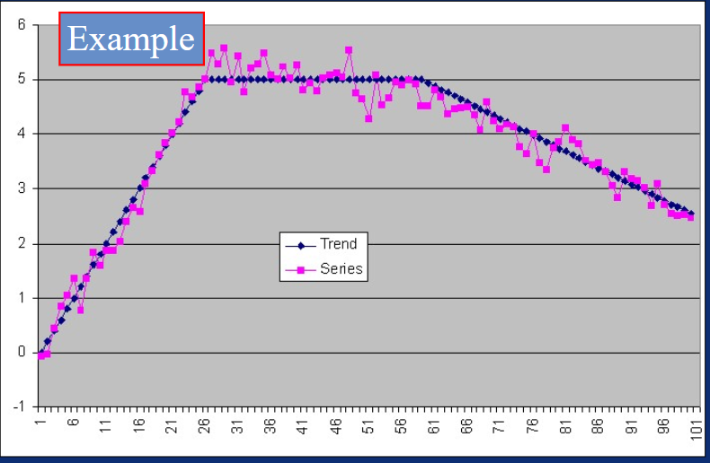
Advantage of Second Order Exponential Smoothing (Example)
Forecasting using simple models
https://slideplayer.com/slide/4919574/
US Consumer Price Index from Jan 1995 (Raw data)

Slide 15
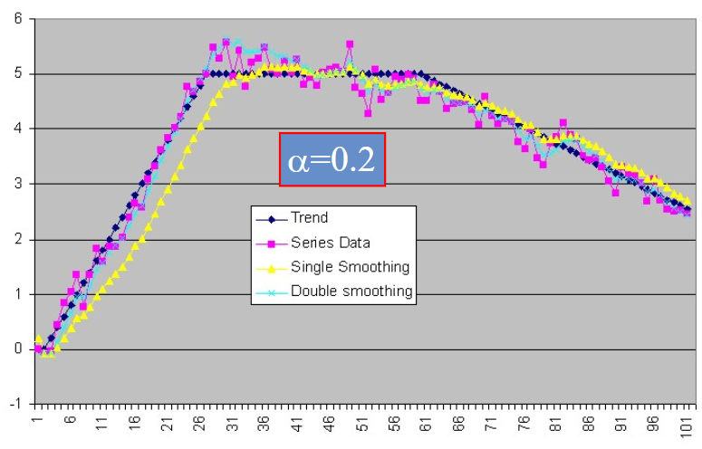
Advantage of Second Order Exponential Smoothing (Example)
Second order smoothing overshoots; must re-learn the slope
λ=0.2
First order
Second order
First order smoothing has bias

Slide 16

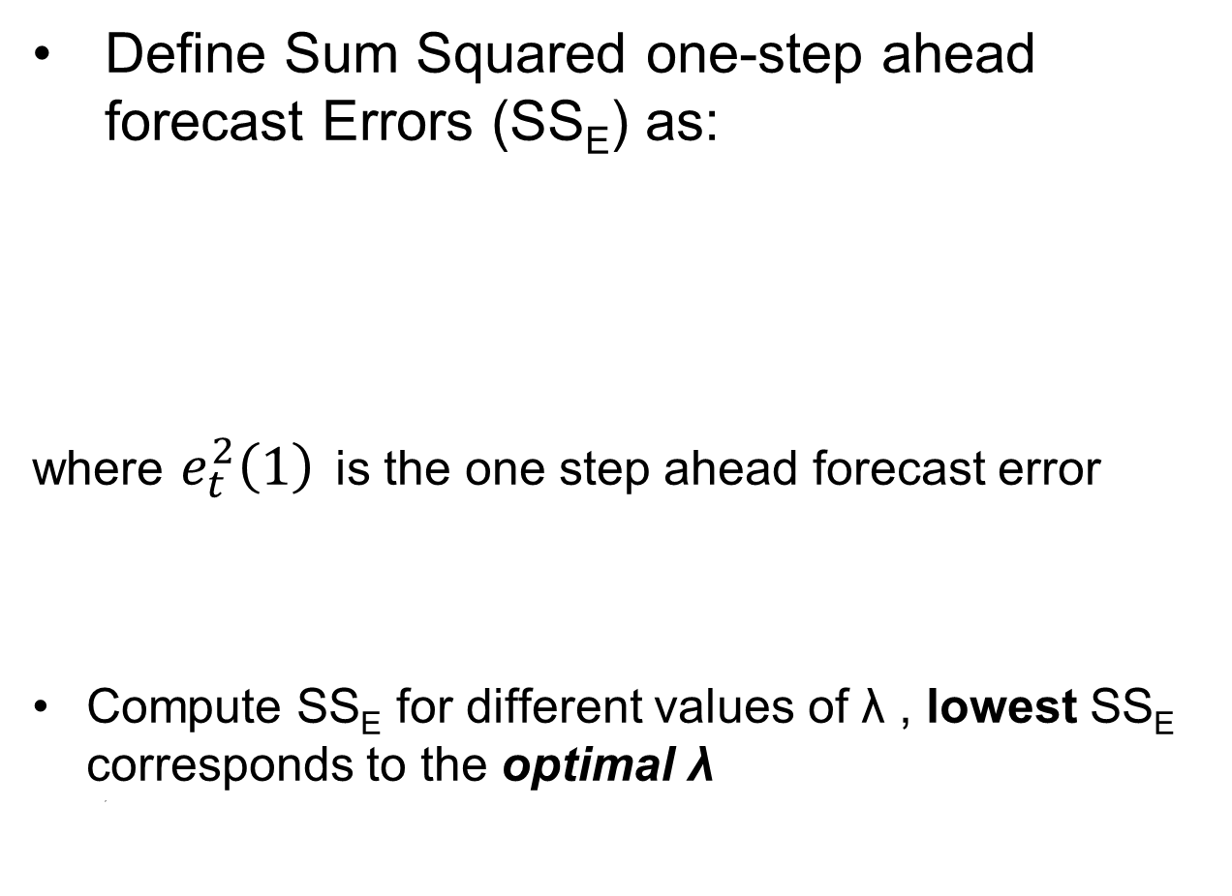

Choice of λ
Define Sum Squared one-step ahead forecast Errors (SS_{E}) as:
where $e_{t}^{2}\left(1\right)$ is the one step ahead forecast error
Compute SS_{E} for different values of λ , lowest SS_{E} corresponds to the optimal λ
,
$$et\left(1\right)=yt−\tilde{y}t(t−1)$$

Slide 17
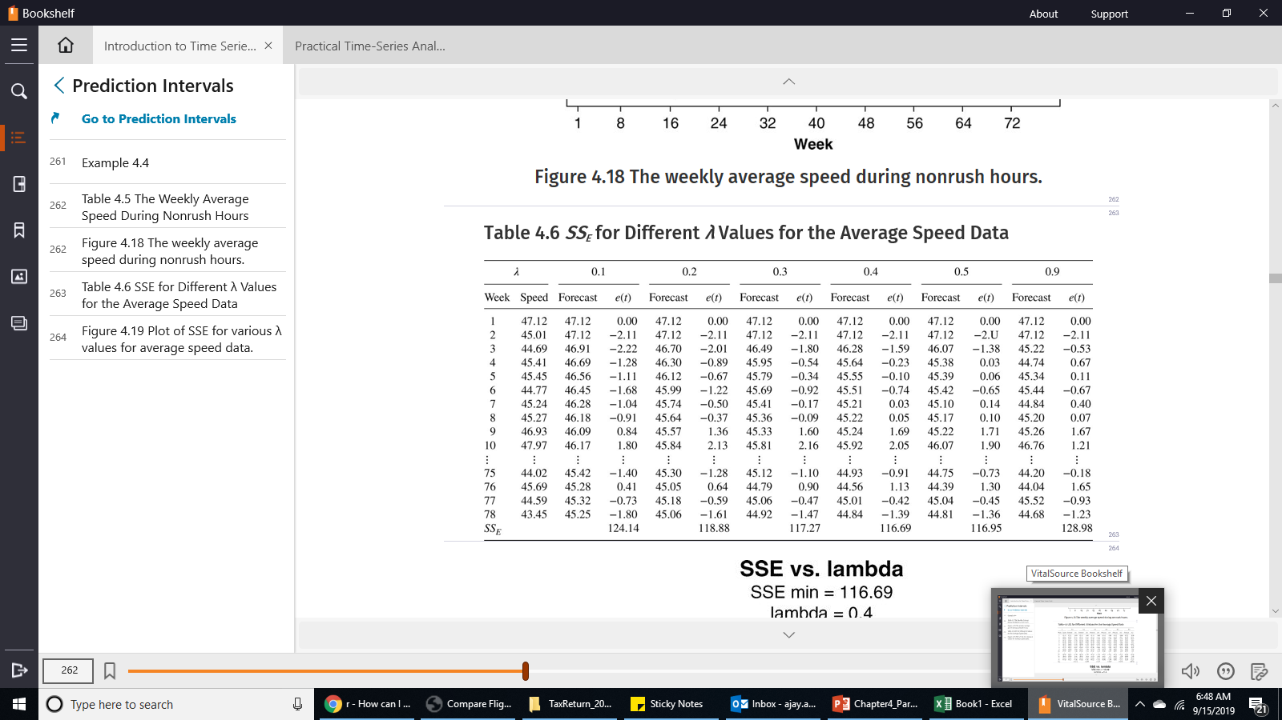
Example: Finding the Optimal λ
Apply

Slide 18

Example: Finding the Optimal λ
For each value of λ, calculate the Sum Squared Error (SS_{E}) → Find minimum error
For the chosen λ, also calculate standard deviation:
e_{t}(1) = forecast error

Slide 19
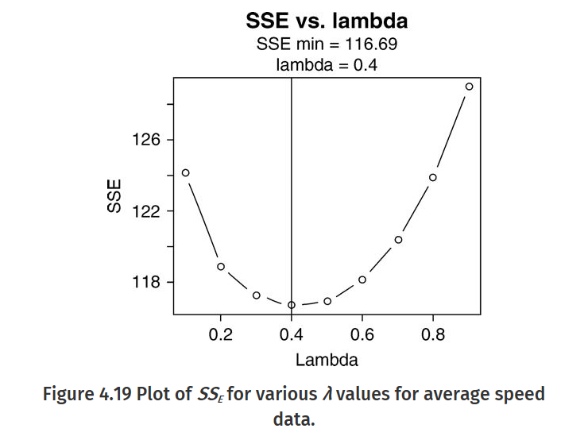
Example: Choosing optimal λ
The “best”
λ value is 0.4

Slide 20
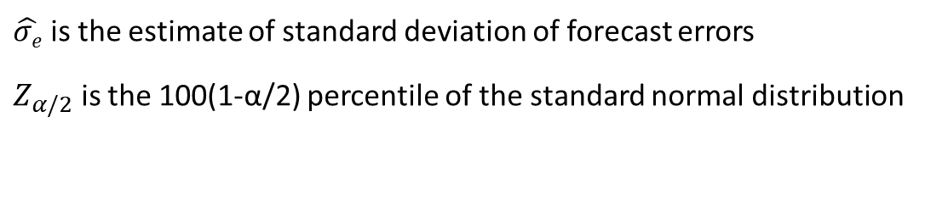
Prediction Intervals
We are less interested in “point estimate”, rather more interested in uncertainty
Hence, we want confidence intervals
Prediction interval can be estimated as:
1.96 at 95% confidence level
$\hat{σe}$is the estimate of standard deviation of forecast errors
$Z_{α/2}$ is the 100(1-α/2) percentile of the standard normal distribution

Slide 21

Forecasting
The τ-step-ahead forecast made at time T is denoted as
For the Simple Exponential Smoother,
and
(future value equal to current value of smoother)

Slide 22
Example: Forecast
Prediction Interval
Constant forecast value

Slide 23
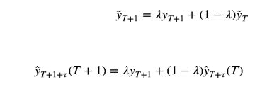
Updating the Forecast
However, this ignores new observations
How can we use new observations to update the forecast?
Using:
Basic equation of Exponential Smoother

Slide 24

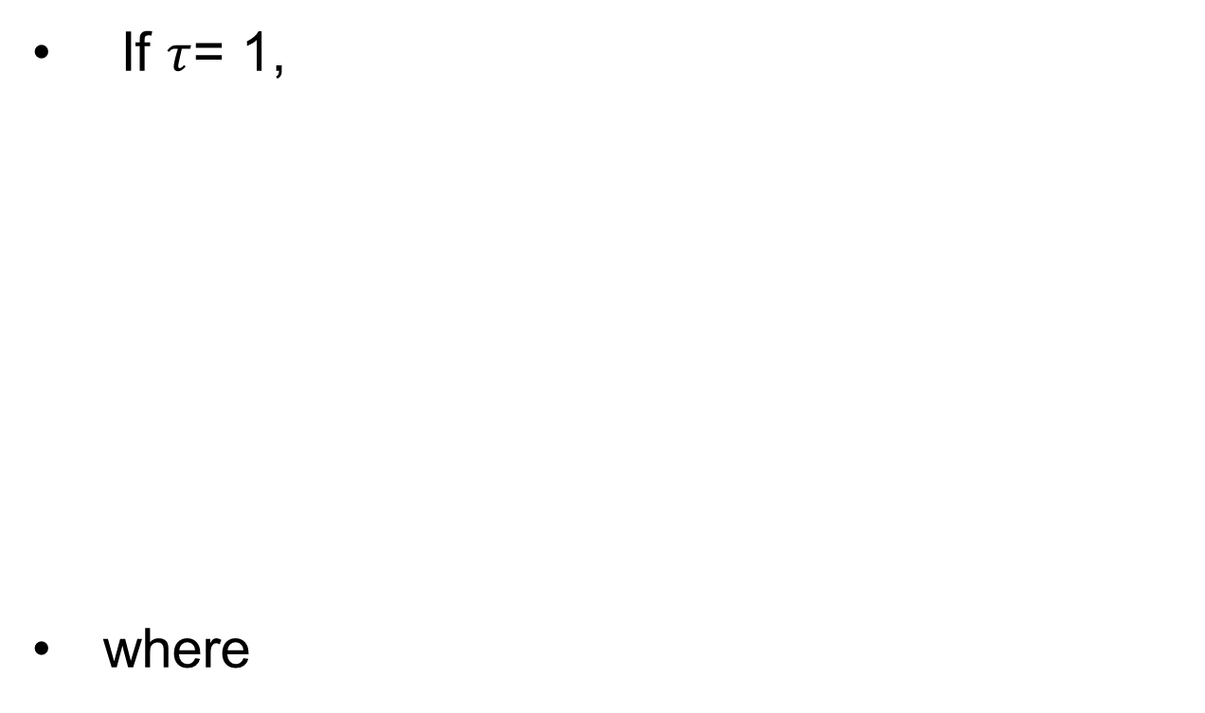
Updating the Forecast
If $τ$= 1,
where
Forecast error

Slide 25
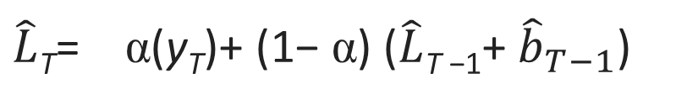
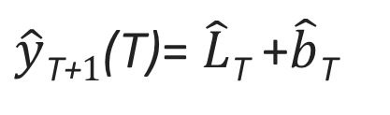
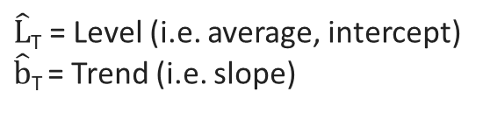
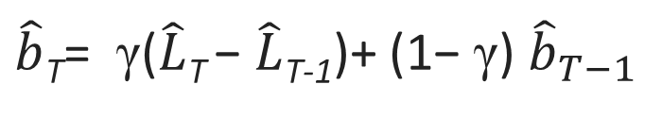
Alternate Representation: Second Order Exponential Smoothing
The data is represented explicitly by two components: Level and Trend
Each component is estimated individually.
$\hat{y}$_{T+}$1$(T)= $\hat{L}$_{T} +$\hat{b}$_{T}
$\hat{L}$_{T} = Level (i.e. average, intercept)
$\hat{b}$_{T} = Trend (i.e. slope)
Two constants:
α and γ
$\hat{L}$_{T}= α(y_{T})+ (1− α) ($\hat{L}$_{T −1}+ ${\hat{b}}_{T−1}$)
$\hat{b}$_{T}= γ($\hat{L}$_{T} − $\hat{L}$_{T-1})+ (1− γ) ${\hat{b}}_{T−1}$

Slide 26










Second-Order Exponential Smoothing: Using Level and Trend
$\hat{y}$_{T+}$2$(T) = $\hat{L}$_{T+1} +$\hat{b}$_{T+1}
$\hat{L}$_{T}= α(y_{T})+ (1− α) ($\hat{L}$_{T −1}+ ${\hat{b}}_{T−1}$)
y_{T+}$1$
$\hat{b}$_{T+1}= γ($\hat{L}$_{T+1} − $\hat{L}$_{T})+ (1− γ) ${\hat{b}}_{T}$
$\hat{y}$_{T} (T-1)= $\hat{L}$_{T-1} +$\hat{b}$_{T-1}
$\hat{L}$_{T+1}
$\hat{y}$_{T+}$1$(T) = $\hat{L}$_{T} +$\hat{b}$_{T}
$\hat{y}$_{T}(T-1)
$\hat{b}$_{T}= γ($\hat{L}$_{T} − $\hat{L}$_{T-1})+ (1− γ) ${\hat{b}}_{T−1}$
$\hat{L}$_{T}
y_{T}
T-1
T
T+1
T+2

Slide 27
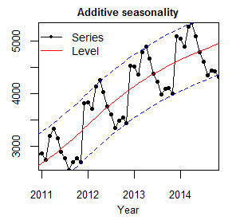

Modeling Seasonal Data
Additive Seasonal Model
If the amplitude of the seasonal pattern is independent of the average level within the season
Multiplicative Seasonal Model
If the amplitude of the seasonal pattern is proportional to the average level within the season

Slide 28
Additive Seasonal Model

Slide 29
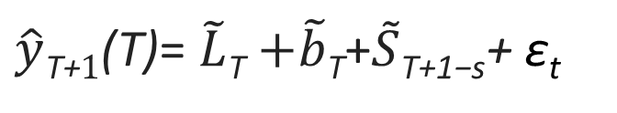
Additive Seasonal Model
Additive seasonal model can be represented by:
L_{t} = linear trend; S_{t} = seasonal adjustment, ε_{t} = uncorrelated (mean 0; variance σ_{ε}²)
S_{t} = S_{t+s} = S_{t+2s} and
$\hat{y}$_{T+}$1$(T)= $\tilde{L}$_{T} $+\tilde{b}$_{T}+$\tilde{S}\text{T}\text{+1−}\text{s}$+ ε_{t}

Slide 30
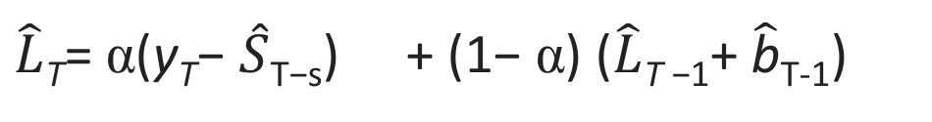
Forecasting (Holt-Winters Method) with Additive Seasonal Model
Also called Triple Exponential Smoothing
Idea is to apply exponential smoothing to seasonal components in addition to level and trend
Made of 4 discrete steps …
Step 1: Update Level
$\hat{L}$_{T}= α(y_{T}− $\hat{S}$_{T−s}) + (1− α) ($\hat{L}$_{T −1}+ $\hat{\text{b}}$_{T-1})
Current value (without seasonality)
Forecast (without seasonal term)

Slide 31
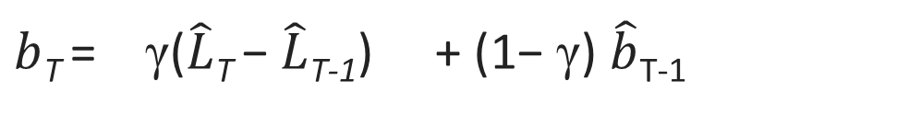


Forecasting (Holt-Winters Method) with Additive Seasonal Model
Step 2: Update Trend
$b$_{T} = γ($\hat{L}$_{T} − $\hat{L}$_{T-1}) + (1− γ) $\hat{b}$_{T-1}
Current value of $b$_{T}
Forecast for $b$_{T}

Slide 32
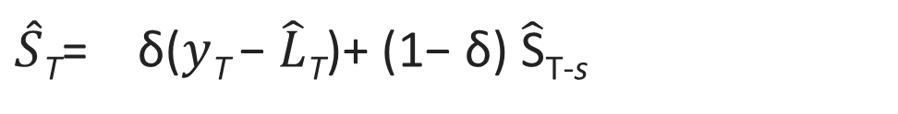
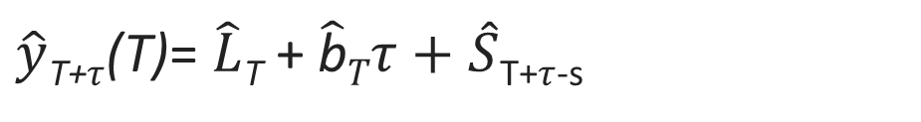
Forecasting (Holt-Winters Method) with Additive Seasonal Model
Step 3: Update Seasonality
Step 4: Finally, create the forecast
$\hat{S}$_{T}= δ($y$_{T} − $\hat{L}$_{T})+ (1− δ) $\hat{\text{S}}$_{T-s}
$\hat{y}$_{T+}$τ$(T)= $\hat{L}$_{T} + $\hat{\text{b}}Tτ+\hat{S}$_{T+}$τ$_{-s}

Slide 33
Multiplicative Seasonal Model
Note that the amplitude gets bigger as average level of the time series gets big.

Slide 34
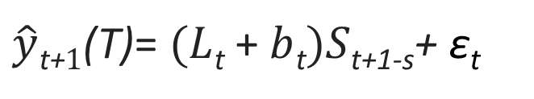
Multiplicative Seasonal Model
Amplitude of seasonal pattern proportional to average level
Multiplicative Season Model can be expressed as :
L_{t} = level; b_{t} = trend; S_{t} = seasonal adjustment, ε_{t} = uncorrelated (mean 0; variance σ_{ε}²)
S_{t} = S_{t+s} = S_{t+2s} and
$\hat{y}$_{t+}$1$(T)= $(L$_{t} + $b$_{t}$)S\text{t}\text{+1−}\text{s}$+ ε_{t}

Slide 35
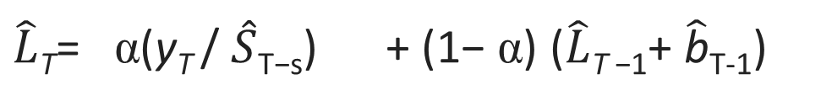
Forecasting (Holt-Winters Method) with Multiplicative Seasonal Model
Made of 4 discrete steps … (Similar to Additive Model)
Step 1: Update Level
$\hat{L}$_{T}= α(y_{T} / $\hat{S}$_{T−s}) + (1− α) ($\hat{L}$_{T −1}+ $\hat{\text{b}}$_{T-1})
Current value of L_{T}
Forecast for L_{T}

Slide 36
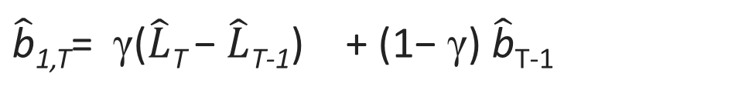


Forecasting (Holt-Winters Method) with Multiplicative Seasonal Model
Step 2: Update Trend
$\hat{\text{b}}$_{1,T}= γ($\hat{L}$_{T} − $\hat{L}$_{T-1}) + (1− γ) $\hat{\text{b}}$_{T-1}
Current value of $\text{b}$
Forecast for $\text{b}$
Same as Additive Trend equation …

Slide 37
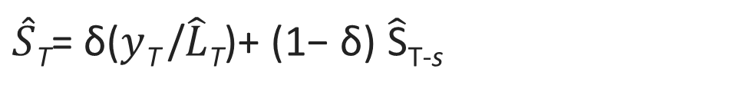
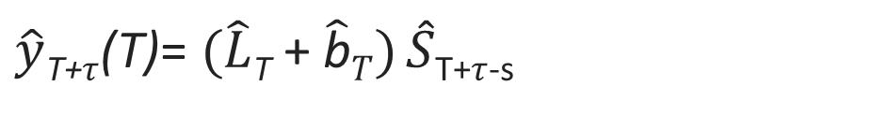
Forecasting (Holt-Winters Method) with Multiplicative Seasonal Model
Step 3: Update Seasonality
Step 4: Finally, create the forecast
$\hat{S}$_{T}= δ($y$_{T} /$\hat{L}$_{T})+ (1− δ) $\hat{\text{S}}$_{T-s}
$\hat{y}$_{T+}$τ$(T)= $(\hat{L}$_{T} + $\hat{\text{b}}T) \hat{S}$_{T+}$τ$_{-s}

Slide 38
Additive or Multiplicative?

Slide 40
How to pick values for the constants α , γ and δ ?
Typically, done by trial and error
Iterative approach where SSE (sum squared error) is evaluated for a range of values of constants α , γ and δ
The values that provide the lowest SSE is chosen

Slide 41
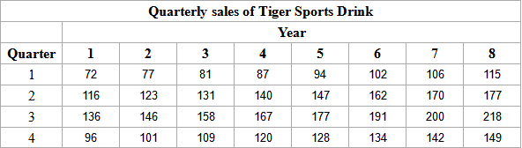
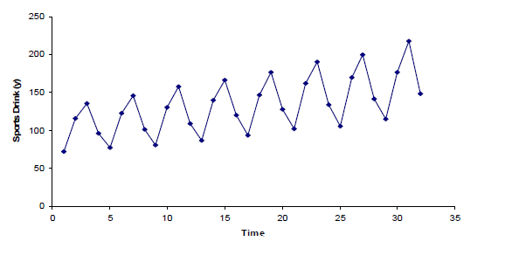
Example
Data Set reference:
http://personal.cb.cityu.edu.hk/msawan/teaching/ms6215/Exponential%20Smoothing%20Methods.ppt
Use Sports Drink example
Observations:
Linear upward trend over the 8-year period
Magnitude of the seasonal span increases as the level of the time series increases
What is the seasonality (L) ? → 4 periods
What is a good forecasting model ?
Multiplicative Holt-Winters method can be applied to forecast future sales
Notes:
personal.cb.cityu.edu.hk/msawan/.../Exponential%20Smoothing%20Methods.ppt

Slide 42
Example
Use Sports Drink example
Step 1 : Initialization
Fit a least squares trend line to the first 16 (~half the data) observations
Trend line gives the initial level, and trend
yˆ_{t}
= 95.2500 + 2.4706t
L₀ = 95.2500; b₀ = 2.4706
Notes:
personal.cb.cityu.edu.hk/msawan/.../Exponential%20Smoothing%20Methods.ppt

Slide 43
Example
Step 2: Find the initial seasonal factors
Compute y^{ˆ}t for the in-sample observations used for fitting the regression. In this example, t = 1, 2,
…, 16.
yˆ₁ = 95.2500 + 2.4706(1) = 97.7206
yˆ₂ = 95.2500 + 2.4706(2) = 100.1912
......
yˆ₁₆ = 95.2500 + 2.4706(16) = 134.7794
Notes:
personal.cb.cityu.edu.hk/msawan/.../Exponential%20Smoothing%20Methods.ppt

Slide 44
Procedures of Multiplicative Holt- Winters Method
Step 2: Find the initial seasonal factors
Detrend the data by computing S_{t} = y_{t} / yˆ_{t} for each time period that is used in finding the least squares regression equation. In this example, t = 1, 2, …, 16.
S₁ = y₁ / yˆ₁ = 72 / 97.7206 = 0.7368
S₂ = y₂ / yˆ₂ = 116 /100.1912 = 1.1578
......
S₁₆ = y₁₆ / yˆ₁₆ = 120 /134.7794 = 0.8903

Slide 45
Example
Step 2: Find the initial seasonal factors
Compute the average seasonal values for each of the L seasons. The L averages are found by computing the average of the detrended values for the corresponding season. For example, for quarter 1,
₌ S₁ + S₅ + S₉ + S₁₃
(e.g. Q1 of all years, Q2 of all years)
S
[1]
4
₌ 0.7368 + 0.7156 + 0.6894 + 0.6831 _{= 0.7062}
4
Notes:
personal.cb.cityu.edu.hk/msawan/.../Exponential%20Smoothing%20Methods.ppt

Slide 46
Example
Step 2: Find the initial seasonal factors
Multiply the average seasonal values by the normalizing constant
L
CF =
L
∑ ^{S}[ i ]
i =1
such that the average of the seasonal factors is 1. The initial seasonal factors are
^{sn}i − L
= S_{[ i ]} (CF ) (i = 1, 2,..., L )
This step is needed because:
Notes:
personal.cb.cityu.edu.hk/msawan/.../Exponential%20Smoothing%20Methods.ppt

Slide 47
Example
Step 2: Find the initial seasonal factors
Multiply the average seasonal values by the normalizing constant such that the average of the seasonal factors is 1.
Example
CF = 4/3.9999 ~ 1.000
sn₋₃ = sn₁₋₄ = S_{[1]}(CF ) = 0.7062(1) = 0.7062
sn₋₂ = sn₂₋₄ = S_{[2]}(CF ) = 1.1114(1) = 1.1114
sn₋₁ = sn₃₋₄ = S_{[3]}(CF ) = 1.2937(1) = 1.2937
sn₀ = sn₄₋₄ = S_{[1]}(CF ) = 0.8886(1) = 0.8886
Notes:
personal.cb.cityu.edu.hk/msawan/.../Exponential%20Smoothing%20Methods.ppt

Slide 48
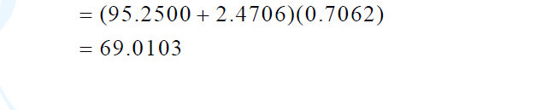


Example
Step 3: Calculate a point forecast of y₁ from time 0 using the initial values
Multiplicative model:
$\hat{y}1$(0)= $(L0$ + $b$₀$)S\text{1−}\text{4}$
$\hat{y}$_{t+}$1$(T)= $(L$_{t} + $b$_{t}$)S\text{t}\text{+1−}\text{s}$+ ε_{t}
Notes:
personal.cb.cityu.edu.hk/msawan/.../Exponential%20Smoothing%20Methods.ppt

Slide 49
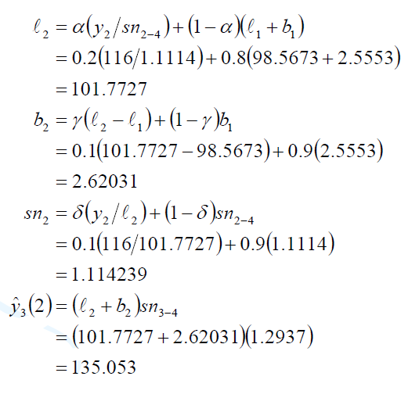
Example
Step 4: Continue for other time steps
Remember: α = 0.2, γ = 0.1, and δ = 0.1 are constants
Notes:
personal.cb.cityu.edu.hk/msawan/.../Exponential%20Smoothing%20Methods.ppt

Slide 50
Chapter Summary
Moving Average
Weighted Moving Average
Simple Exponential Smoothing
– No trend, no seasonal pattern
Second Order Exponential Smoothing
– Trend, no seasonal pattern
• Holt-Winters Methods
– Both trend and seasonal pattern
Multiplicative Holt-Winters method
Additive Holt-Winters Method
Motivation is to introduce multiple different techniques to model time series phenomena of increasing complexity
No one technique will work best for all applications/data sets

Slide 51
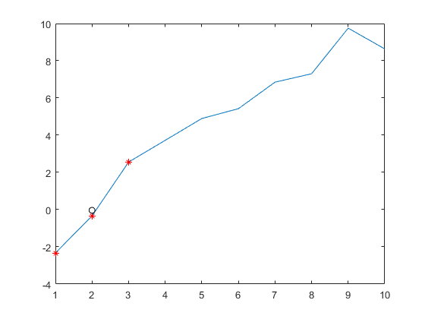
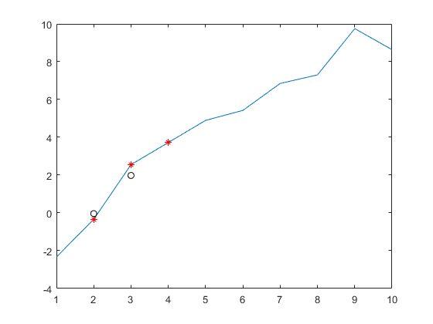
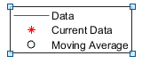
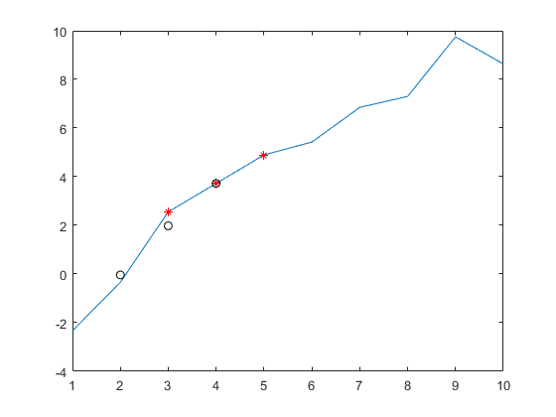
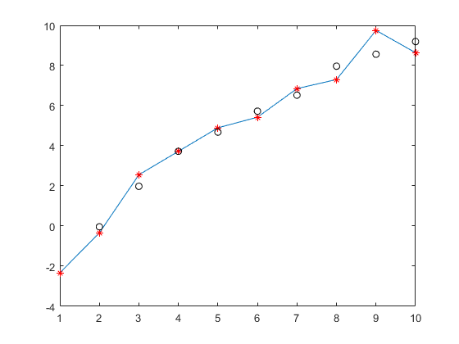
Simple Moving Average – How it works
N=3

Slide 52

Smoothing a Constant Process
Constant process can be smoothed by replacing current observation by best estimate for μ
Error sum of squares is defined as :
Least squares estimate of μ is found by setting SS_{E} = 0
→ which is simply the average of the observations up to time T
$\hat{μ }$ is the least squares estimate of μ

Slide 53
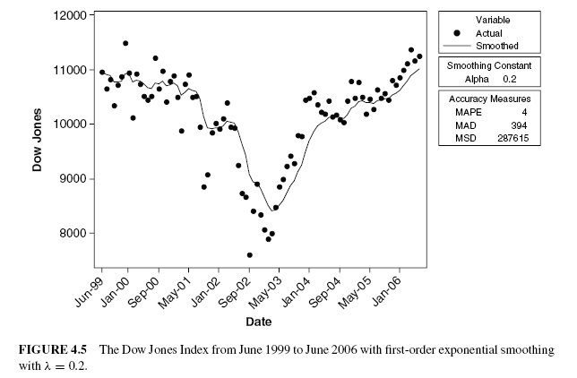
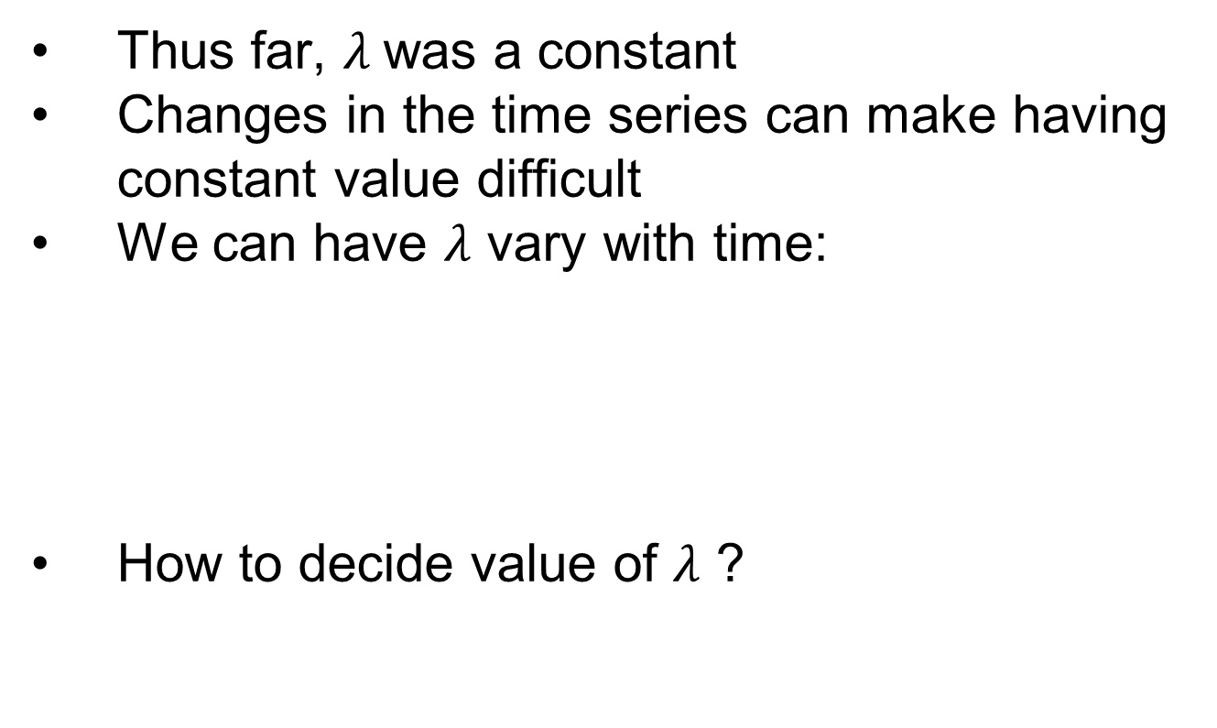
Adaptive Updating of the Discount Factor
Thus far, $λ$was a constant
Changes in the time series can make having constant value difficult
We can have $λ$ vary with time:
How to decide value of $λ$ ?

Slide 54

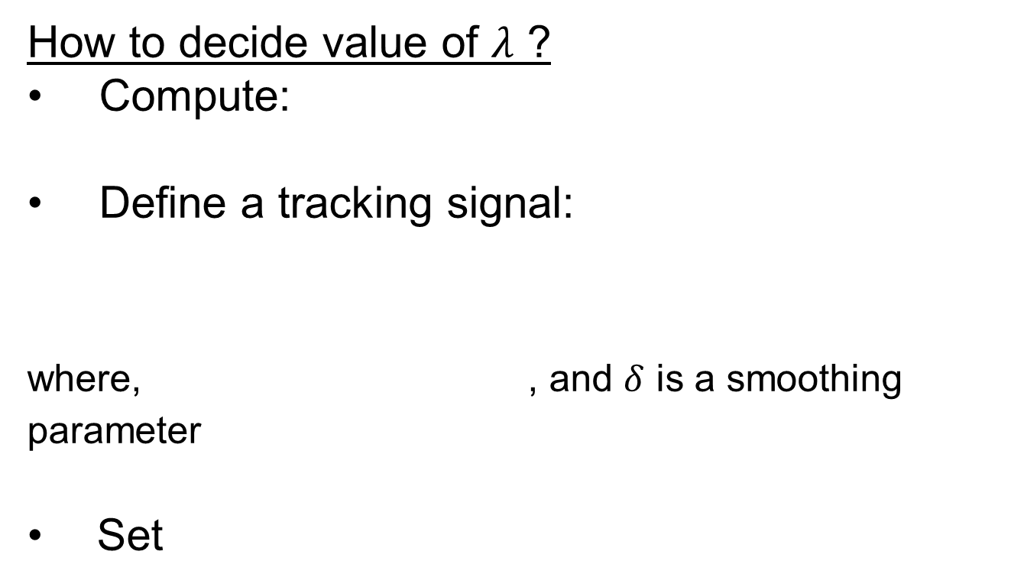
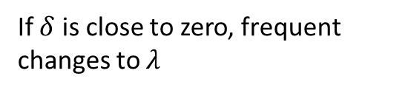
Adaptive Updating of the Discount Factor
W. Trigg, D. and A. G. Leach. Exponential Smoothing With an Adaptive Response Rate.
How to decide value of $λ$ ?
Compute:
Define a tracking signal:
where, , and $δ$ is a smoothing parameter
Set
If $δ$ is close to zero, frequent changes to $λ$

Slide 55
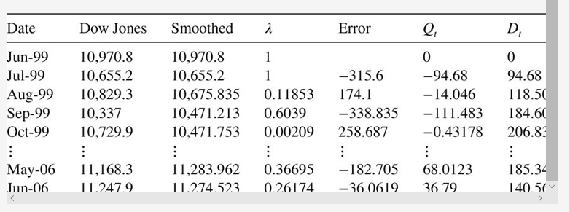

Adaptive Update of $λ$ - Example
λ

