Slide 1
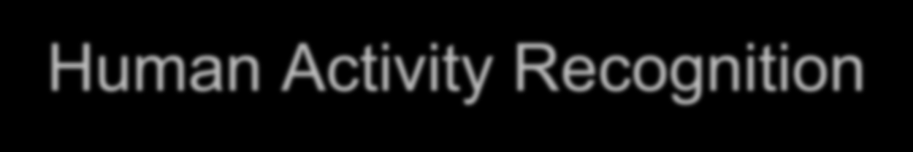
Chapter 5: Auto Regressive Integrated Moving Average (ARIMA) Models Fall 2019

Slide 2
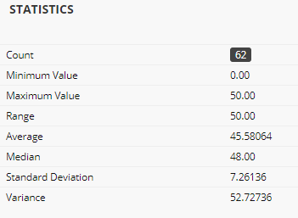
Announcements
HW #1 has been graded
HW#1 Q3(c) seemed more confusing than expected
You will be given the allotted points if you answered shampoo sales is expected to be seasonal

Slide 3
Announcements
HW #2 is due tonight (Sept 24th)
HW #3 has been posted – due Oct 3rd

Slide 4
Outline
Introduction / Motivation
RECAP: Stationarity
Linear Models
Moving Average (MA) Models
AutoRegressive (AR) Models
ARMA (AR + MA)
Incorporating Seasonality and Trend: SARIMA
Not to confuse with moving average window !

Slide 5

Introduction
In previous chapter, focus was on exponential smoothing:
weight (λ) applied to current sample
+
exponentially decaying weights (1- λ)^{t} to previous points
General assumption is that any time series data is modeling as sum of 2 components:
deterministic (signal) + stochastic (random noise)
Drawback: Exponential models do not consider the serial dependence of the data effectively (i.e. correlation between neighboring time samples)

Slide 6
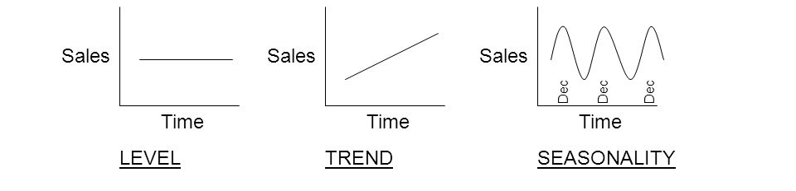
Motivation
It is possible to identify deterministic trends as well as seasonal variation and decompose a series into these components.
→ Using techniques we have learnt so far in this course
Notes:
https://www.quantstart.com/articles/Serial-Correlation-in-Time-Series-Analysis

Slide 7
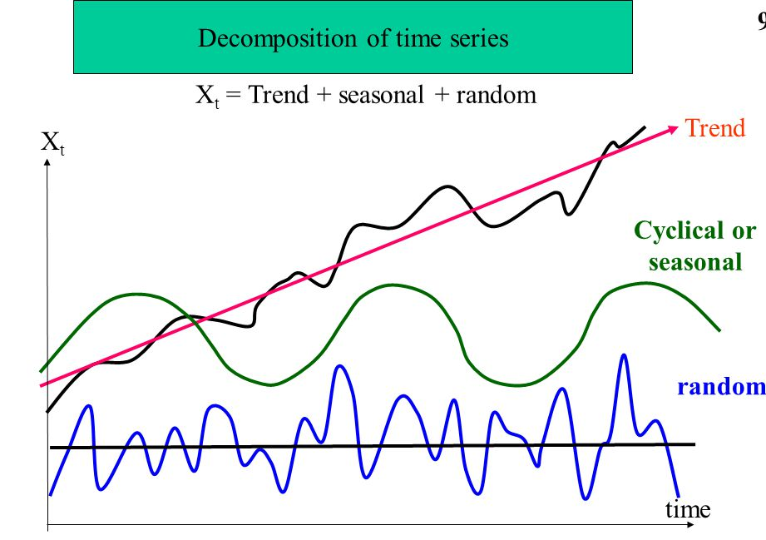
Motivation
However, once such a time series has been decomposed we are left with a random component.
Notes:
https://www.quantstart.com/articles/Serial-Correlation-in-Time-Series-Analysis

Slide 8
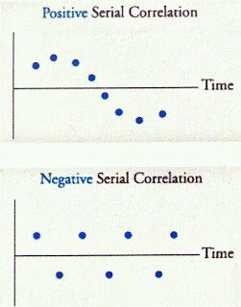
Motivation
When sequential observations of a time series are correlated, we say that serial dependence exists in the time series
Positive Serial Correlation
Positive value for one observation increases the probability of a Positive value for another observation and vice versa.
Negative Serial Correlation
Positive value for one observation increases the probability of a Negative value for another observation and vice versa.
Response
Notes:
https://www.quantstart.com/articles/Serial-Correlation-in-Time-Series-Analysis
https://www.analystforum.com/article/cfa/serial-correlation

Slide 9
RECAP: Strictly Stationary Time Series
Data is strictly stationary if its properties are NOT affected by a change in time origin
The joint probability density function does not change if the time interval changes
same as

Slide 10
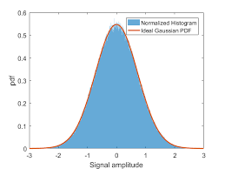
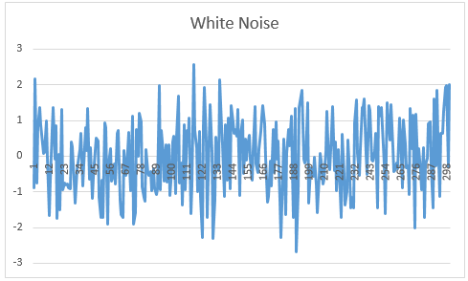
Stationarity
(Strictly) Stationary time series exhibits similar “statistical behavior” for all time…
→ constant probability distribution in time
However, in most cases, we work with weak stationarity
→ What is “weak stationarity” ?
t
t+k

Slide 11
Stationarity
What is “weak stationarity” ?
Expected value of time series does not depend on time → E(y_{t}) = μ (i.e. constant)
The autocovariance function for any lag k is only a function of k and not time; that is,

Slide 12
Some Examples
Stationary
Non-Stationary

Slide 13
Stationary Time Series
Many time series do not exhibit a stationary behavior
True stationarity is in fact a rarity in real life
If the time series in not stationary, differencing (y_{t}-y_{t-1}), detrending, removing seasonality can help
(Explored in Chapter 2)
Notes:
https://www.eviews.com/Learning/timeseries_c.html

Slide 14
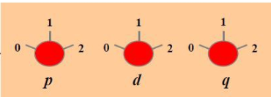
Approach for ARMA modeling
Signal
ARMA(p,d,q)
Time-series
Noise
p, d, q are model parameters
Success criteria: The residuals after you have extracted the signal is random white noise
Theoretical foundations of these concepts originate in Digital Signal Processing (within Electrical Engineering) → used to separate wireless signals from noise

Slide 15
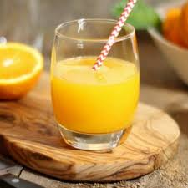
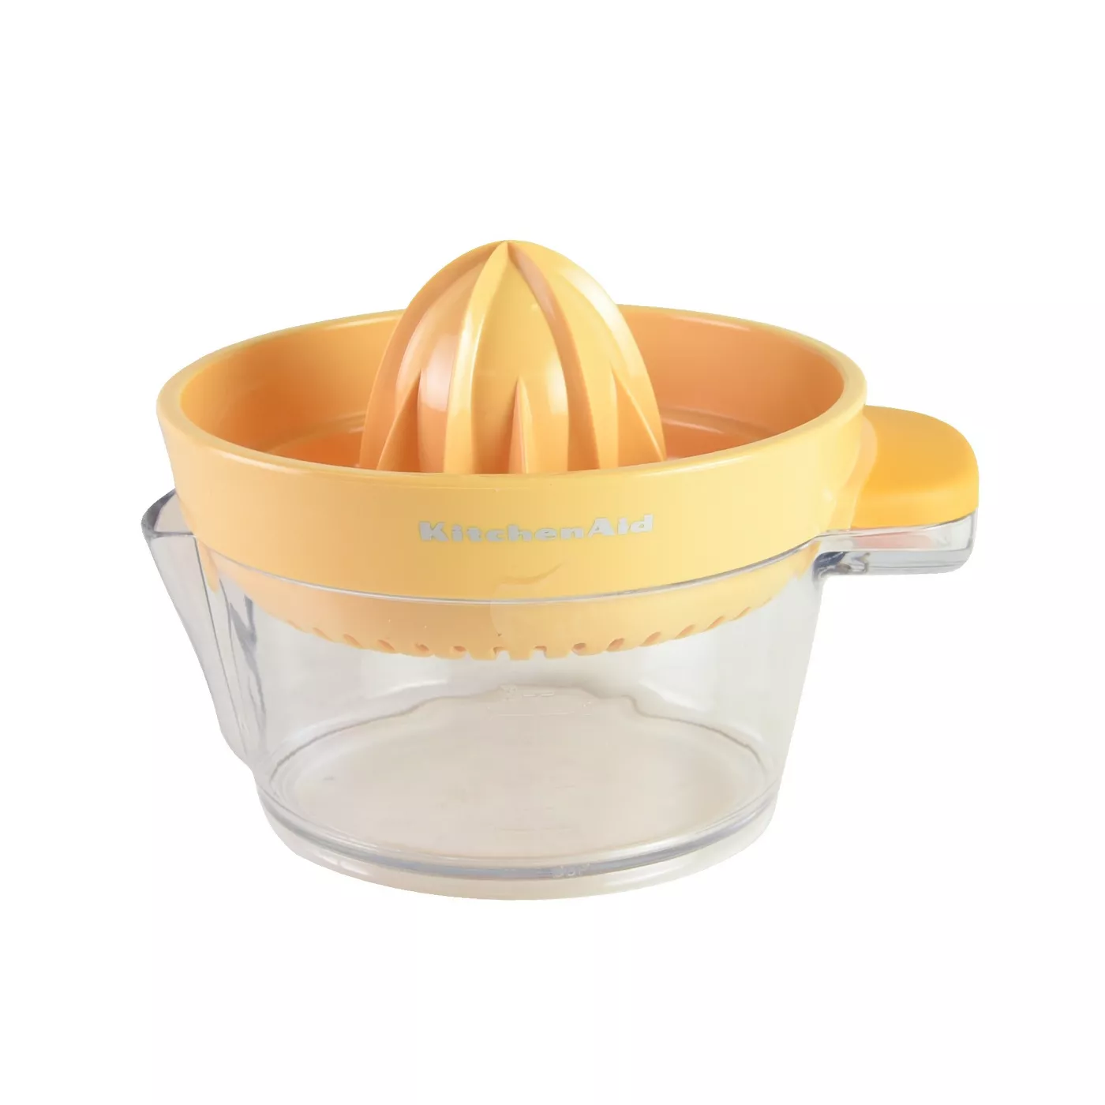

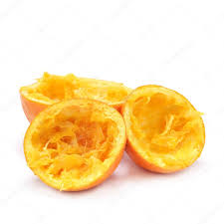
Approach for ARMA modeling (Analogy)
Signal !
Find optimal (model) juicer !
Orange juice
Oranges
Residue / Noise !
Success criteria: The residuals after you have extracted the signal (juice) is random white noise (not valuable)

Slide 16
Linear Models for Stationary Time Series
A linear model (filter) defined as
is said to be

Slide 17
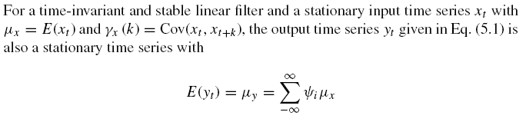

Linear Filter
Does not depend on time (t)

Slide 18

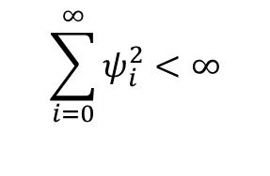
Wold’s Decomposition Theorem
Any weakly stationary time series can be written as sum of two components:
one deterministic and one stochastic
deterministic
$$y_{t}=μ+\sum_{i=0}^{∞}{ψ_{i}ε_{t−i}}$$
Stochastic component
where
$$\sum_{i=0}^{∞}{ψ_{i}^{2}<∞}$$

Slide 19
How useful is this basic form of Wold decomposition theorem ?
Well, not so much!!!
How can we come up with “infinitely” many terms?
As a result, in practice, the AR and MA models have finite number of non-zero weights

Slide 20
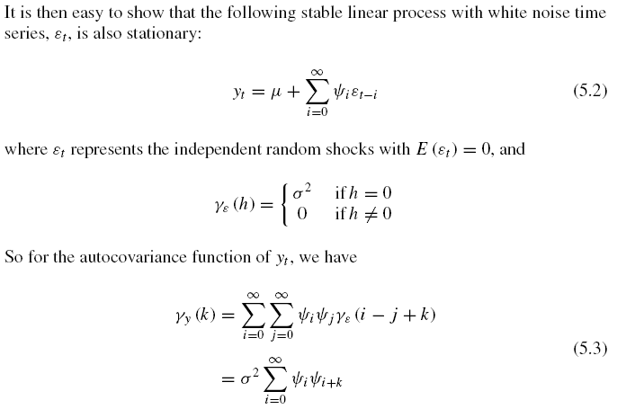
Using the Backshift Operator
Bϵ_{t} = ϵ_{t-1}
B²ϵ_{t} = ϵ_{t-2}

Slide 21
If Input is White Noise …
Zero mean, constant variance
Goal : Show that output time series is also stationary
White noise time series
Inner summation is non-zero only when j= i+k

Slide 22
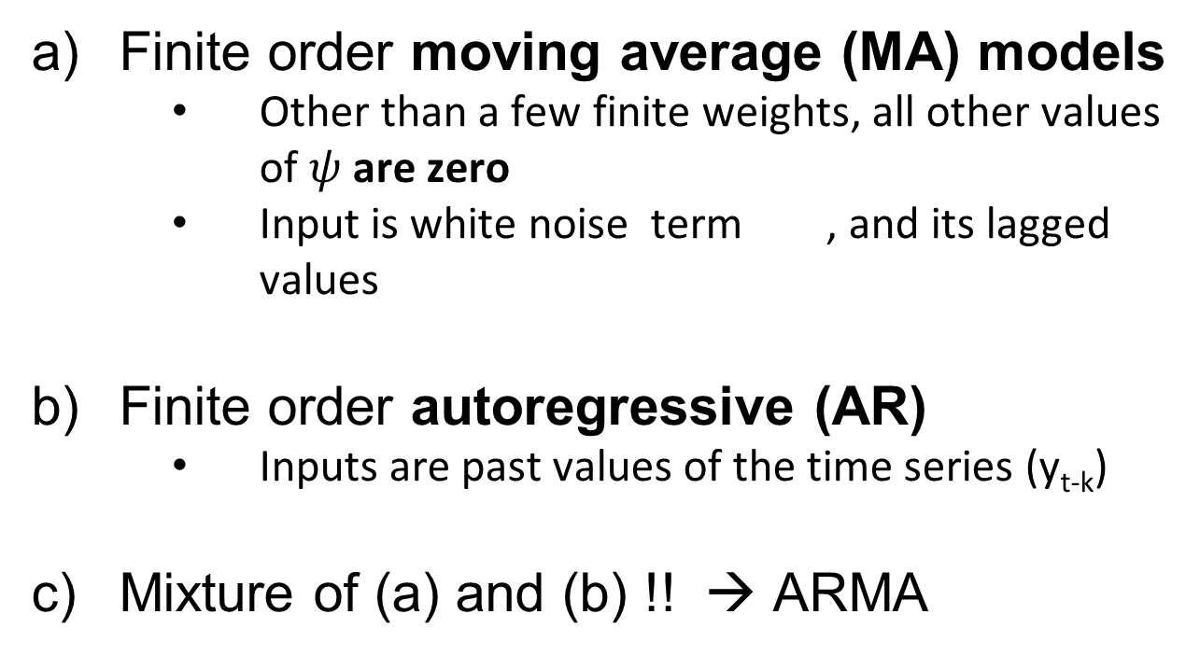
AR and MA models
Finite order moving average (MA) models
Other than a few finite weights, all other values of $ψ$ are zero
Input is white noise term , and its lagged values
Finite order autoregressive (AR)
Inputs are past values of the time series (y_{t-k})
Mixture of (a) and (b) !! → ARMA

Slide 23
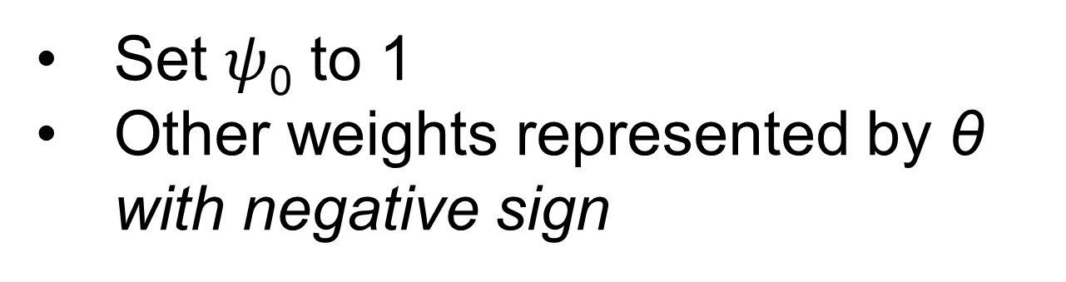
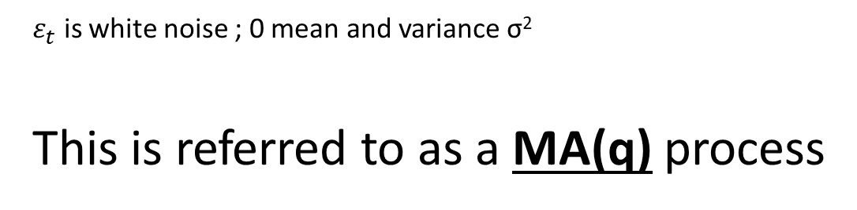
Finite Order Moving Average Processes - MA(q)
Set $ψ$₀ to 1
Other weights represented by θ with negative sign
$ε_{t}$ is white noise ; 0 mean and variance σ²
This is referred to as a MA(q) process

Slide 24

Properties of MA(q) process
Expected Value
Variance

Slide 25
Properties of MA(q) process
Autocovariance Function
Variance

Slide 26
Autocorrelation Function of MA(q)
ACF of MA(q) “cuts off” after lag q
This is very useful in the identification of an MA(q) process

Slide 27
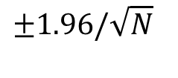
Sample ACF
Will not be EXACTLY zero after lag q for an MA(q)
But it will be small
For the same size of N, this can be tested using the limits:
$$±1.96/\sqrt{N}$$

Slide 28
First-Order Moving Average Process MA(1)
for which autocovariance and autocorrelation functions are given as

Slide 29
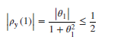
First-Order Moving Average Process MA(1)
and the autocorrelation function cuts off after lag 1 (because k>q)

Slide 30
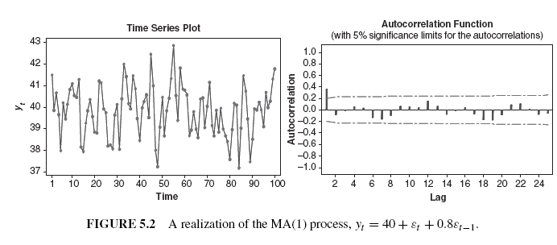

Some Examples
Successive observations close to each other → Positively correlated
Note, the behavior
of sample ACF
Successive observations oscillate → Negatively correlated

Slide 31
Second-Order Moving Average Process MA(2)
for which autocovariance and autocorrelation functions are given as

Slide 32
An Example
Lags 1 and 2 are significant

