Slide 1

Probability and Statistics Review Time Series Analysis and Forecasting Fall 2019

Slide 2
Outline
Random variable
Axioms of probability
Expected Values (Mean) and Variance
Properties of Mean and Variance
Common Probability Distributions (Gaussian/Normal)
Covariance and Correlation
Examples

Slide 3
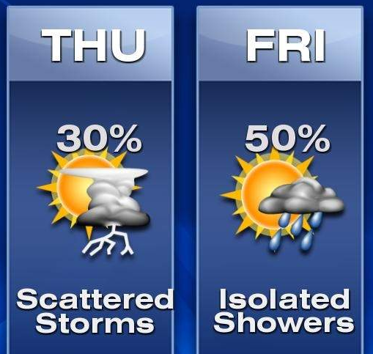
Uncertainty
The world is full of uncertainty:
Weather, storms, unruly financial markets, noisy communications
Uncertainty
Will my coin flip end in heads ?
Will bird flu strike tomorrow?
Probability is the language of uncertainty
Central pillar of modern day artificial intelligence

Slide 4
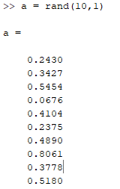
Random variable
A variable, X, whose domain is the sample space, and represents the outcome of an experiment
Examples:
X = coin flip outcome
X = first word in tomorrow’s headline news
X = tomorrow’s temperature
X = rand()

Slide 5
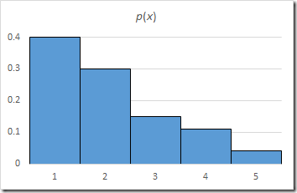
Probability for discrete events
Probability P(X=a) is the fraction of times x takes value a
Often we write it as P(a)
Examples
P(head)=P(tail)=0.5 fair coin
P(head)=0.51, P(tail)=0.49 slightly biased coin
P(first word = “the” when flipping to a random page in the Rochester D&C)=?

Slide 6
Axioms of Probability
0 ≤ P(A) ≤ 1
P(Sample space) = 1
P(A ∨ B) = P(A) + P(B) – P(A ∧ B)

Slide 7
Probability table
Weather
P(Weather = sunny) = P(sunny) = 200/365
P(Weather) = {200/365, 100/365, 65/365}
We can obtain the probabilities by counting frequency from data…
Sunny | Cloudy | Rainy
200/365 | 100/365 | 65/365

Slide 8
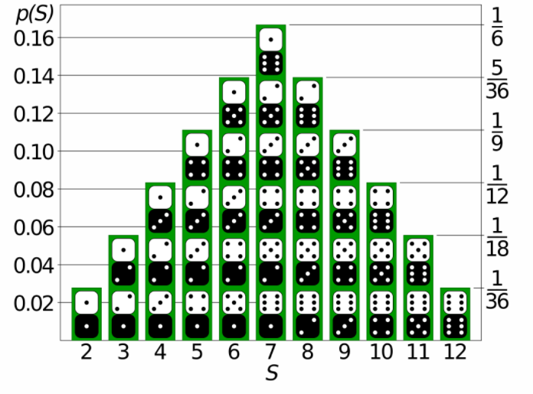
Probability for discrete events
Probability for more complex events A
P(A=“head or tail”)=0.5 + 0.5 = 1 fair coin
P(A=“even number”)=1/6 + 1/6 + 1/6 = 0.5 fair 6- sided die
P(A=“two dice rolls sum to 2”)=1/6 * 1/6 = 1/36
Probabilities on rolling 2 dice

Slide 9
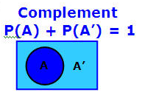
Some theorems derived from the axioms
P(∼A) = 1 – P(A)
If X can take k different values x₁… x_{k}:
P(X=x₁) + … P(X=x_{k}) = 1
P(B) = P(B ∧ ∼ A) + P(B ∧ A), if A is a binary event
Sample space S

Slide 10

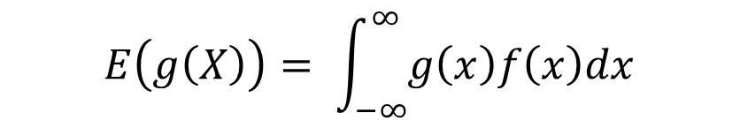
Mean and Variance
“Expected value of random variable X”
Mean (Expectation):
(Discrete)
$$E\left(X\right)= \int_{−∞}^{∞}{xf\left(x\right)dx}$$
(Continuous)
f(x) is pdf of X
(Discrete)
Function of random variable X
$$E\left(g\left(X\right)\right)= \int_{−∞}^{∞}{g\left(x\right)f\left(x\right)dx}$$
(Continuous)

Slide 11
Mean and Variance
Variance:
Covariance:
Discrete →
Continuous →
Notes:
proof

Slide 12
Variance for Single Variable
That is, variance is the expected value of the square deviation from the mean
It can also be written as:
Sample variance is the average squared deviation of the data value x_{i} from the sample mean
Standard deviation is the square root of Variance

Slide 13
Sample Covariance for Two Variables
Covariance between two variables X₁ and X₂
where µ₁ = E[X₁] is the respective mean or expected value of X₁; similarly for µ₂
Sample covariance between X₁ and X₂:
Sample covariance is a generalization of the sample variance:

Slide 14
Covariance for Two Variables
Positive covariance: If σ₁₂ > 0
Negative covariance: If σ₁₂ < 0
Independence: If X₁ and X₂ are independent, σ₁₂ = 0 but the reverse is not true
Some pairs of random variables may have a covariance 0 but are not independent
Only under some additional assumptions (e.g., the data follow multivariate normal distributions) does a covariance of 0 imply independence

Slide 15
Example: Calculation of Covariance
Suppose two stocks X₁ and X₂ have the following values in one week:
(2, 5), (3, 8), (5, 10), (4, 11), (6, 14)
Question: If the stocks are affected by the same industry trends, will their prices rise or fall together?
Covariance formula

Slide 16
Example: Calculation of Covariance (contd)
X₁ | X₂
2 | 5
3 | 8
5 | 10
4 | 11
6 | 14
Its computation can be simplified as:
E(X₁) = (2 + 3 + 5 + 4 + 6)/ 5 = 20/5 = 4
E(X₂) = (5 + 8 + 10 + 11 + 14) /5 = 48/5 = 9.6
σ₁₂ = (2×5 + 3×8 + 5×10 + 4×11 + 6×14)/5 − 4 × 9.6 = 4
Thus, X₁ and X₂ rise together since σ₁₂ > 0

Slide 17
Covariance and Correlation
Covariance:
Correlation:
Notes:
Normalized, can be positive or negative

Slide 18
Correlation between Two Numerical Variables
Correlation between two variables X₁ and X₂ is the standard covariance, obtained by normalizing the covariance with the standard deviation of each variable
Sample correlation for two attributes X₁ and X₂:
where n is the number of tuples, µ₁ and µ₂ are the respective means of X₁ and X₂ , σ₁ and σ₂ are the respective standard deviation of X₁ and X₂
Covariance
Variance

Slide 19
Correlation between Two Numerical Variables
If ρ₁₂ > 0: A and B are positively correlated (X₁’s values increase as X₂’s)
The higher the value, the stronger is the correlation
If ρ₁₂ = 0: independent (under the same assumption as discussed in co-variance)
If ρ₁₂ < 0: negatively correlated

Slide 20
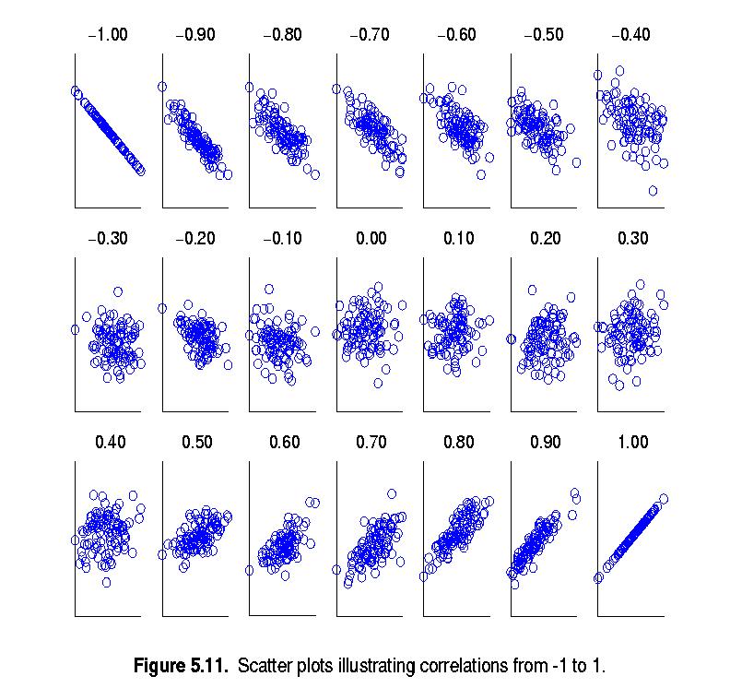
Visualizing Changes of Correlation Coefficient
Correlation coefficient value range: [–1, 1]
A set of scatter plots shows sets of points and their correlation coefficients changing from –1 to 1
Variable 2
Variable 1

Slide 21
The Normal Distribution: as mathematical function (pdf)
Note constants:
π=3.14159
e=2.71828
This is a bell shaped curve with different centers and spreads depending on μ and σ

Slide 22
Common Probability Distributions: The Normal Distribution
Bell-shaped function (also referred to as “Gaussian”)
f(X)
Changing μ shifts the distribution left or right.
Changing σ increases or decreases the spread.
σ
μ
X

Slide 23
The Normal PDF
It’s a probability function, so no matter what the values of μ and σ, must integrate to 1!

Slide 24
Normal distribution is defined by its mean and standard deviation
E(X)= μ =
Var(X)= σ² =
Standard Deviation(X)=σ

Slide 25
The Standard Normal (Z):
The formula for the standardized normal probability density function is
Mean = 0 ; Standard Deviation = 1

Slide 26
The Standard Normal Distribution (Z)
All normal distributions can be converted into the standard normal curve by subtracting the mean and dividing by the standard deviation:

Slide 27
Properties of Mean and Variance
E(x + y) = E(x) + E(y).
E(cx) = c E(y).
If x and y are independent, then Var(x + y) = Var(x) + Var(y).

Slide 28
Properties of Mean and Variance
Var(x + c) = Var(x)
Var(cx) = c² Var(x)
Cov(x + c, y) = Cov(x, y) = Cov(x, y + c)
Cov(cx, y) = c Cov(x, y) = Cov(x, cy)

Slide 29
Covariance Matrix
The variance and covariance information for the two variables X₁ and X₂ can be summarized as 2 X 2 covariance matrix as
Generalizing it to d dimensions, we have,

Slide 30
Questions ?

