Slide 1

Fall 2019 Data Science Capstone Project
University of Rochester Baseball
Ronald Michaels and Head Coach Joe Reina

Slide 2


Ronald (R.J.) Michaels
Junior at UR
Data Science major
Member of baseball team since 2017
Began analytics program last year
Passionate for the game of baseball and how the use of data can improve it
Head Coach Joe Reina
Born and raised in Rochester area
Been at UR for 18 years as head baseball coach
Established as one of the premier coaches in division three baseball
Has over 380 career victories, a UR record for a baseball coach

Slide 3
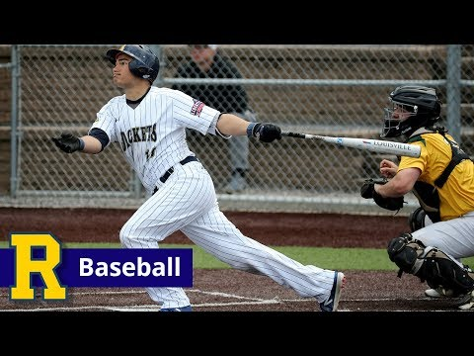
Introduction Video

Slide 4
Project Description and Goals
The purpose of this project is to use the tools learned by data science students to solve baseball analytics and sabermetrics problems.
Use Gamechanger software for data analysis.
Grow the game of baseball across the school community to students who may not be familiar with the game.
Give students full access to team practices, personel, and games for data analysis purposes.
Be a part of a new wave of sports analytics used in today's athletic community.

Slide 5
Describing the game of Baseball (basics)
Each team fields 9 players for the game at one time.
The object of the game is to score more runs (cross home plate safely) than the other team.
Offensive Objective: Reach base safely and rely on teammates to move you over on the basepaths until you score.
Defensive Objective: Stop the other team from scoring through good pitching and defense.
There are three outs in each half inning, and nine innings per game.
Thoughts from Coach Reina...

Slide 6
So what is Baseball Analytics and “Sabermetrics”?
The goal is to look deeper into a player’s statistics to uncover hidden patterns, advantages, and disadvantages that they bring to the team.
After enough data is collected, analytics and “sabermetrics” have the power to change the entire landscape of a team.
Player Personnel
Position Changes
Lineup Changes
Mindset of Players
The term “Sabermetrics” comes from the acronym SABR, which stands for the Society for American Baseball Research, founded in 1971.

Slide 7
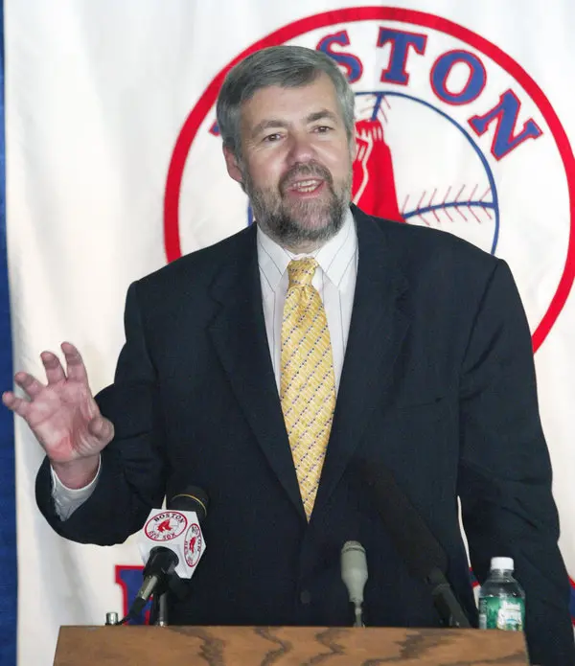
Bill James
Published his now famous book The Bill James Baseball Abstracts in 1977.
Theme of the story was to give insight on new and improved statistics used to evaluate players and help teams win.
Mr. James wrote the book while working night shifts as a janitor.
He was initially seen as a fraud who thought he knew too much.
Soon professional teams adapted his methods and saw they worked.
Now, Mr. James is seen as a genius and works in the front office for the Boston Red Sox.

Slide 8

Gamechanger
Gamechanger is a game tracking software that allows you to input information in real time for parents and friends to follow along.
With Gamechanger, numerous statistics are kept in categories such as:
Offensive
Defensive
Pitching
Quality and Patience
Team Impact
Efficiency
Opponent Batter Results
And Many More!

Slide 9
Gamechanger Demo
https://gc.com/t/spring-2019/2019-university-of-rochester-baseball-5bdb487c873ff300214e74cf

Slide 10
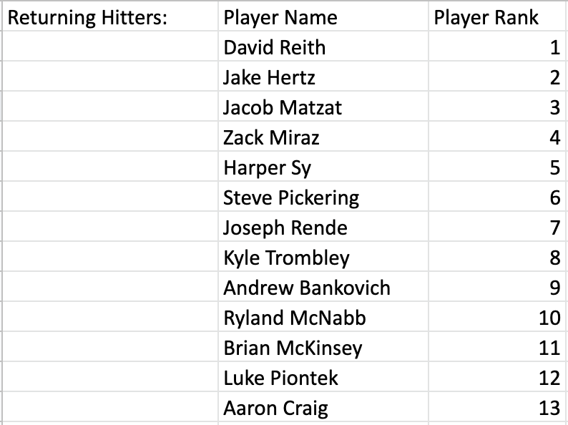
Player Rankings for Training - Returning Hitters

Slide 11
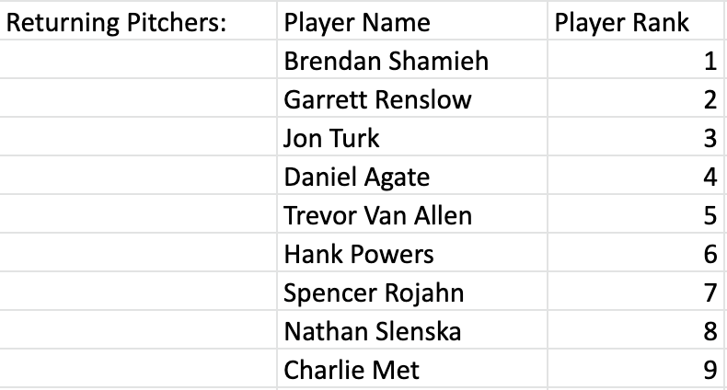
Player Rankings for Training - Returning Pitchers

Slide 12
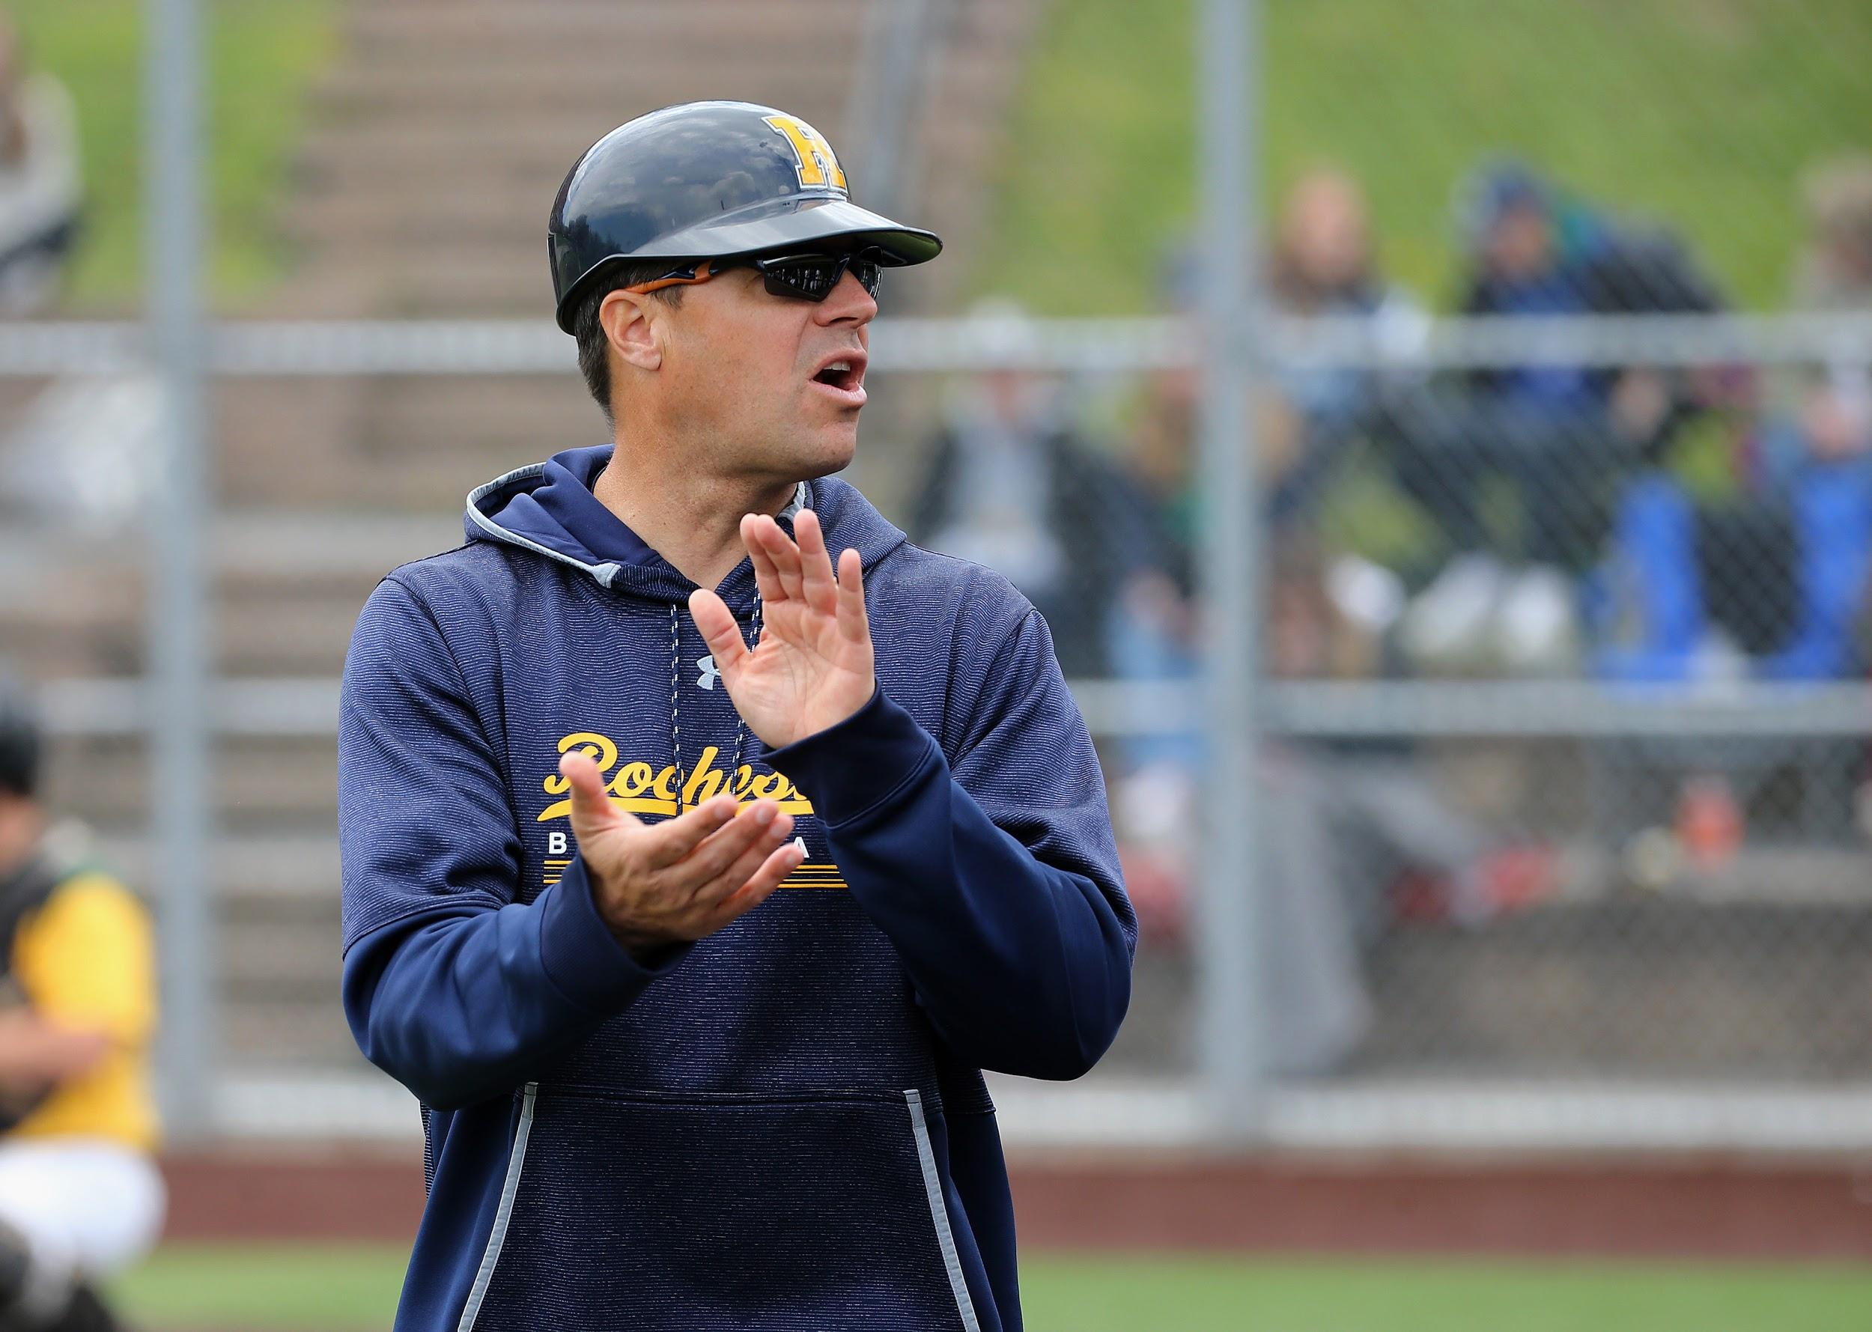
Advantage from a Coaching Perspective
Allows the coaching staff to assess players based on numerical analysis, rather than through the “eye test”.
Gives players advanced feedback through in game data.
Enables coaches to make personnel and in game decisions on a more rational level, making sure we keep players on the team who deserve to be on the team.

Slide 13
Core Question - Offensive (Maximization)
How to maximize runners in scoring position with less than two outs? This question focuses on how to have runners reach either second or third base with two outs or less. The data used for this calculation is batting average with runners in scoring position, quality at bats, on base percentage, and stolen base percentage.

Slide 14
Core Question - Offensive (Characterization)
How can we as a coaching staff characterize and identify our hitters down to one number? Through the use of statistics such as batting average, on base percentage, quality at bat percentage, and batting average with runners in scoring position, can a hitter be quantified on a scale of 1-10, with 10 being a perfect hitter, and 1 being a hitter with the lowest ability? Being able to distinguish between players on a numerical basis will help the coaching staff to better place our hitters in our lineup.

Slide 15
Core Question - Pitching (Forecasting)
The final core question focuses on forecasting how a pitcher will perform based on how many days off he has had. How many pitches someone throws vs response time and performance. The data categories to focus on in this question are pitching schedule, first pitch strike percentage, overall strike percentage, earned run average, whip, and batting average against.

Slide 16
Extra Core Question - Pitching (Charting and Visualization)
The data has yet to be collected for this question. The purpose of this question is to create a computer application that has the ability to chart a pitchers bullpen session. Data points that will need to be inputed are pitch type, pitch location (which quadrant of the strike zone or out of the zone), and pitch velocity. Data will be collected on a practice by practice basis and will be fully collected by the middle of October. The purpose of this question is to be able to track the development of our pitchers over the course of the fall for this semester.

Slide 17
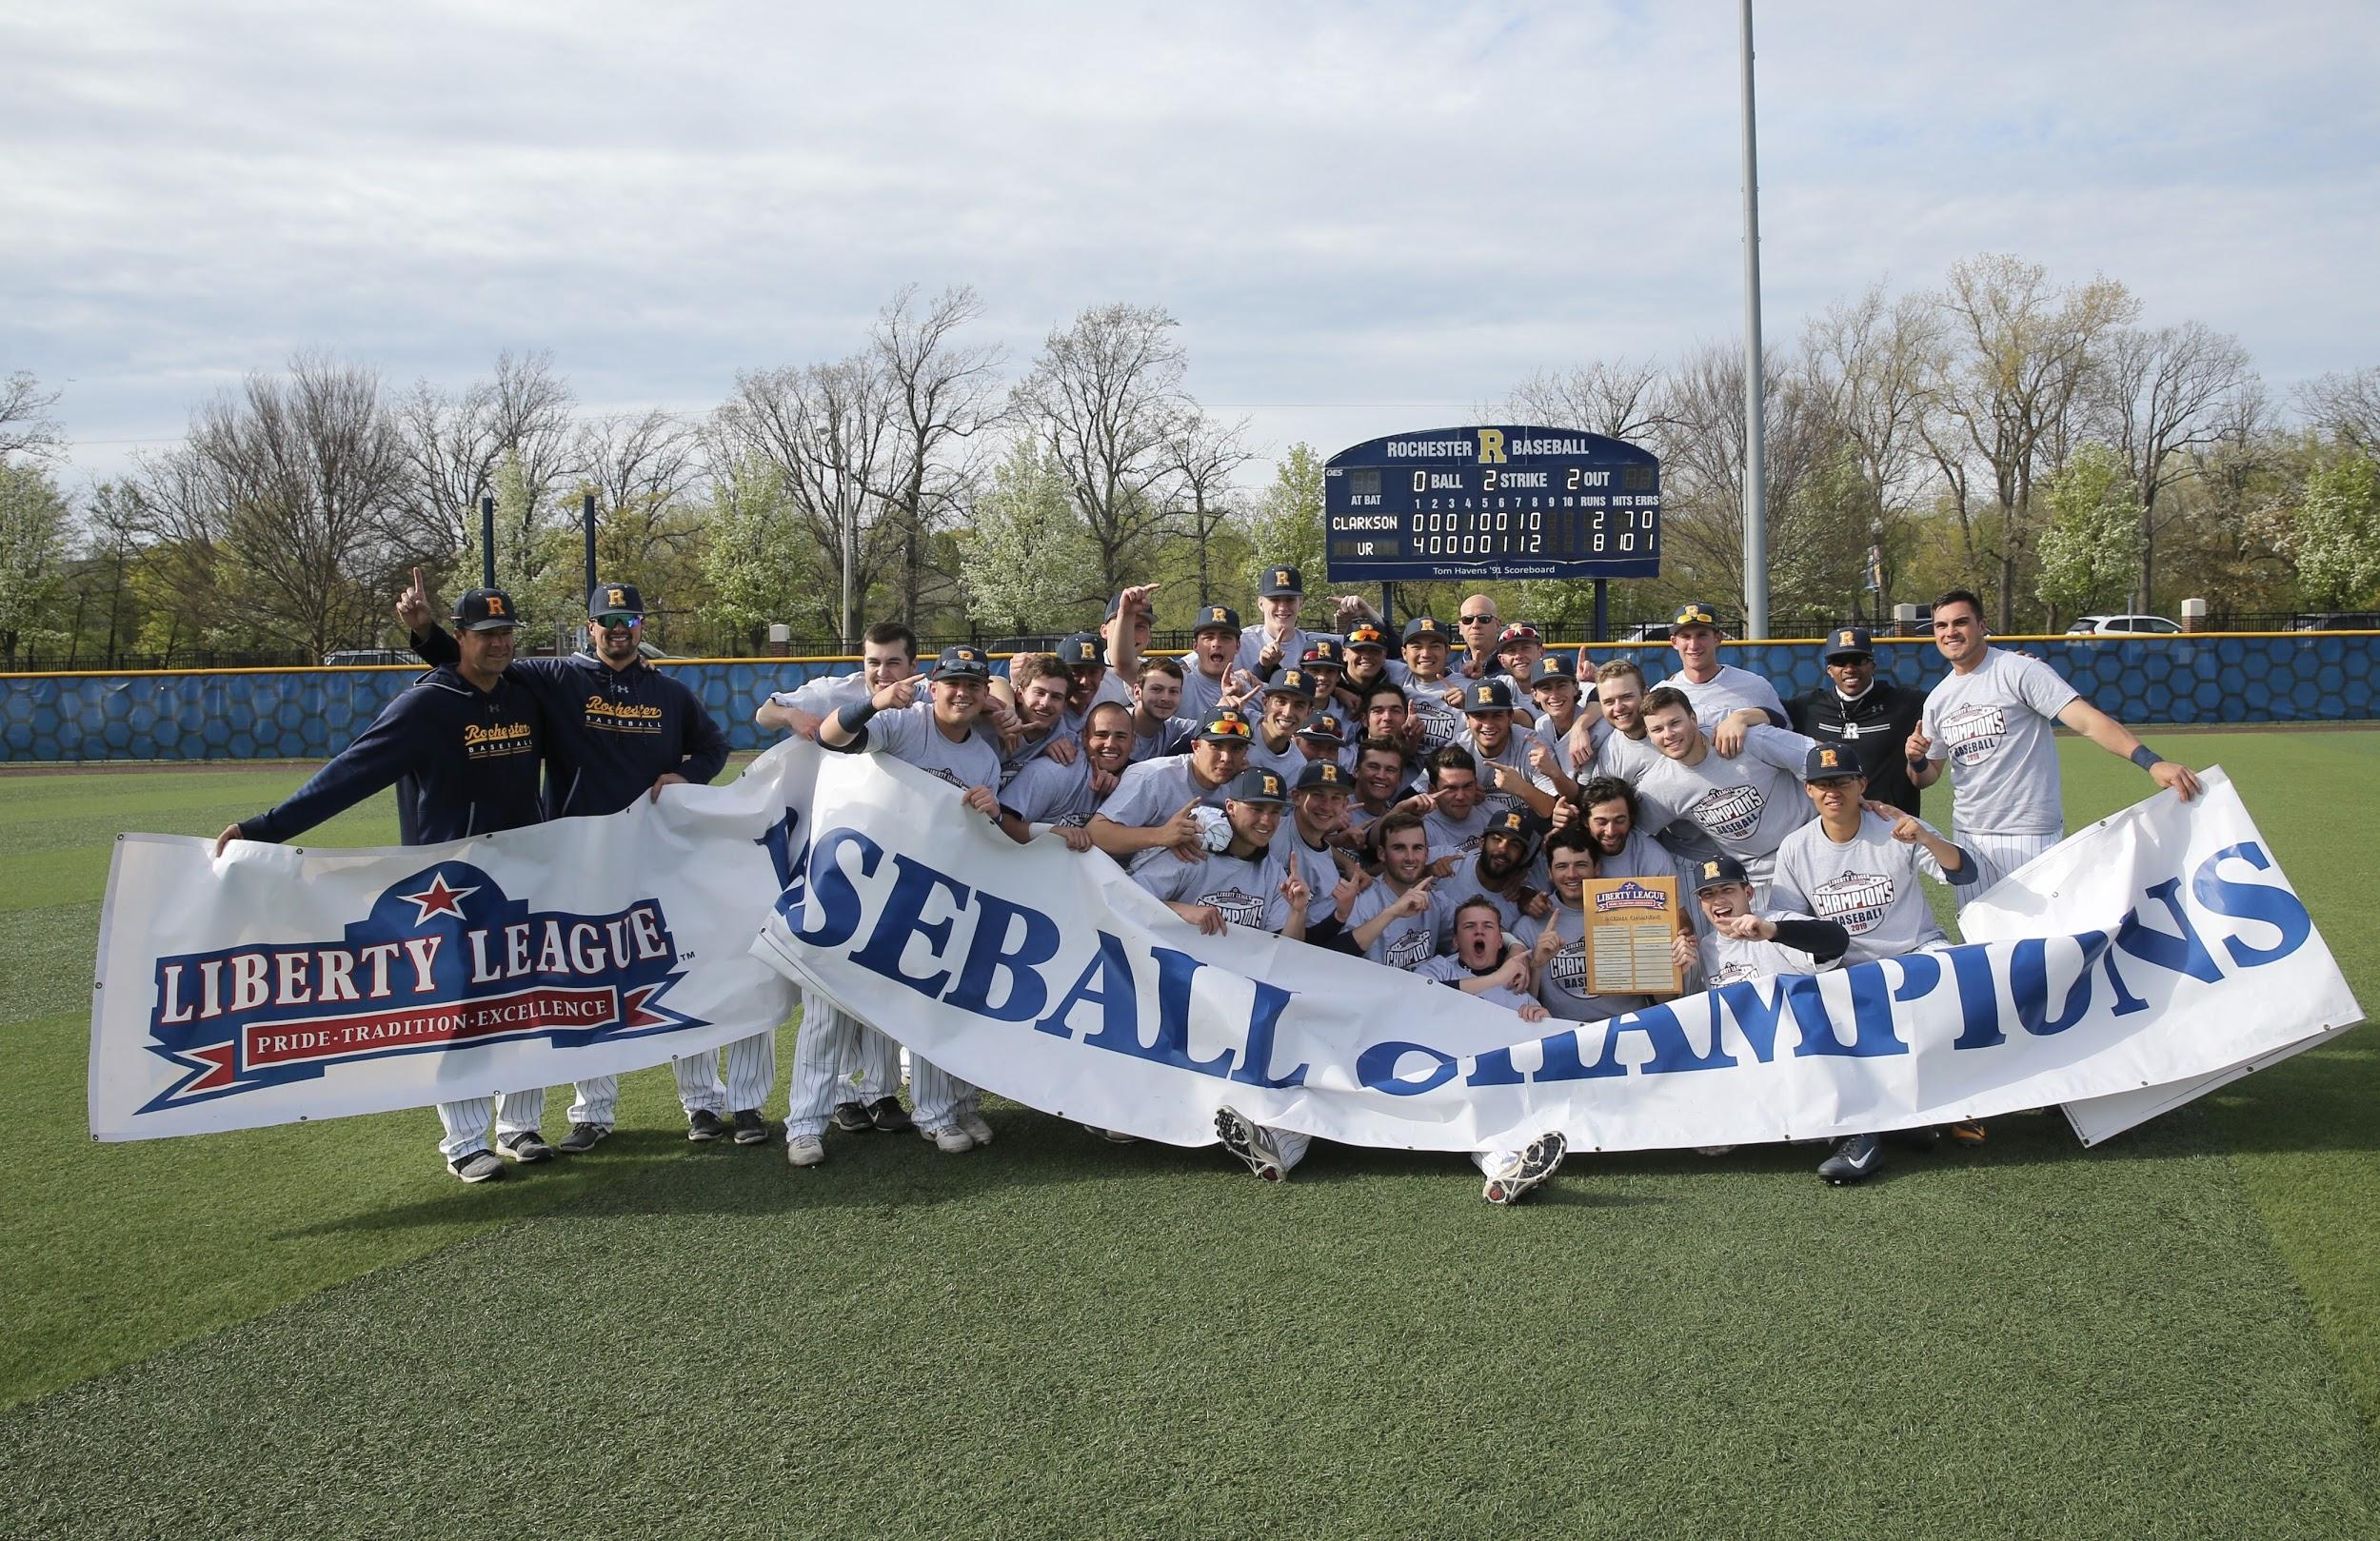
End Goal - Win the Liberty League and Succeed on a National Level

