Slide 1
Coronagraph Plots
Different Telescopes, Stars, and Planets

Slide 2
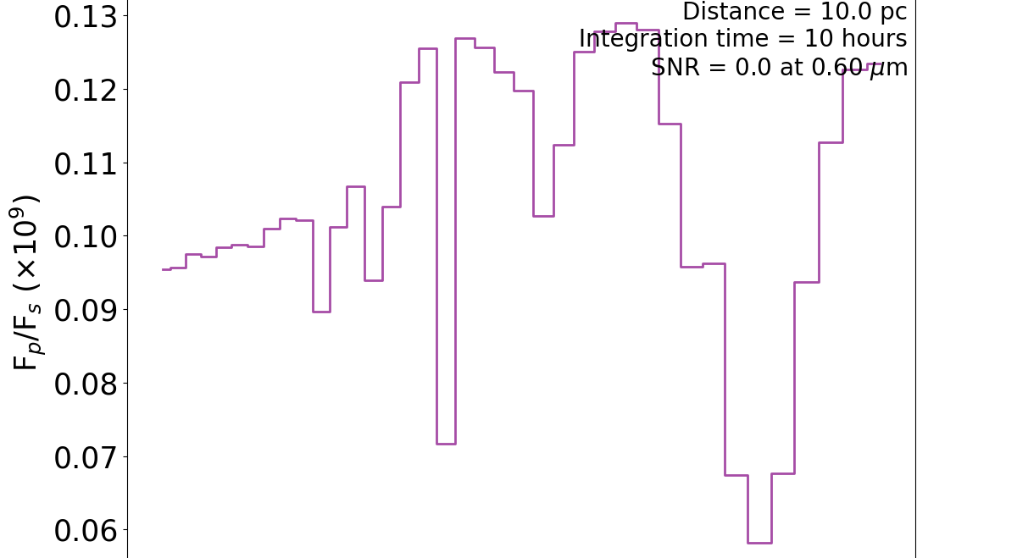
Default Star/Planet, Telescope = default_wfirst

Slide 3
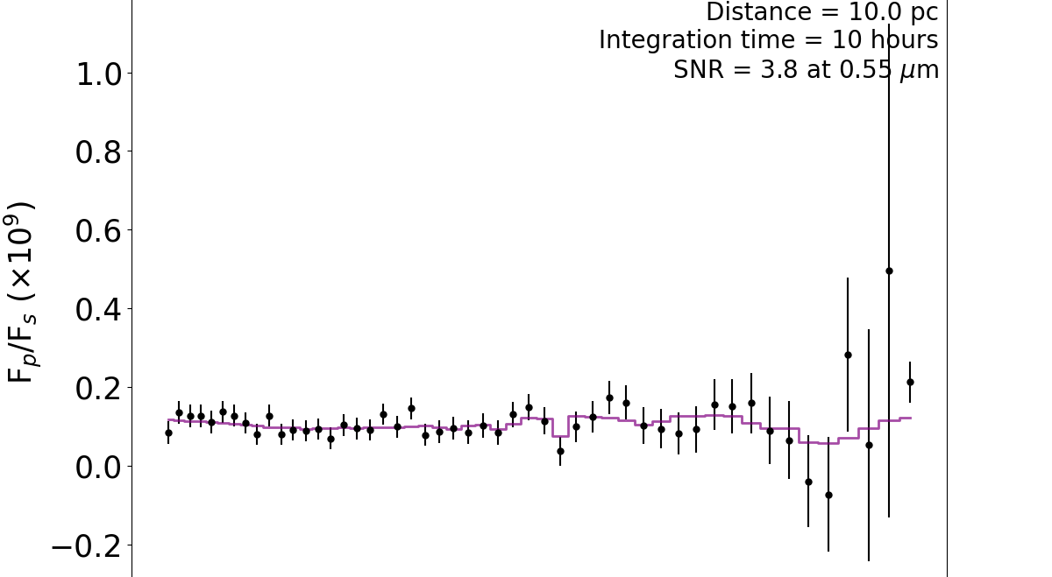
Default Star/Planet, Telescope = default_luvoir

Slide 4
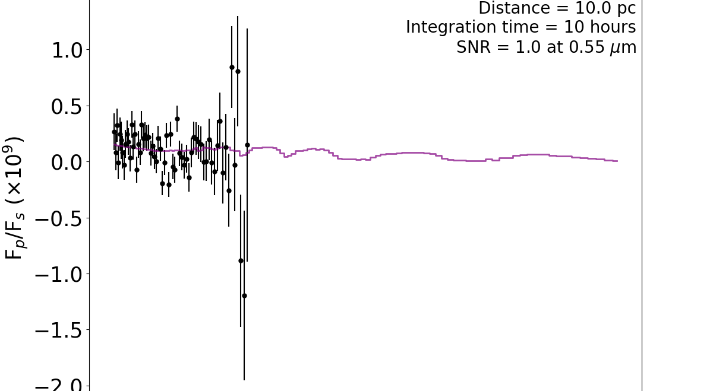
Default Star/Planet, Telescope = default_habex

