Slide 1

TECH ACUMEN
WORKING WITH AI
AI can make your work better. It can also make you a worse judge of your work.
“Self-Evaluation in AI-Assisted Cognition,” Journal of Intelligence 2026, 14(7), 112
Grow the skill. Keep the judgment.
Notes:
Frame the session: AI raises the quality of the output and lowers the quality of your read on it. Everything today is about keeping the second thing intact.

Slide 2

THE FINDING
We judge our own ability by how the work went. When AI does part of the work, that signal breaks.
A fast, polished result feels like proof you are good at something, when it is proof the tool is.
“Self-Evaluation in AI-Assisted Cognition,” Journal of Intelligence 2026, 14(7), 112
Notes:
This is the core finding. The signal we normally use to judge ourselves is how the work went; AI breaks that signal.

Slide 3

WHERE IT COMES FROM
A synthesis of three decades of research, re-examined for work done with AI
NELSON & NARENS, 1990
WINNE & HADWIN, 1998
How people monitor their own thinking
How people manage their own learning
Whether you can tell, in the moment, how well the thinking is going.
What you do with that reading: plan, adjust, and check your work.
Notes:
This is not new advice about AI. It is thirty years of metacognition research applied to AI-assisted work.

Slide 4

CONFIDENCE IS NOT ACCURACY
Feeling sure and being right are different things
Confident and wrong
Hesitant and correct
The work reads well, so the errors never get looked for.
The doubt is uncomfortable and the judgment is sound.
AI widens that gap by making every result feel sure.
Notes:
Separate the feeling from the fact. Confidence and accuracy are two different measurements.

Slide 5




THE FRAMEWORK
Seven axes, three stages, one outcome
◀ YOU GET SHARPER
YOU LOSE THE THREAD ▶
Every axis is a spectrum. The same tool sits at either end depending on how it is used.
Reflect
Decide
Iterate
Review
How well you judge yourself
Where AI enters
How you work with it
What you walk away with
AXIS 08
AXES 01–02
AXES 03–05
AXES 06–07
Notes:
Preview the framework: seven axes, three stages, then one outcome. Each axis is a spectrum, not a rule.

Slide 6
DECIDE
Where AI enters
AXES 01–02
◀ YOU GET SHARPER
YOU LOSE THE THREAD ▶
Early, to help you frame the problem
01
At the end, to produce the answer
When you bring AI in
It offers options you compare and check
02
Coach or stand-in
It does the thinking, you accept it
Notes:
Axes 01 and 02: the decisions you make before you start typing.

Slide 7
ITERATE
How you work with it
AXES 03–05
◀ YOU GET SHARPER
YOU LOSE THE THREAD ▶
Set what good looks like, then check
03
Let the tool keep score and disengage
Who is keeping score
04
Spend it checking and improving
What you do with the time saved
Finishing faster becomes the whole point
05
You question, connect, and rework it
How hard you actually think
You skim, paste, and move on
Notes:
Axes 03 to 05: what happens during the work. This is where most of the damage is done quietly.

Slide 8
REVIEW
What you walk away with
AXES 06–07
◀ YOU GET SHARPER
YOU LOSE THE THREAD ▶
06
You could produce this again unaided
The work vs. what you can do
Great result, no ability gained
07
Trust earned by spot-checking
How much you trust it
Trust given by default, errors invisible
Notes:
Axes 06 and 07: what you are left holding when the work is finished.

Slide 9
CONTEXTUAL FACTORS
These set how strongly each axis moves the result
Task complexity
Your expertise
AI literacy
Time pressure
System transparency
Hard, open tasks hide the cues you would check
Domain knowledge is your error detector; novices are most exposed
Knowing what the tool is bad at targets your trust
Rushing turns into accepting output unchecked
Visible reasoning and sources are easier to judge
Notes:
These five factors set how hard each axis pulls. Novices under time pressure on a complex task are the most exposed.

Slide 10
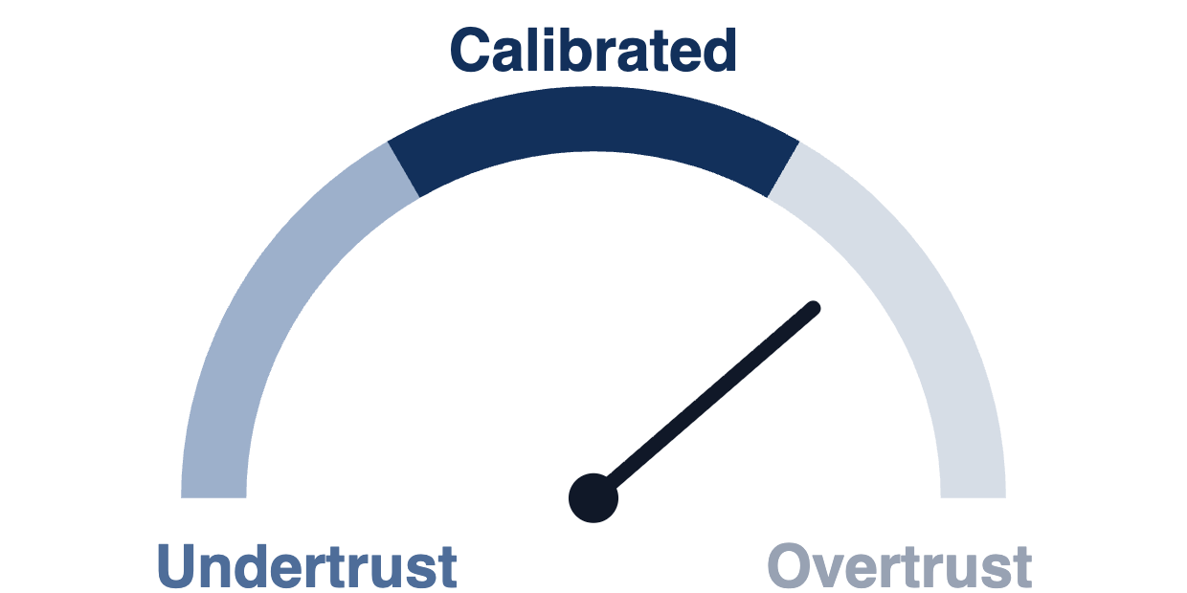
REFLECT
08
How well you judge yourself
Self-evaluation accuracy is the gap between how good you think the work is and how good it actually is.
The other seven axes decide how wide that gap gets.
Notes:
Axis 08 is the outcome the other seven produce: the gap between how good you think the work is and how good it is.

Slide 11
RELIANCE
Two ways to get reliance wrong, one way to get it right
Undertrust
Calibrated
Overtrust
Relying too little on a capable tool.
Reliance matches checked performance.
Relying too much on a fallible tool.
THE COST
THE PAYOFF
THE COST
Missed insights, slower work, lost advantage.
Best outcomes, balanced risk, confidence you can defend.
Missed errors, automation bias, an inflated sense of your skill.
Notes:
Name the two failure modes. Overtrust gets the attention; undertrust also has a real cost.

Slide 12
AFTER THE WORK
How to check yourself when the work is done
1
Predict, then verify.
Before you check anything, say how well you think you did. The gap between your guess and reality is your calibration.
2
Run the one test.
Could you explain it, defend it, reproduce it, or apply it somewhere else without the tool?
3
Treat trust as a practice, not an attitude.
For each output, choose: accept, verify, or question. Let what you verified set your confidence, not the tool’s usual reliability.
4
Discount the shine.
Fluency, polish, and speed belong to the tool. They are not evidence of your skill.
Notes:
Four checks to run after the work is done. Step one is the one people skip.

Slide 13
WHILE YOU WORK
Four habits that keep the signal intact
AXES 01–02
AXES 03–05
Decide AI’s function before you start
Attempt first, then compare
Choose when and how it enters: to surface criteria, structure reflection, and support revision, not only to produce the final output.
Make an independent first attempt, compare your version with the AI’s, and mark out its contribution when you assess yourself.
AXIS 02
AXIS 04
Ask for reasoning, not just answers
Reinvest the time it saves
Have it surface criteria, options, counterpoints, and the sources behind them: ask for citations you can open and check, not just answers.
Spend the saved effort on comparing, improving, and understanding, not just on finishing sooner.
Notes:
Four habits to apply during the work, each tied back to the axes.

Slide 14
TECH ACUMEN
Grow the skill. Keep the judgment.
“Self-Evaluation in AI-Assisted Cognition,” Journal of Intelligence 2026, 14(7), 112
The output belongs to the tool. The judgment is yours to keep.
Notes:
Close on the tagline: the skill and the judgment are two separate things to protect.

