Slide 1
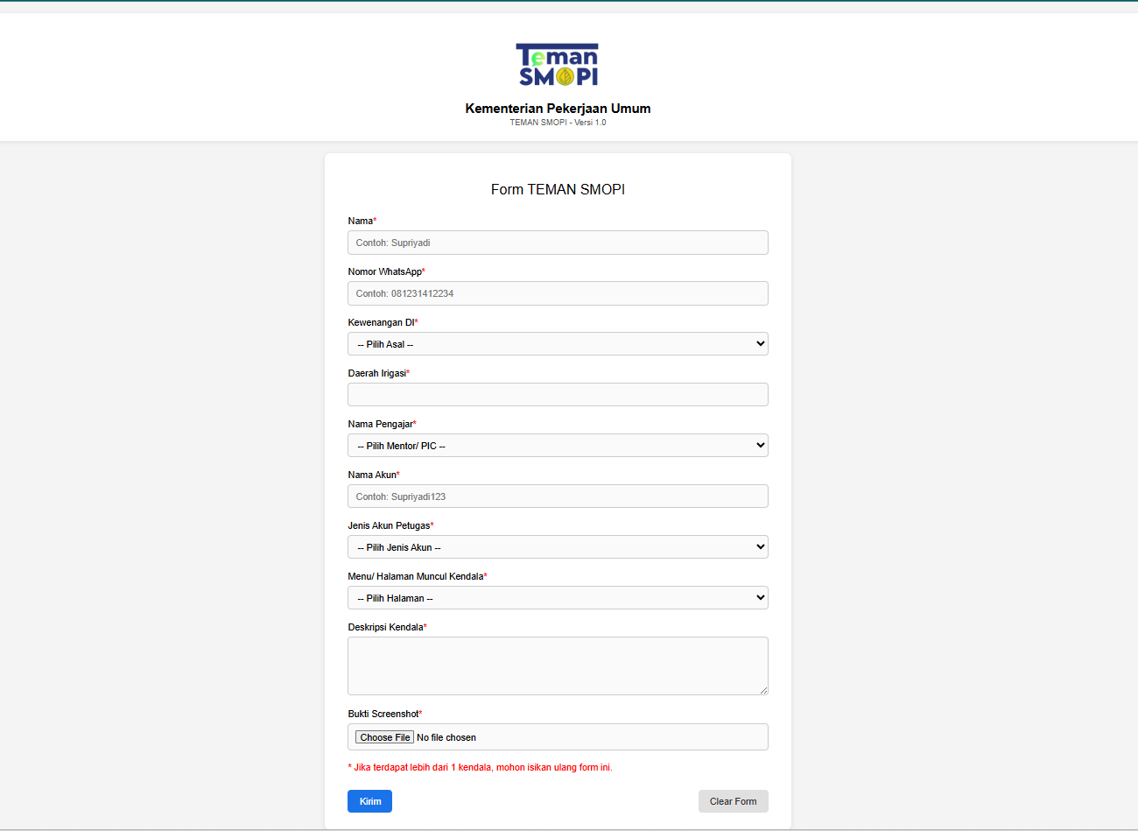

Slide 2
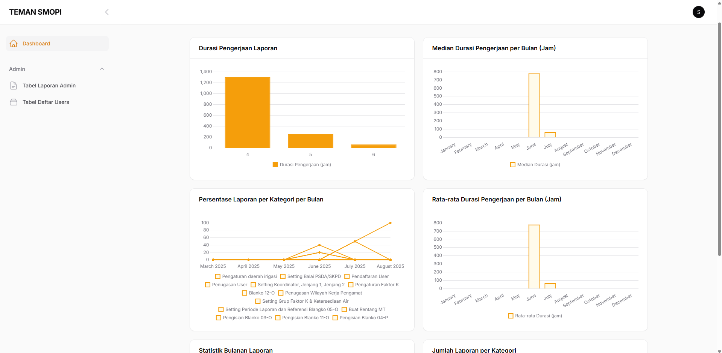
Login as : Super Admin
Username : SuperAdmin
Email: admin@admin.com
Menu : Dashboard

Slide 3
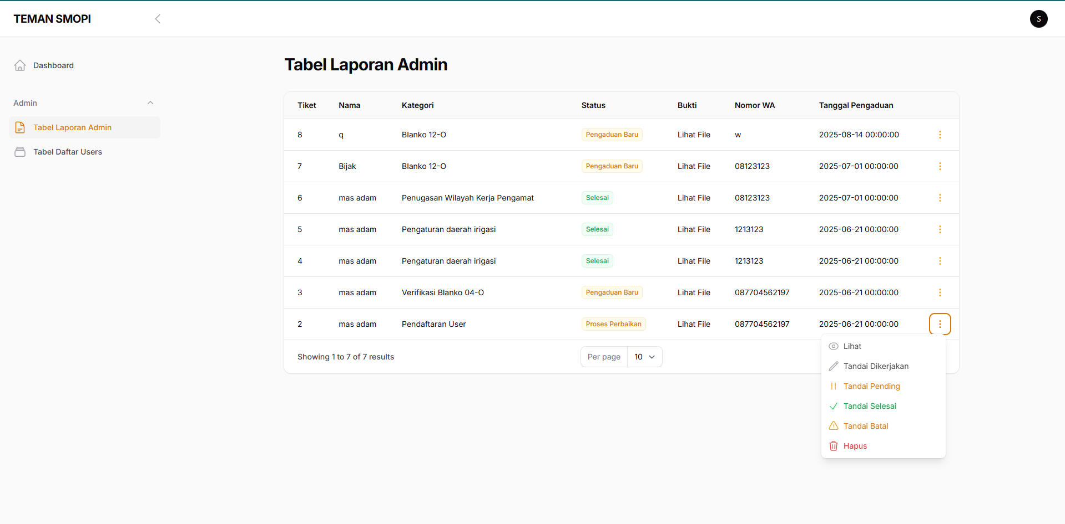
Login as : Super Admin
Username : SuperAdmin
Email: admin@admin.com
Menu : Tabel Laporan Admin

Slide 4
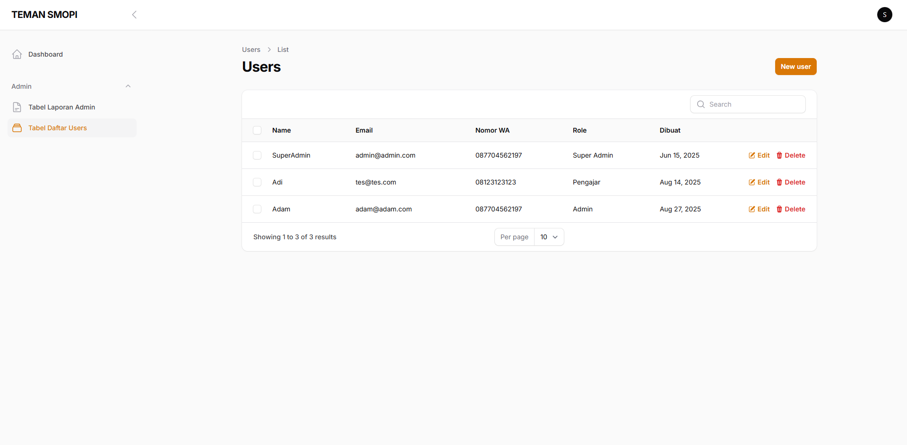
Login as : Super Admin
Username : SuperAdmin
Email: admin@admin.com
Menu : Tabel Daftar User

Slide 5
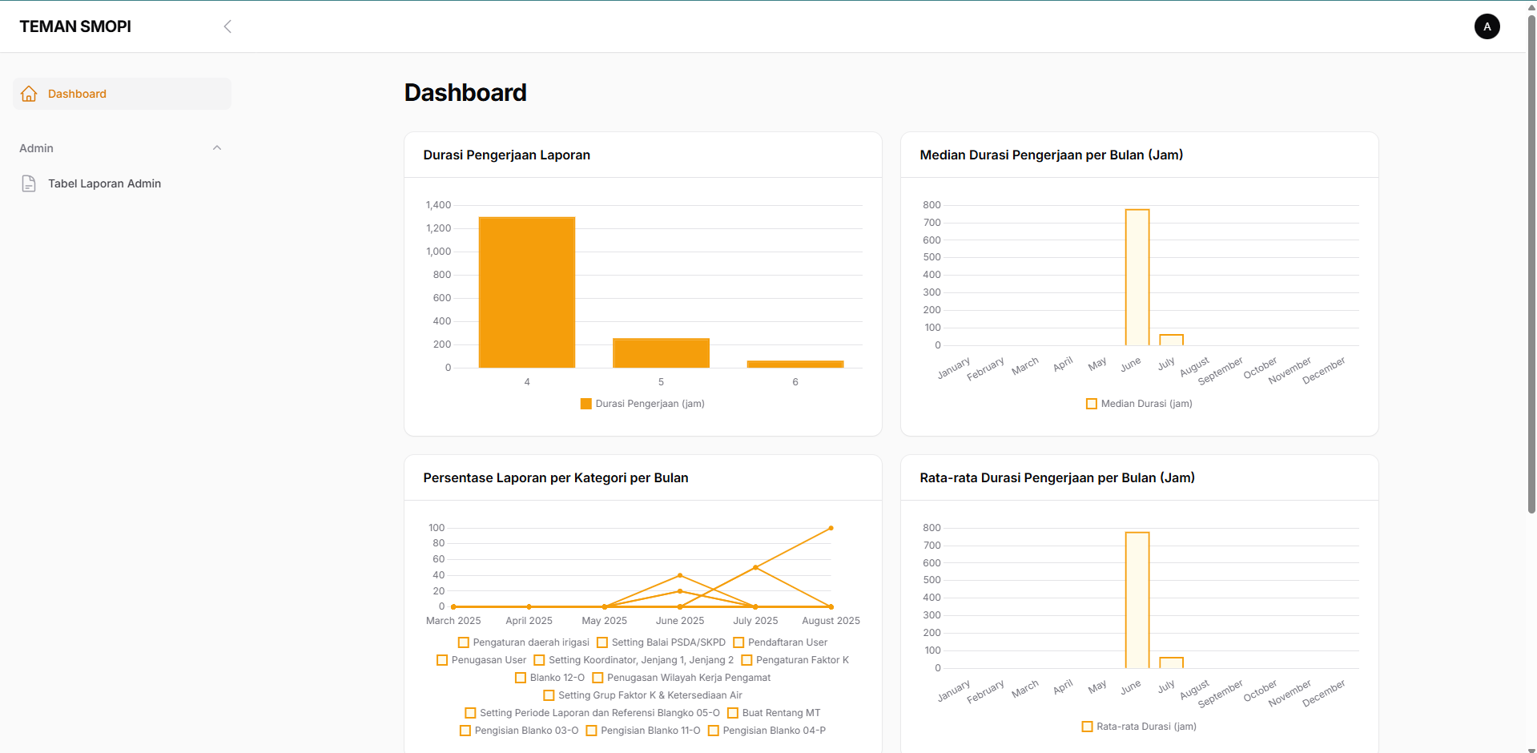
Login as : Admin
Username : Adam
Email: adam@adam.com
Menu : Dashboard

Slide 6
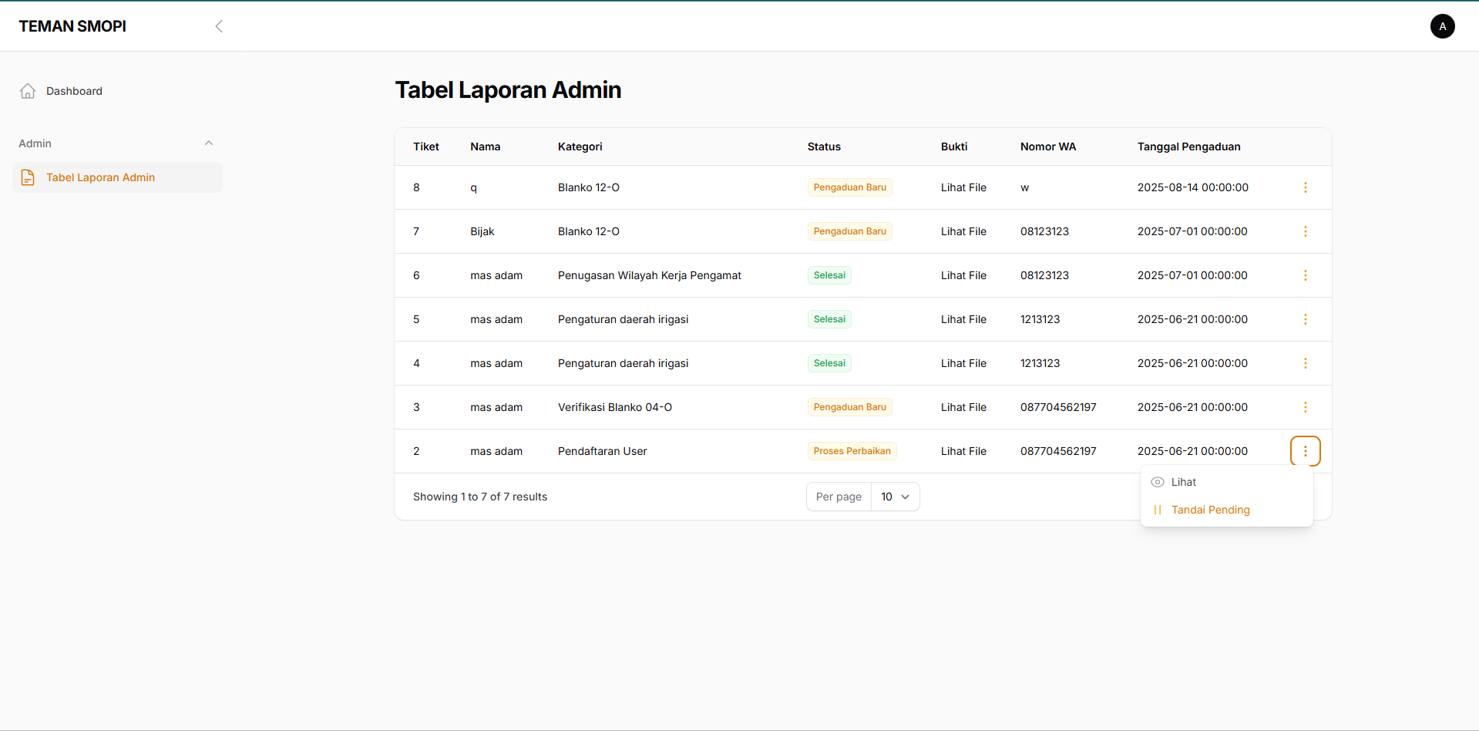
Login as : Admin
Username : Adam
Email: adam@adam.com
Menu : Tabel Daftar User

Slide 7
Login as : Pengembang
Username : Developer
Email: dev@dev.com
Menu : Dashboard

Slide 8
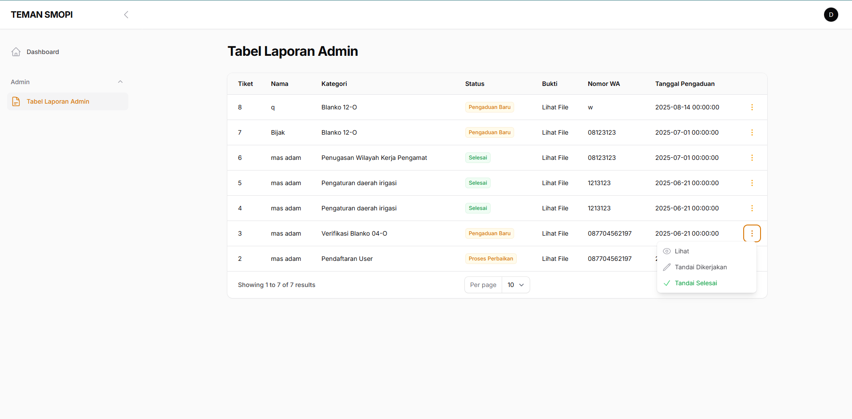
Login as : Pengembang
Username : Developer
Email: dev@dev.com
Menu : Tabel Laporan Admin

