Slide 1
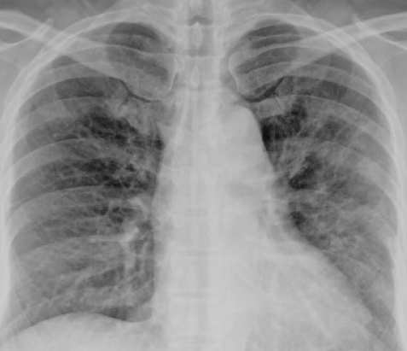
Covid-19 Detection in Chest X-Ray Images
By Adam Ten Hoeve

Slide 2
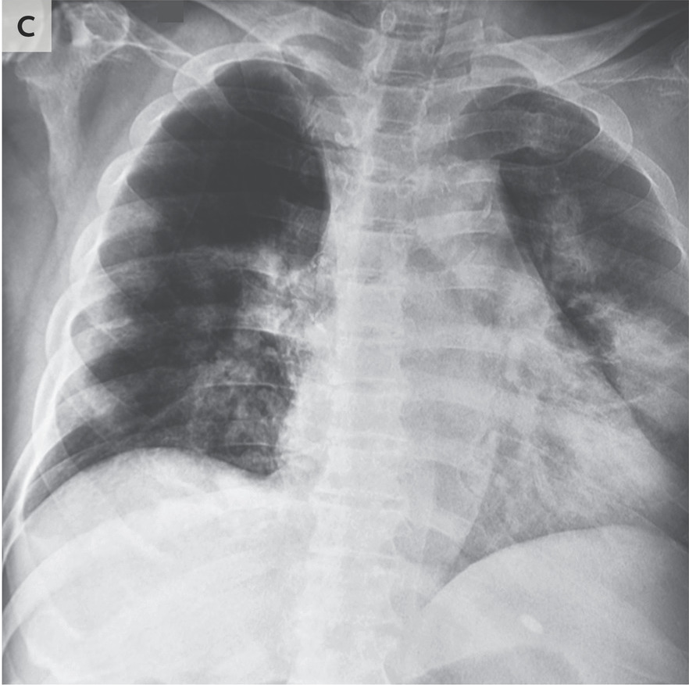
Introduction
The lungs are the primary organ effected by the Covid-19 virus and radiograms of the chest can be essential for early detection and diagnosis.
Covid-19 pneumonia shows up in X-rays as spindly whiteness. In typical cases, it slightly obscures the lung markings (Figure a). In severe cases, the whiteness is much denser and completely obscures the underlying lung markings (Figure b).
Question: Can we train a computational model to detect these indicators, and classify between a normal lung, a lung infected with bacterial pneumonia, and one infected by Covid-19.

Slide 3
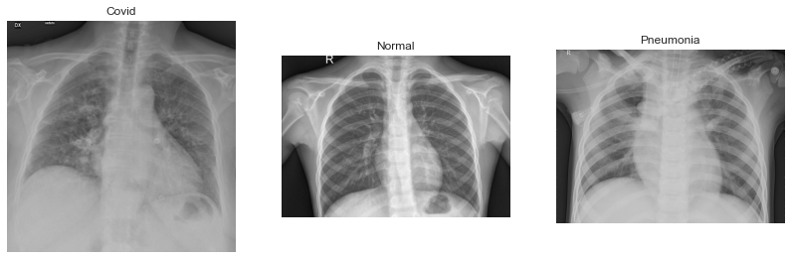
The Dataset
603 X-ray images of chest cavities of varying sizes.
234 Normal
221 Covid-19
148 Bacterial Pneumonia

Slide 4
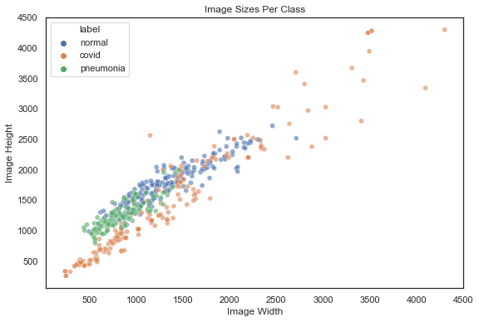
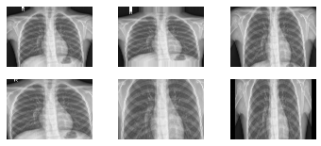
Data Exploration and Preparation
Resize all images to be 224 x 224 pixels. This is to match the image input of the ResNet50 model.
All images are greyscale (1 channel).
This means each input will be have 224 x 224 = 50,176 values.
Image augmentation applied to training set.

Slide 5
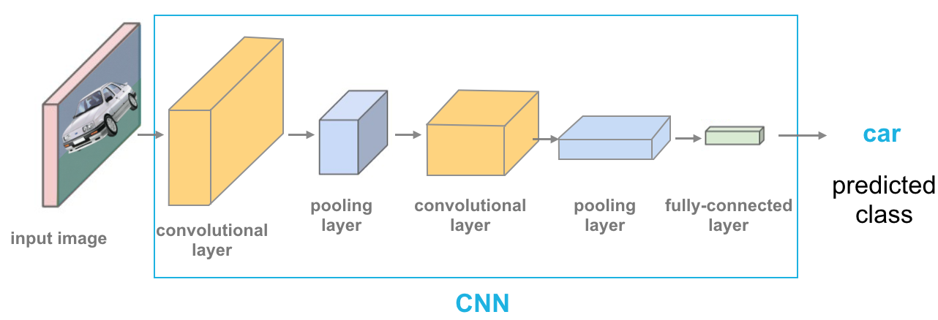
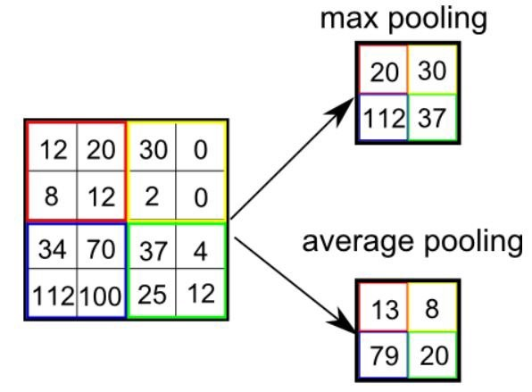

Convolutional Neural Networks (CNN)
Overall Architecture
CNN’s are especially good at computer vision tasks.
CNN’s have 3 main types of layers: the convolutional layer, the pooling layer, and the fully-connected layer.
The convolutional layers take the input matrix and apply a Kernel to it in a moving window pattern, calculating a “score” for that window
Pooling layers do dimensionality reduction and noise suppression by condensing parts of the convolutional layer into a single value.
The fully-connected layer flattens the 2D matrix into a 1D vector and is fed into a regular feed forward Neural Network, which calculates the probability of each class.
Convolutional Layer $→$ Pooling Layer

Slide 6
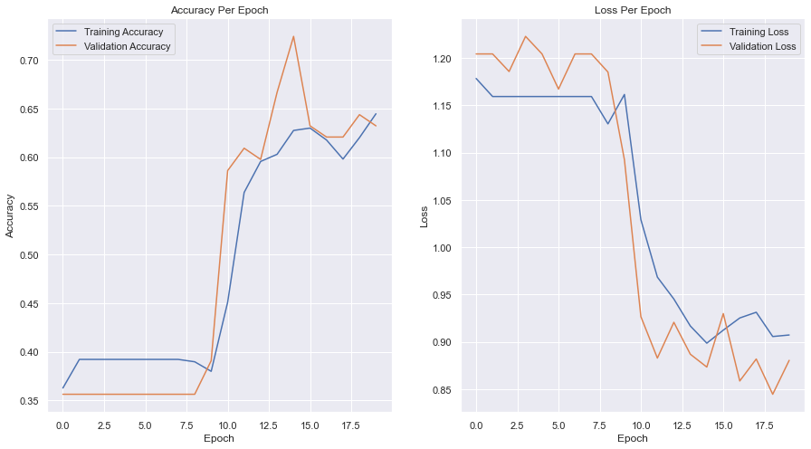
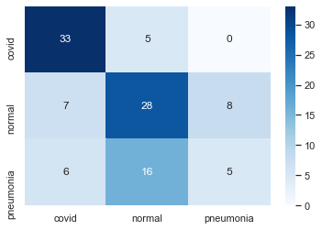
Model Visualization
Validation Accuracy: 67.8%
Test Accuracy: 61.1%
Okay but not great…

Slide 7
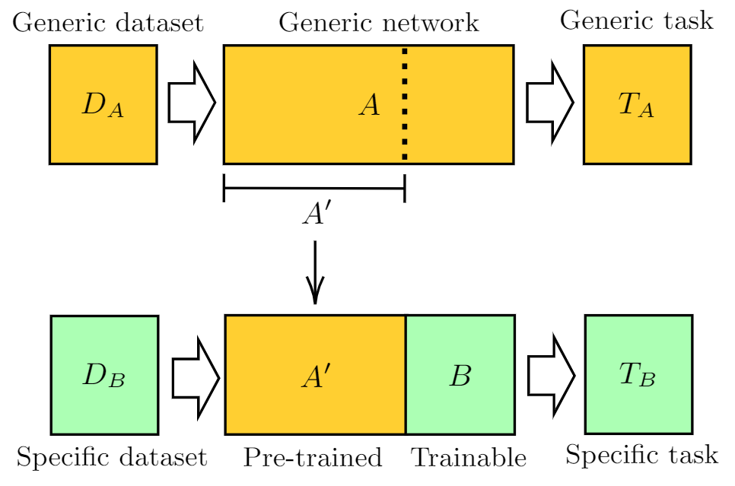
What Can We Do?
Overfitting to the training data
Early Stopping
Regularization Penalties
Dropout Layers
But none of those helped.
The main problem is the size of the training set (408 images). Even with the image augmentation, it’s not enough for our model to generalize.
To try and fix this, I used Transfer Learning.
Transfer Learning is the process of taking an already trained network and using its layers as the basis of a new model. That way the new model is already capable of performing a similar task, and only needs to be adjusted to the specifics of another dataset.
I used the ResNet50 model for the pre-trained network.
Image Credit: https://pennylane.ai/qml/demos/tutorial_quantum_transfer_learning.html

Slide 8
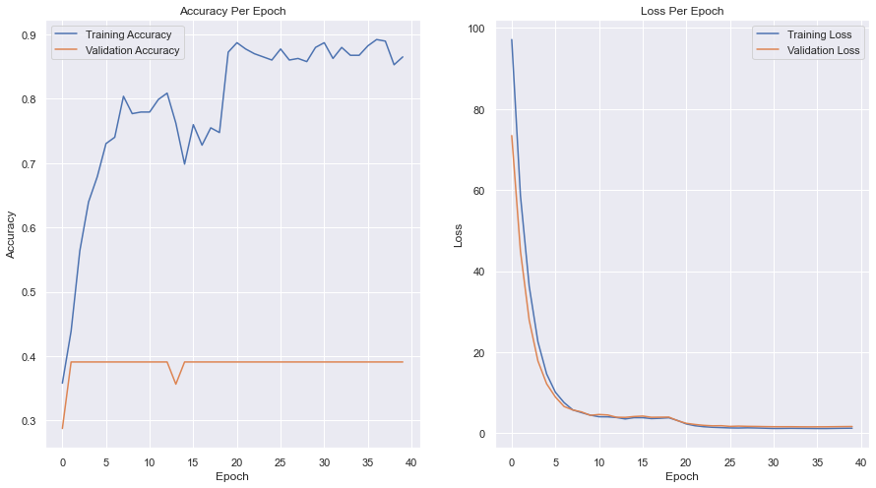
Transfer Learning Model
Validation Accuracy: 39.0%
Test Accuracy: 35.2%
So that did not fix the issue.
We should use the “from scratch” network.

Slide 9
Questions?

