Slide 1
Earthquake Disaster Analysis Using NLP
Project By Adam Ten Hoeve

Slide 2
Introduction
The city of St. Himark has recently been hit by a severe earthquake.
The city has created a social media app to allow citizens to communicate with each other. We will use this app’s messages to investigate what is happening around town.
Question: Can we use the social media messages to:
Understand how the earthquake affected the citizens of St. Himark.
Determine which emergency resources should be distributed to which neighborhoods, and whether those resources change as time goes on.

Slide 3
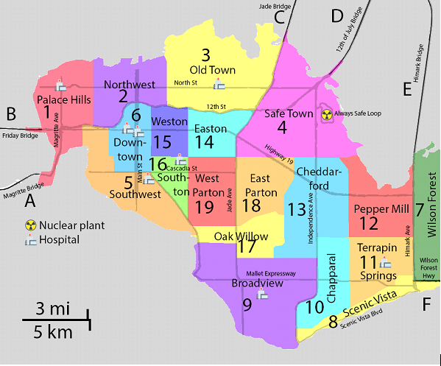
St. Himark
A city built into a peninsula.
19 neighborhoods with unique geography and lifestyle.
There are 8 hospitals spread across the region.
Safe Town (region 4) is home to the Always Safe nuclear power plant.

Slide 4
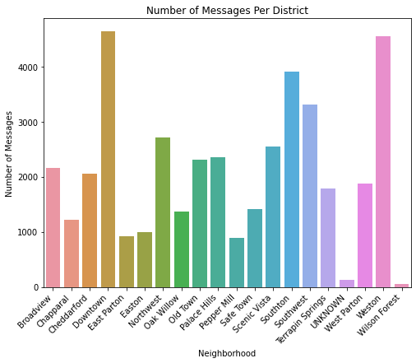
The Data
1 CSV file with 41,941 rows and 4 columns:
Account: Which user sent the message.
Message: The social media post.
Time: The time the message was sent.
Location: Which district the message was sent from.
Times range over 5 days: 12:01am 04/06/2020 – 11:59pm 04/10/2020
12,047 original messages, 29,163 reposts (post cleaning)
The Ugly:
Oh htishis is htishe place ihtisself is well mroeade, easy htiso love, buhtis even mroeore htishan jushtis a neahtis gadgehtis.
Ã\x83Â itÂ theyÂ itÂ itÂ theyÂ heÂ theyÂ sheÂ theyÂ anythingÂ theyÂ heÂ theyÂ someoneÂ
The Good:
Disaster shelters are packed, I can't sleep there.
Old Town hospital is heavily damaged!
The Bad:
Take advantage of these Ten, quaking sales!
theyre trying to keep us from eating so that they can pick us up for there illegal organ harvesting programs

Slide 5
Data Cleaning and Transformation with NLP
How to clean language?
Working with human language (or, at least English) is tricky.
Many words that don’t matter.
Many endings, tenses, and meanings.
Remove messages from obvious bad actors.
Remove stop words.
Remove punctuation, capitalization, special characters, etc.
Lemmatization: drives, drove, driven -> drive
Example:
A lot of people are leaving. But my papa is planning on staying. Think I will, too.
lot people leaving papa planning staying think
Autocorrect spelling?
“Intended Location” and Reposts
Some messages are sent from one place but are actually about another place. For example, a message sent from Downtown: ”Lot of cracks on North St going from Old Town to Northwest!”
Another issue is Reposts. If a person in district A posts the message “The building across from me just collapsed!” and then a person in District B reposts it, which district is the second person talking about?
Decided on three rules to select the likeliest location:
If a message mentions a location, then that location is the “intended location” and not the location that the message was sent from.
If a message does not mention a location, then the location that the message was sent from is the “intended location.”
If a message is a repost, then the “intended location” of the original message is the intended location of the repost as well.

Slide 6
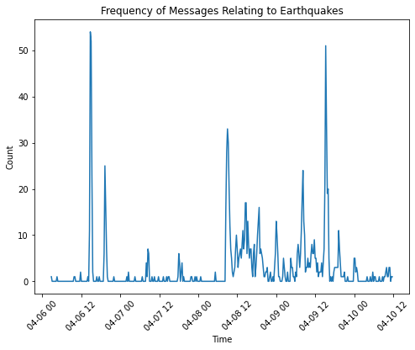
When did the earthquake occur?
Most Reposted Messages From Time:
We jsutust recorded a Northwest.Old Town mild earthquake jsutust northeast of St.Himark town. Did you feel it? Probably no damage #HateDidWonder
What earthquake??? I didntididntn't feel anything!
Earthquake or not I still have to teach
ALERT: A 6.7 earthquake just occurred off the NE shore of the town of St. Himark. This could be severe. Expect heavy damage.
My building collapsed around me!
National Earthquake Center reports a major earthquake with an epicenter near town.

Slide 7
Timeline: When Did the Earthquake Happen?
10/06
10/07
10/08
10/09
10/10
10/11
Time of Earthquake:
10/08 at 8:30am

Slide 8
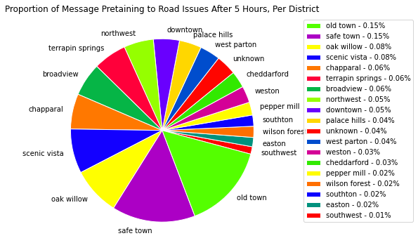
5 Hours After the Earthquake:
Need to start sending out resources: Road Crews, Sewer Repair Teams, Rescue, etc.
How do we go about doing that? We will go through the process for road crews.
Can see that Old Town, Safe Town, Oak Willow, Scenic Vista and Chapparal were the locations that sent the most messages about road issues in the 5 hours.
These are locations on the Northern and Southern borders of the city.
Gives us a clue into what areas have been hit the hardest.
Next, we can check the messages themselves. That we can be sure that these areas are being affected by road issues.

Slide 9
Resource: Road Crews 5 Hours After Earthquake, Cont.
Look at the most reposted messages from those locations.
Use those messages to determine what happened in those areas.
Goes off the assumption that an issue will be mentioned more (i.e., many reposts) if it is of a great concern to an area and mentioned less (i.e., fewer reposts) if it is not of a great concern.
Old Town:
Extensive damage on the north and south sides. Although no neighborhood has escaped damage. Severals fires throughout City.
Our neighborhood has been hit hard. All the old brick buildings have collapsed or are heavily damaged. #neighborhood
Lot of cracks on North St going from Old Town to Northwest!
Safe Town:
Always Safe security fence is down and one their buildings has partially collapsed. You can walk right in! We need some cops out here right away
Extensive damage on the north and south sides. Although no neighborhood has escaped damage. Severals fires throughout City.
A janitor at Always Safe says the plant is damaged but cant give any details. He said he just ran out and drove away.
Scenic Vista:
Extensive damage on the north and south sides. Although no neighborhood has escaped damage. Severals fires throughout City.
We @RunsFrancis_HowardOctopus are trying to evacuate but the roads are jammed. Will there be a tsunami? Does anyone know?
Look at that damage - this was a 4 story apartment building - help needed.

Slide 10
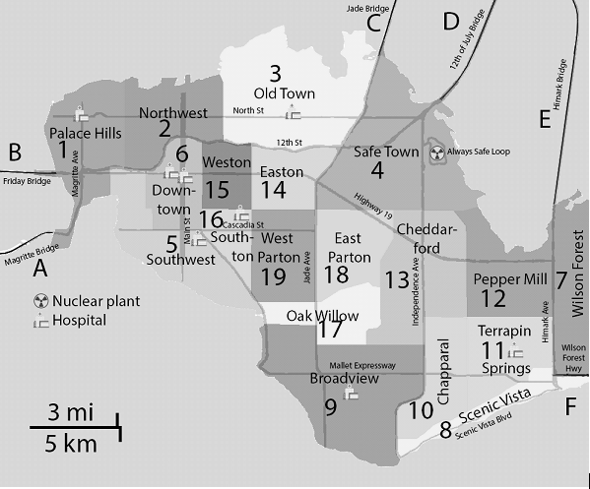


What happened in the first 5 hours?
Repeat process for other resource teams.
Sewer repair team.
Power.
Rescue teams.
Immediate problems:
People trapped.
Collapsed buildings.
Fires across town.
Bridges all closed.
The Northern areas have suffered heavy structural damage.
Old Town hospital collapsed.
Always Safe Nuclear Power Plant suffered damages.
The Southern areas have flooding and fires.
The broken sewer system is raising concerns of the drinking water being contaminated.
Other areas have suffered damage, including power and gas outages, but are largely fine.
= Low Priority
= Moderate Priority
= High Priority
- Rubble
- Power Outage
- Flooding
- Fires
- Facility Closed

Slide 11

Timeline: 5 Hour Later
10/08 9:00am:
Power Plant and Bridges are closed.
10/08
10/09
10/10
10/08 1:00pm:
Announced that drinking water is contaminated in most damaged areas (Old Town, Safe Town, Scenic Vista).

Slide 12
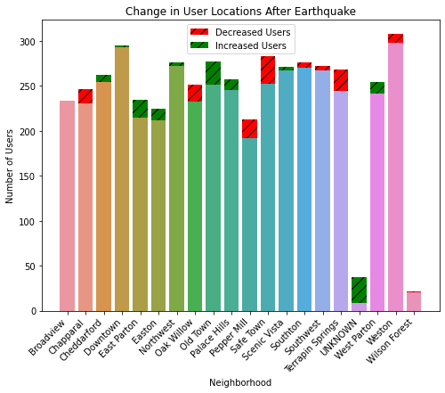
Population Movement After Earthquake
Heavily damaged areas (Safe Town, Scenic Vista, Oak Willow, etc.) have fewer accounts, and less damaged areas have more accounts.
We can infer that people moved from more damaged areas towards the less damaged areas.
= direction of citizen’s movement

Slide 13

Timeline: What Happened next?
10/08
10/09
10/10
10/08 5:00pm:
People evacuate from damaged areas to central areas.

Slide 14
Timeline: The Following Days
= Low Priority
= Moderate Priority
= High Priority
Same methods as before, now over following days.
For most citizens, focus moves from immediate danger to stabilizing and shelter.
Still serious damage in Northern and Southern areas, particularly Old Town and Scenic Vista.
With Downtown, Southton and Southwest become high priority, as they have the main functioning hospitals for most of the city.
We are running out of critical medical supplies, hosptials are burning through IV solutions, medicines, and much more. The roads are making it difficult to supply the hospitals and trucks can't get to our warehouse to keep us supplied. Road clearing from our warehouse in 16 to hospitals should be a priority.
The sewer system continued to decline. There is no potable water across the city.
Power was returned to most of the city, primarily to the Downtown areas and around Safe Town.
Some bridges have reopened, allowing evacuation out of the city.
c
- Rubble
- Power Outage
- Flooding
- Fires
- Facility Closed

Slide 15




Timeline: The Following Days
10/09 7:00pm:
80% of city’s power restored. Primarily in Downtown areas.
10/10 4:00am:
Begins to rain heavily. High risk of landslides.
10/08
10/09
10/10
10/11
10/09 6:30am:
Bridges open, allowing people to evacuate from the city. Some bridges close again at 3:00pm because of risk of collapse.
10/09 8:30pm:
Report posted saying sewers will take months to repair. All citizens should boil water.

Slide 16
Actionable Insights:
Immediately after earthquake:
Send road repair and rescue teams to the northern and southern coasts.
Always Safe Nuclear Power Plant (Safe Town) needs power and reconstruction crews to prevent further damage.
Send road crews to clear bridges to allow people to evacuate the city.
After immediate danger has passed:
Shift focus to central locations, as many citizens have evacuated towards those locations.
Send road teams to clear streets to/from functioning hospitals, particularly in Downtown, Southton and South West, as those have a high population of people.
The sewer system has been greatly damaged. Need to provide clean water across the city.
What I Learned:
Natural Language Processing is HARD.
Geospatial plotting and relative positions are hard.
Plots aren’t everything, you also need to go through the messages.

Slide 17
Questions?
Some fun messages:
does anyone need any candles, i used to date a witch and have some to spare
They clone bunnies
Can't find my fish, Susan. It's been 30 minutes!
You ruttish plume-plucked bum-baileyy!
The vegetables are so friendly.
ferrets and Heroes of St. Himark are natural enemies

