Slide 1

Experimental Search Engine Strategy and Demo
Prepared for Information Retrieval
Prepared by: Danielle Souza Da Silva, Georgia Dean, Adam Toth
14 April 2022

Slide 2
Agenda
Overview of Original Proposal
Overview of Experiment
Overview of Architecture
Data
Data Sources
Data Scraping Pipeline
Data Structures
Tooling and Equations
Tools
Indexing Architecture
Model Configurations
Retrieval Architecture
Demo
Results
Conclusion
Notes:
Today’s presentation I will start with an overview of our experimental search engine goals and design followed by a discussion of the data. Danielle will take over to discuss the tooling and equations backing the retrieval models, Adam will then take you through a demo of the search engine. And Dani will discuss the results and conclusions.

Slide 3
Overview of Experiment
Review of goals for experimental search engine
Our experimental search engine uses BM25F model to improve retrieval results of regulatory text.
Why BM25F? BM25, considered one of the most effective retrieval models, considers texts as unstructured, undifferentiated in any way. As an extension of this model, BM25F considers documents to be composed of several fields (title, abstract, body, etc.) with possibly different degrees of importance, term relevance saturation and length normalisation.
Why regulatory texts? Regulatory texts tend to have consistent structure and unique approach to topic inclusion - highly relevant concepts are mentioned in opening sections, often without repetition in the body. Therefore, some fields may be more predictive of relevance than others.
Goal: by computing and assigning relative weights to pre-specified fields of the documents, the goal is to improve upon the retrieval results of the benchmark model BM25.
Evaluation: performance is measured using mean average precision and recall.
Notes:
Our experimental search engine seeks to use a BM25F model to improve the retrieval results of regulatory texts.
We will use the standard BM25 as the benchmark model because it is consistently one of the most effective retrieval models. BM25F has been selected because it is an extension of BM25 that allows weights to be assigned to specified fields of documents (For example, title, abstract, body) these weights allow us to tune the model to assign more significance specific fields.
Regulatory texts have been selected because of their consistent structure and the fact that they have important terms in the opening preambles that are not repeated through out the document. The preamble briefly explains who the regulation is meant for (for example what type of firm) and the remainder of the regulation speaks to what is being regulated- this makes these texts notoriously difficult to search when using queries that pretrain to who is being regulated.
Our goal is to use the BM25F weighting on the preamble section to bring back more relevant results using queries that are specifically looking to find who a regulation pertains to.
To evaluated our search engine performance, we will use Precision and recall metrics.

Slide 4









Overview of Architecture
Review search engine architecture
BM25
Indexing
Ranked results
Stopword Removal
Stemming
pyTerrier indexing
Q₁
Retrieval Model
BM25 model
Q₂
EU
Euro-Lex
BM25 Scored Indexed Documents
Unstructured
Text
Q₃
UK FCA
Query
BM25F
Indexing
Ranked results
Stopword Removal
Stemming
pyTerrier indexing
Retrieval Model
Intro
BM25F model
Q₁
Body
USA
ECFR
Weighted using optimised variables
Q₂
Intro
Body
BM25F Scored Indexed Documents
Q₃
Notes:
Here we have an architecture of our search engine. I will cover this at a high-level and Dani will dig into the details when she discusses the tooling and equations later on.
The architecture of our search engine starts with the ingestion of our document data from various regulatory sources.
For the BM25 model, the text remains unstructured through the indexing process and retrieval processes.
The BM25F model will follow a similar pipeline, however the data will be structured using fields and the retrieval model will use assign weights to these designated field.
Both models will display results ranked by their relevance.

Slide 5
Data Sources
Overview of data and how it was scraped for the purpose of this experiment
Dataset
The dataset used for this experimental model was comprised regulatory text that was scraped by the researchers from various regulatory bodies’ websites The sources are regulatory texts from the United States, United Kingdom and European Union focusing specifically on financial regulation for a total of 2387 documents.
Jurisdiction | Regulations | Number of documents in corpus
United States | E-CFR (Title 12, Title 17) | 478
United Kingdom | FCA Handbook | 504
European Union | Eur-Lex Financial Regulations | 1405
Query relevant document pairs
The query relevant document pairs were completed by domain experts in the regulatory compliance field.
Total number of queries: 12
Range of relevant documents per query: 575
Notes:
The data for this experiment come from financial regulatory sources from the United States, United Kingdom and European Union.
To acquire this data, we scraped the online sources for each jurisdiction for a total of 2387 document.
The query relevant document pairs were developed using domain expertise. The queries intentionally ranged from 1 – 3 words for complexity and across a variety of subjects to ensure a comprehensive test set.
These queries were then matched with all relevant documents across all jurisdictions.

Slide 6

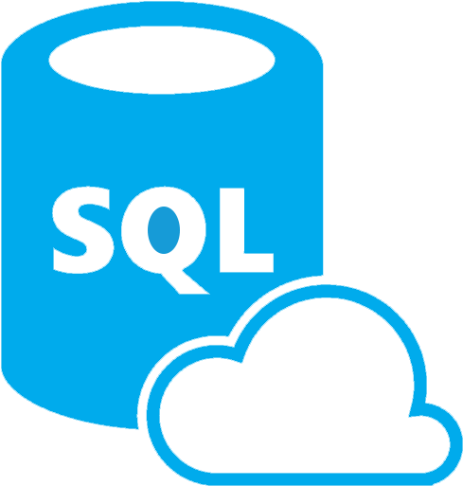


Data Scraping Pipeline
Process used to scrape data
HTML scraped from web pages and XML from APIs
HTML and XML cleaned and parsed in Python Azure ML to extract data fields
Relevant metadata and text rendered as dictionary for use in experimental search engine model
Processed data stored in Azure SQL Server Database for rapid retrieval
Model build in Google Colab Python notebook using PyTerrier library
https://www.iconspng.com/image/68515/python-language-logo
https://www.clipartmax.com/middle/m2H7K9G6b1G6G6m2_azure-sql-database-icon/
https://towardsdatascience.com/azure-machine-learning-service-part-1-an-introduction-739620d1127b
https://miteshparmar1.medium.com/structure-your-code-better-in-google-colab-with-text-and-code-cells-b6fa73feec20
Notes:
To acquire the data we built scrapers that could scrape data from html sources or XML from APIs depending on the juristional source.
This data was then cleaned and parsed into data fields using Azure ML
This data was then stored in an Azure SQL DB where was queried to build data files in the appropriate structure for the search engine pipeline.
Finally, these data files were loaded into a python notebook in colab to kick off the pipeline process.

Slide 7
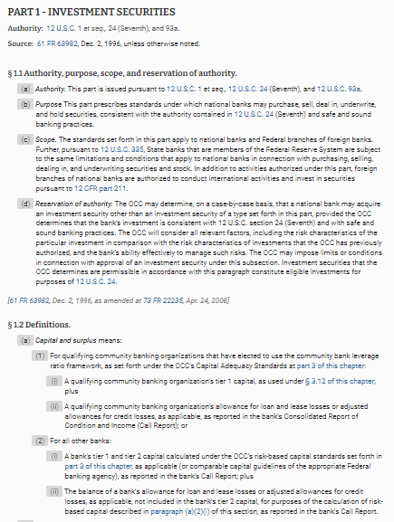
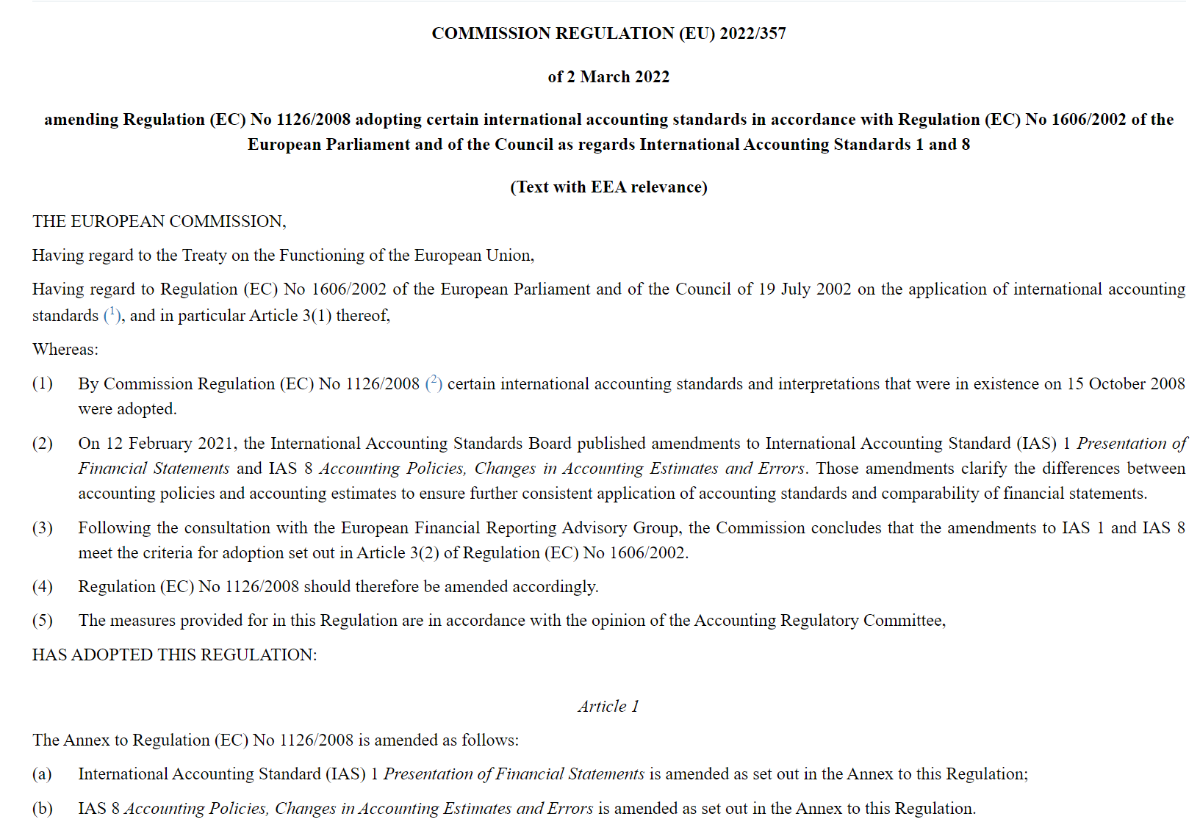
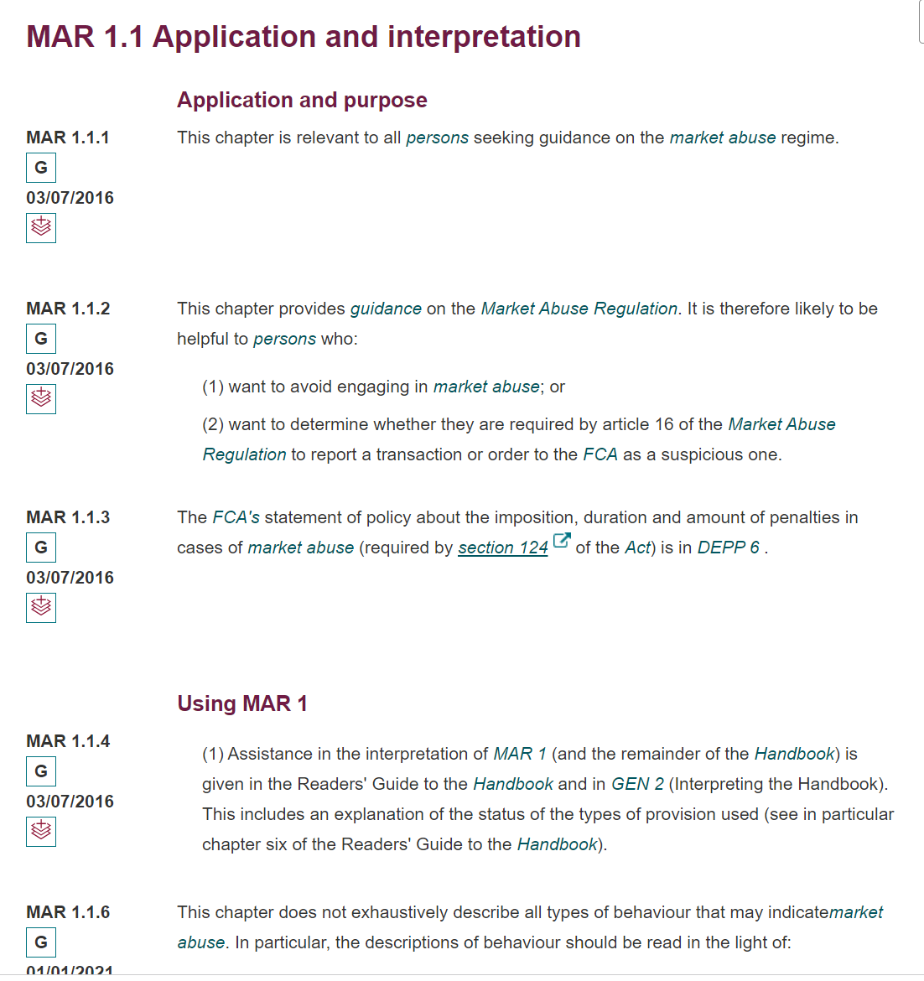
Data Structures
Explanation of how data was structured
ECFR (USA)
Euro-Lex (EU)
FCA Handbook(UK)
Preamble
Text
Notes:
To better understand the data structures here we have examples of regulatory text from each of the Jurisdictions.
In each example, there is a sections that will be treated as the ‘preamble’ field and the rest of the text will be considered the body text field.
Where this occurs and how it is structured differs across the jurisdictions, but the intent of the field is consistent. The preamble explains who the regulation is meant for and the remainder of the regulation sets out what is being regulated .

Slide 8

Tools
Tools utilised for the search engine architecture proposed.
Python was used to implement the search engine components. The libraries that were utilised to scrape and prepare the data, implement the search engine and run experiments with results are listed below.
Python libraryName​ | Description of use in proposed implementation ​
Beautiful Soup​ | It was used to scrape HTML from the web containing the relevant documents.
Requests | It was used to apply HTTP request and get URLs desired for the dataset.
Pickle | This library was used to move data.
Pandas | It was used to read the csv file and transform it to a data frame.
Pyterrier​ | It was used to index the data, apply the retrieval models, tune the parameters (field weights) for the BM25F model and run experiments.
The main library used to implement each step of the architecture proposed was PyTerrier.
PyTerrier is a platform used for information retrieval experiments in Python. It uses Java-based Terrier information retrieval platform to support indexing and retrieval operations.
References: [pyterrier.readthedocs.io.], [terrier.org.],

Slide 9
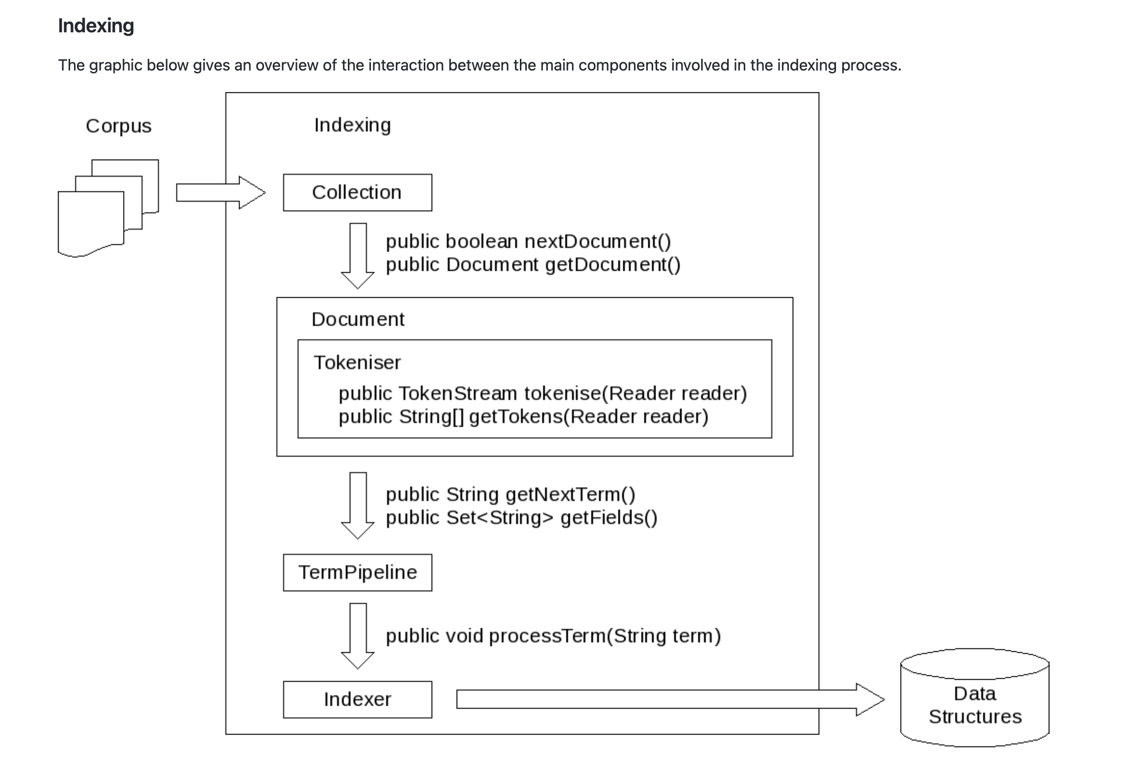
Indexing Architecture
Method used for the search engine architecture proposed.
Indexing
A corpus is represented in the form of a collection object. Documents are provided with an instance of a Tokeniser class that breaks pieces of text into single indexing tokens.
The indexer manages the indexing process. It iterates over the documents of the collection and sends each term found through a TermPipeline component, which where stemming and stop word removal takes place (default PorterStemmer).
Once the terms have been processed through the TermPipeline, they are aggregated and data structures are created by their corresponding DocumentBuilders.
Reference: [GitHub. (2022). terrier-org/terrier-core]

Slide 10
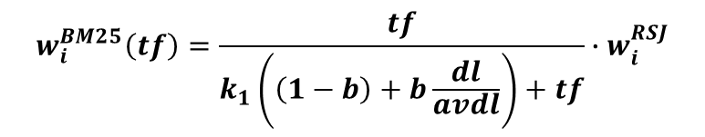

Model Configurations
How the models are configured in PyTerrier
Retrieval Models
BM25: PyTerrier uses a java class to implement the Okapi BM25 weighting model.
BM25F: PyTerrier uses a java subclass of PerFieldNormWeightingModel setup to implement BM25F as described by [Zaragoza TREC-2004], which is the same set up described in the search engine proposal.
The parameters k1 and b are the default for both models and were kept consistent for the experiments.
$$w_{i}^{BM25}\left(tf\right)=\frac{tf}{k_{1}\left(\left(1−b\right)+b\frac{dl}{avdl}\right)+tf}∙w_{i}^{RSJ}$$
$$\tilde{{tf}_{i} }= \sum_{s=1}^{S}{v_{s}\frac{{tf}_{si}}{B_{s}}}$$
$$B_{s}=\left(\left(1−b_{s}\right)+b_{s}\frac{{sl}_{s}}{{avsl}_{s}}\right), 0≤b≤1$$
$$w_{i}^{BM25F}=\frac{\tilde{{tf}_{i} }}{k_{1}+\tilde{{tf}_{i} }}w_{i}^{RSJ}$$
References: [pyterrier.readthedocs.io.], [Robertson, S. and Zaragoza, H., 20]

Slide 11
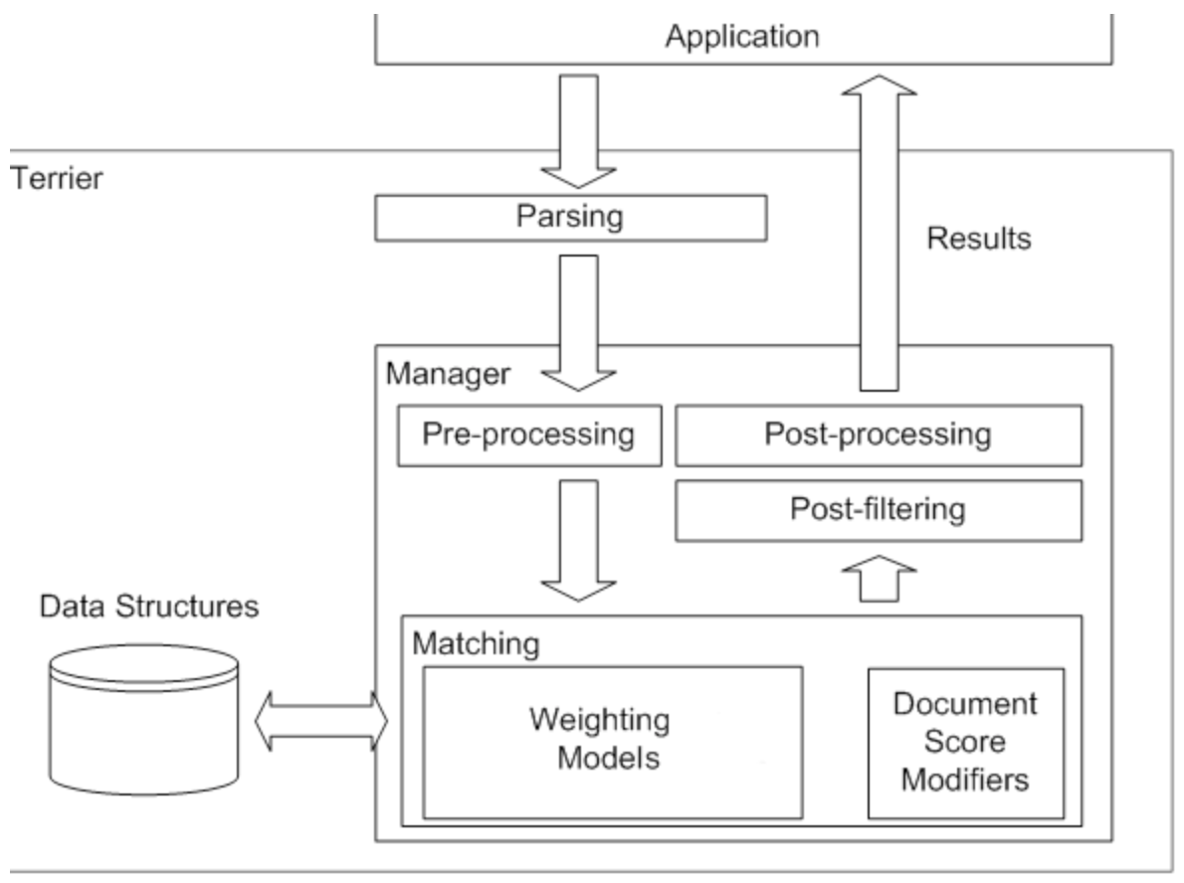
Retrieval Architecture
Steps of how retrieval results are computed
The “Application” in the diagram in our case refers to the Google Colab notebook which in the first step issues a query
The query is parsed and an instantiation of a query object takes place.
The query is then handled to the Manager component, which pre-processes the query by applying it to the configured TermPipeline.
The pre-processed query is handled to the Matching component which initializes the Weighting Model (BM25/BM25F) and Document Score Modifiers. Once all components have been instantiated the score computation with respect to the query will take place.
The PostProcessing and PostFiltering takes place and so the score document list is returned to the application.
Reference: [GitHub. (2022). terrier-org/terrier-core]

Slide 12
DEMO

Slide 13
Results
Overall results using BM25 vs BM25F
Overall Results
Recall@k (R@k): The fraction of relevant documents for a query that have been retrieved by rank k.
Parameters
Parameters k1 and b used were the default values for both models. The field weights for the BM25F model can be seen below:
Field | Weight
Text | 0.5
Preamble | 1.0

Slide 14
Results
Results per query using BM25 vs BM25F

Slide 15
Conclusion
Final thoughts and further research for BM25F and regulation information retrieval
Conclusions
BM25 is still the model to beat!
BM25F showed potential for the more difficult queries where even BM25 had low performance.
The preamble is still an important section of regulation and the highly valuable content it contains continues to prove evasive for search engines to capture in relevance rankings.
Further research
Field length normalization
Preambles had varying lengths that could affect the results. Further research into field length normalization
Improved use of queries for retrieval
It would be beneficial for multi-word queries to rank documents that contain ‘word 1’ AND ‘word2’ higher
N-grams
Using n-grams could better capture the proximity of terms in the text and queries to improve relevant document retrieval for domain-specific topics that are made up of general terms

Slide 16
Division of Work
Task | Team Member | Description | Percentage of work
Data Import and Structure | GD | Bring in and prepare data, both structured and unstructured | 15%
Define Queries | GD | Define 15-20 queries and relevant document pairs | 5%
Indexing of Data | DD, AT | Using team coding, index data to be scored-Including but not limited to, stop word removal, stemming, tf/idf calculations | 5%
Implementation of BM25 | DD, AT | Using team coding, implement BM25 model on the unstructured document data. | 20%
Implementation of BM25F | GD, DD, AT | Using team coding, implement BM25F model on structured document data | 20%
Optimization of Parameters | DD, AT | Optimize BM25F weight parameters and hyper parameters for both models (potentially using gradient descent) | 15%
Results Evaluation | GD | Calculate precision, recall and F-scores to determine quality of retravel results | 2.5%
Presentation Write-Up | GD, DD, AT | Write presentation of | 15%
Record Presentation/Demo | GD, DD, AT | All team members will record and present search engine and results | 2.5%

Slide 17
Sources
Na, S., Kang, I., & Lee, J. (2008). Improving Term Frequency Normalization for Multi-topical Documents and Application to Language Modeling Approaches. ECIR.
Singhal, A., Buckley, C., & Mitra, M. (1996). Pivoted document length normalization. SIGIR Forum, 51, 176-184.
pyterrier.readthedocs.io. (n.d.). Installing and Configuring — PyTerrier 0.8.1 documentation. [online] Available at: https://pyterrier.readthedocs.io/en/latest/installation.html.
terrier.org. (n.d.). Terrier IR Platform - Homepage. [online] Available at: http://terrier.org [Accessed 14 Apr. 2022].
GitHub. (2022). terrier-org/terrier-core. [online] Available at: https://github.com/terrier-org/terrier-core/blob/5.x/doc/basicArchitecture.md [Accessed 14 Apr. 2022].
[Zaragoza TREC-2004] . H. Zaragoza, N. Craswell, M. Taylor, S. Saria, S. Robertson: Microsoft Cambridge at TREC 13: Web and Hard Tracks. In Proc. of TREC 2004
[Robertson, S. and Zaragoza, H., 2009.] The Probabilistic Relevance Framework: BM25 and Beyond. Foundations and Trends® in Information Retrieval, 3(4), pp.333-389.

