Slide 1
Supervised Learning – Political Text Mining
CIS 365 – Artificial Intelligence – Final Project
Gabriel Stepanovich and Adam Terwilliger

Slide 2
Description of Datasets
Twitter sentiment – ~100,000 tweets pre-trained assigned a sentiment (positive/negative)
Debates – Every debate response from 2016 presidential debates (~2,000) assigned an affiliation (Republican/Democrat)
Twitter categories – ~60,000 tweets assigned a category (sports, media, singers, science)
Twitter politics – ~20,000 tweets assigned Democrat or Republican

Slide 3


Approaches
Naïve Bayes classifier
Random shuffling
Training/Test Split
Transferability of features

Slide 4
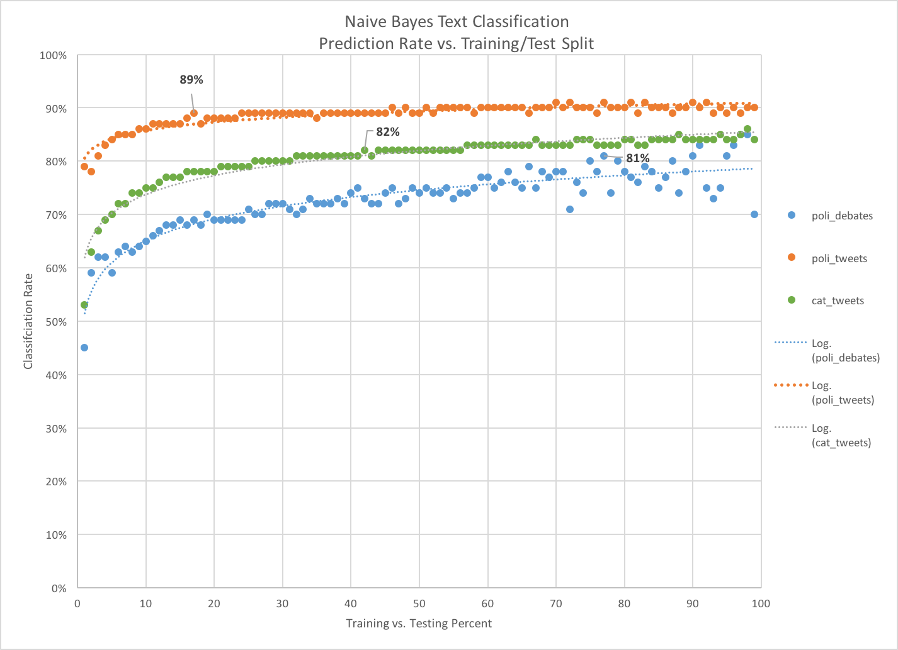

Slide 5
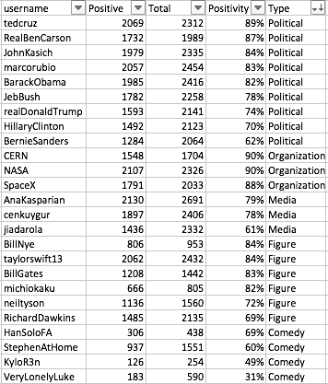

Slide 6

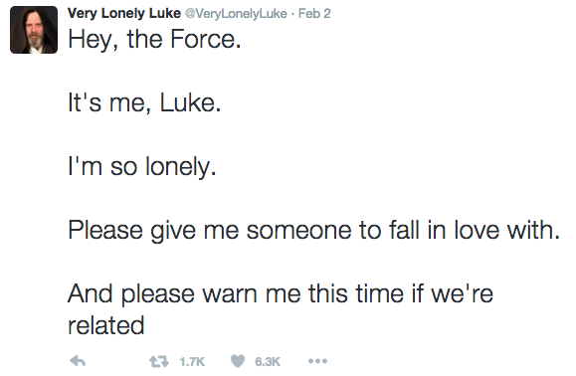

Slide 7
