Slide 1
CHOU3OUR ANALYSIS

Slide 2
AGENDA
PROBLEM
SOLUTION
CONTEXT
BUSINESS MODEL CANVAS
CUSTOMERS
MARKET ANALYSIS
COMPETITORS
FINANCIAL PLAN
TIMELINE

Slide 3

PROBLEM
Arabizi is arabic chat language
Sentiment = شعور = chou3our
Companies are missing information created in
social media using ARABIZI

Slide 4

OUR SOLUTION
We provided sentiment analysis for
text written in arabizi dialect

Slide 5
SOCIAL MEDIA IN MIDDLE-EAST AND NORTH AFRICA

Slide 6
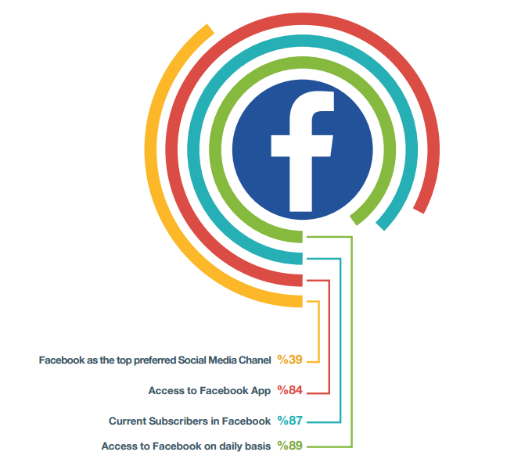

Slide 7
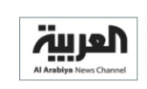

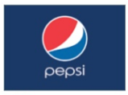
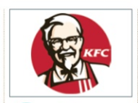
MOST POPULAR BRANDS

Slide 8


USE OF SOCIAL MEDIA MONITORING
Réputation
Engagement
FeedBack
Modern image of companies advetising on social media
Social media allows direct interactions and strengthening the relationship with clients
Benefit from real time feedback

Slide 9












Social media
Sentiment
analysis
Opinions and sentiments
Analyze
Company
Customer
Collects
Needs data

Slide 10

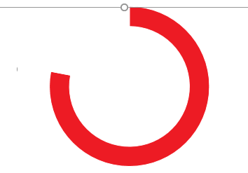
USE OF SOCIAL MEDIA MONITORING
38 %
78 %
77 %
organizations plan to spend more than 20% of their total advertising budgets on social media channels in 2015.
78% of people who complain to a brand via Twitter expect a response within an hour
77% of Twitter users feel more positive about a brand when their Tweet has been replied to.

Slide 11


70 %
Of oung adults use Arabizi
66 %
Think that social medial has impact on cmpanies success

Slide 12
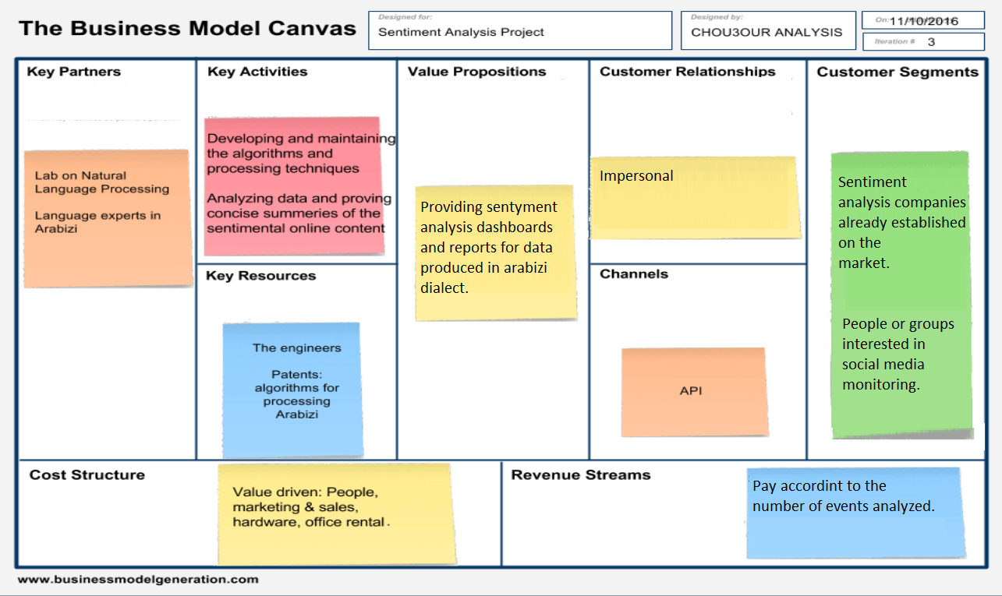

Slide 13
VALUE PROPOSITION
DATASET
OUR
COMPANY
ANALYZED DATA

Slide 14
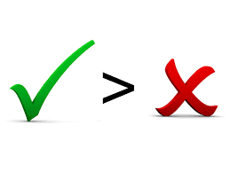
CUSTOMER SEGMENT
Anyone who wants to know people’s opinion on the social media (actors, politicians, enterprises)
Social enterprises.
Which content are they interested?
Customer’s experience.
Content shared by individuals within social networks has greater engagement value to potential audiences than brand-profile-shared content.

Slide 15




WHO IS BUYING

Slide 16


OUR COMPETITORS
Research groups interested in arabizi sentiment analysis.
Potential customers can become very strong competitors if they don’t become key partners.

Slide 17

POTENTIAL CUSTOMERS
The 1st Arabic Focused Internationally Recognized Social Media Monitoring Platform”Services they provide
Sentiment analysis for arabic and many different dialects.
Digital branding consulting: Measure brand value in social media
Influencer Market Surveying: Identify influencers that will help to create more revenues.

Slide 18

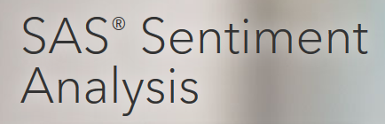






POTENTIAL CUSTOMERS
French
English

Slide 19
KEY PARTNERS
Language Experts

Slide 20

ENTRY BARRIERS
They offer access to dashboards that customers can consult. (Crowd Analyzer)
They offer configurable software packets (Lexaltycs)
Consulting reports (Crowd Analyzer)
They offer API’s (Alchemy API IBM) Pay as you go schemas

Slide 21
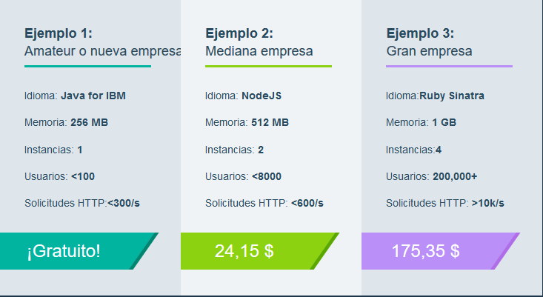
PRICING EXAMPLES

Slide 22
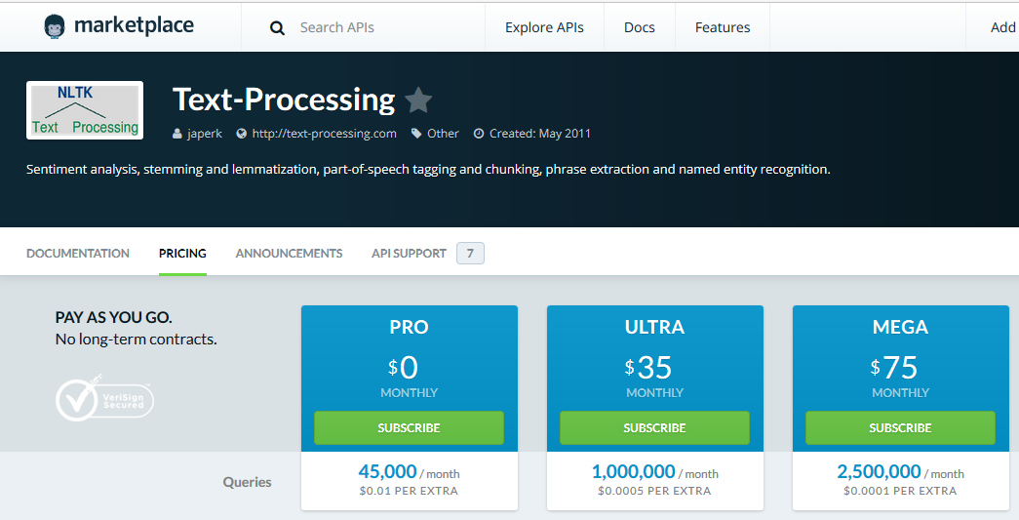
PRICING EXAMPLES

Slide 23
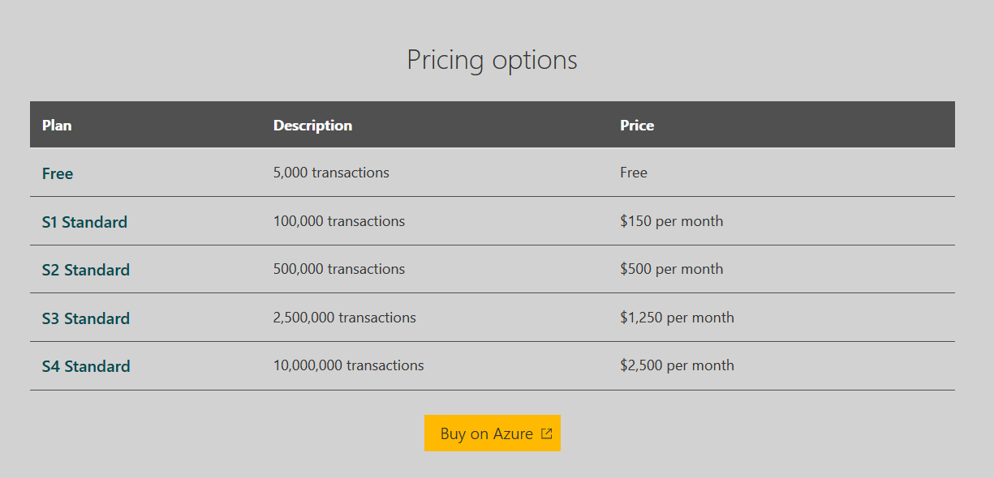
PRICING EXAMPLES

Slide 24
REVENUE STREAM
Several Sentiment analysis platforms charge the same price for every language they support. Thus we can assume the price for Arabizi to final customer should be similar as the one shown in pricing examples.

Slide 25
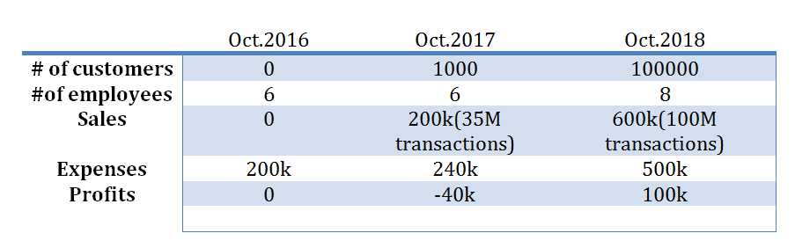
FINANCIAL PLAN

Slide 26
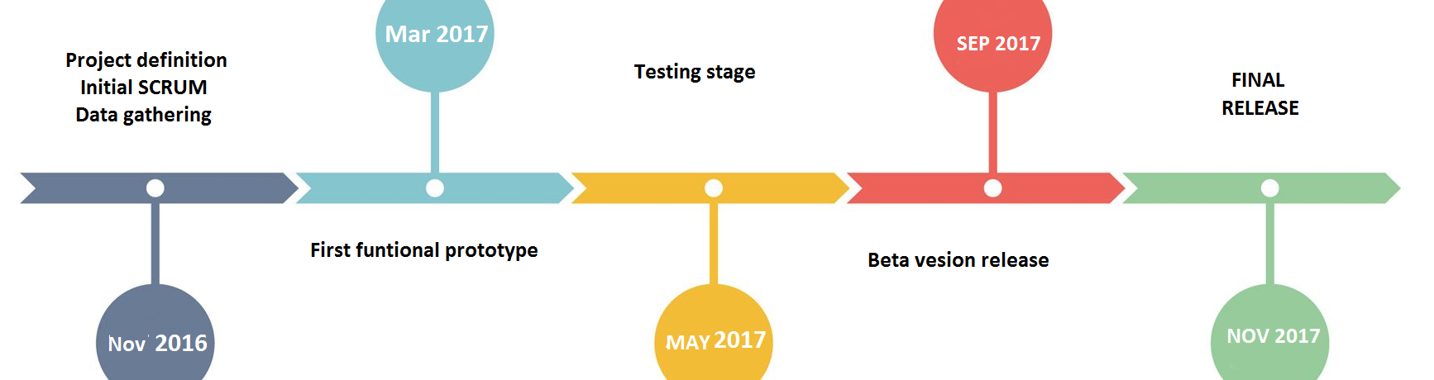
TIMELINE TO BUILD
Notes:
http://mashable.com/2010/04/19/sentiment-analysis/#3D7a1wVgmkq0

Slide 27
THANK YOU !

Slide 28
REVENUE STREAM
We can use english and microsoft pricing as references to calculate the value of arabizi.
54.4% of the web content is in English
25.9 % of users of the web speak English
0.8% of the web is written in Arabic
5% of users speak Arabic.

Slide 29
REVENUE STREAM
If we make the calculation by number of users :
100.000 transactions in english cost 150 dollars.
100.000 transactions in arabic should cost 30 dollars.
If we make the calculation by content on the web
100.000 transactions in english cost 150 dollars.
100.000 transactions in arabic should cost 2,23 dollars.

Slide 30
REVENUE STREAM
If we consider this simple calculations :
Value that a customer would be willing to pay for arabizi would be between 2 to 30 dollars per 100.000 sentences analyzed. If that price is proporcional to content available on the internet and the number of users. But it could be the same

