Slide 1
Day 1: From clinical question to evidence map
Research questions, study design, frameworks and literature in the AI age
Introduction to AI-Assisted Research Methods and Data Analysis
Adamu Onu · NexusHealth

Slide 2
Welcome
Over four days you will take one clinical observation all the way to an auditable mini research report.
Each day builds on the last
Day 1 Question, framework, literature
No coding experience needed
One continuous teaching case, then your own question
AI as an assistant you check, never an author you trust
Day 2 Data cleaning and description
Day 3 Testing and regression
Day 4 Reporting, discussion, capstone
Notes:
Introductions: name, role, one research question you have wondered about in clinic. Keep it to 30 seconds each.

Slide 3
The daily rhythm
Time | Block
08:30 to 10:00 | Block 1
10:00 to 10:15 | Break
10:15 to 11:45 | Block 2
11:45 to 12:45 | Lunch
12:45 to 14:15 | Block 3
14:15 to 14:30 | Break
14:30 to 16:00 | Block 4
Each block: a short demonstration, guided practice in pairs, then a debrief.

Slide 4
Ground rules
All course data are synthetic. The patients do not exist and the associations are simulated. Never cite them as clinical evidence.
Never paste identifiable patient data, confidential manuscripts or restricted full text into a public AI tool.
Follow your institution’s AI, data protection and copyright policies.
An AI-supplied citation is a task to verify, not evidence.
You are responsible for every source, decision and number you report.

Slide 5
How we use AI in this course
AI can help to | You must still
Suggest search terms and synonyms | Choose the final search and record it
Summarise sources you supplied | Check every claim against the exact passage
Explain or draft code | Run it, read it and check the output
Critique your wording | Decide what you actually found
Spot gaps in a plan | Own the design and the conclusions
Every meaningful use goes in your AI-use log.

Slide 6
Our teaching case
Among adults attending primary care, is higher medication adherence associated with lower systolic blood pressure, and with lower odds of uncontrolled blood pressure?
640 synthetic patients from four clinics
Adherence score 0 to 100%
Uncontrolled BP is defined for this course as SBP ≥ 140 or DBP ≥ 90 mmHg.

Slide 7
Block 1: Questions and hypotheses

Slide 8
From observation to question
A clinic observation
Questions to sharpen it
“My hypertensive patients who say they miss doses seem to have worse readings.”
Which patients?
Missing doses compared with what?
Which reading, measured how?
Is the aim to describe, compare, predict or explain?
This is a hunch. It is not yet answerable.

Slide 9
PICO and PECO
 | Intervention studies (PICO) | Exposure studies (PECO) | Teaching case
P | Population | Population | Adults attending primary care
I / E | Intervention | Exposure | Medication adherence score
C | Comparison | Comparator | Lower adherence (per 10 points)
O | Outcome | Outcome | SBP; course-defined uncontrolled BP
Use PECO when you observe an exposure rather than assign it. Most questions from routine clinical data are PECO questions.

Slide 10
Is it a good question? FINER
Letter | Ask yourself | Teaching case
Feasible | Data, time, skills, sample size? | Yes, existing records
Interesting | Does anyone care about the answer? | Adherence is modifiable
Novel | Does it add something? | Check the literature
Ethical | Risks, consent, governance? | Synthetic data, no risk
Relevant | Will it change practice or research? | Could inform adherence support
Revise your question at least once after a FINER check.

Slide 11
Hypotheses
A hypothesis restates the question as a claim that data can contradict.
H0 (null): among adults in primary care, mean SBP does not differ with adherence score, after accounting for age, sex, BMI, diabetes and smoking.
H1 (alternative): mean SBP does differ with adherence score.
Non-directional H1 (“differs”) is the usual default.
Directional H1 (“is lower”) needs a strong prior reason, stated before you see the data.
H0 and H1 must name the same population, exposure, comparison and outcome as the question.

Slide 12
Looking ahead: the estimand
The estimand is the exact quantity your study estimates.
The difference in mean SBP per 10-point higher adherence score, among patients with the same age, sex, BMI, diabetes and smoking status.
Writing it now stops you from choosing an analysis later just because it gives a “nice” p-value. We return to it on Day 3.

Slide 13
AI assist · Using AI to sharpen a question
I am a family physician. Here is my draft research question: [paste]. Using PECO and FINER, list what is vague or missing. Do not rewrite it for me; ask me questions instead.
Check before you accept a suggestion
Does it still answer your clinical question?
Is every element something you can actually measure in your data?
Did it introduce a claim about the literature? If so, verify it or delete it.

Slide 14
Exercise · Frame your clinical question
In pairs, 25 minutes
Write one clinical observation from your own practice.
Turn it into a PICO or PECO question.
Write H0 and H1. Check they match the question element by element.
Run a FINER check. Revise the question once and note what changed.
Done when: one question plus hypotheses that refer to the same population and contrast. Use the worksheet in the participant workbook.

Slide 15
Block 2: Design and frameworks

Slide 16
What each design can and cannot tell you
Design | Supports | Cannot support on its own
Case series | Description, hypothesis generation | Comparison, causation
Cross-sectional | Prevalence, associations at one time point | Which came first
Case-control | Associations for rare outcomes (odds ratios) | Incidence; prone to recall bias
Cohort | Incidence, temporal order, risk ratios | Freedom from confounding
Randomised trial | Causal effect of an assigned intervention | Generalisation beyond its population
Our teaching case is cross-sectional: adherence and BP are measured at the same visit.

Slide 17
Association is not causation
A cross-sectional link between adherence and BP could arise because:
adherence lowers BP (the causal story we might hope for)
high BP readings prompt doctors to stress adherence (reverse causation)
a third factor affects both (confounding)
the way patients entered the dataset links the two (selection)
adherence or BP is measured with error (measurement bias)
Your design decides which of these you can rule out. Your discussion must address the rest.

Slide 18
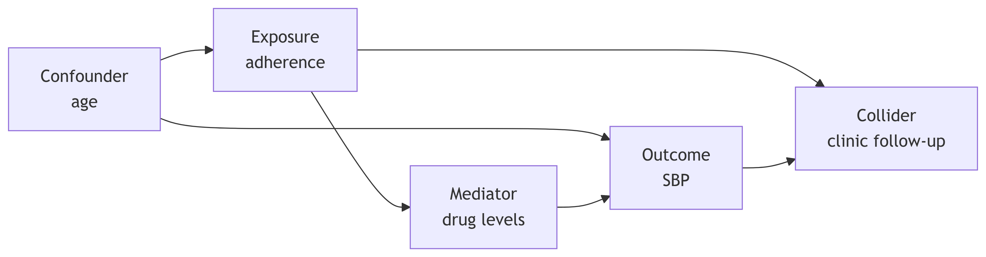
Variable roles
Confounder: causes both exposure and outcome. Adjust for it.
Mediator: on the path from exposure to outcome. Adjusting removes part of the effect you want.
Collider: caused by both. Adjusting or selecting on it creates false associations.

Slide 19
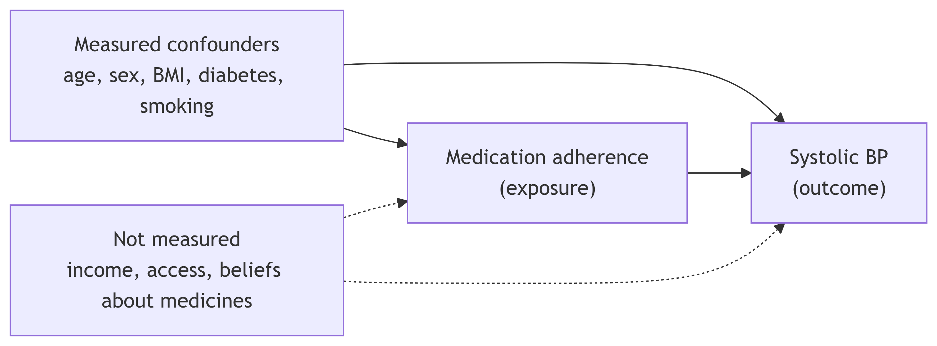
Teaching case variable map
Dashed lines are unmeasured constructs. Income and access could confound the association, and we cannot adjust for them.

Slide 20
Conceptual and theoretical frameworks
 | Conceptual framework | Theoretical framework
What it is | Your map of the variables and how you think they relate | An established theory that explains why
Source | Literature plus clinical reasoning | Published, tested theory
Used for | Choosing variables and adjustment sets | Interpreting findings; framing the discussion
Example | The variable map on the previous slide | COM-B model of behaviour
The framework links your literature review, your analysis and your discussion. Each source you read should map to a construct on it.

Slide 21
A theoretical lens: COM-B
Behaviour (taking medication) depends on Capability, Opportunity and Motivation.
COM-B construct | Example in adherence | Measured in our data?
Capability | Understanding the regimen, memory | No
Opportunity | Cost, pharmacy access, social support | No
Motivation | Beliefs about medicines, perceived need | No
Behaviour | Adherence score | Yes
We use COM-B to interpret findings. Our data do not test it. Never claim a mechanism you did not measure.

Slide 22
Exercise · Draw your variable and framework map
In pairs, 30 minutes
Place your exposure and outcome on a page.
Add at least two confounders, one mediator and one possible collider.
Mark each construct as measured or unmeasured.
Name one framework or theory that could help interpret your findings.
Write one explicit limitation that the map reveals.
Done when: a one-page map with measured and unmeasured constructs and one limitation.

Slide 23
Block 3: Searching and organising with Zotero

Slide 24
Literature review in the AI age
What has not changed
A reproducible search strategy, recorded as you go
Reading the actual sources
Judging quality and relevance yourself
What AI changes
Faster brainstorming of terms and synonyms
Faster first-pass summaries of sources you supply
New risks: invented references, confident misreadings, missing context

Slide 25
Build a search from concept blocks
Concept | Free-text terms | Controlled vocabulary (MeSH)
Adherence | adherence, compliance, persistence | Medication Adherence
Hypertension | hypertension, blood pressure | Hypertension; Blood Pressure
Setting | primary care, general practice, family medicine | Primary Health Care
Combine within a block with OR, and between blocks with AND:
("medication adherence"[MeSH] OR adherence OR compliance)
AND (hypertension[MeSH] OR "blood pressure")
AND ("primary health care"[MeSH] OR "primary care" OR "general practice")

Slide 26
Keep a search log
Date | Database | Search string | Limits | Results | Notes
2026-11-02 | PubMed | (see above) | 2015 onwards, English | 412 | Too broad; add study design filter
Record every search, including the ones that did not work.
Your log lets someone else rerun your search, and is required by most reporting guidelines.
Template: literature/search_log_template.csv

Slide 27
Zotero: your reference library
Install Zotero desktop and the Zotero Connector for your browser.
Make a collection for this project.
Save records with the browser button, or paste a DOI or PMID with Add Item by Identifier (the magic wand).
Check the metadata: authors, year, journal, volume, pages, DOI.
Attach the PDF where you have legal access.
Read in Zotero’s PDF reader. Highlight and annotate, then use Add Note from Annotations.
Use tags for framework constructs (for example COM-B:motivation).

Slide 28
Verify every record
An AI tool, a colleague’s slide or a reference list can all contain errors. Before a source enters your matrix:
Does the DOI or PMID resolve to this paper?
Do title, authors, year and journal match the publisher’s page?
Is it retracted or corrected? (Check the publisher page and Retraction Watch.)
Did you read the relevant passage yourself?
Mark each record’s status in the matrix: verified, pending, or rejected.

Slide 29
Exercise · Search and Zotero practicum
Individually, with a partner checking, 45 minutes
Build concept blocks for your question.
Run one search in PubMed and record it in the search log.
Import three relevant records into a Zotero collection.
Verify each record’s metadata against the source.
Annotate one PDF and create a note from the annotations.
Done when: a search log entry, three verified Zotero records and linked PDF notes.

Slide 30
Block 4: Source-grounded synthesis with NotebookLM

Slide 31
What a source-grounded tool does
NotebookLM (also available as notebooks inside the Gemini app on some accounts) answers questions using only the sources you upload, and shows citations to passages in them.
It is good at | It is not
Finding where your sources discuss a topic | A search engine for new literature
Comparing what several sources say | A judge of study quality
Drafting a first summary for you to check | Immune to misreading tables or numbers
Use it only if your institution allows it, and only with sources you are permitted to upload.

Slide 32
From Zotero to NotebookLM
There is no built-in link between the two, so we move files on purpose, keeping Zotero as the master record.
In Zotero, select your verified items, then drag their PDF attachments to a folder on your computer.
Optionally export your annotation notes as Markdown (right-click note, Export Note).
In NotebookLM, create a notebook for the project and add sources: upload the PDFs and notes.
Ask bounded questions (next slide). Click each citation to see the passage.
Copy findings into your literature matrix, with the page and passage, after you verify them.
Cite from Zotero, never from the AI output.

Slide 33
Ask bounded questions
Weak prompt | Bounded prompt
What does the literature say about adherence? | In each uploaded source, how was medication adherence measured? Quote the passage.
Summarise these papers. | For each source, give the population, design, sample size and main effect estimate with its CI, citing the page.
Is adherence linked to BP? | Which sources report an association between adherence and systolic BP? Give the exact numbers and the passage.
Bounded questions are easier to check, and harder for the tool to answer from thin air.

Slide 34
Five checks for every AI-supported claim
Check | Ask
Entity | Is this the right paper, population and variable?
Passage | Does the cited passage actually say this?
Context | Is it a main finding, a subgroup, a limitation, or someone else’s result being quoted?
Numbers | Do estimates, CIs and sample sizes match the table in the paper?
Record | Is the source in Zotero with verified metadata?
A claim that fails any check does not go in your matrix.

Slide 35
Literature matrix and annotated bibliography
Literature matrix (one row per source)
Annotated bibliography entry
Citation · design · population · exposure measure · outcome measure · main estimate (95% CI) · framework construct · quality notes · supporting passage and page · verification status
Full citation (from Zotero)
Two or three sentences on what was done and found
One sentence on strengths and limitations
One sentence on how it relates to your question and framework
Templates: literature/literature_matrix_template.csv and templates/Annotated_Bibliography_Template.docx.

Slide 36
Exercise · Build and audit a literature mini-set
In pairs, 50 minutes
Upload your three verified sources to a NotebookLM notebook (or use the printed excerpts if you have no access).
Ask three bounded questions.
Audit each answer with the five checks.
Complete three rows of the literature matrix.
Write one annotated bibliography entry.
Log your AI use.
Done when: three matrix rows, one annotated entry and a verification status for each claim.

Slide 37
Day 1 exit
You should now have:
a focused question with matched H0 and H1
a variable and framework map, with measured and unmeasured constructs
a search log and three verified Zotero records with notes
three verified matrix rows and one annotated bibliography entry
Before tomorrow: open notebooks/python/00_setup_and_orientation.ipynb (or the R version), choose the kernel and Run All. You are ready if it prints Setup check passed.

