Slide 1
Day 3: Estimation, comparison and regression
Confidence intervals, bivariate tests, linear and logistic regression
Introduction to AI-Assisted Research Methods and Data Analysis
Adamu Onu · NexusHealth

Slide 2
Where we are
You bring
Today you will produce
the analysis set (522 patients)
your framework map (which variables are confounders?)
your hypotheses
a bivariate comparison with an effect size and 95% CI
an adjusted linear model with a diagnostic note
an adjusted odds ratio and predicted probabilities

Slide 3
Block 1: Estimation and choosing a method

Slide 4
Start with the estimand
Among adults in primary care, how much does mean systolic BP differ per 10-point higher adherence score, among patients of the same age, sex, BMI, diabetes status and smoking status?
It fixes four things before any test is run:
the population (adults in primary care)
the contrast (per 10 points of adherence)
the outcome scale (mean SBP in mmHg)
the adjustment set (from the framework)

Slide 5
Confidence intervals and p-values
95% confidence interval
p-value
The range of values for the true effect that are reasonably compatible with the data.
How surprising the data would be if there were truly no effect.
It is not the probability that H0 is true, and it says nothing about the size of the effect.
Width shows precision. Narrow means precise, not important.
Always report the effect size with its 95% CI. Add the p-value if you like. Then judge clinical importance yourself.

Slide 6
Example: mean SBP
Mean SBP in the analysis set: 141.3 mmHg (95% CI 140.4 to 142.1; n = 522)
Estimate: 141.3
Standard error: SD / √n = 10.0 / √522 ≈ 0.44
95% CI: estimate ± about 2 standard errors
More patients means a smaller standard error, and so a narrower interval.

Slide 7
Choosing a method
Outcome | Exposure | Bivariate method | Effect measure | Model
Continuous | Two groups | Welch t-test | Difference in means | Linear regression
Continuous | Continuous | Correlation | Pearson r / Spearman ρ | Linear regression
Binary | Categories | Chi-square | Difference in proportions | Logistic regression
Binary | Continuous | (go straight to a model) | Odds ratio | Logistic regression

Slide 8
Exercise · Choose the method
Notebook 03, Part A. Individually, then compare, 20 minutes.
For each question name the outcome type, exposure type, bivariate method and effect measure:
Is mean BMI different between current and never smokers?
Does the proportion with uncontrolled BP differ between clinics?
Is adherence associated with uncontrolled BP after allowing for age and diabetes?
Then write H0, H1 and the effect measure for your own question.

Slide 9
Block 2: Bivariate analysis

Slide 10
Comparing two means: Welch t-test
Describe: group sizes, means, SDs.
Picture: a boxplot.
Estimate: the difference in means with 95% CI.
Test: Welch’s t-test (does not assume equal variances).
Diabetes | n | Mean SBP (SD)
No | 393 | 140.4 (10.1)
Yes | 129 | 143.7 (9.4)
Difference 3.3 mmHg (95% CI 1.4 to 5.2), p < 0.001. Clear statistically; modest clinically; unadjusted.

Slide 11
Comparing proportions: chi-square
Smoking | Controlled | Uncontrolled | % uncontrolled
Never | 80 | 189 | 70.3
Former | 57 | 104 | 64.6
Current | 27 | 65 | 70.7
χ² = 1.72, df = 2, p = 0.42. Smallest expected count 28.9 (all above 5, so the test is reliable).
A large p-value is not evidence of no difference. It means the data are compatible with a range of differences, including none.

Slide 12
Correlation
Adherence and SBP: Pearson r = -0.13 (p = 0.003)
r | Rough description
0 to 0.1 | Negligible
0.1 to 0.3 | Weak
0.3 to 0.5 | Moderate
above 0.5 | Strong
Weak: adherence explains under 2% of SBP variation.
Still potentially important at a population level.
Plot first. r only describes straight-line relationships.
Correlation cannot adjust for confounders.

Slide 13
Exercise · Defend a bivariate analysis
Notebook 03, Part B. In pairs, 60 minutes.
Exercise 3A part 1: SBP by diabetes. Summaries, boxplot, Welch test, difference with 95% CI.
Exercise 3A part 2: uncontrolled BP by diabetes. Cross-table, chi-square, difference in proportions.
Interpret each in one or two sentences, plus one limitation.
AI assist: ask Copilot to explain the test output line by line, then confirm which group was subtracted from which. Getting the direction wrong is a very common error.

Slide 14
Block 3: Linear regression

Slide 15
What linear regression estimates
SBP = intercept + b1 × adherence_10 + b2 × age + ... + error
b1: difference in mean SBP per 10-point higher adherence, among people with the same values of the other variables.
Categories are compared with a reference level (Female; Never smoker; no diabetes).
Adjust for confounders from your framework. Do not adjust for mediators or colliders.

Slide 16
Crude and adjusted
Model | Adherence (per 10 points), mmHg | 95% CI | p
Crude | -0.76 | -1.25 to -0.27 | 0.003
Adjusted | -1.01 | -1.49 to -0.53 | < 0.001
Adjusted for age, sex, BMI, diabetes and smoking; n = 522.
The estimate grew after adjustment. Something we adjusted for was masking part of the association (negative confounding). Adjustment can move an estimate in either direction.

Slide 17
Reading the other coefficients
Term | Estimate (mmHg) | 95% CI | Reads as
Age (per year) | 0.17 | 0.11 to 0.23 | Each year older: 0.17 mmHg higher
BMI (per kg/m²) | 0.28 | 0.11 to 0.45 | Each unit of BMI: 0.28 mmHg higher
Current smoker | 2.77 | 0.49 to 5.04 | Compared with never smokers
Male | 0.50 | -1.16 to 2.16 | Compared with females; CI includes 0
Report only what answers your question. The covariates are there to adjust, not to be interpreted one by one.

Slide 18
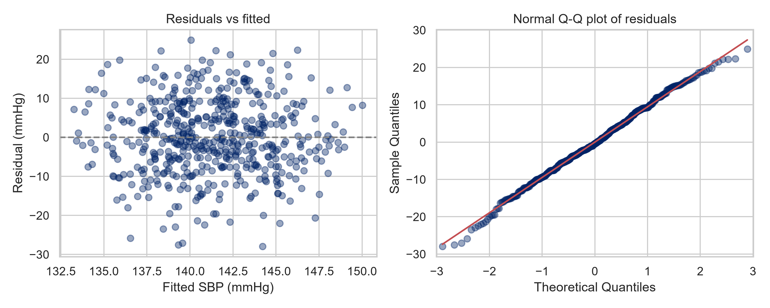
Check the assumptions
No funnel, no curve, Q-Q close to the line: the model looks reasonable. R² ≈ 0.11, so most SBP variation is unexplained, which is common.

Slide 19
Exercise · Fit, check and interpret a linear model
Notebook 03, Part C. In pairs, 60 minutes.
Fit the crude model and read the adherence coefficient.
Exercise 3B: fit the adjusted model; compare crude and adjusted estimates in a small table.
Make the diagnostic plots and write a two-sentence diagnostic note.
Interpret the adjusted estimate in one sentence a colleague could read.
Done when: two-model comparison, adjusted estimate with CI, diagnostic note.

Slide 20
Block 4: Logistic regression

Slide 21
Probability, odds and odds ratios
Scale | Definition | Example
Probability (risk) | Share with the outcome | 0.69
Odds | p / (1 - p) | 0.69 / 0.31 = 2.2
Odds ratio (OR) | Odds in one group ÷ odds in another | 0.81
Logistic regression models the log-odds. Exponentiate a coefficient to get an OR.
OR = 1: no association. OR < 1: lower odds. OR > 1: higher odds.

Slide 22
Odds are not risks
With a common outcome (69% here), the OR exaggerates the change in risk.
Adherence score | Average predicted probability of uncontrolled BP
40 | 78%
60 | 71%
80 | 62%
Adjusted OR per 10 points: 0.81 (95% CI 0.72 to 0.91). “19% lower odds” is correct. “19% lower risk” is wrong.
Use predicted probabilities when you want to talk about risk.

Slide 23
Exercise · Write a defensible logistic interpretation
Notebook 03, Part D. In pairs, 60 minutes.
Fit the crude and adjusted logistic models.
Exercise 3C: odds ratios with 95% CIs; average predicted probability at adherence 40, 60 and 80.
Write three sentences: the adjusted OR with its CI, what it means, and what the predicted probabilities add.
Save the model results for Day 4.
AI assist: ask your assistant to critique your three sentences for odds/risk confusion and causal language. Accept only changes you can justify.

Slide 24
Day 3 exit
You should now have:
the analysis choice, H0/H1 and effect measure for your question
a bivariate comparison with an effect size, 95% CI and limitation
crude and adjusted linear estimates with a diagnostic note
an adjusted OR, predicted probabilities and a three-sentence interpretation
outputs/tables/model_results.csv
Tomorrow: turn these into a reproducible report and a calibrated discussion.

