Slide 1
Day 4: Reproducible reporting, discussion and capstone
From results to an auditable mini research report
Introduction to AI-Assisted Research Methods and Data Analysis
Adamu Onu · NexusHealth

Slide 2
Where we are
You bring
Today you will produce
a question, framework and verified literature (Day 1)
a clean analysis set and cleaning log (Day 2)
bivariate and regression results (Day 3)
a notebook that regenerates everything
Table 1, a results table and a figure
a structured, calibrated discussion
your capstone package

Slide 3
Block 1: A reproducible workflow

Slide 4
What reproducible means
Someone else can regenerate every number, table and figure in your report from your files, without asking you anything.
Habit | Protects against
Restart and Run All | Hidden state from cells run out of order or deleted
Relative paths from the course folder | “File not found” on every other computer
Assertions | Silent changes when the data are updated
Outputs written by code | Copy-paste errors in tables and text
Session and AI-use records | Not knowing which versions or tools produced a result

Slide 5
Restart and Run All
Common failures
Fixes
A variable defined in a cell you later deleted
Cells that only work in a particular order
A file you created by hand and forgot
An absolute path like C:/Users/me/Desktop/...
Run from top to bottom, always
Every input file read by code from data/
Every output written by code to outputs/
Paths built from the course folder

Slide 6
Assertions: tests that stop the notebook
assert df["patient_id"].is_unique, "Duplicate patients in the analysis set"
assert df[MODEL_VARS].notna().all().all(), "Missing values in model variables"
stopifnot("Duplicate patients in the analysis set" = !anyDuplicated(df$patient_id))
When a new export arrives with a duplicate or an impossible value, you find out before you report it.

Slide 7
Exercise · Reproducibility audit
Notebook 04, Part A. In pairs, 50 minutes.
Open Notebooks 02 and 03. Restart, Run All. Fix anything that fails.
Confirm the analysis set still has the same number of patients and the same estimates.
Find one result that depends on something outside the notebook. How is it protected?
Run Part A of Notebook 04 and save the session information.
Update your AI-use log.
Done when: all notebooks run cleanly from a fresh start.

Slide 8
Block 2: Tables, figures and the report

Slide 9
Three outputs, three jobs
Output | Job | Contains
Table 1 | Describe who was studied | Characteristics overall and by outcome; no p-values
Table 2 | Answer the question | Crude and adjusted estimates with 95% CIs
Figure | Show size and uncertainty | Estimate on a readable scale with a confidence band
Use the reporting guideline for your design: STROBE for observational studies, CONSORT for trials (equator-network.org).

Slide 10
Table 1 principles
Mean (SD) for symmetric variables, median (IQR) for skewed ones, n (%) for categories.
State units and the denominator for each column.
Footnote missing data and definitions.
No p-values: Table 1 describes; it does not test.
Notebook 04 builds Table 1 in code and writes it to outputs/tables/table1.md.

Slide 11
Table 2: answer the question
Outcome | Effect measure | Crude (95% CI) | Adjusted (95% CI)
Systolic BP (mmHg) | Mean difference | -0.76 (-1.25 to -0.27) | -1.01 (-1.49 to -0.53)
Uncontrolled BP | Odds ratio | 0.85 (0.76 to 0.95) | 0.81 (0.72 to 0.91)
Per 10-point higher adherence; n = 522; adjusted for age, sex, BMI, diabetes and smoking.
The full adjusted models go in a supplementary table.

Slide 12
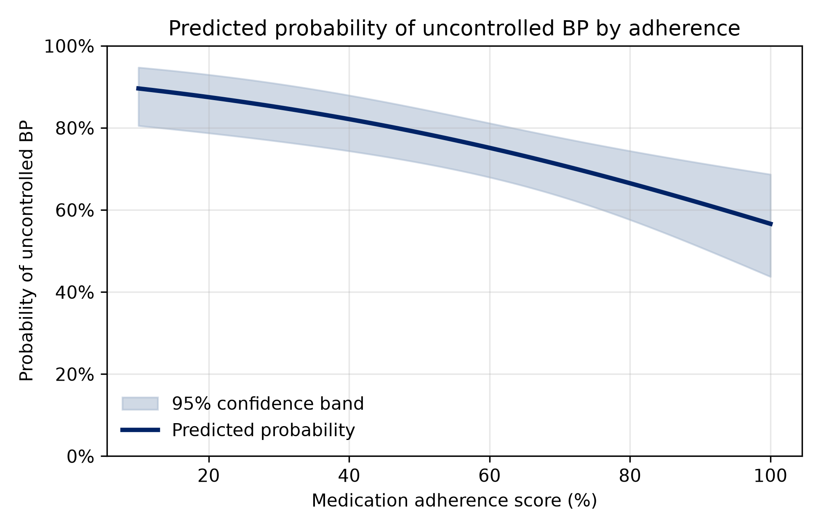
The main figure
Readable scale (probability), uncertainty shown, saved at 300 dpi, with a text description for readers who cannot see it. Do not rely on colour alone.

Slide 13
A report that writes its own numbers
Notebook 04 writes:
The report reports/mini_report.qmd reads them:
Table 1 and Table 2 as Markdown files in outputs/tables/
the figure as a PNG in outputs/figures/
the key numbers in reports/_variables.yml
The adjusted odds ratio was
{{< var log_adj >}} per 10 points.
Quarto renders it to HTML and Word. Change the data, rerun, re-render: every number updates.

Slide 14
Exercise · Rewrite weak results prose
“Adherence was highly significant (p<0.001) for blood pressure, proving that taking medication lowers BP. Patients with good adherence had 19% less uncontrolled BP.”
In pairs, 15 minutes. List what is wrong, then rewrite it in two or three sentences using your Table 2.
Hints: effect size? CI? causal words? odds or risk? what is “good”? what was adjusted for?

Slide 15
Exercise · Results pack practicum
Notebook 04, Part B. In pairs, 60 minutes.
Refit the models. Build Table 1, Table 2 and the supplementary table.
Make the main figure and its text description.
Write the report files and render mini_report.qmd to HTML and Word.
Open the HTML and check that every number matches your notebook.
Done when: a concise results paragraph and regenerated report files.

Slide 16
Block 3: Structured discussion

Slide 17
Five parts: D, L, F, A, R
Label | Part | Question
D | Direct answer | What did we find, with the main estimate?
L | Literature | How does it compare with our verified sources, and why might it differ?
F | Framework | What does our framework suggest it means? What did we not measure?
A | Alternatives and limitations | Confounding, selection, measurement, missing data: direction and size
R | Recommendation | What should practice or the next study do, given this strength of evidence?
Draft in the discussion matrix first, then write prose.

Slide 18
Linking back to Day 1
Literature (L)
Framework (F)
Use only rows from your verified literature matrix. Compare:
COM-B example: our adherence score measures behaviour. We did not measure capability, opportunity or motivation, so we can discuss them as possible explanations but not claim them as mechanisms.
population and setting
how adherence was measured
design and adjustment
size of the estimate, not just its direction

Slide 19
Limitations with direction
Limitation | Likely effect | What would help
Cross-sectional design | Cannot separate cause from reverse causation | Cohort with adherence measured first
Self-reported adherence | Overstatement would likely weaken the association | Pharmacy refill data
Single BP reading | Random error widens CIs; regression to the mean | Repeated or ambulatory BP
Unmeasured confounding (income, access) | Direction uncertain | Measure them; sensitivity analysis
Complete-case analysis (18% excluded) | Less precision; bias if MNAR | Multiple imputation
A good limitation names the problem, its likely direction and a fix.

Slide 20
Calibrate your language
Overclaims | Calibrated
Adherence reduces BP | Higher adherence was associated with lower BP
Proves / confirms | Is consistent with / supports
No effect of smoking | No clear association; the CI was wide
19% lower risk | 19% lower odds; predicted risk fell from 78% to 62%

Slide 21
The claim and evidence audit
For each factual sentence in your discussion, record the evidence:
Claim | Evidence | Status
Adjusted OR 0.81 (0.72 to 0.91) | Notebook 04, Table 2 | Verified
Similar to [study X] | Matrix row 2, p. 5, Table 3 | Verified
Adherence improves with reminders | None found | Delete or soften
AI may critique your wording. It may not supply references, numbers or claims you have not checked.

Slide 22
Exercise · Discussion matrix and claim audit
In teams, 60 minutes.
Complete the discussion matrix: one cell each for D, L, F, A, R.
Write the discussion in labelled paragraphs (D/L/F/A/R).
Run the claim and evidence audit. Fix every claim marked none.
Swap with another team and check one paragraph each.

Slide 23
Block 4: Capstone and feedback

Slide 24
The capstone brief
In teams of two or three, using the synthetic dataset (or an approved equivalent), submit:
question and hypotheses, with framework map
three verified literature-matrix entries and one annotated bibliography entry
cleaning decisions and the analysis-set flow
Table 1, one main results table and one figure
a D/L/F/A/R discussion
an AI-use and verification disclosure
the notebook and all files needed to regenerate the outputs

Slide 25
Capstone rubric
Criterion | Weight | Full-credit evidence
Question and framework | 15 | Focused question, matched hypotheses, coherent map, explicit inference boundary
Literature | 15 | Traceable search, verified sources, accurate source-to-claim links
Data and analysis | 25 | Documented cleaning, suitable models, diagnostics, missing-data decision
Results and discussion | 25 | Accurate estimates and CIs, clear table and figure, proportionate interpretation
Reproducibility and AI use | 20 | Run All succeeds, outputs regenerate, disclosure and verification record
90 to 100 exemplary · 75 to 89 secure · 60 to 74 developing · below 60 incomplete

Slide 26
Peer review protocol
15 minutes per team, using the rubric
Run it: Restart and Run All on the other team’s notebook. Does it finish?
Trace it: pick two numbers in their report. Can you find where each is produced?
Check it: pick one literature claim. Does the matrix passage support it?
Read it: is the discussion calibrated? Any causal or odds/risk slips?
Feed back: one strength, one thing to fix, one question.

Slide 27
Handover
Notebook 04 checks that the package is complete and writes outputs/handover_manifest.csv.
Before you submit:
☐ Restart and Run All succeeds
☐ The report renders and every number matches the notebook
☐ Every literature claim links to a verified source
☐ The AI-use log is complete
☐ No identifiable or confidential data anywhere in the package

Slide 28
Where next
Learn multiple imputation before using complete-case analysis in a real study.
Learn directed acyclic graphs (DAGs) to choose adjustment sets more formally.
Read the STROBE checklist before your next observational analysis.
Ask a statistician to review your analysis plan before you collect or extract data.
Keep practising with your own question: the notebooks are templates you can adapt.
Thank you.

