Slide 1

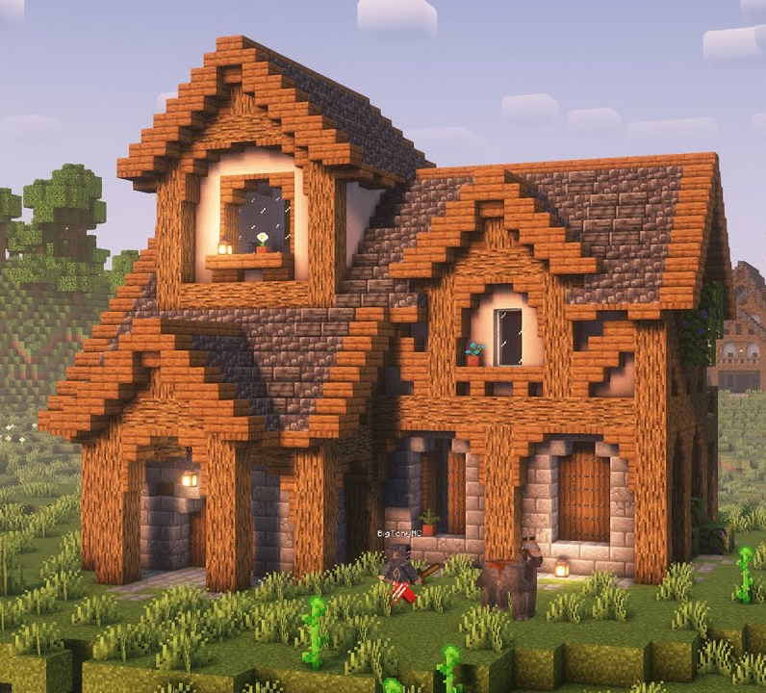
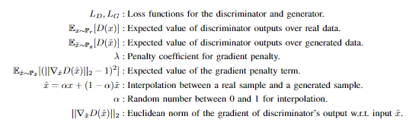
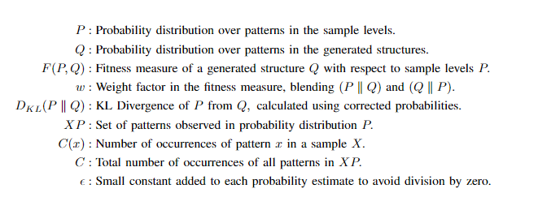





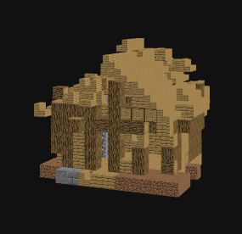
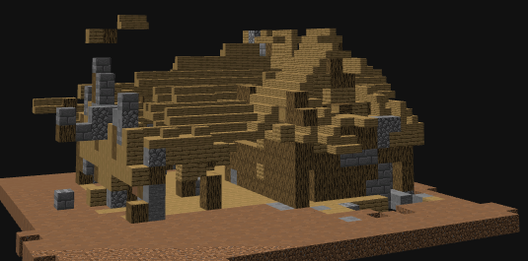
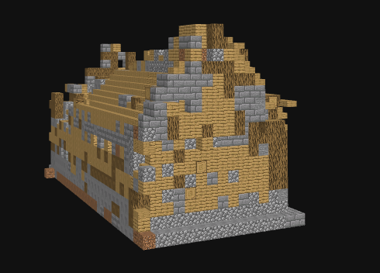
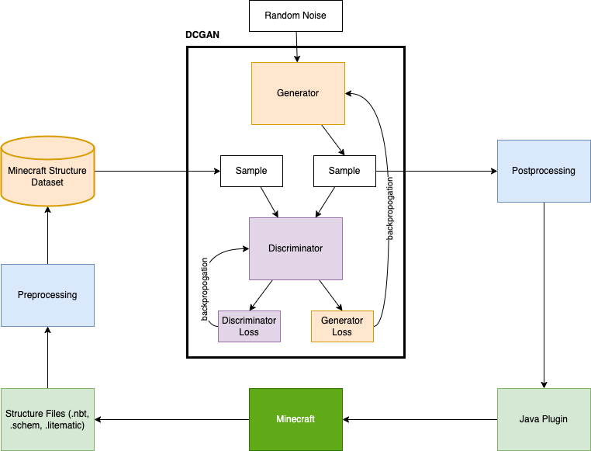

Leveraging Deep Convolutional Generative Adversarial Networks
for Minecraft Structure Generation
Adam Bullard, Wesley Deneke
Western Washington University
Objective
Design Criteria
Evaluation
Develop a DCGAN to generate Minecraft structures. These structures are intended to mimic complex and aesthetically pleasing designs that are usually built by human players. Make this tool publicly available for players to create structures that can be imported into any Minecraft virtual world.
Generate a variety of structures that are not only diverse and visually appealing, but also adhere to architectural styles prevalent in Minecraft.
The structures generated should be realistic within the game’s context, utilizing correct spatial relationships and Minecraft’s block aesthetics.
Utilize existing .schem file architecture for easily previewing and exporting generated structures to Minecraft from a publicly accessible website.
Use embeddings to capture complex relationships between blocks.
To validate our model’s performance, we employed both qualitative feedback as well as KL Divergence quantitative analysis adapted to 3D evaluation.
User Study: Ongoing. A survey is available to take on our website!
Cubic Pattern KL Divergence: A method extended from Tile Pattern KL Divergence used in past work [3] in 2D game levels. We extended this work into a 3D voxel space by comparing the occurrences of 3D patterns between dataset and generated structures to measure structural differences.
Figure 1. Example of a player-built house in a Minecraft world. Minecraft features a variety of terrain generators and simple village generation but does not attempt to generate houses with the level of detail featured here.
Figure 3. Wasserstein GAN loss functions.
Motivation
- Minecraft not only allows players to build structures but also has many official and player-created tools for building easily, such as WorldEdit.
- Automated tools for building can enhance player experience and creativity by providing pre-built structures as starting points or inspiration.
- Minecraft has a long history of importing structures from outside sources, giving the opportunity to integrate more advanced automated generation.
- Leveraging DCGANs introduces the potential for producing varied and complex structures automatically, which can significantly enrich the game environment and reduce the effort required from players.
Figure 4. Embedding contrastive loss function.
Figure 5. Heatmap of KL Divergence results between our models, and an overview of the math used to evaluate a given model against the dataset.
Each cell in the heatmap is an F(P,Q) for a model, w value, and pattern dim.
Implementation
DCGAN Network: Tailored to 3D voxel data, our system utilizes two generator and discriminator neural networks with deep convolutions They train in a loop: generate new structures, then discriminate between real and generated structures, using Wasserstein loss [1] with gradient penalty (See Figure 3).
Regional Attention: This feature present on some of our models allows the network to focus on and weigh the importance of specific areas of the generated structure or during the discriminator’s training process.
Block Embeddings: High-dimension representations of Minecraft blocks that can be given to the DCGAN as an alternative to one-hot vectors, bringing discrete blocks into a continuous space. Embeddings are outputs of a model trained with contrastive loss [2] on our structure dataset (See Figure 4).
Public Access: Visitors to our website can view and generate new samples from our different models in an interactive 3D window, download a .schem of outputs, as well as view other information like KL Divergence rankings.
E-DCGAN
ERA-DCGAN
RA-DCGAN
Figure 6. Examples from our models. E=embeddings, RA=regional attention
Future Work
Figure 2. An overview of our DCGAN training architecture.
Expansion of the training dataset is crucial to improve outputs, such as experimenting with further data augmentation, or a solution for dynamically sized inputs and outputs. Also, labeling a dataset would allow for conditional generator outputs.
Increased model complexity, adjustments to the training regimen, or architecture changes to increase global output quality.
Visit the website to learn more
References
I. Gulrajani, F. Ahmed, M. Arjovsky, V. Dumoulin, and A. Courville, “Improved Training of Wasserstein GANs,” arXiv, 2017. [Online]. Available:https://arxiv.org/pdf/1704.00028
T. Gao, X. Yao, and D. Chen, ``SimCSE: Simple Contrastive Learning of Sentence Embeddings,'' arXiv, 2021. [Online]. Available: https://arxiv.org/abs/2104.08821
S.M. Lucas and V. Volz, ``Tile Pattern KL-Divergence for Analysing and Evolving Game Levels,'' in Proceedings of the Genetic and Evolutionary Computation Conference (GECCO '19)}, July 13--17, 2019, Prague, Czech Republic. ACM, New York, NY, USA, 9 pages. [Online]. Available: https://doi.org/10.1145/3321707.3321781

