Slide 1
Average Fitness: 430.41576456669367

Slide 2
Average Fitness: 430.41576456669367

Slide 3
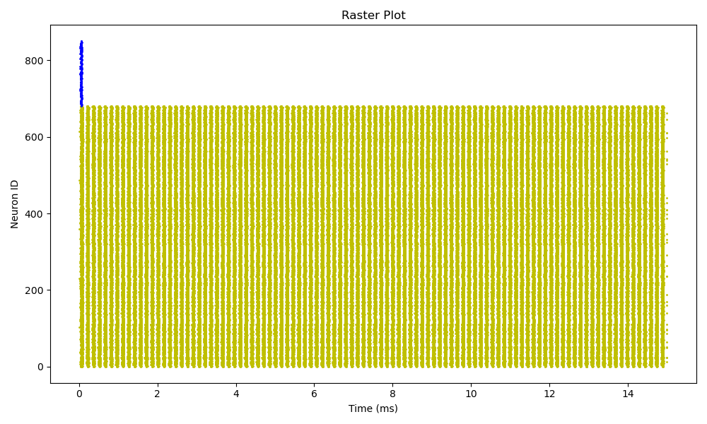
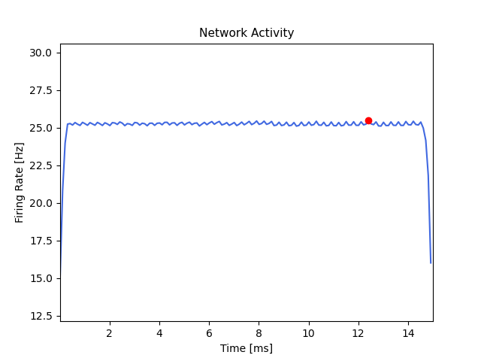
Average Fitness: 430.41576456669367

