Slide 1
Grade Marking System
For Software Engineer and Workshop III
April
Weng Minghong, Qin Luyin, Hu Yunpei, Hong Yuan

Slide 2
Outline
Software Engineer
Techniques, Models and Methods.
Promote the System
Main features
Benefits from using the software
User-friendliness
Demo

Slide 3
Software Engineer
---- Weng Minghong

Slide 4
Software Process Models(The Waterfall Model )
Analysis
Design
Software Architectures
Coding
Source Code
Test
Software Specifications (FBIP)

Slide 5
Design System Flow
Requirements Definition
System and software design
Implementation
(Coding)
Testing
Software Requirement Specification
Architecture Design
Detailed Design
Unit Testing
(System)
Test Plan and Report

Slide 6
Software Requirement Specification(SRS)
Purpose: Specific User Requirements for developer
Use Case Diagrams
State Machine Model
User Interface(demo)

Slide 7
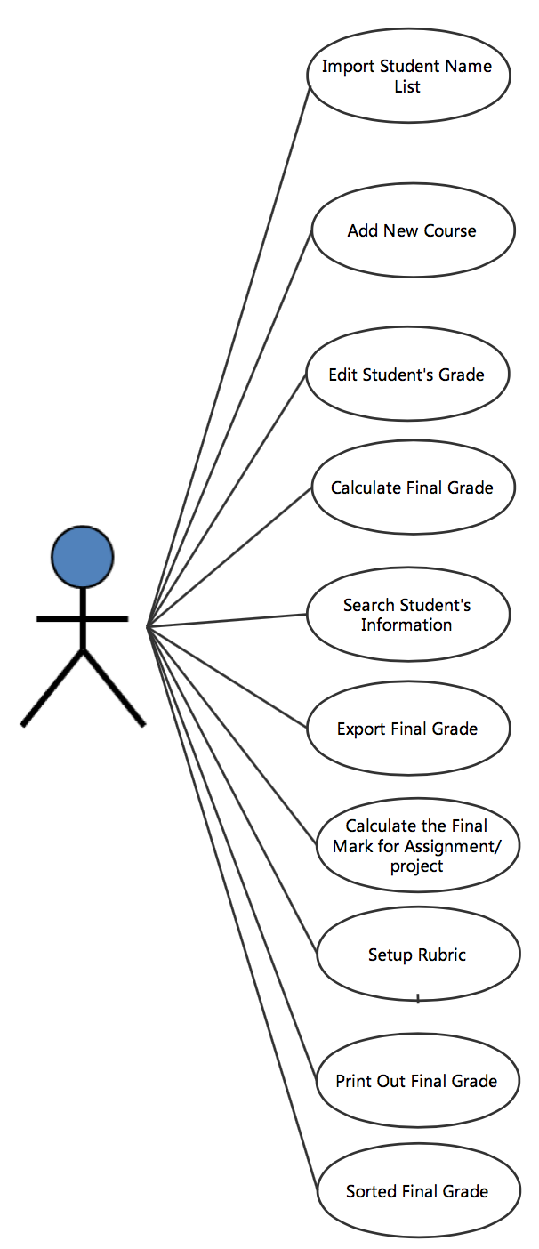
Use Case Diagrams
The role of the users (Only One)
Describe the Main Function
Less Is More.

Slide 8
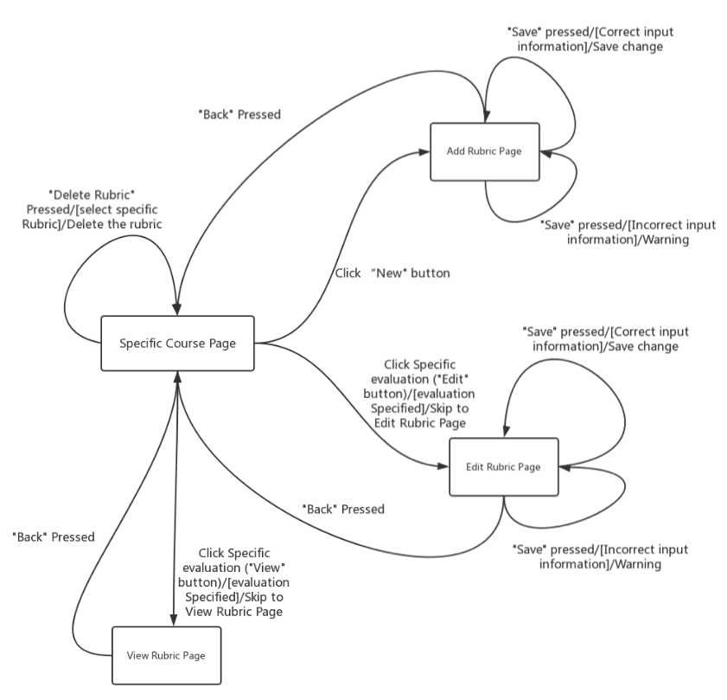
State Machine Model

Slide 9
State Machine Model (Sample)
State: In Specific Course Page
Event: “Delete Rubric” Pressed
Condition: Select Specific Rubric
Action: Delete the Rubric
Specific Course Page
“Delete Rubric” Pressed/
[select specific rubric]
/Delete the rubric

Slide 10
Architecture Design
Purpose: Virtualize the project which makes it simple and clear.
Technologies:
Decompose System Into Manageable Parts —— Subsystem
Identify Subsystems and Establish Relationships Between the Subsystems
Class diagrams
Sequence Diagrams

Slide 11
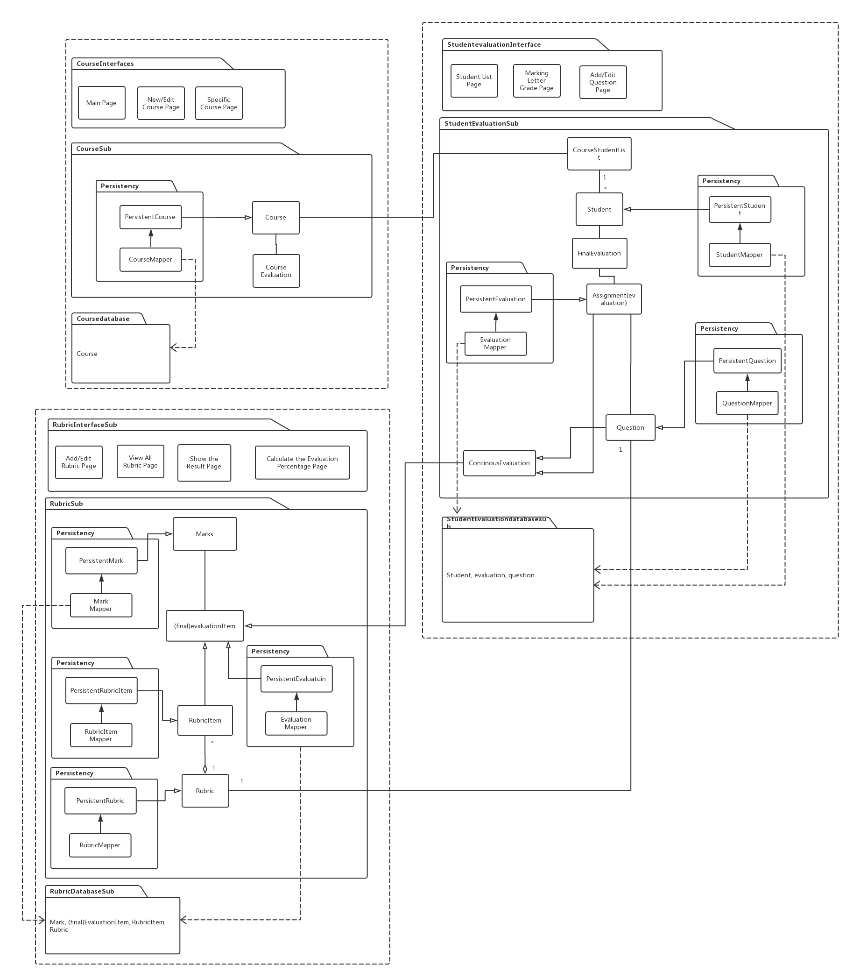

Slide 12
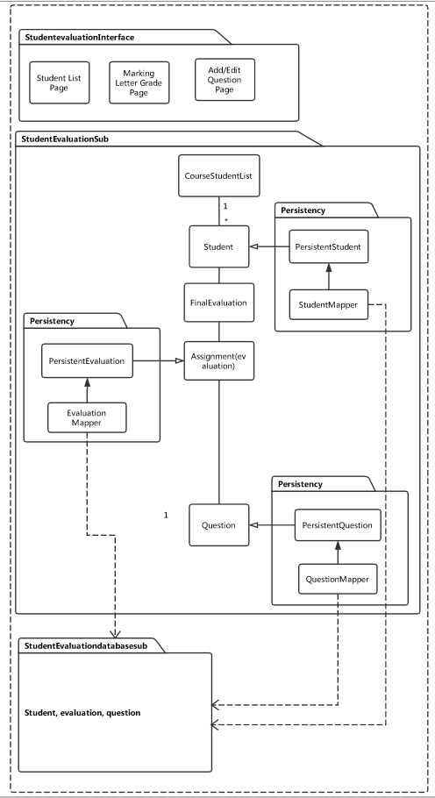
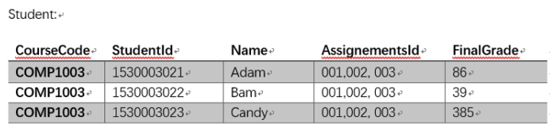
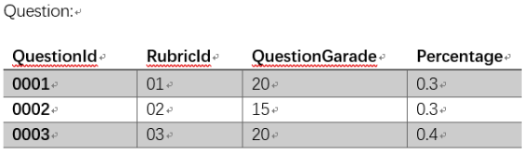
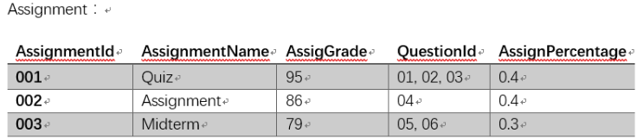
Student List Subsystem (Sample)
Interface
Application Logic
Storage

Slide 13
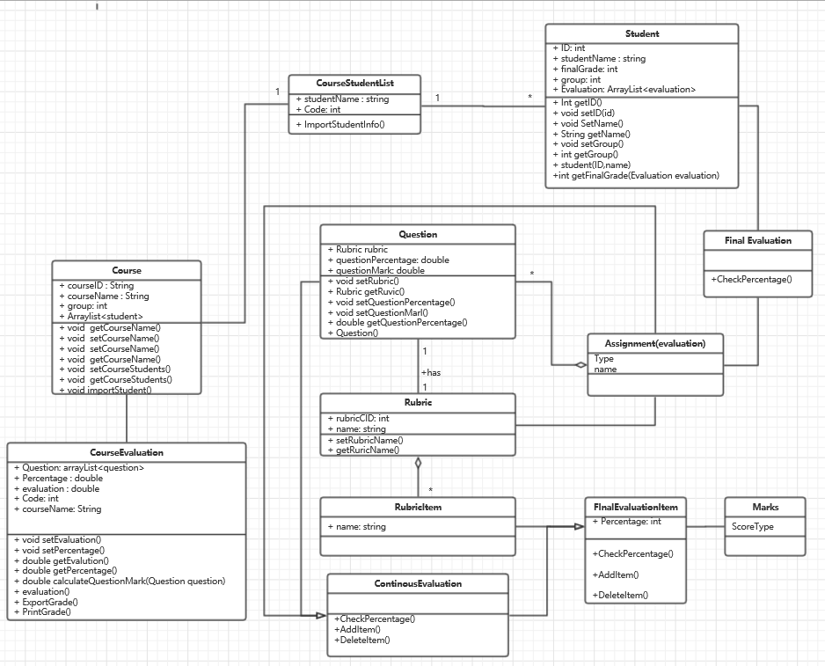
Class Diagrams

Slide 14
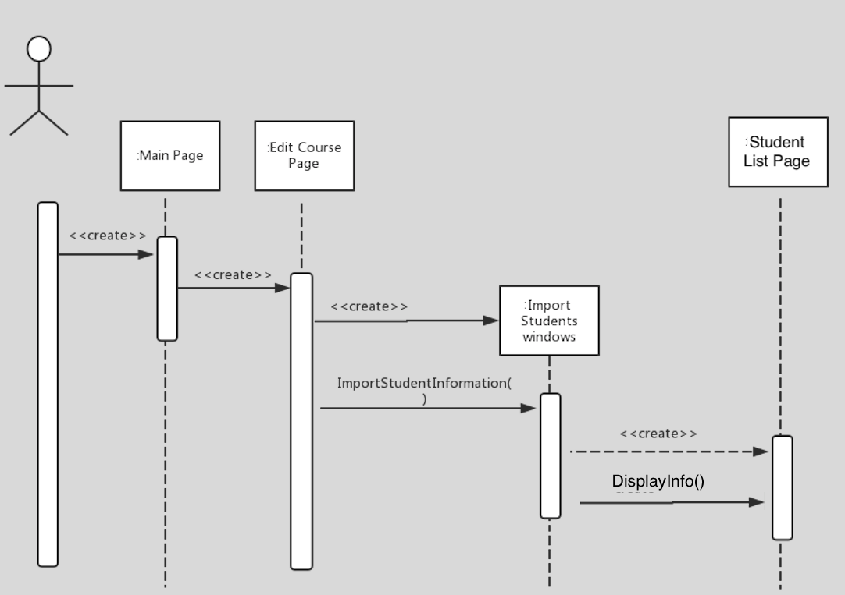
Sequence Diagrams

Slide 15
Detailed Design
Purpose: Identifying Missing things for coders.
Work: More attributes and Operations.
Last Documents before coding.

Slide 16



Techniques
Database Management Tool
Version Control Software
GUI Tool

Slide 17
Testing
Hu Yunpei

Slide 18
The category of our testing is Black-box Testing
The test case will be generated base on the requirements from customer, ignore what the program did in running.
What we concerned in these tests are functionality and features, or we can realize this as standing on the position of users.
Testing levels
(basic) Unit testing → Integration testing → System testing → Regression testing (Advanced)
Our test is a System Testing
In Testing methods
A Dynamic Testing. Which means we will exactly run the program in the test.(Think it as a Test Run).

Slide 19
Feature
Simple and Clear
Easy to operate
Data stored in the database
Not easy to lose data and easy to modify in the future.

Slide 20
Instruction
Login
import
Input id and password to login
Set Rubric
Set rubric for each item, such as a score item
Import student information excel
Set Course
Set a course and set score item for each course

Slide 21
Detailed Instruction Import student list
Login
Choose file
Import
After login this system, user can choose an excel file which contains student information to import into this system.
Users import an excel file then click “Save” to submit.

Slide 22
Detailed Instruction Set Course
Choose specific course
Set course
Add new course
Set specific score items for this course
(such as quiz…)

Slide 23
Detailed Instruction Set Course
Set item’s name of each course
(like Quiz…)
Set weight of this item
Set questions for this item
Set weight of the Question

Slide 24
Detailed Instruction Set Rubric
Rubric is Corresponding to Each Questions.
Set Different evaluation item Name for each question
Set weight for each evaluation item

Slide 25
Feature
Simple and Clear.
Easy to Operate.
Data stored in the database.
Not easy to lose and easy to modify in the future.

Slide 26
Why you should use our system?

Slide 27
Traditional method(Isapce)
Set Rubric for Each Question
Calculate the Grade of an Items by Users
Calculate the Grade of the Course by Users

Slide 28
The main drawback of Isapce
Set Rubric for Each Question
Calculate Each Grade for Course

Slide 29
Why Choose Us?
Import Student List
Set Rubric
Marking Grade
Output the Result!

Slide 30
Always Be
clear
Use it Everywhere
easy
efficiency

Slide 31
Demo
Judy has a Course, which name workshop1.
It only have one quiz and one final exam, quiz for 30%, final exam for 70%.
Quiz have one 1 question, final exam have 2 questions which each of them takes up 50%.

Slide 32
Thanks.

