Slide 1

Trunking 101
Radio Technology Presentation
July 13, 2007
Rey Freeman, GeoComm

Slide 2
Presentation Agenda
Trunking Radio Systems “101”
  Trunked radio vs. conventional radio systems
Simulcast transmitting technology
Voting receiver system technology
Digital vs. analog modulation technology

Slide 3
“Trunking 101”
Central
Controller

Slide 4
What is “Trunking” ?
It is NOT a term that “belongs” to Motorola, Ma/Com, or any other manufacturer
It is NOT a term exclusively for radio systems
It IS a generic term used to describe:
“The sharing of a limited number of communications paths (or Trunks) among Many Users”

Slide 5
Conventional vs. Trunked
Conventional Radio (repeater) system:
  Uses a dedicated radio frequency for each radio channel in a system (unless sharing a channel)
  A Channel = a Frequency (I.e., 154.235 Mhz is County Fire)
  Each frequency is assigned to a group of users

Slide 6
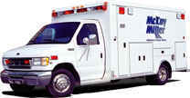
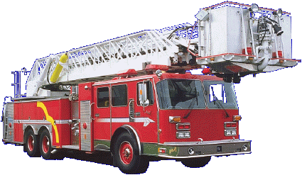

FD
TX
RX
Fire Channel
154.235 Mhz
TX
EMS
RX
EMS Channel
155.340
PD
TX
RX
Law Repeater Channel 155.625 Mhz

Slide 7
FD
TX
TX
RX
EMS
RX
Fire Channel
154.235 Mhz
EMS Channel
155.340
X
??
PD2
PD1
TX
RX
Law Repeater Channel 155.625 Mhz

Slide 8
Your Bank Tellers – as “Conventional”
Queue
by
Account
PD
Admin
EMS
PW
Fire
PD
EMS
FD
PD
FD

Slide 9
Conventional vs. Trunked
Conventional Radio (base or repeater) system:
  A Channel = a Frequency
  If a channel is in use, radio user must wait in “queue” before being able to transmit on the system
  …and a new frequency must be obtained each time another “channel” is needed in the radio system
  The system is limited by the number of frequencies in the system…

Slide 10
Trunked Radio Systems
Central
Controller

Slide 11
Conventional vs. Trunked
Trunked Radio (repeater) system:
  Uses a group of similar radio frequencies to create a “pool” for radio system users to access
  Systems can be built using VHF, UHF or 800 Mhz
  A Channel is NOT a Frequency…(generally)
  A Channel (on your radio) is now a computer-generated code
  …and are now referred to as “Talk Groups”

Slide 12
Conventional vs. Trunked
Trunked Radio (repeater) system:
  The entire system is managed by a computer, often referred to as the “Central Controller”
  All radios in the system also are computer-controlled, and communicate to the central controller via one frequency known as the “Control Channel”

Slide 13
Basic Trunking Diagram
PD
EMS
FD
TX
TX
TX
TX
TX
RX
RX
RX
RX
RX
CH 1
CH 2
CH 3
CH 4
CH 28
Control
Channel
Central
Controller
1 to 28 Channels

Slide 14
Your Bank Tellers – as “Trunked”
Queue
by
First
Available
Teller
Director
CH 2
CH 3
CH 4
CH 5
PD
EMS
FD
PD
FD
IN

Slide 15
Conventional vs. Trunked
Trunked Radio Benefits:
  Greatly improved usage of scarce radio frequencies
  Greater overall radio system flexibility, including:
    Channel (Talk Group) capabilities
    Various user features, including Emergency Alarm, PTT ID, Channel Regrouping, Call Alert, and Radio Inhibit
  Brings radio users together on a common radio system
  Consistency in radio coverage

Slide 16
So How Does It Work?

Slide 17
Control Channel continuously transmits system data to all radios
PD
FD
EMS
TX
TX
TX
TX
TX
RX
RX
RX
RX
RX
CH 1
CH 2
CH 3
CH 4
CH 28
Control
Channel
Central
Controller

Slide 18
Radio user presses TX button, and radio information is sent via control channel to Central Controller
FD
TX
TX
TX
TX
TX
RX
RX
RX
RX
RX
CH 1
CH 2
CH 3
CH 4
CH 28
Control
Channel
Central
Controller

Slide 19
Central Controller processes inbound request, and sends repeater channel command (CH 3) back to all radios selected on same Talk Group
FD
FD
TX
TX
TX
TX
TX
RX
RX
RX
RX
RX
CH 1
CH 2
CH 3
CH 4
CH 28
Control
Channel
Central
Controller

Slide 20
Originating radio user’s radio automatically switches to correct voice channel and begins transmitting; All radios selected on same Talk Group do the same and hear the voice transmission
FD
FD
TX
TX
TX
TX
TX
RX
RX
RX
RX
RX
CH 1
CH 2
CH 3
CH 4
CH 28
Control
Channel
Central
Controller

Slide 21
When transmission is completed, all units revert back to Control Channel
FD
FD
TX
TX
TX
TX
TX
RX
RX
RX
RX
RX
CH 1
CH 2
CH 3
CH 4
CH 28
Control
Channel
Central
Controller

Slide 22
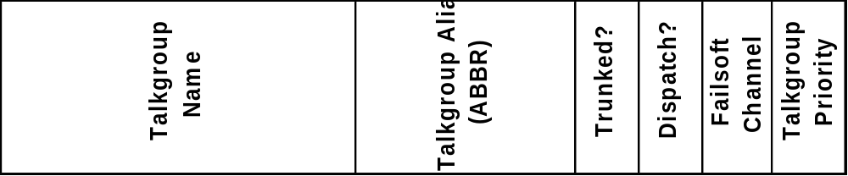
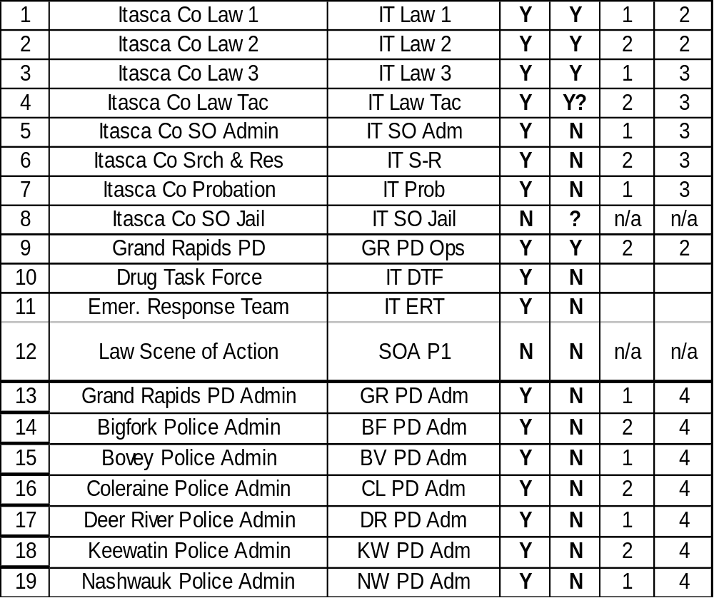
Radio System Fleetmapping:
Radio “channels” are now called “Talk Groups”
(Law Enforcement shown here)

Slide 23
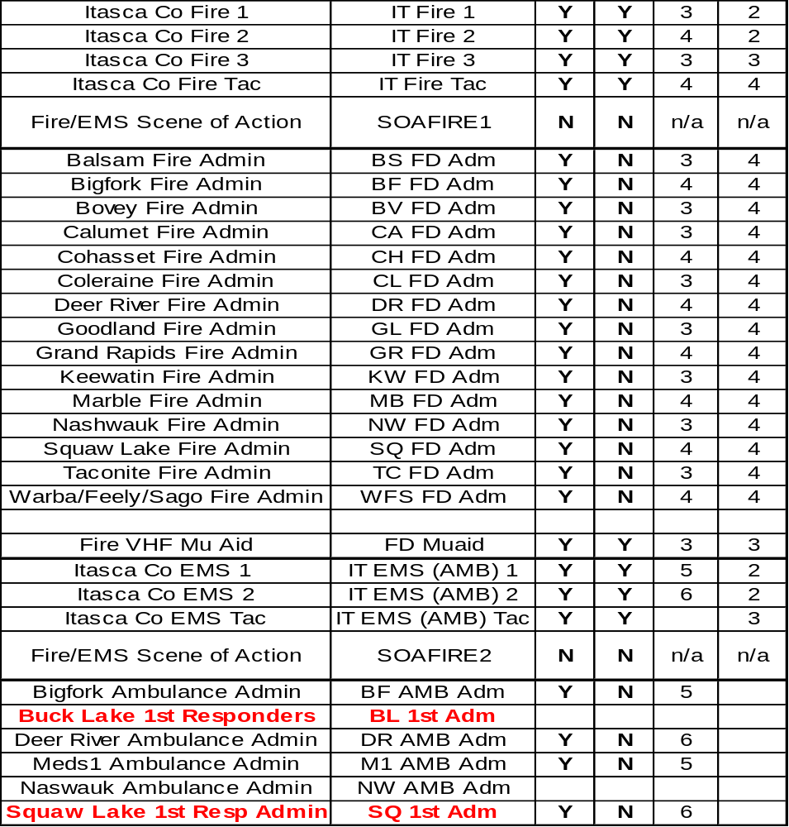
Fire & EMS Talk Groups

Slide 24
Questions…so far?

Slide 25
Simulcast Transmitting Systems
Simulcast Transmitting is defined as:
  A radio system where the same radio frequencies are Simultaneously Broadcast from all tower sites within the radio system
  This allows same radio frequencies to be used throughout the entire coverage area

Slide 26
Simulcast Transmitting Systems
Simulcast Benefits:
  Seamless communications throughout the radio system’s coverage area
  Improved radio frequency utilization
  Improved coverage in areas with difficult terrain
  Improved in-building coverage (signals in overlap zones are “additive”)

Slide 27
Simulcast Transmitting Systems
Simulcast “cons”:
  Not inexpensive technology
  Tower site spacing is critical (especially when using NPSPAC frequencies)
  Signal “timing” is critical between all sites
  Tower site interconnection (microwave, T1, etc.) is also critical and can be expensive

Slide 28
Simulcast Transmitting Systems
Site 1
Site 2
f
f
f
f
f
1
2
3
4
5
f
f
f
f
f
1
2
3
4
5
f
f
f
f
f
1
2
3
4
5
Site 3

Slide 29
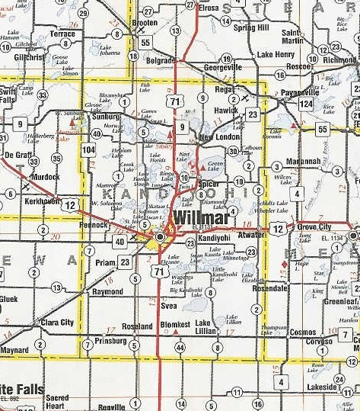
Kandiyohi Co MN – with Simulcast
f
f
f
f
f
1
2
3
4
5
f
f
f
f
f
1
2
3
4
5

Slide 30
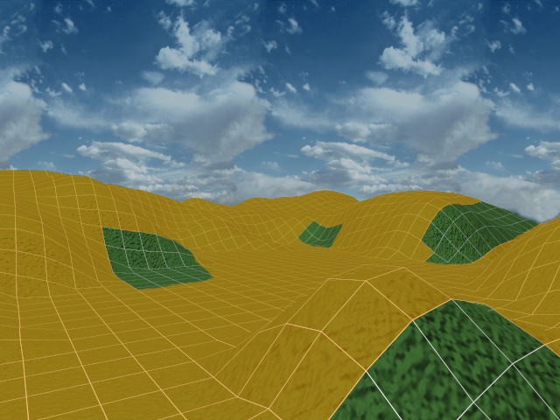

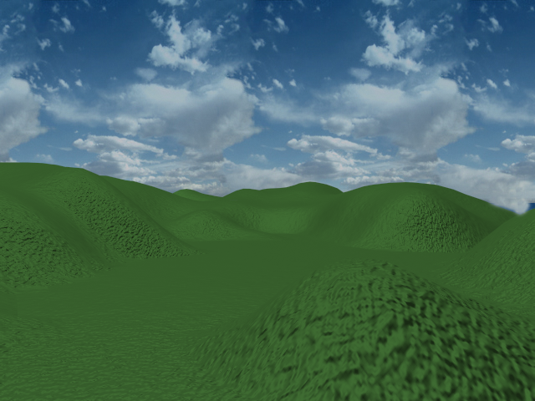
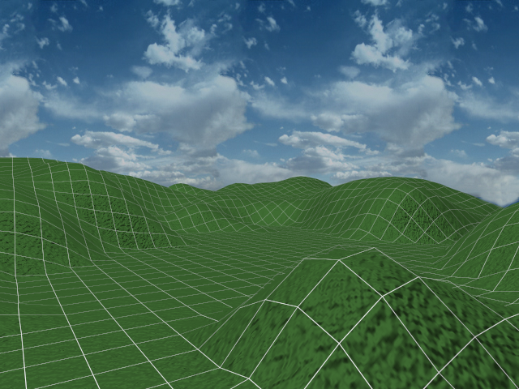
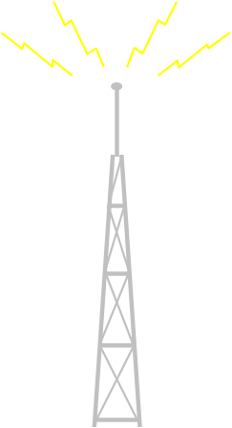
Notes:
This slide is animated. The following sections describe the animation process and give some suggested talking points for each step in the animation. The numbered points below describe the new display after each mouse click.
Initial Display – Photo of tree covered terrain
This is the setup slide for the transition between the real world of the customer’s service area and the digitized model of Mozaik.
Digital Terrain – Transformation of the photo into a digitized terrain model
After a mouse click the photo is transformed. Use this opportunity to talk about the data sources Mozaik uses for terrain modeling (elevations, Land Use Land Clutter etc.) You talk about the accuracy levels of the data that was used for their particular maps at this stage (i.e. how many arc-seconds) and how we might be refining these by using higher resolution as we finalize the maps for CATP usage depending on your design approach.
Databases
Terrain - to determine shadow loss and elevation
Land Use Land Clutter (LULC) - for environmental clutter
Cartographic - roads, water features, political boundaries, feature names, etc.
Population - population data
Radio Site Locations
U.S. Geological Survey
Grid Overlay – A 3-D grid is overlaid on terrain
On the next mouse click the digital terrain is overlaid with a grid. This shows the tile based nature of Mozaik. You could tie in the basis for the program name at this point.
Tower Placement – A tower is placed onto a hill on the terrain
On the next mouse click a radio tower is placed on the hill. Now you can begin discussing how the model of the customer’s system is built up in Mozaik. You can discuss the site filtering design and antenna selections etc.
Calculations – Line of Sight Arrows radiate from the tower
On the next mouse click, a set of arrows radiate from the tower out to the center of some the tiles. Now is the chance to talk about the calculations performed to each individual tile. For simulcast, you can give some details about the Monte Carlo simulation process. Mention how the calculations for signal strength are compared to the design goal for the particular reliability being predicted.
Painting of Grid – The predicted coverage appears
On the next mouse click, the grid is shaded according to the design goal. The holes within the painted areas can be used to illustrate shadow loss or simulcast distortion. You can also discuss service area versus reliability of the coverage area using this part of the animation.
The next mouse click will take you to the next slide.

Slide 31
“Simulcast” fills in where single site can’t
Notes:
This slide is animated. The following sections describe the animation process and give some suggested talking points for each step in the animation. The numbered points below describe the new display after each mouse click.
Initial Display – Photo of tree covered terrain
This is the setup slide for the transition between the real world of the customer’s service area and the digitized model of Mozaik.
Digital Terrain – Transformation of the photo into a digitized terrain model
After a mouse click the photo is transformed. Use this opportunity to talk about the data sources Mozaik uses for terrain modeling (elevations, Land Use Land Clutter etc.) You talk about the accuracy levels of the data that was used for their particular maps at this stage (i.e. how many arc-seconds) and how we might be refining these by using higher resolution as we finalize the maps for CATP usage depending on your design approach.
Databases
Terrain - to determine shadow loss and elevation
Land Use Land Clutter (LULC) - for environmental clutter
Cartographic - roads, water features, political boundaries, feature names, etc.
Population - population data
Radio Site Locations
U.S. Geological Survey
Grid Overlay – A 3-D grid is overlaid on terrain
On the next mouse click the digital terrain is overlaid with a grid. This shows the tile based nature of Mozaik. You could tie in the basis for the program name at this point.
Tower Placement – A tower is placed onto a hill on the terrain
On the next mouse click a radio tower is placed on the hill. Now you can begin discussing how the model of the customer’s system is built up in Mozaik. You can discuss the site filtering design and antenna selections etc.
Calculations – Line of Sight Arrows radiate from the tower
On the next mouse click, a set of arrows radiate from the tower out to the center of some the tiles. Now is the chance to talk about the calculations performed to each individual tile. For simulcast, you can give some details about the Monte Carlo simulation process. Mention how the calculations for signal strength are compared to the design goal for the particular reliability being predicted.
Painting of Grid – The predicted coverage appears
On the next mouse click, the grid is shaded according to the design goal. The holes within the painted areas can be used to illustrate shadow loss or simulcast distortion. You can also discuss service area versus reliability of the coverage area using this part of the animation.
The next mouse click will take you to the next slide.

Slide 32
Simulcast Issues
Amplitude and frequency of transmitted signals must be very accurately timed to ensure good signal quality

Slide 33
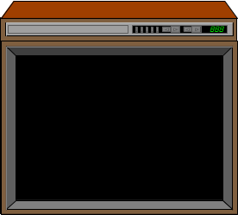
Simulcast Issues
Slightly out of phase - “Ghosting” on a T.V. set
Out-of-phase signals can cause destructive cancellation
Fully in-phase signals produce constructive composite signal

Slide 34
Discussion and questions regarding Simulcast transmission techniques and issues?

Slide 35
Multicast Transmitting Systems
Multicast Transmitting is defined as:
  A radio system where different radio frequencies are used at each tower site within the radio system
Multicast Benefits:
  Reduced system complexity
  Minimized site spacing issues
  Lower system overall system cost

Slide 36
Multicast Transmitting Systems
Multicast “cons”:
  Very high frequency usage (each site needs its own set of frequencies)
  No Simulcast coverage benefits (overlap, voting)
  Units “roam” between sites

Slide 37
Kandiyohi Co MN – with Multicast
f
f
f
f
f
1
2
3
4
5
f
f
f
f
f
6
7
8
9
10

Slide 38
ARMER System
In the ARMER system, each tower site is connected back to Zone Controller via microwave or other network link
Typical ARMER tower site is Multicast
Typical Local Ehancement system is Simulcast

Slide 39
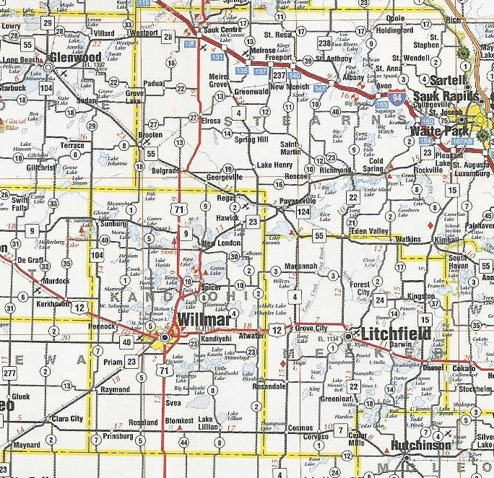
Zone Controller

Slide 40
Radio System Modulation Technologies
Analog vs. Digital:
  Most existing Public Safety radio systems are analog
  New 800 Mhz system are digital
  So what’s the difference?
  Is digital better, and why?

Slide 41
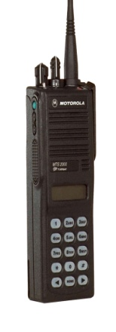
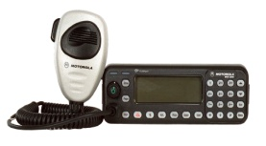
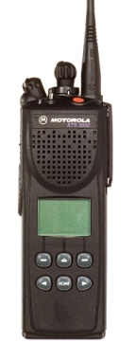
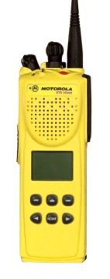
Modulation Techniques
Information is sent by changing the frequency, amplitude or phase of the radio signal
Analog transmission
Information is converted to true data bits, and applied directly to the radio transmitter using FDMA, (or TDMA or CDMA)
Digital transmission

Slide 42
Modulation Techniques
Digital Benefits:
  Clearer audio throughout system coverage area
  Improved radio frequency efficiency
  Improved system coverage
  Imbedded signaling options
  Encryption with no range loss

Slide 43
Voting Receiver Technology
In a multi-tower site radio system, a mobile or portable radio transmitting within the system’s range has a good probability of being heard by more than one tower site
In a Voting receiver system, the same-frequency receivers of the trunked repeater stations are connected together back to a main site…
…where – in a digital system – all received signals from one “channel” are combined (added) together and used to create a the final received product…
…which may be stronger than the original signal!

Slide 44
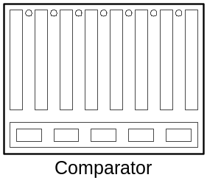
Voting Receiver Systems
Site 2
Site 3
Site 1
f
f
f
f
f
f
f
f
f
f
1
2
3
4
5
1
2
3
4
5
f
f
f
f
f
1
2
3
4
5
Received audio to System

Slide 45
Discussion
&
Questions

