Slide 1
Python Django Capstone
Team Planner Adam Westlake
1

Slide 2
AGENDA
Design
Significant Code
Questions
Intro/Project Outline
Demo
Further Development
Feel free to ask questions at any time besides the final Q&A also
2

Slide 3

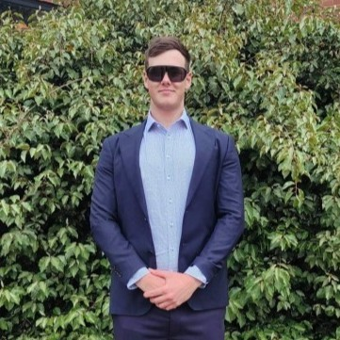
ABOUT ME
Graduated Financial Technology at Monash University with a passion for software development. and web application design.
Training/Resources utilized:
WYWM software engineering pipeline.
Plural Sight Software course (Python & Django).
Hobbies & Interests:
Soccer.
Developing data analyst projects in free time.
3

Slide 4
Overview
PROJECT OUTLINE
A WYWM employee has been contracted to construct a User-Friendly Interface using the Django backend framework. The purpose is to allow members and managers(administrators) to create, read, update and delete changes to a database that dynamically stores and displays employees information.
Users are to experience a readable and accessible User Interface and depending on there role be able to make CRUD changes to the data as necessary.
The data provided to create the database is to be stored inside of an external database, in this example: an SQLite database where the information parsed is stored as a user makes a change.
Display the updated data back to the user.
Further details in handouts.
4

Slide 5

USER STORY
An employee of WYWM ensures that the users and management are able to access employee information. Making changes as necessary.
Navigate to the home page.
Browse the teams, users and there information
Redirect to the admin, create and delete user pages.
Check that the changes have been applied.
I have developed an app that will allow each of these actions, keeping in mind responsive and user-friendly accessibility in addition to constraints outlined by the project requirements.
5

Slide 6
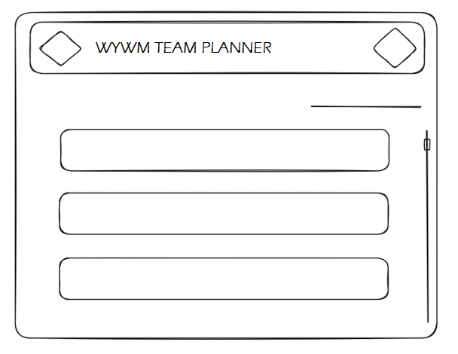
PROJECT DESIGN
More details can be found in handouts section 3
6

Slide 7
DEMO
7

Slide 8
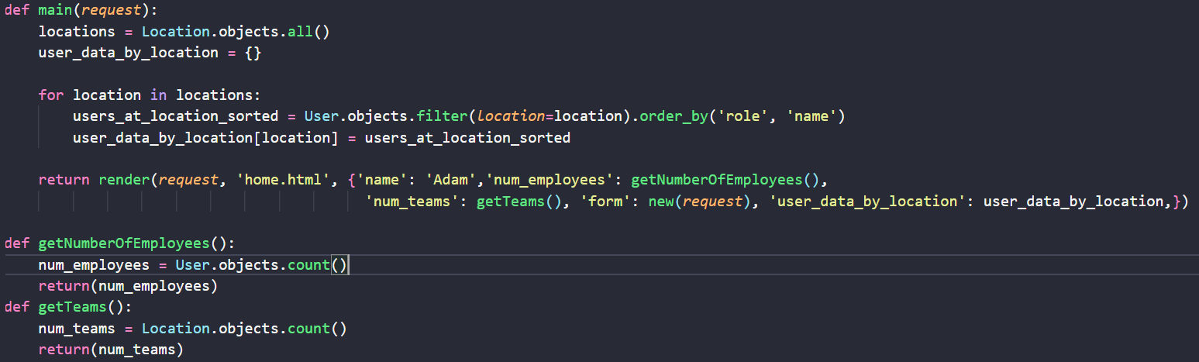
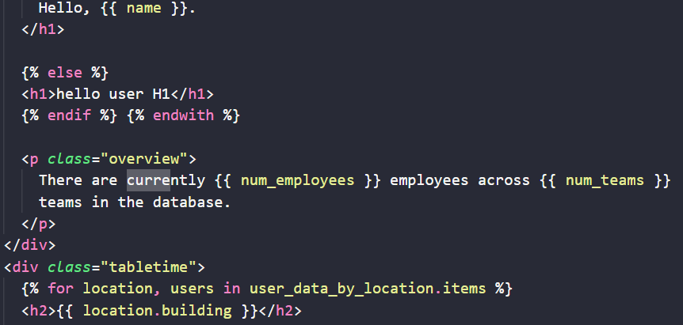
SIGNIFICANT CODE
Links to the repository and demo can be found in handouts
8

Slide 9
FURTHER DEVELOPMENT
Separate the admin and system admin interface.
Combine functions to prevent unnecessary reroutes.
An account login page and model to save user details.
Work with a UI designer.
Error handling and display.
As data loads expand so to will the need for a more capable database. (MySQL for example).
9

Slide 10

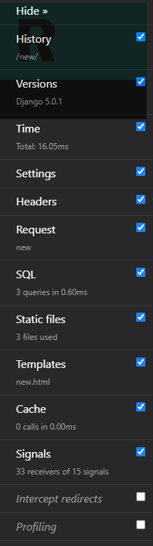
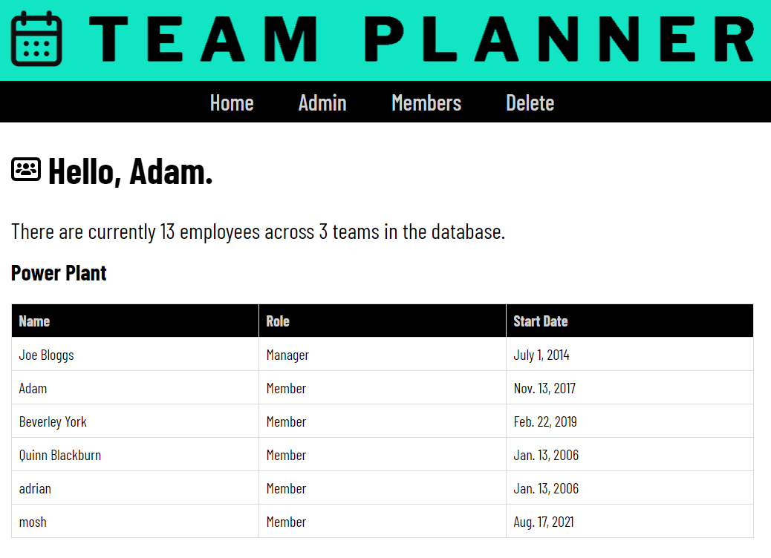
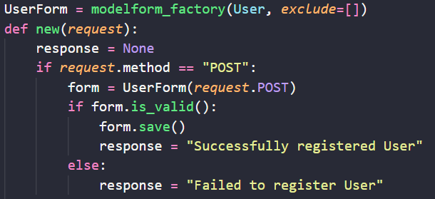
Summary
We have covered:
Project outline
User story
Project design
Demo
Significant Code
Future Improvements
10

Slide 11
THANK YOU
ANY QUESTIONS?
11

