Slide 1
DAWCS
Digital Audio Workstation Control Surface
The team:
Adam
Rory
Jeremy
Jason
Josh
Shain
Chris
Markus

Slide 2
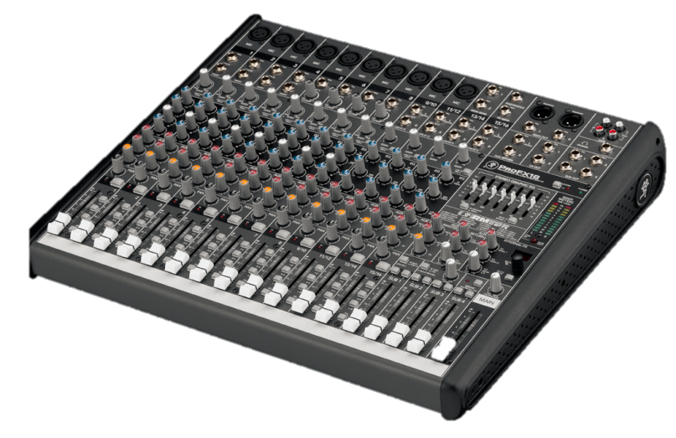
Digital Audio Workstation
Ardour
Pro Tools
Cubase
Cakewalk
Control Surface

Slide 3
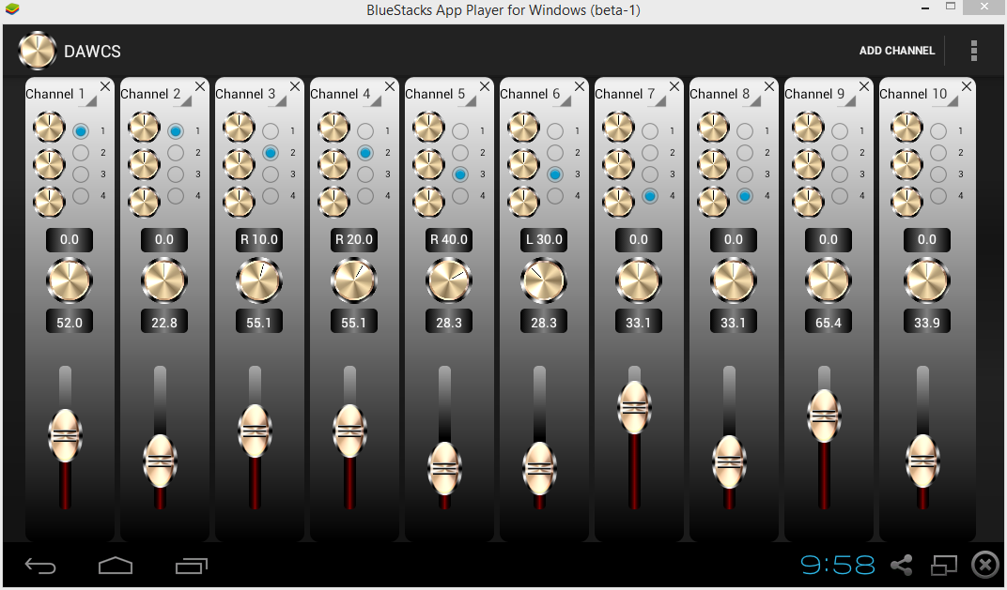
Why use DAWCS?
Cost
Features
Portability

Slide 4
Features
Control DAW over Wifi
Runs on any recent Android device
Android X86
Intuitive channel grouping interface
Support for up to 32 channels
Multiple themes
Database integration
Templates and sessions
Customization

