Slide 1
Introduction to GraphQL - GQL Api with apollo-server, AZ functions and NodeJS
Adam Woźniak – Cytiva Learning Days 2024

Slide 2
What GraphQL is not?
Technology
Library
Database

Slide 3
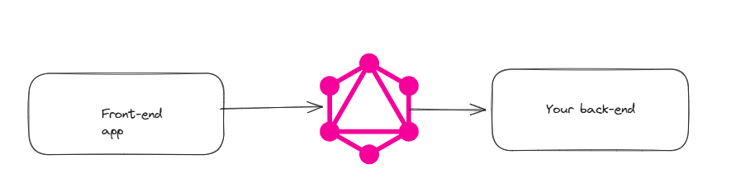
What is GraphQL?
Query language that exists as layer between front-end and back-end of your application that allows you to expose data in a format that was described by GraphQL query

Slide 4
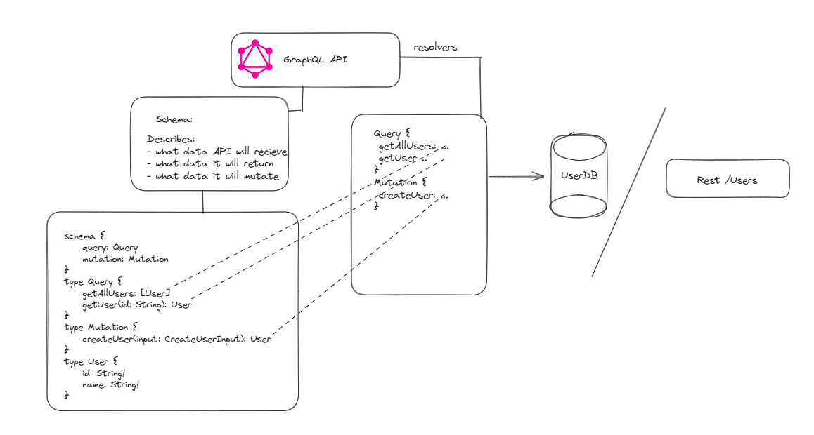
Basics - GrapQL API

Slide 5
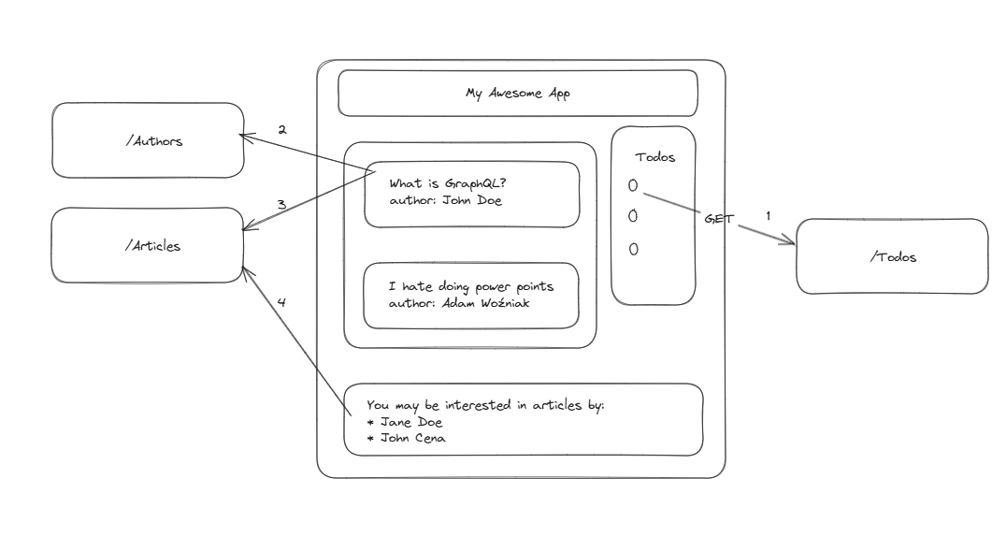
When to use GraphQL?
1. Under fetching 2. Overfetching 3. Loosley copupled services 4. Frequent version changes

Slide 6
Live coding – apollo-server, azure function, nodejs
Cheat-sheet
func init dad-jokes --worker-runtime node https://github.com/apollo-server-integrations/apollo-server-integration-azure-functions npm install @as-integrations/azure-functions @apollo/server graphql @azure/functions func new --template "Http Trigger" --name graphql

