Slide 1





FURTHER STUDY
Recommended reads, videos & repos — go deeper on your own
Good Reads
Economics
Econ & Crypto
AI
Tools & Process
Shidler College of Business · University of Hawaiʻi at Mānoa · Adam W. Stauffer

Slide 2
TABLE OF CONTENTS
Recommended reads, videos & repos — go deeper on your own
2
GOOD READS
Investment Biker
Jim Rogers' world tour on motorcycle — global markets through an investor's eyes
3
GOOD READS
The Alchemy of Finance
George Soros explains his theory of reflexivity and how markets actually move
4
ECONOMICS VIDEO & BOOK
How the Economic Machine Works
Ray Dalio's 30-min video on credit cycles, debt, and how economies function
5
ECONOMICS VIDEO & BOOK
The Changing World Order
Ray Dalio on rising and falling empires — understanding long-term macro shifts
6
ECONOMICS & CRYPTO VIDEO
The Everything Code
Macro framework linking liquidity cycles to crypto and risk assets
7
ARTIFICIAL INTELLIGENCE VIDEO
Build It With AI, Then Attack It
Hands-on AI development workflow: build fast with LLMs, then stress-test your work
8
TOOLS, PROCESSES, BEST PRACTICES
Karpathy's AI Skills & CLAUDE.md
Andrej Karpathy's curated resources for building deep understanding of AI systems
9
TOOLS, PROCESSES, BEST PRACTICES
gstack
A modern developer toolstack optimised for AI-assisted software development that is adaptable to business management
10
ECONOMICS & AI ESSAY
The 2028 Global Intelligence Crisis
A scenario in financial history from the future — how runaway AI could trigger a 2028 crisis

Slide 3
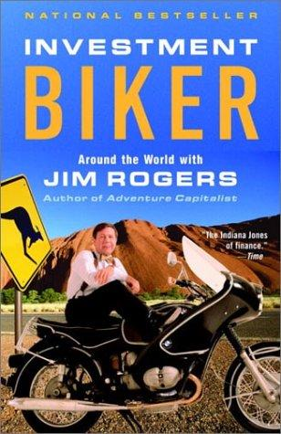
OVERVIEW
Part travelogue, part macro masterclass: Jim Rogers rides 100,000+ miles across six continents, sizing up each country's economy from the ground — borders, black markets, currencies, and street-level commerce.
WHY IT MATTERS
Teaches you to read a market from what you actually observe, not just headline statistics. A vivid first lesson in global macro, country risk, and contrarian thinking.
GOOD READS
Investment Biker
ABOUT THE AUTHOR
Co-founded the Quantum Fund with George Soros, retired at 37, and became a legendary commodities investor and global adventurer.
Jim Rogers
READ
GO FURTHER
Investment Biker — Jim Rogers (1994)
Adventure Capitalist (the follow-up, by car)
Hot Commodities
BOOK
1 / 9

Slide 4
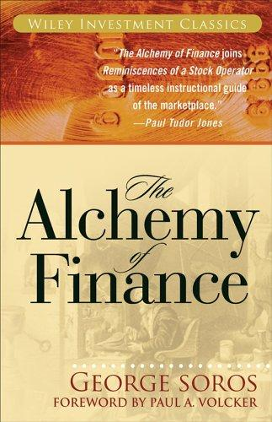
OVERVIEW
Soros lays out his theory of reflexivity: market participants' biased perceptions feed back into and reshape the very fundamentals they are trying to predict, fueling self-reinforcing boom-and-bust cycles — illustrated with a real-time trading diary.
WHY IT MATTERS
A foundational challenge to efficient-market thinking. Prices are not passive reflections of value but active forces that bend reality — sharpening how you reason about bubbles, feedback loops, and reflexive risk.
GOOD READS
The Alchemy of Finance
ABOUT THE AUTHOR
Co-founded the Quantum Fund with Jim Rogers and became one of history's most successful speculators — famously "broke the Bank of England" in 1992 — and later a major philanthropist.
George Soros
READ
GO FURTHER
The Alchemy of Finance — George Soros (1987)
Foreword by Paul A. Volcker
Pairs with Investment Biker — same Quantum Fund founders
BOOK
2 / 9

Slide 5
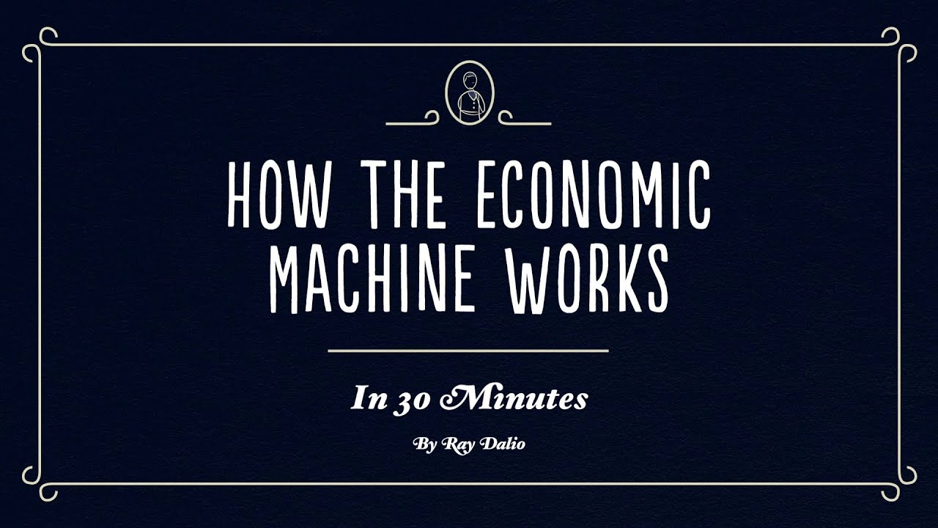

OVERVIEW
A 30-minute animated explainer that builds the whole economy up from a single transaction, then reduces it to three forces: productivity growth plus a short-term and a long-term debt cycle.
WHY IT MATTERS
ECONOMICS
The clearest mental model for why economies expand, overheat, and deleverage — and a working vocabulary (credit, spending, deleveraging) for almost any macro headline.
How the Economic Machine Works
ABOUT THE AUTHOR
Founder of Bridgewater Associates, the world's largest hedge fund, and one of the most influential macro thinkers alive.
Ray Dalio
WATCH
GO FURTHER
youtu.be/PHe0bXAIuk0
Book: Principles
Pairs with The Changing World Order (next)
VIDEO · ~30 MIN
3 / 9

Slide 6
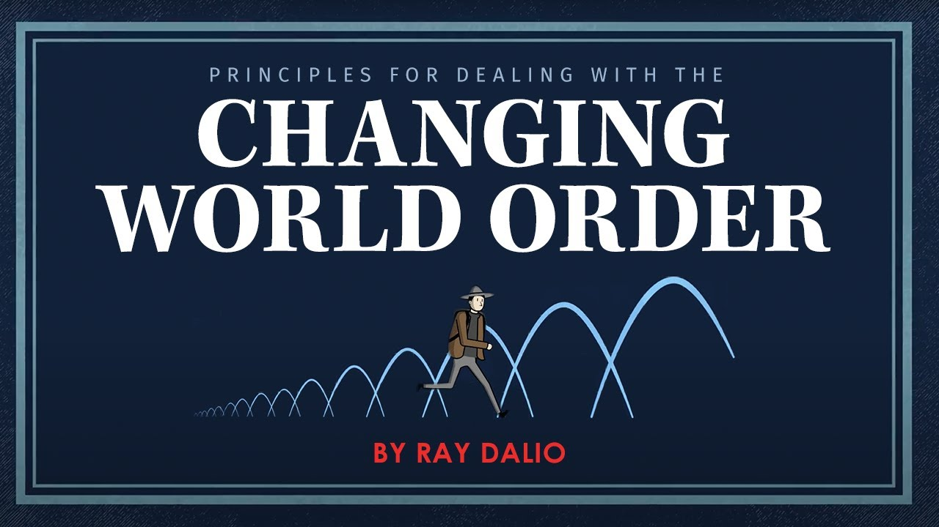
OVERVIEW
Dalio zooms out across 500 years to study how empires and reserve currencies rise and fall — the recurring pattern of debt, internal conflict, and shifting power — and where the US and China sit in that cycle today.
WHY IT MATTERS
ECONOMICS
Frames today's events — debt, inflation, US–China rivalry — inside a repeatable historical arc, so you can read geopolitics as cycles rather than noise.
The Changing World Order
ABOUT THE AUTHOR
Founder of Bridgewater Associates, the world's largest hedge fund, and one of the most influential macro thinkers alive.
Ray Dalio
WATCH
GO FURTHER
youtu.be/xguam0TKMw8
Book: Principles for Dealing with the Changing World Order
Pairs with the Economic Machine (prev)
VIDEO
4 / 9

Slide 7
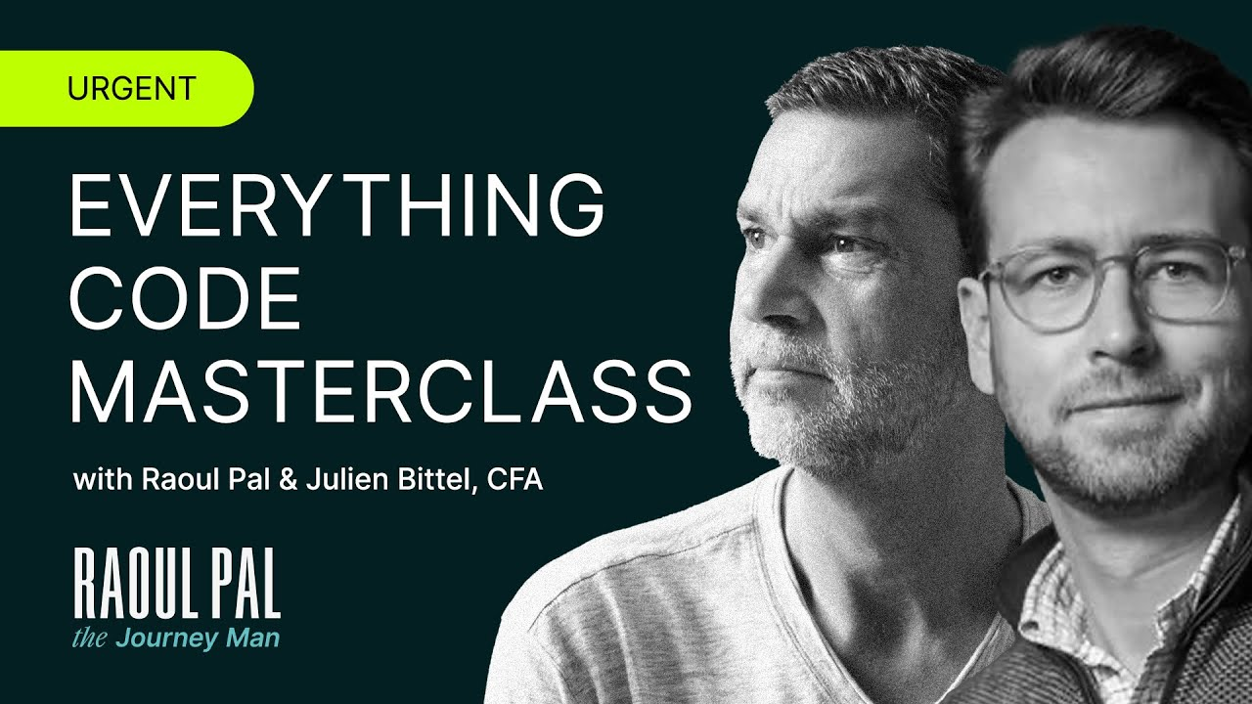
OVERVIEW
Raoul Pal and Julien Bittel lay out a framework tying global liquidity, demographics, and technology adoption to asset prices — a bridge between traditional macro and digital assets.
WHY IT MATTERS
ECONOMICS & CRYPTO
Explains why liquidity cycles drive risk markets and offers a lens for thinking about crypto alongside stocks and bonds rather than in isolation.
The Everything Code
ABOUT THE AUTHOR
Former Goldman Sachs and GLG hedge-fund manager; co-founder of Real Vision and CEO of Global Macro Investor.
Raoul Pal
WATCH
GO FURTHER
youtu.be/I6IraYngzgo
Real Vision interviews
Global Macro Investor research
VIDEO
5 / 9

Slide 8
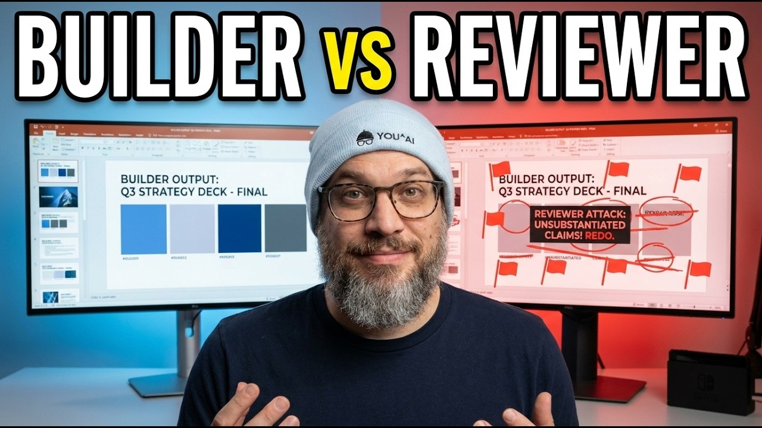
OVERVIEW
A hands-on demo: Jones builds a slide deck with one AI, then sets a second AI to adversarially critique and "attack" it — surfacing weaknesses the first pass missed.
WHY IT MATTERS
ARTIFICIAL INTELLIGENCE
A practical, repeatable template for raising the quality of any AI output: generate, then stress-test. Directly applicable to how you'll use AI on your own projects.
Build It With AI, Then Attack It
ABOUT THE AUTHOR
AI product strategist and educator known for accessible, applied breakdowns of real AI workflows.
Nate Jones
WATCH
GO FURTHER
youtu.be/MFzxIT88zfg
Nate's channel & newsletter on applied AI workflows
VIDEO
6 / 9

Slide 9
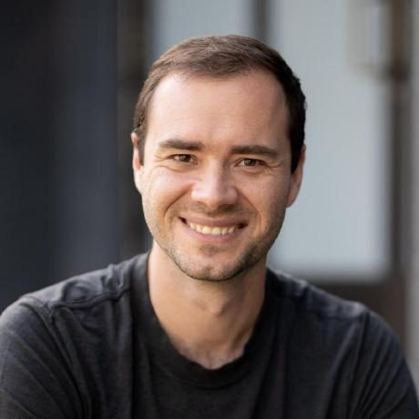
OVERVIEW
A set of reusable AI "skills" that distill disciplined working principles — think before editing, simplicity first, surgical changes, goal-driven verification — into instructions an AI agent follows. The same principles shape this course's own CLAUDE.md.
WHY IT MATTERS
Process beats raw effort. Codifying how you work makes AI output more consistent, reviewable, and professional.
TOOLS & PROCESS
Karpathy's AI Skills
ABOUT THE AUTHOR
Andrej Karpathy — founding member of OpenAI, former Sr. Director of AI at Tesla, and a leading AI educator.
Andrej Karpathy
EXPLORE
GO FURTHER
github.com/multica-ai/andrej-karpathy-skills
Read the CLAUDE.md guidelines
Apply the principles to your own repo
GITHUB REPO
8 / 9

Slide 10
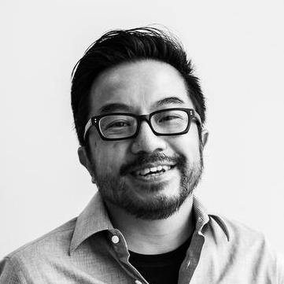
OVERVIEW
An open-source collection of ~23 specialized AI tools that turn Claude Code into a virtual engineering team — letting a solo builder ship at the pace of a much larger team.
WHY IT MATTERS
Shows that structured tooling, not just raw prompting, multiplies what you can build with AI. A concrete starting point for your own workflow.
TOOLS & PROCESS
gstack
ABOUT THE AUTHOR
Garry Tan — President & CEO of Y Combinator; early Palantir engineer and co-founder of Posterous (acquired by Twitter).
Garry Tan
EXPLORE
GO FURTHER
github.com/garrytan/gstack
Pair with Karpathy's skills (next)
Adapt the tools to your own projects
GITHUB REPO
7 / 9

Slide 11
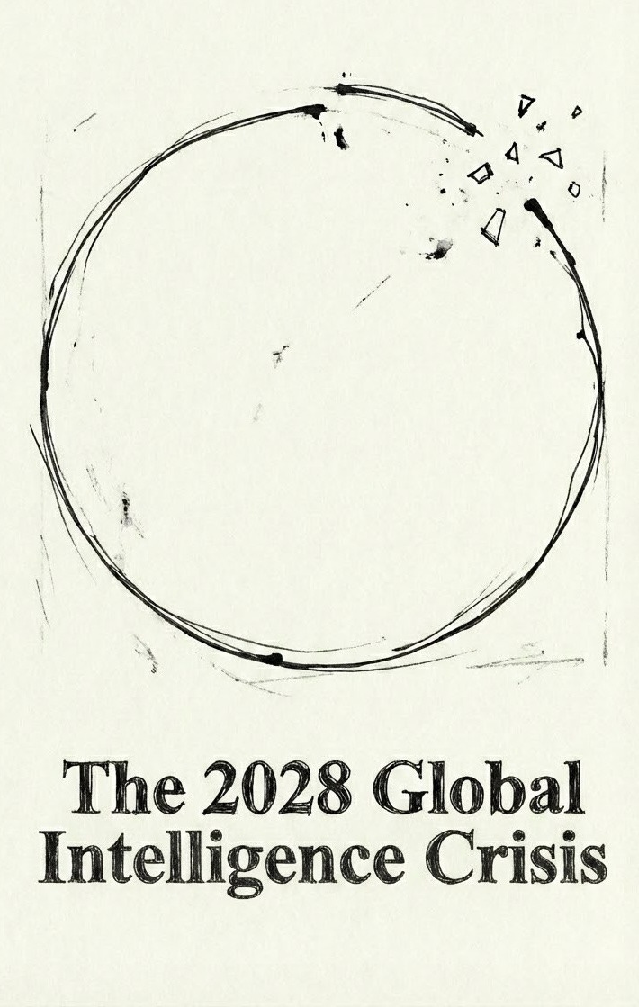
OVERVIEW
A speculative “financial history, from the future”: Citrini and Alap Shah imagine how relentless AI progress could tip into an economic crisis by 2028. As capable AI gets cheaper, firms swap white-collar workers for agents, displaced spending falls, and the loop feeds on itself.
WHY IT MATTERS
Inverts the comforting “AI creates more jobs than it destroys” story by modeling AI as a substitute for labor — and traces how one shock could ripple through mortgages, private credit, and insurance. A disciplined way to reason about left-tail risk.
ECONOMICS & AI
The 2028 Global Intelligence Crisis
ABOUT THE AUTHOR
Citrini Research is a widely-read thematic-investing publication on Substack; this scenario was co-authored with Alap Shah, a public-markets investor and founder of LOTUS Investment Management, Littlebird.ai, and Sentieo.
Citrini & Alap Shah
READ
GO FURTHER
The 2028 Global Intelligence Crisis — Citrini Research (2026)
citriniresearch.com/p/2028gic
Pairs with Dalio's debt cycles & The Everything Code
ESSAY
9 / 9

