Slide 1
ОПТ Транзакции 1
Arkhipov N.A., Alkhanashivli A.Z., Rukavishnikov N.A., Chechulin N.D.

Slide 2
Stages of project implementation
1
Data cleaning
2
Showcase creation
3
MBA
4
Translation result
Data correction, correct merging into a pivot table, filling in gaps, removing outliers.
Response Model
5
Forming an offer
Aggregation of data into showcases for subsequent application of models, analysis of the received showcases
Definition
joint purchase rules
6
Financial justification
Building models that predict the likelihood of a customer returning
Formation of the best personal offers for each of the profiles
Financial
justification

Slide 3
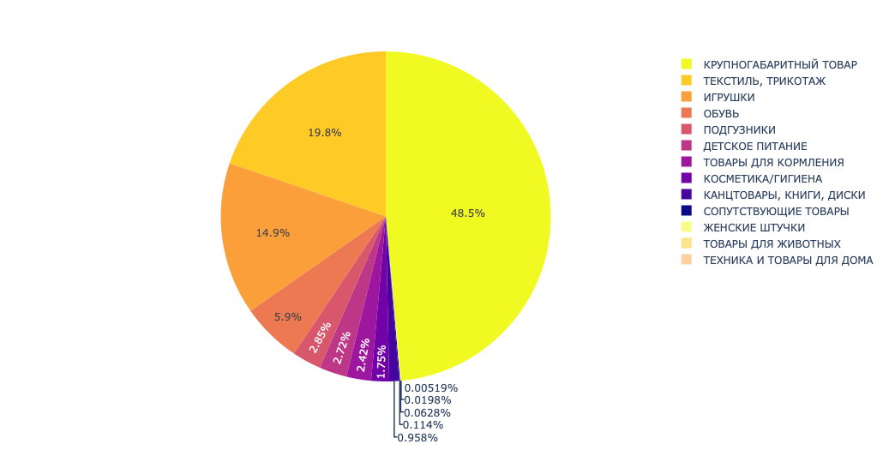
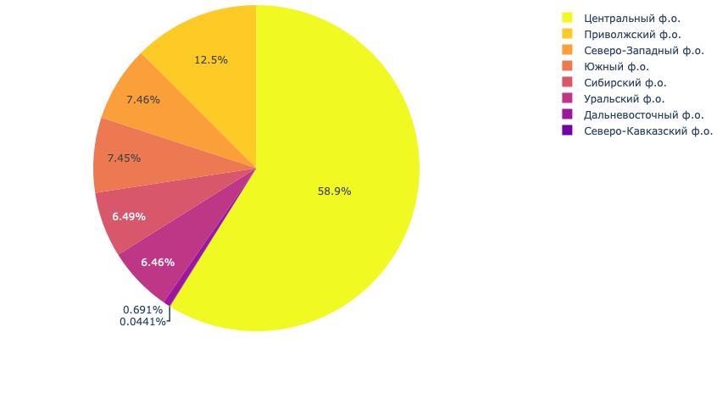
Data visualization
Margin by category
Margin by regions

Slide 4
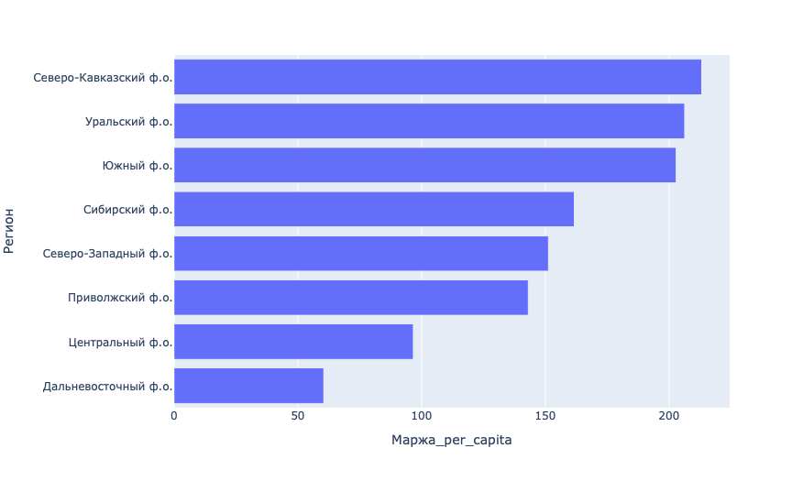
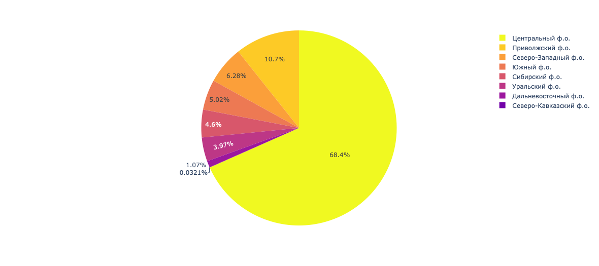
Data visualization
Marginality by regions
Number of checks by region

Slide 5
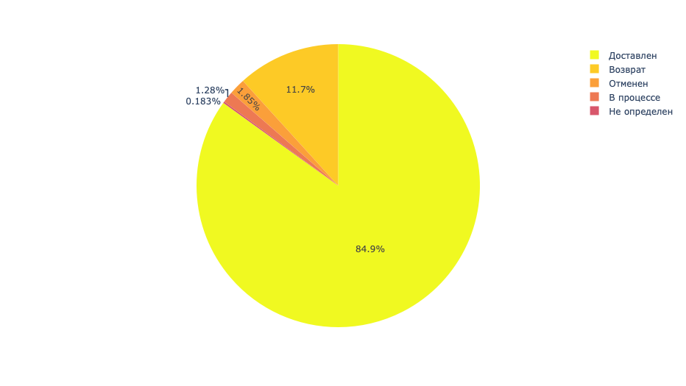
Data cleaning and transformation

Slide 6
Exploratory Data Analysis
I
III
V
Convert columns to the correct data types
Divide geo-data into federal districts
Remove irrelevant columns
Remove incorrect values, clean data and validate calculations
Omit rejected positions and prepare data for pivot tables and analytical base tables
II
IV

Slide 7
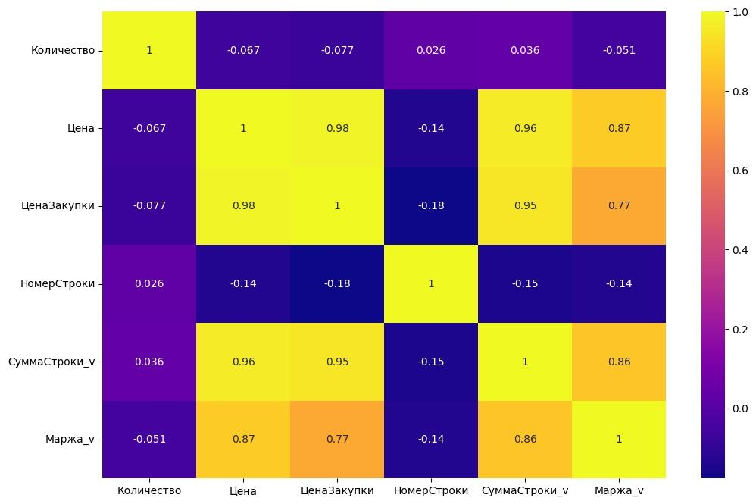
Exploratory Data Analysis
Correlation between features

Slide 8
Realization stages
1
Data cleaning
2
Showcase
3
MBA
4
Data correction, correct merging into a pivot table, filling in gaps, removing outliers.
Response model
5
Aggregation of data into showcases for subsequent application of models, analysis of the received showcases
Formation of an offer
6
Defining co-purchase rules
Financial justification
Building models that predict the likelihood of a customer returning
Formation of the best personal offers for each of the profiles
Calculation of the financial and economic justification of the project

Slide 9
Market Basket Analysis
Association Rule Mining
Rule Evaluation
Find frequent itemsets and generate rules indicating item co-purchases
Evaluate and measure the strength and significance of these rules
Discover which products are frequently purchased together by customers
Recommendation Systems
Inventory Management
Analyze purchase patterns, recommend related items and boost sales
MBA optimizes inventory by identifying frequently co-purchased items

Slide 10
Apriori | FP-Growth | Association rules | FPMax | HMine
Generates association rules by scanning the database multiple times and incrementally discovering itemsets with increasing length. | Constructs a compact data structure called an FP-tree to represent the transactions and then performs recursive mining to find frequent itemsets. | Technique used that utilizes frequent itemsets obtained from algorithms like Apriori or FP-Growth to generate rules of the form "if-then." | An extension of the FP-Growth algorithm that focuses on finding maximal frequent itemsets, which are itemsets that do not have any proper supersets that are also frequent. | Optimized algorithm that improves upon Apriori and FP-Growth, by utilizing the H-struct data structure and a more efficient search space traversal method.
Easy to understand, widely used, and works well for small to medium-sized datasets. | Faster than Apriori as it avoids costly database scans. It can handle large datasets efficiently and has a reduced memory footprint. | Association Rules provide valuable insights into item associations and can guide business decision-making. | Efficiently identifies maximal frequent itemsets, reducing redundancy in the generated rules and improving the interpretability of the results. | The H-struct is a hybrid data structure that combines the benefits of both horizontal and vertical data layouts, making it more efficient for frequent itemset mining.
It can be computationally expensive for large datasets due to its multiple database scans, and it may generate a large number of candidate itemsets, leading to slower execution. | The initial construction of the FP-tree can be memory-intensive for very large datasets. Additionally, it may generate a large number of candidate itemsets for association rule generation. | Association Rules may generate a large number of rules, including many that are irrelevant or less actionable. Selecting meaningful rules and interpreting their significance can be challenging. | FPMax may still generate a large number of candidate itemsets for large datasets, which can impact the execution time and require additional filtering or post-processing steps. | Has minimal and predictable space overhead, operates quickly in memory-based settings, and can scale to large databases through partitioning. Additionally, it dynamically constructs (conditional) FP-trees during the mining process for dense datasets.
The Apriori algorithm uses the "Apriori principle" which states that if an itemset is infrequent, then all its supersets must also be infrequent. |  |  | Maximal frequent itemsets can be useful when a concise set of rules is desired, or when the focus is on the most important or unique associations.

Slide 11
Provide personalized recommendations to users, improving user experience and driving additional profits
SVD
SVD++
NMF
Decomposes the matrix into latent factors representing user preferences and item characteristics. It predicts user ratings for unknown items based on the similarity between user and item latent factors, enabling personalized recommendations.
SVD++ incorporates implicit feedback signals from user interactions. It improves recommendation accuracy and relevance by capturing latent factors representing user preferences and item characteristics more accurately than traditional SVD. This approach is especially useful when explicit ratings are unavailable but user interactions, such as purchases, can be leveraged to infer user preferences.
Decomposes a non-negative matrix into two non-negative matrices representing user preferences and item characteristics. It uncovers latent patterns for accurate and relevant recommendations, especially with non-negative data such as counts or frequencies.

Slide 12
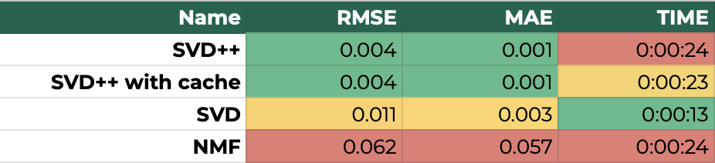
Сomparison of recommender systems algorithms on the whole dataset

Slide 13
Realization stages
1
Data cleaning
2
Showcase
3
MBA
4
Data correction, correct merging into a pivot table, filling in gaps, removing outliers.
Response model
5
Aggregation of data into showcases for subsequent application of models, analysis of the received showcases
Formation of an offer
6
Defining co-purchase rules
Financial justification
Building models that predict the likelihood of a customer returning
Formation of the best personal offers for each of the profiles
Calculation of the financial and economic justification of the project

Slide 14

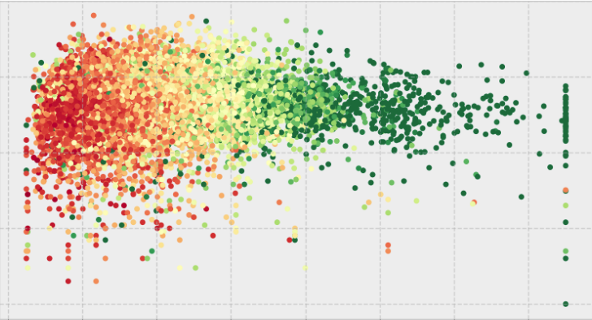


Building a Response Model
Data preparation
Building Models
Classifications
Selection of hyperparameters
Choosing the best model

Slide 15
Classification models
Gradient Boosting
RandomForest
XGboost
Cat boost
Выбранные метрики качества:
ROC-AUC
F1
Gini

Slide 16
Model comparison
Метрики качества | RandomForest | CatBoost | XGboost | Gradient boosting
ROC AUC Train | 0.96 | 0.67 | 0.96 | 0.96
ROC AUC Test | 0.71 | 0.63 | 0.71 | 0.71
F1 Train | 0.96 | 0.71 | 0.96 | 0.96
F1 Test | 0.74 | 0.67 | 0.74 | 0.74
Gini Train | 0.92 | 0.35 | 0.91 | 0.91
Gini Test | 0.42 | 0.26 | 0.41 | 0.41

Slide 17
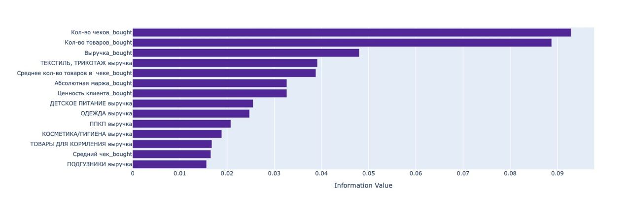
Sample of significant features

Slide 18
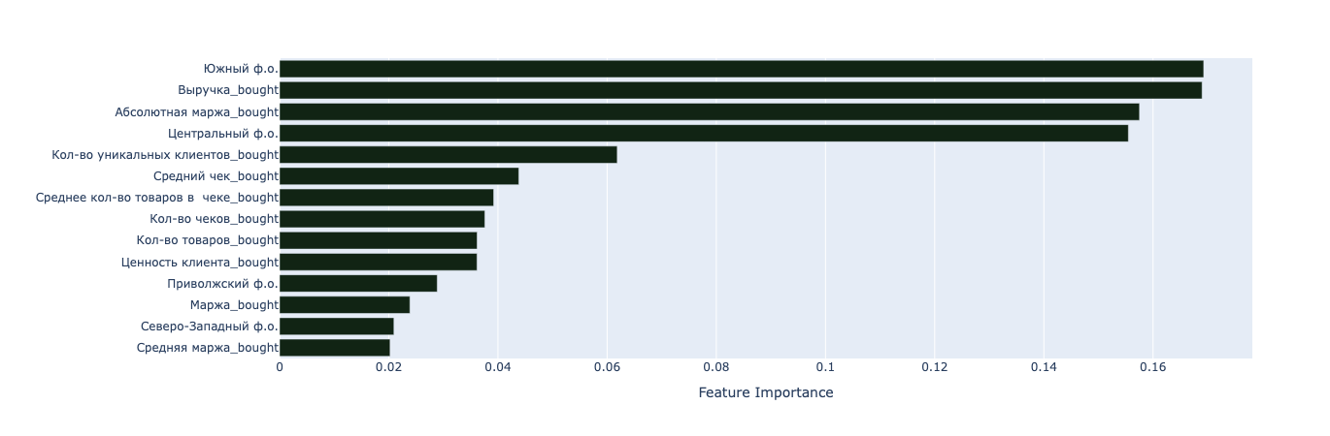
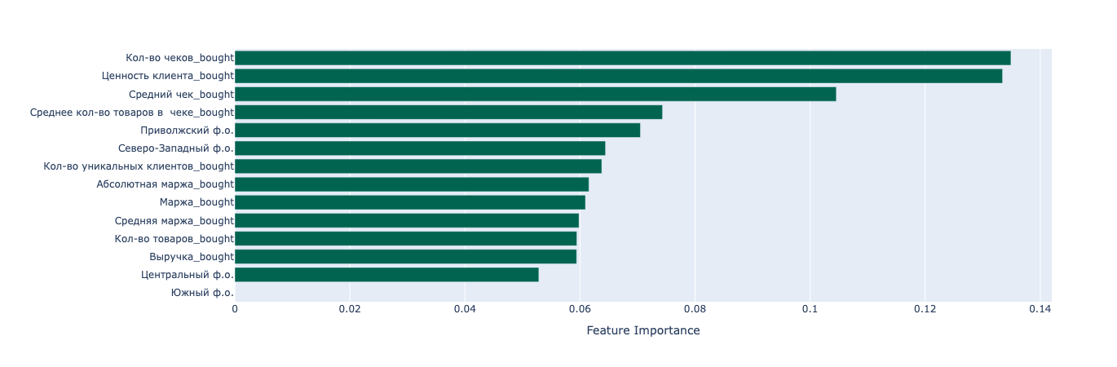
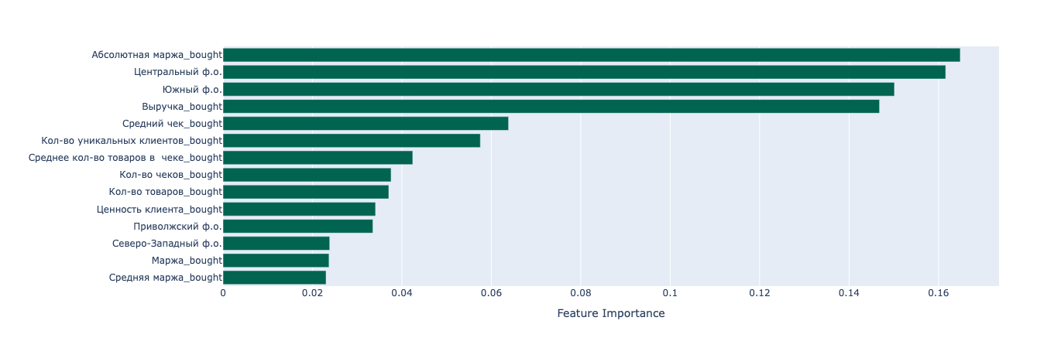
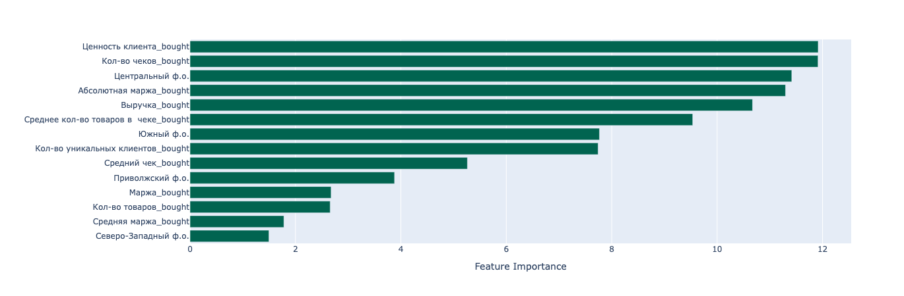
Information values for all models
Random Forest
XGBoost
CatBoost
Gradient Boosting

Slide 19
Realization stages
1
Data cleaning
2
Showcase
3
MBA
4
Data correction, correct merging into a pivot table, filling in gaps, removing outliers.
Response model
5
Formation of an offer
Aggregation of data into showcases for subsequent application of models, analysis of the received showcases
6
Defining co-purchase rules
Financial justification
Building models that predict the likelihood of a customer returning
Formation of the best personal offers for each of the profiles
Calculation of the financial and economic justification of the project

Slide 20
Definition of rules for targeted campaigns and selection of customers
Make a purchase of goods of a certain line from a certain amount and get a 10% cashback
II goal
III goal
I goal
Increase in the average check
Increased shopping frequency
Cart expansion
Cart Margin Increase
Unstable category
more expensive brand
More marginal brand
Minimum basket
Loyalty points increase
Fixed discount
Percentage discount
Second item as a gift

Slide 21
Next best offer
Segment | Aim | Customer processing method | Expected profit (thousand rubles)
I segment baby food | Increasing the average check | Distribution of special offers among clients | 4000
II segment baby clothes | Increasing the average check, expanding the audience | Adding coupons for next purchases when paying online with delivery | 3085

Slide 22
Next best offer
Segment | Aim | Customer processing method | Expected profit (thousand rubles)
III segment Diapers | Increasing the number of goods in the receipt, unloading warehouses | When buying three packs of diapers, the fourth one is a gift | 4175
IV segment Clothes | Increasing the average check | When buying goods from the category "Clothing" in the amount of 3,500 rubles or more, charge 10% of the amount in the form of bonuses | 6090
V segment Toys | Expanding the variability of goods in the receipt | When buying several different products from the group "Toys" in the amount of 1500 rubles or more, a 7% discount | 2580

Slide 23
Realization stages
1
Data cleaning
2
Showcase
3
MBA
4
Data correction, correct merging into a pivot table, filling in gaps, removing outliers.
Response model
5
Formation of an offer
Aggregation of data into showcases for subsequent application of models, analysis of the received showcases
6
Defining co-purchase rules
Financial
justification
Building models that predict the likelihood of a customer returning
Formation of the best personal offers for each of the profiles
Calculation of the financial and economic justification of the project

Slide 24
Result
Aim: Automating the process of selecting customer lists for communication using mathematical modelling
Done:
1.EDA. Data preparation for further analysis
2.Pivot table analysis is done
3.Analytical base table construction
4.Conducting customer segmentation and results analysis
5.Customer response models construction and analysis
6.Conducting Market Basket Analysis
7.Choosing the optimal offer for each of the customer segments

