Slide 1
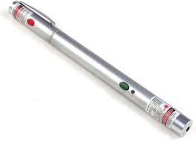
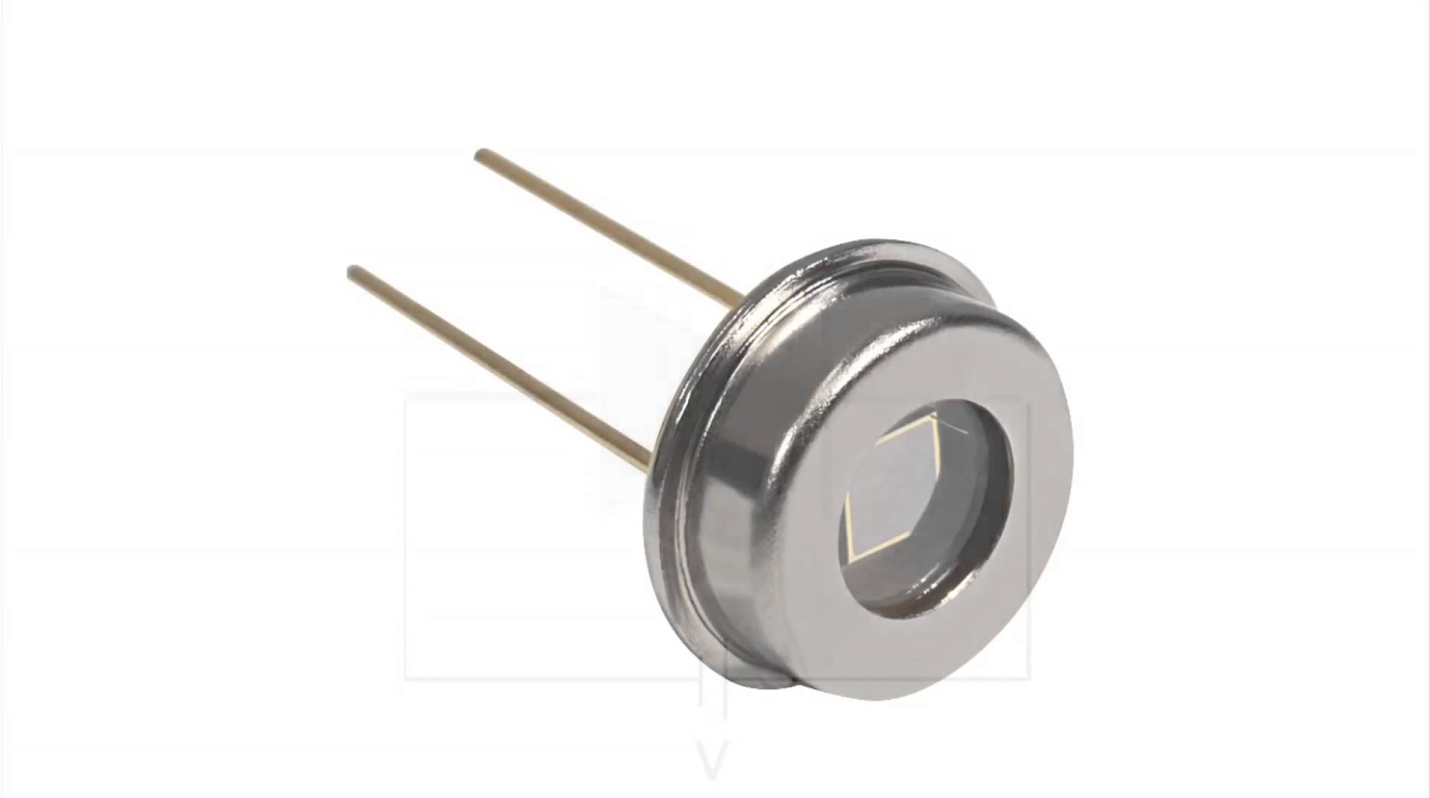
Scenario: Collimated source, unfocussed detector
Source
Target (facet)
Detector
Can we locate the target from a temporal sequence of observations at a single detector location and fixed source location?

Slide 2

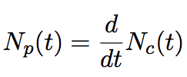


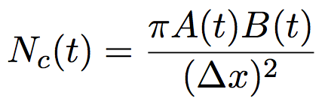

We already have a forward model for the three-bounce problem with a directional source, a focused detector, and a single bounce on a locally linear (i.e. smooth) target. The solution comes from a solution to the one-bounce problem with a divergent source and an unfocused detector.
b+
a-
B
a+
A
b-
Target

Slide 3
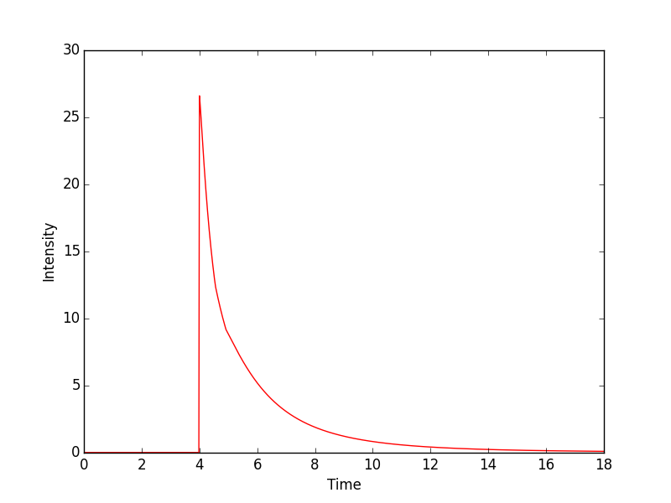
Our forward model allows us to infer a temporal response from a candidate target location:
Intensity information
Time of flight information
Having the full temporal response allows us to make use of both time-of-flight and intensity information—giving us an edge over methods that only use time-of-flight info!

Slide 4
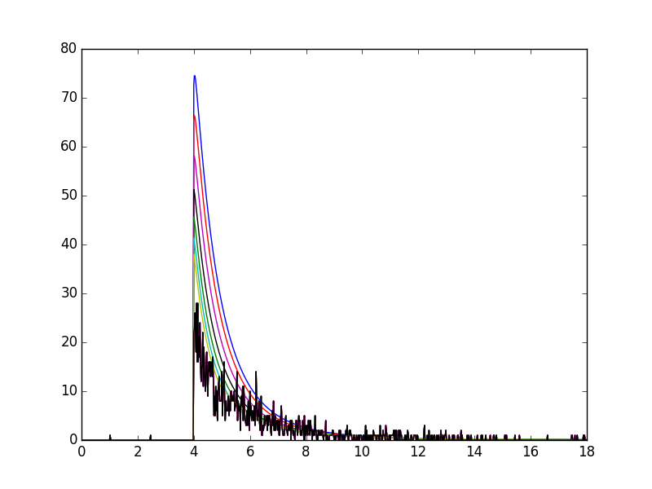
Given a set of observations (black) we can perform a search over target locations that maximizes the likelihood of the observation given the target’s location.
Intensity
Time
The intensity functions implied by our forward model at increasingly plausible target locations are in the other colors.

Slide 5
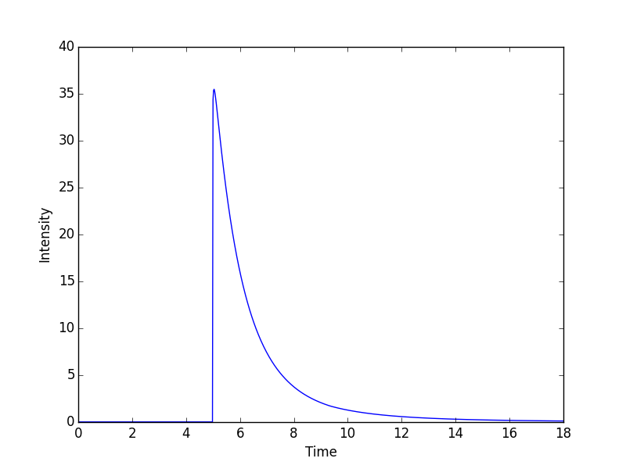
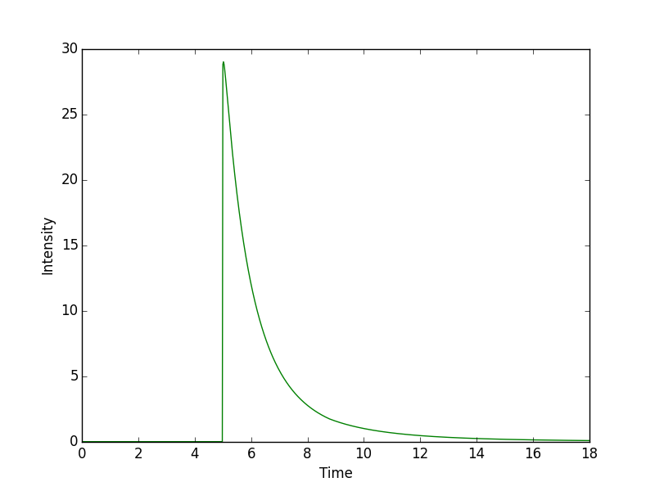

We can use that forward model to perform a sum over possible bounce points on the target wall, to get a forward model for the two-unfocussed-bounce case. Among other benefits, this lets us gather more light, letting us work at lower SNR.

Slide 6
Also, the reflecting wall and target wall may have a specular component. This lets us separate the problem into a series of two-point problems.
Source
Target
Detector
+
+
We can approximate the overall partially-specular response as the sum of the responses if two all but two of the faces are specular, since those paths will dominate the overall response assuming a significant (>1%) specular component. Specular legs are shown above in green.

Slide 7
Each partially-specular sub-component can be approximated as a two-point problem, which we can add together to get a fast and accurate approximation of the true temporal response.
+
+
+
+

Slide 8
Source | Detector | Specularity | Can the target’s location be recovered?
Collimated | Focused | None | Yes
Divergent | Focused | None | Yes, but it’s hard
Collimated | Unfocused | None | Yes, but it’s hard
Divergent | Unfocused | None | Maybe
Collimated | Focused | Partial | Yes
Divergent | Focused | Partial | Yes
Collimated | Unfocused | Partial | Yes
Divergent | Unfocused | Partial | Maybe
Collimated | Focused | Mirror-like | No, unless you’re really lucky
Divergent | Focused | Mirror-like | Maybe
Collimated | Unfocused | Mirror-like | Maybe
Divergent | Unfocused | Mirrorlike | Maybe

