Slide 1
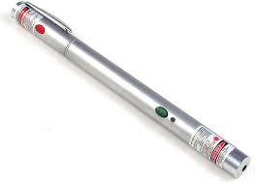
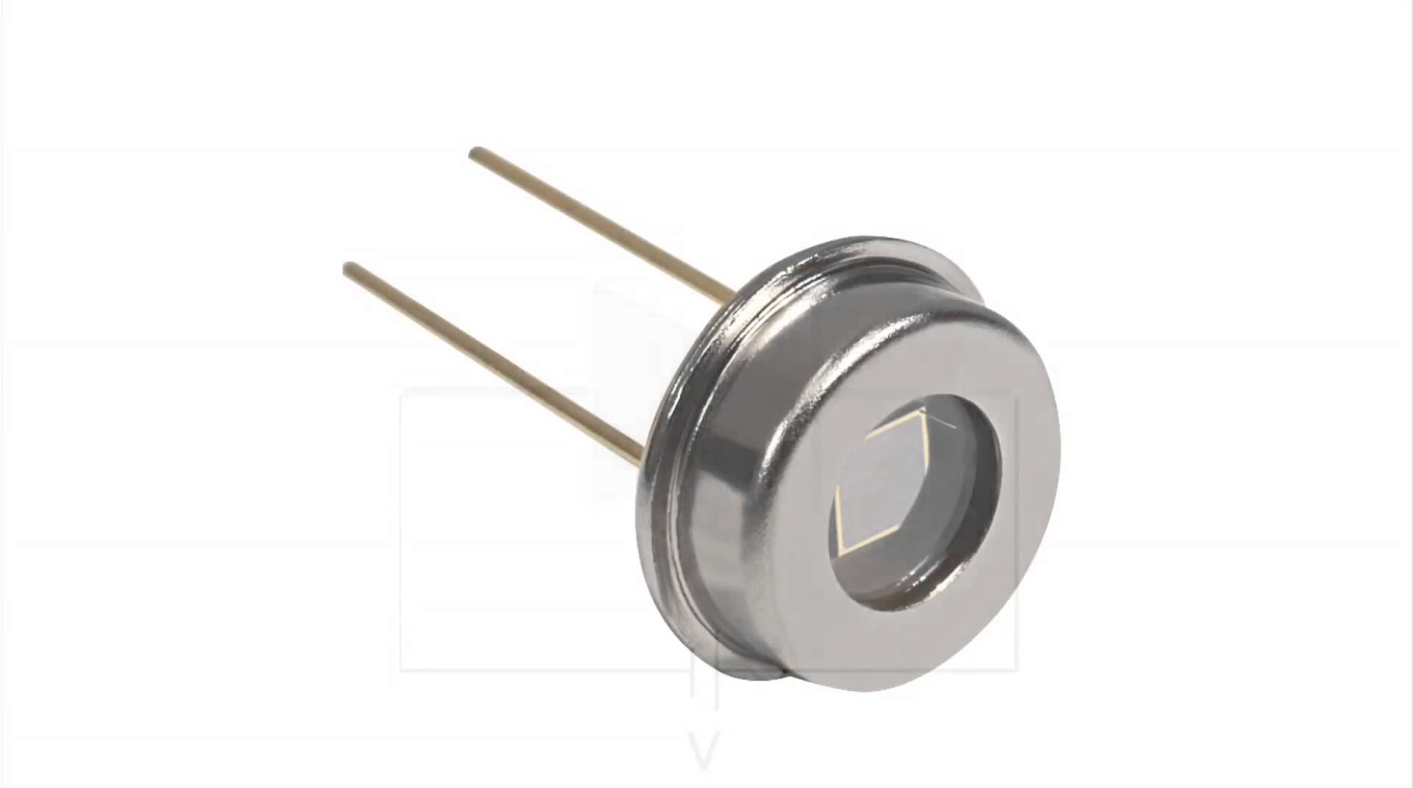
Scenario: Directional source and detector
Source
Target
Detector
Can we locate the target from a single observation?

Slide 2
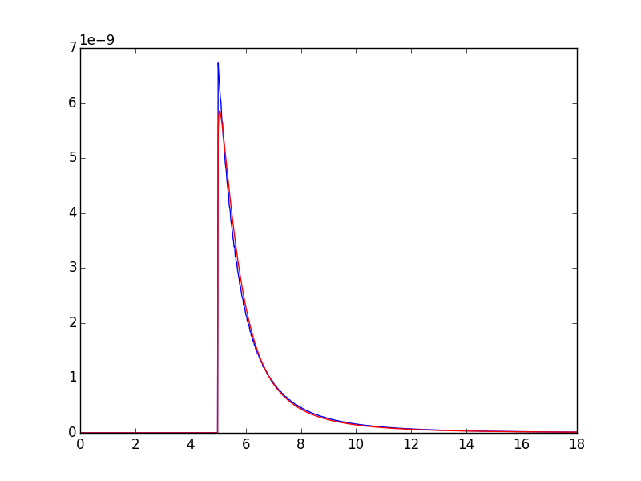
We found a mathematical formula (red) that closely
matches simulation (blue) and is very fast to evaluate.
Intensity
Time
This will make it possible to perform a gradient-descent
search for the location of the target much more quickly.

Slide 3
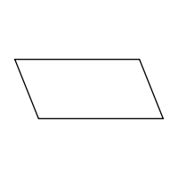
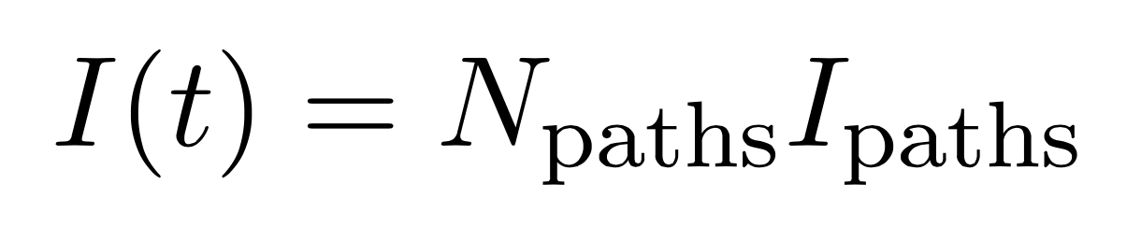
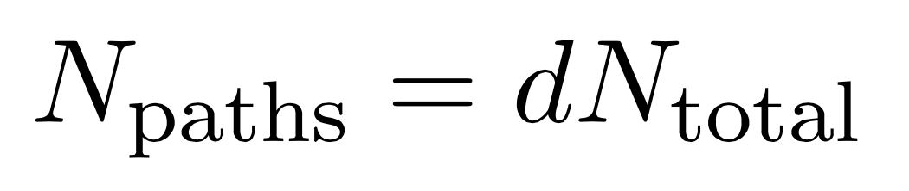
The mathematical formula is derived by considering the size ellipse of collisions which forms on the target wall.
b
a
Target wall
This ellipse will grow with time, and the intensity of the returning light will grow with it.
Area of ellipse

Slide 4
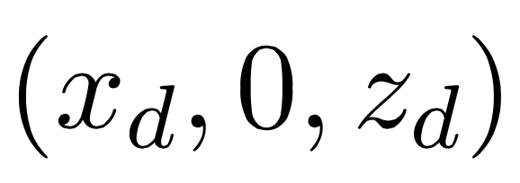
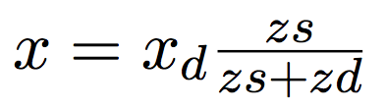
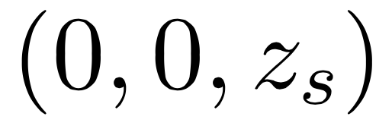
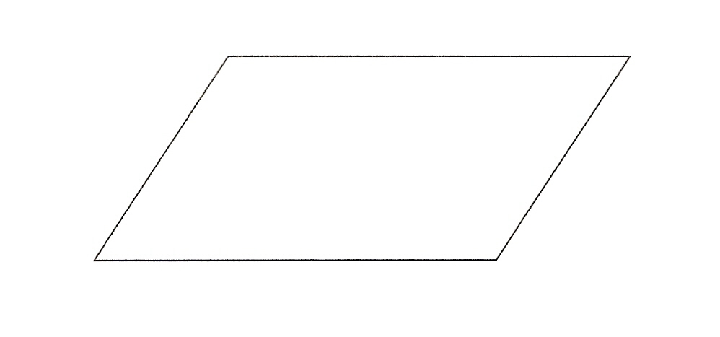
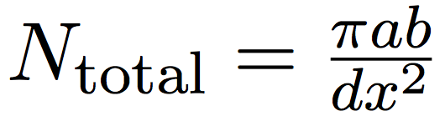
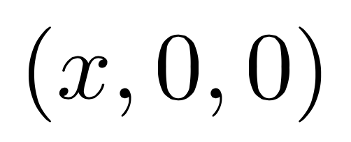
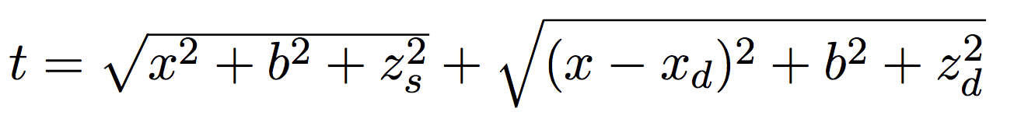
Instead of imagining an unknown wall location and known
detection points, we can imagine a known wall location
and unknown detection points.
b
a
Target wall (z=0)
Plug in
Solve for a
(Average both
solutions)
Solve for b

Slide 5

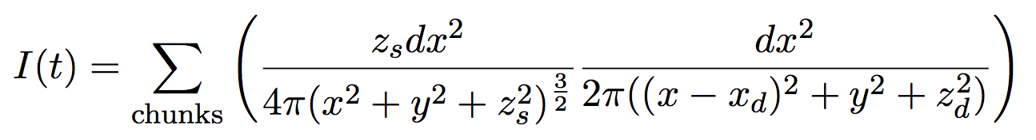
The simulation works by discretizing the wall into small
chunks, and considering the contribution from each.
…
…
y
Target wall (z=0)
x

