Slide 1
Embeddings in 20 Minutes
Turning Meaning into Numbers
High School AI Club Mini-Lesson

Slide 2
HOOK
AI Can Sound Confident and Still Be Wrong
Question: "Which planet is closest to the Sun?"
Answer A
Answer B
"Mercury."
"Venus."
✓ Correct!
✗ Wrong!
Point: We need a way to find info by meaning, not vibes.
Micro-question: Have you ever seen AI give a wrong answer?

Slide 3
THE PROBLEM
Keywords Fail Sometimes
"jaguar speed"
Animal
Car
The big cat in the jungle
The luxury sports vehicle
We want: Search by meaning, not just matching words.
Micro-question: Can you think of another word with two meanings?

Slide 4
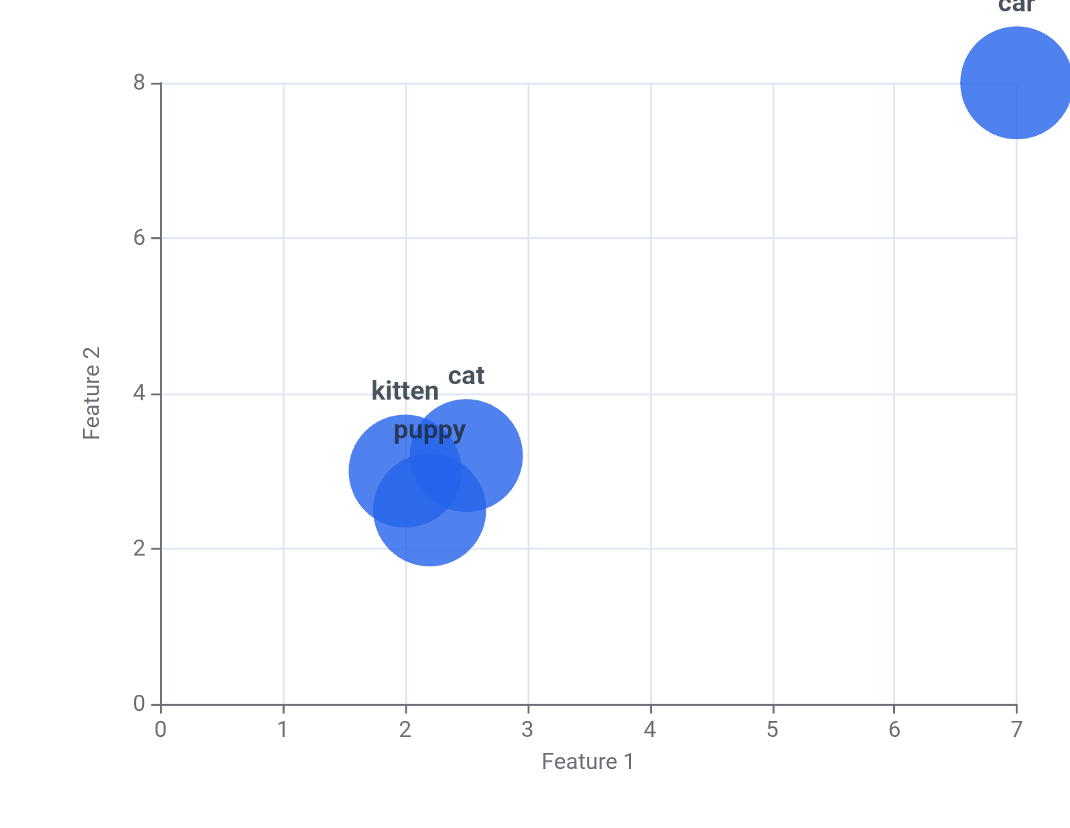
THE SOLUTION
What Is an Embedding?
Meaning Map
Definition
An embedding is a list of numbers that represents meaning.
Analogy: Like GPS coordinates, but for ideas.
Just as coordinates locate places on a map, embeddings locate ideas in "meaning space."

Slide 5
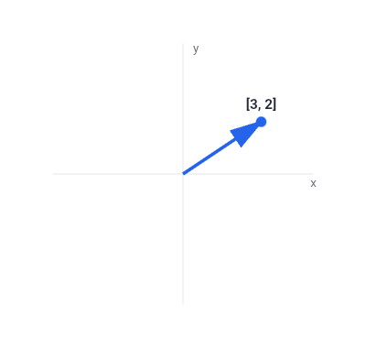
Vectors: Lists of Numbers You Can Draw
Definition
A vector is a list of numbers you can draw as an arrow .
Example: [3, 2] means:
→ Go 3 units right (x-axis)
→ Go 2 units up (y-axis)
x and y are called "features" — they describe properties

Slide 6
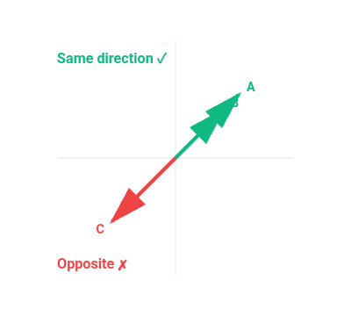
Similarity: Direction Matters More Than Length
Cosine Similarity
A score for how aligned two arrows are.
The Formula (annotated):
cosine(u,v) = (u·v) / (||u|| ||v||)
↑ alignment
↑ sizes
↑ fair compare
Same Direction
Opposite Direction
Score ≈ 1.0 ✓
Score ≈ -1.0 ✗

Slide 7
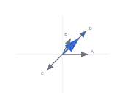
HANDS-ON ACTIVITY (8 MINUTES)
Find the Best Match
Your Tasks:
1. Compute: q·A, q·B, q·C, q·D
2. Rank: most similar → least similar
3. Circle which point the same direction as q
Work in groups of 3-4. No devices needed!
The Vectors:
q = (1, 1)
← query
A = (2, 0)
B = (1, 2)
C = (-1, -1)
D = (3, 3)
Dot Product Reminder:
(x₁,y₁)·(x₂,y₂) = x₁x₂ + y₁y₂

Slide 8
Where Embeddings Show Up in Real Life
Semantic Search
Recommendations
RAG
Find documents by meaning, not just keywords.
Find items like what you already liked.
RAG = chatbot reads relevant docs before answering.
"jaguar speed" → knows if you mean animal or car
"You watched sci-fi → here are similar movies"
"AI looks up facts first, then responds"
All three use the same trick: Turn meaning into numbers, then compare!

Slide 9
Key Takeaways
1
Embeddings = meaning as numbers
2
Cosine similarity = direction match
Exit Question: Why is direction more useful than length?
Next Time: How embeddings are learned

