Slide 1
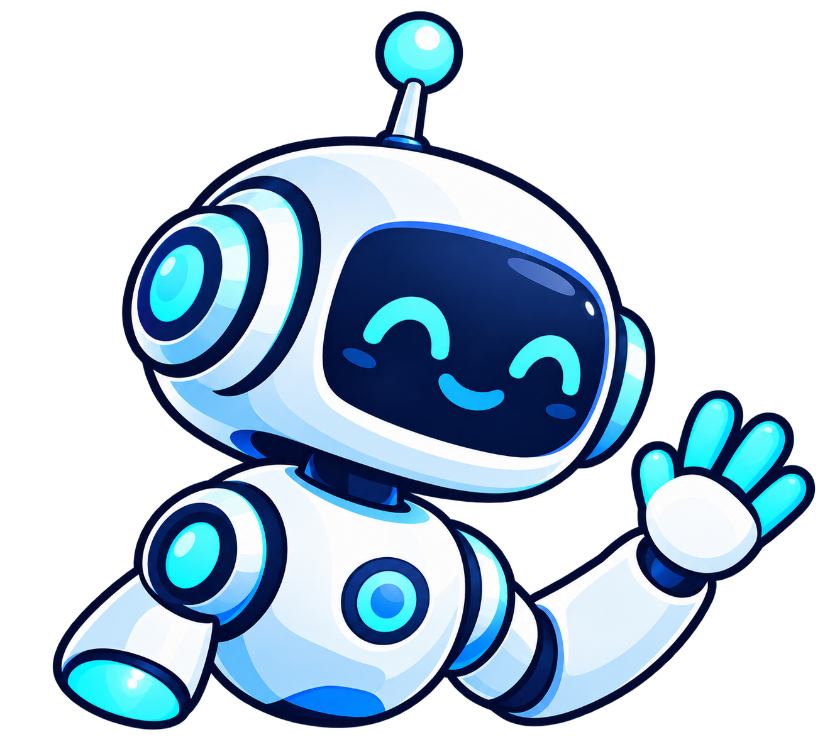
BAYVIEW
AI CLUB
Understand it. Build it. Challenge it.
Learn AI
Build with AI
Question AI
Artificial intelligence
Hello! Welcome to AI club, I’m Byte!
Notes:
Welcome everyone and introduce the execs quickly. Run the three-question poll: used AI, caught AI making a mistake, tried building something with it. Count hands aloud and react with energy. Close by saying that whether someone is trying AI for the first time or already building projects, there is a place for them here.

Slide 2
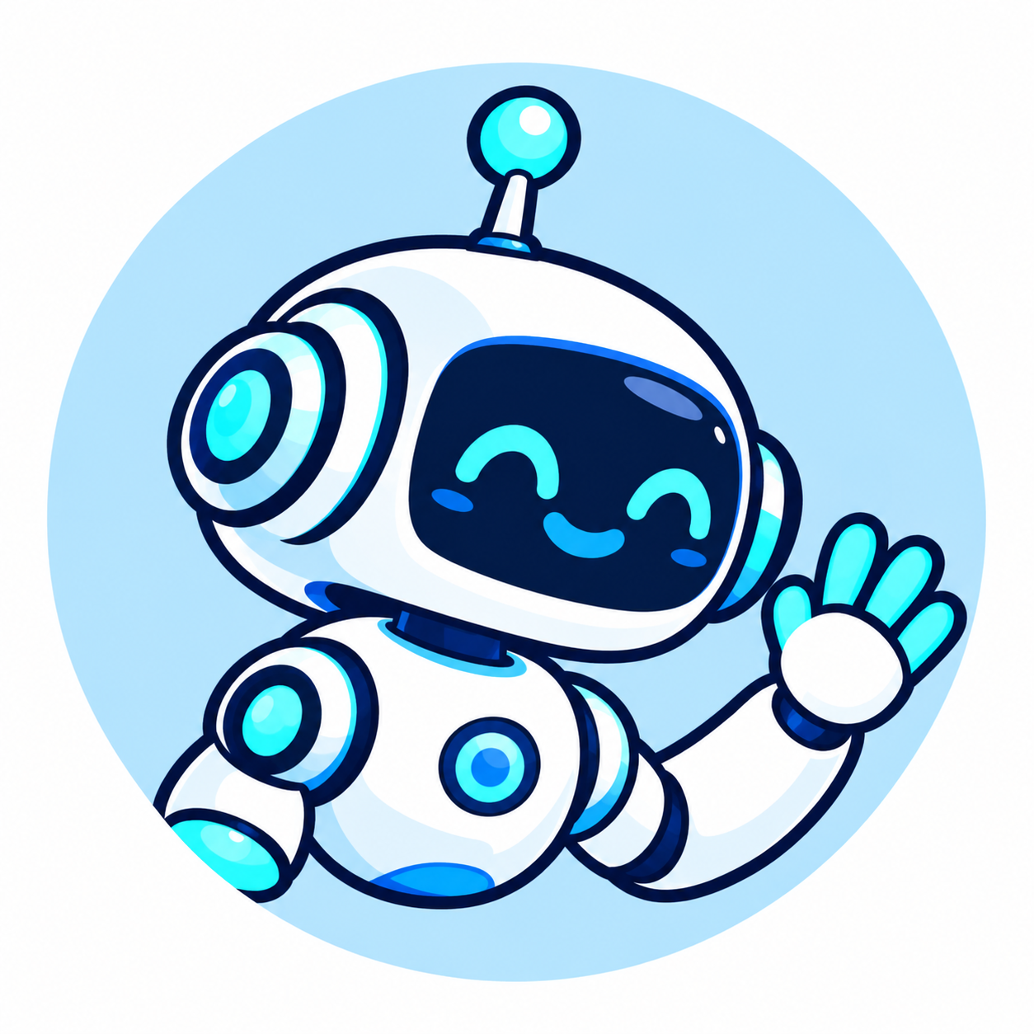
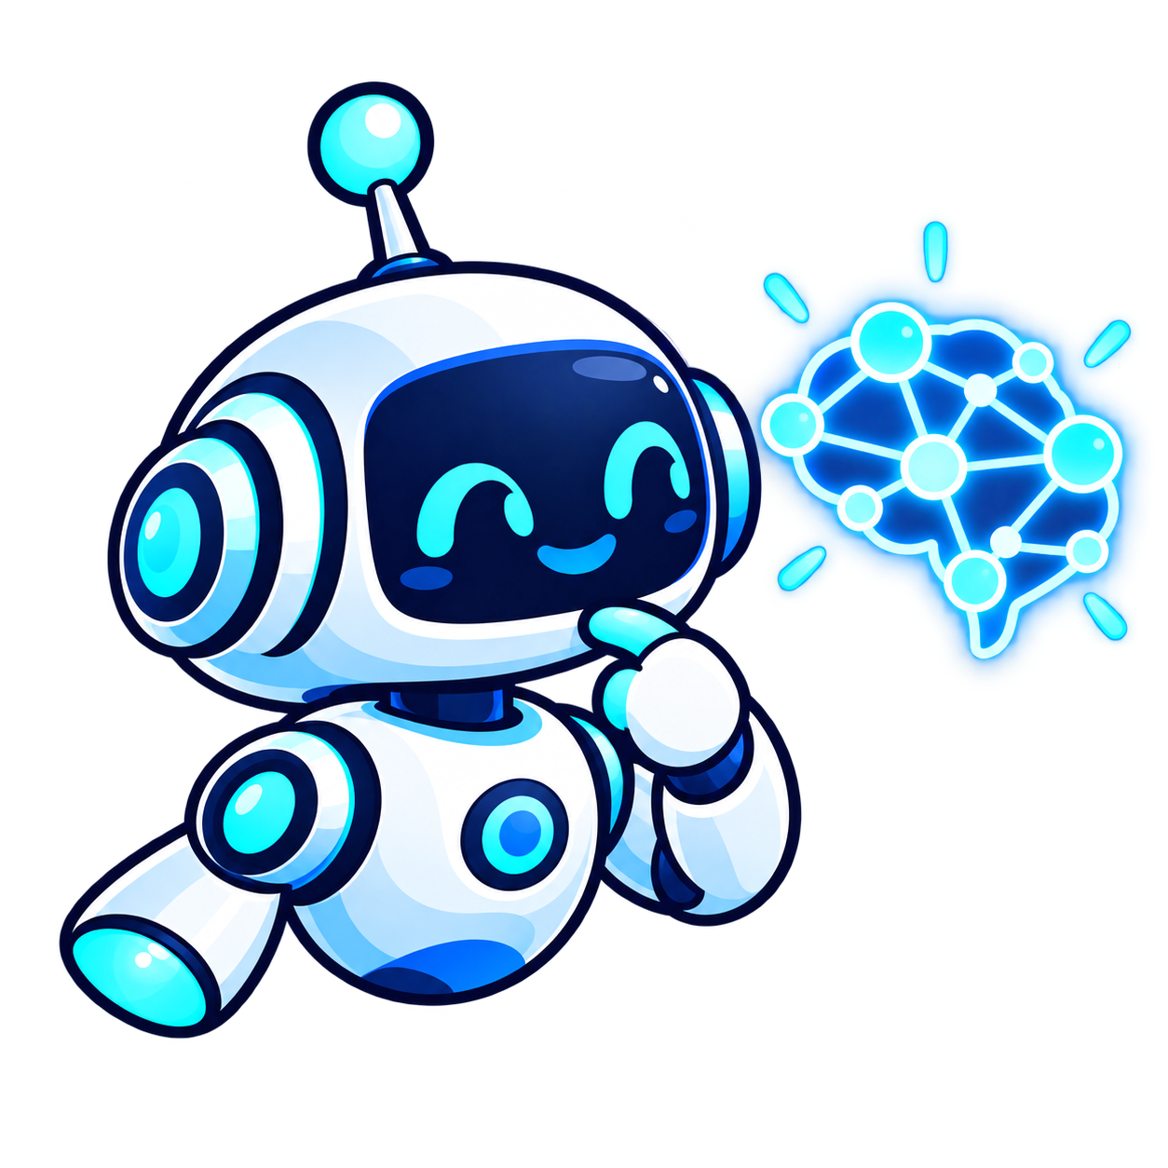
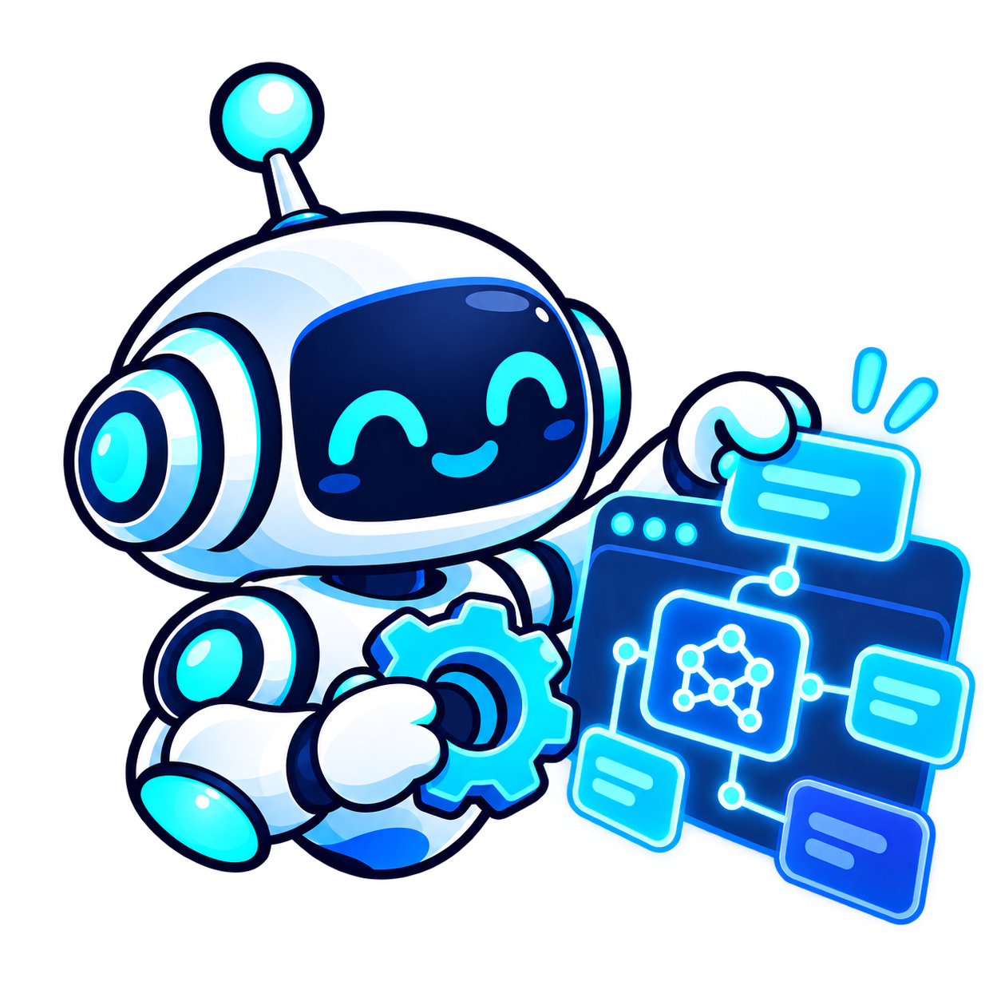
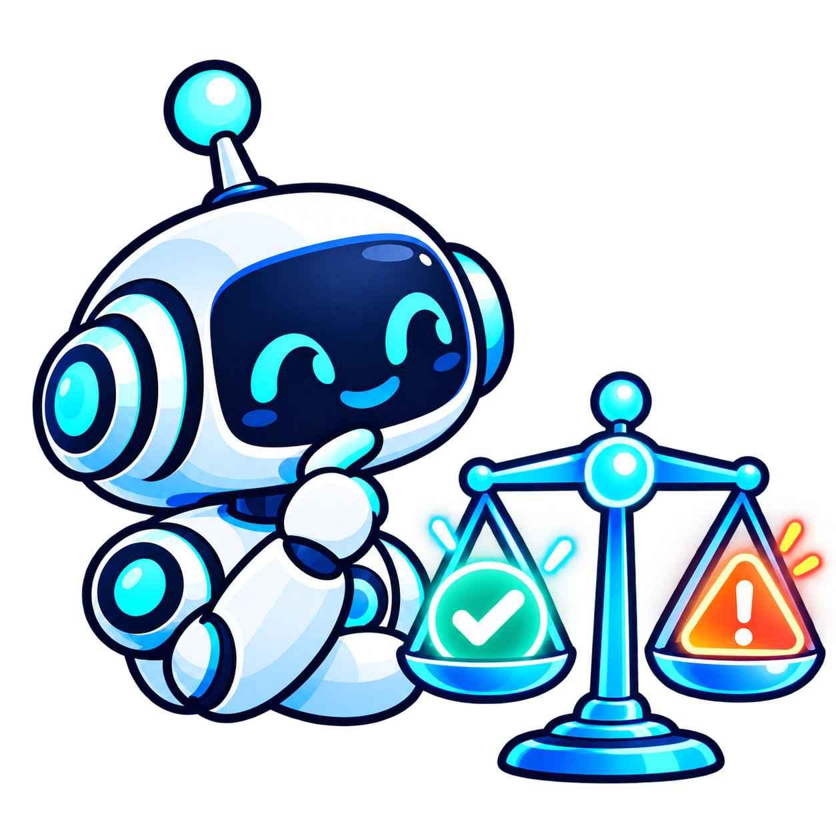

Your Year in AI
This year we will….
01
Learn how AI actually works
02
Build with AI
03
Question AI's risks and limits
04
Collaborate on larger projects
03
Possible extras: Guest speakers and a hackathon
03
Notes:
Frame these as things members will do, not things they will only hear about. Mention guest speakers and a hackathon briefly as possible extras. Tease: we are building things members are allowed to break.

Slide 3
AI hot takes
AGREE
UNSURE
DISAGREE
Move to one side of the room!
01
“AI-generated art is real art.”
“Schools should allow AI on assignments if students explain how they used it.”
02
04
Notes:
Try to ask one exec/pr and one new club member from each side (agree or disagree).

Slide 4
Prompt Battle: Write the best prompt
BATTLE ROUND
3 MINUTES | TEAMS OF 3–4
Your goal: Write a prompt that would make an AI explain “How does a chatbot work?”
AUDIENCE
A Grade 9 student
LENGTH
Under 80 words
ANALOGY
Use a school-life analogy
JUDGING
Clarity, then accuracy, then creativity
05
Notes:
Show the baseline AI response first as the before picture. Explain the judging criteria. After voting, ask: Which instructions helped? Did any analogy become misleading? Land the takeaway: specific prompts help, but convincing answers still need checking.

Slide 5
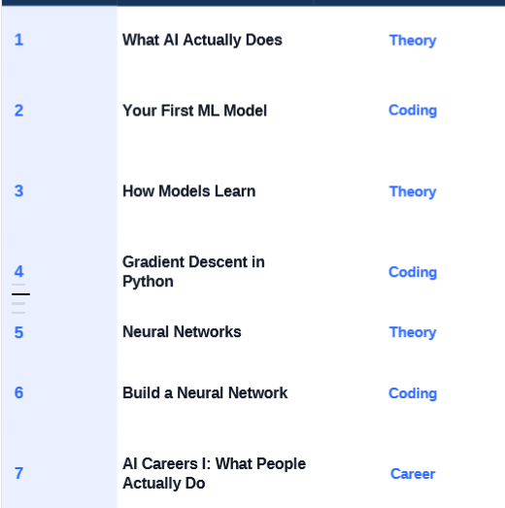
Next Meeting:
Sneak peek into future meetings:
What AI actually does (ML vs generative AI; training, inference, models and data)
Notes:
Tease the next few meetings. Mention that they can check out our roadmap on the website(next slide)

Slide 6
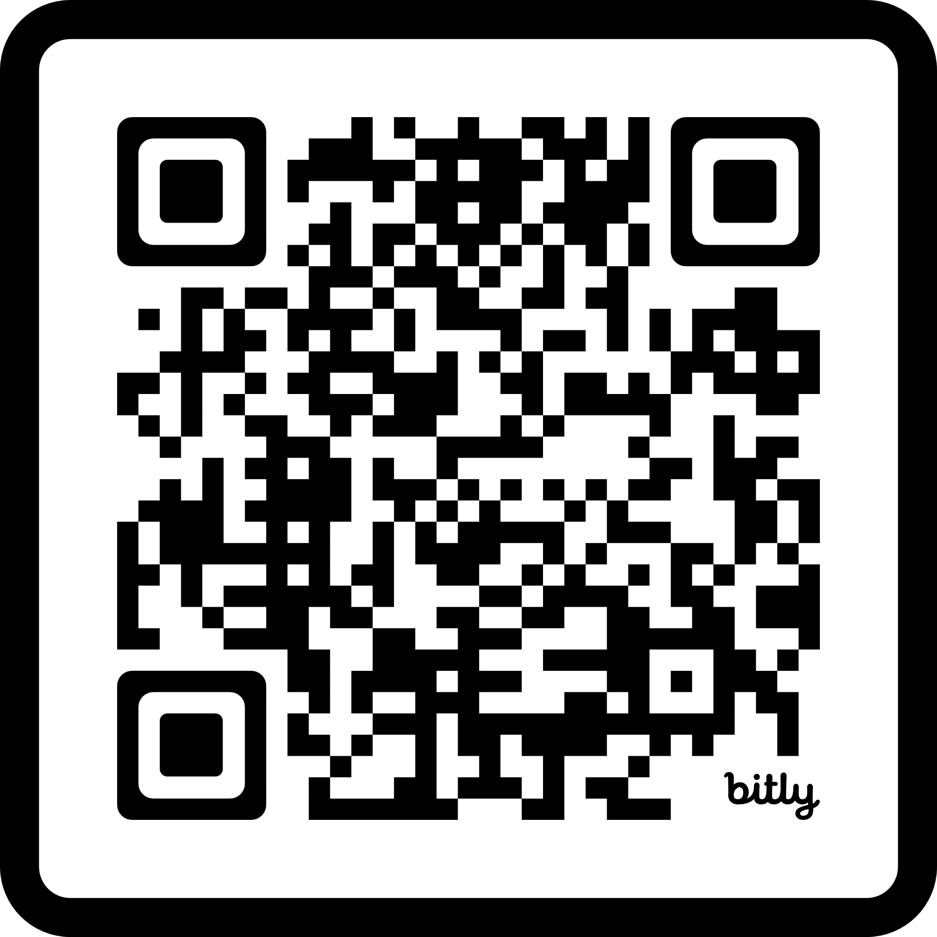
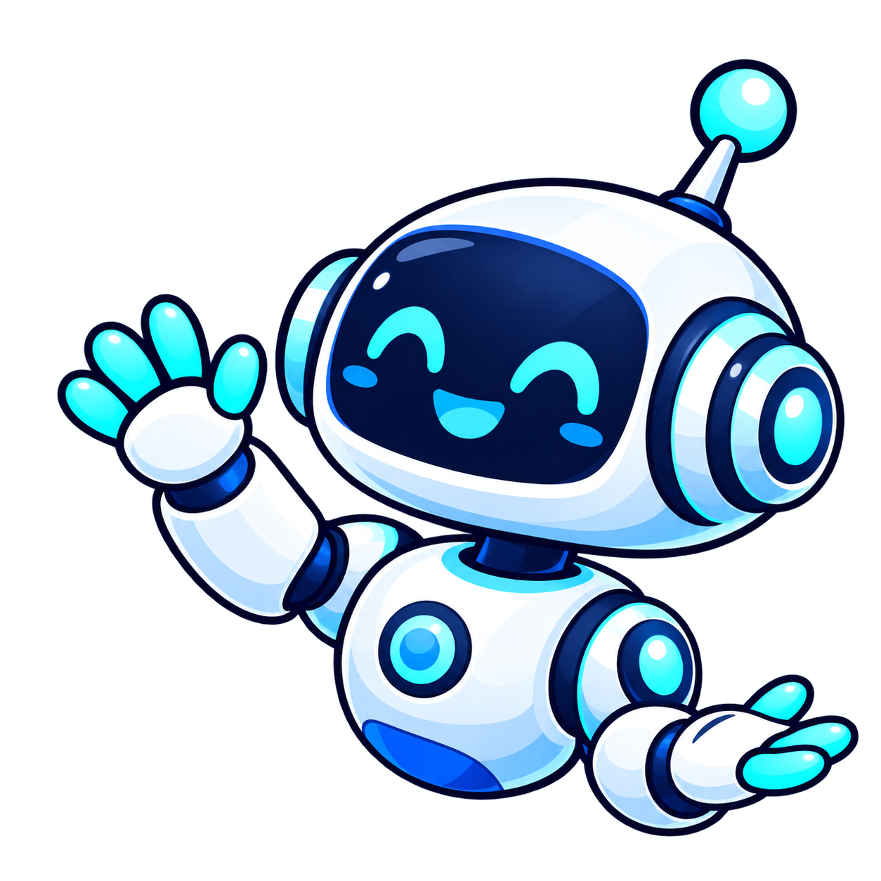
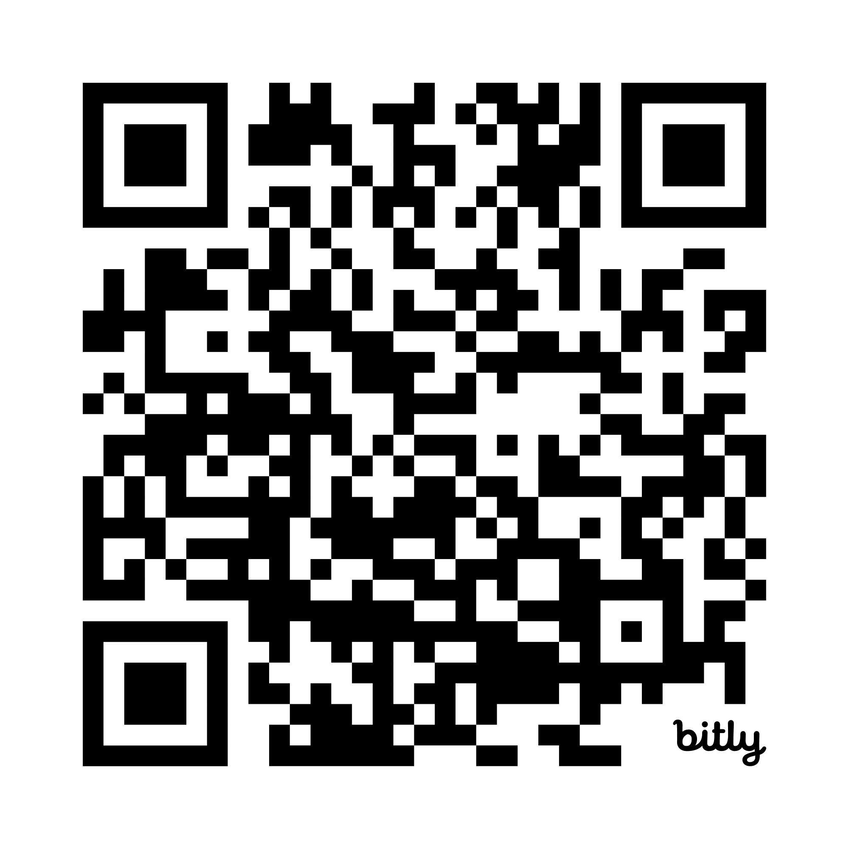
Join Bayview AI Club for an exciting, fun year!
Google classroom code (join with gapps): 7b6loaop
Website
Mysterious server(NOT DISCORD)…
04
Notes:
We will show how we will teach the students Artificial Intelligence, that would help the in the future. We will talk about how the teachers and the execs can help the members who are beginners to learn about AI and learn professional usage of Artificial Intelligence.

