Slide 1
ECO395M - Mid-term Project presentation
March 22, 2022
Finding Risk Factors for Diabetes
Team DIB
Ashesh Shrestha | Rishab Agarwal | Seungwoon Shin | Xiaohan Wu | Youngseok Yim
Notes:
Hello, my name is Yim, And I am presenting for my team DIB.
Our project was to find risk factors for diabetes.

Slide 2
Contents
Goal of the Analysis
Data Source and Cleaning
Methodology and Findings
Limitations and Areas fore more research

Slide 3
Goal of the Analysis
Research Questions
What lifestyle factors, such as food intake, physical exercise, smoking/alchohol, are most related to diabetes?
What medical risk factors are most related to diabetes?
Notes:
Inspired by study on child BMI in our econometrics class last year,
We tried to look for diseases that has significant effects on American people.
And that was Diabetes.
According to CDC, as of 2020, 37 million people have diabetes. That’s 11.3% of the US population
According to some study, the estimated cost of diabetes, in total, is about U$ 327 billion in 2017, and the number is rising.
Based on this ideas, we set up a research questions as follows
- What lifestyle factors, such as food intake, physical exercise, smoking/alchohol, are most related to diabetes?
- What medical risk factors are most related to diabetes?

Slide 4



II. Data Source and Cleaning
Health-related telephone surveys, annually
State data about U.S. residents regarding their health-related risk behaviors, chronic health conditions, and use of preventive services.
More than 500,000 interviews
Notes:
As a next step,
We looked for health related data that is conducted in national level.
And CDC has one.
Among many data published,
BRFSS(The Behavioral Risk Factor Surveillance System) data caught our eyes.
BRSFF conducts health-related telephone surveys that collect state data about U.S. residents
regarding their health-related risk behaviors, chronic health conditions, and use of preventive services.

Slide 5
II. Data Source and Cleaning (continued)
Data for Analysis
211,319 individuals
Raw data
500,000 respondents
300+ questions
Physical/Mental Conditions
state-specific data on
health risk behaviors,
chronic diseases and conditions,
access to health care,
use of preventive health services
in the United States.
BMI
Heart disease
Cholesterol level
Blood pressure
Behavioral Factors
Physical workout
Food intake
Alcohol
Smoking
Demography
Income
Education
Sex
Age
Notes:
Although questions are almost the same across years,
some questions are newly introduced or omitted for different purpose on annual basis.
We picked 2017 data,
because, different from other years,
it has detailed questions regarding food intake behaviors like daily servings of vegetables, French fries, fruit juices etc.
The original data has 500,000 respondents’ answers to 300+ questions.
All of the answers are categorized in numbers or have its own unique numeric values.
And, for our analysis, we selected 13 independent variables and reorganized them to three categories:
And eventually by cleaning data, we managed to trimmed them down to 211,319 rows of data.

Slide 6
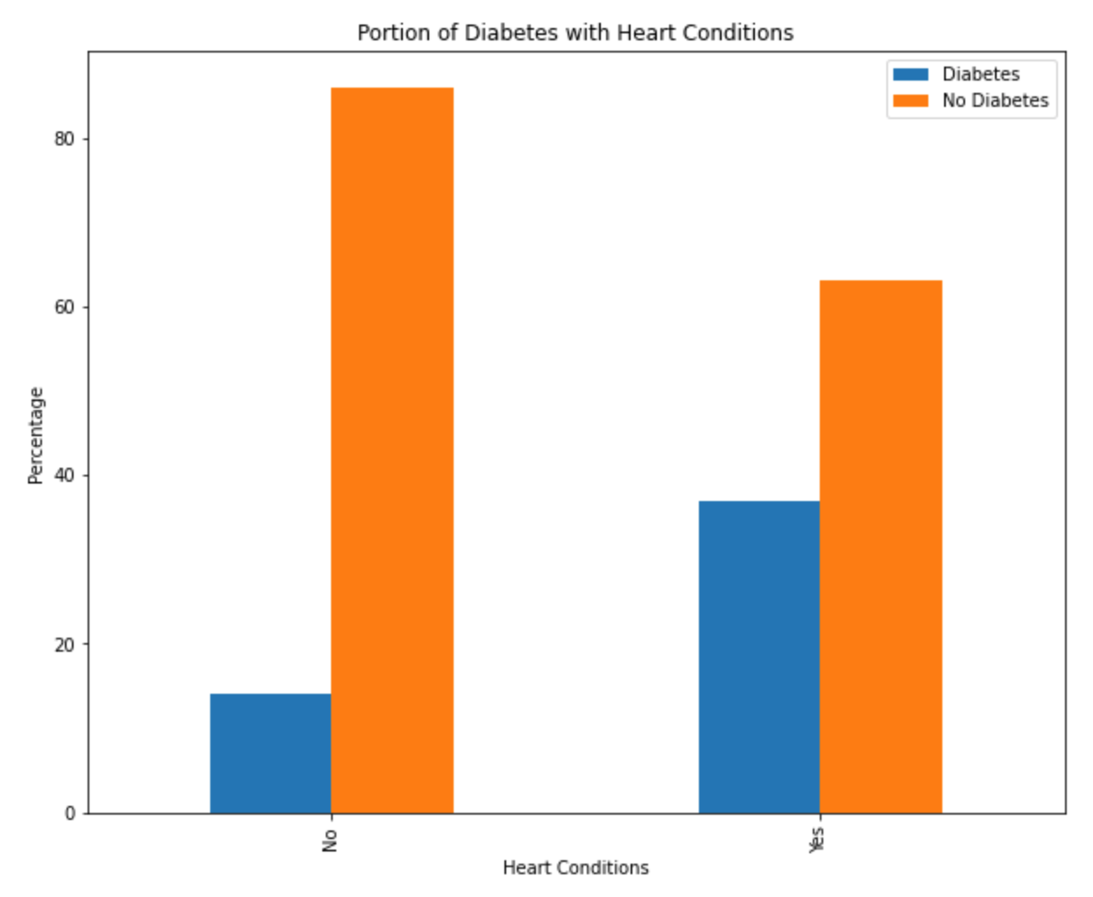
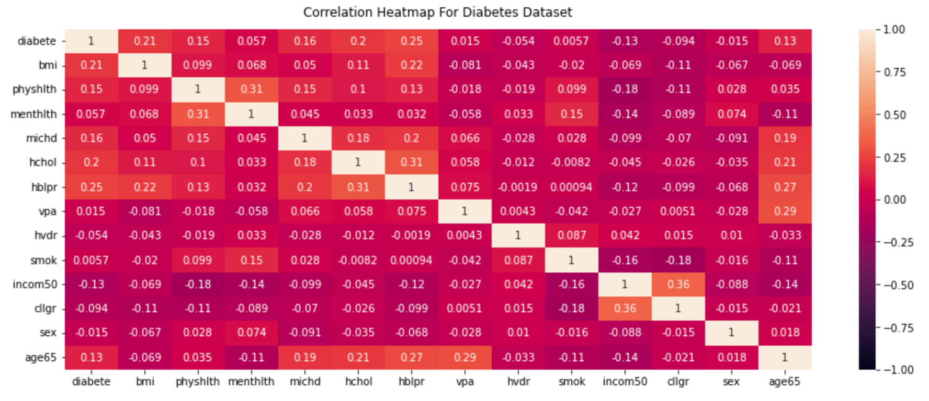
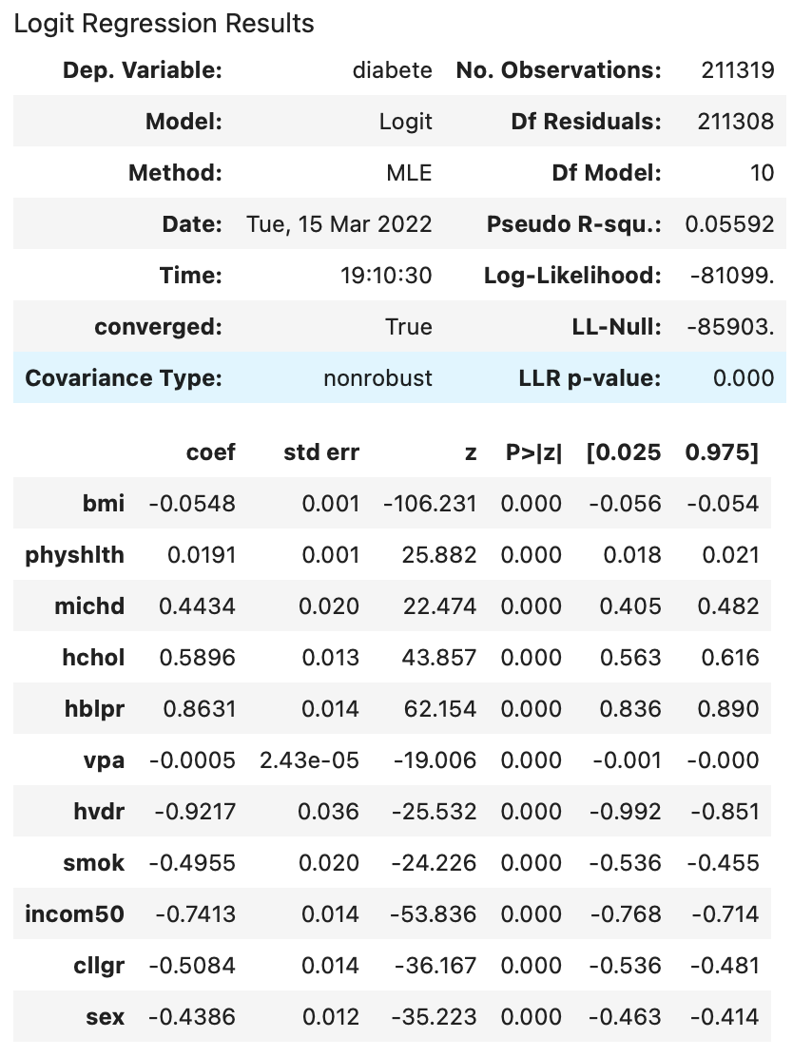
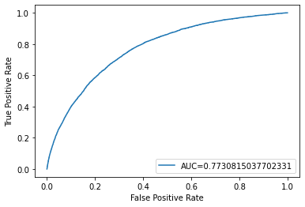
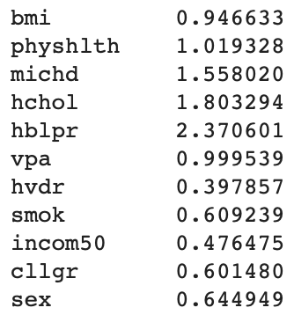
III. Methodology and Findings
Step 1. Data overlook and cleaning
Step 2. Multiple Logistics Regression
Notes:
As for the methodology,
First,
to see the overall picture of diabetes, we selected several variables regarding demograhy, lifestyle factors, and the related medical conditions, and constructed basic graphs.
We witnessed that some patterns or correlations between diabetes and those variables.
And based on the overall picture of the data, we concluded that those tentative variables are worth analyzed to answer our research questions.
We cleaned the data by dropping missing values, ambiguous answers such as 'don't know',
we came up with 13 independent variables. We then further renamed and reorganized the each variables to fit the statistical model we were going to use.
Second,
We did simple multiple regression to see if it fits the dataset. But as it turned out, multiple logitstics regression was for better fitting of the dataset,
because diabetes is the binary response variable with multiple independent variables.

Slide 7
III. Methodology and Findings(continued)
55% greater risk if you have Heart Conditions
80% greater risk if you have High Cholesterol
137% greater risk if you have High Blood Pressure
52% less risk if you earn annual income of $ 50,000 or more
40% less risk if you have higher education(more than bachelor)
Odd Ratio
Notes:
From the odd ratio calculated from the logistics regression results,
we have found some factors are related to the diabetes.
As you can see here:
If you have heart conditions, high cholesterol, or high blood pressure level, the risk of getting diabetes gets higher.
Whereas, if you earn annual income of 50,000 or more, the 50,000 is US median income, or if you have higher education,
you would have 52% less risk of having diabetes.

Slide 8
IV. Limitations and Areas for more research
Limitations of the data
Too many extreme values in some variables that we wanted to analyze.
Limitations of the analysis and Areas for more research
As for Drinking and Alcohol, we need a method of follow-up study rather than analyzing cross-sectional data
Additional Models
Bootstrap Aggregating/ Bagging Classifier
Random Forest Classifier
Gradient Boosting Classifier
Notes:
While doing this research and analysis,
we have found that there are some limitation of the original data.
One of the lifestyle factors that we WANTED to analyze was the food intake such as vegetables, fruitjuice, etc. The original survey did contain those data.
For example, "Total vegetables consumed per day", "Total fruits consumed per day", "How often did you eat any kind of fried potatoes, including french fries, home fries, or hash browns?".
However, the numbers contain too many extreme values that cannot be modified to get valid statistics. We dropped those variables eventually.
It is possible that many respondents misunderstood the survey questions and the interviewer didn't intervene to correct the answers.
And as for more areas of research,
There’s one we want to point out is that
According to the Odd Ratio, drinking(hvdr) and smoking(smok) seem to have reverse relationship with the diabetes.
However, many medical studies show the opposite: if you drink or smoke, you would have higher chance of getting diabetes.
The reverse relationship we obtained is due to the features of our cross-sectional data:
cross-sectional data is simply a snapshot of samples in certain point in time.
So, in order to elaborately examine the relationship, we need a follow-up studies which traces smoking or alcohol intake behaviors of the subjects for certain time periods.

Slide 9
Thank you for listening !

