Slide 1
ECO395M – Final Project presentation
May 13, 2022
Searching for the best city to live
DIB
Notes:
Hello, we are project team DIB. Our project was to find the best to city to live in the world.

Slide 2
Goal of the Analysis
Data Source
Data Description – the Indexes
Methodology
Findings
Limitations and Areas fore more research
Contents
Notes:
I will go through the whole process of our project and then play with an interactive dashboard we created to find out about the cities of our interest.

Slide 3
Goal of the Analysis
Our Questions
What are the best cities to live?
What are the factors that affect the quality of life in that cities?
How the ranking of some of those cities change over the last 5 years?
Notes:
Nowadays, more than 50% of the world's population lives in cities. In the USA, 83% of the population lives in urban areas.
Your quality of life very much depends on what city you live.
We want to find out what are the best cities to live in the world and in the US,
what are the factors that affect the quality of life in that cities,
how the ranking of some of those cities change over the last 5 years.

Slide 4





II. Data Source
Organizations and their Researches
The Global Livability Index
Quality of Life Survey
World's Best Cities To Live
Quality of living city ranking
Quality of Life Index by City
….. and more
Notes:
In search of relevant data sources, we found several sources that regularly release the data on the livability of cities around the world.
For example,
The Economist Group has the ‘Global Livability Index’,
Global affairs and lifestyle magazine based in UK, Monocle, has ’Quality of Life Survey’
Global Finance, based in New York city, also a magazine, announces ’World Best cities to Live’, every year.
Mercer, the consulting firm, has Quality of living city ranking’. I heard that many companies running overseas branches calculate their employees’ salaries and benefits based on the Mercer’s indexes.

Slide 5
II. Data Source
Vienna, Austria
Zurich, Switzerland
Vancouver, Canada
Munich, Germany
Auckland, New Zealand
Dusselforg, Germany
Frankfurt, Germany
Copenhagen, Denmark
Geneva, Switzerland
Basel, Switzerland
London, UK
Tokyo, Japan
Shanghai, China
Singapore
Melbourn, Australia
Sydney, Australia
Paris, France
Beijing, China
New York city, USA
Amsterdam, Netherlands
Auckland, New Zealand
Osaka, Japan
Adelaide, Australia
Wellington, New Zealand
Tokyo, Japan
Perth, Australia
Zurich, Switzerland
Geneva, Switzerland
Mebourne, Australia
Brisbane, Australia
Notes:
If we look at their latest announcement of the rankings of Top10 cities,
We can see that there are some variations due difference in criteria, and method of gathering data.

Slide 6
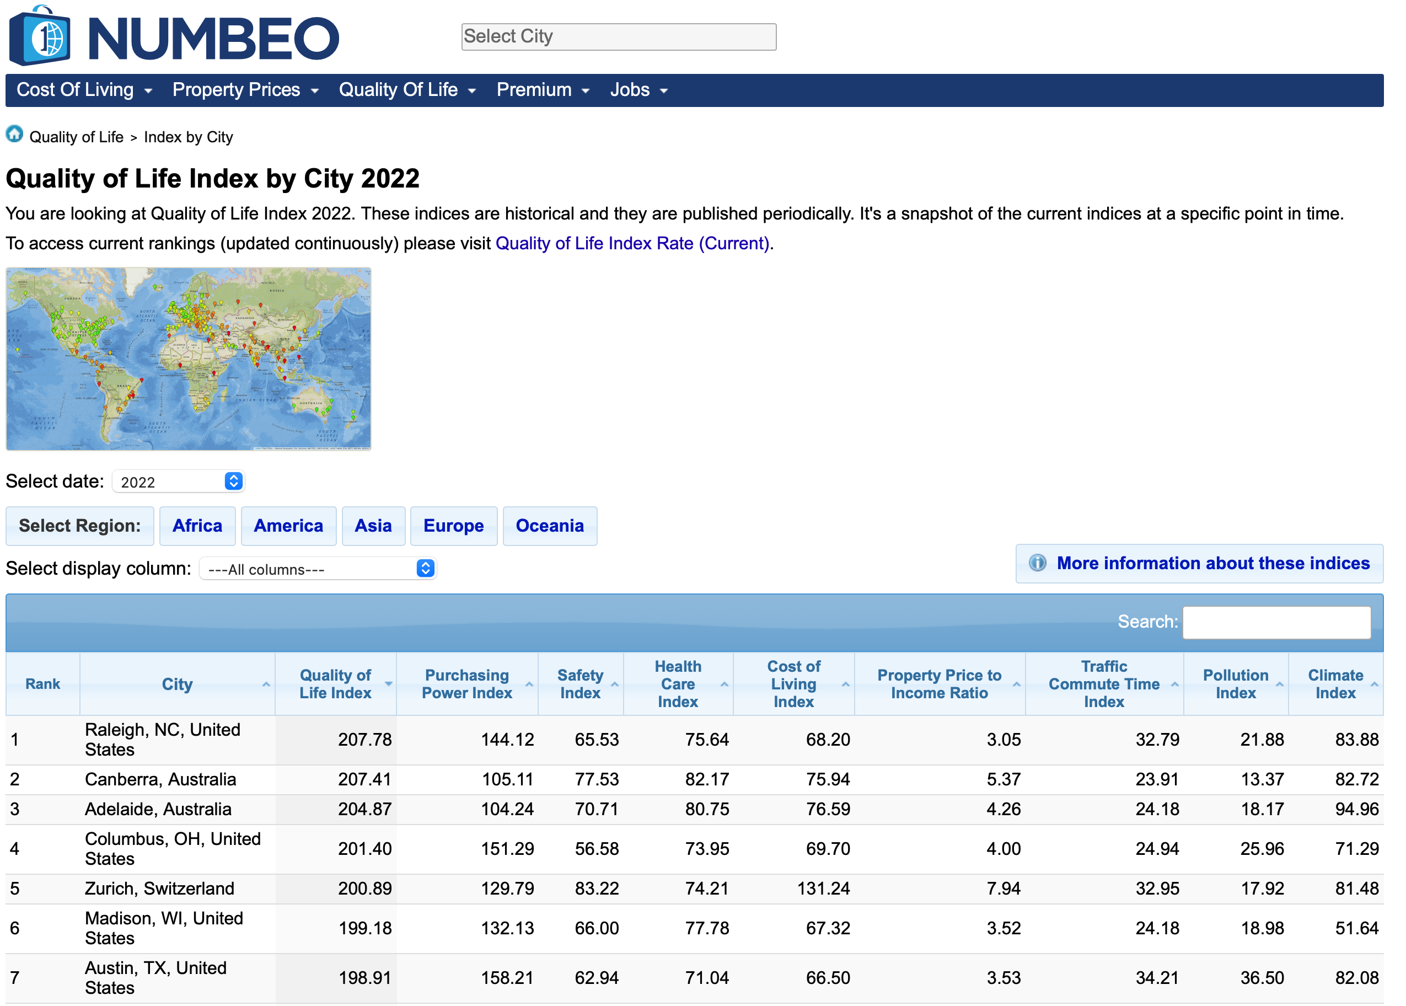
II. Data Source
Notes:
The one that we chose was NUMBEO.
Some of the reasons for the choice are…
Numbeo is the world’s largest cost of living database, as they claimed.
Numbeo is a crowd-sourced global database, which is free. And NUMBEO provides full data on its web page which we could web-scrape.
As you can see in the snapshot of NUMBEO’s web page, you can see the full table of indexes it uses to calculate its main index of our interest, the Quality of Life Index

Slide 7
III. Data Description - the Indexes
Formula
100 + (Purchasing Power Index / 2.5)
- (House Price To Income Ratio * 1.0)
- (Cost of Living Index / 10)
+ (Safety Index / 2.0)
+ (Health Index / 2.5)
- (Traffic Time Index / 2.0)
- (Pollution Index * 2.0 / 3.0)
+ (Climate Index / 3.0)
Quality of Life Index
Notes:
If we look closer at the NUMBEO’s indexes,
“Quality of Life Index” is calculated based on 8 sub-indexes with different weights.
They are purchasing power including rent, safety, healthcare, cost of living, property price to income, pollution, and climate.

Slide 8
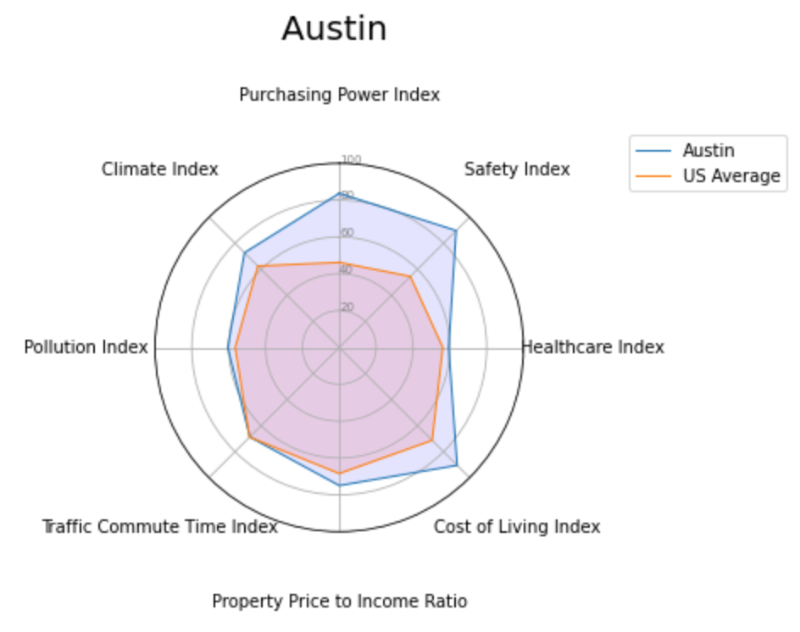
III. Data Description - the Indexes
Notes:
Basically, you will see results like this radar chart where, each sub-index are aggregated to form the competitiveness of a city of your interest

Slide 9
III. Data Description - the Indexes
Quality of Life Index
Purchasing Power Index
Average net salary’s buying power
Cost of Living Index
Basic goods, transportation, utilities, Excl Rent
Property Price to Income Ratio
Price of median apartment vs Income
Traffic Commute Time Index
Time taken, dissatisfaction, CO2 consumption
Climate Index
Moderate temperature, low humidity
Safety Index
Surveys of the website
Healthcare Index
Surveys of the website
Pollution Index
Surveys of the website
Notes:
Before we go into findings and analysis,
I want to briefly explain each index
Purchsing Power Index is a relative purchasing power in buying goods and services in a given city for the average net salary in that city.
Cost of Living Index is a relative indicator of consumer goods prices, including groceries, restaurants, transportation and utilities. And that exclude rents
Property Price to Income Ratio is the ratio of median apartment prices to median family disposable income
Traffic Commute Time index a composite index of time consumed in traffic due to job commute, dissatisfaction caused by the commute, CO₂ consumption estimation in traffic and overall inefficiencies in the traffic system.
Climate Index estimation of the climate likability. For example, cities with the full mark, have moderate temperatures and low humidity and no other major weather condition which is usually not preferred by most people.
Safety, Healthcare, Pollution index are produced based on surveys from visitors of the website. Unfortunately, specific survey
questions are not public,
NUMBEO claims that surveys are similar to other scientific and government surveys.
Also, They claims that they have statistical tools to minimize the bias.
We took last 5 years of the data which is between 2018 and 2022 for our analysis and visualization.

Slide 10




IV. Methodology
Step 1. Web-scraping
Step 2. Data-wrangling
Step 3. Analysis and Visualization
Step 4. Interactive Dashboard
Notes:
As for the methodology,

Slide 11
V. Methodology
Step 1. Web-scraping
Link : NUMBEO
Notes:
Basically, there are tables of the indexes year by year. We scraped the yearly tables
And scrape the continent by continent table to merge to the year-by-year tables.

Slide 12
IV. Methodology
Step 2. Data-wrangling
Scaling: Min-Max Normalization
100 for maximum value 0 for minimum value
Higher score reflects better condition
Converting to Ranking values
Create USA-specific data
51 cities in USA (2022)
Separate scaling and ranking
Downloading Geometrical information for each city
Geopandas
Notes:
First, scale the data by min-max normalization, where we gave 100 for maximum value and 0 for minimum value.
Also, scaled the data so that higher number of index reflects better conditions.
And in addition we created new table by converting index numbers to ranking numbers for later data visualization
And, we separated data for the US cities for those users who would be interested to see relative positions of the cities in the US.
Finally, in order to plot rach city on a map, we downloaded geometrical data such as latitude and longitude using GEOPANDAS

Slide 13
IV. Methodology
Step 3. Analysis and Visualization
Tables, maps, graphs
Step 4. Interactive Dashboard
User-friendly multi-page dashboard with options for search
Notes:
Next step, we analyze the data overall, and visualize the data in various aspects.
And then put those results on a interactive dashboard using Streamlit

Slide 14
V. Findings
See and explore
the Streamlit Interactive Dashboard
https://share.streamlit.io/adamysyim/quality-of-life-eco395m-final/main/app.py

Slide 15
VI. Limitations and Areas for more research
Limitations of the data
Surveys in English. Samples restricted to English-speaking respondents
Since everyone has difference preferences and experiences, those indexes based on surveys might not accurate
Areas for more research
Data such as ‘change in population’ and ‘rate of population influx/outflux’ can be matched with the ‘change in the ranking on Quality of Life’ of each city to see the correlation. This could be developed further into modeling
We can further investigate correlations between indexes.
Notes:
Health, Pollution, Safety indexes are based on surveys on the visitors of the website.
Surveys are in it is in English, so respondents might be restricted to English-speaking people, which may end up in bias.
As for more areas of research, we can look for census data such as change in population and rate of population influx/outflux and match them with our ‘change in the ranking on Quality of Life Index’ of each city to see the correlation.

Slide 16
Thank you for listening !

