Slide 1



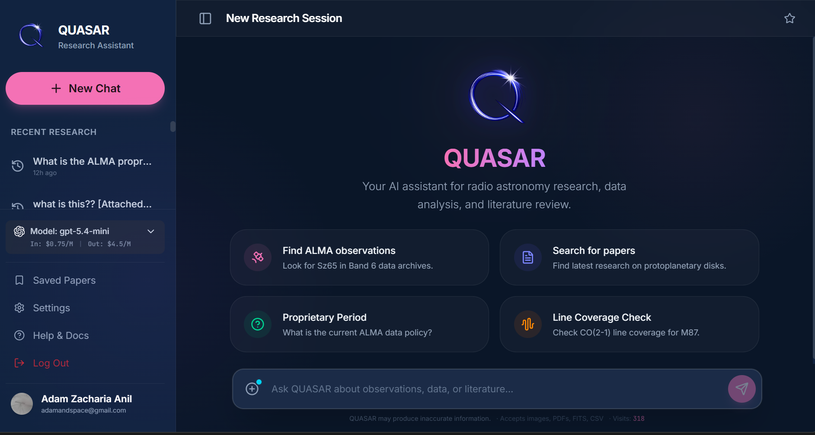
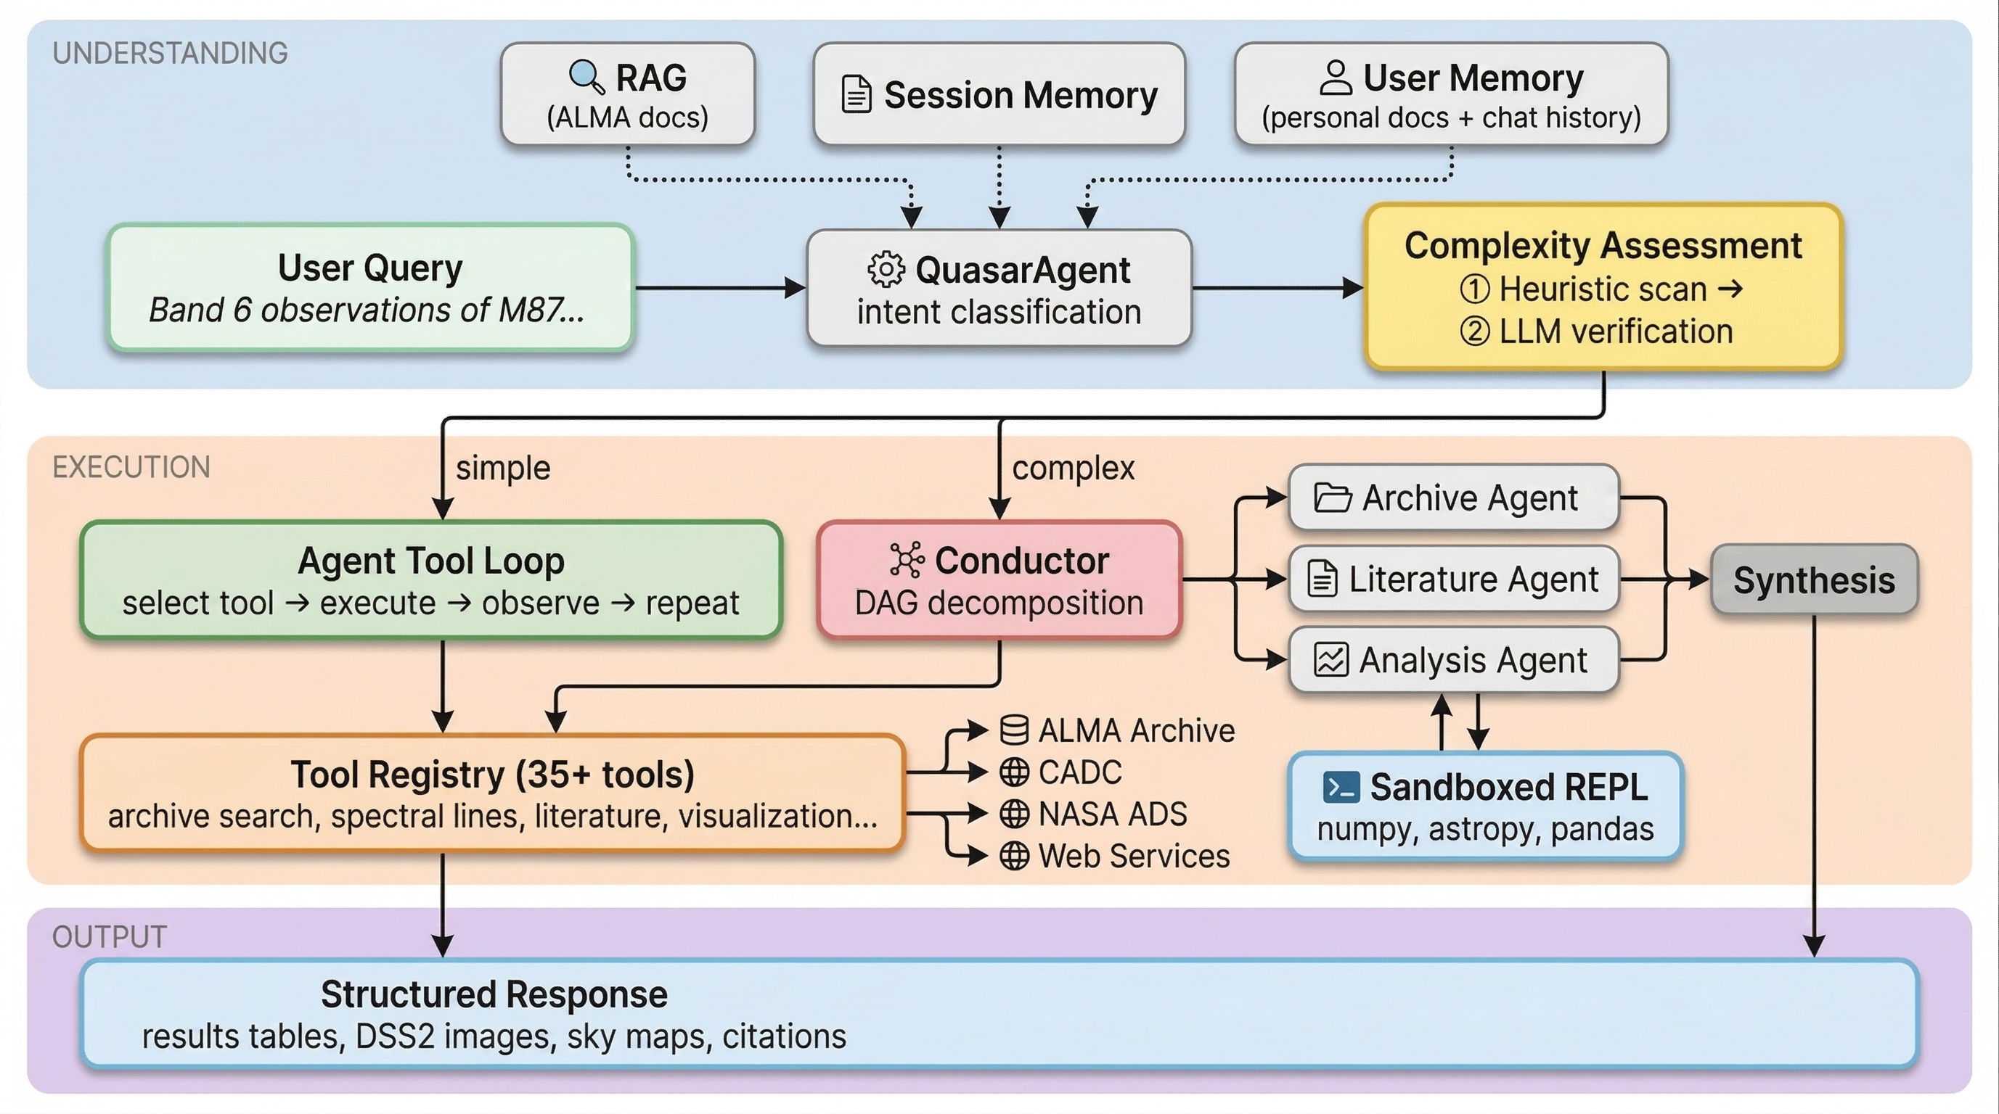



QUASAR
An AI-Powered Research Assistant
for Astronomy Archive Workflows
Adam Zacharia Anil^{1,3} · Adele Plunkett^{1,3} · Brian Mason^{1,3} · Stella Offner^{2,3}
¹National Radio Astronomy Observatory ²University of Texas at Austin ³NSF-Simons AI Institute for Cosmic Origins
https://www.adamzacharia.com/
Quasar lets researchers search, retrieve, and analyze astronomy archive data through natural language with ease.
MOTIVATION
.
The Atacama Large Millimeter/submillimeter Array (ALMA) Science Archive contains more than a decade of public radio astronomy observations, with over 2 PB of data covering a range of scientific applications. The challenge is not just that datasets can be large; the research pipeline often requires moving between archive searches, metadata tables, documentation, papers, and analysis code. Quasar helps researchers start with a scientific question and address it with the necessary archive searches, data retrieval, literature lookup, calculations, and readable final results.
Rather than removing the scientist from the process, Quasar uses AI to reduce the busywork between knowing what to study and actually finding, checking, and using necessary archival data. As a result, Quasar makes archival data more discoverable for astrophysics use cases.
HOW IT WORKS
Users ask natural-language astrophysics questions through the web interface (Fig. 1).
Quasar retrieves relevant context from ALMA documentation (almascience.org), uploaded user files, conversation memory, and optional archive or web search results.
A two-stage complexity detector routes simple queries to a direct tool-based search-and-response workflow, while complex queries are sent to the Conductor for subtasks such as observation search, frequency-coverage checks, calculations, literature lookup, and result synthesis.
Specialist sub-agents for Archive, Literature, and Analysis execute subtasks sequentially or in parallel, depending on dependencies. For precise computation, the Analysis agent runs sandboxed Python.
The overall architecture is shown in Figure 2. Code and implementation details are available at:
https://github.com/adamzacharia/Quasar
Fig. 1: Quasar web interface. Live at https://www.quasarassistant.com/
Quasar currently focuses on ALMA workflows, with ongoing work to expand support to additional astronomy archives, multi-wavelength datasets, and broader research tasks.
Fig. 2: System architecture: simple queries route through the Agent Tool Loop; complex queries decompose through the Conductor into specialist Archive, Literature, and Analysis agents.

