Slide 1


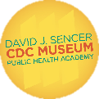

Keeping Food Healthy
Notes:
Have you ever purchased strawberries or blackberries at the grocery store and tasted one before you got home to wash it? You may want to rethink your decision.
Note: These slides are made possible by the David J. Sencer CDC Museum Public Health Academy. https://www.cdc.gov/museum/education/lessons/

Slide 2
Terms to Know
 | people who help collect data for research projects conducted by professional scientists
 | microscopic living organisms
 | an action by a food manufacturer to protect from food that might cause health problems
 | when bacteria or other harmful microorganisms spoil food
 | bacteria found in the intestines of people & animals; most cause salmonellosis
 | the science of protecting and improving the health of people and their communities
 | any illness resulting from spoilage of contaminated food
 | bacteria found in the environment, foods, & intestines of people and animals
Word Bank
contamination
citizen scientists
Salmonella
bacteria
public health
food recall
foodborne illness
E. coli
Notes:
Terms to know:
Citizen scientists: people — young or old — who help collect data for research projects conducted by professional scientists
Bacteria: microscopic living organisms that can be found everywhere; some bacteria are good for your body, while other types can be very harmful
Food recall: an action by a food manufacturer to protect us from food that might cause health problems due to contamination; when food is recalled, it is removed from the shelves
Contamination: when bacteria or other harmful microorganisms spoil food; it is a common cause of food poisoning
Salmonella: bacteria found in the intestines of people and animals; most types of Salmonella cause salmonellosis, which causes diarrhea, fever, and stomach cramps, and sometimes infection in the urine, blood, bones, joints, or the nervous system
Public health: the science of protecting and improving the health of people and their communities
Foodborne illness: any illness resulting from the spoilage of contaminated food, pathogenic bacteria, viruses, or parasites that contaminate food
Escherichia coli (E. coli): bacteria found in the environment, foods, and intestines of people and animals; most strains of E. coli are harmless, while others cause diarrhea, urinary tract infections, respiratory illness, pneumonia, and other illnesses

Slide 3
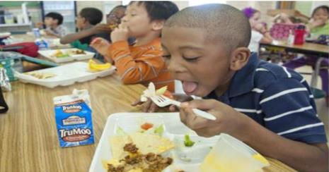
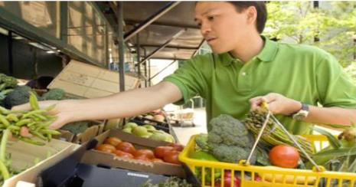
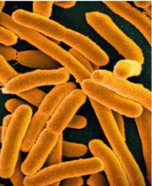
Understanding Foodborne Diseases
Foodborne illness outbreaks:
when two or more people get the same illness from the same contaminated food or drink
Two of most common outbreaks caused by:
E. coli
Salmonella
Notes:
Foodborne illness outbreaks happen when two or more people get the same illness from the same contaminated food or drink. Detecting an outbreak, finding out the cause, and determining steps to stop the outbreak are very important. Two of the most common outbreaks are caused by E. coli and Salmonella. Simple steps like washing your hands, keeping food at the correct temperature, and cleaning your produce can have a positive impact.

Slide 4

Think About It
Are all bacteria harmful?
What are two bacteria that can be found in the human intestines?
Have you heard of any food items that were recalled?

Slide 5
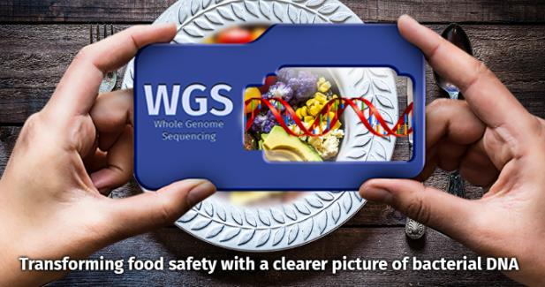
Food Safety and CDC
Division of Foodborne, Waterborne, and Environmental Disease at CDC
monitor surveillance systems that track + monitor reports of foodborne & waterborne diseases
PulseNet:
national laboratory network
connects foodborne illness cases to detect outbreaks
uses DNA fingerprinting of bacteria making people sick
Notes:
Food Safety and the Centers for Disease Control and Prevention (CDC)
We are able to consume food without much thought about foodborne illness thanks to the work of many scientists within the Division of Foodborne, Waterborne and Environmental Disease. Together, they monitor the surveillance systems created to track and monitor reports of foodborne and waterborne diseases in the United States. Most often, information in these systems comes from state and local health agencies. Although some of these systems have been used extensively for decades, new surveillance methods have improved the quality, quantity, and timeliness of their data.
One of the surveillance systems CDC uses to track foodborne illnesses is PulseNet. PulseNet is a national laboratory network that connects foodborne illness cases to detect outbreaks. PulseNet uses DNA fingerprinting of bacteria making people sick to detect thousands of local and multistate outbreaks. Since the network began in 1996, PulseNet has improved our food safety systems through identifying outbreaks early. This allows investigators to find the source, alert the public sooner, and identify gaps in our food safety systems that otherwise would not be recognized.

Slide 6

Food Safety and CDC
FoodNet:
conducts surveillance for infections of nine foodborne bacterial and parasitic pathogens
tracks number of cases + where cases came from, monitors changes
FoodNetFAST:
charts + tables of foodborne illness data
Four steps to protect from food poisoning:
clean, separate, cook, and chill
Notes:
Another surveillance system used by CDC is FoodNet. FoodNet conducts surveillance in ten sites for infections of nine bacterial and parasitic pathogens transmitted commonly through food. FoodNet provides a foundation for food safety policy and prevention efforts in the United States in the following ways: estimating the number of foodborne illnesses, monitoring changes in how often they occur over time, and attributing illnesses to specific foods and settings.
Data from FoodNet can be found using FoodNetFAST (https://www.cdc.gov/foodnet/foodnet-fast.html), which provides charts and tables of the foodborne illness data collected for each year since 1995. Here you can also learn more about the 4 steps to protecting yourself from foodborne illness: clean, separate, cook and chill.

Slide 7
Think About It
Why would an E. coli outbreak with broccoli in California be important to residents of other states across the country?
What dangers could consumers experience if strict guidelines weren’t in place for food handling?
What safety protocols have you noticed when shopping for fresh produce in your local grocery store?

Slide 8
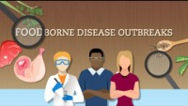
From the Expert
https://youtu.be/iIaKWNZhz74
Notes:
Sometimes foods we love to eat and rely on for good health are contaminated with bacteria, viruses, and parasites that cause illness, and can be deadly for certain people. Scientists at CDC are working to protect people and reduce foodborne illnesses. Watch this informative video from CDC about foodborne illness outbreaks and the important process of collecting information and quickly taking action. https://www.youtube.com/watch?v=iIaKWNZhz74
Learn about the anatomy of an outbreak & the steps in a food recall: https://youtu.be/kKDNEW8XHvs
Learn about the four steps to food safety: https://www.cdc.gov/foodsafety/

Slide 9
Think About It
Why should raw meat be prepared separately from fruits and vegetables?
Why is cooking food to the proper temperature important?
What do you think is the best way to convince other people to follow Clean, Separate, Cook, and Chill?

Slide 10
Give it a Try
Call to Action!
Conduct an Experiment with Fruits & Vegetables
Create a Public Service Announcement (PSA)
Share Your Findings
Why do you think participation is important?

Slide 11
Conduct an Experiment with Fruits and Vegetables
Ask
Ask a question
Research
Do background research
Hypothesis
Construct hypothesis
Test
Test with an experiment
Analyze
Analyze data
Draw conclusions
Conclusions
Share
Communicate results
Notes:
The scientific method is a great tool to use to create a plan to address possible bacteria that lurk on your fresh fruits and vegetables. Use the flow chart below to think out your plan. Record your answers on a piece of lined paper.

Slide 12
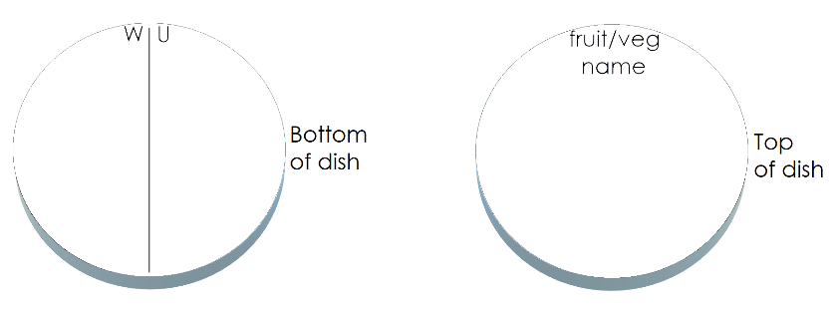
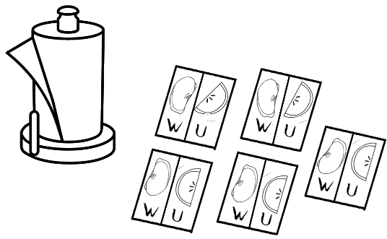
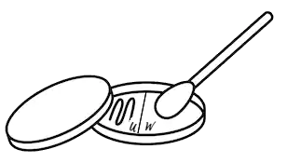
Give It a Try
1. Conduct an Experiment with Fruits & Vegetables
Prepare the petri dishes & cleansing solution
Prepare the fruits/vegetables
Conduct the experiment with unwashed and washed samples
Notes:
Safety First
Do NOT open the petri dishes once you have taped them closed. You could be culturing dangerous bacteria.
Proper disposal is critical for both safety and sanitation. Follow the guidelines at the end of the experiment to properly dispose of your petri dishes.
Tools of the Trade
5 unwashed fresh fruit/vegetable samples (Suggestions: strawberries, kale, lettuce, tomatoes, blackberries, cucumbers, spinach, sprouts, peaches)
Nutrient agar petri dishes (see link below for ordering information)
10 cotton swabs
1-gallon size sealable bag
Clear tape
Permanent marker
Plastic gloves
5 Paper towels
Large bowl
Spoon
Knife
2 cups of water
1 cup of bleach
½ cup of apple cider vinegar (optional)
Nutrient agar petri dishes are easy to order online. Here’s one source:
https://www.homesciencetools.com/product/nutrient-agar-prepared-media-plates-5-pack/
Prepare the Petri Dishes & Cleansing Solution
1. Wash your hands with soap and water.
2. Remove the petri dishes from the box and place them on a clean counter. Do not take the lids off the dishes yet.
3. Turn each dish over to the bottom. Use a permanent marker to draw a line down the middle of each dish. On one side of the line write “W” for washed. On the other side of the line, write “U” for unwashed.
4. Turn the dishes over and write the name of the fruit/vegetable on the top.
5. You now have a choice to make. You will decide which cleansing solution you will use to wash your fruit/veggies. Your choices are plain water, or a mixture of apple cider vinegar & water.
6. If you choose plain water, simply fill the large bowl with water. If you decide to use an apple cider vinegar/water mix, add both to the large bowl and gently stir with the spoon.
Prepare the Fruits/Vegetables
7. Place 5 paper towels on the table. Draw a line down the middle of each paper towel. On one side write “W” and on the other side of the line write “U.”
8. Cut the fruit/vegetables into many pieces.
9. Place a few pieces of unwashed fruit from each fruit/vegetable onto the five paper towels on the “U” side.
10. Place the remainder of the fruit/vegetable pieces into your cleansing solution. Soak the pieces for 5 minutes, gently rub each piece with your hands, and rinse the samples. Place each sample on the paper towel with the unwashed piece. Make sure to put the washed sample on the side marked “W.”
Conduct the Experiment with the Unwashed and Washed Samples
11. Use a clean cotton swab for each sample.
12. Wet each cotton swab with water.
13. Rub each piece of unwashed fruit/vegetable with the wet cotton swab. Be sure to swirl the cotton swab with your fingers as you brush it against the fruit/vegetable to make sure you have fully covered the swab.
14. Open the petri dish for the fruit/vegetable you just swabbed and draw a wavy line down the side labeled “U.”
15. Discard the cotton swab. Get a clean, wet swab for each sample. Repeat the process for each unwashed sample.
16. On the “W” side of each petri Dish, repeat the same process with the washed pieces of fruits/vegetables.
17. Using clear tape, seal each petri dish carefully.
18. Find a dark, cool place in your home for the petri dishes to remain for 1 week. Make sure the spot is safe from family members and pets. Often condensation will form in the petri dish. To make sure water doesn’t drip on the agar, turn each petri dish upside down.

Slide 13
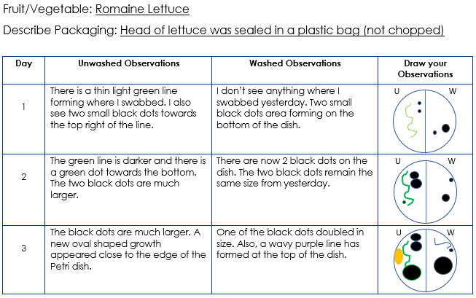
Give it a Try
1. Conduct an Experiment with Fruits/ Vegetables
Data collection
Disposal of your petri dishes
Notes:
Implementing the Plan: Data Collection
You will conduct data collection for one week.
Take a picture of each dish each day and use the chart below to document changes.
Use a different data collection table for each of the fruit/vegetable samples. Try to be very specific with your description and your drawing. Use your daily pictures to help with the details. This will allow you to truly see changes each day. See the example below.
Disposal of Your Petri Dishes
After 1 week of observations, place all the petri dishes into the gallon sealable bag. With a parent’s assistance, add 1 cup of bleach to the bag and seal it. Do NOT open the sealable bag once it is sealed! Any bacteria that has grown may be dangerous.
Throw the entire sealed bag of petri dishes into the trash.

Slide 14
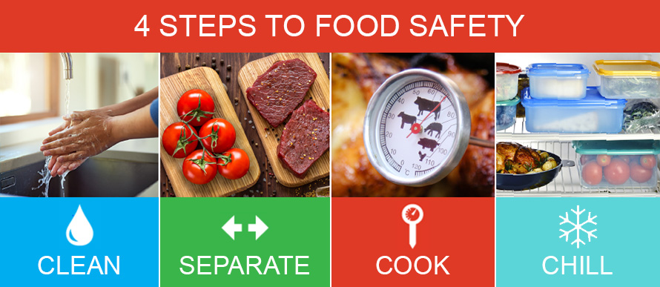
Give it a Try
2. Create a Public Service Announcement (PSA)
Topic: Four Steps to Food Safety
Notes:
Activity 2: Create a Public Service Announcement (PSA)
Topic: Four Steps to Food Safety: Clean, Separate, Cook, Chill
A Public Service Announcement (PSA) is an engaging way to tell others about an important topic. Usually, PSAs are created to encourage positive change in society. Perhaps you’ve seen a PSA about the dangers of smoking, or the need for sunscreen to prevent skin cancer. For this PSA, you will follow these steps to create a persuasive case for cleaning, separating cooking, and chilling food.
Steps to Creating a Powerful PSA
Consider your audience. Are you trying to inform your parents, teachers, friends? Narrow down your audience to 1-2 groups.
Research the topic: Four Steps to Food Safety (see recommended links below)
Write down 5-6 things that you think are important for your audience to know.
Grab your audience's attention with a short and catchy slogan. For example, the United States Forest Service coined the phrase, “Give a hoot. Don’t pollute!”
Create a script. Try to keep it under 30 seconds, like the length of a commercial. Remember to be concise with your information. Don’t overwhelm your audience.
Be sure to watch what you filmed and make any necessary changes before you show it to others. It’s okay to ask for help with filming your PSA. You want this to be personal!
Recommended videos
Example PSAs:
https://www.youtube.com/watch?v=jSGmm9NtcQg
How to Make a PSA:
https://www.youtube.com/watch?v=eywBa0xfQFw

Slide 15
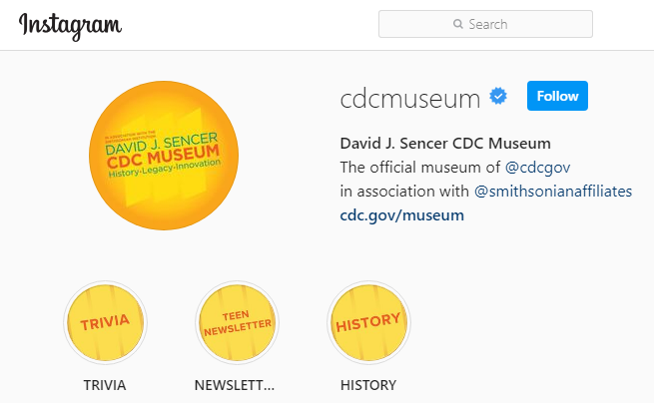
Give it a Try
3. Share Your Findings
Instagram @CDCmuseum
Notes:
Share Your PSA
Sharing your results is not only interesting to others, it is also extremely informative!
Challenge yourself to communicate your procedure and results to at least 5 other people. Encourage them to practice food safety habits
With parental permission, share your PSA on social media:
Instagram: Share with the CDC Museum using @CDCmuseum.
Facebook: Share with CDC using @CDC.
Twitter: Share with CDC using @CDCgov.

Slide 16

Questions?

