Slide 1
EFCLib v1: Styles, Symbols, Templates and Dynamic Windows
RUNNING
STOPPED
STARTING
FAULT
P
I
What changed, why we chose it, and how it behaves on the plant floor
Ignition 8.1 Perspective | Modicon M580 | EFC_Library project + PCLib T_ types
Notes:
SAY:
This deck covers EFCLib v1: what the library contains, the rules behind the symbols and dynamic windows, and how they behave when things go wrong. Every rule on the slides traces to a design note (1-42 in docs/design-notes.md) or a review decision (1-30 in steward/DECISIONS.md). Quote the number when someone asks where a rule came from.
KEY POINTS:
- Ignition 8.1 Perspective project EFC_Library, released as v7.0 on 2026-10-19 (CHANGELOG.md).
- PLC side: the PCLib EFCLib v1 T_ data types for the Modicon M580, built in Control Expert.
- Visual rules: ISA-101 grayscale, ISA-18.2 alarm priorities, NFPA 79 P and I badges.
CHECK:
- Blinking alarm classes need the Advanced Stylesheet, which requires Ignition 8.1.22 or later. On older 8.1 builds the same classes show solid (docs/library-reference.md).
- The 28 PLC types are PCLib version 1.00 (types/README.md).

Slide 2
EFCLib v1 at a glance
OVERVIEW
1
64
314
Perspective project
views
style classes
EFC_Library replaces 7 separate projects
templates, faceplates, windows and parts
EFC_Styles: the only source of look
28
10
214
PLC T_ types
dynamic windows
P&ID SVGs
PCLib v1.00 DDTs = Ignition UDTs
one per device family, 400 x 860
static symbols, same palette
Every device template binds an EFCLib v1 T_ type through one tagPath, and a click opens that type's dynamic window.
Notes:
SAY:
Four numbers matter here: one project, 28 PLC types, 10 dynamic windows and 314 style classes. The rest is supporting material.
KEY POINTS:
- One Perspective project, EFC_Library, replaces seven: EFC_Styles, PID_Symbols, EFC_PID_Library, EFC_ProcessValues, PID_Loops, EFC_IOFaceplates and EFC_StationFaceplates (CHANGELOG, v7.0).
- 64 views in total. 49 of them sit under Templates/ in the project tree.
- 314 style classes in the project. The 166 figure in older documents counts only the original EFC_Styles part, before the PV, loop and station classes were merged in.
- 28 PLC T_ types in PCLib v1.00 (types/README.md). T_Heater was the 27th and T_Station the 28th (CHANGELOG, Unreleased).
- 10 dynamic windows: nine Docks views plus dw_Station (the WINDOWS table in generator/docks/efc_ui.py).
- 214 SVG files in symbols/: 198 static v2 symbols plus 16 active symbols in symbols/Active/. Say "SVG source files" rather than "plain P&ID SVGs", because 16 of them are the active sources for the Drawing components.
CHECK:
- "Every template binds a T_ type" is not quite true yet. The analog indicators bind T_KPI, which is only a proposal and is not among the 28 types (types/T_KPI/README.md). The I/O faceplates bind the native Modicon x80 DDTs (decision 23). Station_Fill takes only a tagPath, and the demo views have no type.
IF ASKED: "Why one project instead of seven?"
- One parent and one Templates tree means one import and one set of view paths. The CHANGELOG records the consolidation; it does not give a further reason.

Slide 3
Standards behind every decision
REFERENCES
Standard | What it governs | Where you see it in EFCLib v1
ANSI/ISA-101.01 | HMI design: gray background, color only for abnormal | Palette, state fills, no decorative color, flashing rules
ISA-18.2 / IEC 62682 | Alarm priorities and the alarm state model | 4 priority colors, unacked blink, PV alarm letters, ACK
ISA-5.1 / ISA-5.5 | Tag naming and graphic symbols | Cfg_Tag (FT-101), HH/H/L/LL, P&ID symbol shapes
NFPA 79 | Industrial machinery indicator colors | Orange P (permissive) and red I (interlock) badges
ANSI Z535 / OSHA 1910.144 | Safety colors | Purple reserved; simulated moved to teal
ISA-88 / IEC 61512 | Modes, states, ownership | T_Mode AUTO / MAN (+ MAINT, OOS site extensions)
NAMUR NE107 / NE43 | Device diagnostics, 4-20 mA failure levels | NE107 chip in windows, T_AI bad-signal limits
IEC 61511 / ISA-84 | Bypass management | Reason, time limit, indication, audit; no SIS bypass
IEC 61131-3 / VDI 2658 MTP | PLC data types, modular plant objects | Elementary types; each T_ type maps to an MTP object
Notes:
SAY:
This table is the source list. Each row is a standard that drove a specific decision. None of them is a certification, and the PCLib README says so directly.
KEY POINTS:
- ISA-101.01 (HMI design): grayscale for normal states, color only for abnormal. The standard gives no hex values; the palette is EFC's own style guide (isa101-color-palette.md).
- ISA-18.2 / IEC 62682 (alarms): the A to H alarm state model in T_Alarm, and the priority order of the alarm colors.
- ISA-5.1 (tags): the Cfg_Tag format, for example FT-101. ISA-5.5 (graphic symbols): the P&ID symbol approach (design note 11).
- NFPA 79: the P and I badge colors. Design note 11 cites it for the badges.
- ANSI Z535 / OSHA 1910.144 (safety colors): purple is reserved, which is why simulated is teal (isa101-color-palette.md).
- ISA-88 / IEC 61512-1 (modes and ownership): T_Mode. ISA-88 itself defines Automatic, Semi-automatic and Manual. Out-of-Service and Maintenance are site extensions (types/README.md).
- NAMUR NE107 (device status): F, C, S and M on Sts_NE107. NAMUR NE43 (4-20 mA failure levels): T_AI bad limits at -2.5 % (3.6 mA) and 106.25 % (21 mA).
- IEC 61511 / ISA-84 (bypass management): T_Intlk covers authorisation, time limit, indication and logging. It is basic process control only, not a safety function.
- IEC 61131-3 (data types) and VDI/VDE/NAMUR 2658-4 (MTP): elementary data types only. Member names are not MTP attribute names, so an MTP export needs a mapping layer.
IF ASKED: "Are you ISA-18.2 compliant?"
- The library implements the state model. Priorities, delays and classes come from your own alarm philosophy and rationalisation (types/README.md). Compliance is a site exercise.
IF ASKED: "Where is the Maintenance mode in ISA-88?"
- It is not. Maintenance and Out-of-Service are site extensions, as above.
CHECK:
- Confirm the NFPA 79 clause before quoting it. The library cites the standard for the badge colors; the exact requirement has not been checked against the text in these files.

Slide 4
Gray is normal, color means abnormal
PHILOSOPHY
1
2
3
Normal is grayscale
Color only for abnormal
Flashing only for unacked
Running is white, stopped is gray. No red/green run states, no colored process lines.
Saturated color is reserved for alarms and blocking conditions, always backed by text or shape.
Only an active, unacknowledged alarm blinks. Everything else is steady.
RUNNING
STOPPED
HH
H
L
P
I
HI ACTIVE, UNACKED
screen #D9D9D9
every color sits next to a letter or word
HI CLEARED, UNACKED
blinks / steady and faded
Notes:
SAY:
Three rules, and the rest of the deck follows from them. Gray is normal. Color means abnormal. Flashing means an alarm needs someone to act.
KEY POINTS:
- Rule 1: normal states are grayscale. Screen D9D9D9, running white, stopped 9E9E9E, transition C4C4C4 (design notes 11 and 32).
- Rule 2: saturated color appears only for alarms and abnormal states, and always with something else: FAULT text, P and I letters, or outline weight (docs/isa101-audit.md, passes).
- Rule 3: flashing only for active, unacknowledged alarms. Util/Blink was removed (design note 11). A cleared alarm that is still unacknowledged is steady, not flashing (audit fix 5).
WHY:
- The ISA-101 idea is that an operator should be able to scan a screen and see only the abnormal items. If normal equipment is colored, the color stops meaning anything.
- Putting the state in text and shape as well as color means the state still reads without color.
STANDARD:
- ANSI/ISA-101.01-2015 asks for a neutral low-contrast gray background, muted grays for normal states and saturated color kept for abnormal conditions. It does not specify hex values (isa101-color-palette.md).
IF ASKED: "Why is a running pump white and not green?"
- Green would be a second color meaning normal, which the rules keep out of the screen. The audit records "no red/green run states" as a pass.
- If the site wants green, that is a design-note change, not a style tweak.

Slide 5
Palette: structure and equipment states
STYLES
Structure
Equipment states
Meaningful accents
Screen
#D9D9D9
Running / open
#FFFFFF
Editable / command
#1F4E99
Header
#C4C4C4
Stopped / closed
#9E9E9E
Simulated (fill)
#D7EEEB
Panel
#E6E6E6
Transition
#C4C4C4
Simulated (text)
#00695C
Card
#F0F0F0
Fault
#3A3A3A
Bad quality
#B000B0
Border
#A6A6A6
Fault adds a 3 px red border and FAULT text
Manual M marker
#FFD200
Transition gray #C4C4C4 is darker than the #D9D9D9 screen on purpose, so a travelling valve never disappears into the background.
Notes:
SAY:
These are the swatches. The important ones are the gray set, the three equipment states and the two non-alarm colors that carry meaning: editable blue and simulated teal.
KEY POINTS:
- Background: screen D9D9D9, panel E6E6E6, card F0F0F0, header C4C4C4 (isa101-color-palette.md).
- Equipment: running FFFFFF, stopped 9E9E9E, transition C4C4C4 as a solid fill, fault 3A3A3A with a red border on symbols.
- Editable values and commands: blue 1F4E99. Simulated or forced: fill D7EEEB with text 00695C. Bad quality: magenta B000B0.
- Highlight DCE3EC (design note 11).
WHY:
- Transition was darkened from D9D9D9 to C4C4C4 because it disappeared against the screen (design note 32).
- Fault is dark gray, not red, so red stays reserved for Critical alarms. The red fault border is the one documented exception (audit deviations).
- Simulated is teal because purple is reserved in the safety color scheme. Design note 11 first recorded 00897B; the palette values above are the current ones.
CHECK:
- Blue: the audit rule is "do not introduce any other blues". The ideal band on the analog indicators (9DB4D0) is a second blue. See slide 15.
IF ASKED: "Why is the screen gray and not white?"
- A low-contrast gray background is the ISA-101 rule in the palette file. It makes colored elements stand out only when they are abnormal.
IF ASKED: "Does this meet WCAG?"
- The audit reports contrast ratios, for example 5.5:1 for out-of-service text and 4.9:1 for the permissive text form. It does not claim a WCAG conformance level.

Slide 6
Alarm priorities and P / I badges
STYLES
CRITICAL
Priority 1
#D50000
Blocking badges (NFPA 79)
Documented deviations
HIGH
Priority 2
#FF7A00
P
Permissive missing
Orange #F08000, black text. Left of the symbol.
Manual M is yellow, same as Medium; it sits on a dark split chip so it never reads as an alarm
Fault border uses Critical red, always with FAULT text and dark fill
Editable blue #1F4E99 vs Low alarm #00A3E0: different hue and lightness; no other blues allowed
MEDIUM
Priority 3
#FFD200
LOW
Priority 4
#00A3E0
I
Interlock active
Red #C00000, white text. Right of the symbol.
DIAGNOSTIC
Priority -
#6E6E6E
Never placed on the process line.
The only saturated colors on a screen (ISA-18.2 order).
Notes:
SAY:
Priority order is the same as the alarm standard: Critical, High, Medium, Low, then Diagnostic. The two badges are the only other colored elements on the symbols.
KEY POINTS:
- Alarm colors in ISA-18.2 order: Critical D50000, High FF7A00, Medium FFD200, Low 00A3E0, Diagnostic 6E6E6E.
- Diagnostic moved from 7A7A7A to 6E6E6E (audit fix 4) so that white text on it reaches 5.1:1.
- P badge: orange F08000 with black text. I badge: red C00000 with white text (design note 11). The permissive text form on light backgrounds is 8F4500 (audit fix 3).
- PLC priority in T_Alarm: Cfg_Priority 1 is Emergency, 2 High, 3 Medium, 4 Low, default 3 (types/README.md). The dynamic windows map 1 to Critical.
WHY:
- The order matters more than the exact hex. A yellow outline must never look more urgent than an orange or red one.
DOCUMENTED DEVIATIONS (kept by user decision):
- Manual M is yellow, the same as Medium (design note 17, option C2). It sits on a dark segment so it reads as a mode, not an alarm.
- Fault border is Critical red, always shown with FAULT text and the dark fill (design note 31).
- The I badge red is close to the Critical red. The audit lists the badge colors as a deviation, because NFPA 79 is the source for them.
CHECK:
- The templates use Ignition's own priority numbers (4 is Critical, 1 is Low). T_Alarm uses the reverse numbering (1 is Emergency). The alarm pipeline must map PLC 1 to Ignition Critical. Confirm this on the gateway before presenting the outline colors as tied to PLC priority.
IF ASKED: "Why not use the same yellow for Medium and the manual M?"
- That is the documented deviation. Options C1 (white M) and C3 (orange M) are in design note 17, and the color is one value in Mode/ManualSplit, so it can be changed in one place.

Slide 7
Style classes: one library, no inline styles
STYLES
Type scale (px at 1080p, sized in vh)
props.style.classes =
"Text/Value Text/Mod/Right"
// bind the class to the state
if({[.]Fault}, "State/Fault",
if({[.]Run}, "State/Running", "State/Stopped"))
XXS
Aa
10 px | Micro
XS
Aa
11 px | Status, Units
S
Aa
12 px | TagName, Label
M
Aa
14 px | Body, Value
Look comes from EFC_Styles classes only; generators move any static inline style into a class (decision 28)
Change a color once in the generator and every view follows
Folders: Text/, Container/, Button/, State/, Mode/, Indicator/, Alarm/, Util/
L
Aa
16 px | Subheader
XL
Aa
20 px | Header
XXL
Aa
24 px | Title
XXXL
Aa
32 px | ValueHero
1080p = 1x, 1440p = 1.33x, 2160p = 2x
Notes:
SAY:
Every color, size and border on a symbol comes from a named class in EFC_Styles. Nothing is typed into a component. That is what makes the library re-skinnable from one place.
KEY POINTS:
- Classes are applied through props.style.classes. Where state changes the look, a binding picks the class (docs/style-library.md).
- All sizes are in vh. At 1080p, 1 vh is 10.8 px, so 1440p is 1.33 times and 2160p is 2 times.
- Type scale at 1080p: XXS 10 px, XS 11, S 12, M 14, L 16, XL 20, XXL 24, XXXL 32.
- Folders: Text, Container, Button, State, Mode, Indicator, Alarm, Util, plus Input, Value, Bar, Table and the PV, Loop and Station sets.
- Design note 28: the generators move static inline styles into generated classes per view. Bound style properties stay as bindings.
CHECK:
- The no-inline-styles rule holds for the production templates and windows. Demo and catalog views still carry inline styles: Styles/_Catalog has 146, Loops/_Demo 17 and ProcessValues/_Demo 16 (steward/CATALOG.md). Say so if someone opens a demo view and finds them.
WHY:
- One value per color means the M color, the fault red border and the badge orange are each changed once.
- vh units keep the same template usable from 1920x1080 to 3840x2160 (docs/screen-layout-standard.md).
IF ASKED: "What happens on Ignition 8.1.21?"
- Blinking alarm classes show solid, because they need the Advanced Stylesheet (8.1.22 or later). Everything else works (docs/library-reference.md).

Slide 8
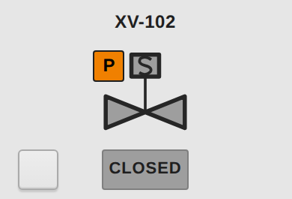
Anatomy of a device template
TEMPLATES
1
Tag name above
From the type's tag; description shows as tooltip
2
Status chip below
Centered on the symbol centerline: OPEN, CLOSED, RUNNING, FAULT, NN %
3
P left, I right
Beside the actuator on valves, above the ports on pumps
4
Command button
Blank square, bottom left, only visible in Manual
5
Alarm outline
3 px in the highest active priority color
6
Parameters
tagPath (+ useButton, tType, dockId, dblCmd); everything else comes from the type
Notes:
SAY:
This is one device template, the on/off valve. Every template has the same frame: tag above, status below, P left, I right, and the command button bottom left when the device is in Manual.
KEY POINTS:
- Tag name above, centered on the symbol centerline. The description is the tooltip (design note 15).
- Status chip below the symbol, centered on the same line. Values and units go under it.
- P badge left and I badge right, beside the actuator, never on the process line (design notes 9, 15, 34).
- Command button bottom left, on the status row, visible only in Manual (design note 36; the template shows it when useButton is true and the device is in Manual).
- Alarm outline in the highest active alarm priority on any member of the instance. A fault adds a red border that overrides the outline (design note 31).
- Parameters: tagPath (required); useButton (default true); tType (picks the dynamic window); dockId and dwTagPath (override the window and its tag); dblCmd (default true, effective only in touch mode and only for T_DValve and T_Motor).
- Clicking the symbol opens its dynamic window. The symbol's hit box is about 44 by 44 px in the 120 by 100 valve template, which meets the 44 px minimum in decision 1.
WHY:
- One template per symbol means an engineer drags the right symbol onto the screen and sets one tag. Design note 20 made tagPath the only parameter; later notes added the others.
CHECK:
- Besides the parameters on the slide, dwTagPath is also a parameter (the tag path handed to the window when it differs from tagPath).
- Design note 20 says tagPath is the only parameter. That was amended by note 37 and the later changes, so do not quote note 20 as current.
IF ASKED: "Can a symbol show two devices?"
- No. One template per symbol, with no nested symbol views (design note 21).

Slide 9
Equipment state logic
TEMPLATES
State | Fill | Discrete valve (ZSO / ZSC) | Motor (Run vs Cmd)
CLOSED / STOPPED |  | ZSC made, ZSO not | Run off, Cmd off
OPEN / RUNNING |  | ZSO made, ZSC not | Run on, Cmd on
OPENING / STARTING ... |  | Neither switch made (travel) | Run and Cmd disagree
FAULT |  | Both switches made, or fault bit | Fault bit set
No feedback?
With feedback disabled the symbol follows the command, so it never shows a false travel or fault.
Transition is a solid light gray
The dashed travel outline was tried and removed: it read as noise and fought the alarm outline.
Notes:
SAY:
Each symbol shows a small set of states. The PLC status bits decide them, and the HMI only maps them to fills and words.
KEY POINTS:
- Discrete valve, from T_DValve status bits: open (Sts_Opened) is white; closed (Sts_Closed) is 9E9E9E; neither, so travelling, is C4C4C4 and says OPENING or CLOSING from the commanded direction; a fault (Sts_Fault) is 3A3A3A with a red border.
- Motor and running equipment: fault or trip shows as fault; running is white; stopped is gray; when run feedback and command disagree the symbol shows the transition state (docs/library-reference.md).
- Transitions are a solid light gray with no dashed outline (design note 32). The dashed travel outline was tried and removed in v4.1.
- Words: CLOSED, OPEN, OPENING, CLOSING, FAULT for valves; STOPPED, RUNNING, STARTING, STOPPING, FAULT for motors.
BEHAVIOUR:
- Both limit switches made. T_DValve has no separate fault bit for this. Alm_PosConflict reports "both limit switches made", and Sts_Fault means any fault is present. Whether the PLC sets Sts_Fault on a position conflict is PLC logic. Design note 18 treated both-made as the fault itself, from the earlier plant UDT.
- Feedback disabled. Design note 18 and the library reference say the symbol then follows the command. The current valve template reads Sts_Opened and Sts_Closed, so the PLC has to drive those bits when there are no limit switches.
CHECK:
- Confirm both behaviours in the PLC logic before saying the symbol handles them.
IF ASKED: "Why doesn't a moving valve blink?"
- Flashing is only for unacknowledged alarms (design note 11). Motion is shown by the transition color and word.

Slide 10
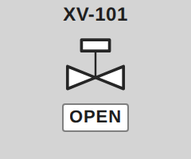
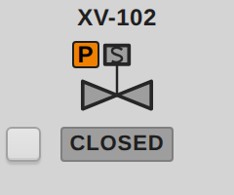
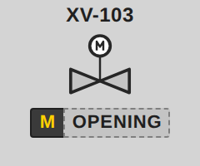
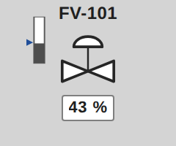
Valves: head shows command, body shows feedback
TEMPLATES
On/off pneumatic
Solenoid
Motor-operated
Control valve
Discrete valves (T_DValve)
Control valves (T_CValve)
Actuator head color = commanded state
Body color = limit-switch feedback
No ball circle in the body; stem runs to body center
Position bar left of the valve: fill = actual position
Blue pointer = commanded output; overhangs so it shows at 0 % and 100 %
Status chip shows NN %; no on-symbol button
Notes:
SAY:
Two valve types on the screen. On-off valves show two positions. Control valves show a number, and the symbol shows the number as a bar.
KEY POINTS:
- Discrete valves (pneumatic on-off, solenoid, motor-operated) use T_DValve. The actuator head shows the command and the body shows limit-switch state (docs/screen-layout-standard.md; docs/library-reference.md).
- Control valve (Valve_Control) uses T_CValve. The body shows actual position, with anything above 1 % counted as open. The head shows the commanded output, with anything above 1 % counted as on.
- The position bar sits left of the valve, outside the P badge (design note 35). The fill height is the actual Pos. The blue pointer is the commanded Out. The pointer overhangs the bar, so it stays visible at 0 % and 100 %.
- Status text is NN % with the position, or FAULT. The position and output are in the hover tooltip (v4.1).
- No button on control valves (design note 22). Operators set the output in dw_ValveAnalog, in Manual only, with presets 0, 25, 50, 75 and 100 % (decision 12).
WHY:
- The head shows what was asked and the body shows what happened. A valve that does not follow its command is visible as a head and body that disagree (the split is in docs/screen-layout-standard.md; the mismatch reading is my interpretation).
BEHAVIOUR:
- With no feedback, the status uses the commanded output (docs/library-reference.md).
IF ASKED: "Why does the control valve have no button?"
- Its position is a number, not an open or close command. Manual entry and presets live in the dynamic window.
IF ASKED: "What is the fail position?"
- T_DValve has Cfg_FailOpen and Cfg_IntlkOpen, which set the fail and interlock positions. The symbol does not show those; they are configuration bits.

Slide 11
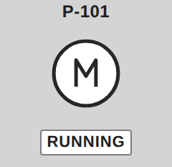
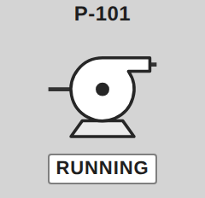
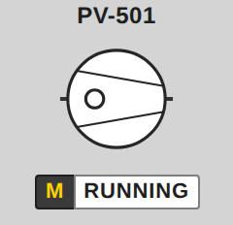
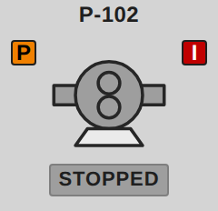
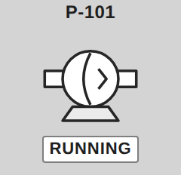
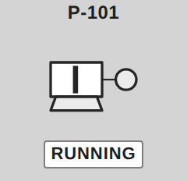
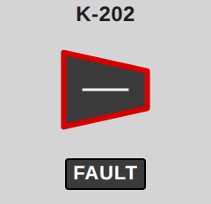
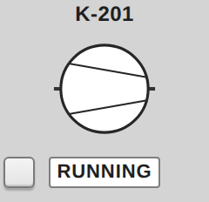
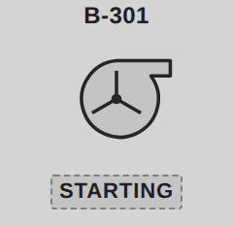
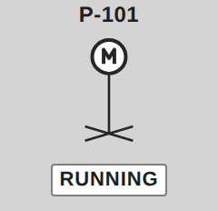
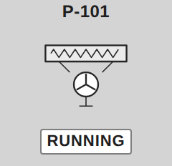
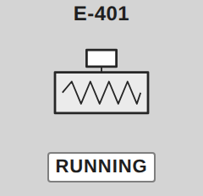
Running equipment and heat transfer
TEMPLATES
Bound type
T_Motor by default
tType = T_VFD
for agitators and compressors on a drive
Heater = T_Heater
contactor, SSR or SCR
Motor
Pump Centrifugal
Pump Vacuum
Pump PD Rotary
Pump Diaphragm
Pump Reciprocating
Compressor Centrifugal
Compressor Diaphragm
Blower
Agitator
HX AirCooled
Heater Electric
Same layout on all of them: tag above, status below, P above the left port, I above the right port
Centrifugal pump and blower drop the I badge to lower right so it clears the top discharge
Notes:
SAY:
Running equipment, heat transfer and electric heaters share one button pattern. The drive type changes what the window shows; the symbol stays the same.
KEY POINTS:
- Ten rotating templates (pumps, compressors, blower, agitator, motor), the VFD template, HX_AirCooled and Heater_Electric (steward/CATALOG.md).
- Motor-type templates bind T_Motor. The VFD binds T_VFD. The agitator and compressor take a tType parameter, so one symbol can be wired either way (decision 11). T_Agitator and T_Compressor are not used until a use case appears.
- Heater_Electric binds T_Heater (decision 17). Cfg_CtrlType 0 is an on/off contactor. 1 is a time-proportioned SSR on a PLC output, with duty, Cfg_CycleTime and Cfg_MinPulse. 2 is an SCR power controller on an analog reference. A series isolating contactor is always present.
- The excess-temperature limit is hardwired and independent of the PLC. The PLC monitors it through Inp_HiLimitOK and does not drive it.
- Running-equipment button: one toggle that writes Cmd_Start or Cmd_Stop as a one-shot, with the same enable rules as the valve button (design note 16).
WHY:
- A fixed-speed motor and a drive-fed compressor look the same on a P&ID. A tType parameter keeps one symbol and one template instead of two.
STANDARD:
- types/README.md cites NFPA 86 for the excess-temperature limit on T_Heater, and IEC 60947-4-3 for semiconductor controllers on non-motor loads. Check the clauses before quoting them.
IF ASKED: "Can the HMI reset a tripped heater limit?"
- The design monitors the limit only (decision 17). The files do not describe any reset path from the HMI, so do not offer one.

Slide 12
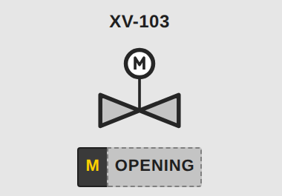
Manual mode and commanding from the symbol
BEHAVIOUR
Command rules
Click the symbol: opens its dynamic window
Double-tap: commands T_DValve / T_Motor only
Only when in Manual, available, not interlocked, not blocked by a permissive, not Local, not faulted
Opening or starting is blocked by P or I; from the symbol button, closing or stopping is always allowed
Hand cursor only when a click would act
The PLC still enforces every rule
useButton = true
useButton = false (touch)
Button mode: a blank raised key appears only in Manual. Touch mode: no button; a yellow M joins the status and the symbol itself is the command target.
Auto shows no marker: only abnormal modes are flagged.
Notes:
SAY:
There are two ways to command a device from its symbol, and both obey the same rules: Manual only, device available, and no blocking condition. The difference is the screen, not the rules.
KEY POINTS:
- useButton true (default): a blank Button/Command square sits bottom left and appears only in Manual (design note 36).
- useButton false (touch mode): no button. In Manual a yellow M joins the status as a split chip (design note 38). A single click opens the dynamic window. A double-tap sends the command (decision 1).
- The button writes one-shot Cmd_Open or Cmd_Close (valves), or Cmd_Start or Cmd_Stop (running equipment).
- Button enable rule in the template: Manual, available, not local, not out of service, and either closing or stopping is allowed when the device is commanded open or running, or opening or starting is allowed only when neither P nor I is showing.
- Double-tap rule (efc.ui.dblCmd): Operator or higher; touch mode only; T_DValve and T_Motor only; Manual and available; not interlocked, not permissive-blocked, not local, not faulted.
BEHAVIOUR:
- Design note 37 said a click commands the device in touch mode. Decision 1 replaced that: click opens the window, double-tap commands.
- On the symbol button, closing is allowed even when interlocked, provided the device is in Manual, available, not local and not out of service. The double-tap path and the window CLOSE button do not allow it. See CHECK.
CHECK:
- Decide whether closing and stopping should be allowed when interlocked. The symbol button allows it; the double-tap and the window's CLOSE button do not, and window STOP is ungated. This is an inconsistency in the current build.
WHY:
- A single click is already used for the window, so the command needs a second gesture. The files give double-tap as the choice (decision 1) and no further reason.
IF ASKED: "Can an operator run a valve in Auto from the symbol?"
- No. Symbol commands exist only in Manual. Auto is a mode change in the window.
IF ASKED: "What about a Guest user?"
- No commands. The double-tap and the window commands both require Operator or higher. The PLC still enforces every permissive and interlock.

Slide 13
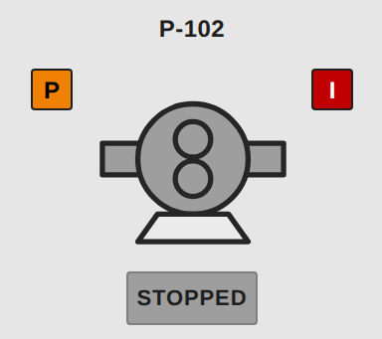
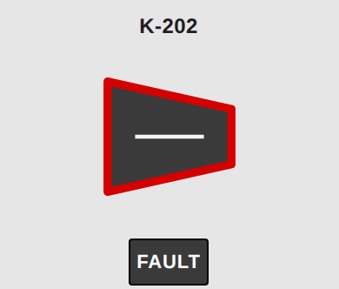
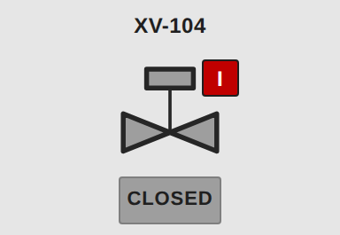
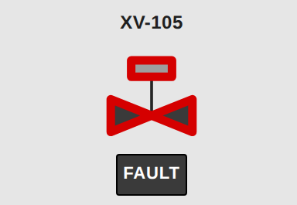
Alarms, faults and bad data on a symbol
BEHAVIOUR
Outline precedence
Fault: red 3 px border
Highest active alarm priority
No alarm: normal 1.5 px outline
Interlock active
Permissive + interlock
Fault (valve)
Fault (compressor)
wins over
Alarm outline: the highest active priority on any member of the instance; shelved alarms are ignored
Fault: dark fill + red border + FAULT text, so it reads without color
Missing or bad tag: every read is wrapped in coalesce() with safe defaults (not interlocked, not manual), and the alarm lookup is quality-guarded so a bad member cannot turn the whole symbol red
Simulated / bad quality: flagged in the dynamic window (teal SIM chip, magenta bad-quality state), not by recoloring the symbol
Notes:
SAY:
The outline and the fill tell the operator what is wrong, and a missing or bad tag must never break the symbol. Those two goals drive most of the binding design.
KEY POINTS:
- Outline color: the highest active alarm priority on any member of the instance. The template checks priorities 4 to 1 with isAlarmActiveFiltered on the tag path (design note 22; docs/library-reference.md).
- Outline weight: heavier for alarm or fault. Design intent is 3 px; the template stroke is 8.333 in alarm or fault and 4.167 otherwise, in Drawing units. Check the on-screen weight on a gateway. Open item: 2 px on 36 px valves is suggested.
- Fault: dark fill 3A3A3A with a red 3 px border, which overrides the alarm outline (design note 31).
- Every tag read is wrapped in coalesce(). The alarm lookup is wrapped in try() and forceQuality() (design notes 39 and 42; changelog v4.5 and v5.1).
BEHAVIOUR:
- With no alarms configured on the instance, the lookup returns Bad_NotFound. The wrapper turns that into "no alarm", so the bad quality does not spread to the outline bindings (design note 42).
- With bad or missing tags, the defaults apply: closed, no permissive missing, no interlock, not manual, feedback enabled. The changelog calls these safe. Read that as "no false P, I or command", not as a signal to the operator that the data is stale.
CHECK:
- The symbol itself does not turn teal or magenta: no such binding exists in the valve templates, and the coalesce defaults hide bad quality. The SIM chip and the bad-quality state appear in the dynamic window, which is what the slide says.
- "Shelved alarms ignored" comes from docs/library-reference.md. Confirm against the isAlarmActiveFiltered arguments on a gateway.
IF ASKED: "Why does a fault override the alarm outline?"
- The files do not say why the fault wins. The likely reason is that a faulted state is not trustworthy, so the fault marker overrides. The FAULT text and dark fill carry it too (design note 31).

Slide 14
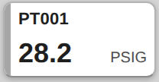
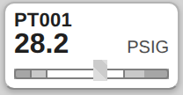
Process value cards (T_AI)
VALUES
Alarm letters, in fixed order
FLT
HH
H
L
LL
OVR
UNR
INH
Example priorities shown; each letter takes its configured priority color.
PV_StatusStrip
PV_RangeBar
At most 2 letters show; the rest collapse into +N with an "Also: ..." tooltip
+N blinks if a hidden letter is unacknowledged
Letter blinks while unacked, goes solid once acked, fades when cleared but unacked
Hardware fault gets its own High alarm and shows dark gray
100 x 50 cards, vh-scaled. Click opens dw_ProcessValue.
Why letters and not just color?
ISA-101: color must be backed by text. HH vs H is readable by a color-blind operator.
Notes:
SAY:
A process value card carries a value, its range and up to two alarm letters. Four letters per card would not fit at 100 by 50, so the card shows the most important two and a plus-count for the rest.
KEY POINTS:
- Two templates: PV_StatusStrip (primary) and PV_RangeBar, both 100 by 50 cards. Both bind T_AI (steward/CATALOG.md). docs/pv-display.md still says DDT_Process_Value; use T_AI.
- Letters appear in a fixed order: FLT, HH, H, L, LL, OVR, UNR, INH. At most two show. The rest collapse into +N with an "Also" tooltip, and +N blinks if a hidden alarm is unacknowledged.
- A letter blinks while unacknowledged and goes solid when acknowledged. A cleared alarm that is still unacknowledged shows faded.
- HW_Fault is a new High alarm and shows dark gray.
- Alarm state is read with system.alarm.queryStatus (v1.1). isAlarmActiveFiltered was replaced because Perspective did not re-run it when alarms changed.
- Versions 1.1 to 1.3 have not been retested on the gateway.
WHY:
- A fixed order means the same letter is in the same place on every card.
STANDARD:
- ISA-18.2 defines the RTN-Unacknowledged state (D). A cleared alarm that is still unacknowledged is in that state, which is why it stays visible (types/README.md, alarm state model).
- ISA-101: flashing only for unacknowledged alarms.
IF ASKED: "Why not show every alarm?"
- Space. The +N tooltip lists the rest.
CHECK:
- The A1 tag truncates with three or more letters. Four-letter units only just fit. Text is 9 to 11 px at 1080p.
- The faded level is 0.25 in the PV design but 0.45 in the Alarm/Status/ClearedUnacked class. Open item: raise the PV level to about 0.4.

Slide 15
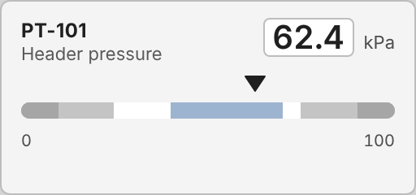
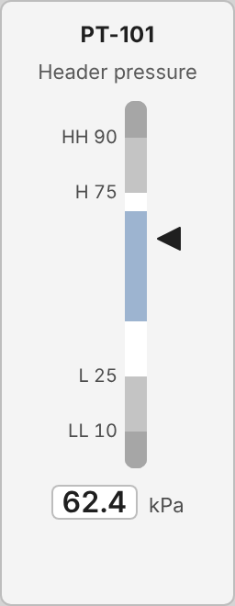
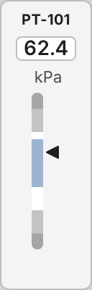

Analog indicators A to D (T_KPI, proposed)
VALUES
Zones
LL / HH
#7F7F7F
L / H
#C4C4C4
Normal, off-ideal
#FFFFFF
A Range Bar
Ideal range
#9DB4D0
Pointer takes the alarm's priority color while in alarm
Ideal blue is muted so it never competes with alarm colors
C Compact Row
D
B
Notes:
SAY:
Four analog indicators, A to D, show the same value in four layouts. Pick one per screen by space. The zones and ideal band are the same on all four.
KEY POINTS:
- A Range Bar, B Pointer Scale, C Compact Row, D Mini Column (mockups/analog-indicator-options.md).
- Zones: LL and HH dark gray, L and H light gray, off-ideal white, ideal band muted blue 9DB4D0.
- In alarm the pointer takes the alarm priority color.
- Built into EFC_Library as Templates/AnalogIndicator (CHANGELOG, Unreleased).
- Opens dw_ProcessValue, through the T_KPI mapping in efc_ui.py.
CHECK:
- The templates bind T_KPI, which is a proposal (types/T_KPI/README.md). It is not in the 28 PCLib types, and its function block FB_KPI is still needed. Say this plainly if asked whether the PLC side is ready.
- The ideal band uses a second blue. The audit says not to introduce other blues (docs/isa101-audit.md, deviations). Decide whether the band should move to a gray.
- The files do not record which of the four options was chosen. All four templates ship.
IF ASKED: "Why is the ideal band blue?"
- So that the normal range is visible without using an alarm color. Because it is blue, it can be confused with the editable blue. That is the open question above.

Slide 16
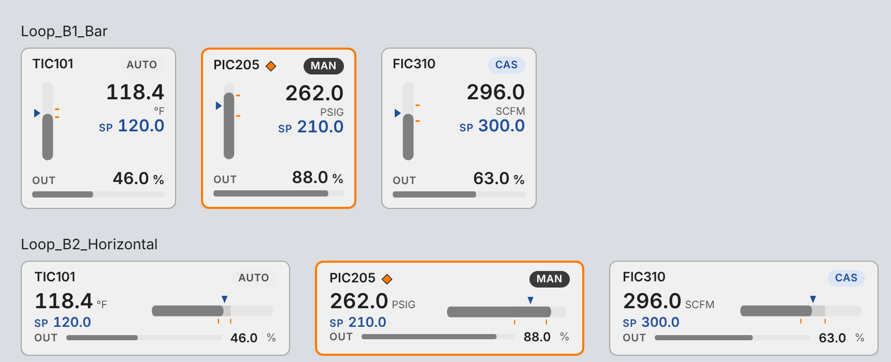
PID loop cards B1 to B4 (T_PID)
VALUES
B1
Bar
Vertical PV bar, SP pointer, alarm ticks
B2
Horizontal
Normal band between AlmLo and AlmHi
B3
Sparkline
B1 + 1 minute PV/SP trend + deviation chip
B4
Column
Twin bars: PV and output
Setpoint is blue: blue always means "an operator can change this"
The whole card opens dw_Loop; the old LoopConfig popup is retired (decision 15)
Mode chip, right of the tag: AUTO light gray, MAN dark (abnormal), CAS light blue. Orange diamond and outline = deviation alarm
Notes:
SAY:
Four loop cards, B1 to B4, show the same PID loop in four shapes. Clicking any card opens the same loop window, so tuning is no longer in a popup.
KEY POINTS:
- B1: vertical bar with an SP pointer and alarm ticks. B2: horizontal bar with a normal band between the low and high alarm limits. B3: sparkline with a one-minute PV and SP trace and a deviation chip that turns orange past the deviation alarm. B4: twin columns for PV and OUT.
- Setpoint is blue because it is editable (palette).
- Mode chip: a pill at the right end of the header (B4: its own row under the tag). AUTO is light gray with gray text, MAN is dark with white text because Manual is the abnormal mode, CAS is light blue with blue text. This matches the option B mockup.
- The orange diamond beside the tag and the orange card outline mean a deviation alarm is active (high or low). They do not show the mode.
- The whole card calls efc.ui.openDynamic, which opens dw_Loop.
- The LoopConfig popup is retired (decision 15). Tuning and limits are in dw_Loop, with tuning collapsed and editable at Engineer or higher.
- In dw_Loop, MAN, AUTO and CAS buttons are at Operator; the setpoint is locked in CAS; the output is editable only in MAN.
BEHAVIOUR:
- The B3 trend needs history on PV, SP and output (docs/pid-loop-templates.md). Without it the sparkline is empty.
CHECK:
- docs/pid-loop-templates.md (2026-10-05) still describes the popup, the old PID_Loop UDT and inline styles. Those are superseded. Quote the decision and the changelog, not that file.
- The old document drives card alarm state from PV against the AlmHi and AlmLo limits. Confirm what the current T_PID alarms drive.
IF ASKED: "Can an operator change tuning?"
- No. Tuning and limits need Engineer or higher, and writes are audit-logged with the old and new values (decision 14).

Slide 17
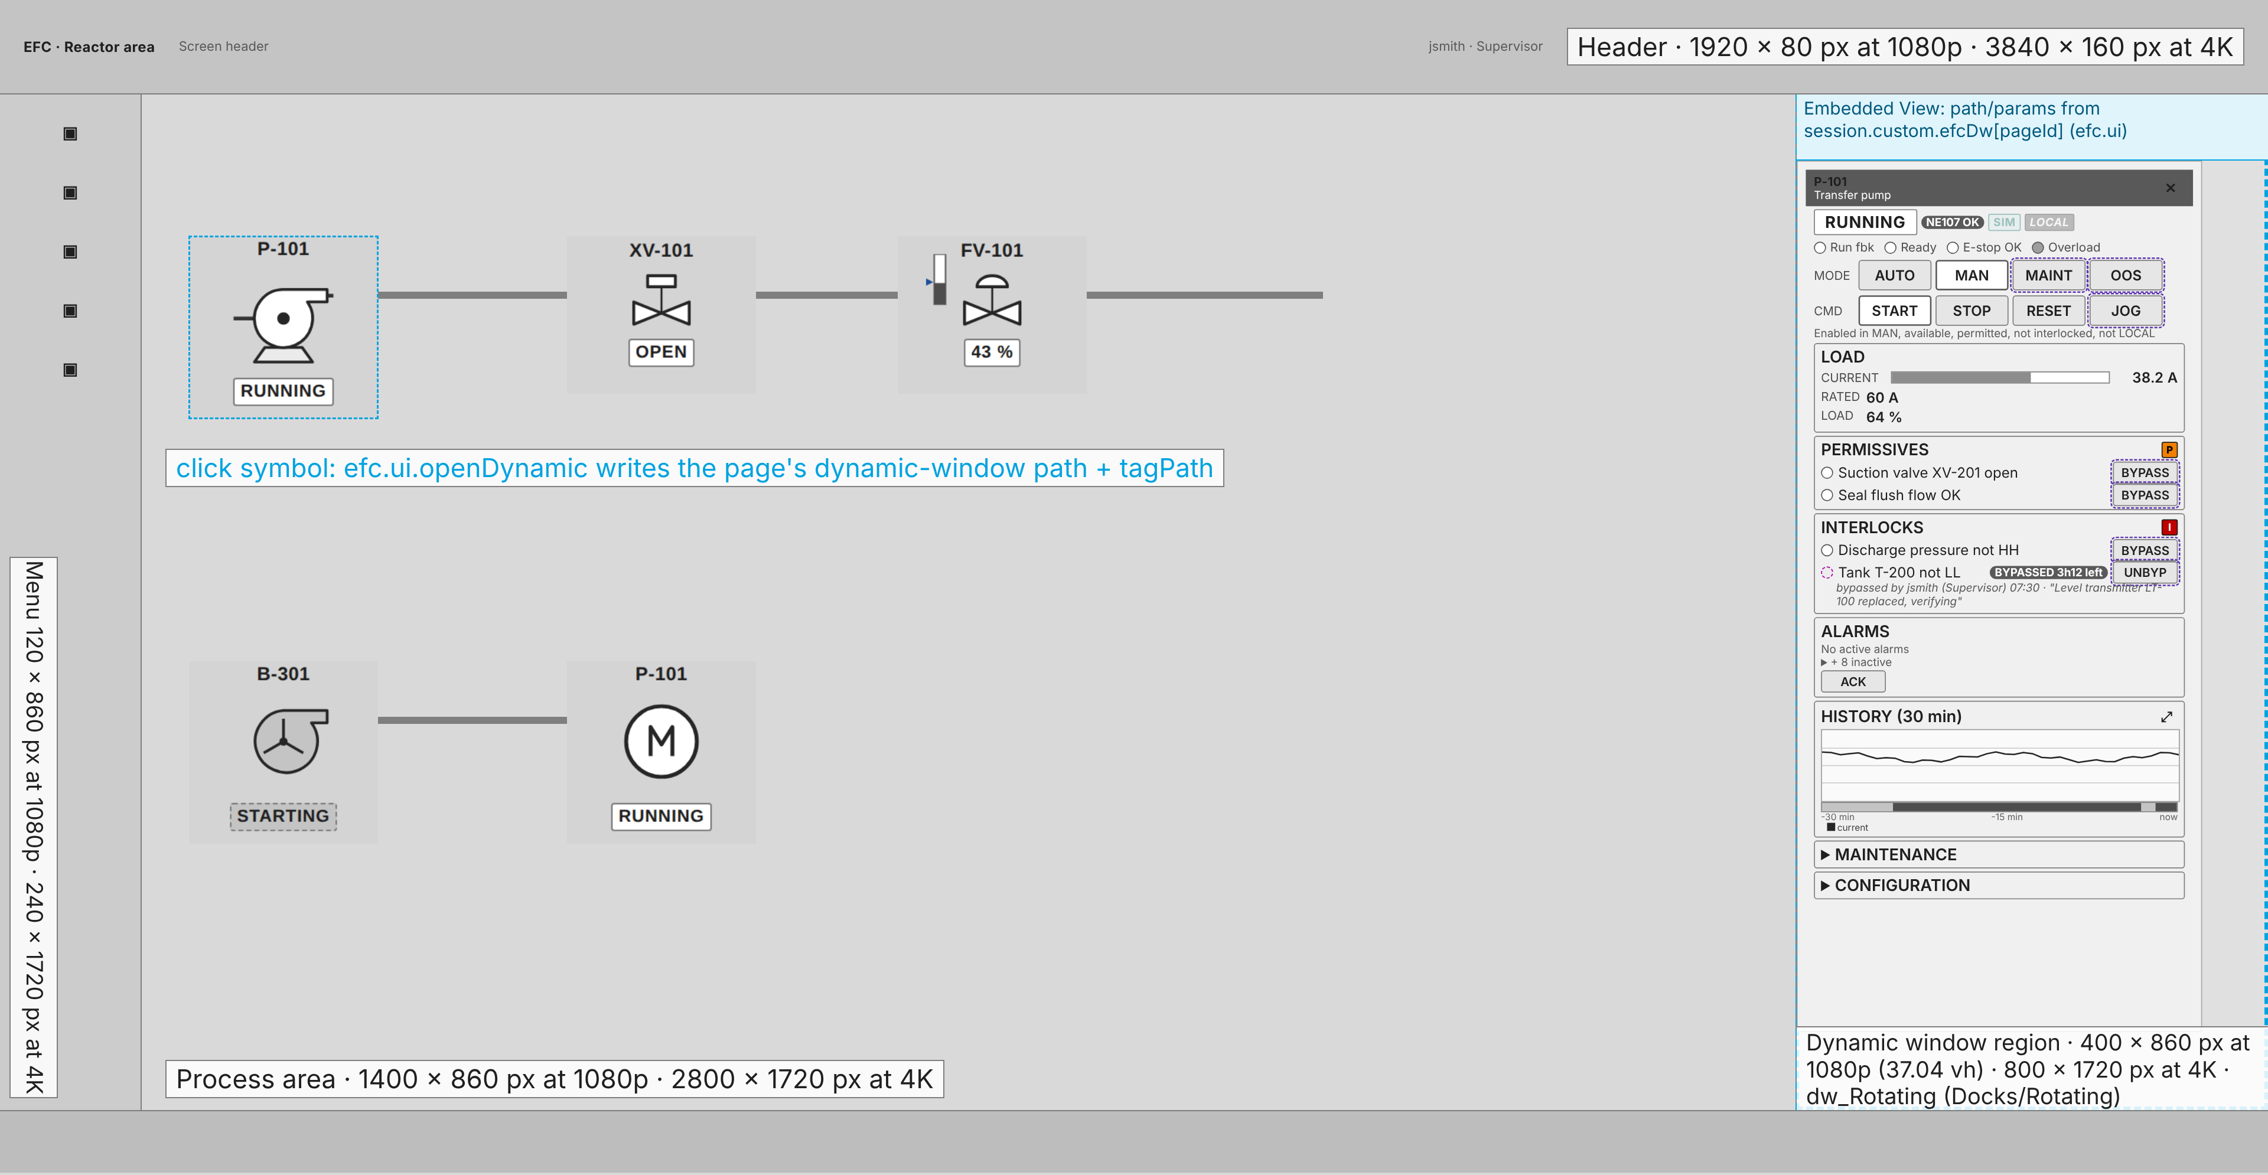
The screen shell and the dynamic-window region
DYNAMIC WINDOWS
Regions at 1920 x 1080
Header
1920 x 80 px
Left menu
120 x 860 px
Process area
1400 x 860 px
Dynamic window
400 x 860 px
Alarm bar
1920 x 140 px
Everything doubles at 3840 x 2160. The window is 37.04 vh x 79.63 vh.
Notes:
SAY:
This is the screen the operator actually sees. The process area is the left part, the dynamic window is the right strip, and the header and alarm bar frame the whole thing.
KEY POINTS:
- Design size 1920 by 1080, with 3840 by 2160 as the double. Header 1920 by 80. Left menu 120 by 860. Main process area 1400 by 860. Dynamic window 400 by 860, which is 37.04 vh by 79.63 vh. Alarm bar 1920 by 140.
- The widths add up: 120 + 1400 + 400 = 1920. The heights add up: 80 + 860 + 140 = 1080.
- Dynamic windows are 800 wide at 4K (decision 3).
- Decision 25 corrected the earlier mockups, which had a 60 px header, a 70 px alarm bar, a 60 px menu and a 940 px window.
- The Station dock moved to Docks/Station and was resized to 400 wide (decision 4). The CHANGELOG has the upgrade note for the id and path.
WHY:
- The window fills the full height between header and alarm bar, so it has no dead space at the bottom.
STANDARD:
- The sizes follow the Controls Standard rev I screen design appendix (decision 25; docs/screen-layout-standard.md).
IF ASKED: "What about a screen narrower than 1920?"
- Everything is in vh and scales at 16:9. Smaller displays scale all regions down proportionally.
CHECK:
- docs/screen-layout-standard.md still says the window expands to about 50 % of the screen. That is superseded by decision 26. The window stays 400 by 860, and an expanded graph fills the window below the header.

Slide 18
How a dynamic window opens and closes
DYNAMIC WINDOWS
Click symbol
operator clicks a template
efc.ui.openDynamic
picks the window from tType or dockId
Session value
efcDw[pageId] = path + tagPath
Docks/Region
embedded view swaps to the window
Close (X) calls efc.ui.closeDynamic and returns the region to the screen's defaultDock view. One window per page; a second click replaces it.
Type | Window
T_DValve | dw_ValveDiscrete
T_CValve | dw_ValveAnalog
T_Motor | dw_Rotating
T_VFD | dw_VFD
T_Heater | dw_Heater
Type | Window
T_HeatEx | dw_HeatTransfer
T_AI, T_KPI | dw_ProcessValue
T_PID | dw_Loop
T_Station | dw_Station
x80 card DDT | dw_IOCard
Why an embedded view, not Perspective docks?
The region is a fixed part of the shell, so the process area never shifts or gets covered, and it matches the Controls Standard screen appendix (decision 24).
Notes:
SAY:
One click on a symbol shows its window in the right region. Close puts the screen's default view back. The mechanism is a single session value per page, which the region watches.
KEY POINTS:
- Click: efc.ui.openDynamic picks the window from dockId, or from tType through the BY_TYPE table. It reads the tag path and writes {path, params} into session.custom.efcDw under this page's id.
- Docks/Region is an Embedded View. Its path and params are bound to that session value, so changing the value swaps the window.
- Close: efc.ui.closeDynamic writes the screen's default view back. Each screen sets its default with defaultDock on Docks/Region (decision 2).
- Mapping: T_DValve to dw_ValveDiscrete; T_CValve to dw_ValveAnalog; T_Motor to dw_Rotating; T_VFD to dw_VFD; T_Heater to dw_Heater; T_HeatEx to dw_HeatTransfer; T_AI and T_KPI to dw_ProcessValue; T_PID to dw_Loop; T_Station to dw_Station; native x80 DDT to dw_IOCard.
- Keys are per page, so a window open on one screen does not change another screen.
WHY embedded view, not Perspective docks:
- Decision 24 records the choice: an embedded view bound to one session value, sized in vh, matching the Controls Standard screen design appendix. The files give no further reason. My reading is that one fixed region driven by one value is simpler to control, but that is not recorded.
BEHAVIOUR:
- If tType is missing or unknown, openDynamic logs a warning and does nothing.
- The code does not check that the tag path is set. A window opened with an empty path shows empty values, not an error. I read this in the code; I did not run it.
IF ASKED: "Why does the window not reload when the tag changes?"
- The window's own values are tag bindings, so they update live. Only the choice of window is a session value.

Slide 19
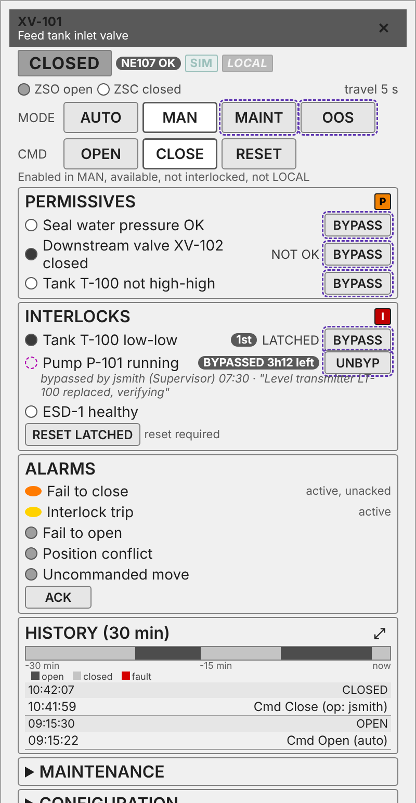
Anatomy of a dynamic window: dw_ValveDiscrete
DYNAMIC WINDOWS
1
Header Tag, description, close
2
State banner + chips CLOSED plus SIM, LOCAL, INTLK, NOT PERM chips
3
Mode row AUTO / MAN / MAINT / OOS; current mode highlighted
4
Command row OPEN / CLOSE / RESET, with the enable reason underneath
5
Permissives (P) Each named condition, OK / NOT OK, BYPASS
6
Interlocks (I) First-out, LATCHED, BYPASSED + time left + who and why
7
Alarms Priority dot, state, ACK
8
History 30 min trend with expand
9
Maintenance / Configuration Collapsible, role-gated sections
Approved rev 2 mockup (decision 8). Dashed purple = role-gated; the built view differs in detail (see notes).
Notes:
SAY:
This is the discrete valve window, the most complete of the set. Read it top to bottom: state, mode, commands, feedback, permissives and interlocks, alarms, history, then maintenance and configuration.
KEY POINTS:
- Header: tag name, description, close button.
- Banner: the state word, with the first match winning in the order FAULT, OPENING, CLOSING, OPEN, CLOSED. Chips: SIM, LOCAL, INTLK and NOT PERM.
- Mode: current mode, with AUTO and MAN at Operator and MAINT and OOS at Maintenance. Maintenance-level mode changes are audit-logged.
- Commands: OPEN and CLOSE (Operator, gated by readiness), RESET.
- Feedback: open limit and closed limit if fitted, and the NE107 diagnostic.
- Permissives and interlocks: the same embedded list view, once for each group.
- Alarms: fail to open, fail to close, position conflict, uncommanded move, interlock trip. ACK at Operator.
- History: 30 minute trend of the commanded output and open state.
- Maintenance section at Maintenance. Configuration section at Engineer, collapsed by default.
CHECK:
- The picture is the approved rev 2 mockup. In the build, NE107 is a row in the Feedback section; the chips are SIM, LOCAL, INTLK and NOT PERM (the slide text follows the build).
- The mockup shows a state strip with last events. The build has a 30 minute trend with range buttons, and no last-events list yet.
- The mockup shows Maintenance and Configuration collapsed. In the build only Configuration is collapsible.
- The CLOSE button is gated by the same readiness as OPEN. See slide 12.
IF ASKED: "Why is the window not greyed out when I lack the role?"
- Controls below the user's level are hidden, not greyed (decision 27).

Slide 20
Role gating: hidden, not greyed out
DYNAMIC WINDOWS
5
How it works
4
Level = highest role the user holds, read from session roles at login
Controls above your level are hidden, so operators only see what they can use
Every write goes through efc.ui.cmd, which re-checks the level on the gateway
MAINT and above: audited writes (old -> new, user, time)
3
2
1
0
Guest
Operator
Maintenance
Supervisor
Engineer
Admin
View only
Commands, mode AUTO/MAN, setpoints, ACK
MAINT / OOS, JOG, simulate, maint reset
Bypass with reason, alarm shelving
Alarm limits, configuration, tuning
Everything
Notes:
SAY:
Six levels, from Guest to Admin. Each control is shown only to the levels that may use it, and each write is checked again in the script before it reaches the tag.
KEY POINTS:
- Levels: Guest 0, Operator 1, Maintenance 2, Supervisor 3, Engineer 4, Admin 5 (decision 5; efc_ui.py ROLES).
- Operator: commands, setpoints, mode buttons, ACK, station setpoints (decision 20).
- Maintenance: MAINT and OOS modes, JOG (decision 12), simulate, maintenance reset, latched reset.
- Supervisor: bypass (reason required) and unbypass, both audit-logged.
- Engineer: alarm limits, configuration and tuning (decision 14). Edits are audit-logged with old value, new value, user and time.
- Hidden, not greyed (decision 27).
- The user's level is the highest recognised role on the session. Role matching is exact text.
BEHAVIOUR:
- efc.ui.cmd checks the level inside the script before writing the tag, and the decision says this re-check is server-side. A user who sees no button cannot write through the script.
- A role name that is not in the list counts as Guest (level 0).
- Shelving is at Supervisor (decision 14). The build has no shelve control in any window, so do not demonstrate one.
WHY:
- Hidden controls stop the screen suggesting that an operation is available to someone who cannot perform it.
IF ASKED: "Where are the audit records kept?"
- In the Ignition audit profile, through system.util.audit. If there is no audit profile, the code logs the record to the efc.ui logger only. A site must set up the audit profile for this to count as an audit trail.

Slide 21
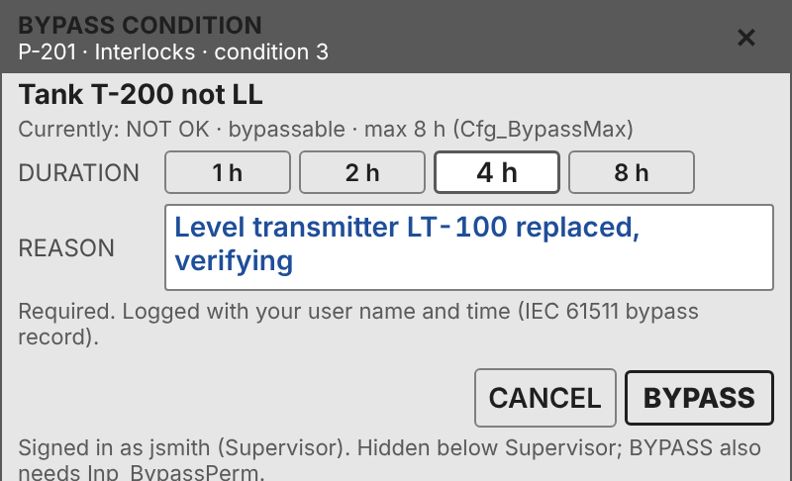
Permissives, interlocks and bypass
DYNAMIC WINDOWS
Named groups in the PLC type: Perm and Intlk (T_Intlk) inside T_DValve, T_Motor, T_VFD, T_Heater; Prot in equipment modules. ANDed with the existing Inp_PermOK / Inp_IntlkOK
Up to 16 conditions per group, each with first-out, latched state and its own bypass time left (Sts_BypLeft)
BYPASS (Supervisor+): reason required, written to the audit log, times out at Cfg_BypassMax. Duration presets and the Inp_BypassPerm check are approved (decision 10) but not built yet
Each bypassed condition shows its own time left
Approved BypassConfirm mockup (decision 10)
SAFETY
Safety signals (SIS, E-stops, safety interlocks) can never be bypassed or forced in software. Only process conditions engineering marked Cfg_Bypassable under MOC can be bypassed from the HMI (decision 29).
Notes:
SAY:
Permissives stop a device starting. Interlocks stop it running. Bypass is allowed for process conditions only, under one supervisor's authority with a reason, and it times out. Safety signals can never be bypassed in software.
KEY POINTS:
- T_Intlk groups hold up to 16 named conditions each, with first-out, optional latch, per-condition bypass and time left (Sts_BypLeft). Device types embed Perm for permissives and Intlk for interlocks; equipment modules embed Prot (decision 7).
- The existing Inp_PermOK and Inp_IntlkOK inputs are kept and ANDed with the groups.
- A permissive only blocks a start. An interlock stops running equipment (types/README.md, conventions).
- BypassConfirm asks for a reason. Only Supervisor or higher can bypass; efc.ui.bypass refuses an empty reason and writes the audit record. The bypass times out at the block's Cfg_BypassMax, which defaults to 8 hours.
- Safety signals (safety PLC, E-stops, safety interlocks) can never be bypassed or forced in software. Cfg_Bypassable is set only for process conditions, under MOC at design (decision 29).
- Decision 19: the Controls Standard two-person or MOC rule for online changes is amended to exempt HMI bypasses made this way. Forces and logic changes keep MOC. The change is queued in steward/DOC-QUEUE.md (row 2 covers the HMI bypass rules).
STANDARD:
- IEC 61511 bypass management, as cited in types/README.md: authorisation, time limit, indication and logging. T_Intlk is basic process control only, not a safety instrumented function.
CHECK:
- Decision 10 wanted duration presets. The built BypassConfirm has none. It runs to Cfg_BypassMax.
- Decision 10 also says BYPASS needs Inp_BypassPerm. The HMI code does not check it, so confirm the PLC side enforces it.
- Decision 10 asks for an audit line per condition (user, role, time, reason). The interlock list shows the minutes left, not an audit line. First-out and latched status are not in the list either.
IF ASKED: "Can someone bypass a safety interlock from the HMI?"
- No. Decision 29 forbids it. The HMI bypass is for basic process control conditions only.

Slide 22
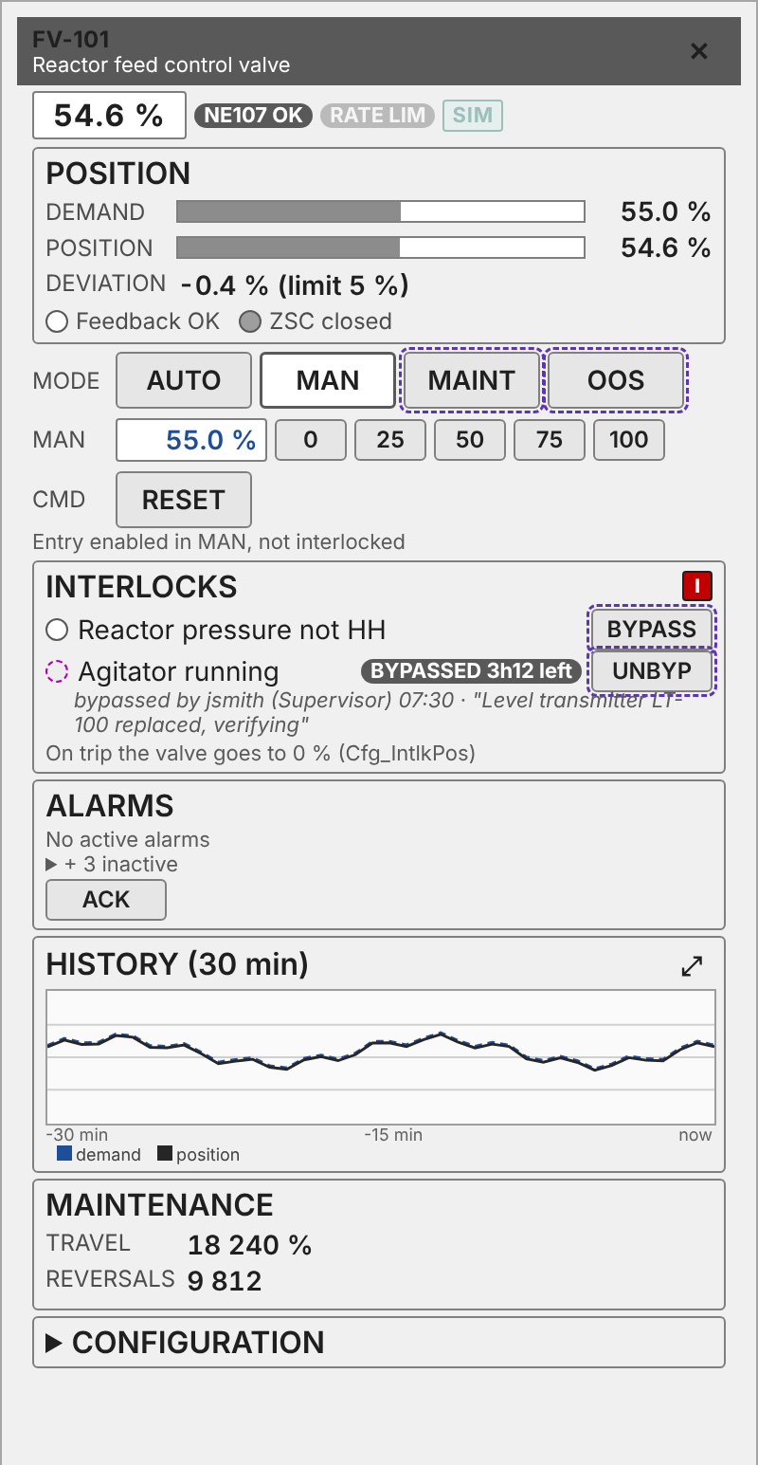
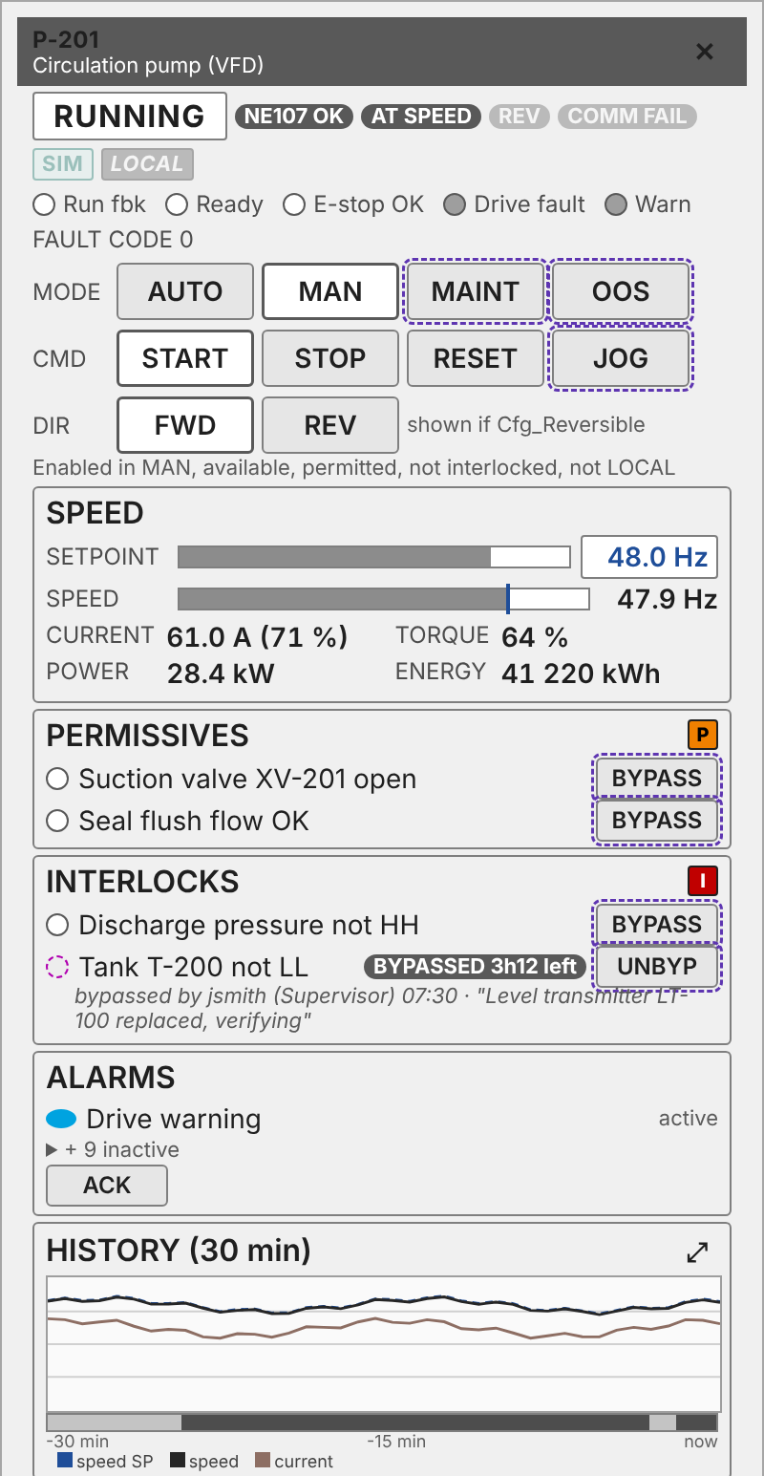
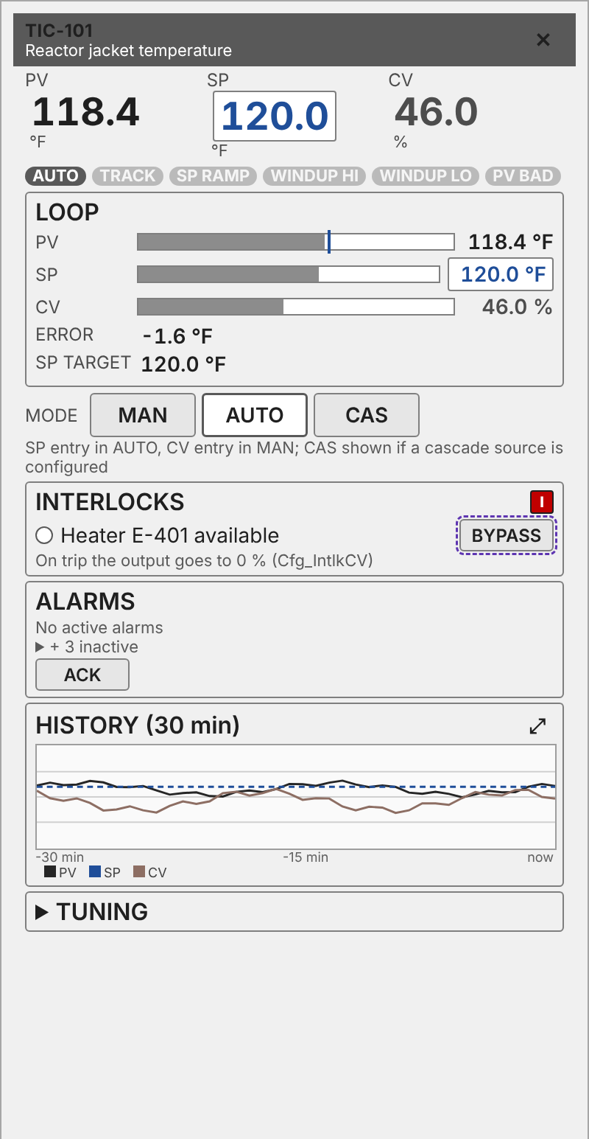
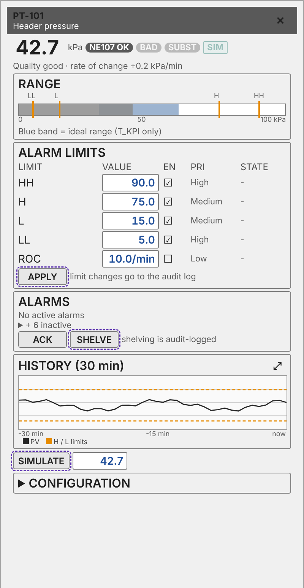
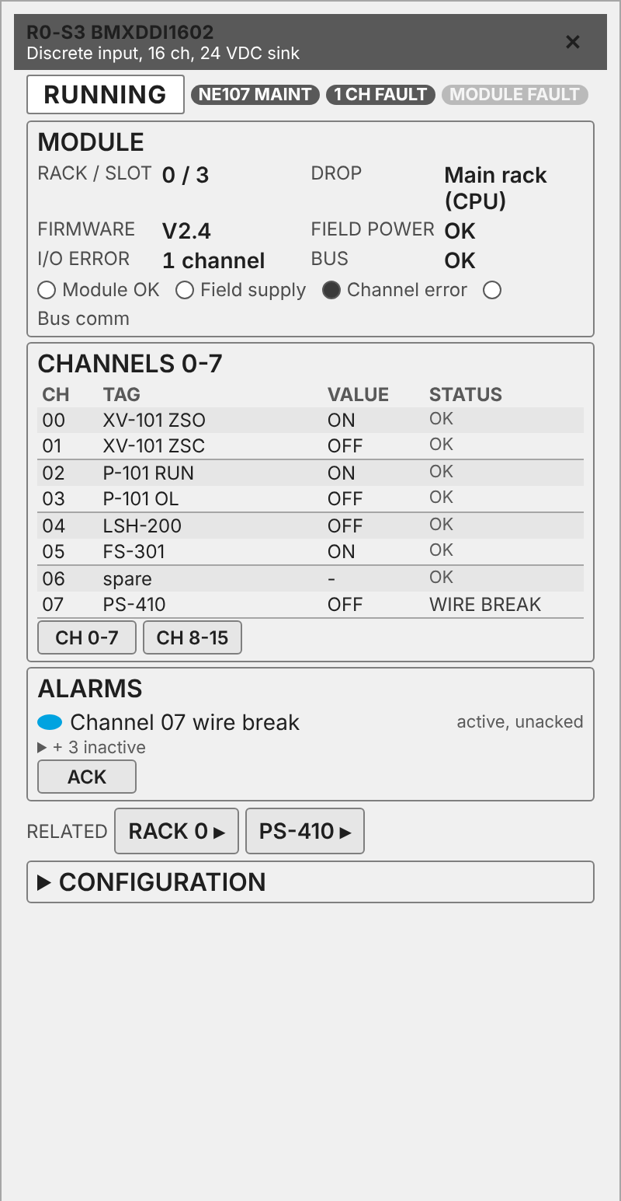
One window per device family, same layout everywhere
DYNAMIC WINDOWS
dw_ValveAnalog
Presets 0/25/50/75/100 %
dw_VFD
Speed, FWD/REV, load
dw_Loop
PV / SP / CV, MAN AUTO CAS
dw_ProcessValue
Range, alarm limits, simulate
dw_IOCard
x80 channels and health
Notes:
SAY:
The windows share one shape: header, state banner, mode, commands, values, interlocks, alarms, history, then maintenance and configuration. The differences are the values and the commands.
KEY POINTS:
- dw_ValveAnalog: manual position entry and presets at 0, 25, 50, 75 and 100 % (decision 12), in Manual and not interlocked. Values: demand, position, deviation, travel, reversals. Configuration collapsed.
- dw_VFD: speed entry at Operator in Manual, and FWD and REV when the drive is reversible. Values: speed reference, speed, torque, power and drive fault code.
- dw_Loop: MAN, AUTO and CAS at Operator; setpoint entry disabled in CAS; output entry enabled in MAN; tuning and limits at Engineer.
- dw_ProcessValue: value, rate of change, range and the alarm limits. Simulation at Maintenance.
- dw_IOCard: I/O channel faceplates bound to the native Modicon x80 DDTs (decision 23).
- Buttons: command tier is one size, Button/Default, with the current state in Button/Toggle/On. Secondary tier is Button/Small. Button/Danger appears only on the bypass confirm (decision 13).
CHECK:
- Decision 13 puts JOG in the command tier as Button/Default. The build uses Button/Momentary for JOG.
- Decision 13 says 72 by 30 px. The build sets the command buttons to a 32 px row height, with width flexible.
- dw_ProcessValue has no shelve control in the build yet (decision 14 puts shelving at Supervisor+). The mockup image shows a SHELVE button.
IF ASKED: "Why one button size?"
- The files give the rule, not the reason. A single size for all command buttons is the stated rule in decision 13.

Slide 23
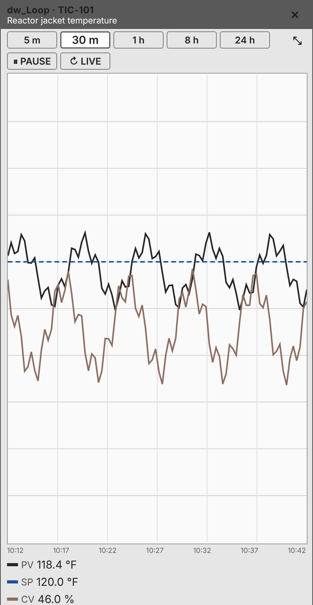
History and the expanded trend
DYNAMIC WINDOWS
Every window carries a short history trend, 30 min by default
The expand button fills the window below its header, about 400 x 760 at 1080p
Range buttons 5 m / 30 m / 1 h / 8 h / 24 h and collapse; pause / live and a last-events list are approved but not built yet
The other sections hide while expanded and come back on collapse
The region never widens, so the process area is never covered (decision 26)
Expand state is local to the window, not a session value
Requires tag history on the pens the window trends (PV, SP, CV, position, current).
Notes:
SAY:
Every window has a short history strip. Expanding the strip makes the graph taller inside the window. It never widens the screen.
KEY POINTS:
- Default range 30 minutes. Each window plots its own pens, for example output and open state for discrete valves, demand and position for analog valves, PV, SP and output for loops.
- Expand makes the graph about 400 by 760 inside the window (decision 26). Range buttons appear only when expanded: 5 minutes, 30 minutes, 1 hour, 8 hours, 24 hours.
- Expanded state is an in-out parameter of the trend view, local to that window. It is not a session value.
- Decision 26 replaced the earlier "about 50 % of the screen" behaviour in decisions 16 and 24. The right region never changes width.
- Data comes from system.tag.queryTagHistory, averaged to 200 points, with bad-quality samples ignored.
BEHAVIOUR:
- With no history configured on the tags, the graph is empty. The code catches the exception and returns nothing, so there is no error on screen.
- The axis labels show the range and "now".
CHECK:
- Decision 16 and decision 6 ask for pause and live, and for last events. The build has neither.
- Decision 6 asks for an 8 hour state strip. The build's 8 hour setting is a range choice inside the expanded trend, not a separate strip.
IF ASKED: "Is it live?"
- Yes, it refreshes from history. Pause is not built.

Slide 24
PLC types behind the graphics (EFCLib v1 / PCLib)
TYPES
Prefix | Meaning | HMI may write?
Sts_ | Status from the PLC | No, never
Inp_ | Field / logic inputs | No
Cmd_ | Operator commands (one-shot) | Yes
Cfg_ | Configuration (limits, tag, bypassable) | Yes, Engineer+
Sim_ | Simulation | Yes, Maintenance+
Prm_ | Recipe parameters (batch) | No (batch server)
Prog_ | Commands from the owning phase / EM | No (PLC owner)
What the types give the HMI
Modes and states as integers, so graphics need no color logic in the PLC
NE107 status on every field device
Alarms from T_Alarm: priority 1-4; ACK in Ignition writes Cmd_Ack, so the PLC stays authoritative
ISA-88 ownership through T_Mode (acquire / release)
I/O faceplates bind the native Modicon x80 DDTs; no extra type
ISA-101: the HMI never writes PLC status.
Notes:
SAY:
The PLC types are the contract. The HMI writes commands and configuration, the PLC writes status, and every name prefix says who owns it.
KEY POINTS:
- Prefixes (types/README.md, conventions): Inp_ from I/O or upstream logic; Cfg_ written by the engineer through the HMI with access control; Cmd_ one-shot commands from the HMI; Prog_ commands from the ISA-88 owner; Prm_ recipe parameters from the batch server; Sts_ status from equipment logic; Sim_ from the engineer; Out_ to field or downstream.
- Each type has an ISA-88 role and, where one exists, the MTP data assembly it maps to (types/README.md).
- Sts_NE107 is on every field-device control module, with Inp_NE107 for HART or fieldbus status.
- Alarms are T_Alarm. Cmd_Ack is one-shot. The ACK button writes Cmd_Ack to each unacknowledged alarm listed in its window.
- I/O card and rack faceplates bind to the Modicon x80 device DDTs from Control Expert. There is no PCLib type for them (decision 23).
CHECK:
-Prm_ is written by the batch server, not the HMI (the slide shows this). The HMI does write Sim_En through the SIMULATE button at Maintenance level.
- T_Alarm priority 1 is Emergency. The HMI maps it to Critical. See slide 6.
IF ASKED: "Why can't the HMI write Sts_?"
- Status belongs to the logic that sees the field. The HMI writes requests (Cmd_) and settings (Cfg_), never results.
IF ASKED: "Why do OK booleans read TRUE when healthy?"
- So that a broken wire or lost signal reads as unhealthy, not healthy (types/README.md, conventions).

Slide 25
What happens when...?
BEHAVIOUR
Situation | What the operator sees
Comms lost / tag quality bad | Safe defaults via coalesce(); bad quality in magenta; outline does not go red from bad data
UDT member missing (older PLC) | Treated as "not missing / not active"; template keeps working
No alarms configured on the instance | Alarm lookup returns no alarm instead of an error
Interlock trips while running in Manual | Red I badge; start/open blocked; stop/close allowed from the symbol button
Both limit switches made | FAULT: dark fill, red border, FAULT text
Feedback disabled | Symbol follows the command; no false travel
User below the needed role | Control not shown at all; gateway re-checks any write
Bypass time runs out | Condition returns to normal enforcement; time left was shown per condition
Screen at 1440p or 4K | All sizes in vh: 1.33x or 2x, same layout
Notes:
SAY:
Use this when someone asks what the screen does in a failure. Each answer is from the build or the notes, and where the answer is a judgement, the slide says so.
KEY POINTS:
- Communication loss or bad quality: the tag reads fall back to defaults, so the symbol shows a plausible state (closed, no P or I, no button). It does not show an error. The changelog calls these defaults safe; they are safe against false commands, not a stale-data warning.
- A UDT member is missing, such as Permissive before the PLC has it: the read shows Bad_NodeIdUnknown and the template treats the permissive as not missing until the variable exists (design note 42).
- No alarms configured on the instance: the alarm lookup returns no alarm, not an error (design note 42).
- Interlock trips in Manual: the I badge shows, opening is blocked, closing is allowed on the symbol button, and Alm_IntlkTrip is raised. The PLC drives the valve to Cfg_IntlkOpen.
- Both limit switches made: Alm_PosConflict is raised, and the state shows FAULT with the red border if Sts_Fault is set (slide 9).
- Feedback disabled: the symbol needs the PLC to drive Sts_Opened and Sts_Closed (slide 9).
- User below the role: the control is hidden. A direct script call is refused before the write (slide 20).
- Station at 4K: everything is in vh and the window is 800 wide (slide 17).
- Trend with no history: the graph is empty, with no error (slide 23).
- Window type missing: nothing opens and a warning is logged (slide 18).
- No audit profile: the record goes to the efc.ui logger only (slide 20).
CHECK:
- Confirm the "closing always allowed while interlocked" answer on the window CLOSE button before a demonstration. The build gates it (slide 12).

Slide 26
Open items and next steps
Decisions and build gaps before release
SYMBOLS
VALUES
WINDOWS
ROLLOUT
2 px alarm outline on small valves?
OPENING / CLOSING width
Center status chip, or M + status?
PV faded level 0.25 -> 0.4
PV diagnostic gray -> #6E6E6E
HW_Fault alarm in the UDT
Finalize T_KPI + FB_KPI
Bypass presets + Inp_BypassPerm
One close/stop rule when interlocked
Pause / live + last events
Gateway-test PV and loop cards
Controls Standard edits in one batch
Re-point HMI projects to EFC_Library
Notes:
SAY:
These are the open items as the files record them. Some are design questions and some are gateway tests that have not happened yet.
KEY POINTS:
- Valve alarm outline: 3 px may swamp a 36 px valve. 2 px on valves is suggested and not decided (design note open items).
- Valve status width: OPENING and CLOSING are tight next to the command button (design note open items).
- Manual M with the status: should the status stay on the centerline, with the M hanging off its left, or should the M and status center as a unit? Not decided (design note open items).
- PV cards: raise the faded level from 0.25 to about 0.4 on white (docs/pv-display.md).
- PV diagnostic classes still use 7A7A7A. Diagnostic moved to 6E6E6E in the audit (docs/pv-display.md).
- Add the HW_Fault alarm (High) to the real process value UDT (docs/pv-display.md).
- Gateway testing of PV versions 1.1 to 1.3 and of the loop cards is still to do (docs/pv-display.md; docs/pid-loop-templates.md).
- Analog indicators: T_KPI and FB_KPI are still to be written (types/T_KPI/README.md).
- Window gaps from the decisions: shelving, pause and live, last events, the first-out and latched status and audit line in the interlock list, and bypass duration presets (slides 19 to 23).
- Controls Standard edits are queued in steward/DOC-QUEUE.md (decision 18), including the HMI rules and the bypass exemption (decision 19).
CHECK:
- Before saying the PV cards are ready, confirm which type they bind. docs/pv-display.md says DDT_Process_Value; the catalog says T_AI.
IF ASKED: "What's the next step?"
- Gateway test the PV and loop versions, then close the window gaps or drop them from the requirement list.

