Slide 1
Python Project: Kiosk
Adam Zmijewski, Shawn Smith, Shaunak Vaghasia, Jeff Hall

Slide 2
General Idea
Transportation kiosk for Michigan travel.
Type in selected destination, calculates best route, return tickets/price, and transaction follows a id
Each input is based on one mode of transport.
Everything entry is recorded into a database.

Slide 3
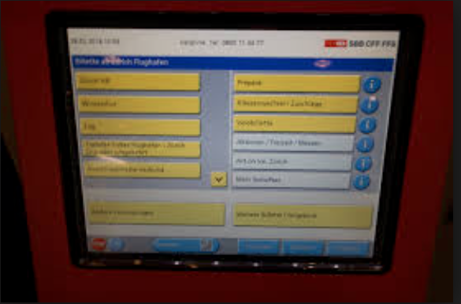
Picture Example
Source: Swiss transit

Slide 4
Three Level Project
Two data tables one for ticket purchases, and the other for routes for the selected mode of transportation.
User interface prefiberably HTML
Python code/ logic connecting the top two actions.

Slide 5
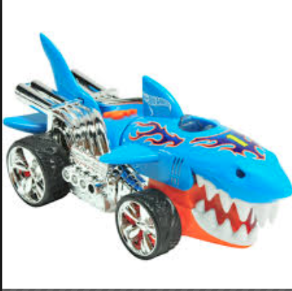
Detroit Transit Proposal

