Slide 1
Pivotal Marketplace Overview
An orientation to what, why, and how Pivotal offers services on PCF
Version: August 2015

Slide 2
Agenda
Services Basics
Spring Cloud Services
Data Services
Mobile Services

Slide 3
Marketplace Basics

Slide 4
How do services fit into Pivotal’s solution for cloud-native apps?
Professional Services for Agile, CI/CD
Cloud Native
Data Services
BDS
Services
Pivotal
Labs
Pivotal Cloud Foundry
PCF
Mobile
Services
Spring
Cloud
Services
Cloud Native
Mobile Services
Cloud Native
Application Framework

Slide 5

What is a Service?
Allows resources to be easily provisioned on-demand
Typically middleware, frameworks, and other “components” necessary for applications
Can be a persistent, stateful layer

Slide 6

Two Types of Services
Managed - Fully integrated, with full lifecycle management
User-Provided – Created and managed external to the platform

Slide 7
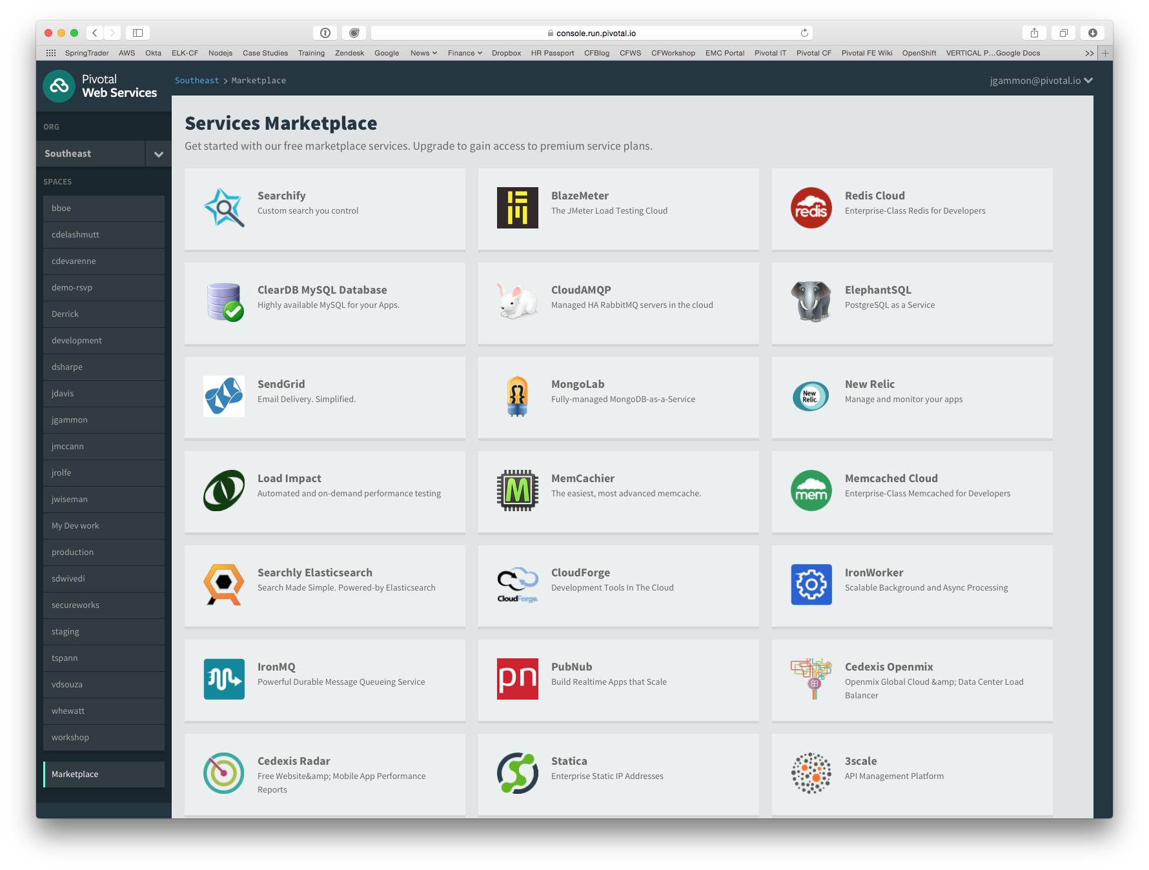

Slide 8
Service Broker
Flexible, RESTful API
Allows Service Authors to provide self-provisioning Services to developers
Cloud Controller
Create
Service Broker
Service Nodes
Bind
Connect
DEA
Apps

Slide 9
Creating and Binding a Service
Service
credentials
DB
CLI
create service (HTTP)
Cloud Controller
create service (HTTP)
Service
Broker
reserve resources
Data
Service
Router
bind service (HTTP)
bind service (HTTP)
obtain connection data
Pivotal Cloud Foundry
Elastic Runtime
Notes:
An application runs in a DEA, which is a droplet execution agent. The Cloud Controller orchestrates the routing and lifecycle of all DEAs in the pool. Routers manage application traffic. Health Manager reports mismatched application states to the CC. A service gateway provides an interface for services (native or external). A messaging bus manages all system communication. Apps are accessed directly through the router while web and CLI clients (e.g., vmc, STS) access Cloud Controller via RESTful services.

Slide 10


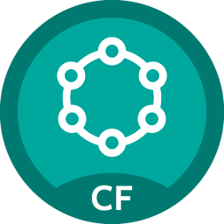




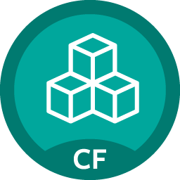











Pivotal Cloud Foundry Services
Mobile
Datastore
Other
SpringCloud
API Gateway
Redis
DataStax Cassandra
Config Server
RabbitMQ
Push Notification
MySQL
GemFire
Jenkins Enterprise
Service Directory
Data Sync
Session state caching
Circuit Breaker
PivotalHD
Spring XD
App Distribution
Single Sign-on
Neo4j
MongoDB

Slide 11

Pivotal Cloud Foundry Services
Operated ‘as a Service’
Configured and integrated to enable push button deployment
Full lifecycle management - software updates and patching
Bind to apps through an easy-to-use interface
Common view into access control and audit trails across a breadth of services
EASY
Notes:
In many organizations, provisioning of data and messaging services for applications can take weeks, if not months because of the number of teams, administrators and exchange of credentials involved. We are striving to address this problem by providing a common model for services deployment via Pivotal Cloud Foundry that developers can easily find and their applications bind to – and scale those services as needed.
PCF Services allow administrators to provide pre-defined database and middleware services, and this gives developers the ability to rapidly deploy a software product from a menu of options without the typical slow and manual provisioning process. This is also done in a consistent and supportable way. PCF Services are managed and operated ‘as a Service,’ and this means they are automatically configured upon request. The provisioning process also incorporates full lifecycle management support, like software updates and patching.
This automation removes the overhead from developers, who are often saddled with service configuration responsibility. It makes administrators’ lives easier and addresses security risks by standardizing how services are configured and used.

Slide 12
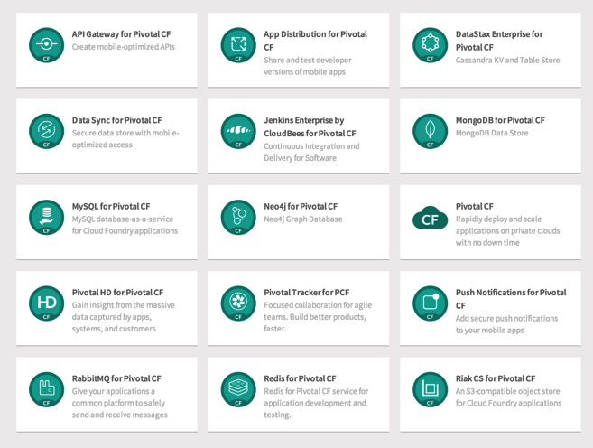
PCF Marketplace
Broad Services Ecosystem
Easy accessibility
Quick, self-provisioning

Slide 13




Spring Cloud
Notes:
http://www.wired.com/wp-content/uploads/2014/06/google-cloud.jpg

Slide 14

Companies want to be fast like Netflix
Netflix needed to be faster to win / disrupt
Pioneer & vocal proponent of microservices - the key to their speed and success
Netflix OSS supplies parts, but it’s not a solution
Difficult for enterprises to build it themselves
Pivotal offers the closest thing to “Netflix in a box” today
“
“Velocity on the JVM is the Killer App”
- Andy Glover (Netflix Eng) @ SpringOne2GX 2014 Keynote
https://youtu.be/xU267-YHN5c?t=1938
Notes:
NetFlix, an undisputed business & technology leader
34% of peak N. American internet traffic from 6-9pm
If speed was why they won, microservices was how
They pioneered / began to popularize micro service concept
All they had was Amazon EC2 back then
They had to invent a distributed platform, cloud native platform with PaaS – like features
They had to invent microservice infrastructure at the application level
All before writing one line of code that relates to the application you and I know as Netflix
NetflixOSS is a talent acquisition and retention strategy, they are in the movie business 1st, and the software business 2nd.
Open source and supporting their developer’s efforts in the industry is how they are able to attract and retain the best engineers, giving them the ability to invent all this stuff.
That’s tough to duplicate.
Detail on Netflix quote: Netflix needed the performance, stability, concurrency of the JVM, but was searching the right RAD capability to give them the velocity they wanted.

Slide 15



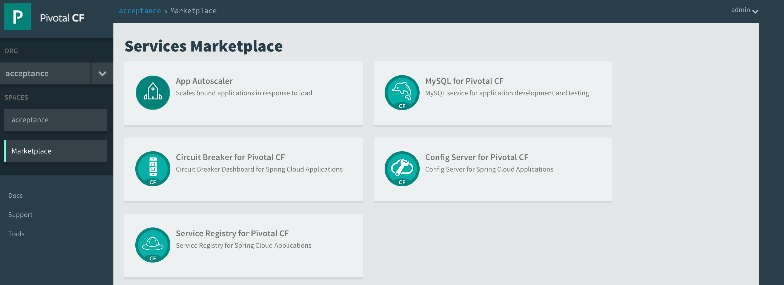

Spring Cloud Services Suite
Installed via Pivotal Ops Manager
Adds all services to Pivotal Cloud Foundry Marketplace
Config Server
Service Registry
Spring Cloud
Services
Circuit Breaker Dashboard
Notes:
ONE CLICK INSTALL
1 config server AI
2 AIs for eureka (for F/T)
2 Ais for Turbine
1 SI for turbine (Rabbit perhaps for pub/sub to hystrix dashboard?)
1 SI for svc broker (mysql) for config server?

Slide 16

Spring Cloud Config Server
Spring Cloud Config Server
Service Binding via Spring Cloud Connector
Git URL for Config Repo provided via Service Dashboard (post-provisioning)
Single tenant, scoped to CF space (nothing prevents shared Git repo)
Config Server
Notes:
ASK

Slide 17

Spring Cloud Service Registry
Service Registration and Discovery via Netflix OSS Eureka
Service Binding via Spring Cloud Connector
Single-tenant, scoped to CF space
Registration via CF Route
PCF 1.4.1 (Q2 ’15): Support Direct Address (“promiscuous”) Mode
Service Registry
Notes:
Ask
Consul, Zoookeeper

Slide 18

Spring Cloud Circuit Breaker
Netflix OSS Turbine + Hystrix Dashboard
Aggregation via AMQP (RabbitMQ)
Binding via Spring Cloud Connector
Single-tenant, scoped to CF space
Circuit Breaker
Dashboard

Slide 19

Big Data

Slide 20
BDS Vision: Make all data products cloud-ready.
Open.
Agile.
Cloud-ready.
Pivotal BDS on PCF
Production: RabbitMQ, Redis
Beta: PivotalHD (includes HAWQ), Spring XD
Coming soon: GemFire

Slide 21
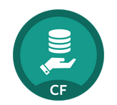
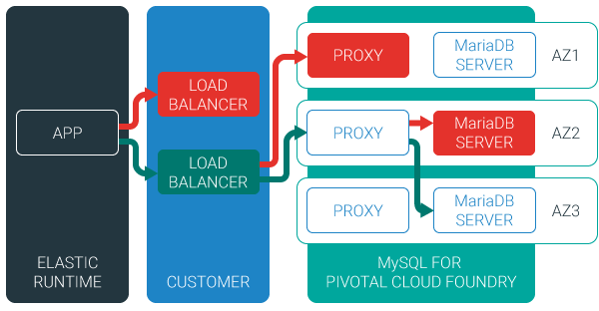
MySQL for Pivotal Cloud Foundry
Relational Database as a Service for Your Applications
Minimized effort to create, configure, and manage a MySQL cluster
Multi-node cluster
Data replication across nodes
Failover functionality ensures app traffic only routed to healthy nodes
Notes:
Deployed with a multi-node cluster; Balanced across Availability zones
Highly Available
Data replication
Failover functionality
Customizable plans
Secure - Different credentials to each application, operators can revoke access selectively!

Slide 22

Redis for Pivotal Cloud Foundry
Advanced Key-Value Store and Cache as a Service
Pre-provision a pool of Redis VMs
Supports persistence to disk
Consolidated logging and monitoring
VM health monitoring, and recovery
User Application
Binding
Instance (Redis process)
VM
VM
VM
VM
Pre-provisioned VMs in the ‘pool’
Ready to be created as instances and bound with apps
Notes:
Developers can quickly develop features for their applications such as:
live, in-memory caching for very fast reads
real-time computation on data structures
ranked lists and leaderboards
publishing and subscribing
queuing

Slide 23

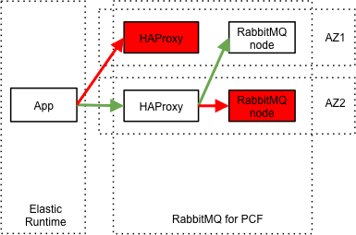
RabbitMQ for Pivotal Cloud Foundry
Apps safely send and receive messages at scale
Messaging broker for communication between servers, applications and devices
Highly available queues, flexible routing, support for multiple protocols and client libraries
Wide range of client libraries, in all languages
Push button deployment and upgrades of a RabbitMQ Cluster

Slide 24

Session State Caching (SSC) by GemFire
Configure, manage, monitor, and consume GemFire in a client/server topology
A turn-key GemFire session replication cache service optimized for Java buildpack apps deployed in Tomcat
No need to modify your app
Tomcat from the java buildpack “knows” how to use the service
GemFire pre-configured for session replication
Session state management independent from app servers
App servers can come and go without affecting session lifetime
Not affected by load balancing

Slide 25

Mobile Services

Slide 26




Diversity of clients, more load
In January 2014, mobile devices accounted for 55% of Internet usage in the United States. Apps made up 47% of Internet traffic and 8% of traffic came from mobile browsers.
http://money.cnn.com/2014/02/28/technology/mobile/mobile-apps-internet/
Notes:
When we established the predominant enterprise architecture paradigms, the vast majority of our clients were usually tethered to a desk with a workstation. Now that has flipped…

Slide 27

Pivotal CF Mobile Services
Consumer-grade, mobile backend services built for the enterprise
Built on Pivotal CF for simplified deployment and operation in private cloud
Enables businesses to apply the power of Pivotal’s Big Data Suite to mobile solutions
Enterprise Backend Applications
Pivotal CF Mobile Services
Push
Notifications
API
Gateway
Data
Sync
App
Distribution
Pivotal CF

Slide 28
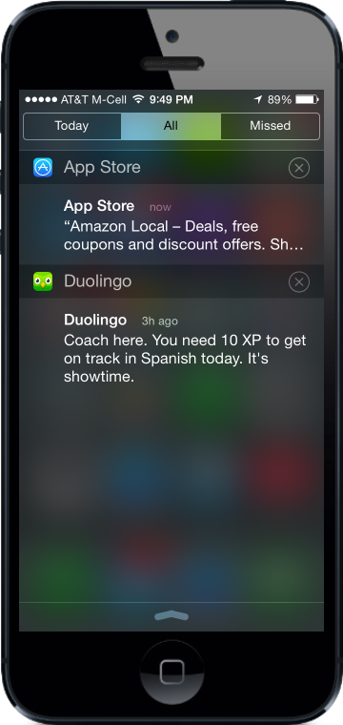
Push Notifications
Problem
Push is difficult to implement across platforms and at scale
Most existing push solutions are public / shared
Data owned by SaaS provider and cannot be fully leveraged by enterprise
Difficult to integrate SaaS push providers with services behind the firewall
Solution / Benefits
Dedicated, comprehensive solution built to scale
Full control of data and comprehensive logging / tracing
Direct integration with enterprise services

Slide 29
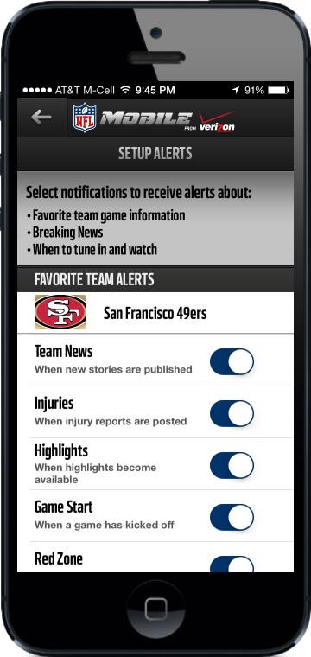
Data Sync
Problem
Apps need to store mobile-specific data, but the existing backend cannot accommodate
Data sync / store is difficult for an app developer to set up
Existing services provide public cloud “black box” storage
Solution / Benefits
Mobile-optimized API for access to multiple types of storage
Simple for developers, yet enterprise-grade and highly scalable

Slide 30
API Gateway
Problem
Legacy APIs are not optimized for mobile
Too much unnecessary content delivered to devices
Mobile very sensitive to latency (often weak or no signal)
Mobile apps often require several API calls to display a single page of content
Solution / Benefits
Allows mobile developers to easily transform APIs
Deliver mobile-optimized, device specific content
Results in improved performance and user experience

Slide 31
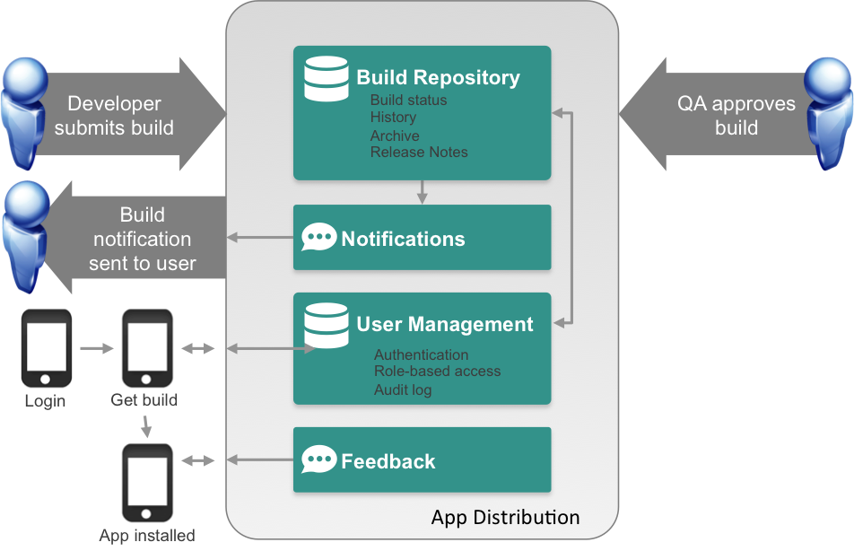
App Distribution
Problem
Extensive user testing of apps is critical to success
Difficult to distribute pre-release apps to test users
Existing solutions are public cloud
Solution / Benefits
Easy OTA app distribution
User / team management
Supports all major platforms
Private cloud for control / security

