Slide 2
Pivotal CF
Intro

Slide 3
The Cloud Platform Evolution
Traditional
IaaS
PaaS
Your Application Code
Your Application Code
Your Application Code
Database
Web Server
Messaging
PAAS
Database
Web Server
Messaging
IAAS
IAAS
Operating System
Virtualization Platform
Physical Servers
Notes:
No need to configure VMs, databases, AppServers, Load-balancers…
Developers can focus on development and not infrastructure plumbing
Separate the concerns of AppDev and Operations
Eliminate the bottleneck of provisioning and deployment processes
Make full use of investments in the “Cloud”

Slide 4
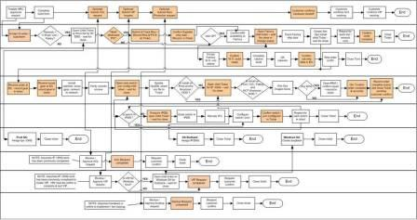
How Long Would it Take to…
Lookup an application, understand all its dependencies
Install runtime, container and libraries needed
Install needed services (database, messaging, Hadoop cluster)
Bind the services to the application, handle IP/port assignments
Setup dynamic routing and load-balancer
Setup four layers of built-in High-Availability
Setup streaming logging aggregation
Setup Application Performance Monitoring
Later: scale-out to 10 additional instances
… and do it all over again from Dev → Test → Prod on any infrastructure

Slide 5
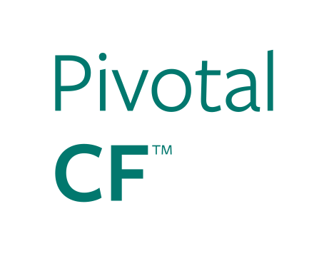




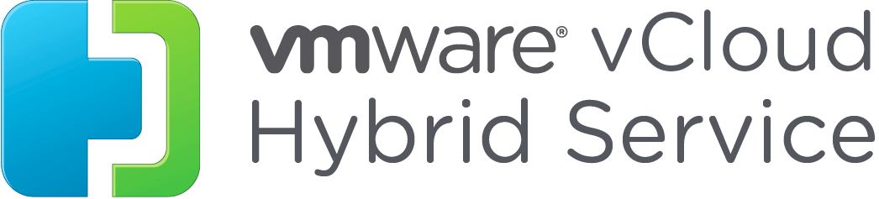

The Pivotal CF Way…
provision <my cloud>
target <my cloud>
push <my app>
bind <my services>
scale <my app> +100
upgrade/scale <my cloud>
Notes:
An enterprise PaaS, powered by Cloud Foundry, is the key enabler for achieving the modern, software driven organization. Purpose built for continuous delivery and horizontal architectures, Cloud Foundry allows developers to focus on the application as the unit of deployment and scale, not infrastructure. It provides an abstraction layer that enables enterprises to make infrastructure choices based on price, performance, location and efficiency.
Companies seeking to become a software-driven enterprise for greater agility are often impeded by the complexity of deploying, upgrading and scaling a PaaS on their private cloud.

Slide 6
The Power of PaaS
Traditional IT
IaaS
PaaS
Applications
You Manage
Applications
Applications
Data
Data
Data
Pivotal CF on IaaS
Agility and Cost Savings
You Manage
Runtime
Runtime
Runtime
Middleware
Middleware
Middleware
O/S
O/S
IaaS Provider
O/S
Virtualization
Virtualization
Virtualization
Servers
Servers
Servers
Storage
Storage
Storage
Networking
Networking
Networking
Cloud Enablement
Notes:
PaaS in its most basic sense is an extension of the IaaS pattern to include management of runtimes, middleware, configuration, etc.

Slide 7
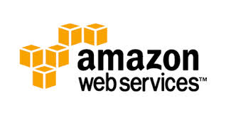
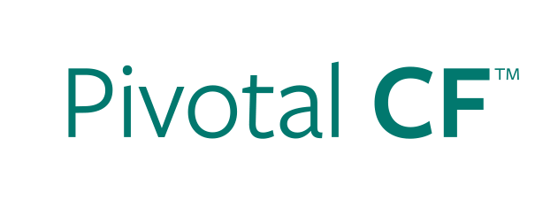

Deploying an Application
IaaS versus PaaS
Provision VM
Install Application Runtime
Deploy Application
Configure Load Balancer
cf push
Configure SSL Termination
Configure Service Connectivity
Configure Firewall
Notes:
Highlight that not only are the steps longer in IaaS, but often there are multiple groups involved (ie, Dev, Operations, etc).
Management of configuration information is often manual in IaaS (though not always).
Explain that for non-virtualized customers, the steps are even greater.

Slide 8
Scaling an Application
IaaS versus PaaS
Provision New VM
Install Application Runtime
Deploy Application
cf scale
Configure Load Balancer / Update Route
Configure Service Connectivity
Configure Firewall
Notes:
Highlight that not only are the steps longer in IaaS, but often there are multiple groups involved (ie, Dev, Operations, etc).
Management of configuration information is often manual in IaaS (though not always).
Explain that for non-virtualized customers, the steps are even greater.

Slide 9
Pivotal CF: Enterprise Grade SW Delivery
Simple & Comprehensive
End to end platform to iterate quickly and build highly scalable cloud apps
IT Ops automation with no scripts, no templates, no config headaches
Easy to use management dashboard
Scalable & Efficient
Elastic scale of PaaS capacity and applications through simple interfaces or scripting
Higher application instance density on the same IaaS footprint through advanced containerization
Governed & Secure
Individual and team-based roles and permissions
Easy integration w/ 3rd party tools and agents
Extensible
Independent of the IaaS provider, the runtime languages supported & the brokered services
Simple APIs ensure easy extension and customization
Highly Available
Built in health monitoring and management of applications and the platform
Zero downtime deploys/updates of the platform and applications
Notes:
The previous 2 slides showed the basics of CF vs IaaS, this is a more detailed overview of what else you get w/ Pivotal CF

Slide 10
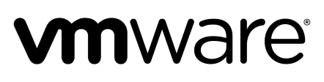

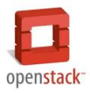

Pivotal CF:
The Platform for a New Era of Software Innovation
Integrated operator functions
Ready Middleware Services
Auto deploy and scale
Instant Dynamic Routing
Streaming Logging Agg
ID/team/RBAC/Policy
APM, Auto-scaling
Ready integration
Four layers of built-in Availability
Auto-detect runtimes, frameworks
“Push and it works” model
CF Push [.WAR]
CF Push [Docker]
CF Push [.ASP]
Elastic Pivotal HD
HAWQ Analytics
Mobile Push
Mobile Sync
Mobile API
MySQL HA
Redis
Rabbit MQ
Elastic Search
Cassandra
Jenkins (Partner)
Deploy, Operate, Update, Scale on any Infrastructure
….and more

Slide 11
Foundations, Organizations and Spaces

Slide 12
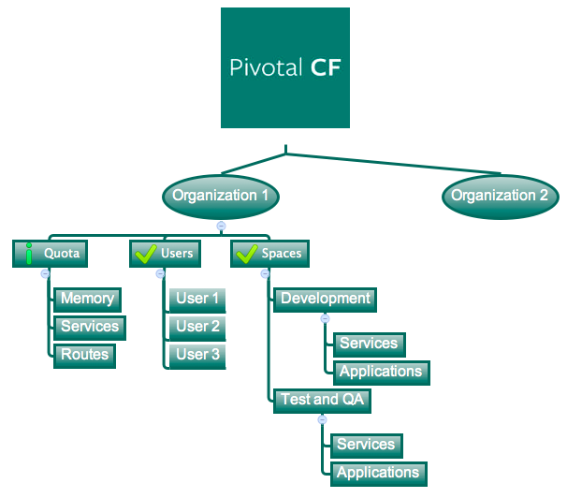
A Pivotal CF Foundation
Physical division for completely separate managed environments
Sub-divided in Organizations.
Targeted to an specific IaaS infrastructure (e.g. VSphere cluster)
Production environment should always be a separate Foundation.

Slide 13
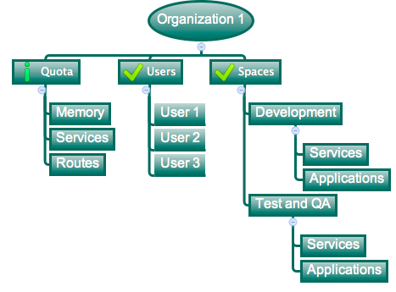
Organizations
Logical divisions for tenants, having their own Quotas and Users.
Sub-divided in Spaces.
User permissions are specified per ORG and per SPACE

Slide 14
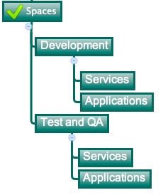
Spaces
Logical sub-division inside an organization
Users specified at the organization level can have different access levels per space
Services and Applications are created / specified per Space

Slide 15
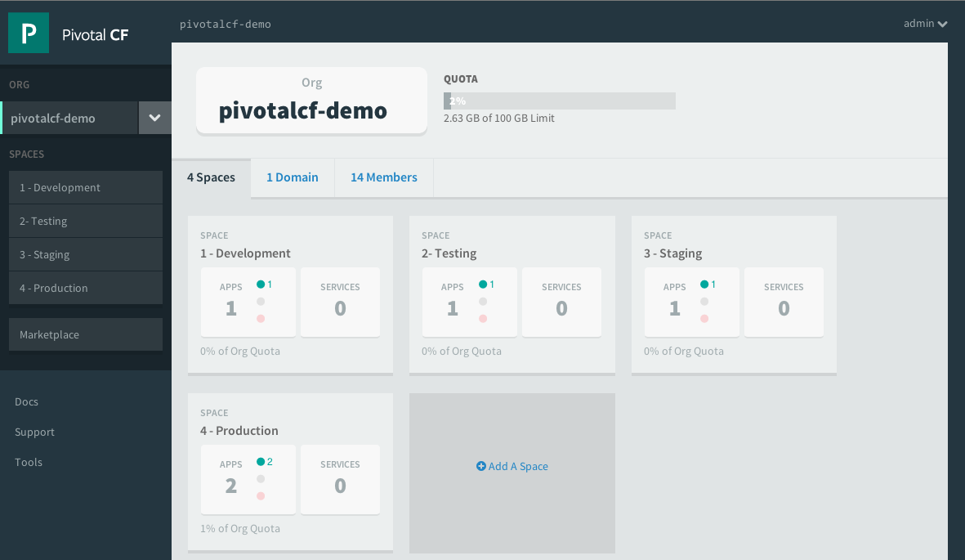
Organizations

Slide 16
Organization Quotas and Plans
Different quota limits (e.g. “small”, “enterprise”, “default”, “runaway”) can be assigned per Organization
Quota constraints currently enforced:
Total Memory
Total # of Services
Total # of Routes
Notes:
Changing quota definitions: http://corneliadavis.com/blog/2014/01/17/changing-quota-definitions/
Current quota constraints:
- Total Memory
- Total Services
- Total Routes

Slide 17
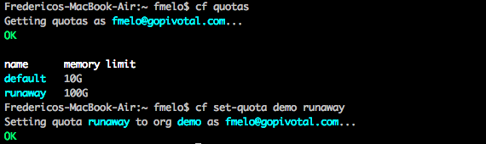
Organization Quotas and Plans
Checking and updating quotas per org.
Notes:
Changing quota definitions: http://corneliadavis.com/blog/2014/01/17/changing-quota-definitions/
Current quota constraints:
- Total Memory
- Total Services
- Total Routes

Slide 18
Pivotal CF IT Operations Tool Set

Slide 19
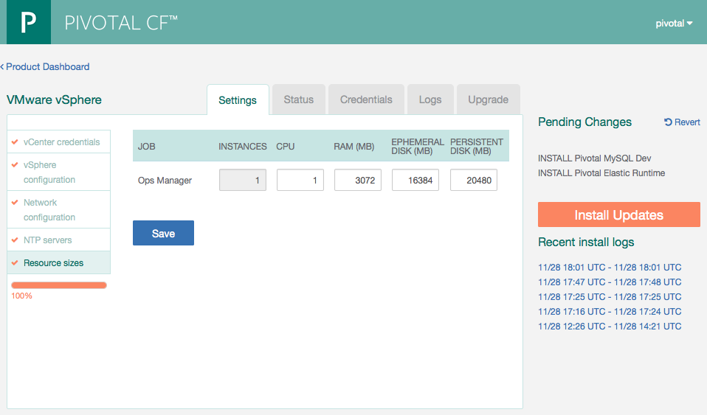
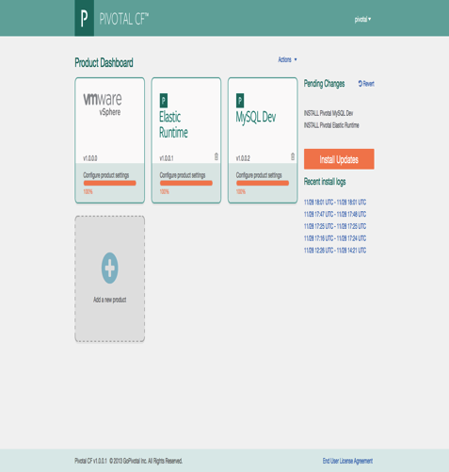
Operations Manager
The Ops Manager is the core orchestrating component.
It controls creation of VMs, deployment, and other life cycle events of software and services.
Web form allowing an operator to scale the Operations Manager both
vertically (CPU, RAM, Disk) and
horizontally (number of instances).
Hit save and afterwards hit Install Updates.

Slide 20
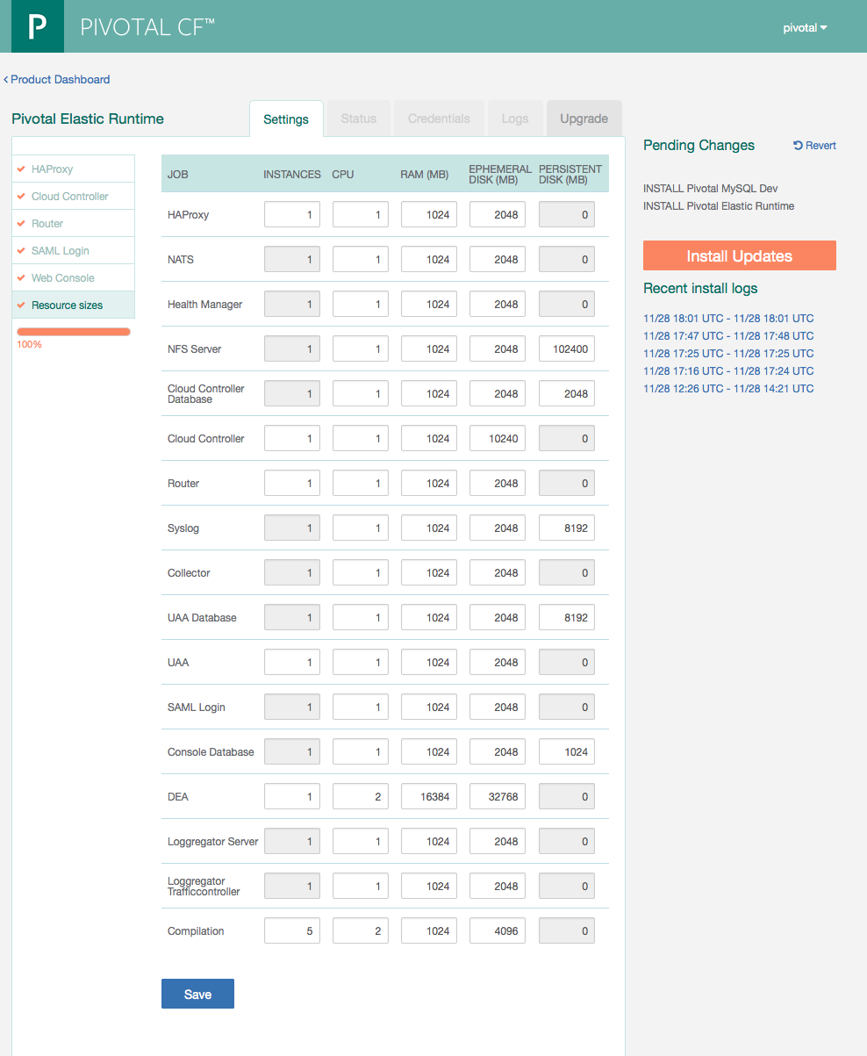
Operations Manager Elastic Runtime tile
Web form allowing an operator to scale components both
vertically (CPU, RAM, Disk) and
horizontally (number of instances).
This results in updating the deployment manifest followed by a “bosh deploy.”

Slide 21
Bosh
BOSH is an open source tool chain for release engineering, deployment, and lifecycle management of large-scale distributed services.
BOSH was developed to deploy Cloud Foundry, however it has a more general purpose - it can be used to deploy other distributed services.
BOSH can deploy these services on Infrastructure as a Service (IaaS) providers such as vSphere, vCloud Director, Amazon Web Services EC2, and OpenStack.
Pivotal CF Operations Manager uses bosh. No need to interact with bosh directly.

Slide 22
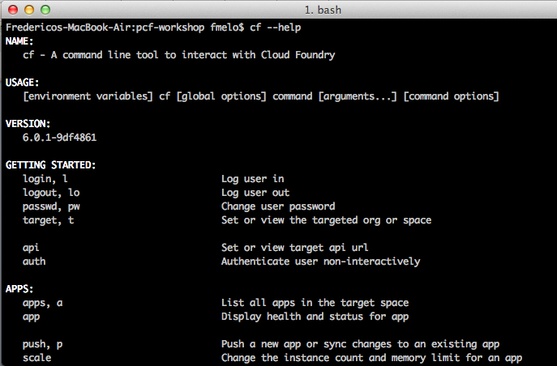
CLI – Command Line Interface
Command line utility providing easy access to the Pivotal CF commands.
Scriptable
Fully documented (cf –help)

Slide 24
Introduction to BOSH

Slide 25
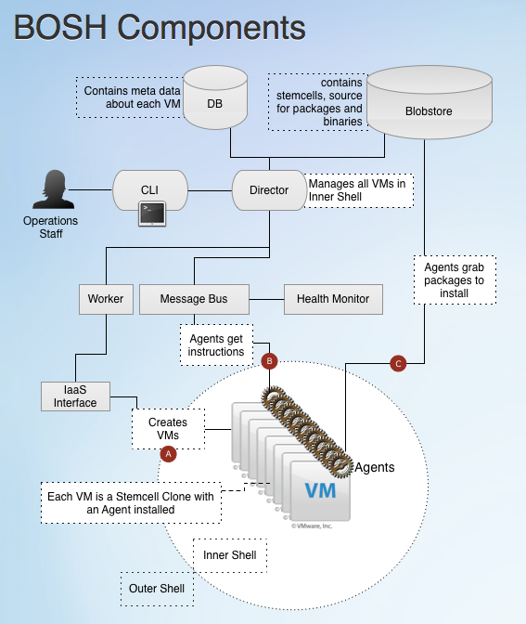
Bosh Components
Director
Workers
Health Monitor
CPIs
Message Bus
Blobstore
Ressurector
Name Server

Slide 26
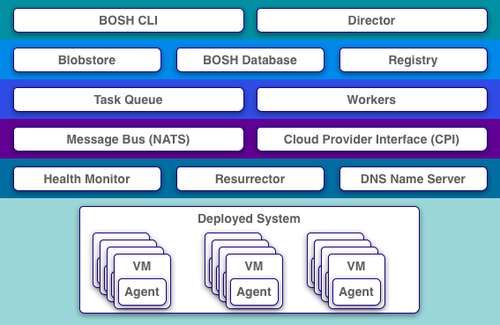

Slide 27

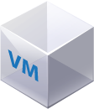
BOSH (Outer Shell) Logical View
DB
Blob Store
Deploys and manages large scale distributed systems. BOSH provides the means to go from deployment (i.e., Chef/Puppet) to VM creation and management (i.e., cloud CPI). It includes interfaces for vSphere, vCloud, AWS and OpenStack. Additional CPI can be written for alternative IaaS providers.
Key Elements:
CLI
Director
Blobstore
Workers
CLI
Director
Worker
NATS
Health Monitor
CPI
Message Bus
Health Monitor
IaaS CPI
Agents
Inner shell
Agents
Outer shell

Slide 28
BOSH: Command Line Interface
DB
Blob Store
The Command Line Interface is how users interact with BOSH using a terminal session to do a deployment, create and upload releases, and upload ‘stemcells’ (i.e. a VM template with an embedded Agent).
CLI
Director
Worker
NATS
Health Monitor
CPI
Inner shell
Agents
Outer shell

Slide 29
BOSH: Director
DB
Blob Store
The core orchestrating component in BOSH which controls creation of VMs, deployment, and other life cycle events of software and services. Command and control is handed over to the the Director-Agent interaction after the CPI has created resources.
CLI
Director
Worker
NATS
Health Monitor
CPI
Inner shell
Agents
Outer shell

Slide 30
BOSH: Cloud Provider Interface (CPI)
DB
Blob Store
The core BOSH engine is abstracted from any particular IaaS. IaaS interfaces are implemented as plugins to BOSH. Currently, BOSH supports both VMware vSphere and Amazon Web Services. These CPIs allow for automated VM and storage disk provisioning, and network management.
CLI
Director
Worker
NATS
Health Monitor
CPI
Inner shell
Agents
Outer shell

Slide 31



BOSH: Cloud Provider Interface
Stemcell
create_stemcell(image, cloud_properties)
delete_stemcell(stemcell_id)
VM
create_vm(agent_id, stemcell_id, resource_pool,
networks, disk_locality, env)
delete_vm(vm_id)
reboot_vm(vm_id)
configure_networks(vm_id, networks)
Disk
create_disk(size, vm_locality)
delete_disk(disk_id)
attach_disk(vm_id, disk_id)
detach_disk(vm_id, disk_id)
IaaS Neutral
...ETC

Slide 32
BOSH: Blobstore
DB
Blob Store
Used to store the content of Releases, Jobs and Packages in their source form as well as the compiled image. When you deploy a Release, BOSH will orchestrate the compilation of packages and store the result in Blobstore. When BOSH deploys a Job to a VM, the Agent will pull the specified Job and associated Packages from the Blobstore.
CLI
Director
Worker
NATS
Health Monitor
CPI
Inner shell
Agents
Outer shell

Slide 33
BOSH: Agents
DB
Blob Store
Every VM contains an Agent. Through the Director-Agent interaction, VMs are given Jobs, or roles, within Cloud Foundry. If the VM's job is to run MySQL, for example, the Director will send instructions to the Agent about which packages must be installed and what the configurations for those packages are.
CLI
Director
Worker
NATS
Health Monitor
CPI
Inner shell
Agents
Outer shell

Slide 34
BOSH: Stemcells
DB
Blob Store
A Stemcell is a VM template with an embedded Agent. Stemcells are uploaded using the CLI and used by the Director when creating VMs through the CPI. When the Director creates a VM through the CPI, it will pass along configurations for networking and storage, as well as the location and credentials for the Message Bus (NATS) and the Blobstore.
CLI
Director
Worker
NATS
Health Monitor
CPI
Inner shell
Agents
Outer shell

Slide 35
BOSH: Health Monitor
DB
Blob Store
Receives health status and life cycle events from Agents and can send alerts through notification plugins (such as email) to operations staff.
CLI
Director
Worker
NATS
Health Monitor
CPI
Inner shell
Agents
Outer shell

Slide 36
BOSH: NATS
DB
Blob Store
BOSH components use NATS, a lightweight pub sub messaging system, for command and control.
CLI
Director
Worker
NATS
Health Monitor
CPI
Inner shell
Agents
Outer shell

Slide 37
BOSH: Putting it all together
DB
Blob Store
When you deploy Cloud Foundry the following sequence of steps occur:
Target a BOSH director using CLI
Upload a Stemcell
Get a Release from a repo
Create a deployment manifest
BOSH Deploy Cloud Foundry:
Prepare deployment
Compile packages
Create and bind VMs
Pull in job configurations
Create needed job instances – this is where things get pushed live
CLI
Director
Worker
NATS
Health Monitor
CPI
Inner shell
Agents
Outer shell

Slide 38

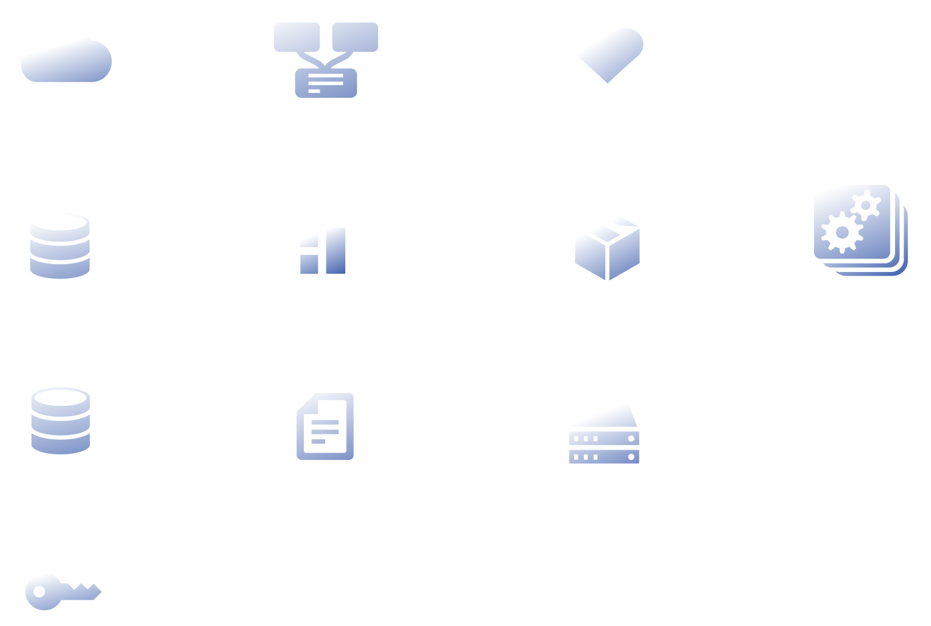

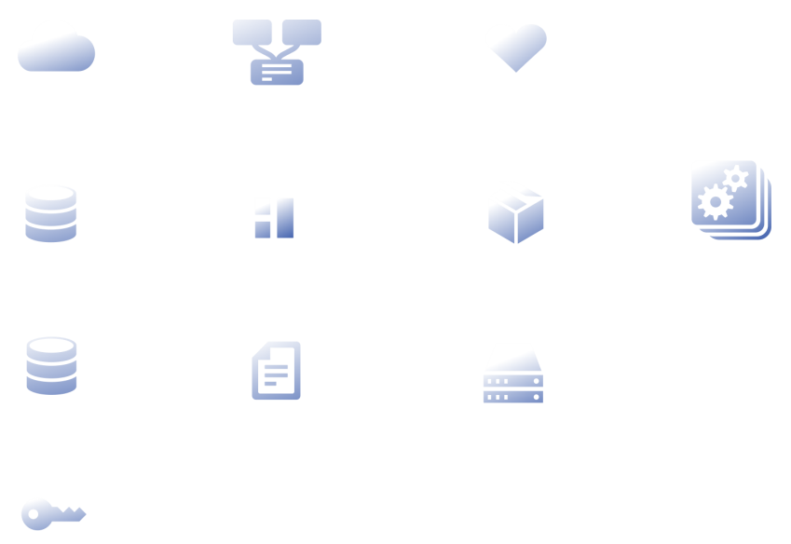




Pivotal Cloud Foundry BOSH
Cloud Foundry BOSH
Deploys and manages large scale distributed systems. BOSH provides the means to go from deployment (i.e., Chef/Puppet) to VM creation and lifecycle management (i.e., cloud CPI).
Continuous and predictive updates with no downtime.
Built-in High Availability.
Includes interfaces for vSphere, vCloud, AWS and OpenStack. Additional CPI can be written for alternative IaaS providers.
Router
UAA
Cloud Controller
Health Manager
Service Gateway
DEA Pool
Apps
Service Nodes
Service Connector
Build Packs
Messaging
Cloud Foundry BOSH
Cloud Provider Interface
Public Clouds
Private Clouds
Micro Clouds
Notes:
Dozens of component types (Cloud Controller, Routers, etc.)
Components communicate over a message bus
Most components can have one or more instances
Components can share a VM or be broken out into separate VMs
Each deployment can be configured appropriately
Each Cloud Foundry instance can be deployed differently
Based on requirements e.g. for capacity and resilience
Regular updates
Think of Cloud Foundry itself as a Large, Distributed Application

Slide 39
Cloud Provider Interface
Stemcell
create_stemcell(image, cloud_properties)
delete_stemcell(stemcell_id)
VM
create_vm(agent_id, stemcell_id, resource_pool,
networks, disk_locality, env)
delete_vm(vm_id)
reboot_vm(vm_id)
configure_networks(vm_id, networks)
Disk
create_disk(size, vm_locality)
delete_disk(disk_id)
attach_disk(vm_id, disk_id)
detach_disk(vm_id, disk_id)
IaaS Neutral
...ETC

