Slide 2
Pivotal CF Architecture

Slide 3
Architectural Components

Slide 4









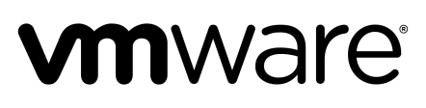


Cloud Foundry Architecture
Internet
Dynamic Router
The Cloud Foundry platform is abstracted as a set of large-scale distributed services. It uses Cloud Foundry Bosh to operate the underlying infrastructure from IaaS providers (e.g., VMware, Amazon AWS, OpenStack).
Cloud Controller
UAA/Login Servers
Health Manager
Service Broker Node(s)
DEA Pool
Apps
User Provided
Service Instances
Build Packs
PaaS
Logging
Components are dynamically discoverable and loosely coupled, exposing health through HTTP endpoints so agents can collect state information (app state & system state) and act on it.
Messaging (NATS)
Cloud Foundry BOSH
Underlying
Infrastructure

Slide 5
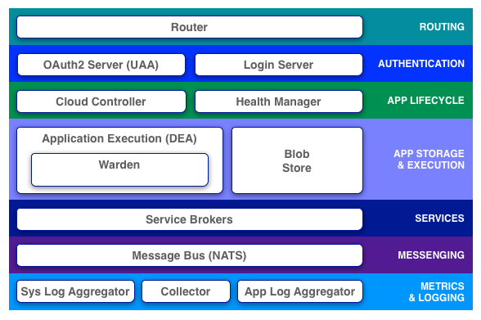
Pivotal CF Elastic Runtime Architecture
Notes:
Cloud Foundry PaaS
An application runs in a DEA, which is a droplet execution agent. The Cloud Controller orchestrates the routing and lifecycle of all DEAs in the pool. Routers manage application traffic. Health Manager reports mismatched application states to the CC. A service gateway provides an interface for services (native or external). A messaging bus manages all system communication. Apps are accessed directly through the router while web and CLI clients (e.g., vmc, STS) access Cloud Controller via RESTful services.

Slide 6

Overview: Deploying App to Pivotal CF Elastic Runtime
Blobstore
Service
credentials
Upload app bits and metadata
DB
push app
+ app MD
Cloud Controller
Service Broker Node(s)
Create and bind services
Stage application
Deploy application
Manage application health
Router
DEA
DEA
DEA
DEA
+
=
Pivotal CF Elastic
Runtime (PaaS)
Notes:
Cloud Foundry PaaS
An application runs in a DEA, which is a droplet execution agent. The Cloud Controller orchestrates the routing and lifecycle of all DEAs in the pool. Routers manage application traffic. Health Manager reports mismatched application states to the CC. A service gateway provides an interface for services (native or external). A messaging bus manages all system communication. Apps are accessed directly through the router while web and CLI clients (e.g., vmc, STS) access Cloud Controller via RESTful services.

Slide 7
The Buildpack Approach
Blobstore
DB
Cloud Controller
Router
DEA
System
Buildpacks
Detect
Compile
Upload
Yes
No
+
=
Pivotal CF Elastic
Runtime (PaaS)
Notes:
Cloud Foundry PaaS
An application runs in a DEA, which is a droplet execution agent. The Cloud Controller orchestrates the routing and lifecycle of all DEAs in the pool. Routers manage application traffic. Health Manager reports mismatched application states to the CC. A service gateway provides an interface for services (native or external). A messaging bus manages all system communication. Apps are accessed directly through the router while web and CLI clients (e.g., vmc, STS) access Cloud Controller via RESTful services.

Slide 8
The App-Container Approach
Blobstore
Cloud Controller
Messaging (NATS)
Router
Access App
DEA
DEA
DEA
Pivotal CF Elastic
Runtime (PaaS)
Notes:
Cloud Foundry PaaS
An application runs in a DEA, which is a droplet execution agent. The Cloud Controller orchestrates the routing and lifecycle of all DEAs in the pool. Routers manage application traffic. Health Manager reports mismatched application states to the CC. A service gateway provides an interface for services (native or external). A messaging bus manages all system communication. Apps are accessed directly through the router while web and CLI clients (e.g., vmc, STS) access Cloud Controller via RESTful services.

Slide 9
Router
How It Works:
Responsible For:
The router shapes and routes all external system traffic (HTTP/API) and application traffic from the internet/intranet. It maintains a dynamic routing table for each load-balanced app instance with IP addresses and ports.
Load balancing
Maintaining an active routing table
Access logs
Supports web-sockets

Slide 10
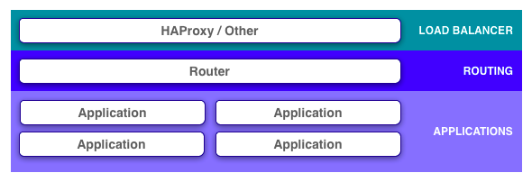
HA Proxy / External Load Balancer

Slide 11
HA Proxy
myapp.<mycfdomain.com>
Access App
DNS
Resolve app and system domain names to HA Proxy IP
Software single-instance LB, for non-production purposes
HA Proxy
Router
Router
Router
DEA
DEA
DEA
Pivotal CF Elastic
Runtime (PaaS)
Notes:
Cloud Foundry PaaS
An application runs in a DEA, which is a droplet execution agent. The Cloud Controller orchestrates the routing and lifecycle of all DEAs in the pool. Routers manage application traffic. Health Manager reports mismatched application states to the CC. A service gateway provides an interface for services (native or external). A messaging bus manages all system communication. Apps are accessed directly through the router while web and CLI clients (e.g., vmc, STS) access Cloud Controller via RESTful services.

Slide 12
External Load Balancer
myapp.<mycfdomain.com>
Access App
DNS
Resolve app and system
domain names to LB IP
External LB, usually
hardware-based (F5 or similar)
Load Balancer
Load Balancer
Router
Router
Router
DEA
DEA
DEA
Pivotal CF Elastic
Runtime (PaaS)
Notes:
Cloud Foundry PaaS
An application runs in a DEA, which is a droplet execution agent. The Cloud Controller orchestrates the routing and lifecycle of all DEAs in the pool. Routers manage application traffic. Health Manager reports mismatched application states to the CC. A service gateway provides an interface for services (native or external). A messaging bus manages all system communication. Apps are accessed directly through the router while web and CLI clients (e.g., vmc, STS) access Cloud Controller via RESTful services.

Slide 13
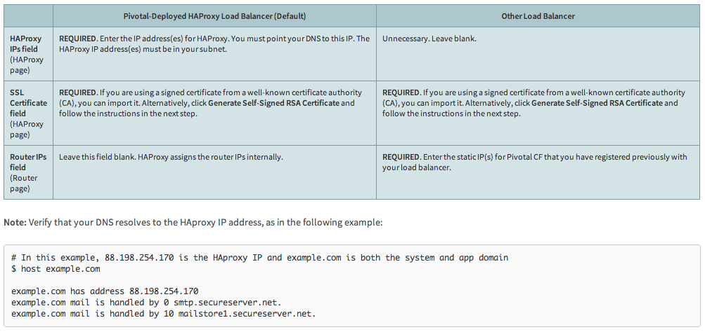
http://docs.gopivotal.com/pivotalcf/opsguide/ssl-term.html

Slide 14
Cloud Controller
How It Works:
Responsible For:
The Cloud Controller maintains command and control systems, including interface with clients (CLI, Web UI, Spring STS), account and provisioning control. It also provides RESTful interface to domain objects (apps, services, organizations, spaces, service instances, user roles, and more).
Expected App state, state transitions, and desired convergence
Permissions/Auth
Orgs/Spaces/Users
Services management
App placement
Blob storage

Slide 15
UAA and Login Servers
How It Works:
Responsible For:
“User Authorization and Authentication” provides identity, security and authorization services. It manages third party Oauth 2.0 access credentials and can provide application access and identity-as-a-service for apps running on Cloud Foundry. Composed of: UAA Server, Command Line Interface, Library.
Token Server
ID Server (User management)
OAuth Scopes (Groups) and SCIM
Login Server
UAA Database
SAML support (for SSO integration) and Active Directory support with the VMWare SSO Appliance
Access auditing

Slide 16
Health Manager
How It Works:
Responsible For:
Health Manager monitors application uptime by listening to the NATS message bus for mismatched application states (expected vs. actual). The Cloud Controller publishes expected state and the DEAs publish actual state. State mismatches are reported to the Cloud Controller.
Maintains the actual state of apps
Compares to expected state
Sends suggestions to make actual match expected (cannot make state changes itself – only CC can do that!)

Slide 17
DEA
How It Works:
Responsible For:
“Droplet Execution Agents” are secure and fully isolated containers. DEAs are responsible for an Apps lifecycle: building, starting and stopping Apps as instructed. They periodically broadcast messages about their state via the NATS message bus.
Managing Linux containers (Warden)
Monitoring resource pools
Process
File system
Network
Memory
Managing app lifecycle
App log and file streaming
DEA heartbeats (NATS to CC, HM)

Slide 18
Messaging (NATS)
How It Works:
Responsible For:
NATS is a fast internal messaging bus to manage system wide communication via a publish-and-subscribe mechanism.
Non-Persistent messaging
Pub/Sub
Queues (app events)

Slide 19
Service Broker
How It Works:
Responsible For:
Service Brokers provide an interface for native and external 3rd party services. Service processes run on Service Nodes or with external as-a-service providers (e.g., email, database, messaging, etc.).
Advertising service catalog
Makes create/delete/bind/unbind calls to service nodes
Requests inventory of existing instances and bindings from cloud controller for caching, orphan management
SaaS marketplace gateway

Slide 20
User Provided Service Instances
How It Works:
Responsible For:
UPSI store meta-data in the Service Broker to enable Cloud Foundry to connect to local services that are NOT managed by Cloud Foundry (e.g., OracleDB, DB2, SQLServer, etc.)
Metadata management

Slide 21
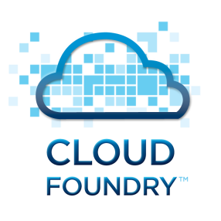
User Provided Service Instances and Service Brokers
Synchronous
Synchronous
Service Broker
UPSI Service
Connector
Service Broker
UPSI Service
Connector
IBM DB2
ORACLE DB
Synchronous
CF MySQL
3rd Party Provider (e.g. AppDirect)
INTERNET
Custom Service Broker
MYSQL DB
Another Service
Mongo Lab
Send Grid
ClearDB

Slide 22
Creating and Binding a Service
Developer
Service
credentials
DB
CLI
create service (HTTP)
Cloud Controller
create service (HTTP)
Service
Broker
reserve resources
Data
Service
Router
bind service (HTTP)
bind service (HTTP)
obtain connection data
Cloud Foundry
Runtime (PaaS)
Notes:
Cloud Foundry PaaS
An application runs in a DEA, which is a droplet execution agent. The Cloud Controller orchestrates the routing and lifecycle of all DEAs in the pool. Routers manage application traffic. Health Manager reports mismatched application states to the CC. A service gateway provides an interface for services (native or external). A messaging bus manages all system communication. Apps are accessed directly through the router while web and CLI clients (e.g., vmc, STS) access Cloud Controller via RESTful services.

Slide 23
CloudFoundry BOSH
How It Works:
Responsible For:
A tool chain for release engineering, deployment and lifecycle management of large scale distributed systems. Continuous and predictive updates with minimal downtime. Control primitives (CPI) written for each underlying infrastructure provider.
VM creation and management
Continuous and predictive updates with minimal downtime
CPI (Cloud Provider Interface) to control underling infrastructure (e.g., IaaS) primitives

Slide 24
To: Pushing apps to the cloud with a few easy verbs
Operator
Developer
cf-iaas.yml
provision <my cloud>
add_capacity <my cloud>
target <my cloud>
push <my app>
create <my services>
bind <my services>
scale <my app> +100

Slide 25

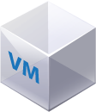
Operations Manager: Behind the Scenes (BOSH)
DB
Worker VMs
Deploy my Services
BOSH Director
Blobs
Messaging
Message Bus
Deployment
Packages
Jobs
Blobs
Source
Manifest
Health Manager
Health Monitor
Target VM
Cloud Controller
Target VM
Pivotal CF Operations Manager Director
Target VM
IaaS
Notes:
Services: e.g. Elastic Runtime, HD, Rabbit, 3rd party “BOSH enabled” services, all the same operational experience

Slide 27
myapp.<mycfdomain.com>
api.<mycfdomain.com>
console.<mycfdomain.com>
Access
DNS
Monitoring of platform components health and KPIs
Resolve app and system
domain names to LB IP
External LB, hardware
based (F5 or similar)
Load Balancer
Monitoring Tool
Load Balancer
JMX
Aggregation, storage, filtering and analytics on system and app logs
Router
Router
Router
JMX Provider
Pivotal CF
Elastic Runtime
UAA/Login Server
Collector
DEA
DEA
Enterprise Log
Mgr (e.g. Splunk)
DEA
TCP
Health Manager
Loggregator
Service Broker
Service Broker
Cloud Controller
NATS
Cloud Controller
HTTP
HTTP
Custom Service lifecycle management and binding
Service Broker
Versioning /configuration mgmt of buildpacks and apps
Git repository

