Slide 2
High Availability
Pivotal CF

Slide 3
4 Layers of built-in High Availability
Pivotal CF takes care of the availability of the platform and of the applications.
PaaS
Virtual Infrastructure
Applications
Notes:
No need to monitor all aspects in detail. Cloud Foundry is to simplify the live of the people in charge of platform and application operations. Cloud Foundry can be seen as a black box that takes care of the availability of itself, the provisioned applications.

Slide 4
1. App Instance
The Health Manager is essential to ensuring that apps running on Cloud Foundry remain available.
Monitor applications to determine their state (e.g. running, stopped, crashed, etc.), version, and number of instances.
Determine applications' expected state, version, and number of instances.
Reconcile the actual state of applications with their expected state.
Direct Cloud Controller to take action to correct any discrepancies in the state of applications.
Notes:
Monitor applications to determine their state (e.g. running, stopped, crashed, etc.), version, and number of instances. The actual state of an application is updated based on heartbeats and droplet.exited messages issued by the DEA running the application.
Determine applications' expected state, version, and number of instances. The desired state of an application is obtained from a dump of the Cloud Controller database.
Reconcile the actual state of applications with their expected state. For instance, if fewer than expected instances are running, the Health Manager will instruct the Cloud Controller to start the appropriate number of instances.
Direct Cloud Controller to take action to correct any discrepancies in the state of applications.
The Health Manager is essential to ensuring that apps running on Cloud Foundry remain available. It is needed to restart applications whenever the DEA running an app shuts down for any reason; Warden kills the app because it violated a quota; or the application process exits with a non-zero exit code.

Slide 5












Health Manager
Internet
Dynamic Router
Health Manager monitors application.
Cloud Controller publishes expected state and the DEAs publish actual state.
State mismatches are reported to the Cloud Controller.
Cloud Controller
UAA/Login Servers
Health Manager
Service Broker Node(s)
DEA Pool
Apps
PaaS
Build Packs
User Provided
Service Instances
Logging
Messaging (NATS)
Underlying
Infrastructure
Cloud Foundry BOSH
Notes:
Monitor applications to determine their state (e.g. running, stopped, crashed, etc.), version, and number of instances. The actual state of an application is updated based on heartbeats and droplet.exited messages issued by the DEA running the application.
Determine applications' expected state, version, and number of instances. The desired state of an application is obtained from a dump of the Cloud Controller database.
Reconcile the actual state of applications with their expected state. For instance, if fewer than expected instances are running, the Health Manager will instruct the Cloud Controller to start the appropriate number of instances.
Direct Cloud Controller to take action to correct any discrepancies in the state of applications.
The Health Manager is essential to ensuring that apps running on Cloud Foundry remain available. It is needed to restart applications whenever the DEA running an app shuts down for any reason; Warden kills the app because it violated a quota; or the application process exits with a non-zero exit code.

Slide 6
Monitoring and Replacing an Application
Desired State
Actual State
Blobstore
Cloud Controller
Health Manager
Messaging (NATS)
Router
DEA
DEA
DEA
Pivotal CF Elastic
Runtime (PaaS)
Notes:
Cloud Foundry PaaS
An application runs in a DEA, which is a droplet execution agent. The Cloud Controller orchestrates the routing and lifecycle of all DEAs in the pool. Routers manage application traffic. Health Manager reports mismatched application states to the CC. A service gateway provides an interface for services (native or external). A messaging bus manages all system communication. Apps are accessed directly through the router while web and CLI clients (e.g., vmc, STS) access Cloud Controller via RESTful services.

Slide 7
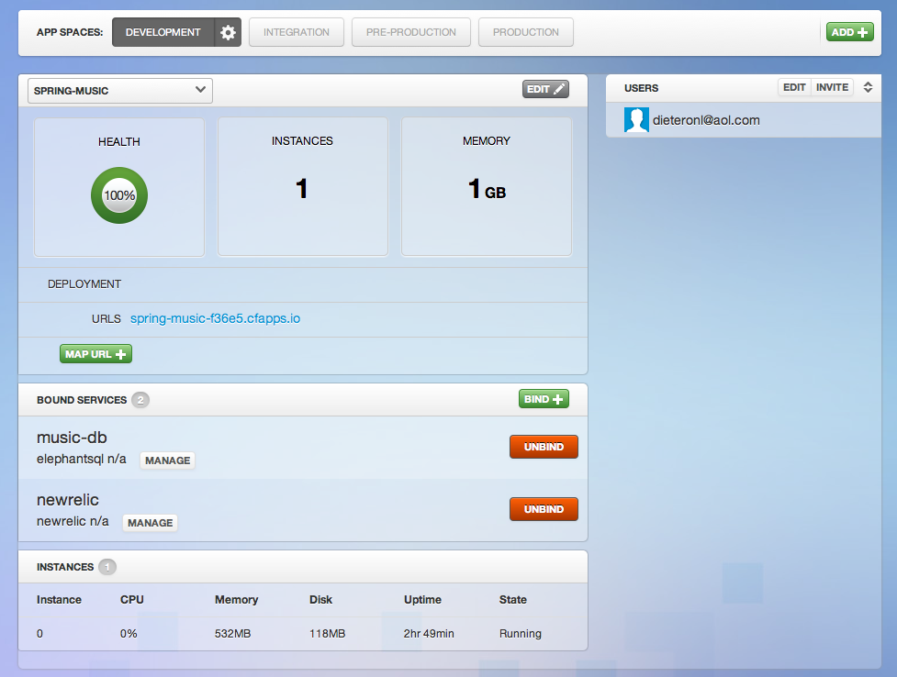
Application Health – Web Console
health
usage, status

Slide 8

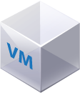
2. Platform processes
DB
Blob Store
Both Health Monitor receives health status and life cycle events from Agents and can send alerts through notification plugins (such as email) to operations staff.
CLI
Director
Worker
NATS
Health Monitor
CPI
Inner shell
Agents
Outer shell

Slide 9
Platform processes and Health Monitor
Health Monitor
The Health Monitor uses status and lifecycle events received from BOSH Agents to monitor the health of VMs. If the Health Monitor detects a problem with a VM, it can send an alert through a notification plugin, or trigger the next HA level: the BOSH Resurrector.
NATS
Health Monitor
Agents

Slide 10
3. Resurrector
NATS
Health Monitor
If enabled, the BOSH Resurrector plugin automatically recreates VMs identified by the Health Monitor as stopped or unresponsive.
Ressurector
✔
Re-create VMs
Agents

Slide 11
4. Availability Zones
Provides High Availability of application instances by putting application instances on separate hardware.
api.pcf.com
App
DEAs
AZ1
AZ2
AZ3
AZ4
AZ5
Availability Zones
Chassi_1
Chassi_2
Chassi_3

Slide 12
Live Updates and Upgrades

Slide 13
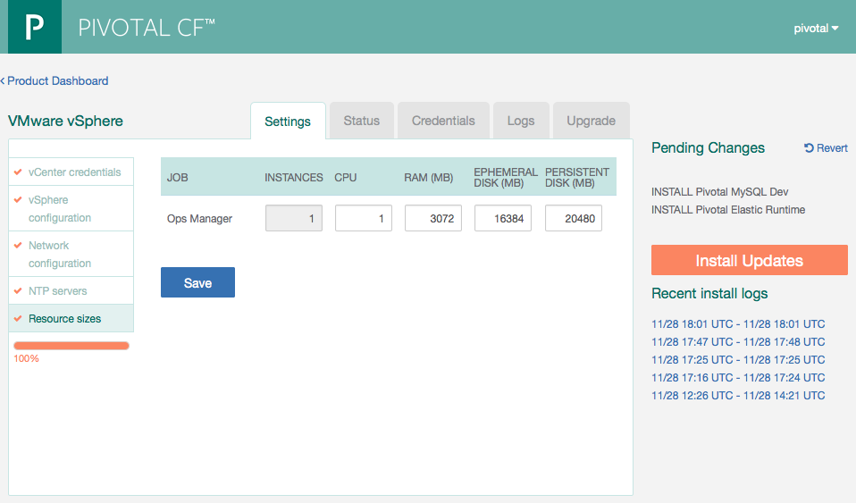
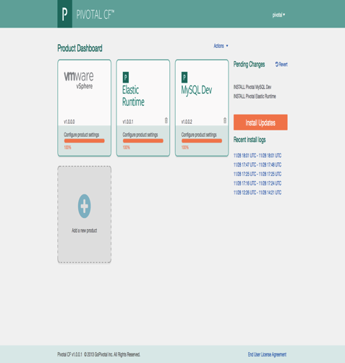
Operations Manager
The Ops Manager is the core orchestrating component.
It controls creation of VMs, deployment, and other life cycle events of software and services.
Web form allowing an operator to scale the Operations Manager both
vertically (CPU, RAM, Disk) and
horizontally (number of instances).
Hit save and afterwards hit Install Updates.

Slide 14
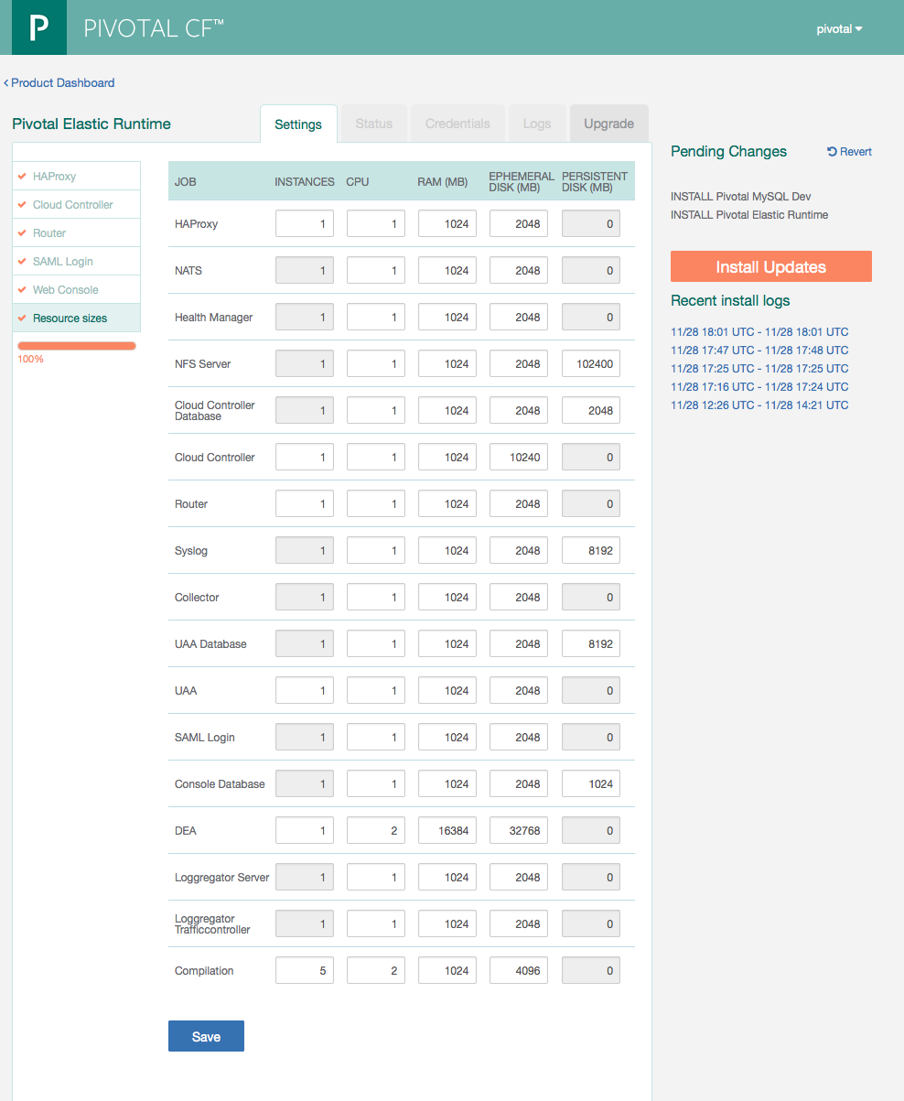
Elastic Runtime
Web form allowing an operator to scale components both
vertically (CPU, RAM, Disk) and
horizontally (number of instances).
This results in updating the deployment manifest followed by a “bosh deploy.”

Slide 15
Bosh
BOSH is an open source tool chain for release engineering, deployment, and lifecycle management of large-scale distributed services.
BOSH was developed to deploy Cloud Foundry, however it has a more general purpose - it can be used to deploy other distributed services.
BOSH can deploy these services on Infrastructure as a Service (IaaS) providers such as vSphere, vCloud Director, Amazon Web Services EC2, and OpenStack.
Pivotal CF Operations Manager uses bosh. No need to interact with bosh directly.

Slide 16
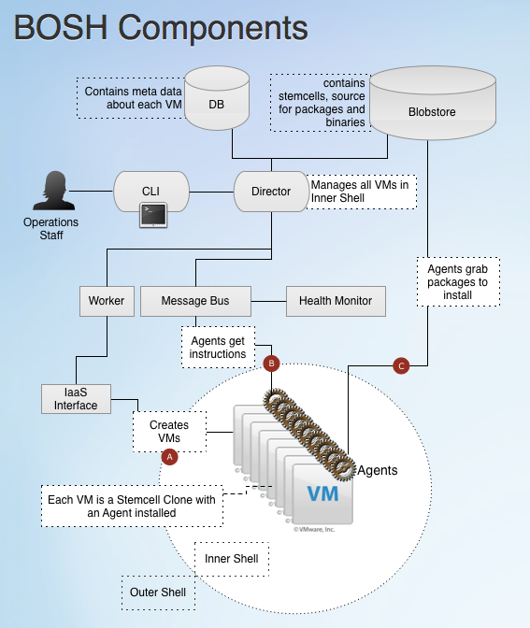
Bosh Components
Director
Messaging
Workers
Health Monitor
CPIs
Message Bus
Blobstore

Slide 17
Live Updates/Upgrades – Bosh
BOSH is able to update a running system without suffering any downtime.
Canary style deployments
subset of each managed component is removed from service, updated, and if the update is successful, returned to service.
If the update succeeds, another subset is updated as BOSH “rolls through” the system.
If the update fails, the failed components are left in their failure state (for troubleshooting purposes) while the remaining healthy components continue to serve load.
Notes:
Live Capacity UpdatesOne of the great benefits of BOSH is the ability to update a running system without suffering any downtime. This is accomplished by employing canary-style deployments, where by a subset of each managed component is removed from service, updated, and if the update is successful, returned to service. If the update succeeds, another subset is updated as BOSH “rolls through” the system. If the update fails, the failed components are left in their failure state (for troubleshooting purposes) while the remaining healthy components continue to serve load.
This style of update allows a CF operator to easily add and remove application hosting capacity from a running system. When adding capacity, BOSH simply spins up additional Execution Agent VM’s, which then advertise themselves via NATS as being ready to serve application workloads. When removing (or updating) capacity, BOSH first triggers a “drain” event on the Execution Agent to be removed. This drain event triggers an “evacuation” of all application instances running on that Execution Agent to another Execution Agent. Once this evacuation is complete, the Execution Agent is either removed or updated. In either case, end user applications do not suffer downtime.
The Pivotal CF installer takes this to another level by providing a web form allowing an operator to scale components both vertically (CPU, RAM, Disk) and horizontally (number of instances). Simply update and save the form, and then click “Update” on the home page. This results in the installer application updating the deployment manifest followed by a “bosh deploy.” You can see this in action at the 3:50 mark in the embedded video. Here’s an updated screenshot showing the form as of our latest beta release:
The ease with which platform capacity can be managed enables extreme agility in operations. One can imagine horizontally scaling a vSphere cluster by adding additional ESXi nodes and storage capacity and then allowing a running CF instance to expand across the newly added resources with a button click!
To put this agility into perspective, we decided “on the fly” during a demo session with the customer to demo scaling up the capacity. We visited the web form, increased the number of Execution Agent’s to 2, clicked “Save” and then “Update.” We were greeted with a “friendly” red error message:
Unable to allocate enough IPs to complete deployment
The Pivotal CF Installer was kind enough to validate that we had enough IP addresses left in the allocation we provided to it. An administrator in the room allocated another IP address for us. We updated the reserved ranges in our network configuration, and again clicked “Save” and then “Update.” A couple of minutes later we had a new Execution Agent running. Adding to the excitement in the room, one administrator happened to be watching the vCenter console on his laptop during the update and exclaimed “Look! There it is spinning up the VM!”

Slide 18
Canary Style Updates/Upgrades
Platform Management:
Platform maintenance uses canary style upgrades. Side by side deployments of core PCF components without a need to take an outage.
BOSH orchestrates the dynamic configuration changes to the platform.
DEA and Container Management:
A application focused use case where BOSH scales up/down the platform – verify.
Router
Agent
DEA
DEA
DEA
Warden
Warden
Warden
Warden
Warden
Warden
Warden
Warden
Warden
Warden
Warden
Warden
Agent
Agent
Agent
Health
Manager
Health
Manager
Agent
Agent

Slide 19
Live Capacity Updates/Upgrades
CF operators can add and remove application hosting capacity from a running system.
Adding capacity:
BOSH spins up additional Execution Agent VM’s.
Removing (or updating) capacity:
BOSH triggers a “drain” event on the Execution Agent.
This drain event triggers an “evacuation” of all application instances.
Once evacuation is complete, the Execution Agent is either removed or updated.
➔ End user applications do not suffer downtime.

Slide 20
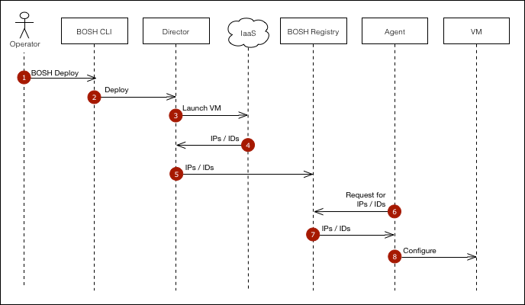

Slide 21
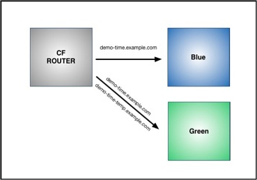
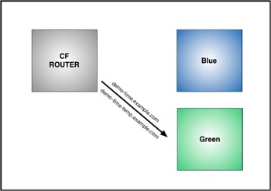
App level updates (blue-green deployments)

