Slide 2
Pivotal CF
Services

Slide 3
CF Services What is really a service?
Service is an external application dependency or component such as
Database
Message Queue
Monitoring App
Hadoop instance
Generic Service Endpoint (Web Services)
Other dependent applications

Slide 4
CF Services What is really a service?
Services in PaaS are one of the main possible charging units / elements (instead of hardware resources as in IaaS) and can come as:
Out-of-box Services
Custom built services
User-provided

Slide 5
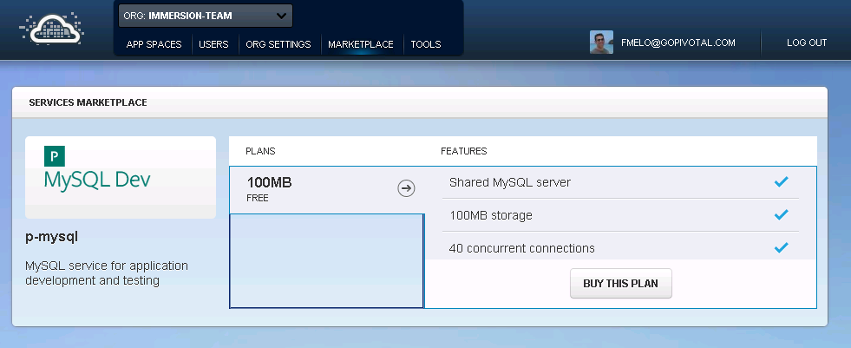
Choose the
plan

Slide 6

Review: Deploying App to Pivotal CF Elastic Runtime
Blobstore
Service
credentials
Upload app bits and metadata
DB
push app
+ app MD
Cloud Controller
Service Broker Node(s)
Create and bind services
Stage application
Deploy application
Manage application health
Router
DEA
DEA
DEA
DEA
+
=
Pivotal CF Elastic
Runtime (PaaS)
Notes:
Cloud Foundry PaaS
An application runs in a DEA, which is a droplet execution agent. The Cloud Controller orchestrates the routing and lifecycle of all DEAs in the pool. Routers manage application traffic. Health Manager reports mismatched application states to the CC. A service gateway provides an interface for services (native or external). A messaging bus manages all system communication. Apps are accessed directly through the router while web and CLI clients (e.g., vmc, STS) access Cloud Controller via RESTful services.

Slide 7
Creating and Binding a Service
Developer
Service
credentials
DB
CLI
create service (HTTP)
Cloud Controller
create service (HTTP)
Service
Broker
reserve resources
Data
Service
Router
bind service (HTTP)
bind service (HTTP)
obtain connection data
Cloud Foundry
Runtime (PaaS)

Slide 8
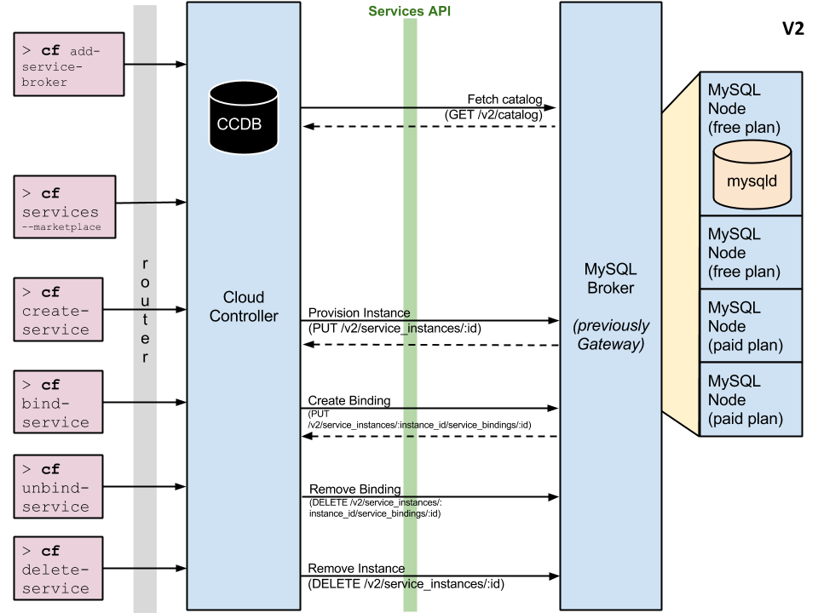

Slide 9
What happens behind the scenes…

Slide 10


Broker Services (un)provision and (un)bind
Service Broker
(i.e. mysql)
CLI
up to you
VM for Service Instances
credentials
(un)provision (HTTP)
UAA
My Service
(process)
Router
Cloud Controller
(un)bind (HTTP)
Browser
DEA
Droplet
10
credentials

Slide 11
Orphan Management
Broker is responsible for eventual consistency...
Authenticate
Service Broker
(i.e. mysql)
CLI
token
up to you
VM for Service Instances
Services Catalog
Get catalog (HTTP)
UAA
My Service
(process)
Router
Cloud Controller
11

Slide 12
It’s Up To YOU Patterns
One option...
VM for Service Instances
VM for Service Instances
VM for Service Broker
My Service
(process)
My Service
(process)
provision
Service Broker
Node
Node
VM for Service Instances
My Service
(process)
NATS
Node
12

Slide 13
It’s Up To YOU Patterns
Another...
VM for Service Instances
VM for Service Instances
Warden
Warden
VM for Service Broker
Warden
provision
Svc Process
Svc Process
Svc Process
Service Broker
Node
Node
VM for Service Instances
Warden
Svc Process
NATS
Node
13

Slide 14
It’s Up To YOU Patterns
And another...
VM for Service Instances
VM for Service Instances
VM for Service Broker
Warden
Warden
provision
Svc Process
Svc Process
Service Broker
Node
Node
VM for Service Instances
Warden
Svc Process
NATS
Node
14

Slide 15


But what about...
core
3PP Service Broker
Service Broker
Service Broker
?
ERP
Oracle
MySQL
MySvc
15

Slide 16
User-provided Service Instances
CLI
provide service credentials (HTTP)
credentials
(un)bind (HTTP)
ERP
UAA
Router
Cloud Controller
Browser
DEA
Oracle
Droplet
credentials
16

Slide 17
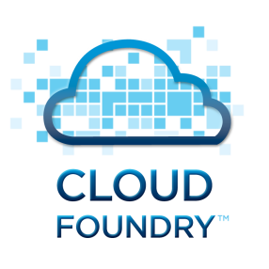
User Provided Service Instances and Service Brokers
Synchronous
Synchronous
Service Broker
UPSI Service
Connector
Service Broker
UPSI Service
Connector
IBM DB2
ORACLE DB
Synchronous
CF MySQL
3rd Party Provider (e.g. AppDirect)
INTERNET
Custom Service Broker
MYSQL DB
Another Service
Mongo Lab
Send Grid
ClearDB

Slide 18
CF Services Deploying service instances and brokers
Pivotal CF only cares about the Service Broker URL.
Several possibilities can be used for deploying services: BOSH, vCAC, Puppet / Chef, etc
BOSH provides built-in resilience, VM monitoring and HA, multi-cloud support.
For simpler cases, your own IaaS automation tool can be used.
For quickly integration or when a Service Broker managing the service lifecycle is not desired, just use User-Provided Services. (analogy to App Server Data Sources config)

