Slide 2
Pivotal CF Platform Monitoring

Slide 3
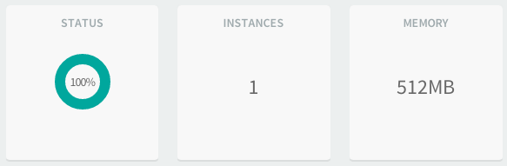
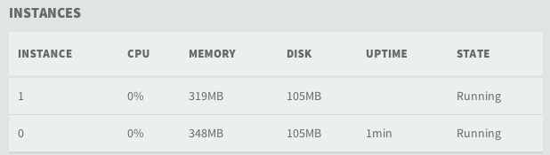
Application Monitoring
Pivotal CF currently provides health monitoring and basic monitoring (CPU, memory, disk usage) for Apps.
APM tools can be easily integrated as services.
Buildpacks can be leveraged for automatically deploying agents colocated to application instances.

Slide 4
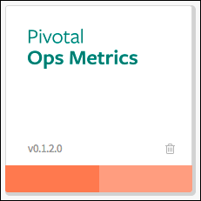
Platform Monitoring
Ops Metrics provides a JMX interface to access metrics from different Pivotal CF components
Cloud Controller
Router
DEAs
All VMs

Slide 5
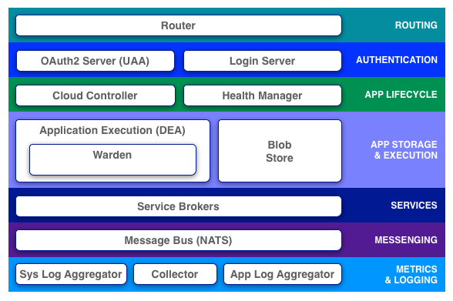
Ops Metrics Architecture
JMX Client
Collector
JMX Provider
IaaS

Slide 6

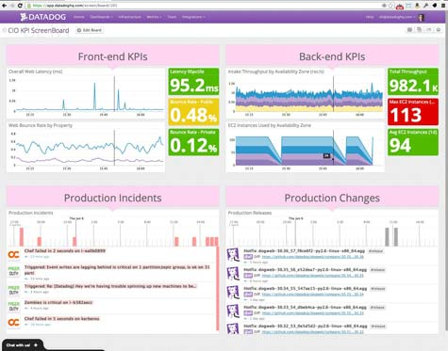
Monitoring CF Components
PaaS Ops
Customer Monitoring JMX-compatible tool of choice
Health Monitor
/varz
Collector
JMX (1.1)
Cloud Controller
/varz
Datadog (~1.0)
Messaging (NATS)
/varz
Pivotal CF Elastic Runtime
DEA
/varz

Slide 7
PCF KPIs

Slide 8
KPIs for Health Manager
Name | Query | Message
Number Of Apps With All Instances Reporting | Avg(last_5min) < 0 | HM has not been able to update its actual/desired state in the last 5 minutes
Actual State Listener Store Usage Percentage | Avg(last_5min) > 70 | HM’s store usage has been > 70% for the last 5 minutes
Desired State Synch Time in Milliseconds | Avg(last_5min) > 5000 | HM’s taking more then 5 seconds to save off desired state.

Slide 9
KPIs for Droplet Execution Agent (DEA)
Name | Query | Message
Mem_free_bytes | Avg(last_5min) > 1GB | Minimum free RAM to stage on a DEA is 1GB
Reservable_stagers | Avg(last_10min) | Aggregate of DEAs that have reservable stagers
Can Stage Error | Avg(last_30min) | Aggregate of DEAs that can stage
Can Stage Warning | Avg(last_15min) < 6 | Six or fewer stagers have been available for the past 15 minutes

Slide 10
KPIs for Routers
Name | Query | Message
Total_routes | Avg(last_10min) <~ 100 | Total number of expected routes
Milliseconds_since_last_registry_update | Avg(last_5min) > 30000 | Its been more then 30 seconds since router received a route registration.

Slide 11
KPIs for BOSH
Name | Query | Message
Persistent_disk | Avg(last_10min) < 90 | Persistent MicroBOSH disk is 90% full
CPU Usage | Avg(last_30min) > 80% | MicroBOSH has been using more then 80% of its compute on average of last 30 minutes
RAM | Avg(last_10M) > 90% | MicroBOSH is using 90% of its RAM of last 10 minutes

Slide 12
Dashboard Examples
Pivotal CF

Slide 13
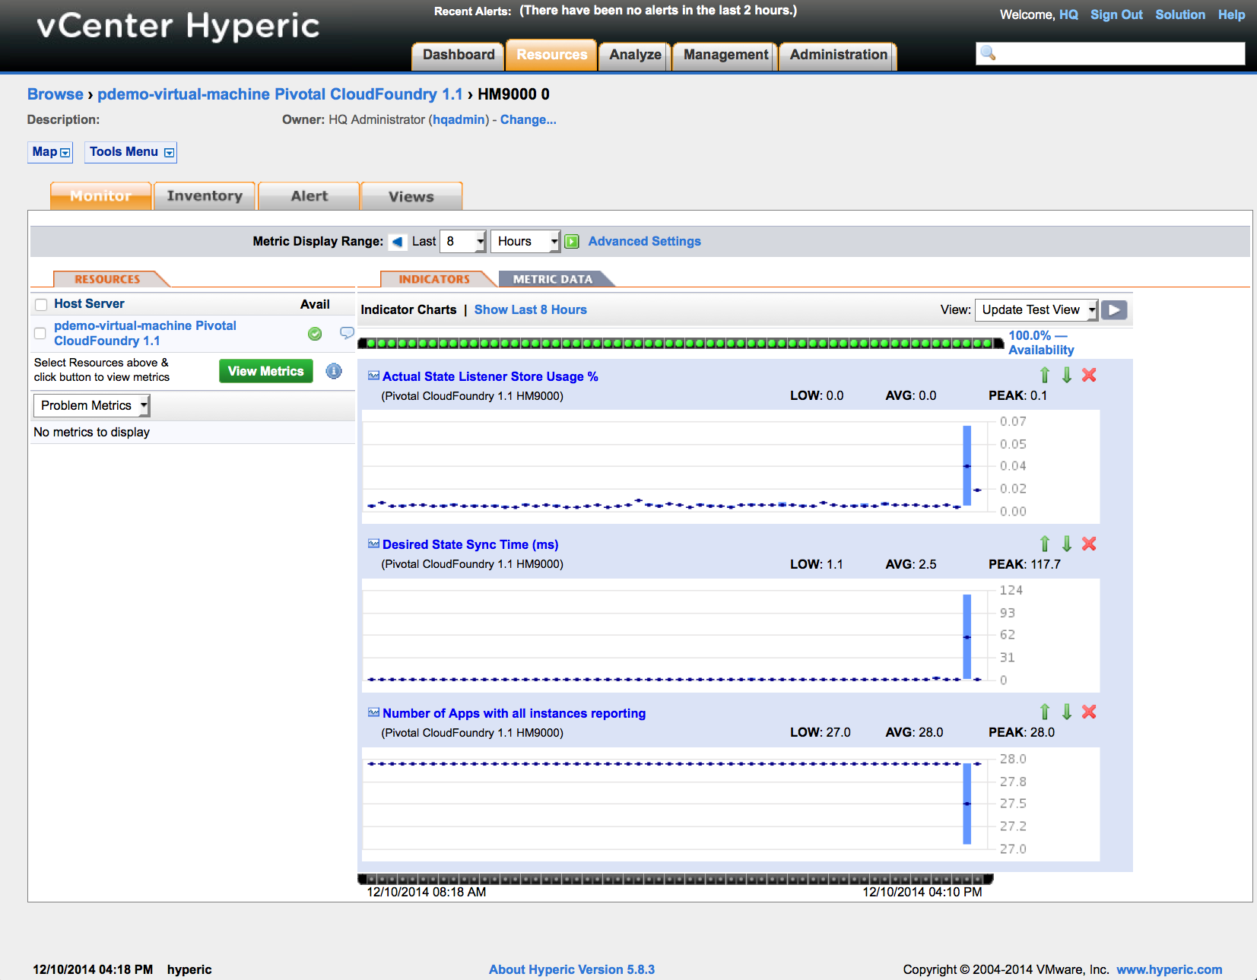

Slide 14
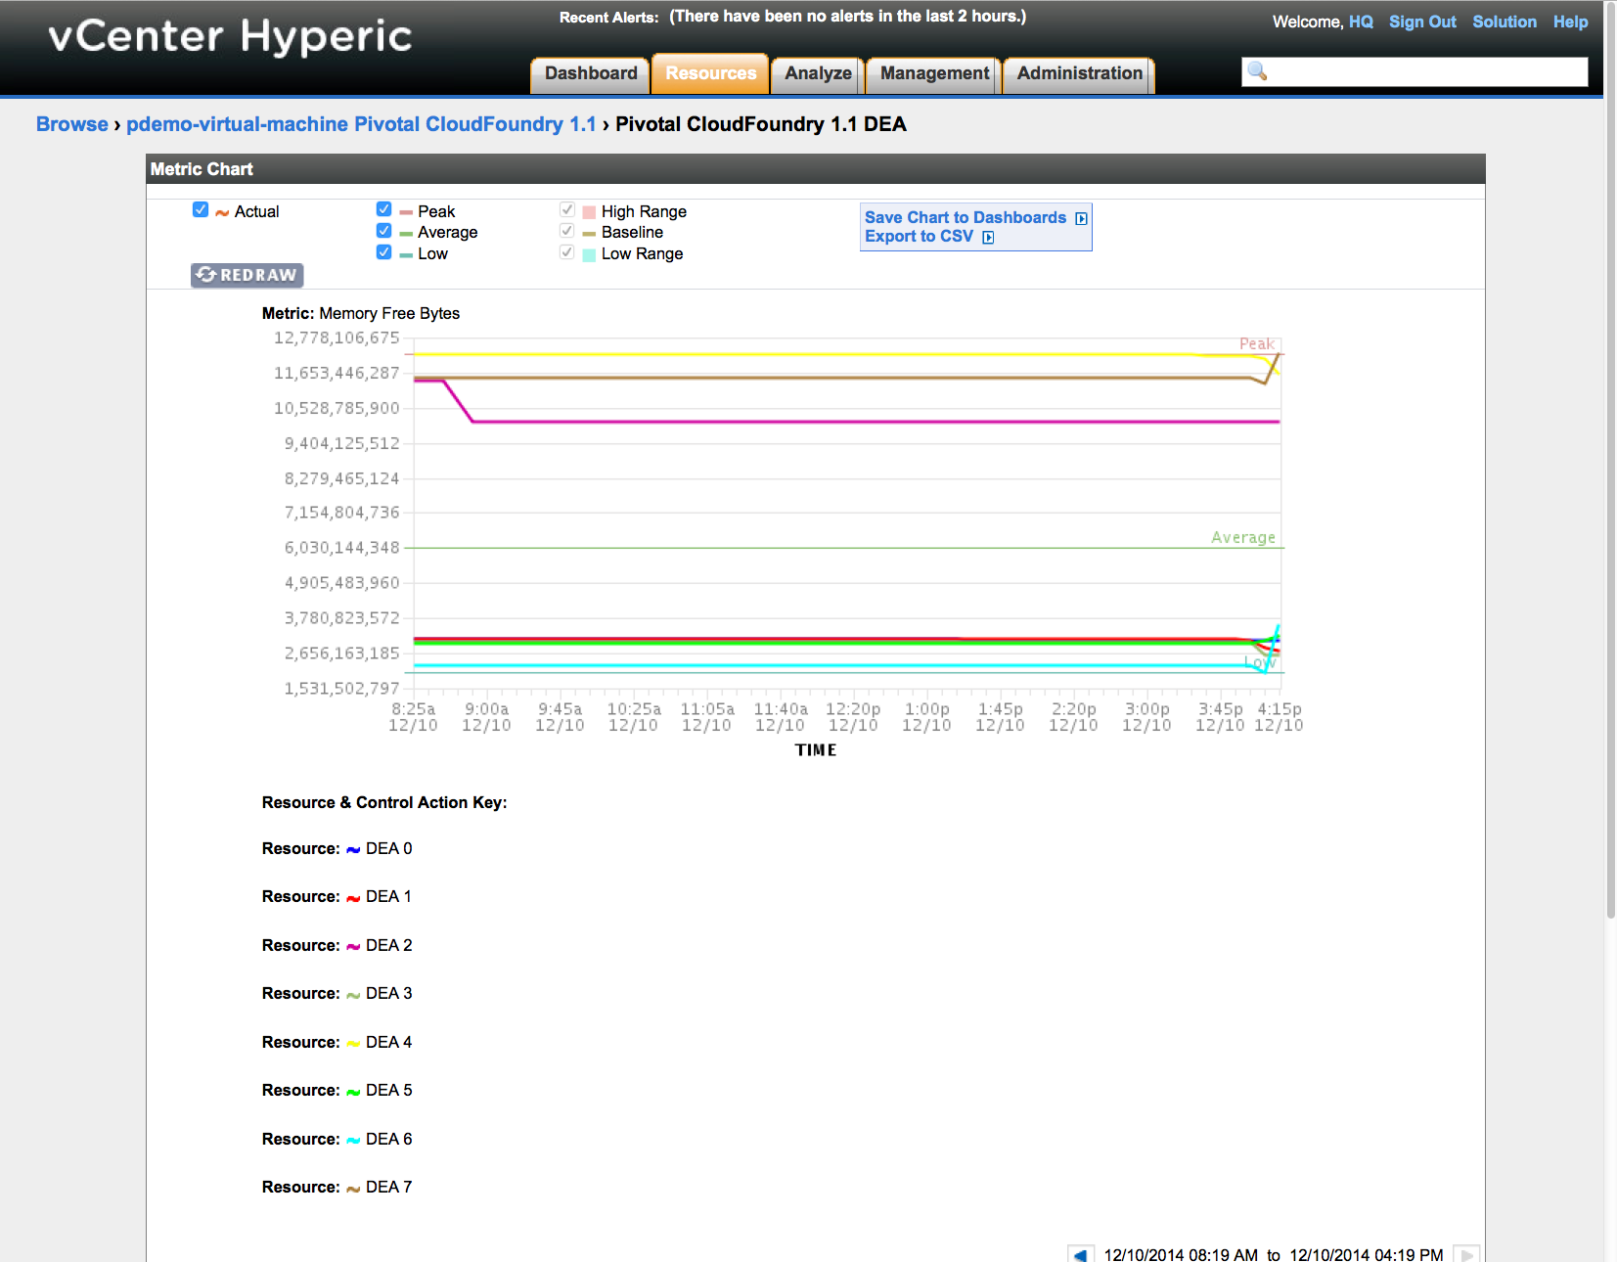

Slide 15
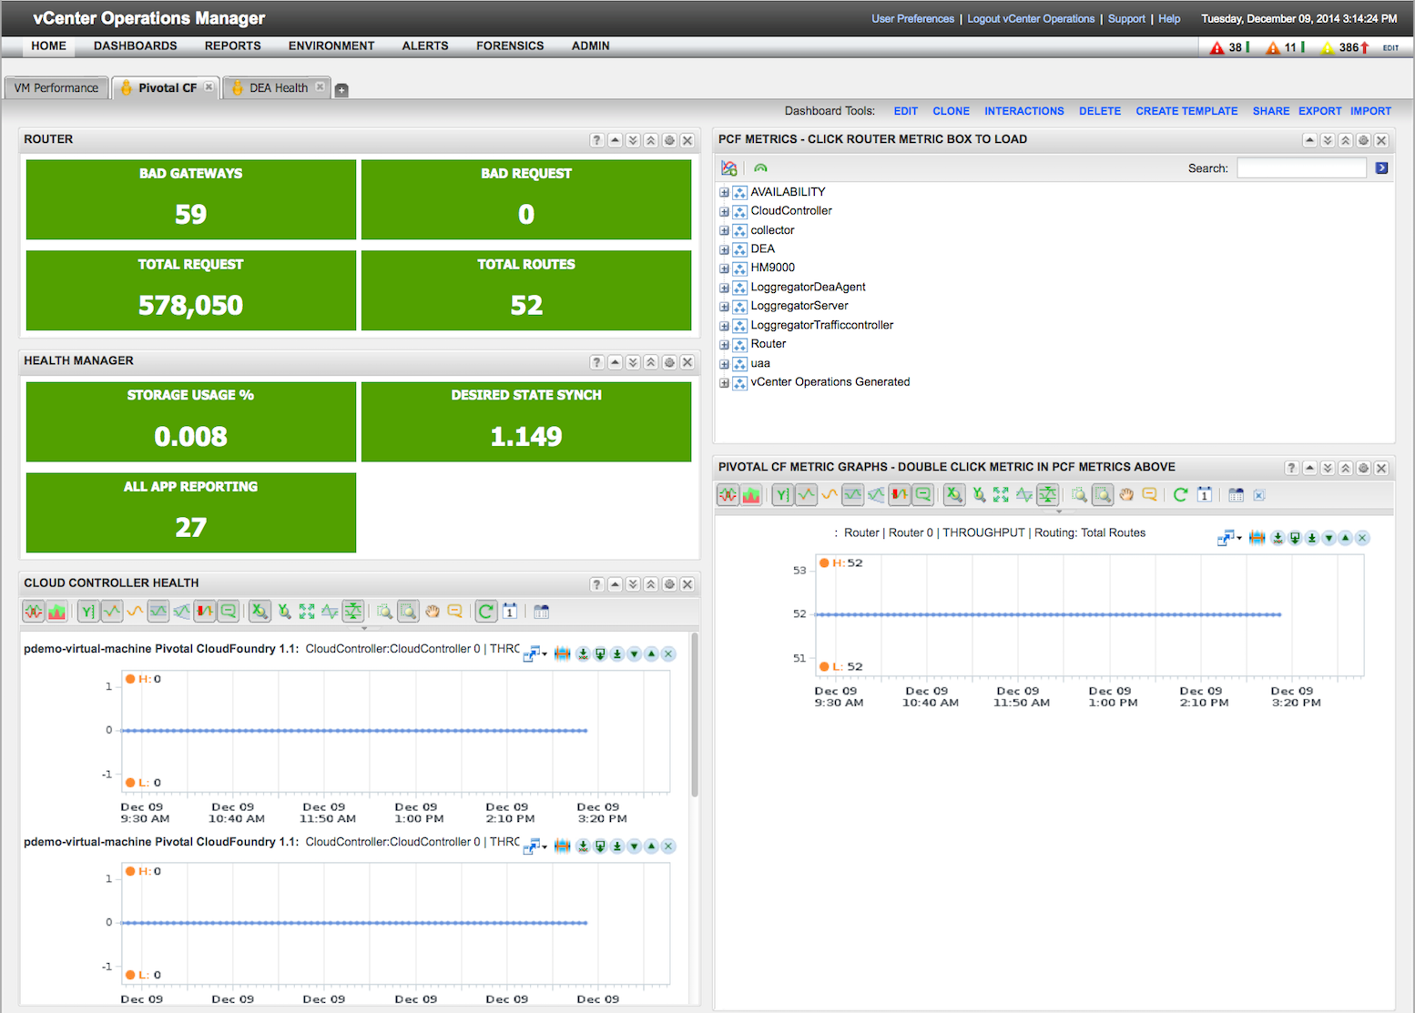

Slide 16
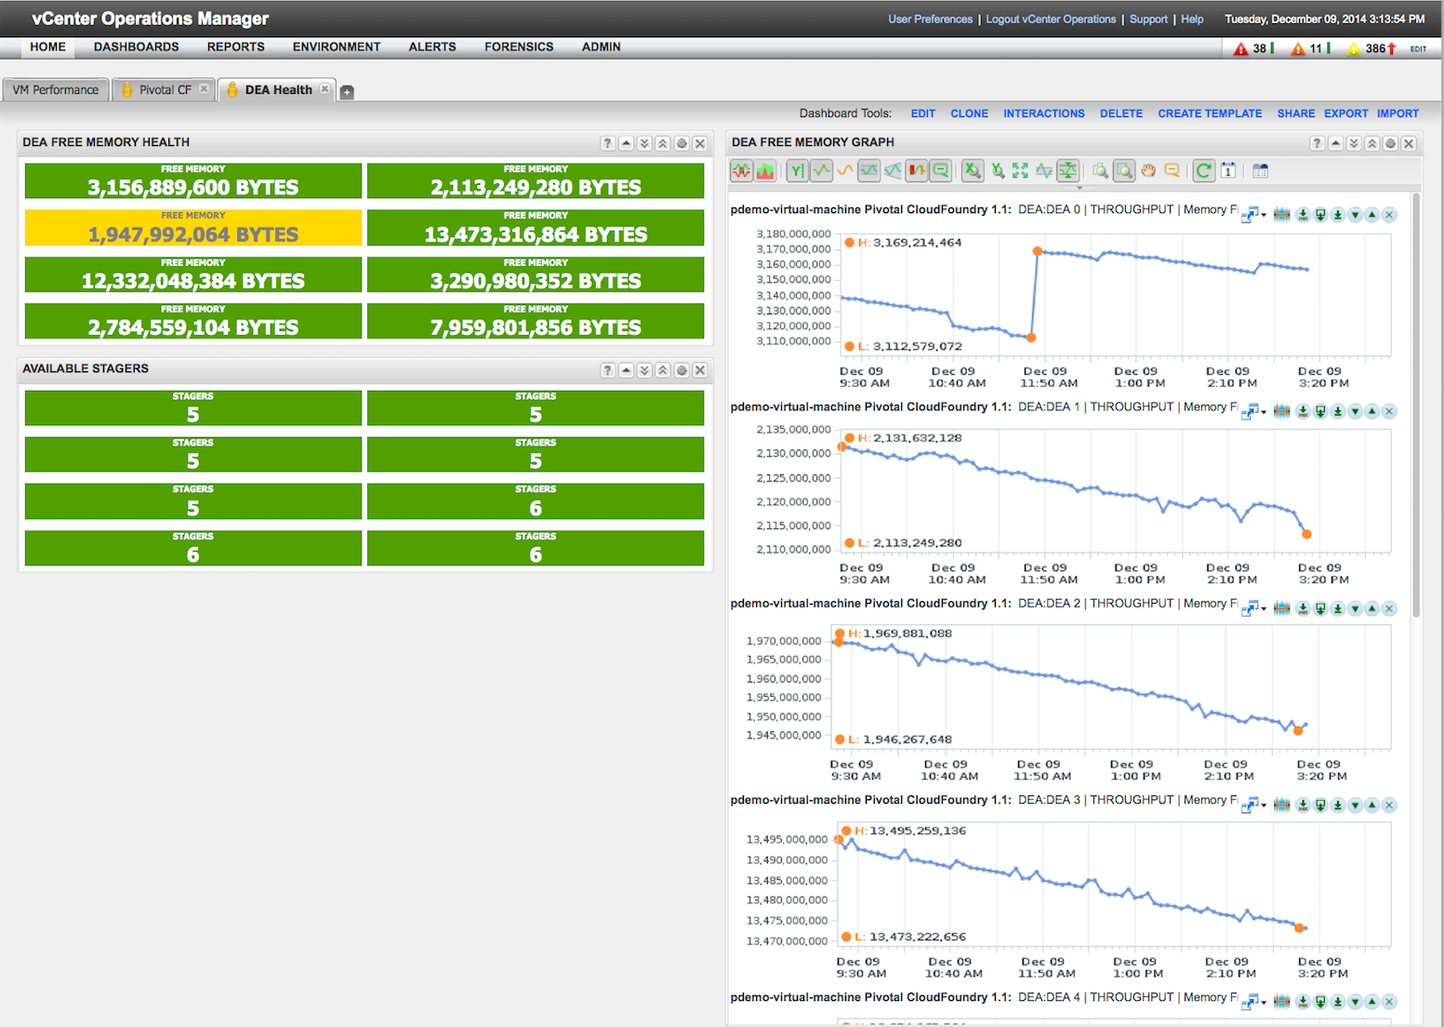

Slide 17
