Slide 2
Pivotal CF Logging

Slide 3
Log Aggregation Benefits

Slide 4
Log aggregation and distributed environments
Log aggregation delivers a real-time log management.
Some solutions also provide machine learning-based Intelligent Grouping and high performance search across physical and cloud environments.
Log aggregation provides a centralized location to view events using consistent tooling.
Log aggregation provides an opportunity to discover unknown events and how frequently they occur.
Pivotal CF Log aggregation works for both platform and application logs.

Slide 5
PCF Log Architecture

Slide 6
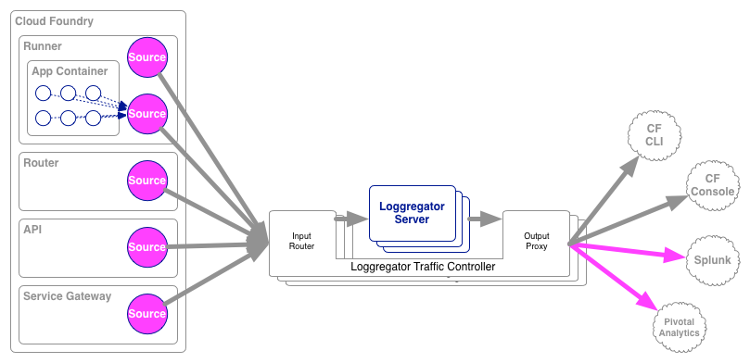
Pivotal CF Log Streaming and Aggregation
Notes:
Cloud Foundry PaaS
An application runs in a DEA, which is a droplet execution agent. The Cloud Controller orchestrates the routing and lifecycle of all DEAs in the pool. Routers manage application traffic. Health Manager reports mismatched application states to the CC. A service gateway provides an interface for services (native or external). A messaging bus manages all system communication. Apps are accessed directly through the router while web and CLI clients (e.g., vmc, STS) access Cloud Controller via RESTful services.

Slide 7
Pivotal CF Log Streaming and Aggregation
Every new app instance starts streaming logs immediately.
“Loggregator” component aggregates logs and streams back to different outputs
Streaming can be send directly to an log and analytic tool of your choice
Notes:
Cloud Foundry PaaS
An application runs in a DEA, which is a droplet execution agent. The Cloud Controller orchestrates the routing and lifecycle of all DEAs in the pool. Routers manage application traffic. Health Manager reports mismatched application states to the CC. A service gateway provides an interface for services (native or external). A messaging bus manages all system communication. Apps are accessed directly through the router while web and CLI clients (e.g., vmc, STS) access Cloud Controller via RESTful services.

Slide 8
Log Aggregation for CF Components
PaaS Ops
Health Monitor
Syslog
Syslog Aggregator
Cloud Controller
vCenter Insight
Syslog
Logstash
Messaging (NATS)
Splunk
Syslog
DEA
Pivotal CF Elastic Runtime
…
Syslog

Slide 9
Log Examples
Pivotal CF

Slide 10
