Slide 1
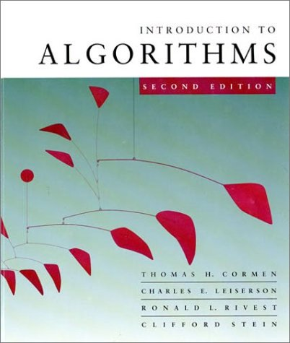
Data Structures and Algorithms
Lecture 1
Vidya Rangasayee
CS 146 Fall 2023

Slide 2
Longest increasing subsequence
Given a sequence of numbers X = x₁, x₂, …, x_{n} find the longest increasing subsequence
(i₁, i₂, …, i_{k}), that is a subsequence where numbers in the sequence increase.
5 2 8 6 3 6 9 7

Slide 3
Longest increasing subsequence
Given a sequence of numbers X = x₁, x₂, …, x_{n} find the longest increasing subsequence
(i₁, i₂, …, i_{k}), that is a subsequence where numbers in the sequence increase.
5 2 8 6 3 6 9 7

Slide 4
Step 1: Define the problem with respect to subproblems
5 2 8 6 3 6 9 7
Two options: Either 5 is in the LIS or it’s not

Slide 5
Step 1: Define the problem with respect to subproblems
5 2 8 6 3 6 9 7
include 5
5 + LIS(8 6 3 6 9 7)

Slide 6
Step 1: Define the problem with respect to subproblems
5 2 8 6 3 6 9 7
include 5
5 + LIS(8 6 3 6 9 7)
What is this function exactly?
longest increasing sequence of the numbers
longest increasing sequence of the numbers starting with 8

Slide 7
Step 1: Define the problem with respect to subproblems
5 2 8 6 3 6 9 7
include 5
5 + LIS(8 6 3 6 9 7)
What is this function exactly?
longest increasing sequence of the numbers
This would allow for the option of sequences starting with 3 which are NOT valid!

Slide 8
Step 1: Define the problem with respect to subproblems
5 2 8 6 3 6 9 7
include 5
5 + LIS’(8 6 3 6 9 7)
longest increasing sequence of the numbers starting with 8
Do we need to consider anything else for subsequences starting at 5?

Slide 9
Step 1: Define the problem with respect to subproblems
5 2 8 6 3 6 9 7
include 5
5 + LIS’(8 6 3 6 9 7)
5 + LIS’(6 3 6 9 7)
5 + LIS’(6 9 7)
5 + LIS’(9 7)
5 + LIS’(7)

Slide 10
Step 1: Define the problem with respect to subproblems
5 2 8 6 3 6 9 7
don’t include 5
LIS(2 8 6 3 6 9 7)
Anything else?
Technically, this is fine, but now we have LIS and LIS’ to worry about.
Can we rewrite LIS in terms of LIS’?

Slide 11
Step 1: Define the problem with respect to subproblems
Longest increasing sequence for X is the longest increasing sequence starting at any element
And what is LIS’ defined as (recursively)?

Slide 12
Step 1: Define the problem with respect to subproblems
Longest increasing sequence for X is the longest increasing sequence starting at any element
Longest increasing sequence starting at i

Slide 13
Step 2: build the solution from the bottom up
LIS’:
5 2 8 6 3 6 9 7

Slide 14
Step 2: build the solution from the bottom up
LIS’: 1
5 2 8 6 3 6 9 7

Slide 15
Step 2: build the solution from the bottom up
LIS’: 1
5 2 8 6 3 6 9 7

Slide 16
Step 2: build the solution from the bottom up
LIS’: 1 1
5 2 8 6 3 6 9 7

Slide 17
Step 2: build the solution from the bottom up
LIS’: 1 1
5 2 8 6 3 6 9 7

Slide 18
Step 2: build the solution from the bottom up
LIS’: 2 1 1
5 2 8 6 3 6 9 7

Slide 19
Step 2: build the solution from the bottom up
LIS’: 3 2 1 1
5 2 8 6 3 6 9 7

Slide 20
Step 2: build the solution from the bottom up
LIS’: 2 3 2 1 1
5 2 8 6 3 6 9 7

Slide 21
Step 2: build the solution from the bottom up
LIS’: 2 2 3 2 1 1
5 2 8 6 3 6 9 7

Slide 22
Step 2: build the solution from the bottom up
LIS’: 4 2 2 3 2 1 1
5 2 8 6 3 6 9 7

Slide 23
Step 2: build the solution from the bottom up
LIS’: 3 4 2 2 3 2 1 1
5 2 8 6 3 6 9 7

Slide 24
Step 2: build the solution from the bottom up
LIS’: 3 4 2 2 3 2 1 1
5 2 8 6 3 6 9 7

Slide 25
Step 2: build the solution from the bottom up
What does my data structure for storing answers look like?

Slide 26
Step 2: build the solution from the bottom up
1-D array: only one thing changes for recursive calls, i

Slide 27
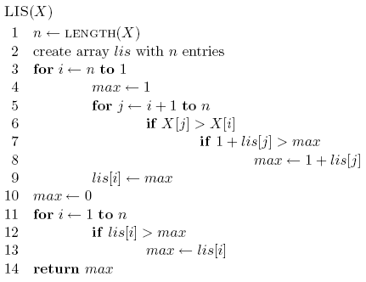
Step 2: build the solution from the bottom up

Slide 28
Step 2: build the solution from the bottom up
start from the end (bottom)

Slide 29
Step 2: build the solution from the bottom up

Slide 30
Step 2: build the solution from the bottom up

Slide 31
Step 2: build the solution from the bottom up
initialization?

Slide 32

Running time?
Θ(n²)

Slide 33
Another solution
Can we use LCS to solve this problem?
5 2 8 6 3 6 9 7
LCS
2 3 5 6 6 7 8 9

Slide 34
Another solution
Can we use LCS to solve this problem?
5 2 8 6 3 6 9 7
LCS
2 3 5 6 6 7 8 9

Slide 35
Memoization
Sometimes it can be a challenge to write the function in a bottom-up fashion
Memoization:
Write the recursive function top-down
Alter the function to check if we’ve already calculated the value
If so, use the pre-calculate value
If not, do the recursive call(s)

Slide 36
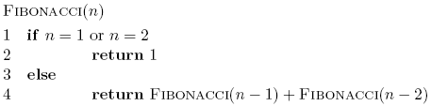
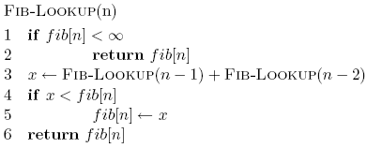
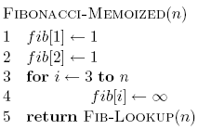
Memoized fibonacci

Slide 37
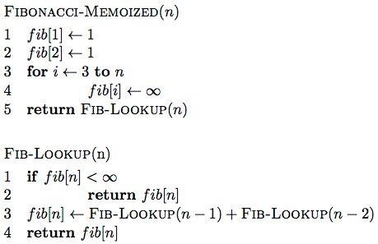
Memoized fibonacci

Slide 38
Memoized fibonacci
Use ∞ to denote uncalculated

Slide 39
Memoized fibonacci
What else could we use besides an array?
Use ∞ to denote uncalculated

Slide 40
Memoized fibonacci
Check if we already calculated the value

Slide 41
Memoized fibonacci
calculate the value

Slide 42
Memoized fibonacci
store the value

Slide 43
Memoization
Pros
Can be more intuitive to code/understand
Can be memory savings if you don’t need answers to all subproblems
Cons
Depending on implementation, larger overhead because of recursion (though often the functions are tail recursive)

Slide 44
Edit distance (aka Levenshtein distance)
Edit distance between two strings is the minimum number of insertions, deletions and substitutions required to transform string s₁ into string s₂
Insertion:
ABACED
ABACCED
DABACCED
Insert ‘C’
Insert ‘D’

Slide 45
Edit distance (aka Levenshtein distance)
Edit distance between two strings is the minimum number of insertions, deletions and substitutions required to transform string s₁ into string s₂
Deletion:
ABACED

Slide 46
Edit distance (aka Levenshtein distance)
Edit distance between two strings is the minimum number of insertions, deletions and substitutions required to transform string s₁ into string s₂
Deletion:
ABACED
BACED
Delete ‘A’

Slide 47
Edit distance (aka Levenshtein distance)
Edit distance between two strings is the minimum number of insertions, deletions and substitutions required to transform string s₁ into string s₂
Deletion:
ABACED
BACED
BACE
Delete ‘A’
Delete ‘D’

Slide 48
Edit distance (aka Levenshtein distance)
Edit distance between two strings is the minimum number of insertions, deletions and substitutions required to transform string s₁ into string s₂
Substitution:
ABACED
ABADED
ABADES
Sub ‘D’ for ‘C’
Sub ‘S’ for ‘D’

Slide 49
Edit distance examples
Edit(Kitten, Mitten) =
1
Operations:
Sub ‘M’ for ‘K’
Mitten

Slide 50
Edit distance examples
Edit(Happy, Hilly) =
3
Operations:
Sub ‘a’ for ‘i’
Hippy
Sub ‘l’ for ‘p’
Hilpy
Sub ‘l’ for ‘p’
Hilly

Slide 51
Edit distance examples
Edit(Banana, Car) =
5
Operations:
Delete ‘B’
anana
Delete ‘a’
nana
Delete ‘n’
naa
Sub ‘C’ for ‘n’
Caa
Sub ‘a’ for ‘r’
Car

Slide 52
Edit distance examples
Edit(Simple, Apple) =
3
Operations:
Delete ‘S’
imple
Sub ‘A’ for ‘i’
Ample
Sub ‘m’ for ‘p’
Apple

Slide 53
Edit distance
Why might this be useful?

Slide 54
Is edit distance symmetric?
that is, is Edit(s₁, s₂) = Edit(s₂, s₁)?
Why?
sub ‘i’ for ‘j’ → sub ‘j’ for ‘i’
delete ‘i’ → insert ‘i’
insert ‘i’ → delete ‘i’
Edit(Simple, Apple) =? Edit(Apple, Simple)

Slide 55
Calculating edit distance
X = A B C B D A B
Y = B D C A B A
Ideas?

Slide 56
Calculating edit distance
X = A B C B D A ?
Y = B D C A B ?
After all of the operations, X needs to equal Y

Slide 57
Calculating edit distance
X = A B C B D A ?
Y = B D C A B ?
Operations:
Insert
Delete
Substitute

Slide 58
Insert
X = A B C B D A ?
Y = B D C A B ?

Slide 59
Insert
X = A B C B D A ?
Edit
Y = B D C A B ?

Slide 60
Delete
X = A B C B D A ?
Y = B D C A B ?

Slide 61
Delete
X = A B C B D A ?
Edit
Y = B D C A B ?

Slide 62
Substitution
X = A B C B D A ?
Y = B D C A B ?

Slide 63
Substition
X = A B C B D A ?
Edit
Y = B D C A B ?

Slide 64
Anything else?
X = A B C B D A ?
Y = B D C A B ?

Slide 65
Equal
X = A B C B D A ?
Y = B D C A B ?

Slide 66
Equal
X = A B C B D A ?
Edit
Y = B D C A B ?

Slide 67
Combining results
Insert:
Delete:
Substitute:
Equal:

Slide 68
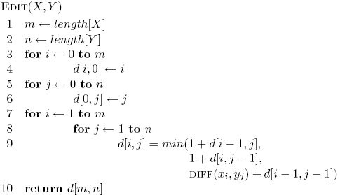
Combining results

Slide 69
Running time
Θ(nm)

Slide 70
Variants
Only include insertions and deletions
What does this do to substitutions?
Include swaps, i.e. swapping two adjacent characters counts as one edit
Weight insertion, deletion and substitution differently
Weight specific character insertion, deletion and substitutions differently
Length normalize the edit distance

Slide 71
Quick summary
Step 1: Define the problem with respect to subproblems
We did this for divide and conquer too. What’s the difference?
You can identify a candidate for dynamic programming if there is overlap or repeated work in the subproblems being created
Step 2: build the solution from the bottom up
Build the solution such that the subproblems referenced by larger problems are already solved
Memoization is also an alternative

Slide 72
0-1 Knapsack problem
0-1 Knapsack – A thief robbing a store finds n items worth v₁, v₂, .., v_{n} dollars and weight w₁, w₂, …, w_{n} pounds, where v_{i} and w_{i} are integers. The thief can carry at most W pounds in the knapsack. Which items should the thief take if he/she wants to maximize value?
Repetition is allowed, that is you can take multiple copies of any item

