Slide 1
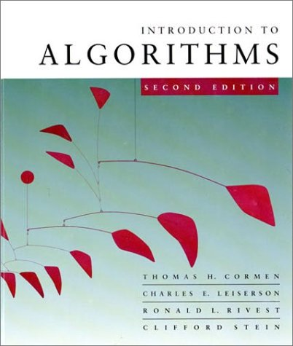
Data Structures and Algorithms
Lecture 9
Vidya Rangasayee
CS 146 Fall 2023

Slide 2
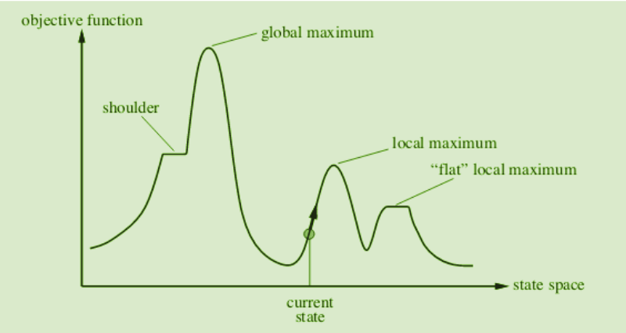
Non-optimal greedy algorithms
All the greedy algorithms we’ve looked at so far give the optimal answer
Some of the most common greedy algorithms generate good, but non-optimal solutions
clustering
hill-climbing
relaxation

Slide 3
Knapsack problems: Greedy or not?
0-1 Knapsack – A thief robbing a store finds n items worth v₁, v₂, .., v_{n} dollars and weight w₁, w₂, …, w_{n} pounds, where v_{i} and w_{i} are integers. The thief can carry at most W pounds in the knapsack. Which items should the thief take if he wants to maximize value.
Fractional knapsack problem – Same as above, but the thief happens to be at the bulk section of the store and can carry fractional portions of the items. For example, the thief could take 20% of item i for a weight of 0.2w_{i} and a value of 0.2v_{i}.

Slide 4
Dynamic programming
One of the most important algorithm tools!
Very common interview question
Method for solving problems where optimal solutions can be defined in terms of optimal solutions to sub-problems
AND
the sub-problems are overlapping

Slide 5
Fibonacci numbers
1, 1, 2, 3, 5, 8, 13, 21, 34, …
What is the recurrence for the n^{th} Fibonacci number?
F(n) = F(n-1) + F(n-2)
The solution for n is defined with respect to the solution to smaller problems (n-1 and n-2)

Slide 6
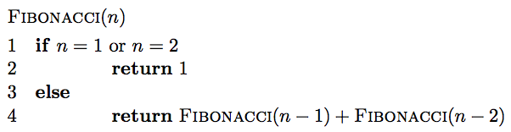
Fibonacci: a first attempt

Slide 7
Is it correct?
F(n) = F(n-1) + F(n-2)

Slide 8
Running time
Each call creates two recursive calls
Each call reduces the size of the problem by 1 or 2
Creates a full binary of depth n
O(2^{n})

Slide 9
Can we do better?
Fib(n)
Fib(n-1)
Fib(n-2)
Fib(n-2)
Fib(n-3)
Fib(n-3)
Fib(n-4)
Fib(n-3)
Fib(n-4)
Fib(n-4)
Fib(n-5)
Fib(n-4)
Fib(n-5)
Fib(n-5)
Fib(n-6)

Slide 10
A lot of repeated work!
Fib(n)
Fib(n-1)
Fib(n-2)
Fib(n-2)
Fib(n-3)
Fib(n-3)
Fib(n-4)
Fib(n-3)
Fib(n-4)
Fib(n-4)
Fib(n-5)
Fib(n-4)
Fib(n-5)
Fib(n-5)
Fib(n-6)

Slide 11
Identifying a dynamic programming problem
The solution can be defined with respect to solutions to subproblems
The subproblems created are overlapping, that is we see the same subproblems repeated

Slide 12
Overlapping sub-problems
divide and conquer
dynamic
programming
…

Slide 13
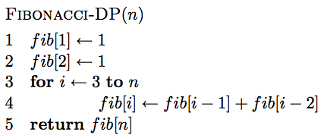
Creating a dynamic programming solution
Step 1: Identify a solution to the problem with respect to smaller subproblems (pretend like you have a solver, but it only works on smaller problems):
F(n) = F(n-1) + F(n-2)
Step 2: bottom up - start with solutions to the smallest problems and build solutions to the larger problems
use an array to store solutions to subproblems

Slide 14
Is it correct?
F(n) = F(n-1) + F(n-2)

Slide 15
Running time?
Θ(n)

Slide 16
Counting binary search trees
How many unique binary search trees can be created using the numbers 1 through n?
4
2
5
1
3
6

Slide 17
Step 1: What is the subproblem?
Assume we have some black box solver (call it T) that can give us the answer to smaller subproblems
How can we use the answer from this to answer our question?
How many options for the root are there?
1
2
3
n
…

Slide 18
Subproblems
i
How many trees have i as the root?

Slide 19
Subproblems
i
1, 2, …, i-1
i+1, i+2, …, n
?

Slide 20
Subproblems
i
1, 2, …, i-1
i+1, i+2, …, n
T(i-1)
?
subproblem of size i-1

Slide 21
Subproblems
i
1, 2, …, i-1
i+1, i+2, …, n
T(i-1)
Number of trees for i+1, i+2, …, i+n is the same as the number of trees from 1, 2, …, n-i

Slide 22
Subproblems
i
1, 2, …, i-1
i+1, i+2, …, n
T(i-1)
T(n-i)
Given solutions for T(i-1) and T(n-i) how many trees are there with i as the root?

Slide 23
Subproblems
i
1, 2, …, i-1
i+1, i+2, …, n
T(i-1)
T(n-i)
T(i) = T(i-1) * T(n-i)

Slide 24
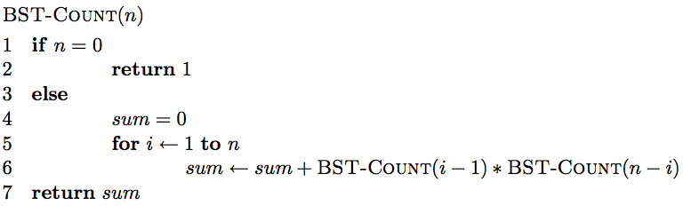
Step 1: define the answer with respect to subproblems
T(i) = T(i-1) * T(n-i)

Slide 25
Is there a problem?
As with Fibonacci, we’re repeating a lot of work

Slide 26
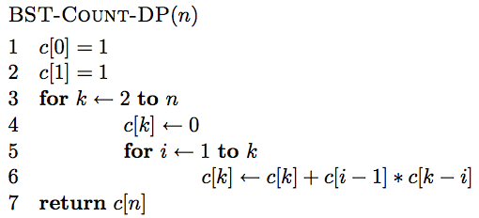
Step 2: Generate a solution from the bottom-up

Slide 27
0 1 2 3 4 5 … n

Slide 28
1 1
0 1 2 3 4 5 … n

Slide 29
c[0]*c[1] + c[1]*c[0]
1 1
0 1 2 3 4 5 … n

Slide 30
1
2
2
1
c[0]*c[1] + c[1]*c[0]
1 1
0 1 2 3 4 5 … n

Slide 31
1 1 2
0 1 2 3 4 5 … n

Slide 32
1
2
3
c[0]*c[2] + c[1]*c[1] + c[2]*c[0]
1 1 2
0 1 2 3 4 5 … n

Slide 33
1 1 2 5
0 1 2 3 4 5 … n

Slide 34
1 1 2 5 …
0 1 2 3 4 5 … n

Slide 35
Running time?
Θ(n²)

Slide 36
Longest common subsequence (LCS)
For a sequence X = x₁, x₂, …, x_{n}, a subsequence is a subset of the sequence defined by a set of increasing indices (i₁, i₂, …, i_{k}) where 1 ≤ i₁ < i₂ < … < i_{k} ≤ n
X = A B A C D A B A B
ABA?

Slide 37
Longest common subsequence (LCS)
For a sequence X = x₁, x₂, …, x_{n}, a subsequence is a subset of the sequence defined by a set of increasing indices (i₁, i₂, …, i_{k}) where 1 ≤ i₁ < i₂ < … < i_{k} ≤ n
X = A B A C D A B A B
ABA

Slide 38
Longest common subsequence (LCS)
For a sequence X = x₁, x₂, …, x_{n}, a subsequence is a subset of the sequence defined by a set of increasing indices (i₁, i₂, …, i_{k}) where 1 ≤ i₁ < i₂ < … < i_{k} ≤ n
X = A B A C D A B A B
ACA?

Slide 39
Longest common subsequence (LCS)
For a sequence X = x₁, x₂, …, x_{n}, a subsequence is a subset of the sequence defined by a set of increasing indices (i₁, i₂, …, i_{k}) where 1 ≤ i₁ < i₂ < … < i_{k} ≤ n
X = A B A C D A B A B
ACA

Slide 40
Longest common subsequence (LCS)
For a sequence X = x₁, x₂, …, x_{n}, a subsequence is a subset of the sequence defined by a set of increasing indices (i₁, i₂, …, i_{k}) where 1 ≤ i₁ < i₂ < … < i_{k} ≤ n
X = A B A C D A B A B
DCA?

Slide 41
Longest common subsequence (LCS)
For a sequence X = x₁, x₂, …, x_{n}, a subsequence is a subset of the sequence defined by a set of increasing indices (i₁, i₂, …, i_{k}) where 1 ≤ i₁ < i₂ < … < i_{k} ≤ n
X = A B A C D A B A B
DCA

Slide 42
Longest common subsequence (LCS)
For a sequence X = x₁, x₂, …, x_{n}, a subsequence is a subset of the sequence defined by a set of increasing indices (i₁, i₂, …, i_{k}) where 1 ≤ i₁ < i₂ < … < i_{k} ≤ n
X = A B A C D A B A B
AADAA?

Slide 43
Longest common subsequence (LCS)
For a sequence X = x₁, x₂, …, x_{n}, a subsequence is a subset of the sequence defined by a set of increasing indices (i₁, i₂, …, i_{k}) where 1 ≤ i₁ < i₂ < … < i_{k} ≤ n
X = A B A C D A B A B
AADAA

Slide 44
LCS problem
Given two sequences X and Y, a common subsequence is a subsequence that occurs in both X and Y
Given two sequences X = x₁, x₂, …, x_{n} and Y = y₁, y₂, …, y_{n},
What is the longest common subsequence?
X = A B C B D A B
Y = B D C A B A

Slide 45
LCS problem
Given two sequences X and Y, a common subsequence is a subsequence that occurs in both X and Y
Given two sequences X = x₁, x₂, …, x_{n} and Y = y₁, y₂, …, y_{n},
What is the longest common subsequence?
X = A B C B D A B
Y = B D C A B A

Slide 46
Step 1: Define the problem with respect to subproblems
X = A B C B D A B
Y = B D C A B A
Assume you have a solver for smaller problems

Slide 47
Step 1: Define the problem with respect to subproblems
X = A B C B D A ?
Y = B D C A B ?
Is the last character part of the LCS?

Slide 48
Step 1: Define the problem with respect to subproblems
X = A B C B D A ?
Y = B D C A B ?
Two cases: either the characters are the same or they’re different

Slide 49
Step 1: Define the problem with respect to subproblems
X = A B C B D A A
LCS
The characters are part of the LCS
Y = B D C A B A
What is the recursive relationship?
If they’re the same

Slide 50
Step 1: Define the problem with respect to subproblems
X = A B C B D A B
LCS
Y = B D C A B A
If they’re different

Slide 51
Step 1: Define the problem with respect to subproblems
X = A B C B D A B
LCS
Y = B D C A B A
If they’re different

Slide 52
Step 1: Define the problem with respect to subproblems
X = A B C B D A B
Y = B D C A B A
?
X = A B C B D A B
Y = B D C A B A
If they’re different

Slide 53
Step 1: Define the problem with respect to subproblems
X = A B C B D A B
Y = B D C A B A
(for now, let’s just worry about counting the length of the LCS)

Slide 54
Step 2: Build the solution from the bottom up
What types of subproblem solutions do we need to store?
LCS(X_{1…j}, Y_{1…k})
two different indices

Slide 55
Step 2: Build the solution from the bottom up
What types of subproblem solutions do we need to store?
LCS(X_{1…j}, Y_{1…k})

Slide 56
j
0 1 2 3 4 5 6 y_{j} B D C A B A
i
0 x_{i} 1 A 2 B 3 C 4 B 5 D 6 A 7 B
For Fibonacci and tree counting, we had to initialize some entries in the array. Any here?

Slide 57
j
0 1 2 3 4 5 6 y_{j} B D C A B A
i
0 x_{i} 1 A 2 B 3 C 4 B 5 D 6 A 7 B
0 0 0 0 0 0 0 0 0 0 0 0 0 0
Need to initialize values within 1 smaller in either dimension.

Slide 58
j
0 1 2 3 4 5 6 y_{j} B D C A B A
i
0 x_{i} 1 A 2 B 3 C 4 B 5 D 6 A 7 B
0 0 0 0 0 0 0 0 ? 0 0 0 0 0 0
LCS(A, B)

Slide 59
j
0 1 2 3 4 5 6 y_{j} B D C A B A
i
0 x_{i} 1 A 2 B 3 C 4 B 5 D 6 A 7 B
0 0 0 0 0 0 0 0 0 0 0 0 0 0 0

Slide 60
j
0 1 2 3 4 5 6 y_{j} B D C A B A
i
0 x_{i} 1 A 2 B 3 C 4 B 5 D 6 A 7 B
0 0 0 0 0 0 0 0 0 0 0 ? 0 0 0 0 0 0
LCS(A, BDCA)

Slide 61
j
0 1 2 3 4 5 6 y_{j} B D C A B A
i
0 x_{i} 1 A 2 B 3 C 4 B 5 D 6 A 7 B
0 0 0 0 0 0 0 0 0 0 0 1 0 0 0 0 0 0
LCS(A, BDCA)

Slide 62
j
0 1 2 3 4 5 6 y_{j} B D C A B A
i
0 x_{i} 1 A 2 B 3 C 4 B 5 D 6 A 7 B
0 0 0 0 0 0 0 0 0 0 0 1 1 1 0 1 1 1 1 2 2 0 1 1 2 2 2 2 0 1 1 2 2 ? 0 0 0
LCS(ABCB, BDCAB)

Slide 63
j
0 1 2 3 4 5 6 y_{j} B D C A B A
i
0 x_{i} 1 A 2 B 3 C 4 B 5 D 6 A 7 B
0 0 0 0 0 0 0 0 0 0 0 1 1 1 0 1 1 1 1 2 2 0 1 1 2 2 2 2 0 1 1 2 2 3 0 0 0
LCS(ABCB, BDCAB)

Slide 64
j
0 1 2 3 4 5 6 y_{j} B D C A B A
i
0 x_{i} 1 A 2 B 3 C 4 B 5 D 6 A 7 B
0 0 0 0 0 0 0 0 0 0 0 1 1 1 0 1 1 1 1 2 2 0 1 1 2 2 2 2 0 1 1 2 2 3 3 0 1 2 2 2 3 3 0 1 2 2 3 3 4 0 1 2 2 3 4 4
Where’s the final answer?

Slide 65
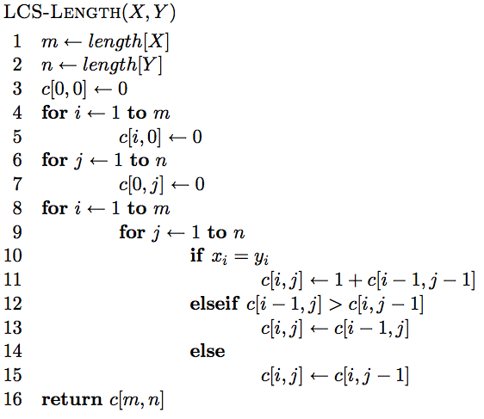
The algorithm

Slide 66
The algorithm
Base case initialization

Slide 67
The algorithm
Fill in the matrix

Slide 68
The algorithm

Slide 69
The algorithm

Slide 70
The algorithm

Slide 71
Running time?
Θ(nm)

Slide 72
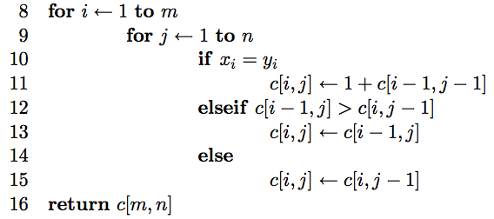
Keeping track of the solution
Our LCS algorithm only calculated the length of the LCS between X and Y
What if we wanted to know the actual sequence?
Keep track of this as well…

Slide 73
j
0 1 2 3 4 5 6 y_{j} B D C A B A
i
0 x_{i} 1 A 2 B 3 C 4 B 5 D 6 A 7 B
0 0 0 0 0 0 0 0 0 0 0 1 1 1 0 1 1 1 1 2 2 0 1 1 2 2 2 2 0 1 1 2 2 3 3 0 1 2 2 2 3 3 0 1 2 2 3 3 4 0 1 2 2 3 4 4
We can follow the arrows to generate the solution

Slide 74
j
0 1 2 3 4 5 6 y_{j} B D C A B A
i
0 x_{i} 1 A 2 B 3 C 4 B 5 D 6 A 7 B
0 0 0 0 0 0 0 0 0 0 0 1 1 1 0 1 1 1 1 2 2 0 1 1 2 2 2 2 0 1 1 2 2 3 3 0 1 2 2 2 3 3 0 1 2 2 3 3 4 0 1 2 2 3 4 4
We can follow the arrows to generate the solution
BCBA

