Slide 1
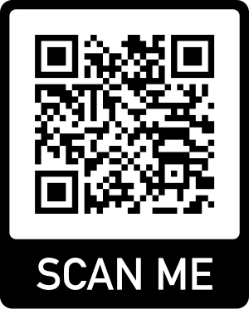
Using Problem-Oriented Discussion Cases to Develop Neuroscience Students’ Thinking Skills
Dan Johnson, Dept. Biology,
Wake Forest University
NTC 2023, July 20, 2023
Workshop Resources Site

Slide 2
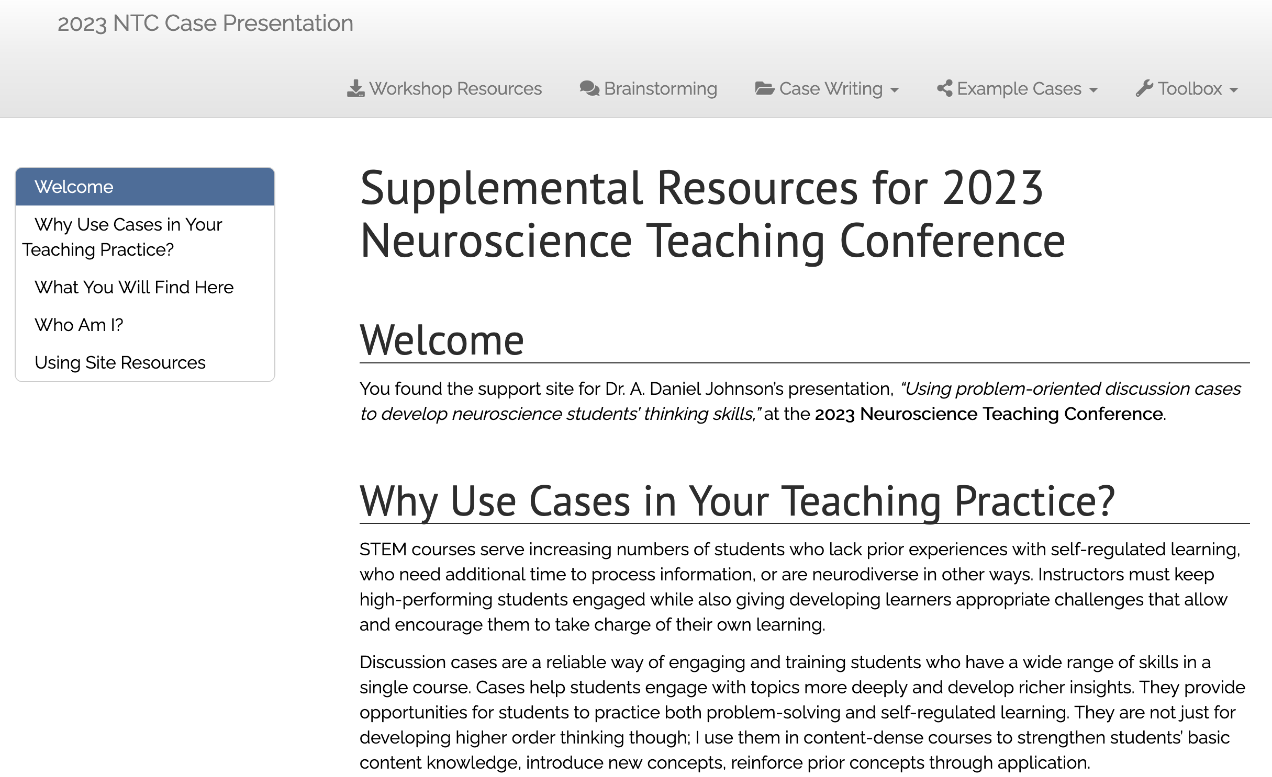
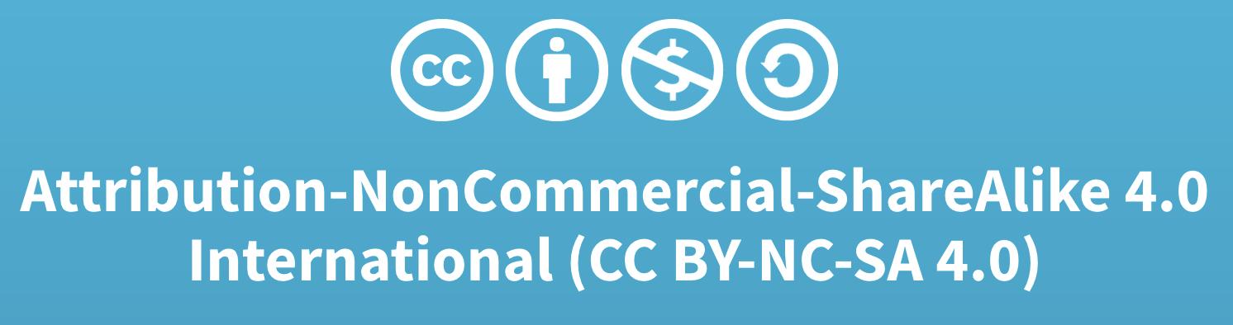
Companion Site: Cases & Writing Resources
Notes:
Direct URL: https://adanieljohnson.github.io/NTC2023/index.html

Slide 3
Part 1: Why, Where, & How
Notes:
Direct URL: https://adanieljohnson.github.io/NTC2023/index.html

Slide 4
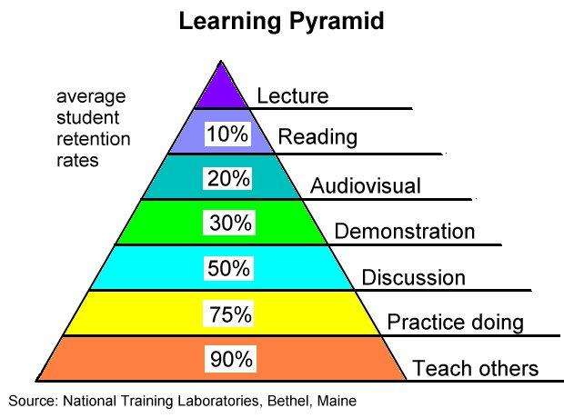
Why I Use Cases: The RETENTION Pyramid

Slide 5
Why I Use Cases: The RETENTION Pyramid
120 concepts; 6-15 concepts to next semester
30 concepts; 15-20 concepts to next semester
Notes:
There is a durable misconception about learning outcomes that biases instructors against using cases in content-intensive courses. A typical lecture course can deliver 3-5 central concepts per hour. Over a semester that averages to ~120 central concepts. Students may do well on short-term recall (i.e., in-class exams), but just 5-10% of these are retained 15-30 days. In other words, students take just 6-12 central concepts forward to the next semester.
If a case-based course covers 25% of that same content (30 concepts), but students have 60% retention, they take (120 x .25 x .60 = ) 18 core concepts forward. Beyond the 50% greater retention (18% vs. 12%), the instructor has a better idea of which concepts are carried forward, because they have selected which 25% of the lecture-based concepts they prioritized. Also, retained content is more readily transferred to new situations.

Slide 6
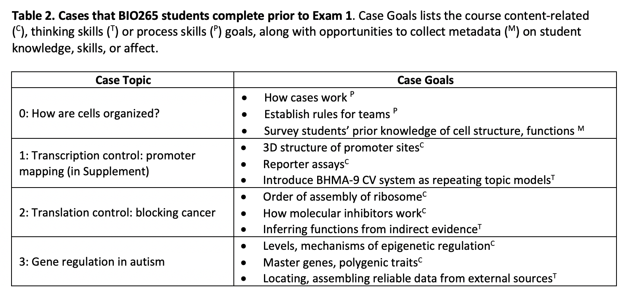
Where I Use Cases: BIO265

Slide 7
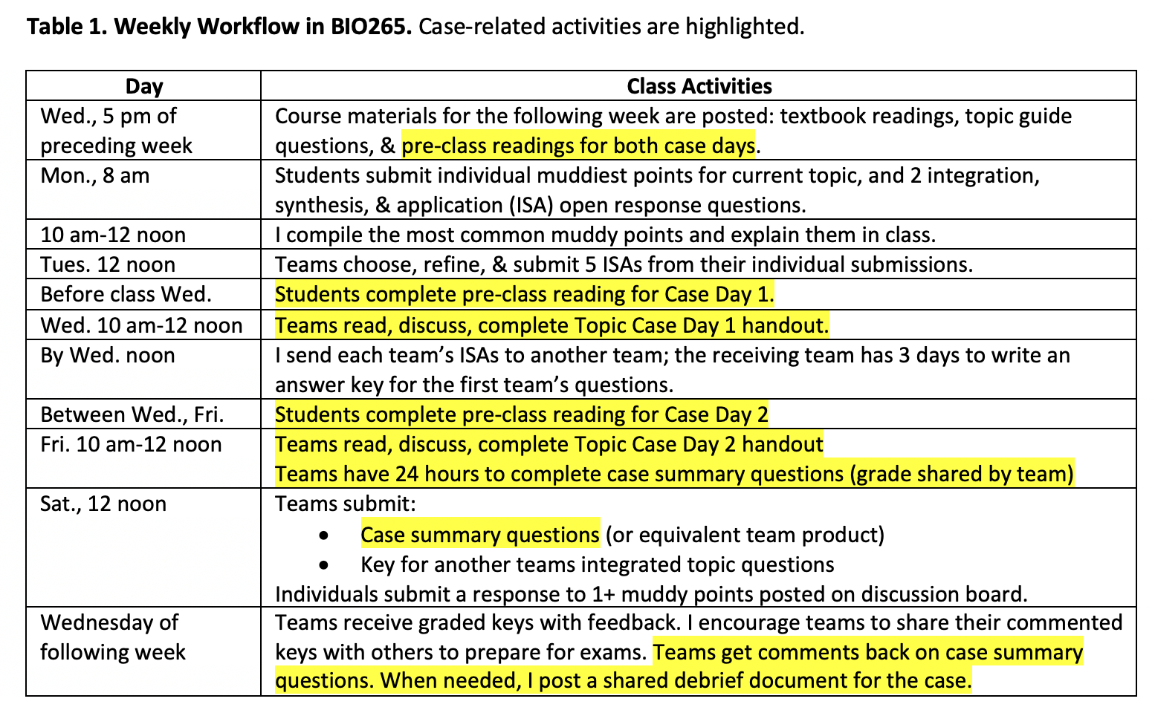
How I Use Cases: BIO265 Weekly Flow

Slide 8
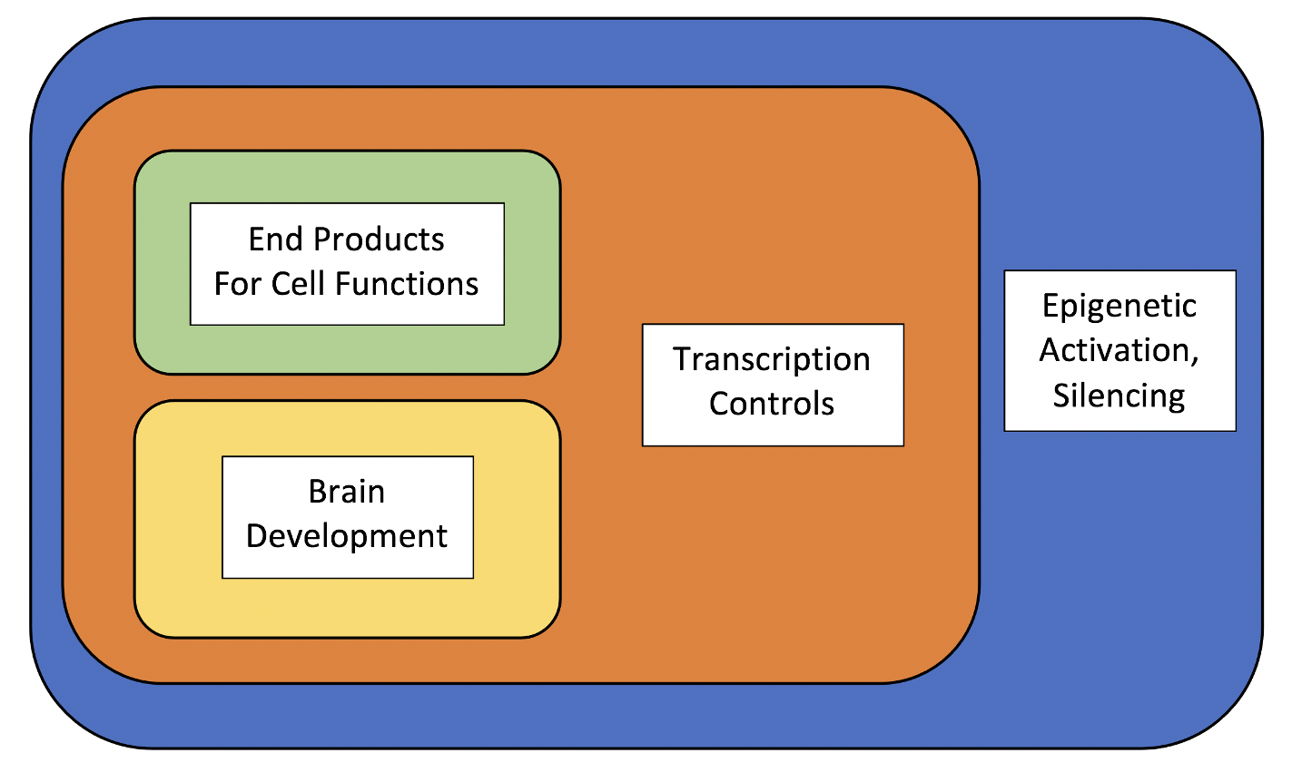
Sample/H’out Case: Genes of Autism (Wk. 3)
What students do not understand yet:
Simultaneous epigenetic regulation of multiple genes
How many paths can lead to a common phenotype
??
ASD
Phenotype
Diagram above is given to students as part of the DEBRIEF, not intro.

Slide 9
Main Case Elements
Background Reading
In-Class Handouts
Teams’ Goals In, After Class
Pre-class, on LMS
Includes
Conceptual orientation
OVERVIEW of activities
Links to ext. resources
Print copy of background *
Instructions
Dataset:
Key 4 features of ASD
3-line o’views of 20 genes linked to ASD
Day 1:
ID min. gene set
Draw interax. map
Day 2:
Present map, logic
Revise, reflect
Graded on:
REVISED map (team)
Reflection (indiv.)

Slide 10
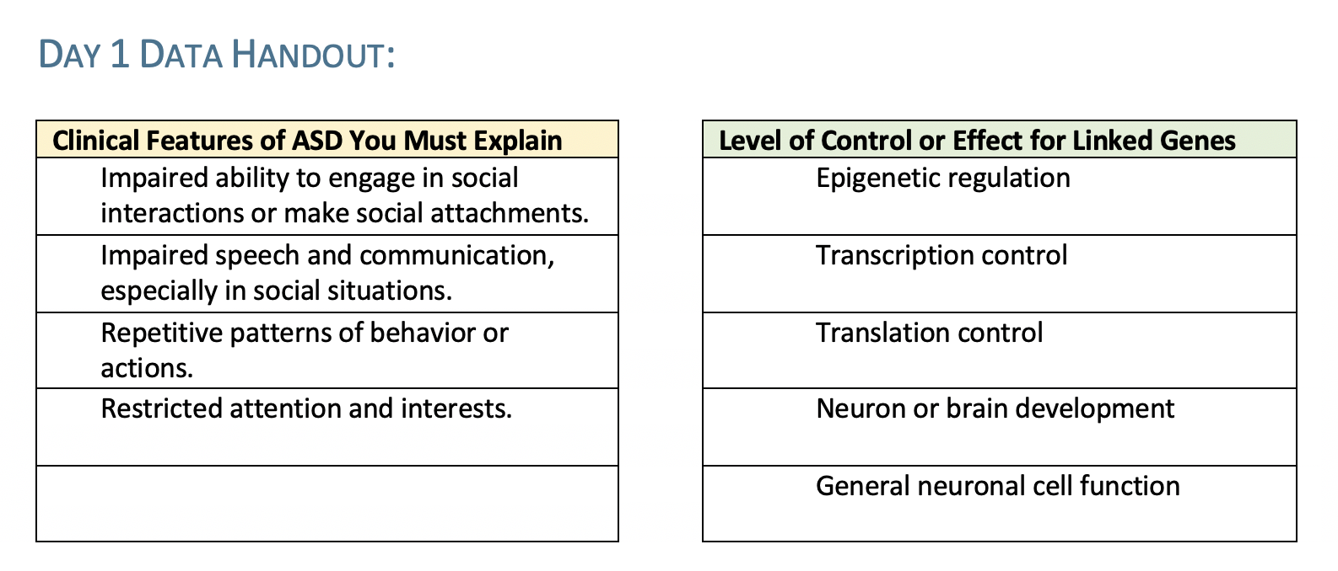
In-Class Datasets

Slide 11
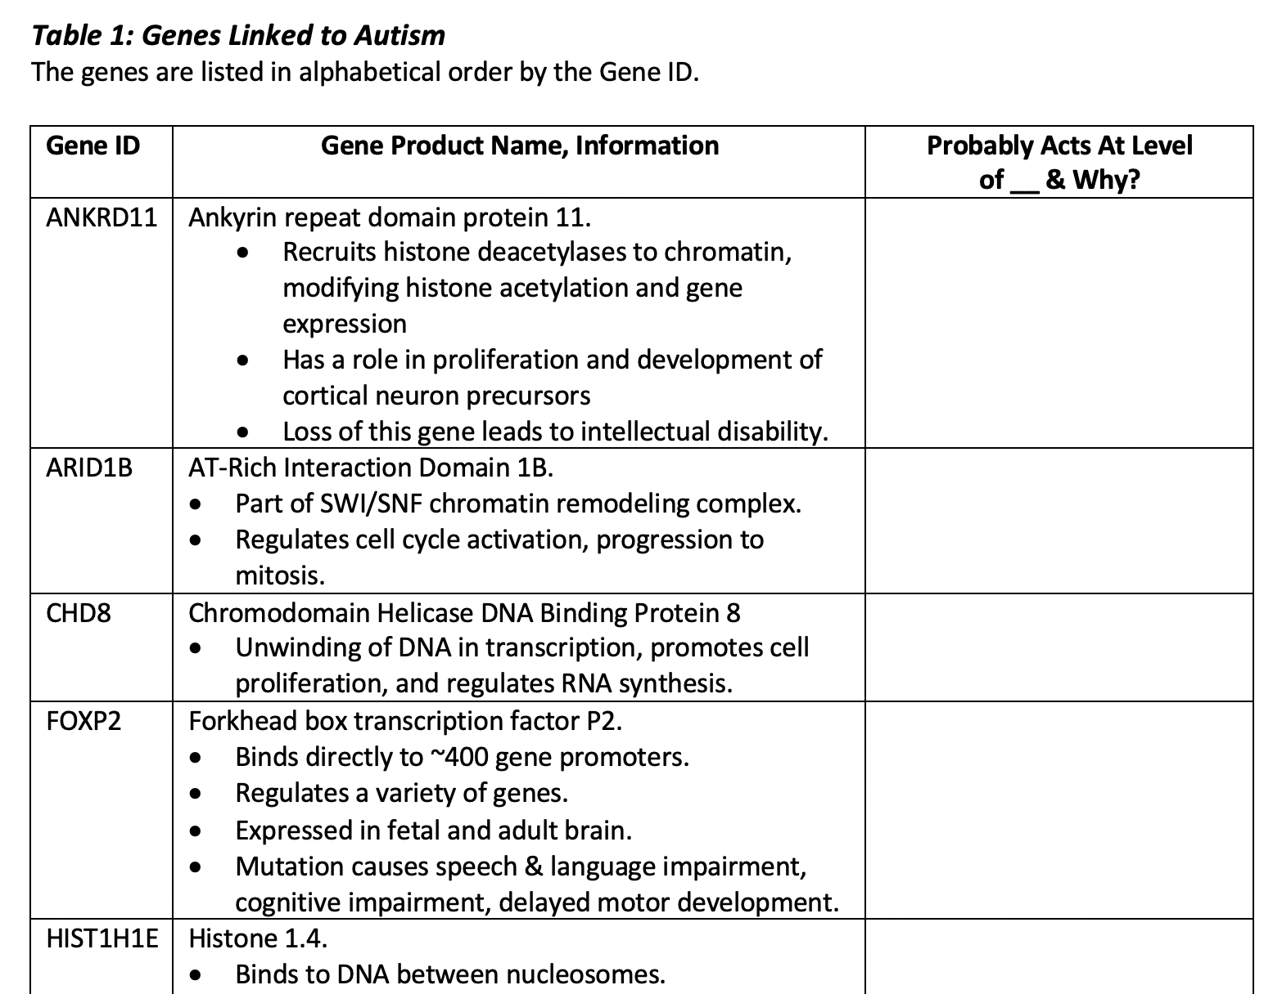
In-Class Datasets, cont.
Column 3 is part of assignment
Provides both:
Waypoints for students
Formative data
Source: Wiśniowiecka-Kowalnik, 2019. Genetics and epigenetics of autism spectrum disorder—current evidence in the field. J. Appl. Genet. 60:37–47. doi: 10.1007/s13353-018-00480-w

Slide 12
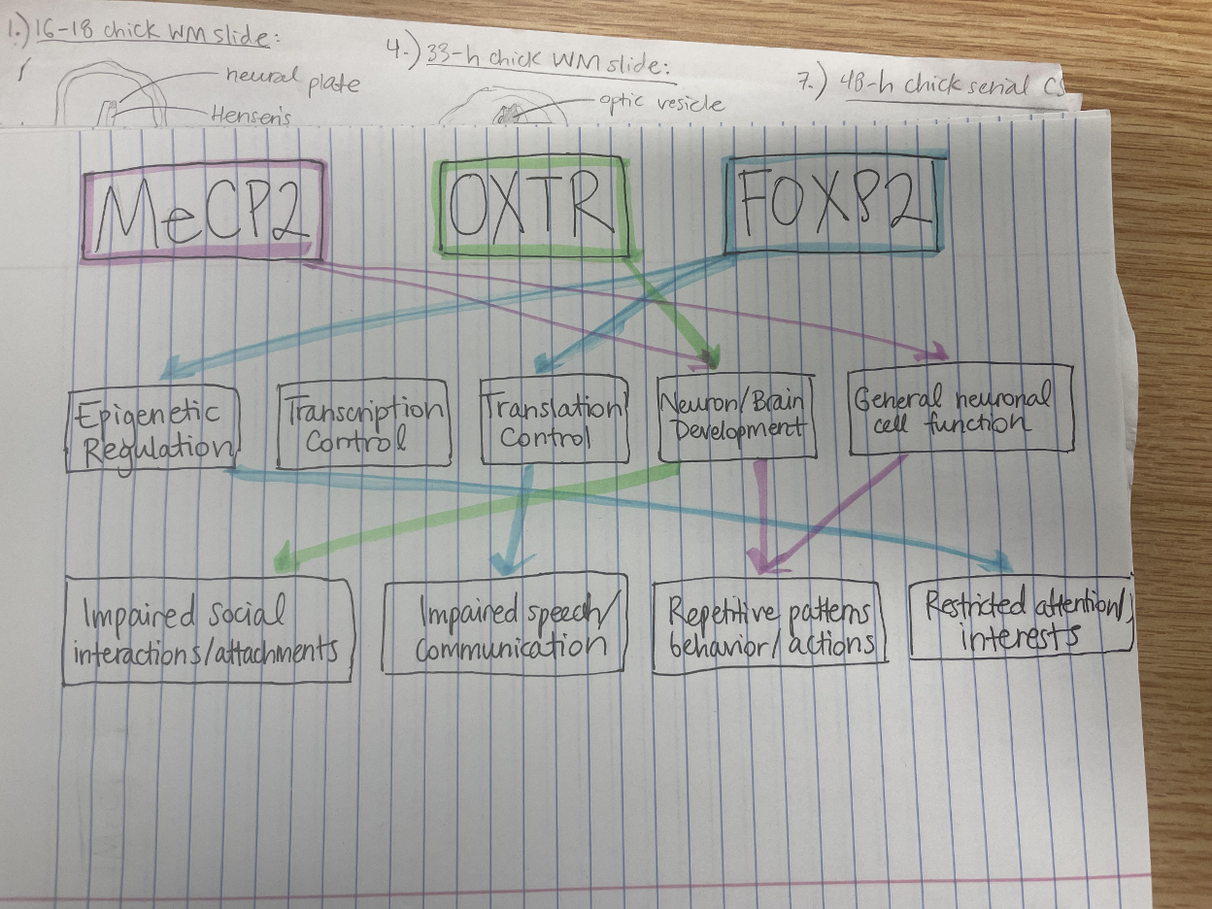
Sample Student Map #1

Slide 13
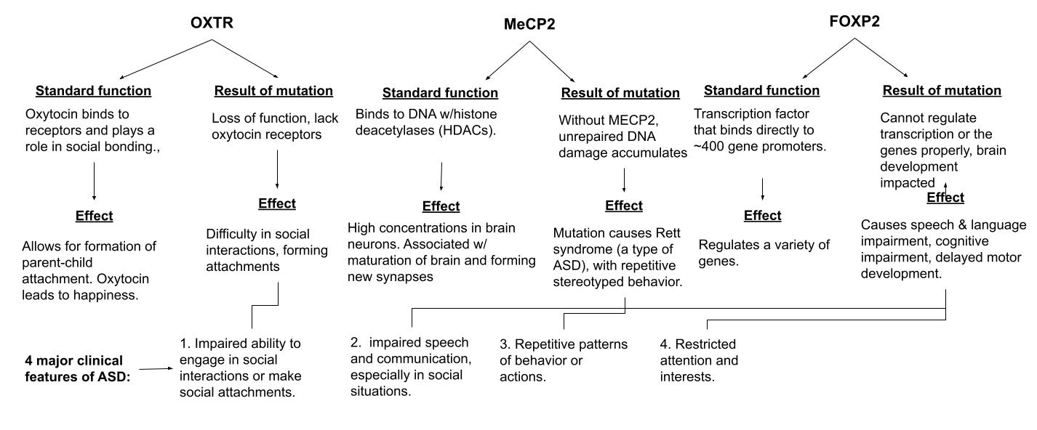
Sample Student Map #2

Slide 14
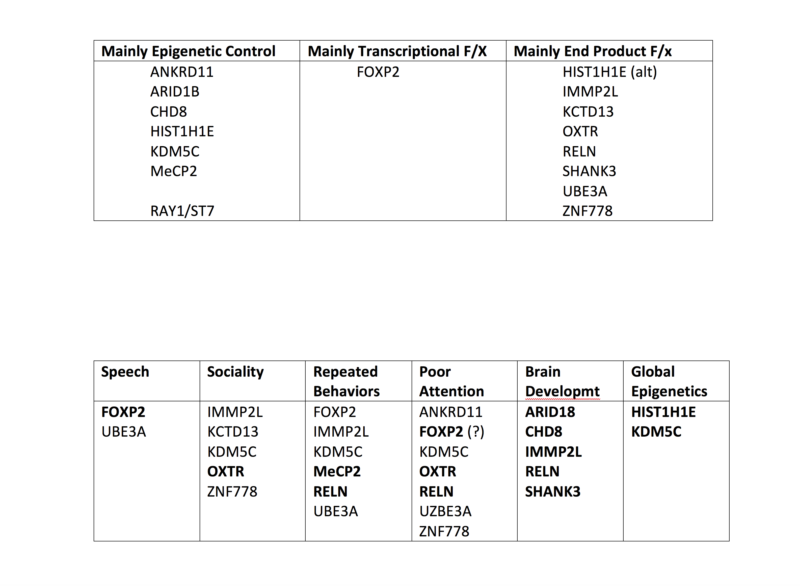
Debrief, Reflection Have Error Self-Correction

Slide 15
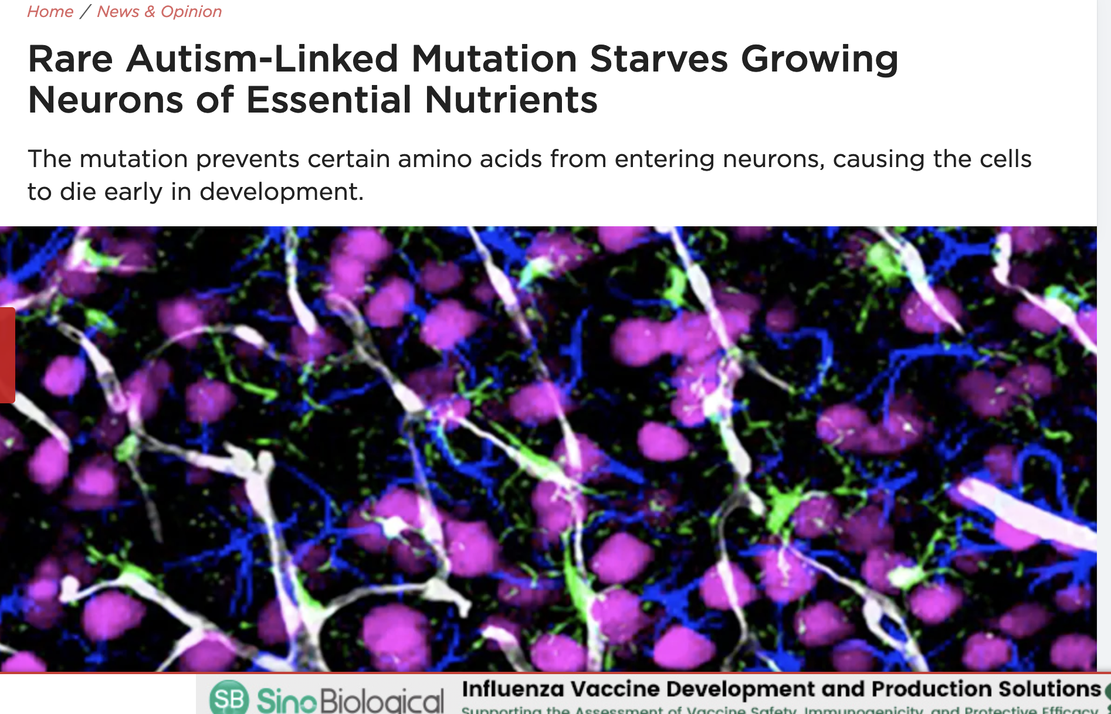
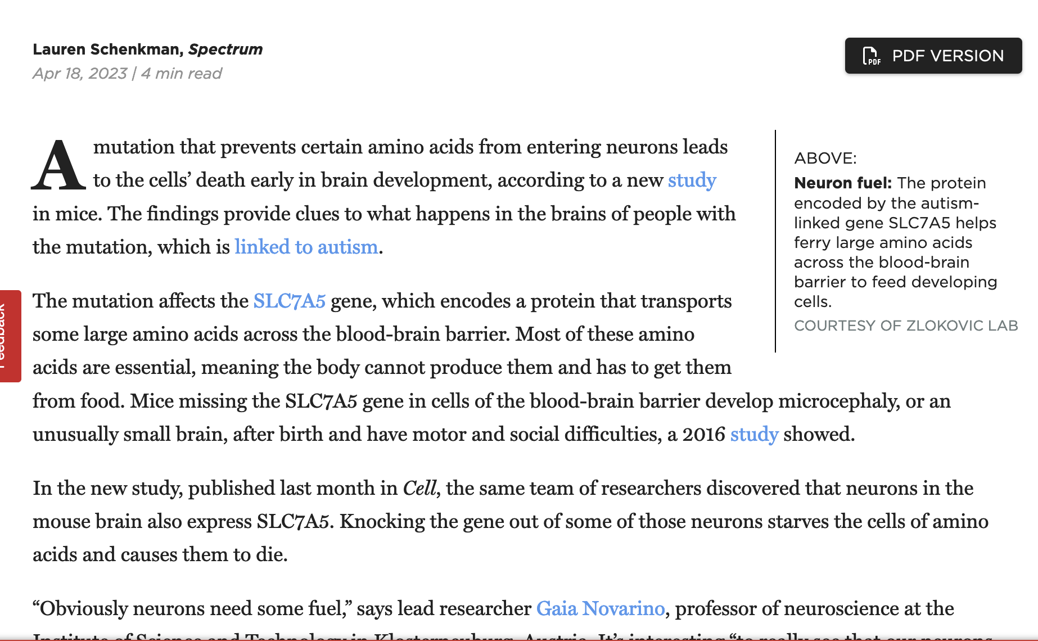
Case Is Structured to Be Expandable
??
Where would this gene go?

Slide 16
Part 2: How Can YOU Start Using Cases?
What do you hope to accomplish or support with neuroscience teaching cases? (Link)
What case style(s), formats would be most useful? (Link)
What problems do you foresee? What else do you want to know? (FAQ)
What “core” neuroscience topics, skills, thinking strategies would widely useful teaching cases use? (Chen-Liu Presentation)
Notes:
Direct URL: https://adanieljohnson.github.io/NTC2023/index.html

Slide 17
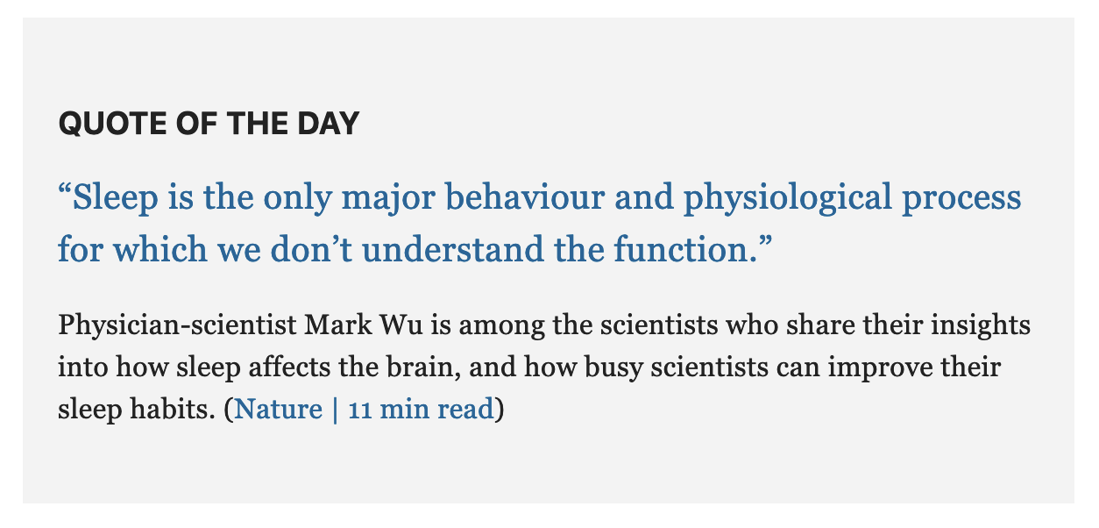
Inspiration: What Cases Could We Write?
Released 7/17/23

Slide 18
Resources on NTC23 “Draft” Cases Site
Strategies, guides, and tools for case design, writing, implementation & evaluation
What else do YOU need to start writing, using cases?
Library of sample cases (shows different types)
Interest in a shared NS Cases archive?
Toolbox
What is missing?
Notes:
Direct URL: https://adanieljohnson.github.io/NTC2023/index.html

Slide 19
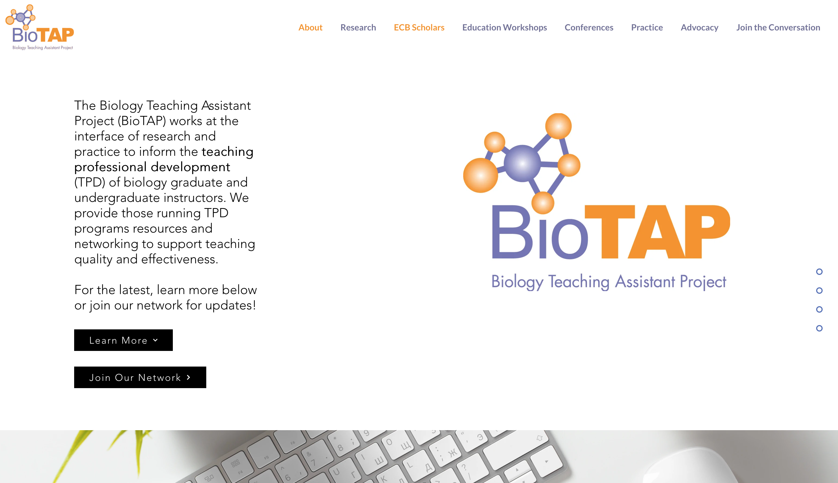
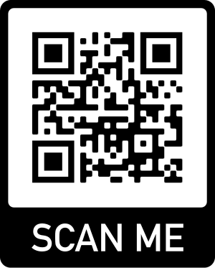
https://www.biotap.org/
If you train, supervise or lead UTA/GTA professional development…

Slide 20
Thanks For Listening!
Email:
johnsoad@wfu.edu
Phone:
336-758-5320

