Slide 1

WFU BIO783: Instructional Methods
Spring 2024
Notes:
1920 x 1080

Slide 2
What Is “Essential Knowledge”?
Notes:
1920 x 1080

Slide 3
Essential Knowledge: Knowledge Domains
Knowledge (broadly defined) can be divided into two general domains:
Disciplinary knowledge that provides a basis for logic, thinking, and understanding within a field
General knowledge that is relevant independent of disciplinary context

Slide 4
Essential Disciplinary Knowledge: Vision & Change 2011
Five Core Areas of Disciplinary Knowledge
EVOLUTION: Diversity of life evolved over time by processes of mutation, selection, genetic change.
STRUCTURE AND FUNCTION: Basic units of structure define function of all living things.
INFORMATION FLOW, EXCHANGE, AND STORAGE: Growth, behavior of organisms are expressions of genetic information in context.
PATHWAYS AND TRANSFORMATIONS OF ENERGY AND MATTER: Biological systems grow, change by processes based upon chemical transformation pathways governed by laws of thermodynamics.
SYSTEMS: Living systems are interconnected and interacting.

Slide 5
Essential Biology Knowledge: Vision & Change ‘11
Six Core Competencies/Abilities
CAN APPLY PROCESS OF SCIENCE: Biology is evidence based, grounded in formal practices of observation, experimentation, and hypothesis testing.
CAN USE QUANTITATIVE REASONING: Biology relies on applications of quantitative analysis and mathematical reasoning.
CAN USE MODELING AND SIMULATION: Biology focuses on the study of complex systems.
CAN TAP INTO INTERDISCIPLINARY NATURE OF SCIENCE: Biology is an interdisciplinary science.
CAN COMMUNICATE AND COLLABORATE WITH OTHER DISCIPLINES: Biology is a collaborative scientific discipline.
CAN UNDERSTAND THE RELATIONSHIP BETWEEN SCIENCE AND SOCIETY: Biology is conducted in a societal context.

Slide 6
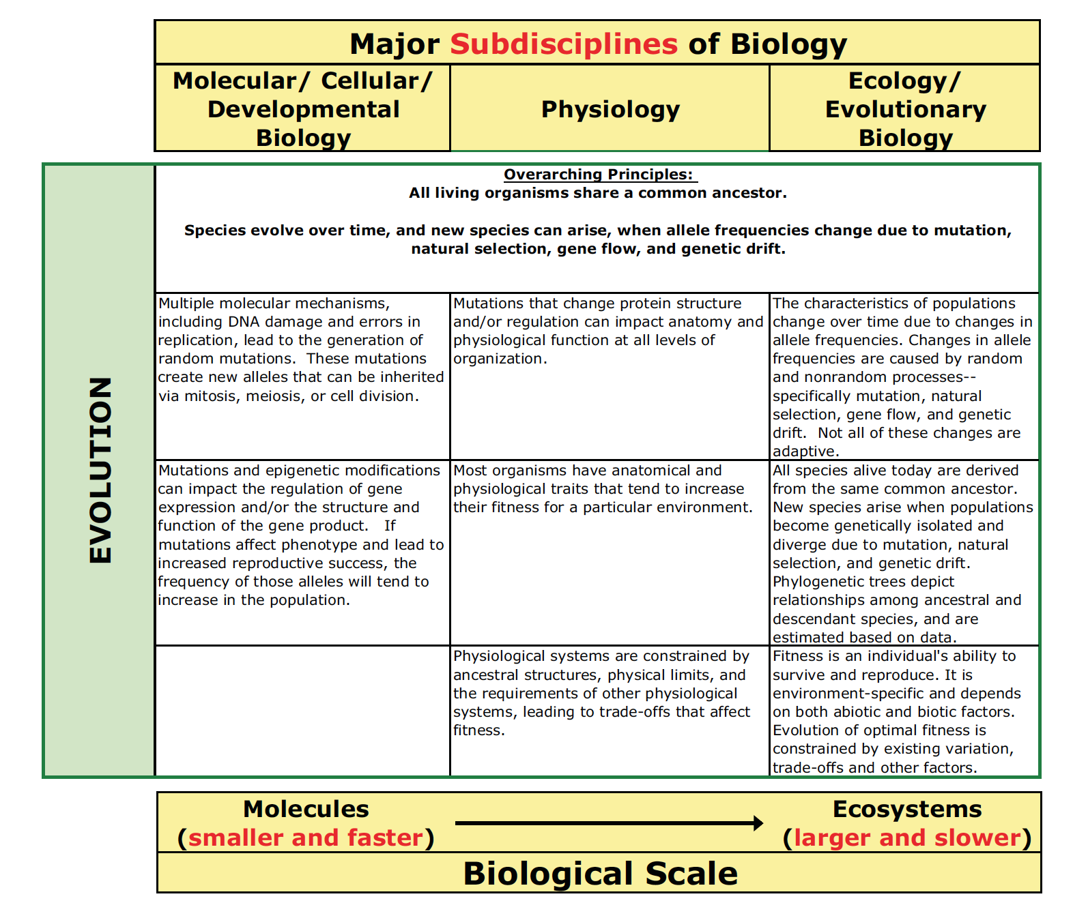
Essential Disciplinary Knowledge: Brownell, 2014
First widely used set of outcomes-oriented learning goals for gen’l biology
Model for specialized fields (micro, neuro, genetics, etc.)

Slide 7
Essential Disciplinary Knowledge: Brownell, 2014
Cells, mols.
Physiol.
Eco/Evo

Slide 8
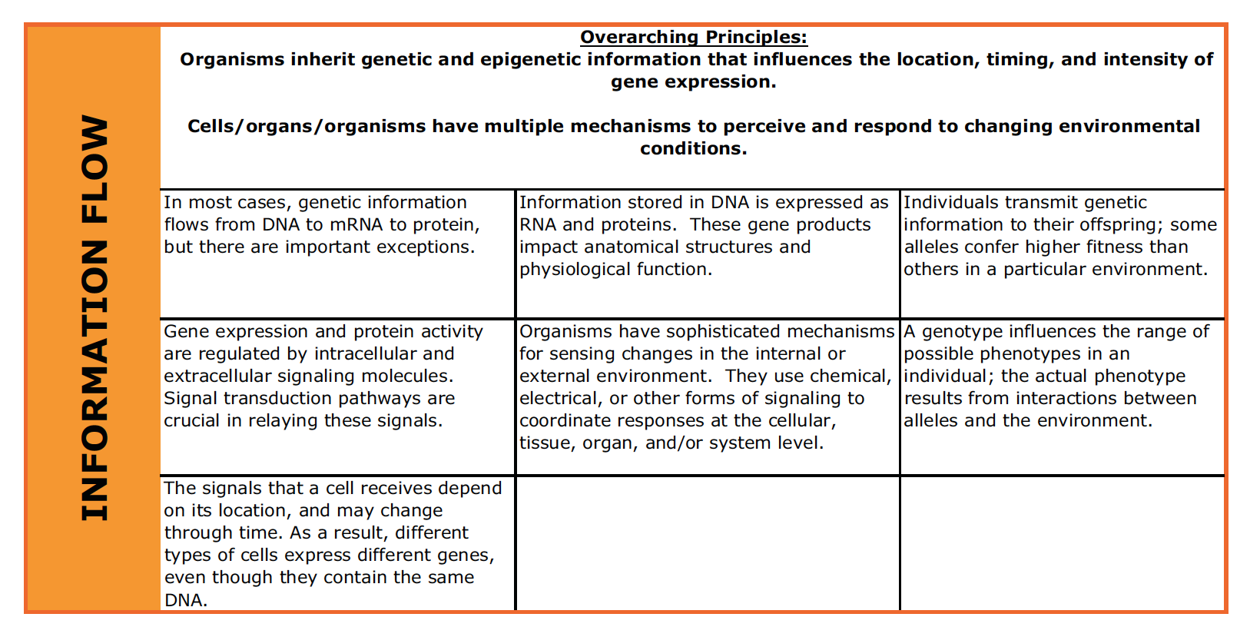
Essential Disciplinary Knowledge: Brownell, 2014
Cells, mols.
Physiol.
Eco/Evo

Slide 9
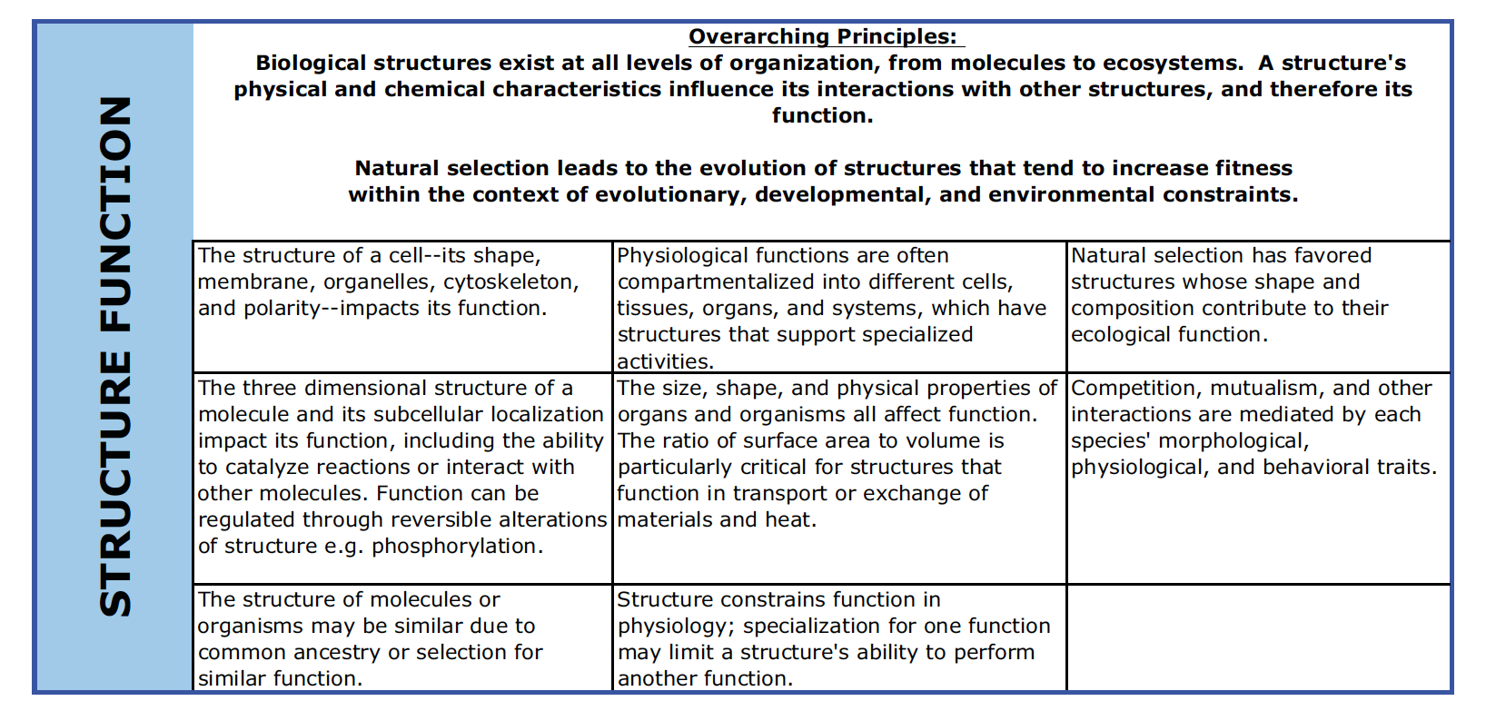
Essential Disciplinary Knowledge: Brownell, 2014
Cells, mols.
Physiol.
Eco/Evo

Slide 10
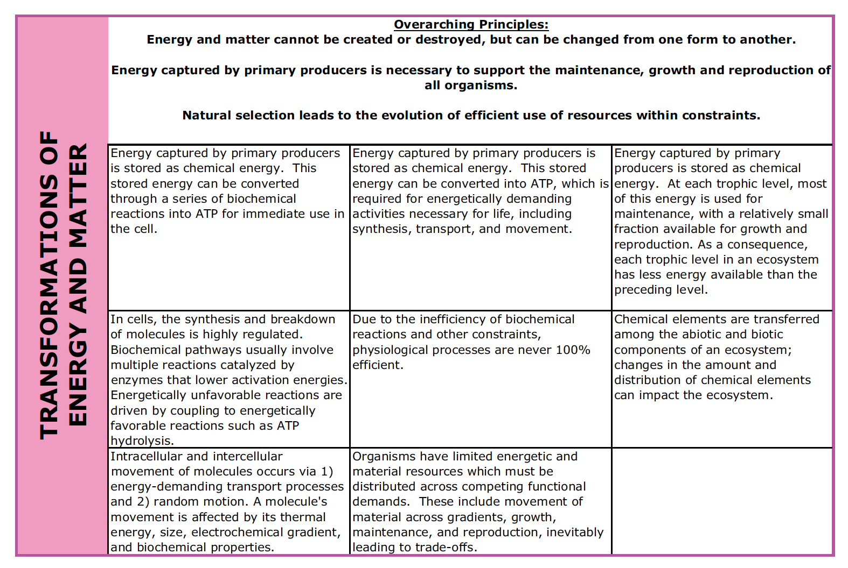
Essential Disciplinary Knowledge: Brownell, 2014
Cells, mols.
Physiol.
Eco/Evo

Slide 11
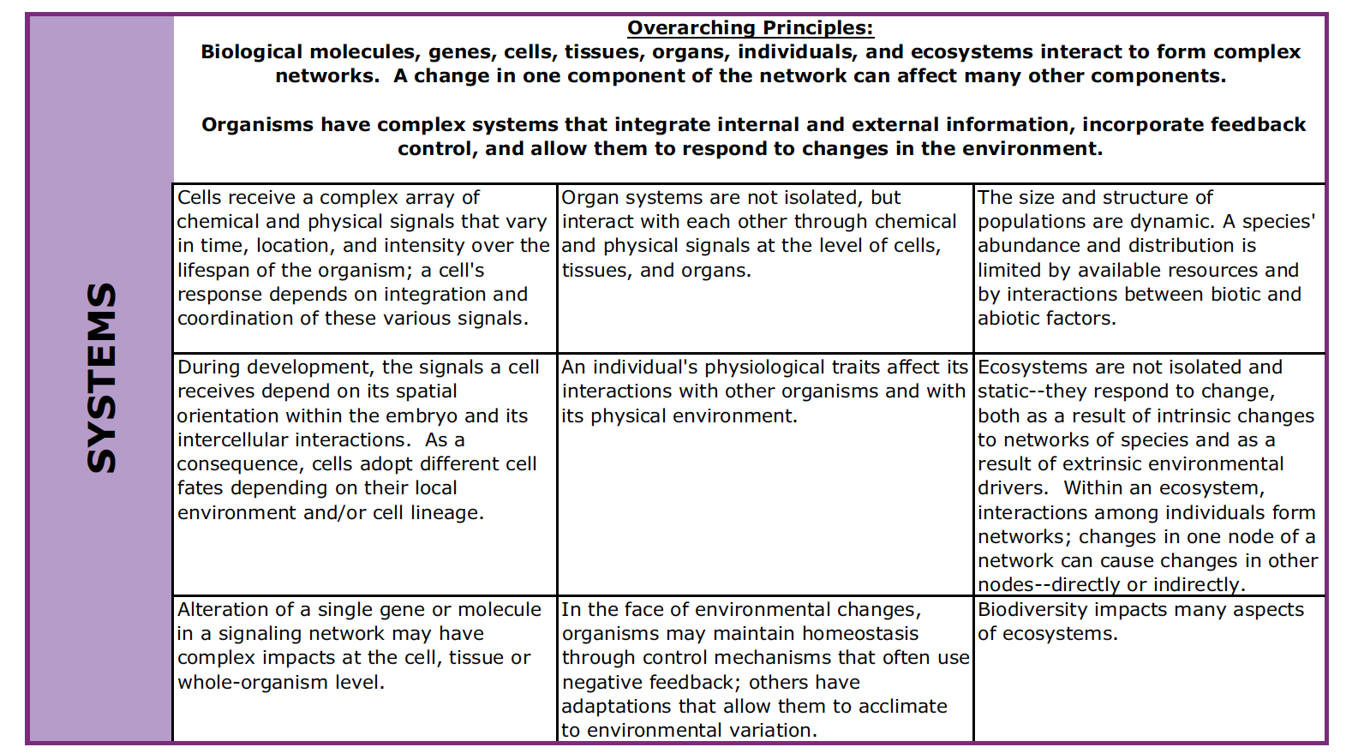
Essential Disciplinary Knowledge: Brownell, 2014
Cells, mols.
Physiol.
Eco/Evo

Slide 12
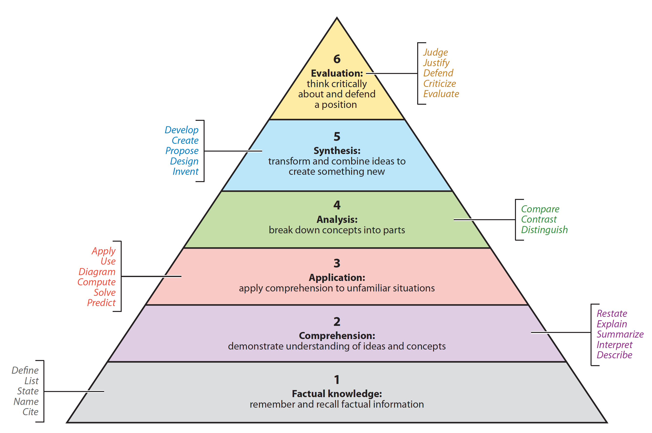
“Classic” Bloom’s Taxonomy of General Cognitive Domain
Higher
transfer
Notes:
Bloom’s levels of understanding. Originally termed Bloom’s taxonomy of the cognitive domain, this schema defines six levels of conceptual understanding according to the intellectual operations that students at each level are capable of (Bloom & Krathwohl 1956).
The italicized verbs have been added to the original hierarchy; they indicate performance tasks that test achievement of learning goals at each level. Fine distinctions in the hierarchy are difficult, and some educators prefer to classify goals on only three levels: low (1, 2),
medium (3, 4), and high (5, 6). (Based on Allen & Tanner 2002.)

Slide 13
Knowledge Domains: The REAL Bloom’s Taxonomy
Original 1956 taxonomy has been diluted, ignored:
Was NOT a pyramid
Covered 3 domains (cognitive, psychomotor, affective)
Recognized SUB-domains
Has been updated, extended, revised several times
Most recent by an original author was 2001

Slide 14
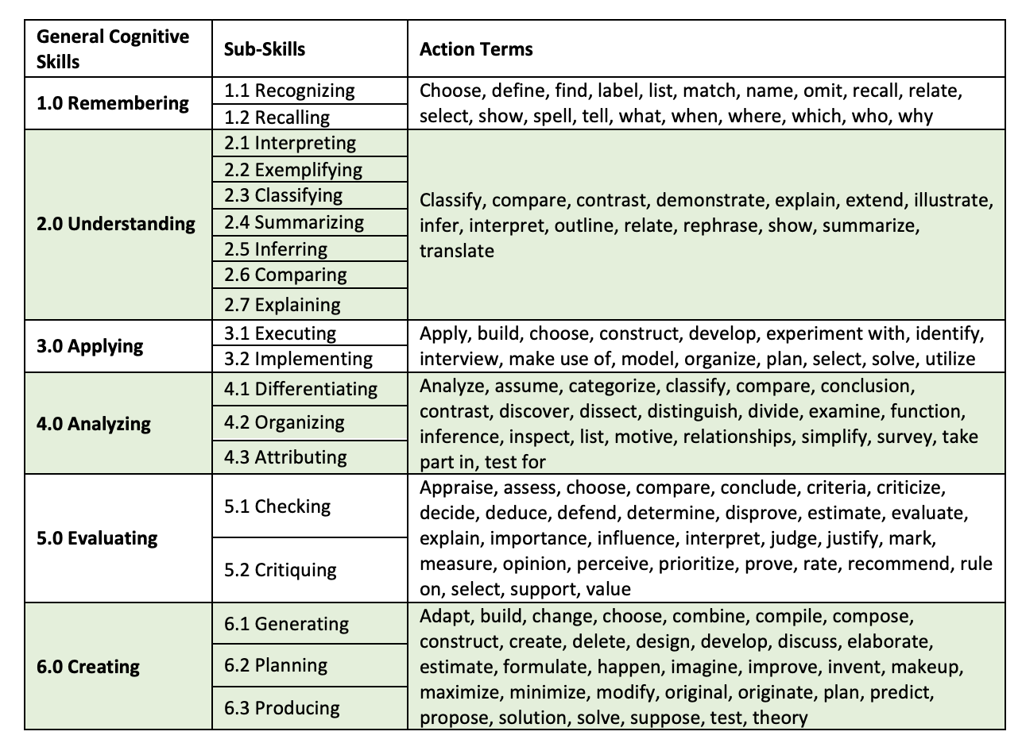
Knowledge Domains: Bloom, Krathwohl, & Anderson
Cognitive domain
Basis for the short-hand pyramid
Includes:
Factual
Conceptual
Procedural
Metacognitive

Slide 15
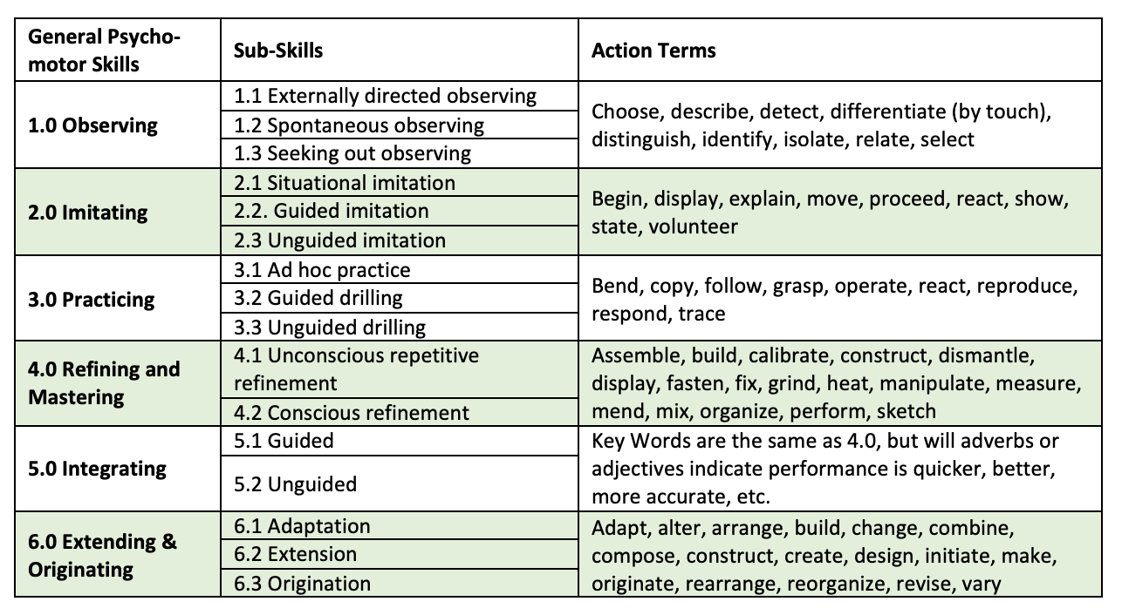
Knowledge Domains: Bloom, Krathwohl, & Anderson
Psycho-
motor

Slide 16
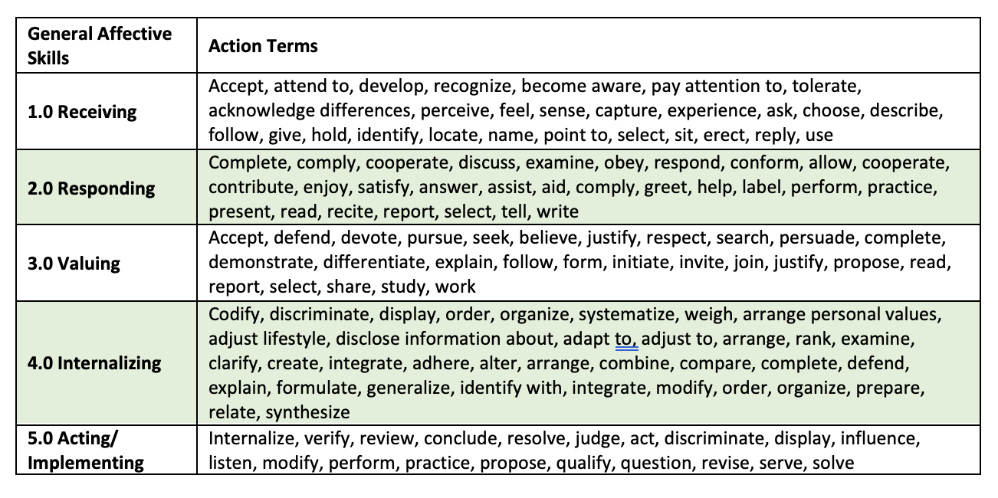
Knowledge Domains: Bloom, Krathwohl, & Anderson
Affective

Slide 17
How Do We Operationalize Bloom’s Taxonomy?

Slide 18
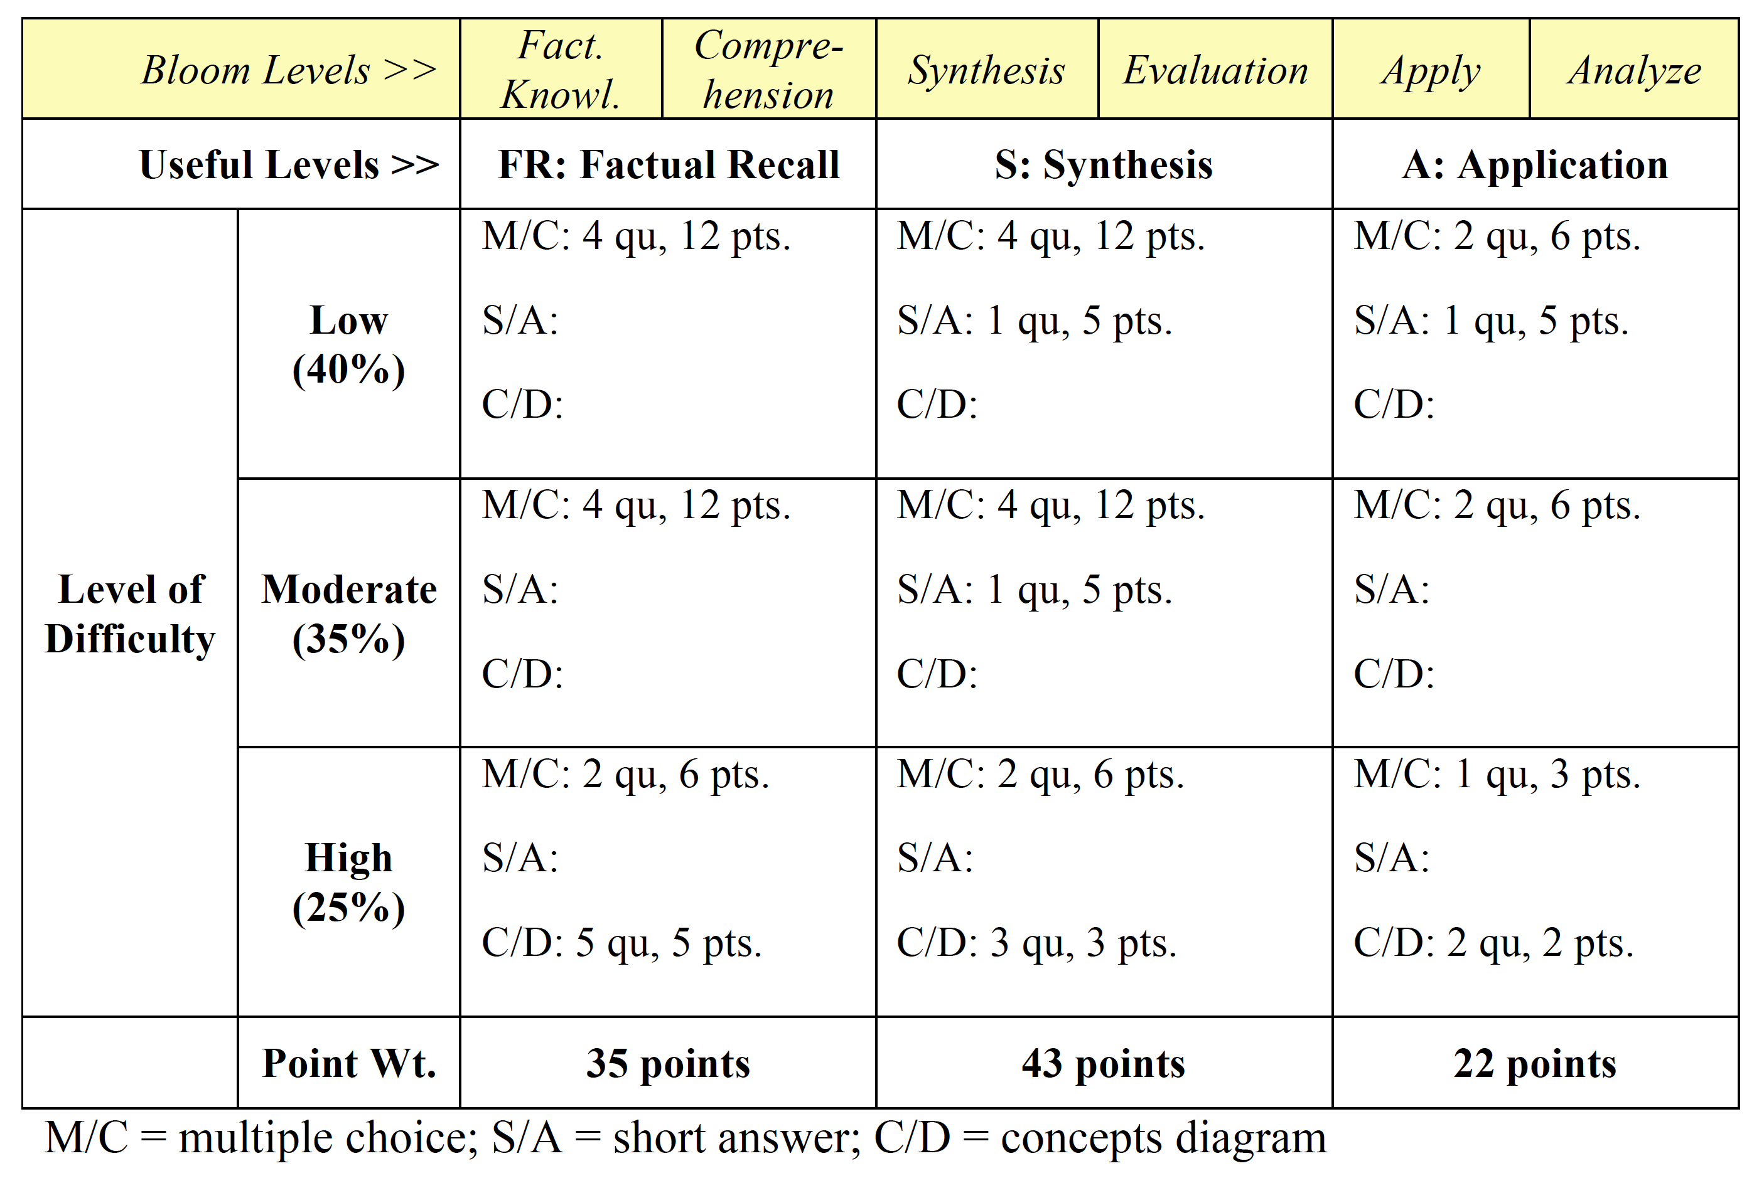
Example of Bloom Applied to a Course Exam
Action words guide question design

Slide 19
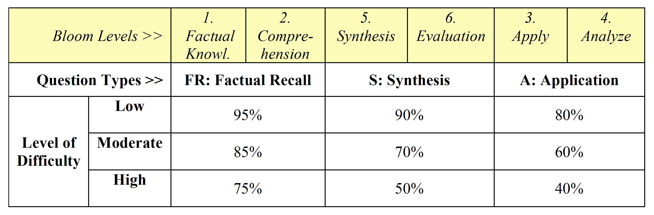
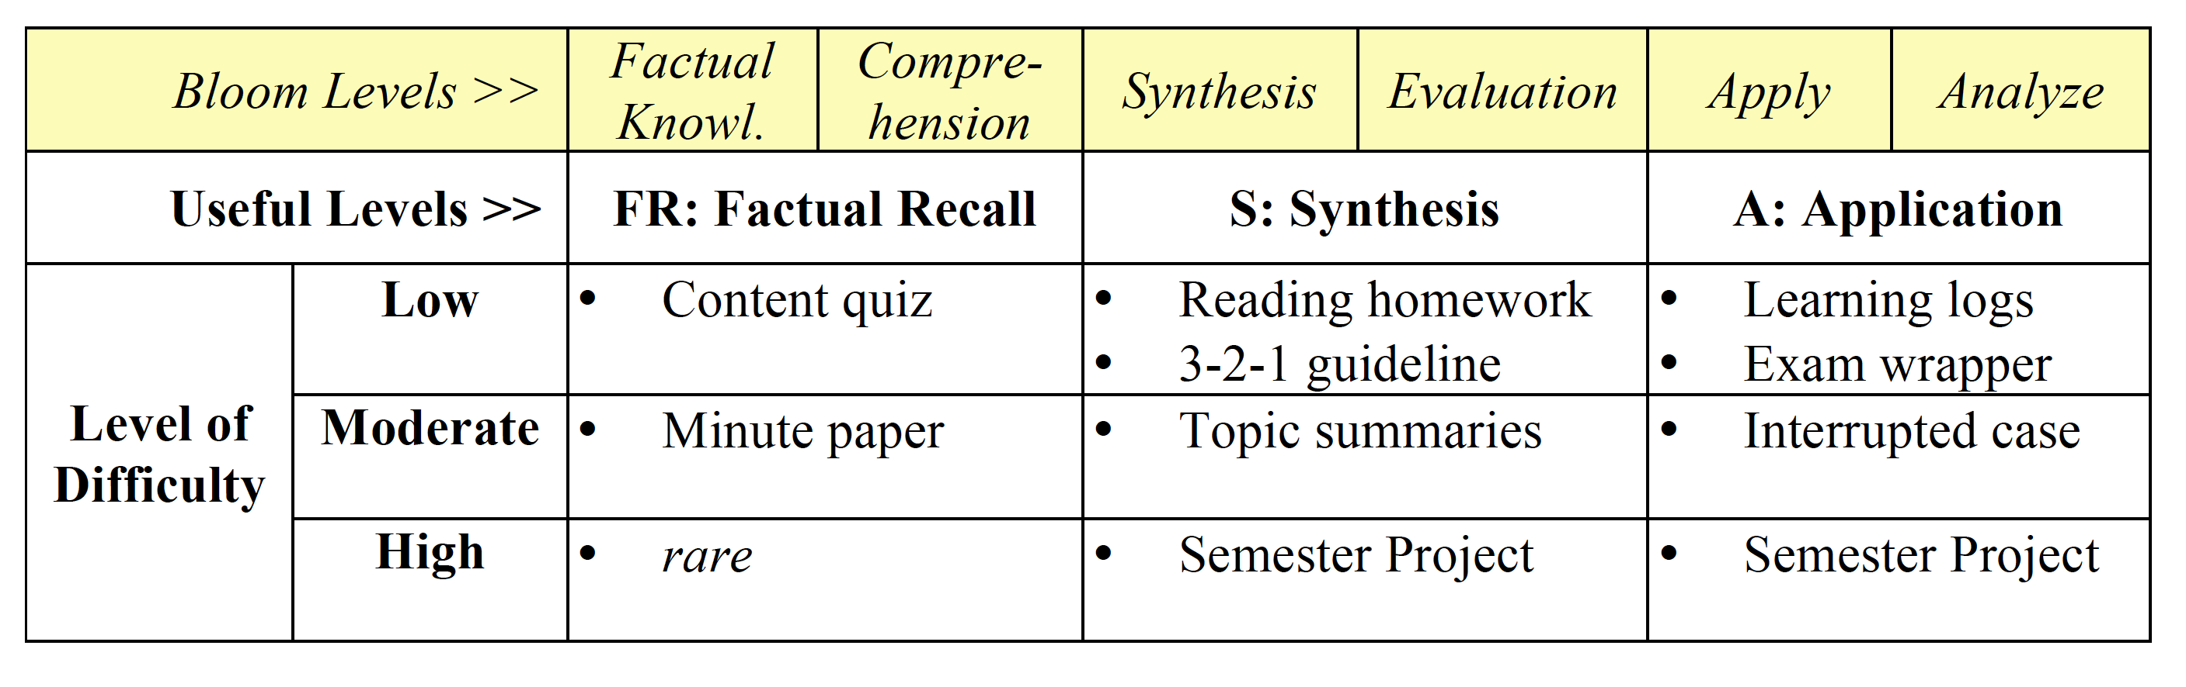
Other Examples of Bloom’s Taxonomy In Use
Generic model for points distribution on exams, over course, etc.
12%
11%
11%
11%
11%
11%
11%
11%
11%
Course-level model for choosing types of assignments

