Slide 1
Notes to Instructor
This case designed for the first day of a nonmajors gen-ed lecture course.
It is organized around Bybee’s 5E Model of Instructional Design
The notes to instructors are in boxes on slides or in the Notes section below.

Slide 2
What IS Science?
See what your neighbors think
Notes:
NOTE:
This is an example of using a Think-Pair-Share activity to do more than test knowledge application. My aims are to:
1. Determine the general level of students’ prior knowledge.
2. Get the students engaged and start exploring the topic immediately.
3. Break the mold of spending Day 1 explaining the syllabus. Instead they read it as homework, and I answer questions about it on Day 2.

Slide 3
What IS Science?
Science is a process of making sense of the world around us by:
Asking and testing questions
Reducing uncertainty & ambiguity AND
Increasing confidence & precision
Notes:
The goal of the starting question is to get students to Engage and Explore, which are the first steps in the 5E model. After collecting students’ ideas, I show this slide which moves the group into the 5E Explain phase.

Slide 4
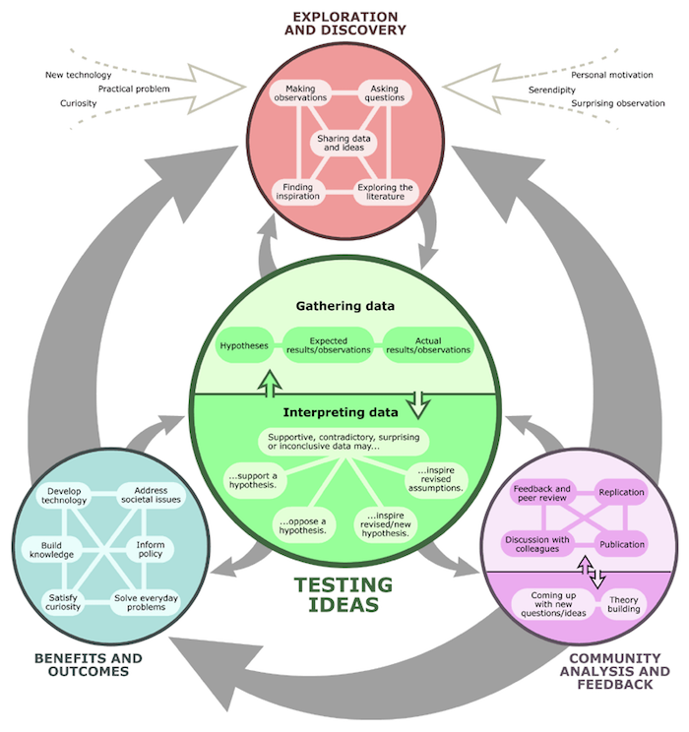
What Is the “Nature of Science?”
System of exploration and discovery
Testing ideas by gathering, interpreting data
A community to debate, discuss ideas
A source of innovation
Credit: Understanding Science Project (https://undsci.berkeley.edu/)
Notes:
This slide continues the Explanation stage of 5E.

Slide 5
Life—The Final Frontier What Are the Key Characteristics of Life?
Created by
William Rogers, Ball State University
Thomas Horvath, SUNY-Oneonta
Revisions by
A. Daniel Johnson, James Curran, Wake Forest University
Notes:
The case moves students into 5E Elaboration. Now they must start to apply scientific thinking. The embedded questions provide the informal 5E Evaluation. Formal evaluation comes later on exams.
The original case was published by NCCSTS (now NSTA), but I have modified it extensively. It is a single-session case that works equally well with small groups or individual students using clickers.

Slide 6
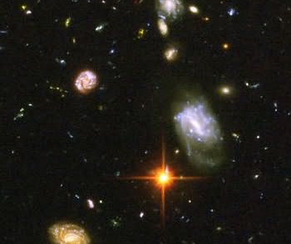
Group Question (GQ) 1: Do you think life exists elsewhere in the universe besides here?
A: Yes
B: No
WHY?
Photo courtesy of http://hubblesite.org/
Notes:
NOTE: citing sources of images is not always required under fair use exclusions to copyright law, but not doing so sends the wrong message. It is better if we model behaviors we want to see in our students.

Slide 7
The Situation…
To avoid a tax increase, Congress and the President are under pressure to find ways to reduce the federal budget.
Space science is often first target for budget cuts.
Political pressure is very strong this time “Public just does not see its value.”

Slide 8
The Situation…
The president’s Science Advisor points out there is a (small) chance of life from space entering Earth’s biosphere, saying:
“Extra-planetary species could have severe to catastrophic ecological and health consequences.”
Because of this, the President does not want to cut funding for the space program.

Slide 9
Your Task
The President wants to know if he can announce that extraterrestrial life has been discovered, as a way to boost public support for space programs.
As Chief Aide to the President’s Science Advisor, you must make a recommendation based on findings you are about to discuss.

Slide 10

Improving Your Thinking Process
When faced with a complex question:
Information: what do we know already?
Facts
Assumptions
What more do we want to know?
Where, how do we get more information?
Thinking process: is this my opinion, or facts?
How can I protect my thinking from bias?
Notes:
Note that I included the talking brain icon as a visual flag for important information that students will need again in the future. Icons like this can be reused the entire semester.

Slide 11
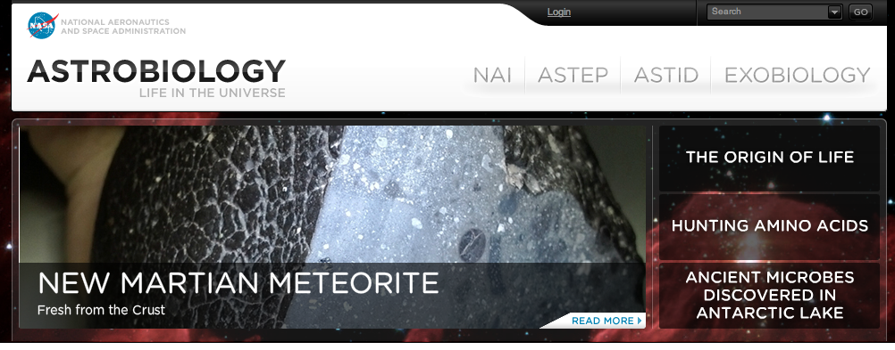
NASA’s Division of Astrobiology has 3 missions:
Protect other planets, moons, etc., from contamination by Earth life
Protect Earth from possible life forms from other solar system bodies.
Search for evidence of life beyond our planet.
Notes:
This is the authentic element of the case. This NASA Division really exists.

Slide 12
NASA Exobiology received subterranean ice core retrieved from Mars by one of the rovers.
They are evaluating the ice for evidence of life.
Notes:
12

Slide 13
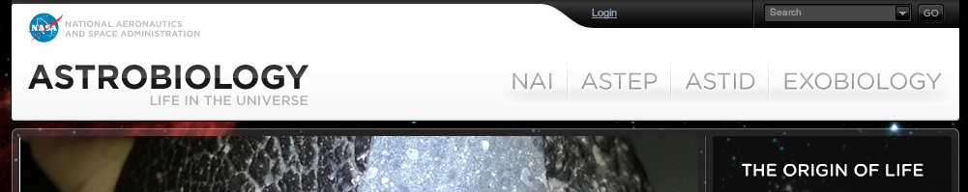
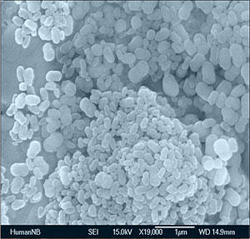
Light microscopy shows bacteria-shaped nano-particles <100 nm long.
Chemical tests show they contain DNA.

Slide 14
GQ2: How do you determine if the nanoparticles are alive?
A: Thaw the ice and see if they are mobile.
B: Thaw the ice and see if they grow and reproduce.
C: Keep it frozen and run tests to determine more about their chemical composition.
D: Take a different approach (what, briefly?)
Notes:
14

Slide 15
Results of the Analysis
Surrounded by shell
Composed of calcium phosphate rather than phospholipids
No internal membrane-bound structures (organelles)
Not mobile
Small amounts of DNA and proteins
Reproduce in oxygen-free environment
Antibiotics prevent reproduction
Notes:
15

Slide 16
GQ3: Based on the evidence, is there enough evidence to say that the nanoparticles are alive?
A: Yes
B: No
WHY?
Notes:
16

Slide 17
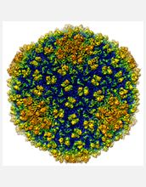
Electron microscopy shows what looks like viruses attached to some nanoparticles
Image Courtesy of the National Science Foundation
Notes:
Evidence for case

Slide 18
Results of Analysis
The “virus-like” particles:
Contain RNA and proteins.
Are not mobile.
Don’t use any type of nutrients presented them.
Reproduce, but only when nanoparticles are present.
Notes:
18
Evidence for case

Slide 19
GQ4: Based on the evidence, is there enough evidence to say that the nanoparticles are alive?
A: Yes
B: No
WHY?
Notes:
19

Slide 20
Endings
The next 3 slides show 3 alternative endings for this case.
Students change each semester; cases in earlier sessions may need to be adjusted in real time
Preparing 2+ endings lets you adjust the final assignment based on what happens during class

Slide 21
Final Decision: Will you recommend the President announce extra-terrestrial life has been discovered?
A: Yes
B: No
Why or why not?
Notes:
21
NOTE: This closing option does not include follow-up homework. Depending on how the conversation has unfolded I can decide at last minute to ask a different question, or make one of the homework assignments on the next slides.

Slide 22
Homework: Make Your Case
Based on the findings, the President wants to know whether to announce that extraterrestrial life has been discovered.
Write a 1-page summary letter stating your position and how you arrived at it.
Notes:
NOTE: This is a SECOND possible closing option I can decide at last minute to use.

Slide 23
Homework: Supplemental Analysis
A second assay finds the RNA in the virus-like particles has small amounts of a 5th base: inosine
Does this change your interpretation of the evidence?
What is your rationale?
Notes:
23
This is the THIRD possible closing activity.

Slide 24
Improving Your Thinking Process, Pt. 2
After working on a complex question you should:
Debrief
What did I/we accomplish?
What did I/we do well?
What did I/we struggle with?
Plan for next time
What could I do better individually, OR
How can we work better as a group?
Notes:
This is one way I try to make my expectations explicit AND introduce students to metacognitive reflection.

Slide 25
Another Example of a Mini-Case (20-30 minutes)
Scenario/Questions:
Is Facebook alive? (vote)
What are features of life? Which ones does Facebook meet? (group)
Again, is it alive? (vote)
Learning Goals:
Provisional, socially constructed nature of science
Multiple points of view, ways to interpret evidence
Notes:
The Facebook scenario is one of two mini-cases that I created while class was in session. I do not recommend it as a habit, but also do not be afraid to take advantage of creative thoughts or opportunities.

